Slide 1
Intro To Array In c
Taher Mohamed

Slide 2
Array
Array is a group of data that holds fixed number of value all of them are the same type.
Syntax
Array_Type Array_Name[Length];
Array_Type like (int , char , double …….)

Slide 3
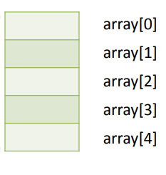
Example
int array [5] ;
This line creates an array of int of size 5.
Notes:
1- The array index always starts from 0, it means that this array has elements from element 0 till element 4.
2- Array length must be constant value, can not be variable

Slide 4
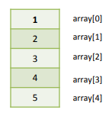
Array Initialization
Array can be initialized at the time of definition. To initialize the arry use the following syntax:
Array_Type Array_Name [Length] = { values separated by comma };
int array [ 5 ] = { 1 , 2 , 3 , 4 , 5 } ;

Slide 5
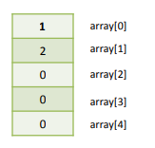
Special Cases
1- Initializing the array with values less than its length, the remaining elements will be initialized with 0.
array [5] = { 1 , 2 } ;
2- Initializing the array with values more than its length, it would gives a compilation error.
array [4] = { 1 , 2 , 3 , 4 , 5 } ; (compilation error)

Slide 6
Accessing Array Elements
All elements of the array can be accessed at the same statement only at initialization. After initialization the array can be accessed only element by element.
Syntax
Array_Name [Element_Index] ;
array [ 1 ] = 3 ;
printf ( “ Element 1 = %d ” , array [ 1 ] ) ;

Slide 7
Note:
1- Again, array index starts from 0.
2- You can use a variable to indicate for the element index,
for ex:
array [ i ] = 10;
where i is variable equals to the desired index number.

Slide 8
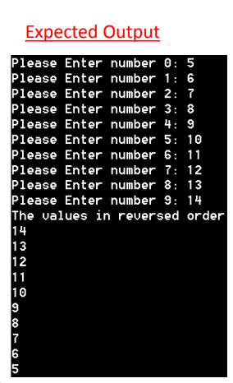
LAB1
Write a C code that ask the user to enter 10 values and save them in an array using a for loop. Then print the values entered by the user in reverse order using another for loop.

Slide 9
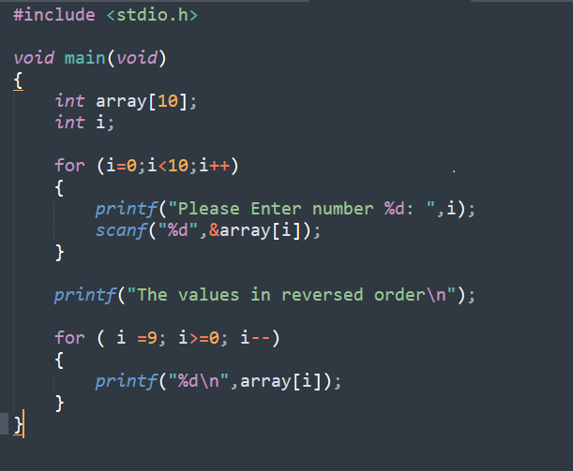

Slide 10
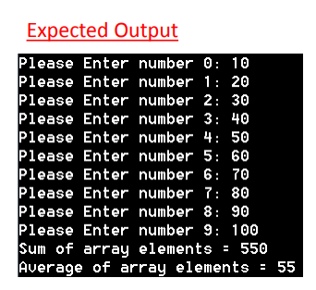
LAB2
Write a C code that ask the user to enter 10 values and save them in an array using a for loop. Then print the summation and the average of the values entered.

Slide 11
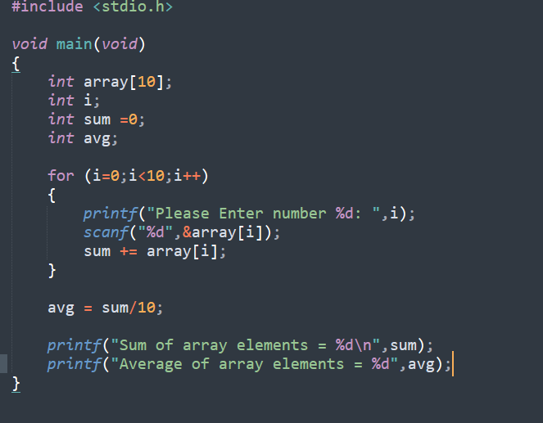

Slide 12
LAB3
Write a C code that ask the user to enter 10 values and save them in an array using a for loop. Then print the minimum and the maximum of the values.

Slide 13
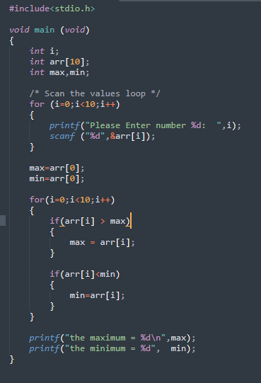

Slide 14
Assignment1
Write C code that manage a small school. The school has 3 classes each class contains 10 students. Define three arrays for the three classes each one with a length of 10. Save a random numbers in all array elements to indicate the students grade. The program will calculate and display the following statistics: 1- Number of passed students
2- Number of Failed students
3- Highest grade
4- Lowest grade
5- Average grade Knowing that the total grade is from 100 and the minimum passing grade is 50

Slide 15
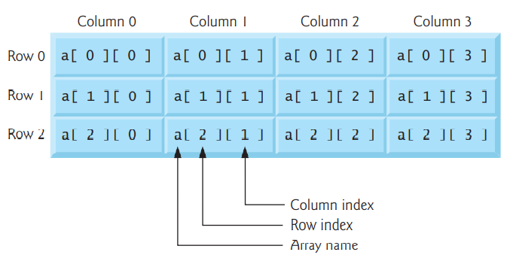
Multidimensional Arrays
Syntax
array_type array_name [ ROW ][ Column ];
Example:
int b [ 3 ][ 4 ] ;
Accessing Array Elements:
b [ 0 , 0 ] = 0;

Slide 16
Note:
1-A multidimensional array can be initialized when it’s defined
int b[ 2 ][ 2 ] = { { 1, 2 }, { 3, 4 } };
2-If there are not enough initializers for a given row, the remaining elements of that row are initialized to 0.
int b[ 2 ][ 2 ] = { { 1 }, { 3, 4 } }; → b[0][1] to 0
3-we can write a multidimensional array without row index but must write column index
int a [ ][ 3 ] ;

Slide 17
For example:
Write C code that print three multidimensional array but use function
Output
Values in array1 by row are:
1 2 3 4 5 6
Values in array2 by row are:
1 2 3 4 5 0
Values in array3 by row are:
1 2 0 4 0 0

Slide 18
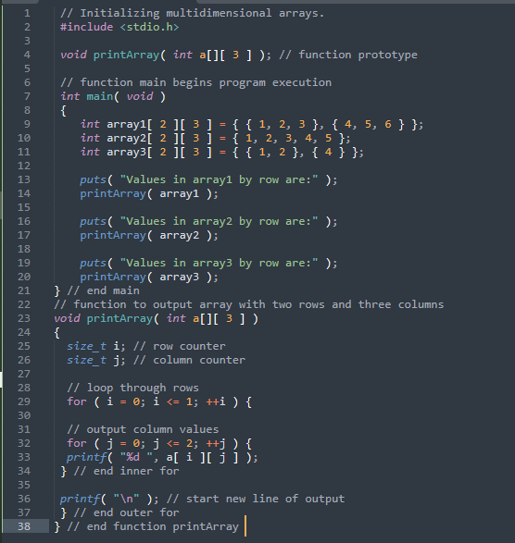

Slide 19
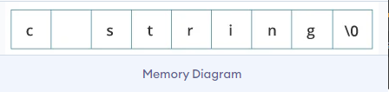
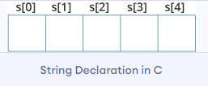
String
string is a sequence of characters terminated with a null character \0.
For example :
char c [ ] = "c string“ ;
declare strings:
char s [ 5 ] ;

Slide 20
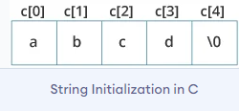
initialize strings in a number of ways.
char c[ ] = "abcd";
char c[50] = "abcd";
char c[] = {'a', 'b', 'c', 'd', '\0’};
char c[5] = {'a', 'b', 'c', 'd', '\0’};

Slide 21
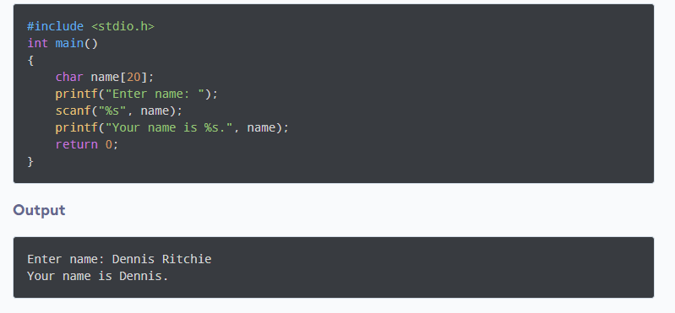
Example:
1-Read String from the user

