Slide 1
Looping
Iteration/Looping in C Programming
Mina Maher
@menamosadef5@gmail.com

Slide 2
What is Looping ?
• The looping can be defined as repeating the same process multiple times until a specific condition satisfies. It is known as iteration also. There are three types of loops used in the C language language. In this part of the tutorial, we are going to learn all the aspects of C loops.

Slide 3
Why looping?
The looping simplifies the complex problems into the easy ones. It enables to alter the flow of the program so that instead of writing the same code again and again, we can execute the same code for a finite number of times.
For example, if we need to (printf) ‘UNIVERSITY OF CALCUTTA’ 10-times then, instead of using the (printf) statement 10 times, we can use (printf ) once inside a loop which runs up to 10 iteration.

Slide 4
What are the advantages of Looping?
It provides code reusability.
Using loops, we do not need to write the same code again and
again.
Using loops, we can traverse over the elements of data structures (array or linked lists).

Slide 5
Types of C Loops
There are three types of loops in C language those are given below:
While
do while
for

Slide 6
Essential components of a loop
Counter
Initialisation of the counter with initial value
Condition to check with the optimum value of the counter .
Statement(s) to be executed by iteration
Increment/decrement

Slide 7
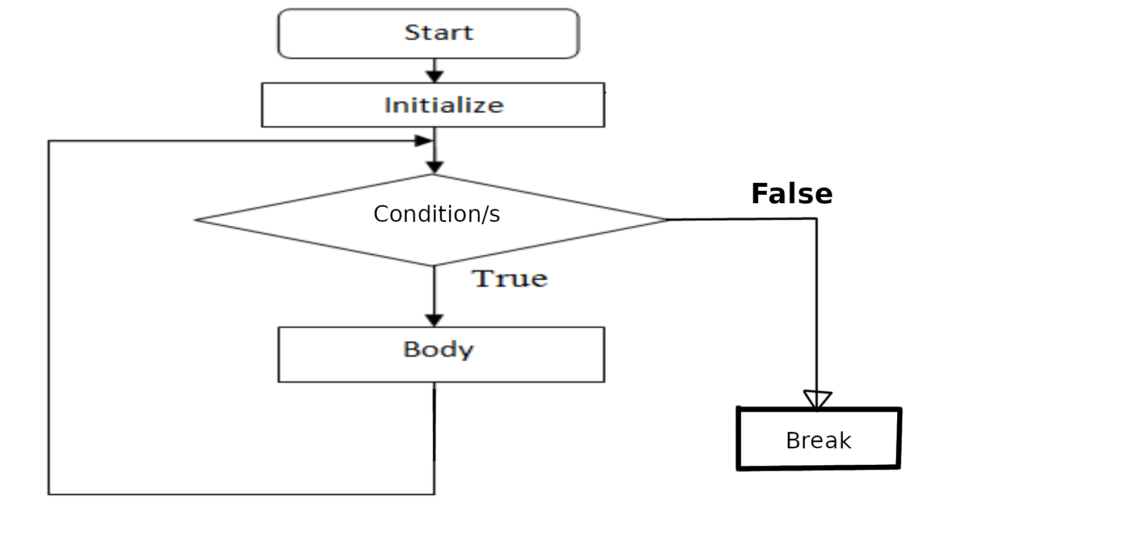
Flowchart for a loop

Slide 8
“while” loop in C
The “while” loop executes the code block “block” as long as the conditional statement “condition” is true, in this case the loop is denoted as a pre-tested loop (the condition encircles the code block).
The syntax of while loop in c language is given below :
variable-initialisation;
while (condition) {
block;
}

Slide 9
Write a C-program to print 10 natural numbers
#include <stdio.h> output
int main() { 1
int i=1; 2
while(i <= 10)
{
printf("%d \n",i);
i=i+1;
}
} 10

Slide 10
do-while loop in C
The “do-while” loop continues until a given condition satisfies. It is also called post-tested loop. It is used when it is necessary to execute the loop at least once (mostly menu driven programs).
The syntax of The syntax of do-while loop in c language loop in c language is given below: is given below:
int index = 0;
do
{
block;
} while (condition);

Slide 11
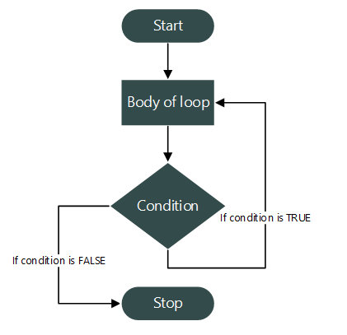
Flowchart for the “do-while” loop

Slide 12
/* same above project */
#include <stdio.h>
int main(void)
{
int i = 0; output
do 1
{
printf("%d \n",i);
i=i+1;
} while(i<=10);
return 0;
} 10

Slide 13
“for” loops in C
The syntax of for loop in c language is given below: .
for (initialization; condition/s; statement/s)
{
block;
}
A “for” loop in C language is used to iterate the statements or a part of the program several times. It is frequently used to traverse the data structures like the array and linked list.

Slide 14
Initialization: an initialization of the loop variable and more than one variable can be initialised.
Condition/s: a conditional expression, it checks for a specific condition to be satisfied and if it is not, the loop is terminated, it also can have more than one condition. However, the loop will iterate until the last condition becomes false. Other conditions will be treated as statements.
Statement/s: can be used as a statement to update the value of the loop variable (re-assignment statement).
The syntax of for loop in c language is given below: .
for (initialization; condition/s; statement/s)
{
block;
}

Slide 15
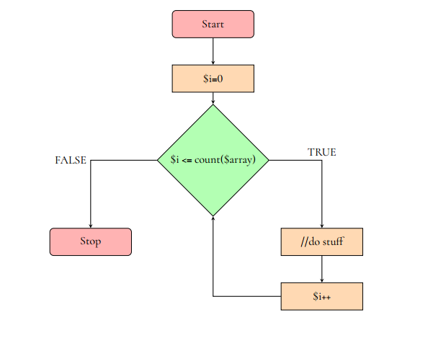
Flowchart : “for” loop

Slide 16
program to print natural numbers 1 to 15
#include <stdio.h>
int main()
{
int i;
for (i = 1; i <= 15; i = i+1) {
printf("%d, ", i);
}
return 0;
}
output 1, 2, 3, 4, 5, 6, 7, 8, 9, 10, 11, 12, 13, 14, 15,

Slide 17
Nested loops in C
C programming language allows to use one loop inside another loop.
for (init/s; condition/s; statement/s)
{
for (init/s; condition/s; statement/s)
{
statement(s);
}
statement(s);
}

Slide 18
The syntax for a nested while loop statement in C programming language is as follows :
while (condition)
{
while (condition)
{
statement(s);
}
statement(s);
}

Slide 19
The syntax for a nested do...while loop statement in C programming language is as follows:
NOTE :
loop nesting is that you can put any type of loop inside of any other type of loop. For example, a for loop can be inside a while loop or vice versa
do
{
statement(s);
do
{
statement(s);
} while (condition);
} while (condition);

Slide 20
break-statement in C
The break statement in C programming language has the following two usages :
1. When the break statement is encountered inside a loop, the loop is immediately terminated and program control resumes at the next statement following the loop.
2. It can be used to terminate a case in the switch statement (covered in the next chapter).
NOTE :
If you are using ( nested loops ) (i.e., one loop inside another loop), the break statement will stop the execution of the innermost loop and start executing the next line of code after the block

Slide 21
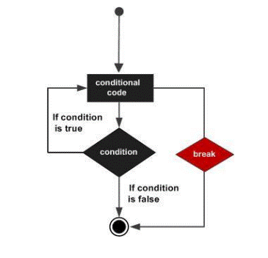
SYNTAX and FLOWCHART
The syntax for a break statement in C is as follows:
break ;
Flowchart of break :

Slide 22
/* project about break statement */
#include <stdio.h>
int main ()
{
/* local variable definition */
int a = 10;
/* while loop execution */
while (a < 20)
{
printf("value of a: %d\n", a);
a++;
if (a > 15)
{
/* terminate the loop using break statement */
break;
}
}
return 0;
}

Slide 23
When the above code is compiled and executed, it produces the following
Output :
value of a: 10
value of a: 11
value of a: 12
value of a: 13
value of a: 14
value of a: 15

Slide 24
Continue-statement in C
The continue statement in C programming language works somewhat like the break statement. Instead of forcing termination, however, continue forces the next iteration of the loop to take place, skipping any code in between.
For the “for” loop, the continue statement causes the conditional test and increment portions of the loop to be executed. For the “while” and “do...while” loops, the continue statement causes the program control to pass the conditional tests.

Slide 25
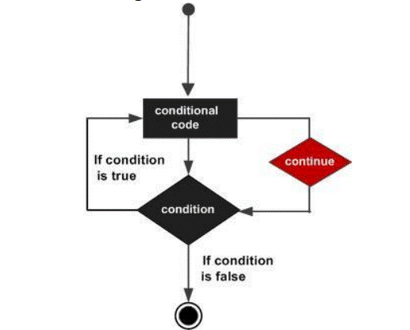
Syntax and Flowchart
The syntax for a continue statement in C is as follows:
continue;
Flowchart of Continue

Slide 26
#include <stdio.h>
int main ()
{
/* local variable definition */
int a = 10;
/* do loop execution */
do {
if (a == 15) {
/* skip the iteration */
a = a + 1;
continue;
}
printf("value of a: %d\n", a);
a++;
} while( a < 20 );
return 0;
}

Slide 27
When the above code is compiled and executed, it produces the following
Result :
value of a: 10
value of a: 11
value of a: 12
value of a: 13
value of a: 14
value of a: 16
value of a: 17
value of a: 18
value of a: 19

Slide 28
goto statement in C
A goto statement in C programming language provides an unconditional jump from the goto to a labeled statement in the same function.
NOTE:
Use of goto statement is highly discouraged in any programming language because it makes difficult to trace the control flow of a program, making the program hard to understand and hard to modify. Any program that uses a goto can be rewritten so that it doesn't need the goto.

Slide 29
Syntax and Flowchart
The syntax for a goto statement in C is as follows:
goto label;
..
.
label: statement;
Note :
Here label can be any plain text except C keyword and it can be set anywhere in the C program above or below to goto statement.

Slide 30
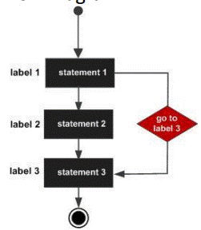
Flowchart of go to :

Slide 31
Example
#include <stdio.h>
int main ()
{
/* local variable definition */
int a = 10;
/* do loop execution */
LOOP:
do
{
if (a == 15) {
/* skip the iteration */
a = a + 1;
goto LOOP;
}
printf ("value of a: %d\n", a);
a++;
} while (a < 20);
return 0;
}

Slide 32
When the above code is compiled and executed, it produces the following result:
value of a: 10
value of a: 11
value of a: 12
value of a: 13
value of a: 14
value of a: 16
value of a: 17
value of a: 18
value of a: 19

Slide 33
The Infinite Loop
#include<stdio.h>
int main () {
for( ; ; )
{
printf("This loop will run forever.\n");
}
return 0;
}
A loop becomes infinite loop if a condition never becomes false.
.
The for loop is traditionally used for this purpose. Since none of the three expressions that form the for loop are required, you can make an endless loop by leaving the conditional expression empty.

Slide 34
When the conditional expression is absent, it is assumed to be true. You may have an initialization and increment expression, but C programmers more commonly use the for(;;) construct to signify an infinite loop.
NOTE:
You can terminate an infinite loop by pressing Ctrl + C keys.
Thank you
At the end please JUST SMILE

