Slide 1
FAQs for Client Self-Service

Slide 2
Index
Changing your password while logged in Slide – 4
Resetting your password when not logged in Slide – 6
Updating your profile Slide – 8
Browser troubleshooting (Chrome) Slide – 11

Slide 3
Resetting Your Gartner.com Password
Gartner FAQ
Notes:
Ver 2020-1119
Presenter's Name
Presenter's Name

Slide 4
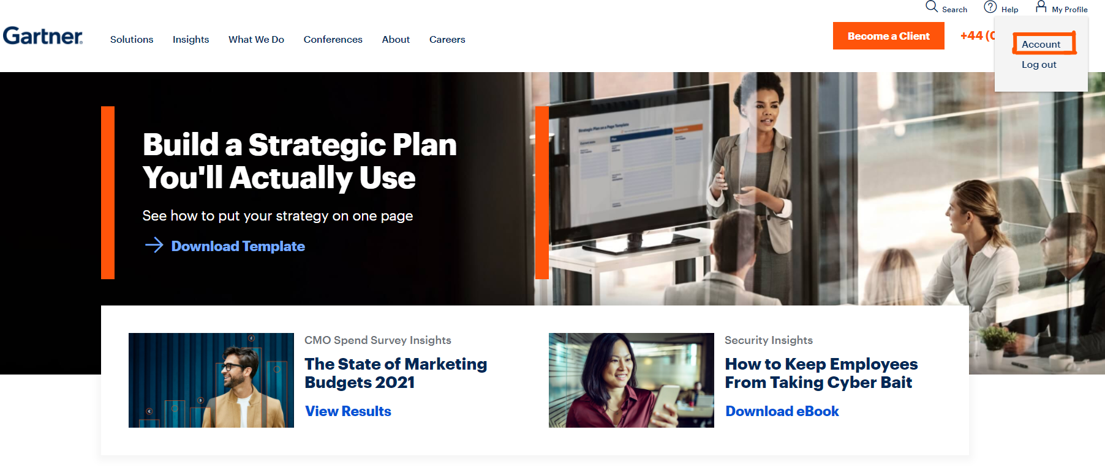
Changing your password
when logged in to gartner.com
Step 1: On the gartner.com homepage, go to My Profile in the top right corner. Click on Account from the drop-down.

Slide 5
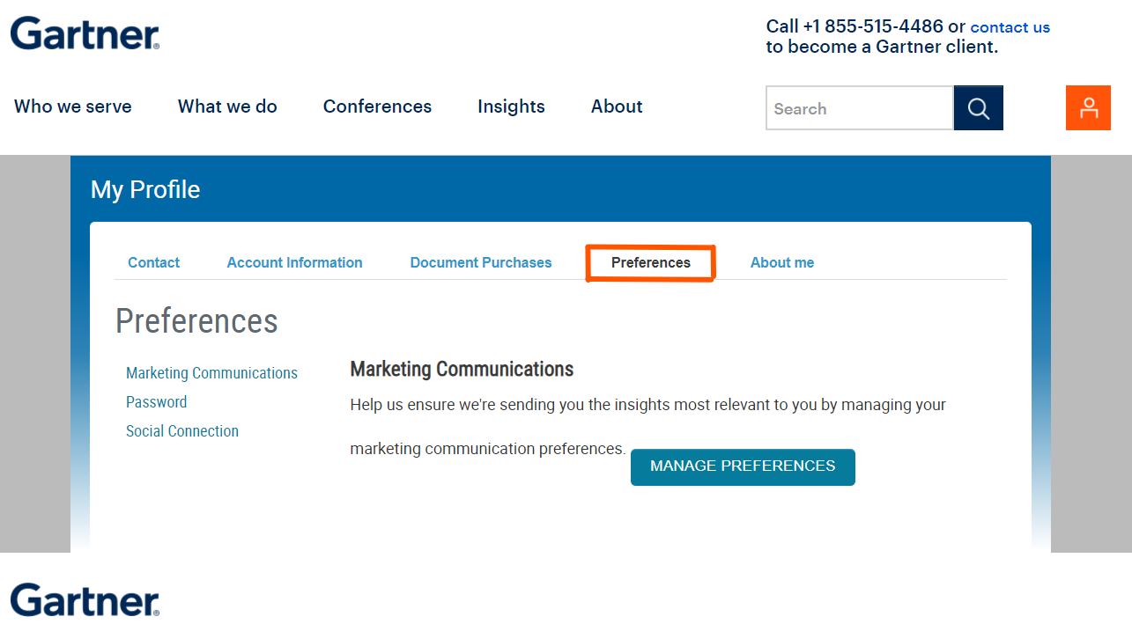
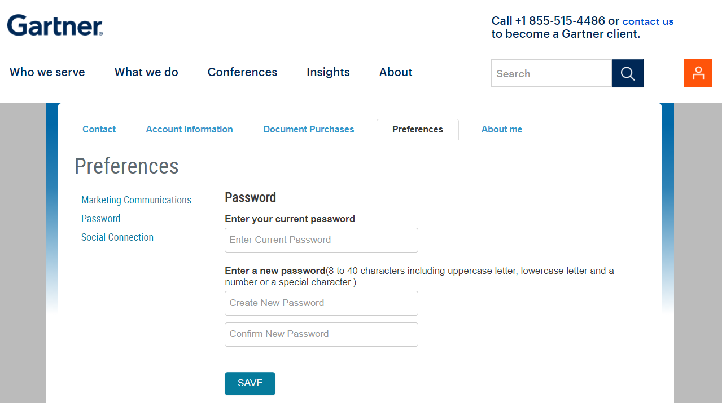
Step 2: Click on Preferences.
Step 3: Click on Password in the panel on the left.
Step 4: Enter your current and new passwords. Re-enter your new password to confirm and click on Save.

Slide 6
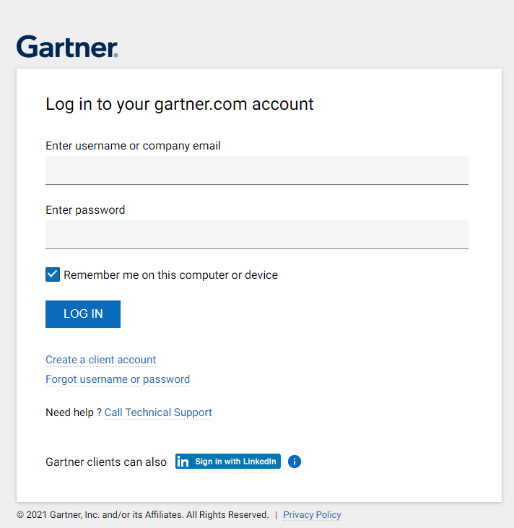
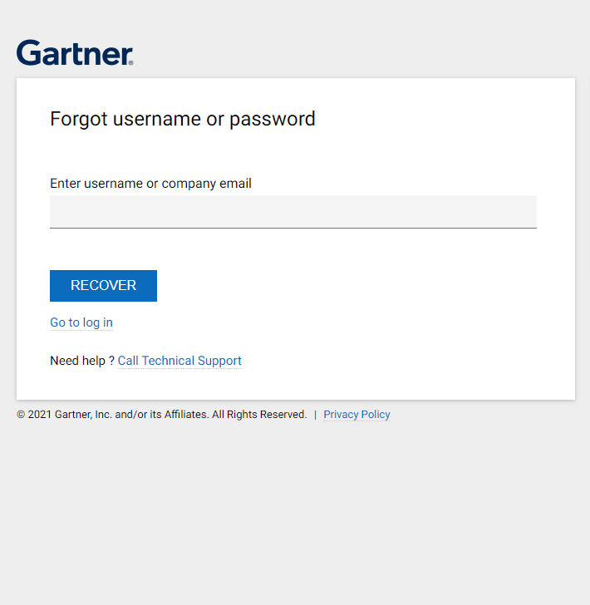
Resetting your password
when not logged in
Step 1: On the gartner.com login page, click on “Forgot username or password.”
Step 2: Enter username or company email in the prompt.

Slide 7
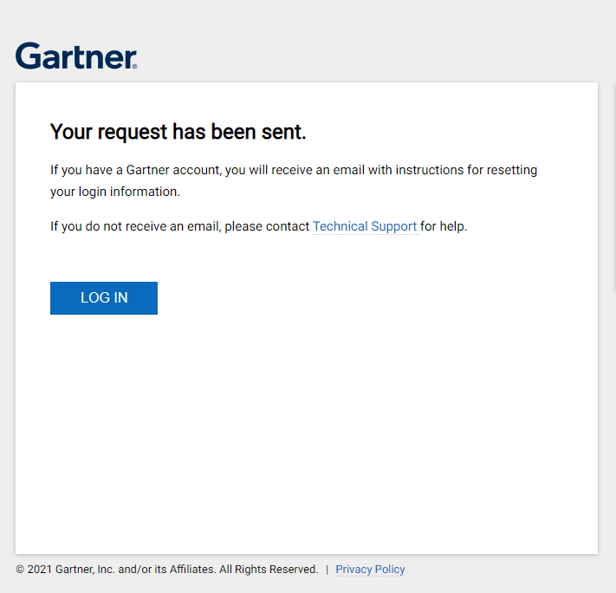
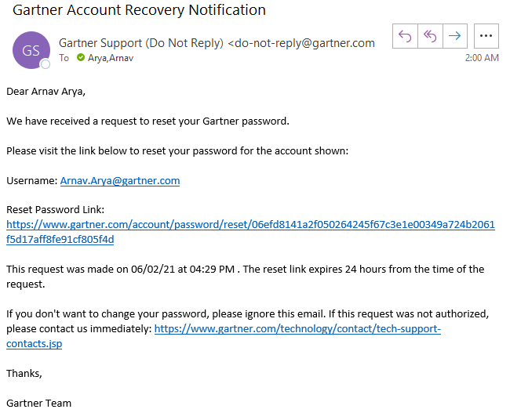
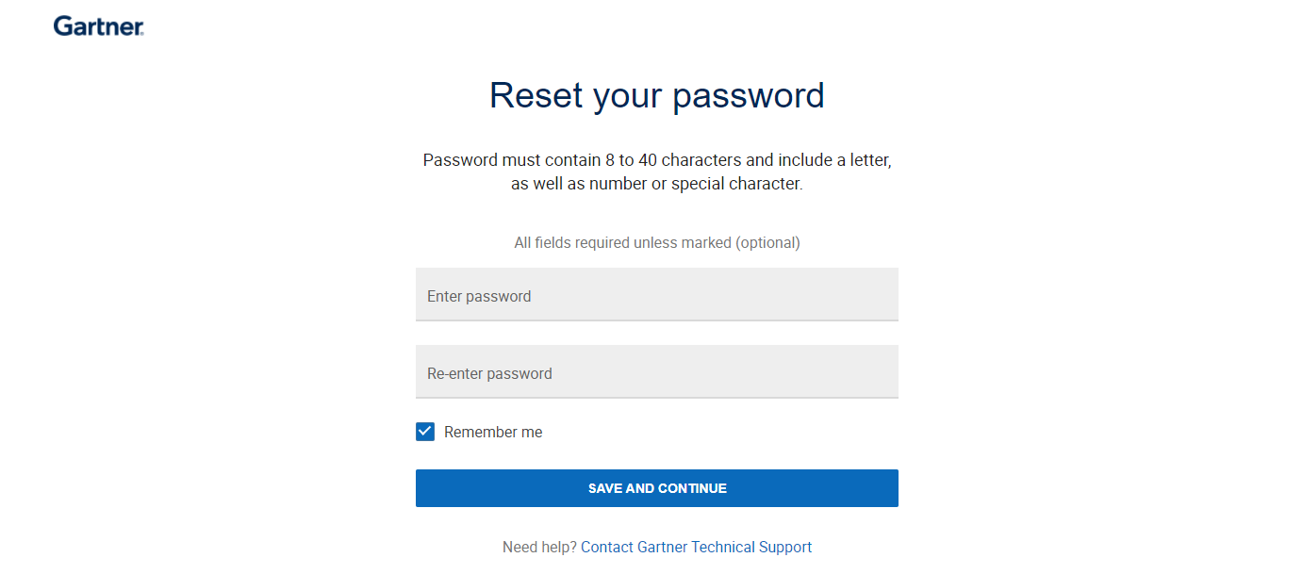
Step 3: An email with instructions for resetting your login information will be sent to your email address. Follow the link in the email.
Check your spam folder if you don’t see the password reset email in your inbox.
Step 4: Enter and re-enter your new password and click on Save and Continue.
The system will log you in and your password will be changed.

Slide 8
Updating Your Gartner.com Profile
Gartner FAQ
Notes:
Ver 2020-1119
Presenter's Name
Presenter's Name

Slide 9
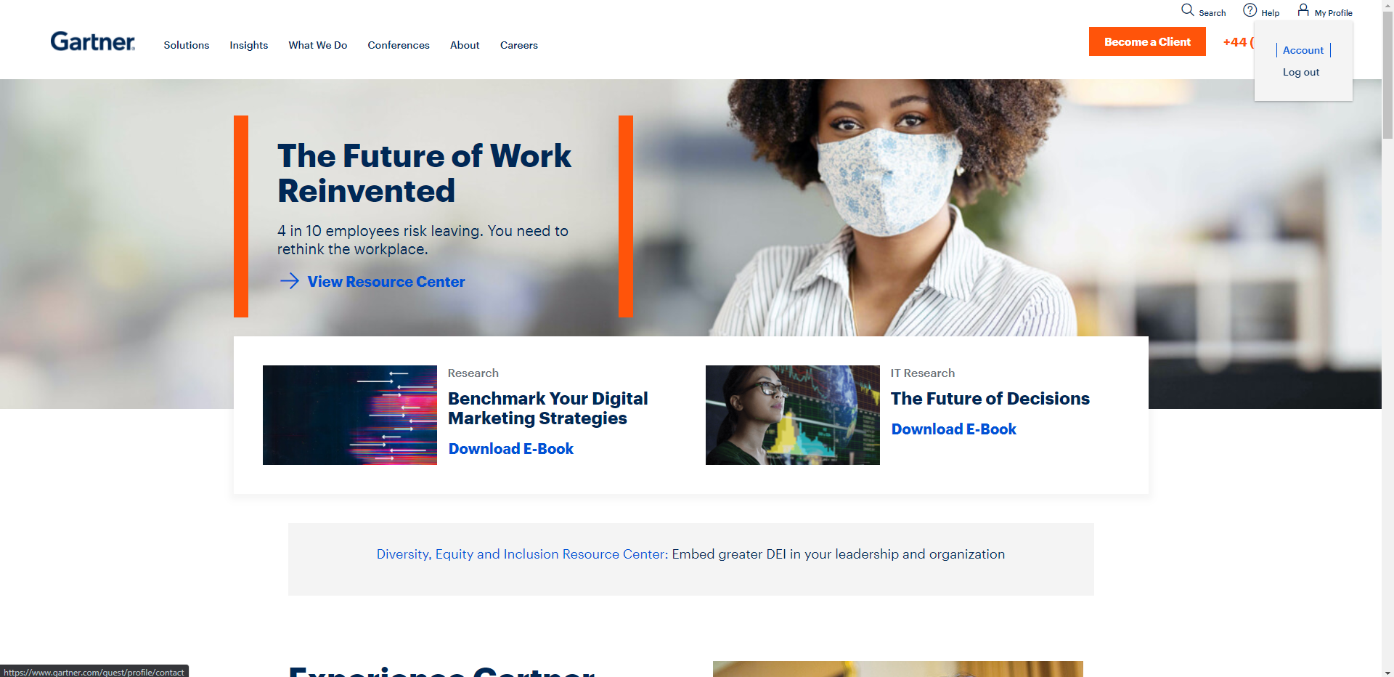
Updating your profile
Step 1: Log in to gartner.com as a guest user and go to My Profile in the top right corner. Click on Account.

Slide 10
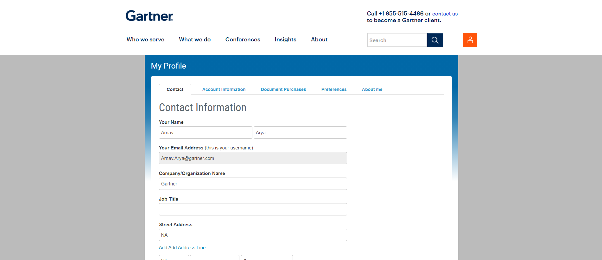
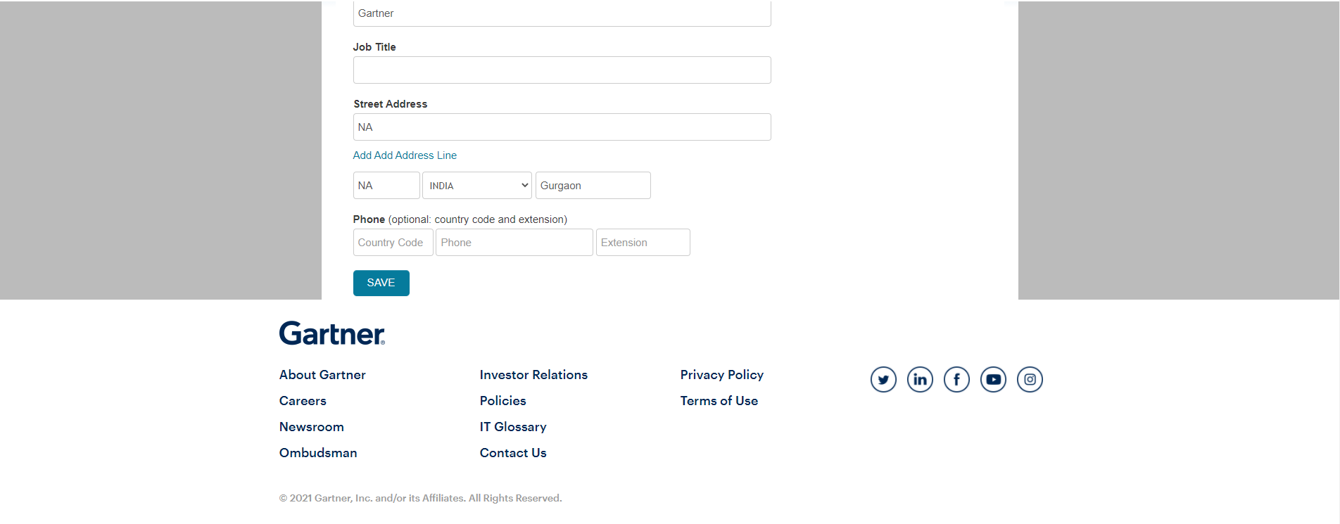
Step 2: Select the Contact tab. Update the required fields like name, email, organization name, address, etc.
Step 3: Click on Save at the bottom of the page.

Slide 11
Browser Troubleshooting
Gartner FAQ
Notes:
Ver 2020-1119
Presenter's Name
Presenter's Name

Slide 12
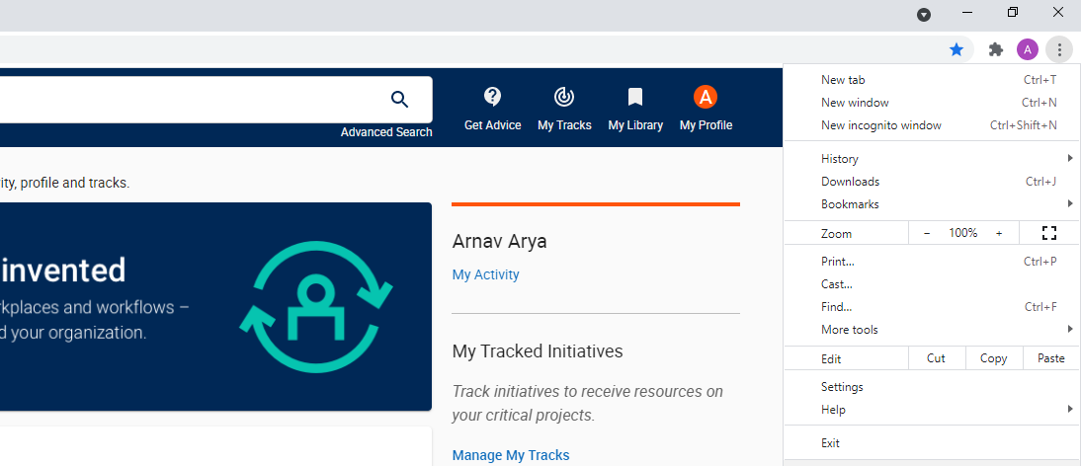
Troubleshooting issues on Chrome
Gartner recommends using the Google Chrome browser. Following these troubleshooting steps may cause you to be signed out of all websites on your browser.
Step 1: On Chrome, click the 3 dots at the top right for the “Customize and control Google Chrome” menu.
Step 2: Click on Settings.

Slide 13
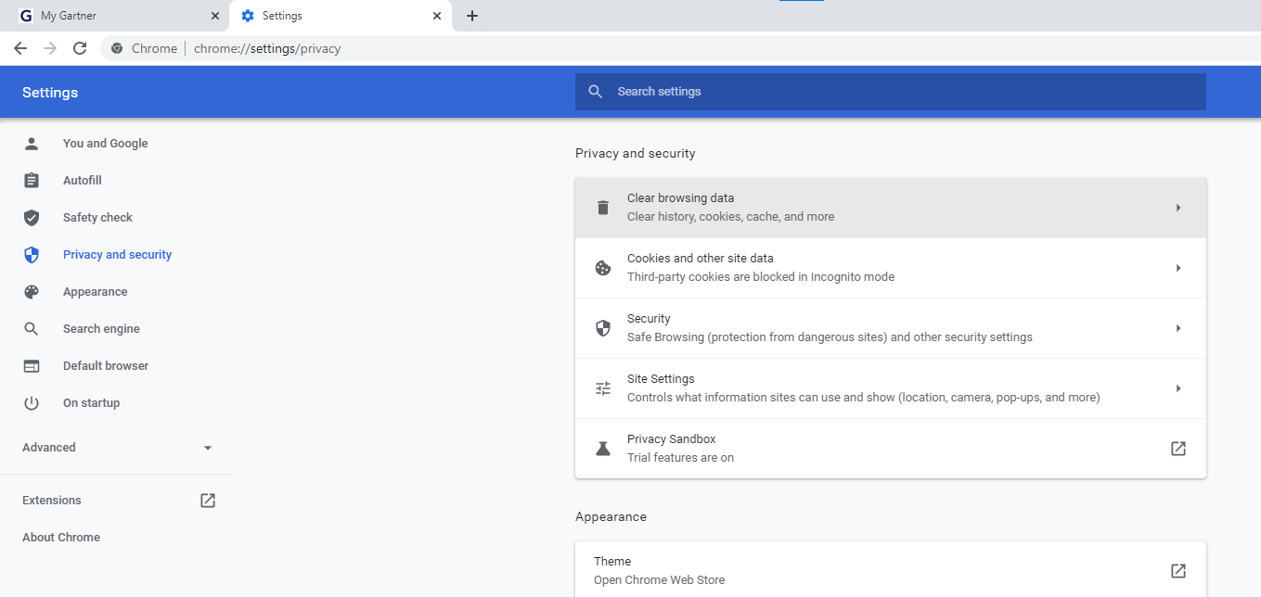
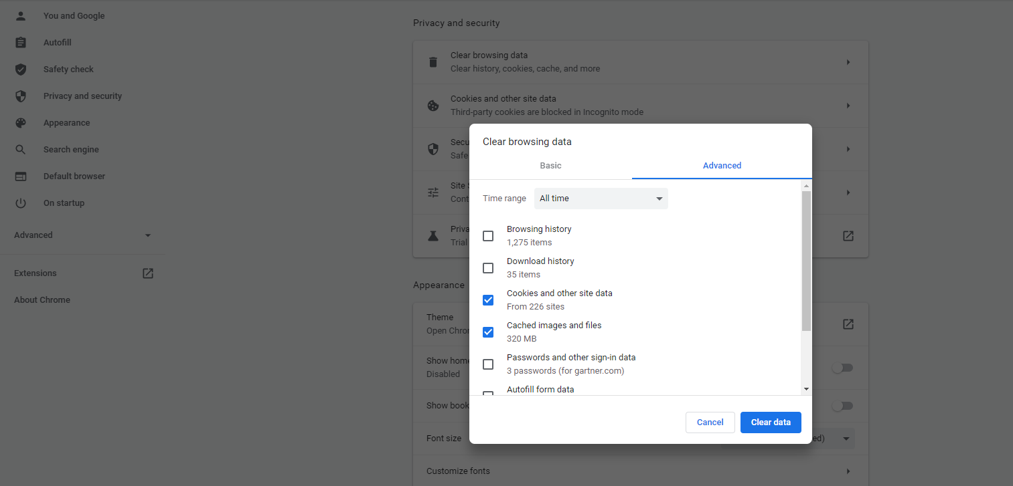
Step 3: Click on “Privacy and security” from the panel on the left.
Step 4: Select “Clear browsing data” from the menu.
Step 5: Change tab to Advanced.
Step 6: Change time range to “All time” and select Browsing History, Cookies and other Site data, and Cached images and files. Then click on “Clear data.”

Slide 14
Thank You

