Slide 1
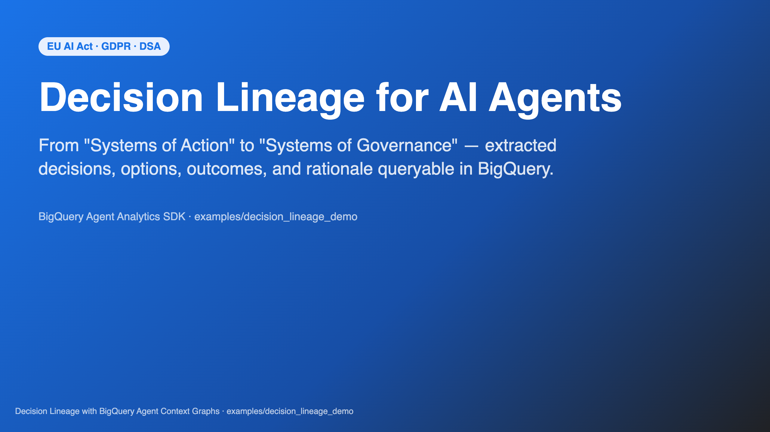
Notes:
Copyright 2026 Google LLC Licensed under the Apache License, Version 2.0. Decision Lineage with BigQuery Agent Context Graphs — leadership deck. Render with Marp (https://marp.app): marp SLIDES.md --html --pdf # SLIDES.pdf marp SLIDES.md --html --pptx # SLIDES.pptx marp SLIDES.md --html # SLIDES.html marp SLIDES.md --watch --html # live preview `SLIDES.html` and `SLIDES.pptx` are checked in alongside this source so reviewers can open the deck without installing Marp. After editing this file, regenerate both with: npx -y @marp-team/marp-cli@latest SLIDES.md --html npx -y @marp-team/marp-cli@latest SLIDES.md --html --pptx --no-stdin (or `marp SLIDES.md --html --pptx` if you have Marp installed globally via `npm install -g @marp-team/marp-cli`). SPEAKER NOTE — 30s Open with business pressure, not fear. Frame: AI agents are no longer just doing tasks (Systems of Action) — regulators now require we can prove what they did and why (Systems of Governance). The deck walks that line, top to bottom.

Slide 2
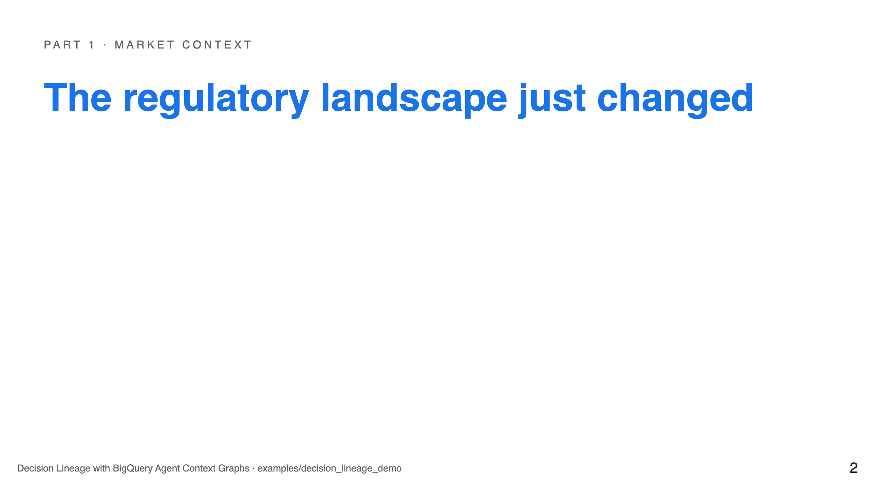

Slide 3
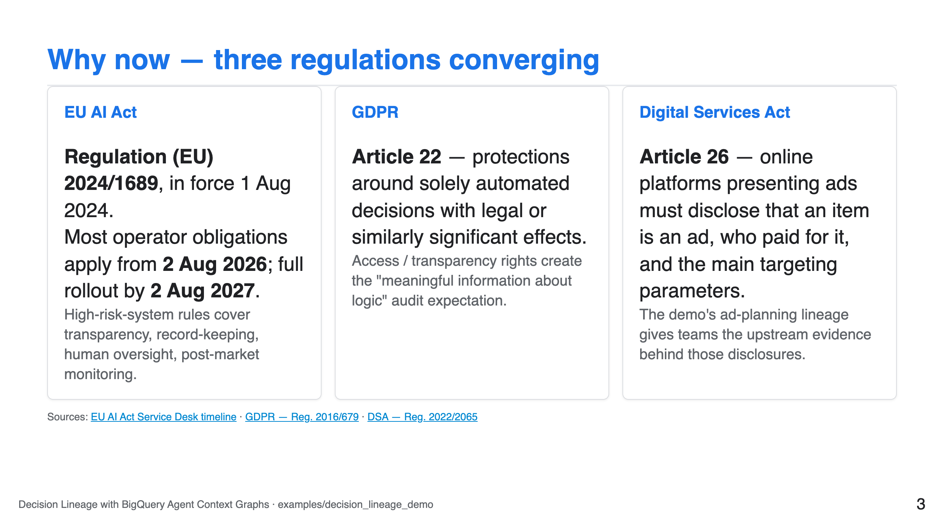

Slide 4
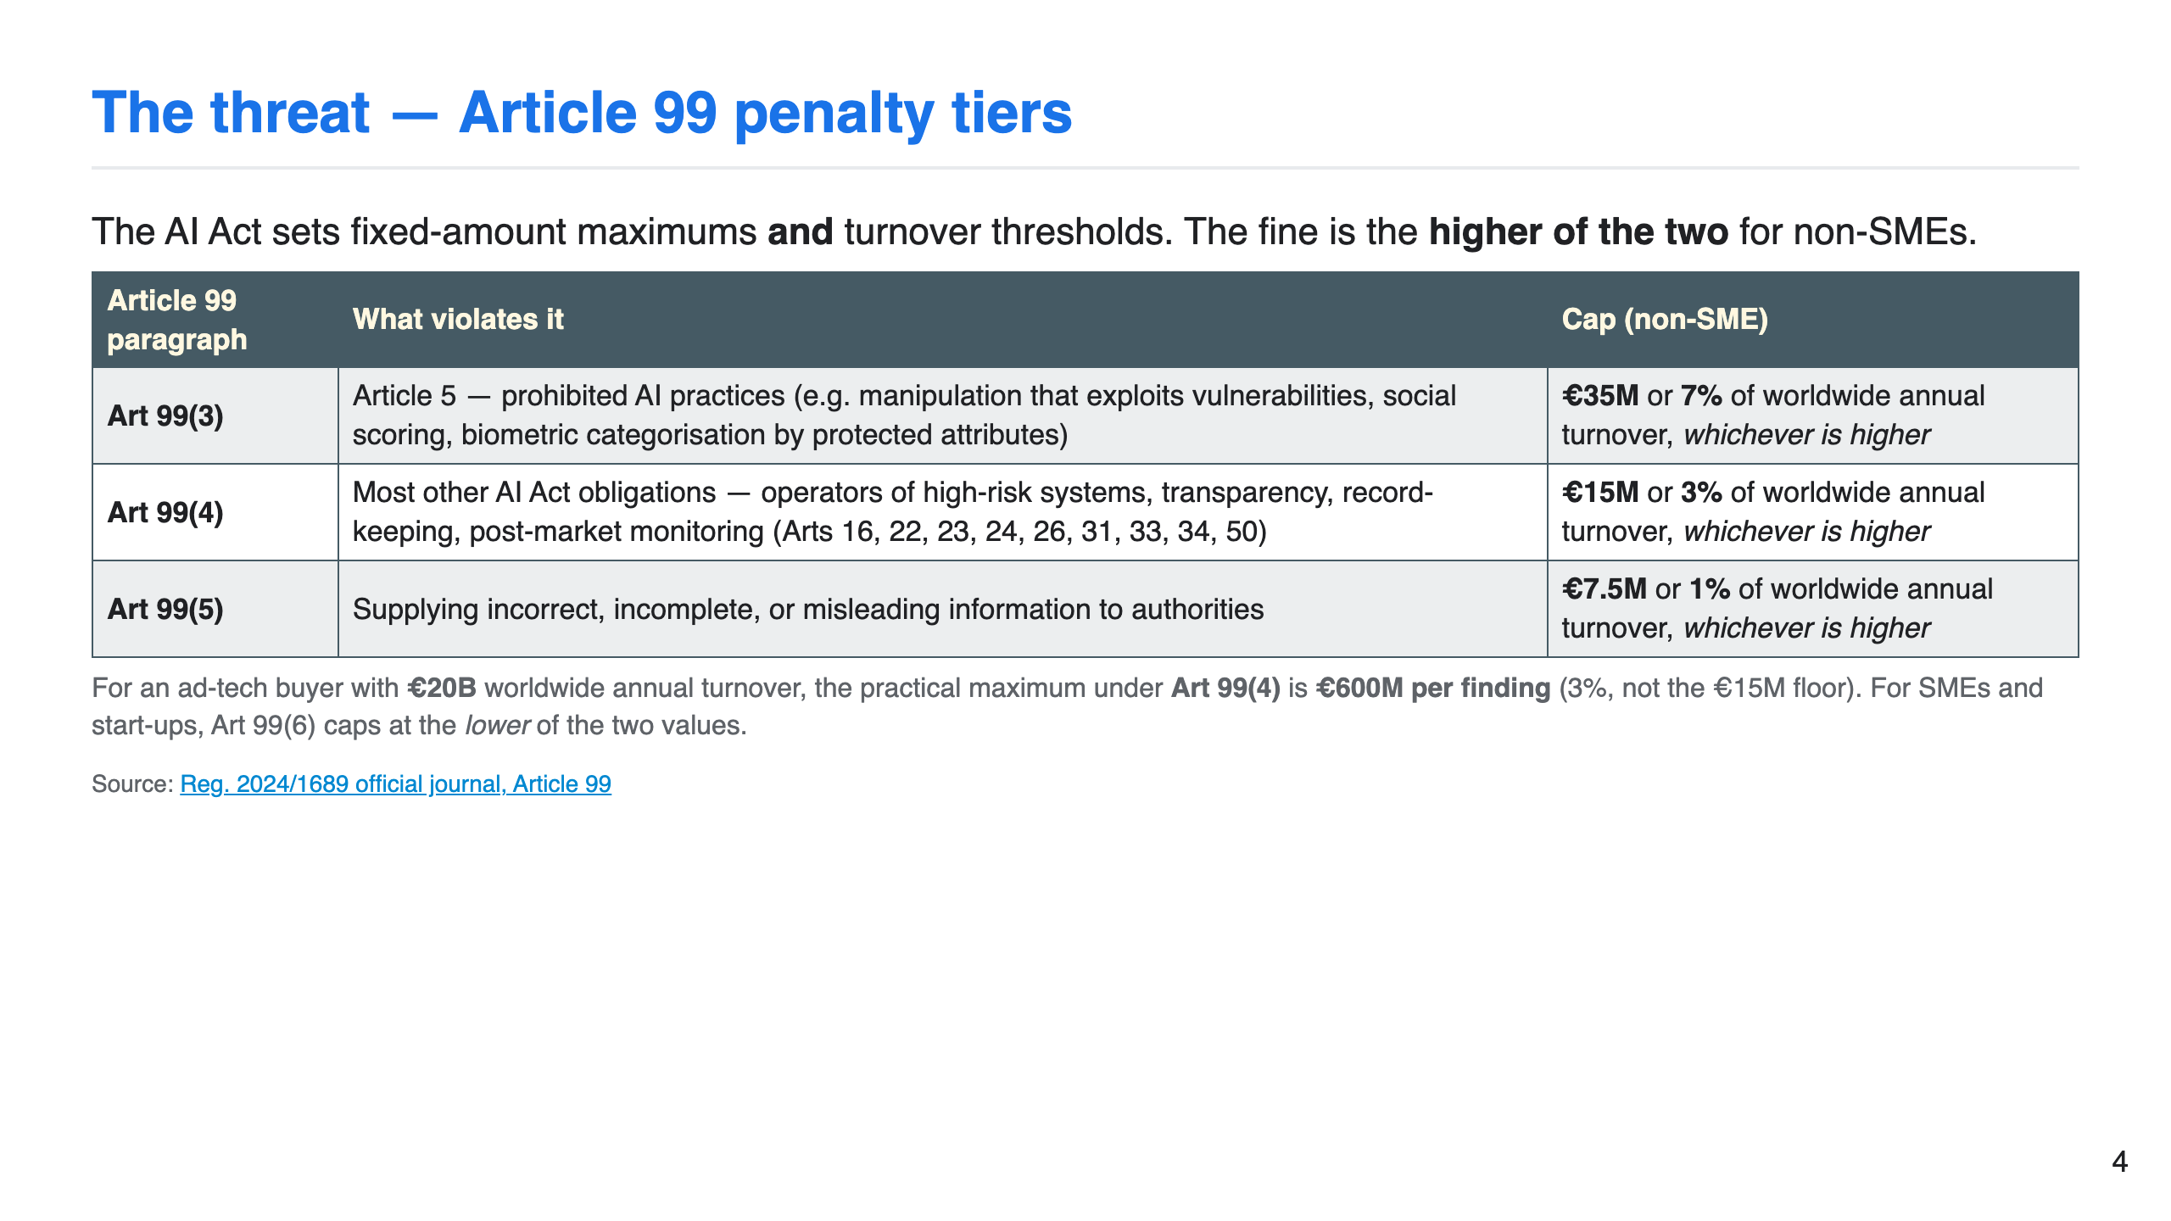

Slide 5
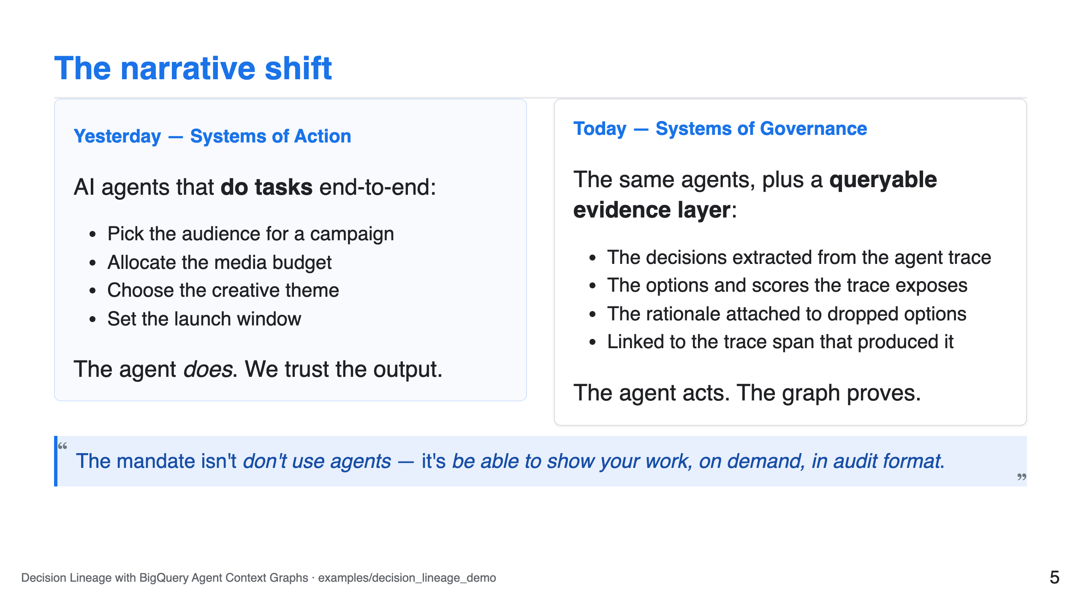

Slide 6
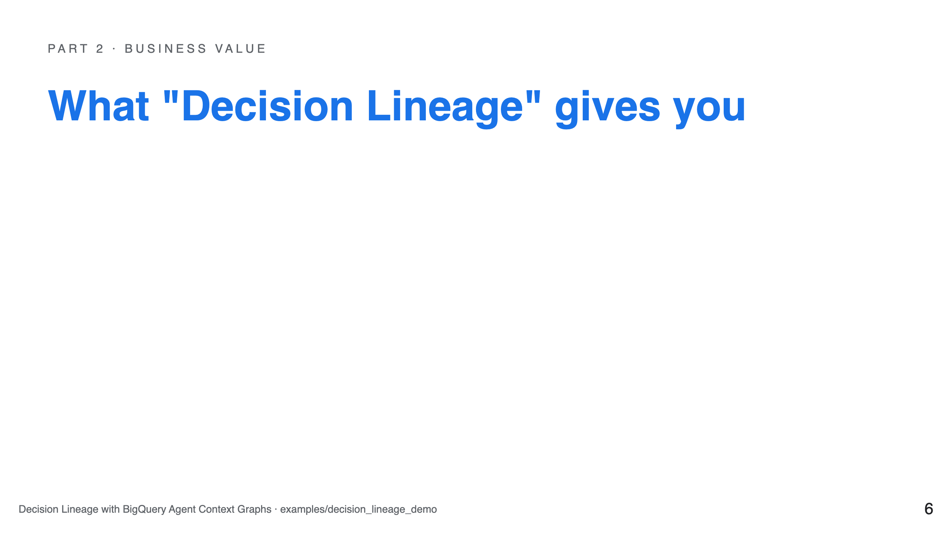

Slide 7
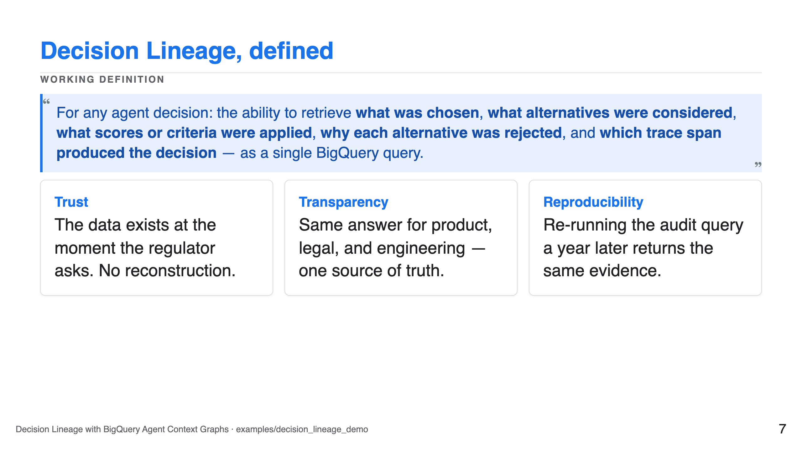

Slide 8
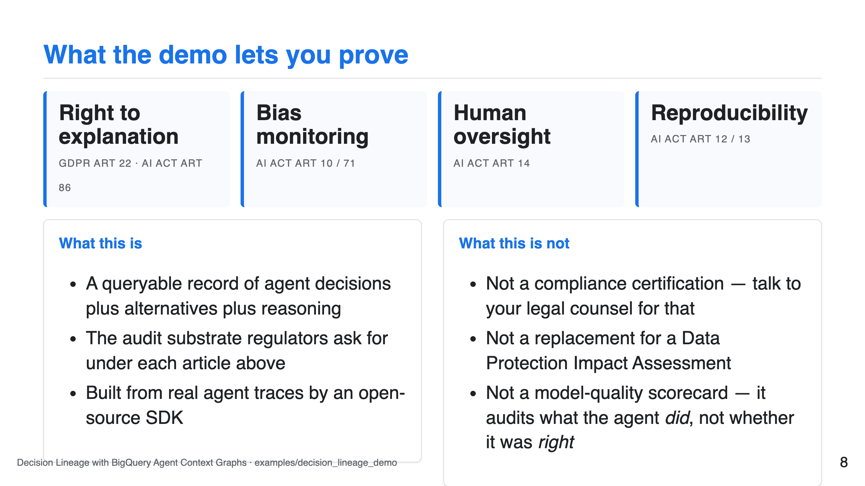

Slide 9
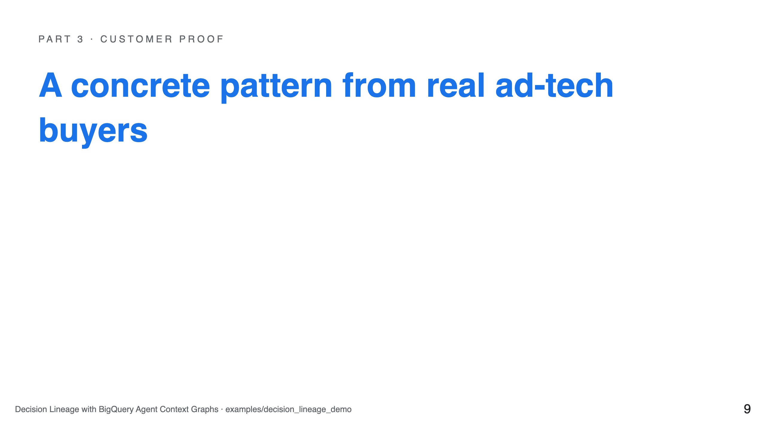

Slide 10
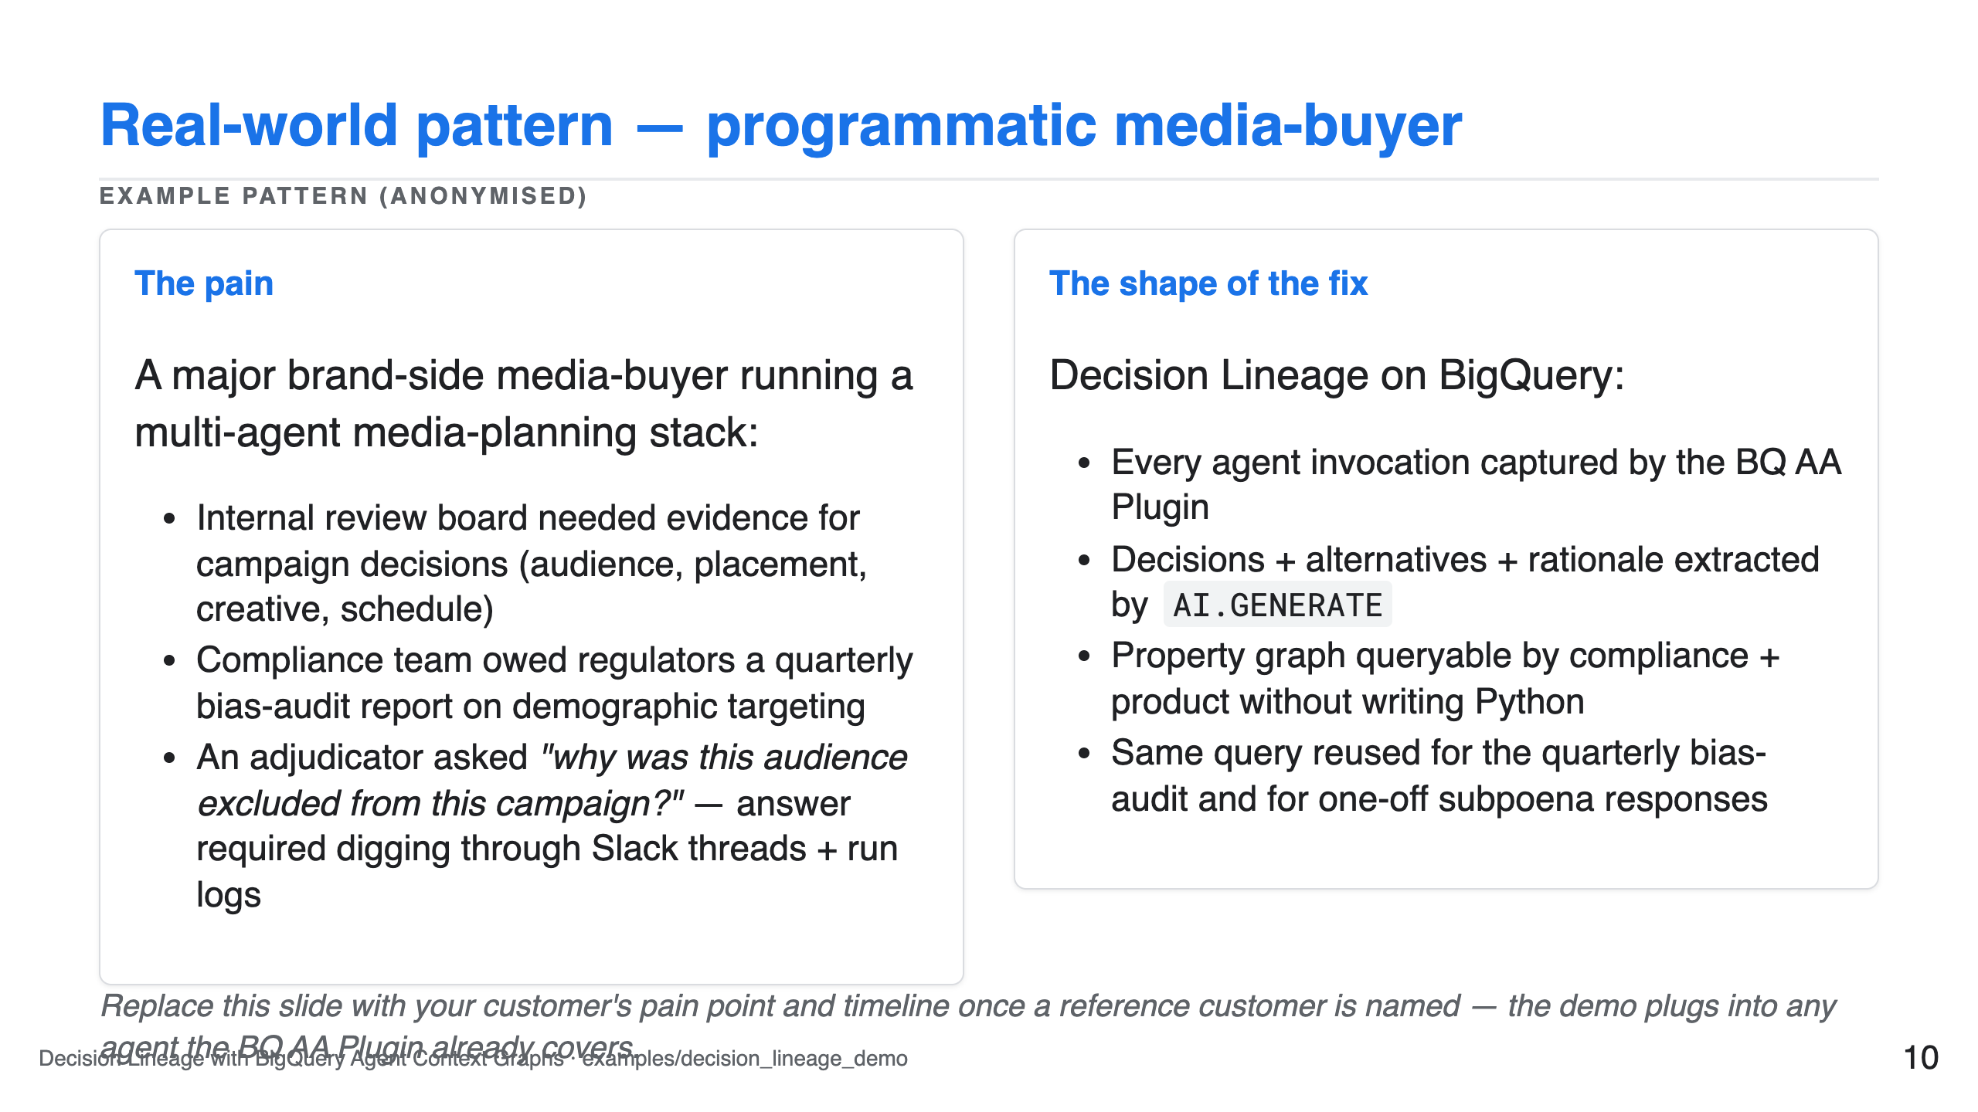

Slide 11
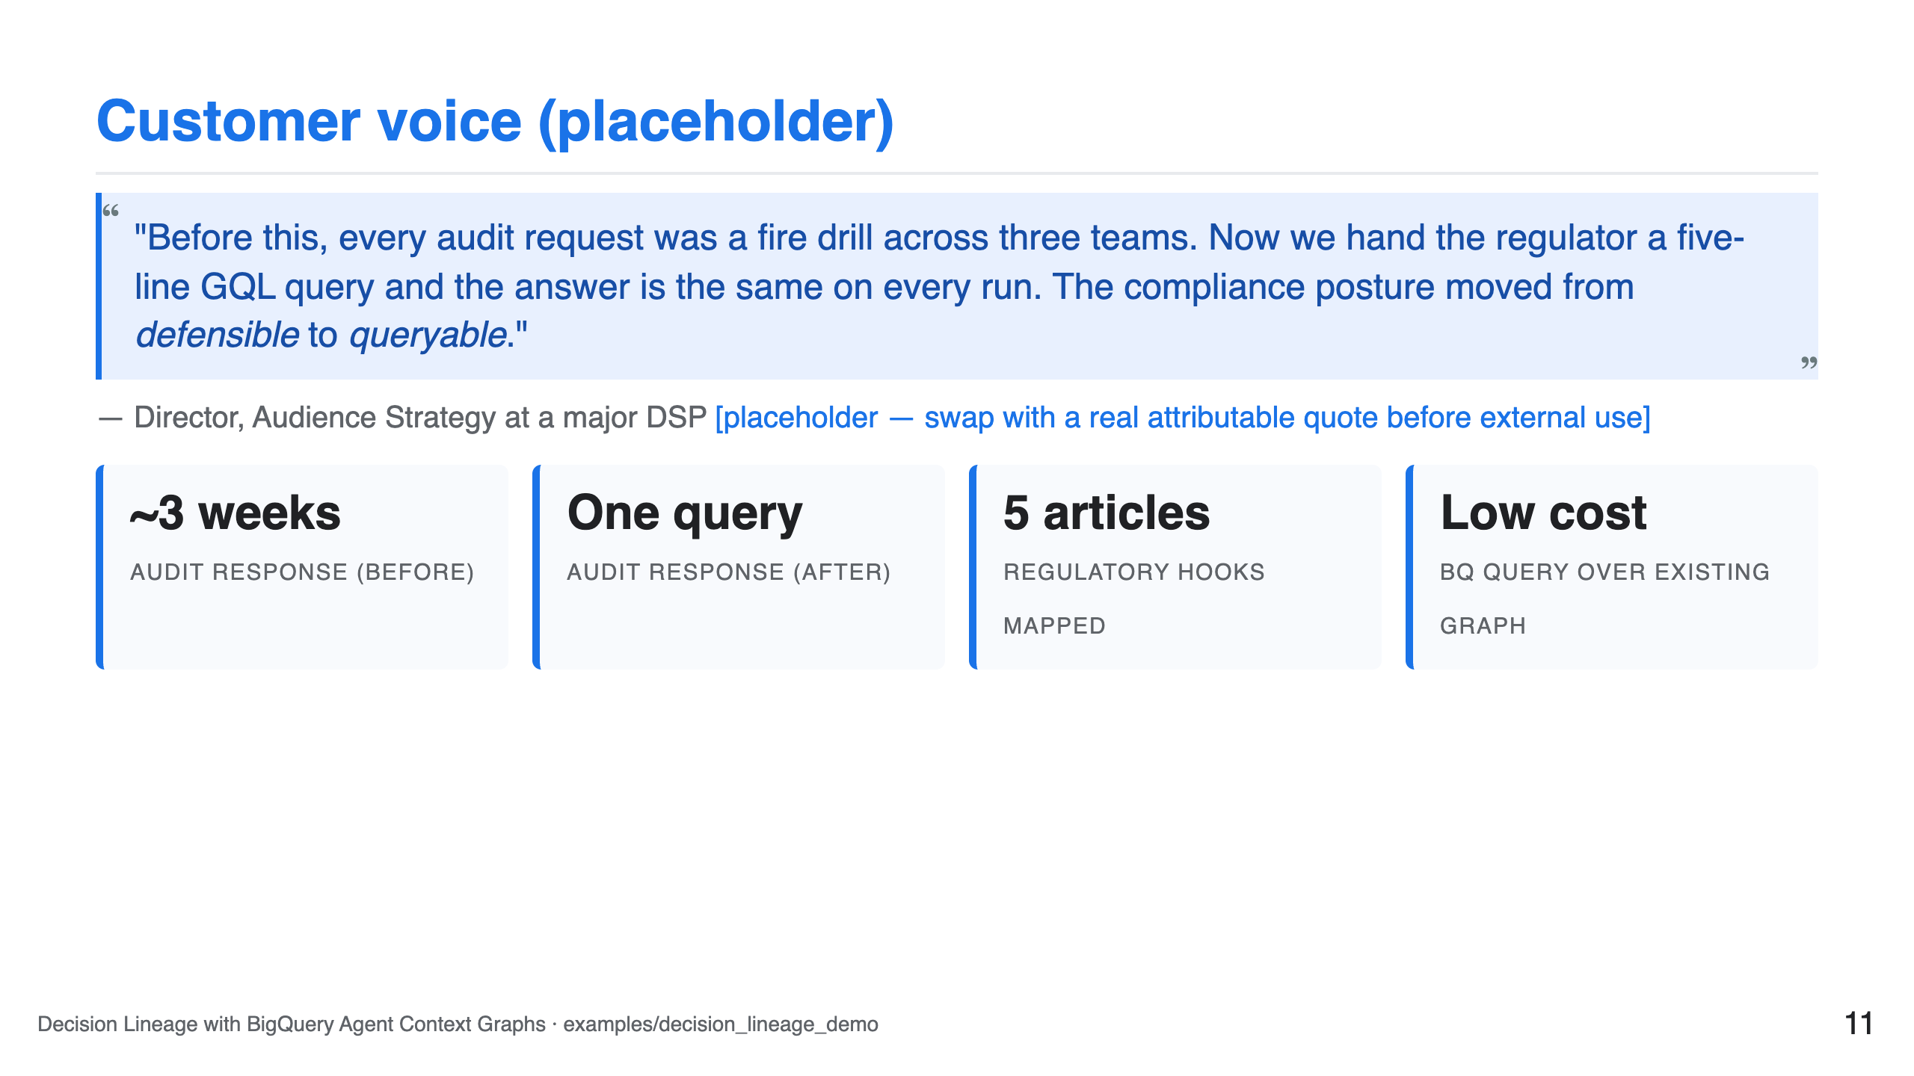

Slide 12
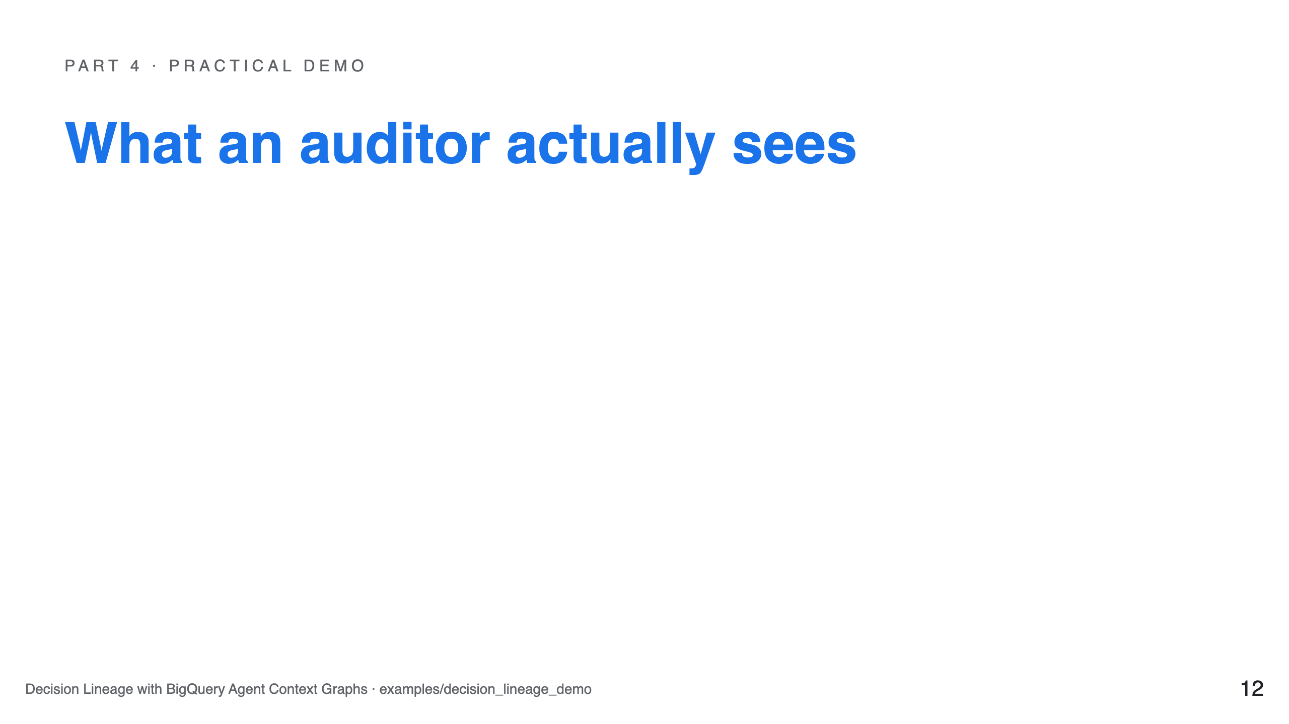

Slide 13
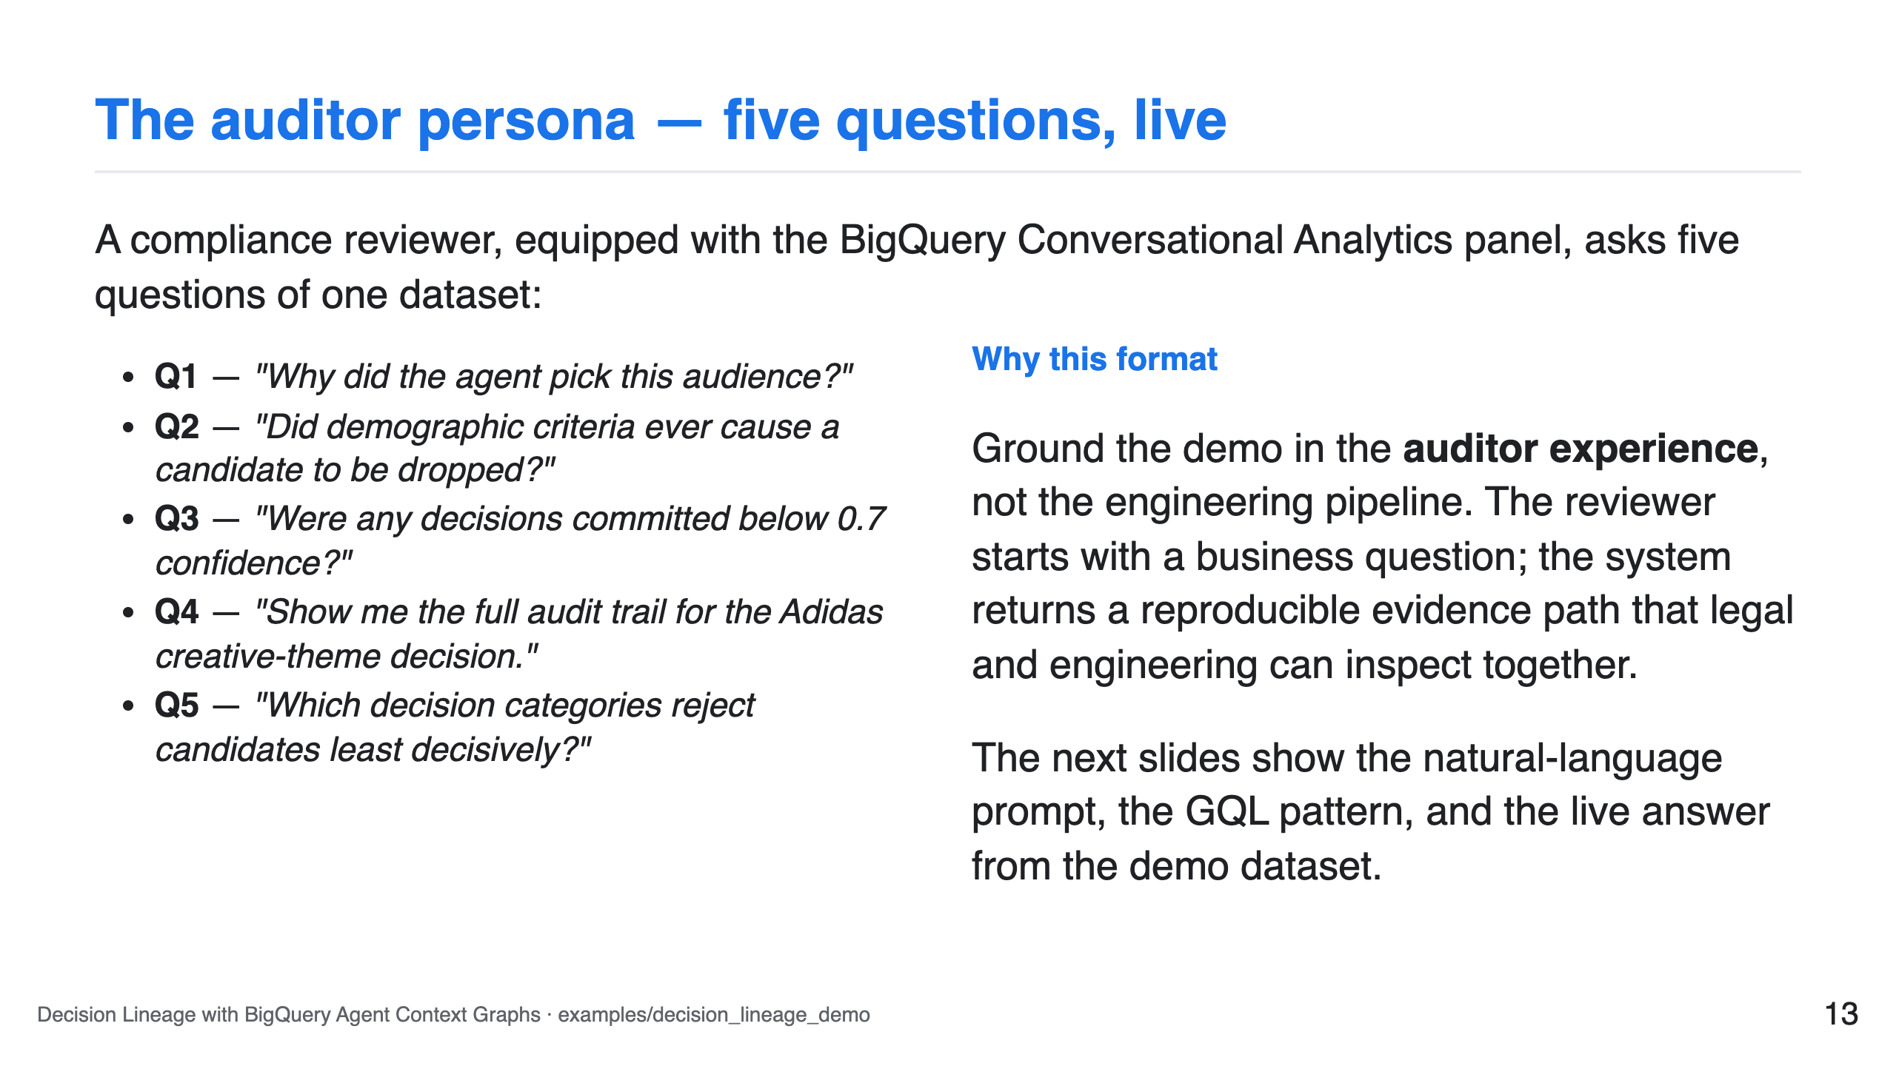

Slide 14
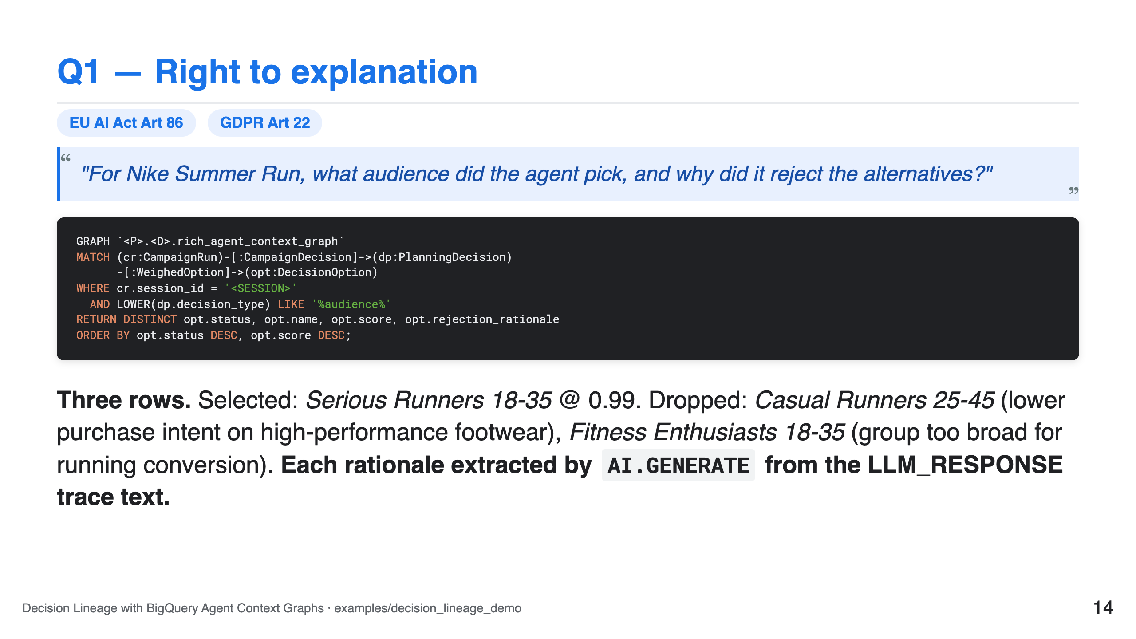

Slide 15
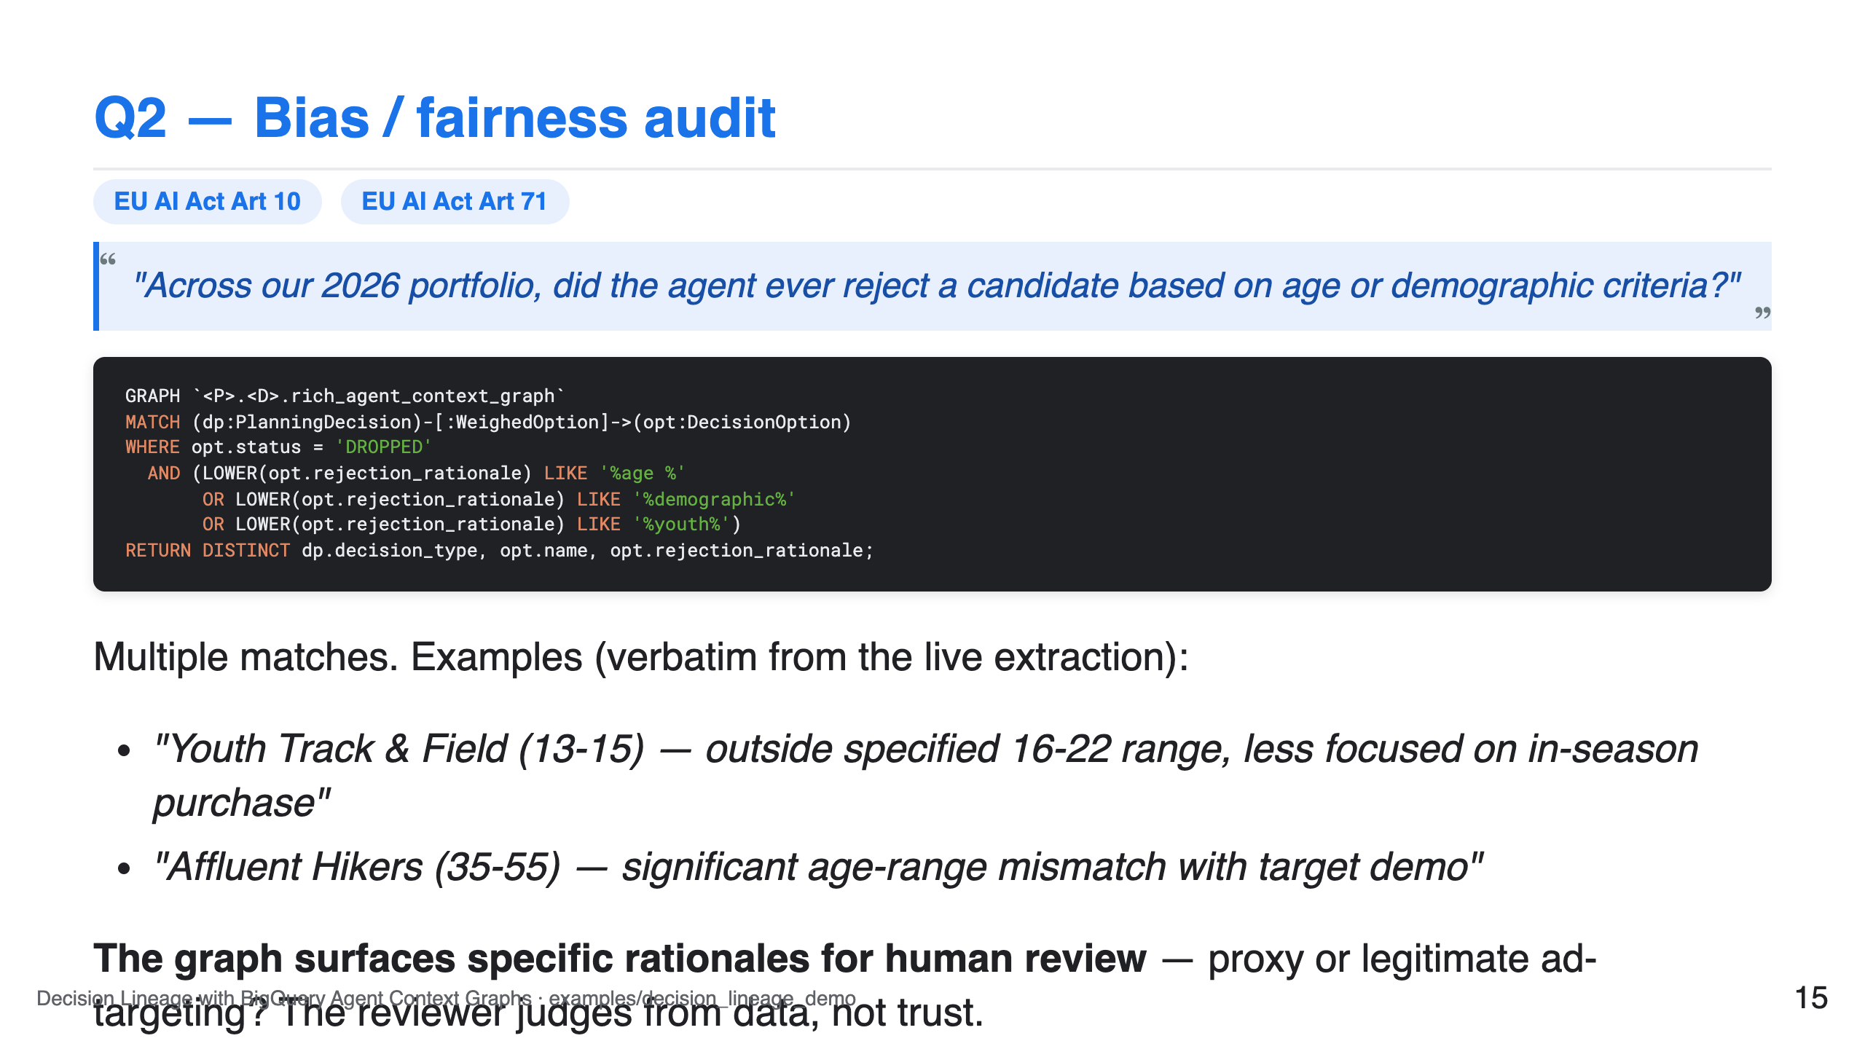

Slide 16
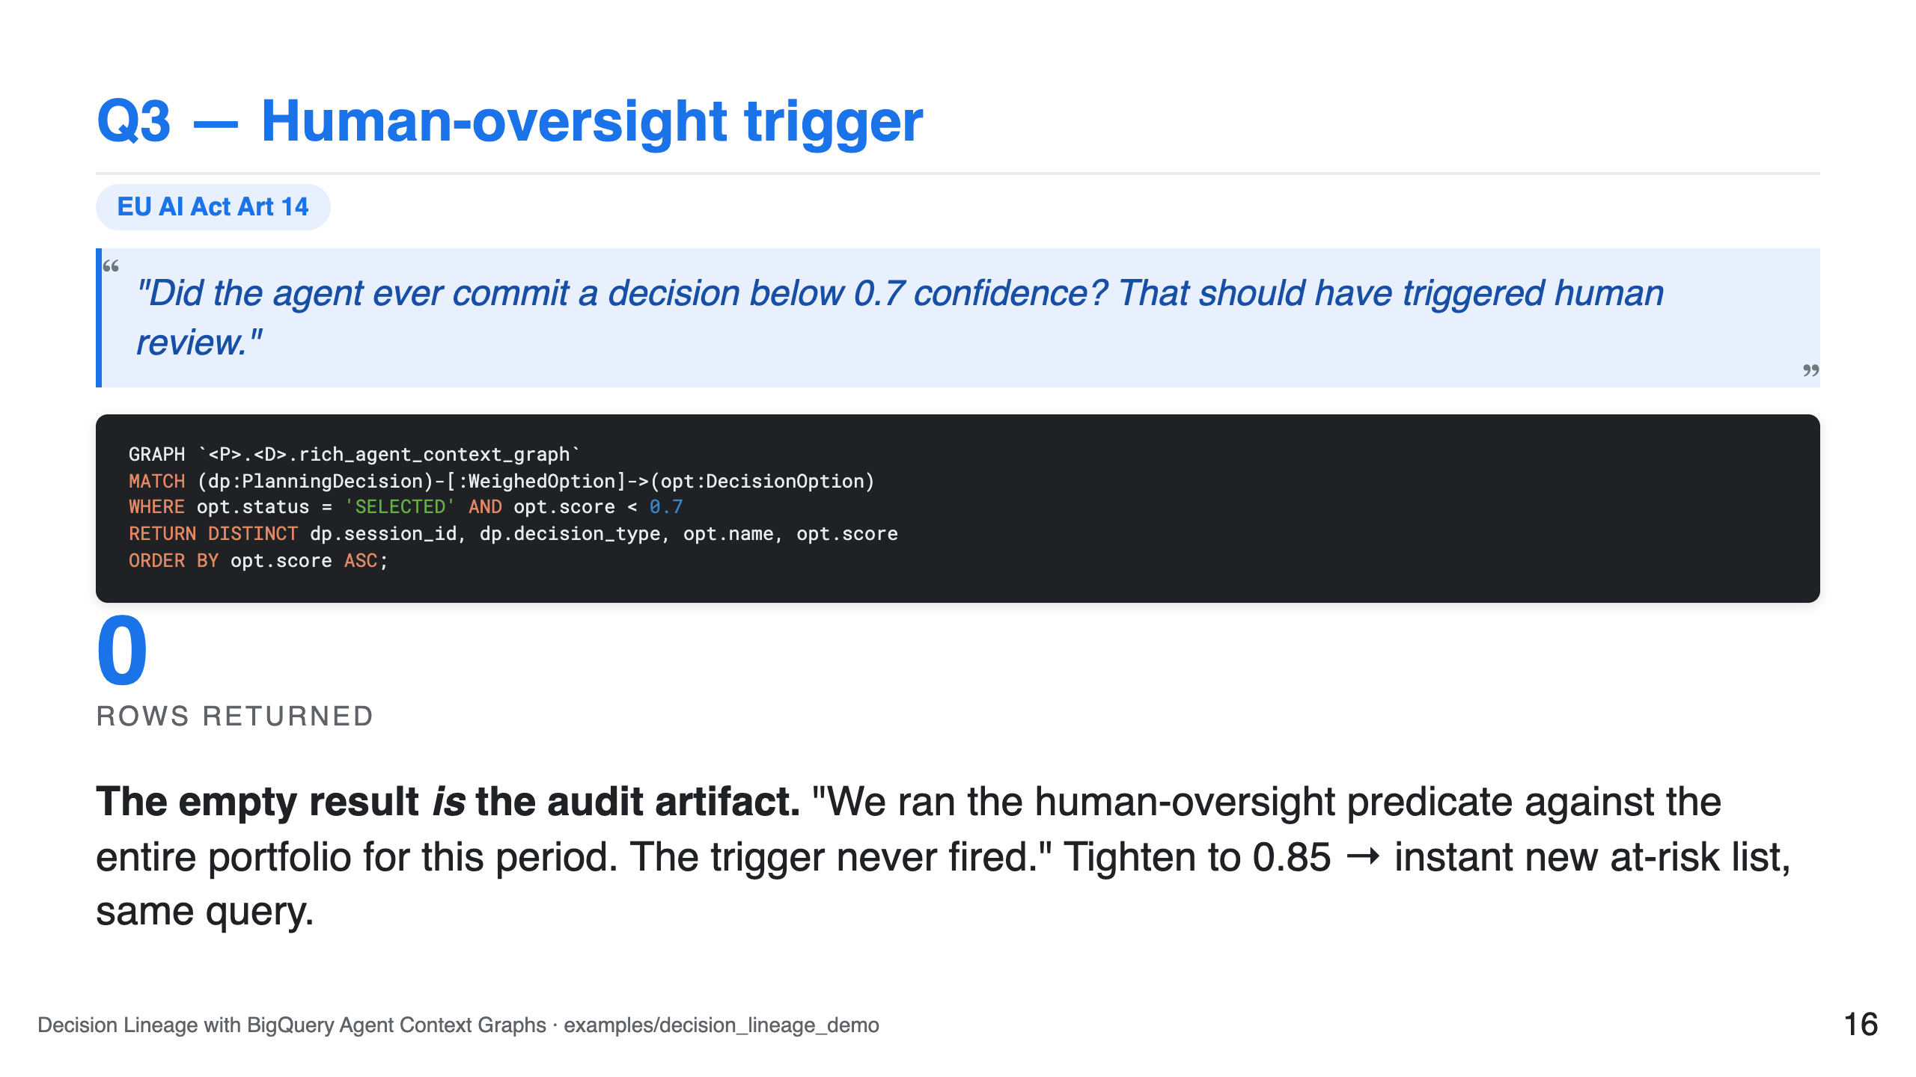

Slide 17
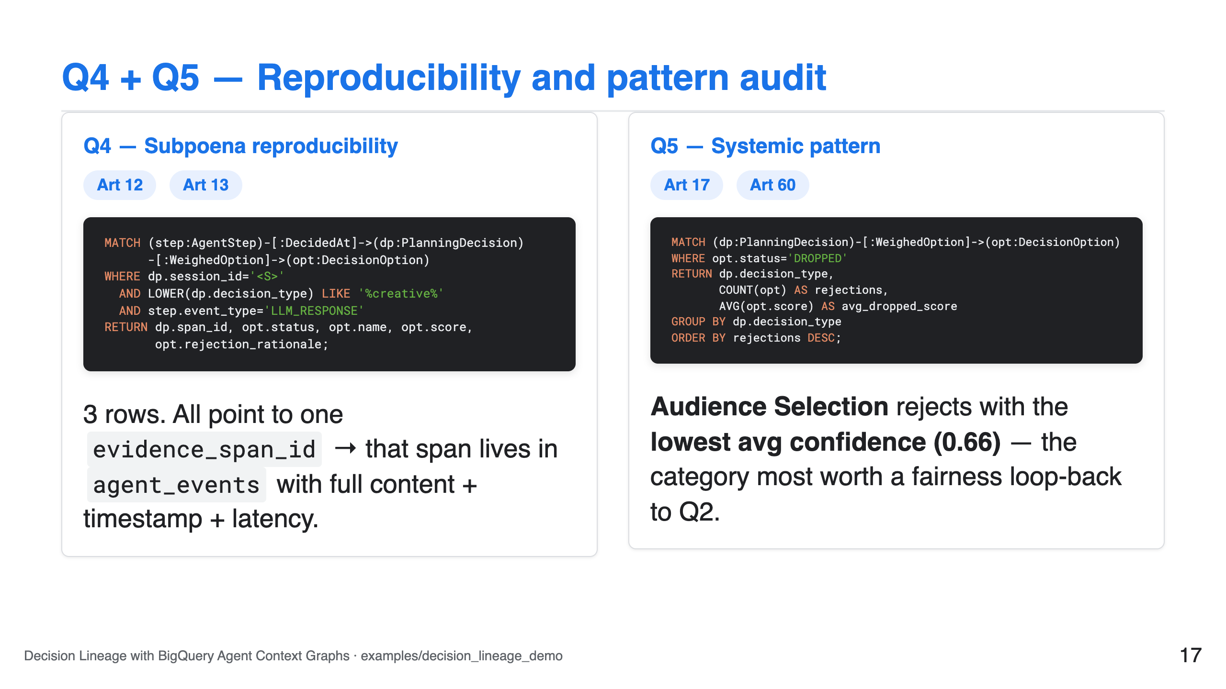

Slide 18
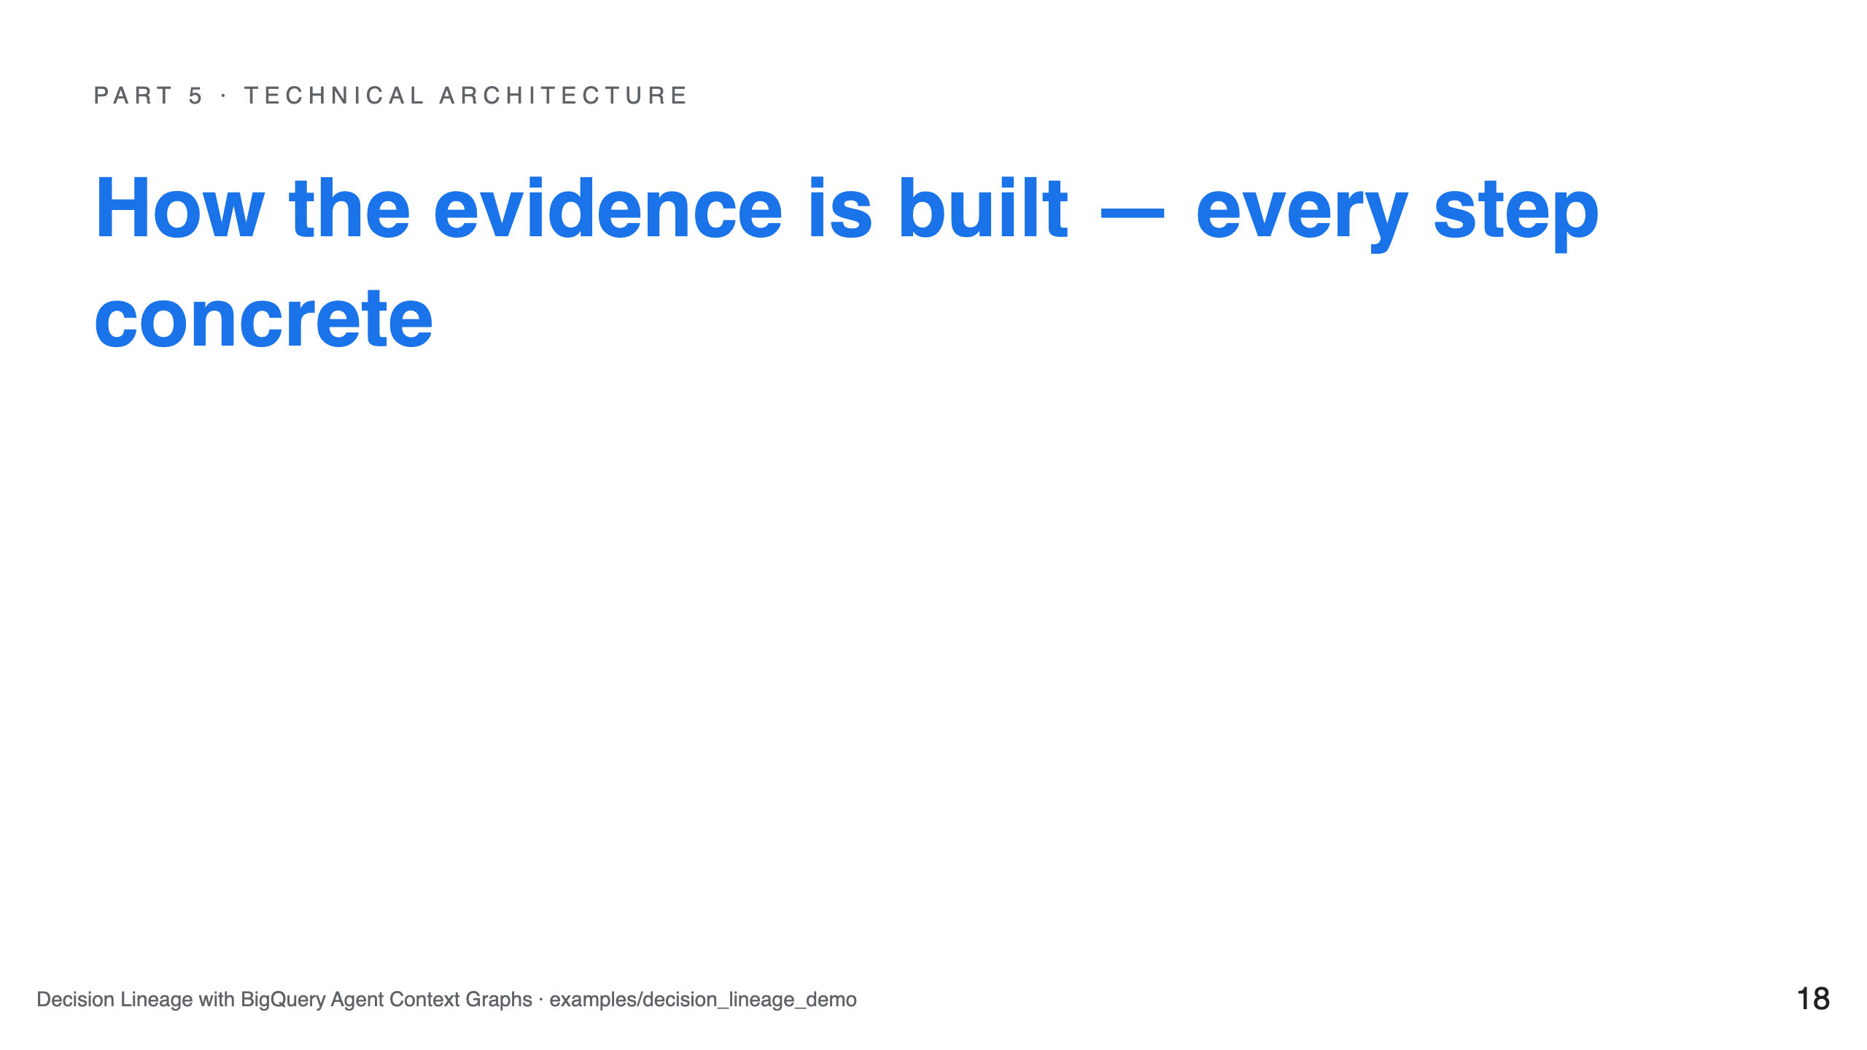

Slide 19
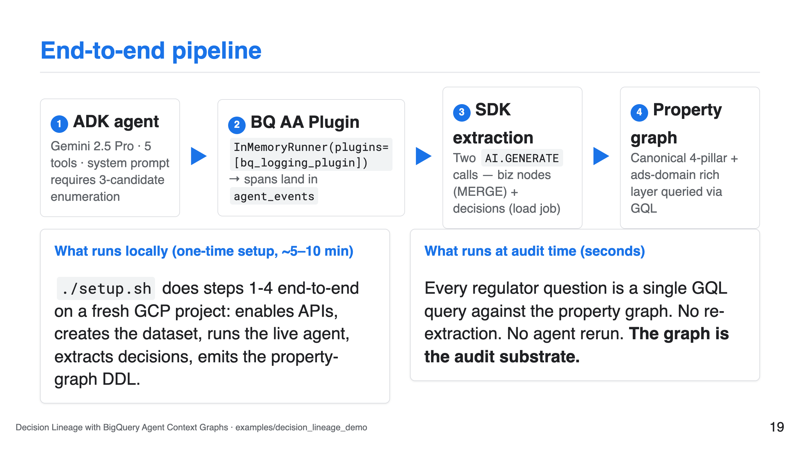

Slide 20
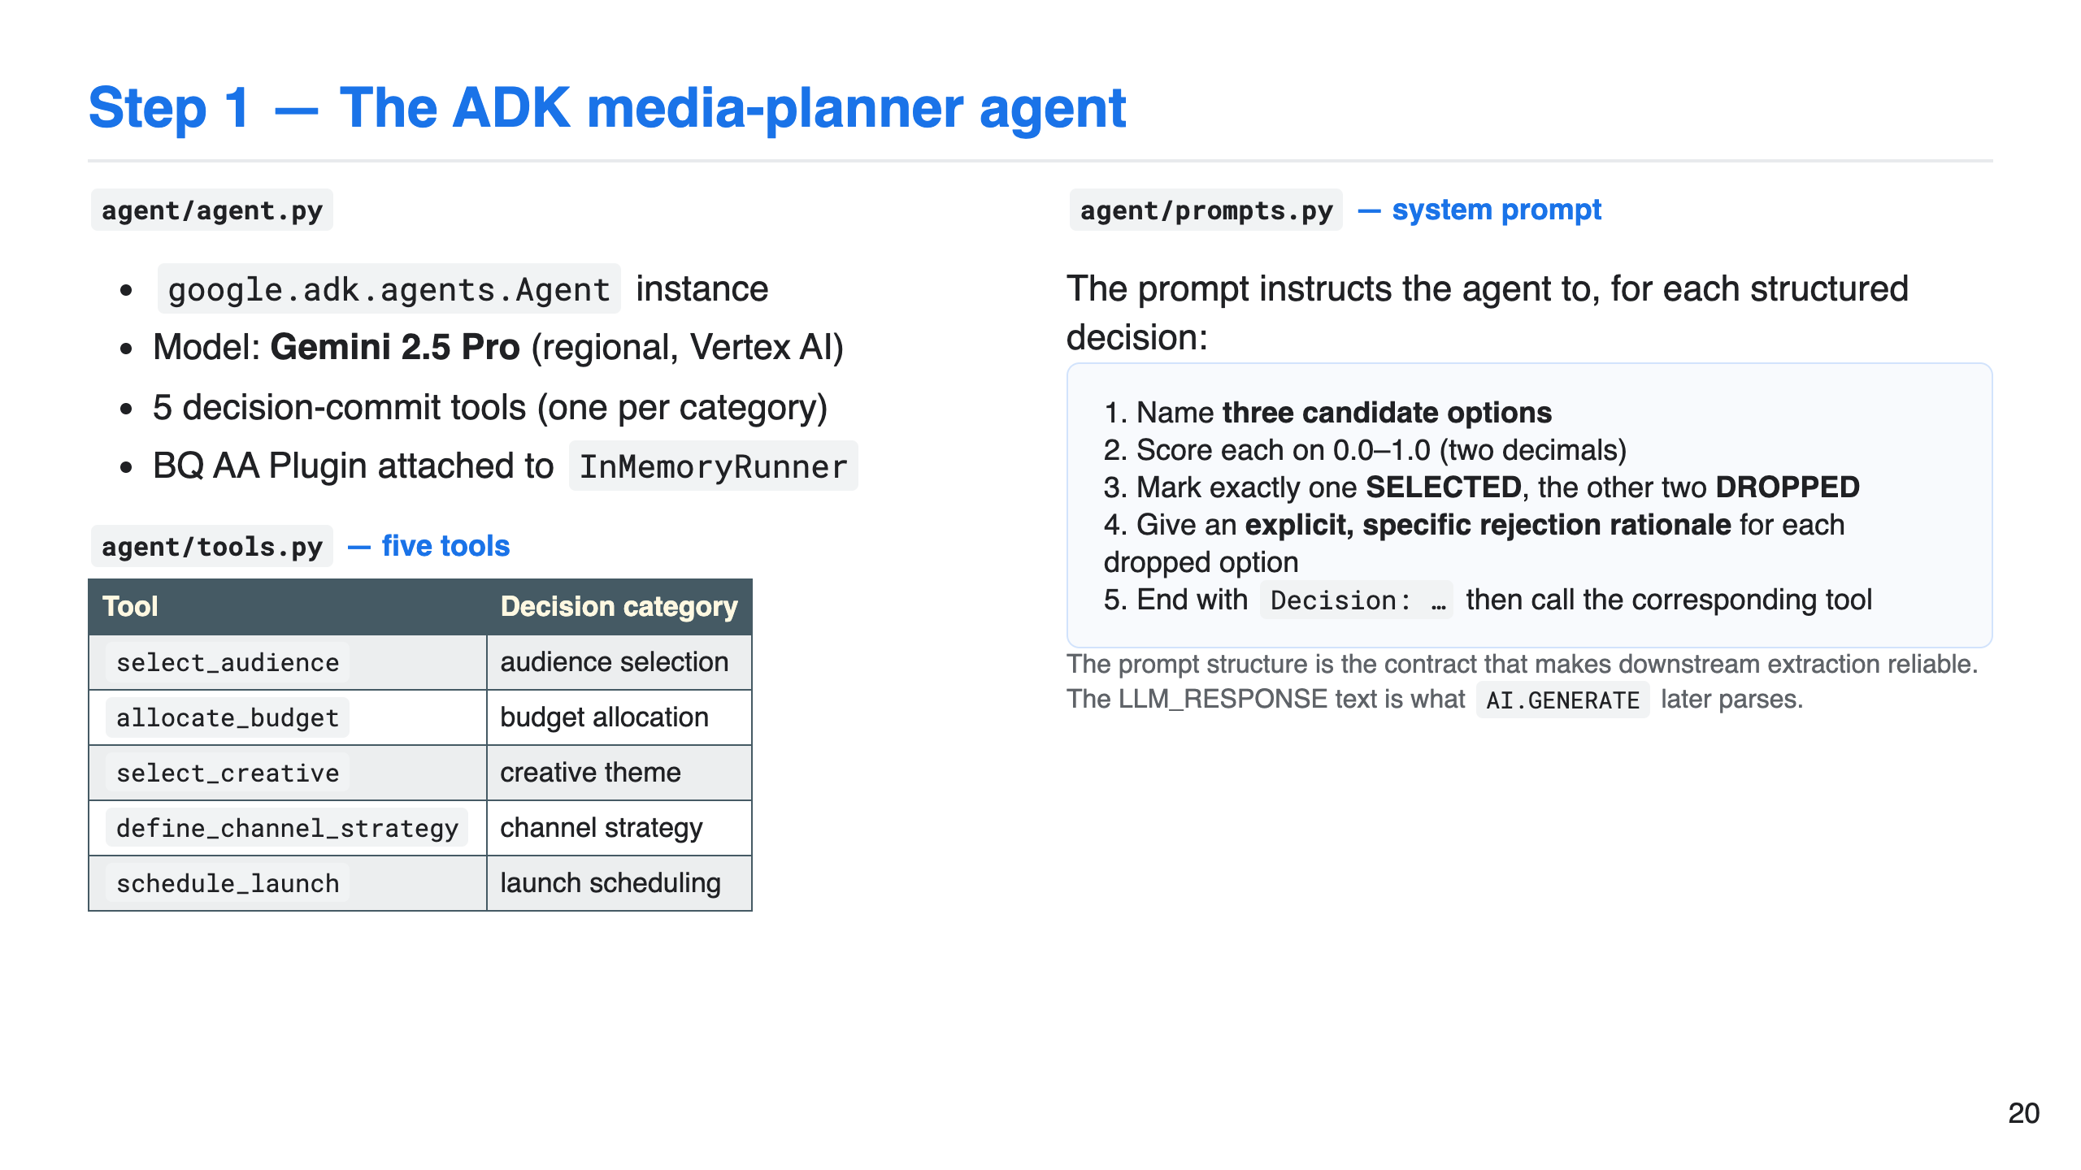

Slide 21
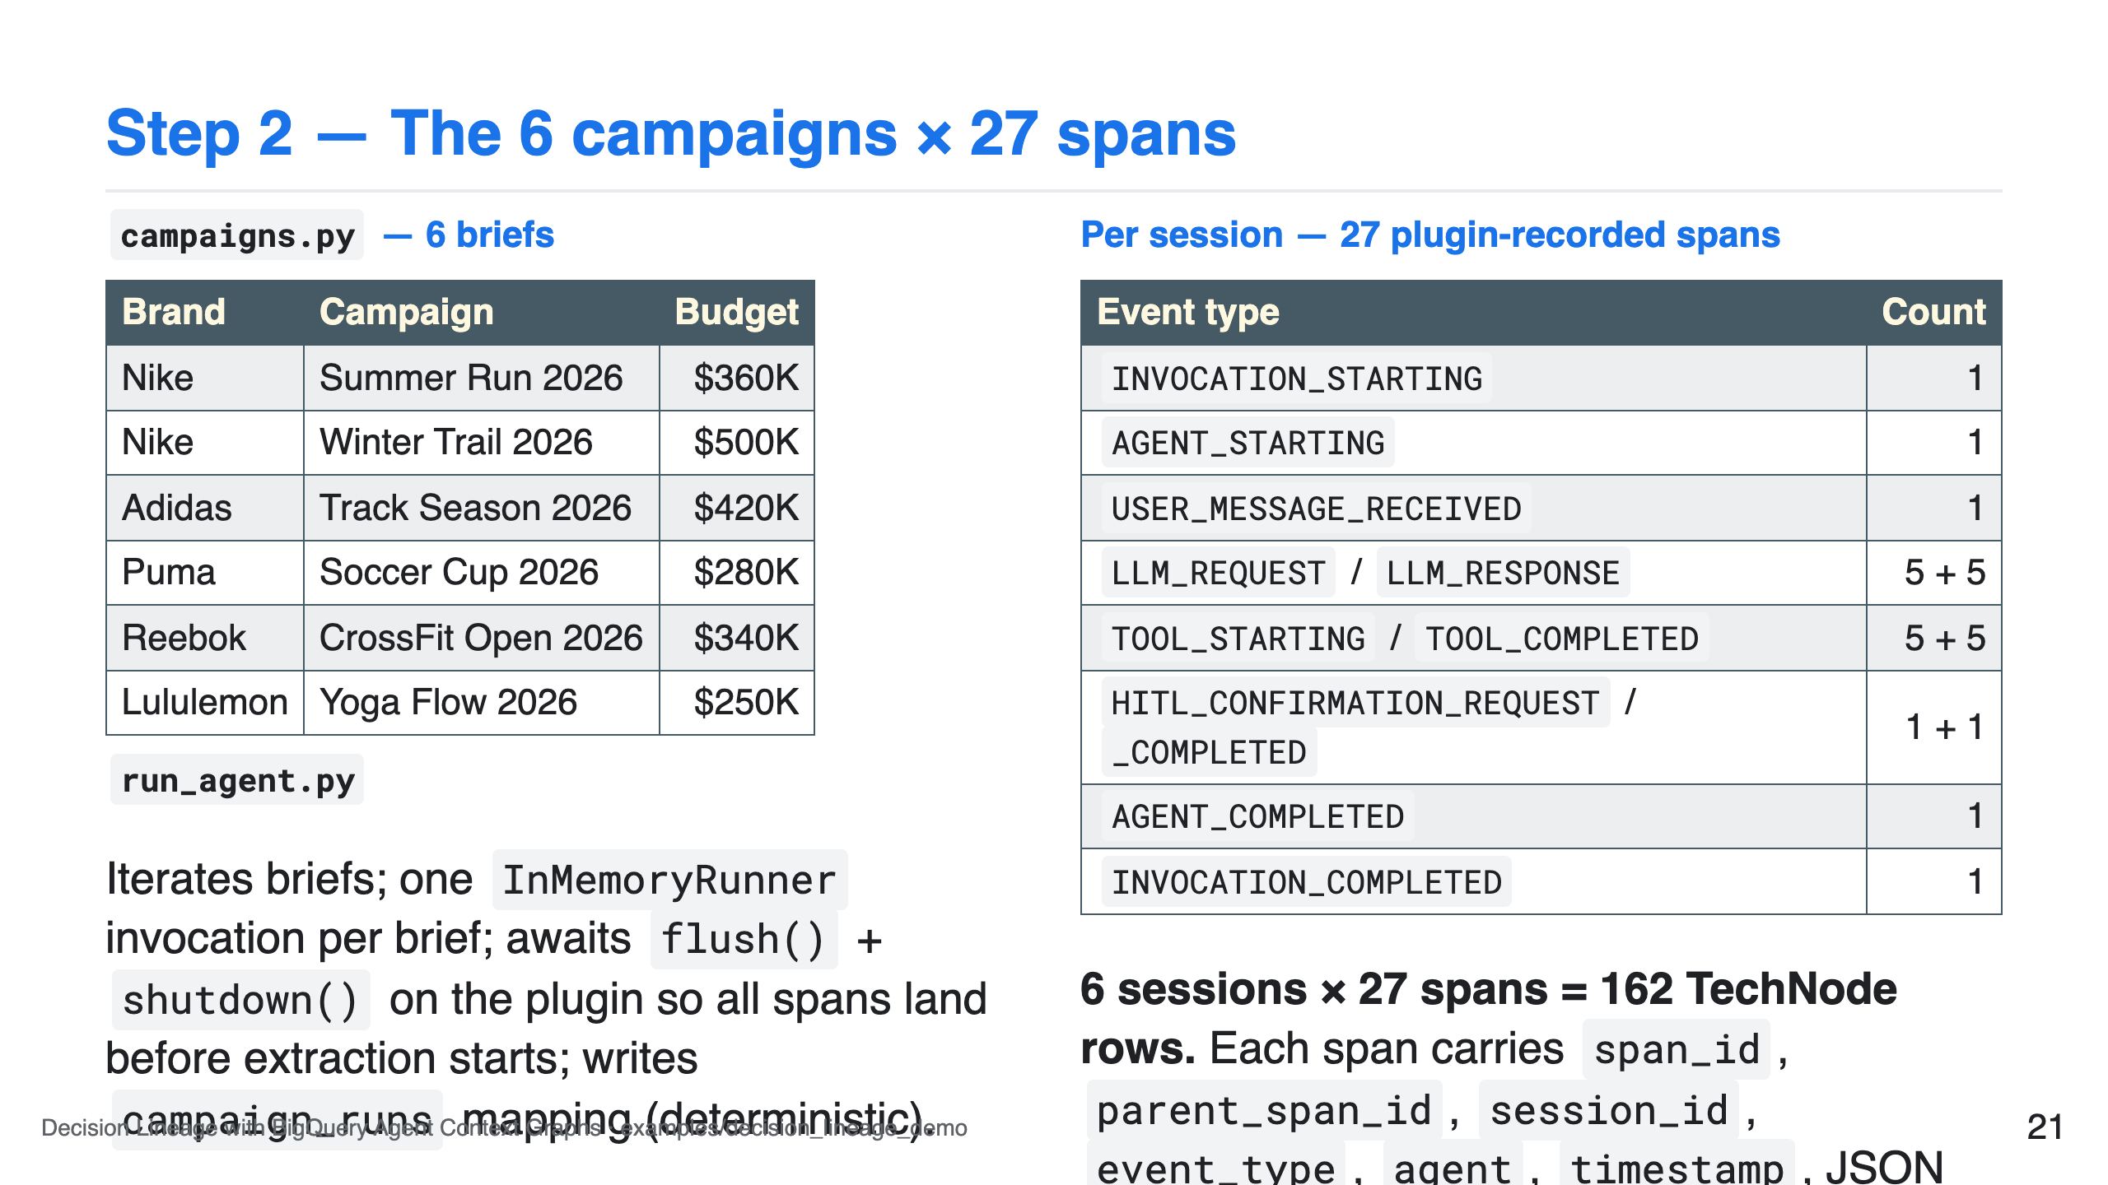

Slide 22
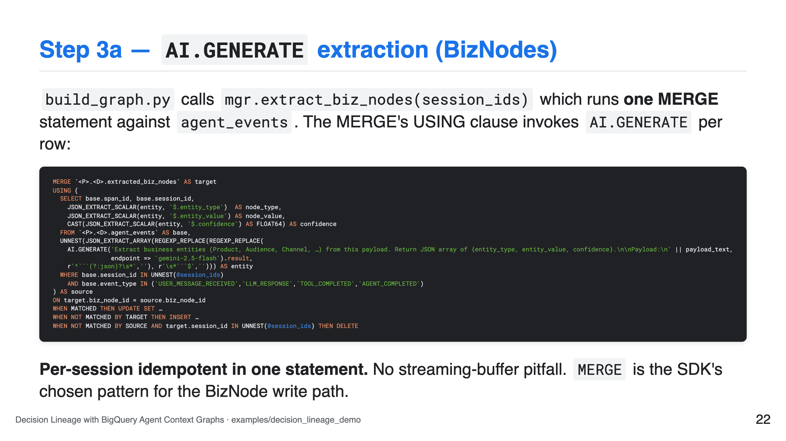

Slide 23
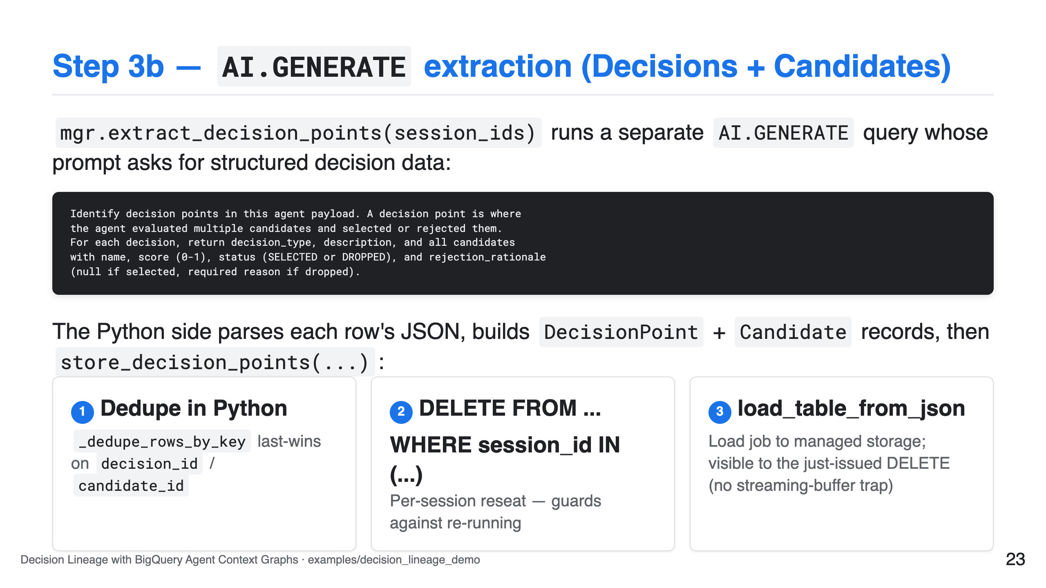

Slide 24
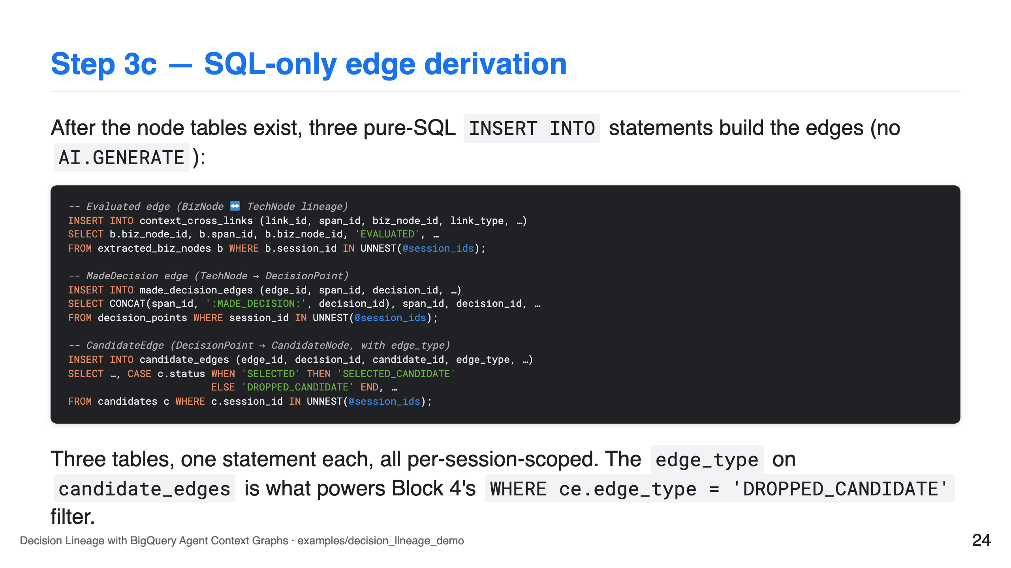

Slide 25
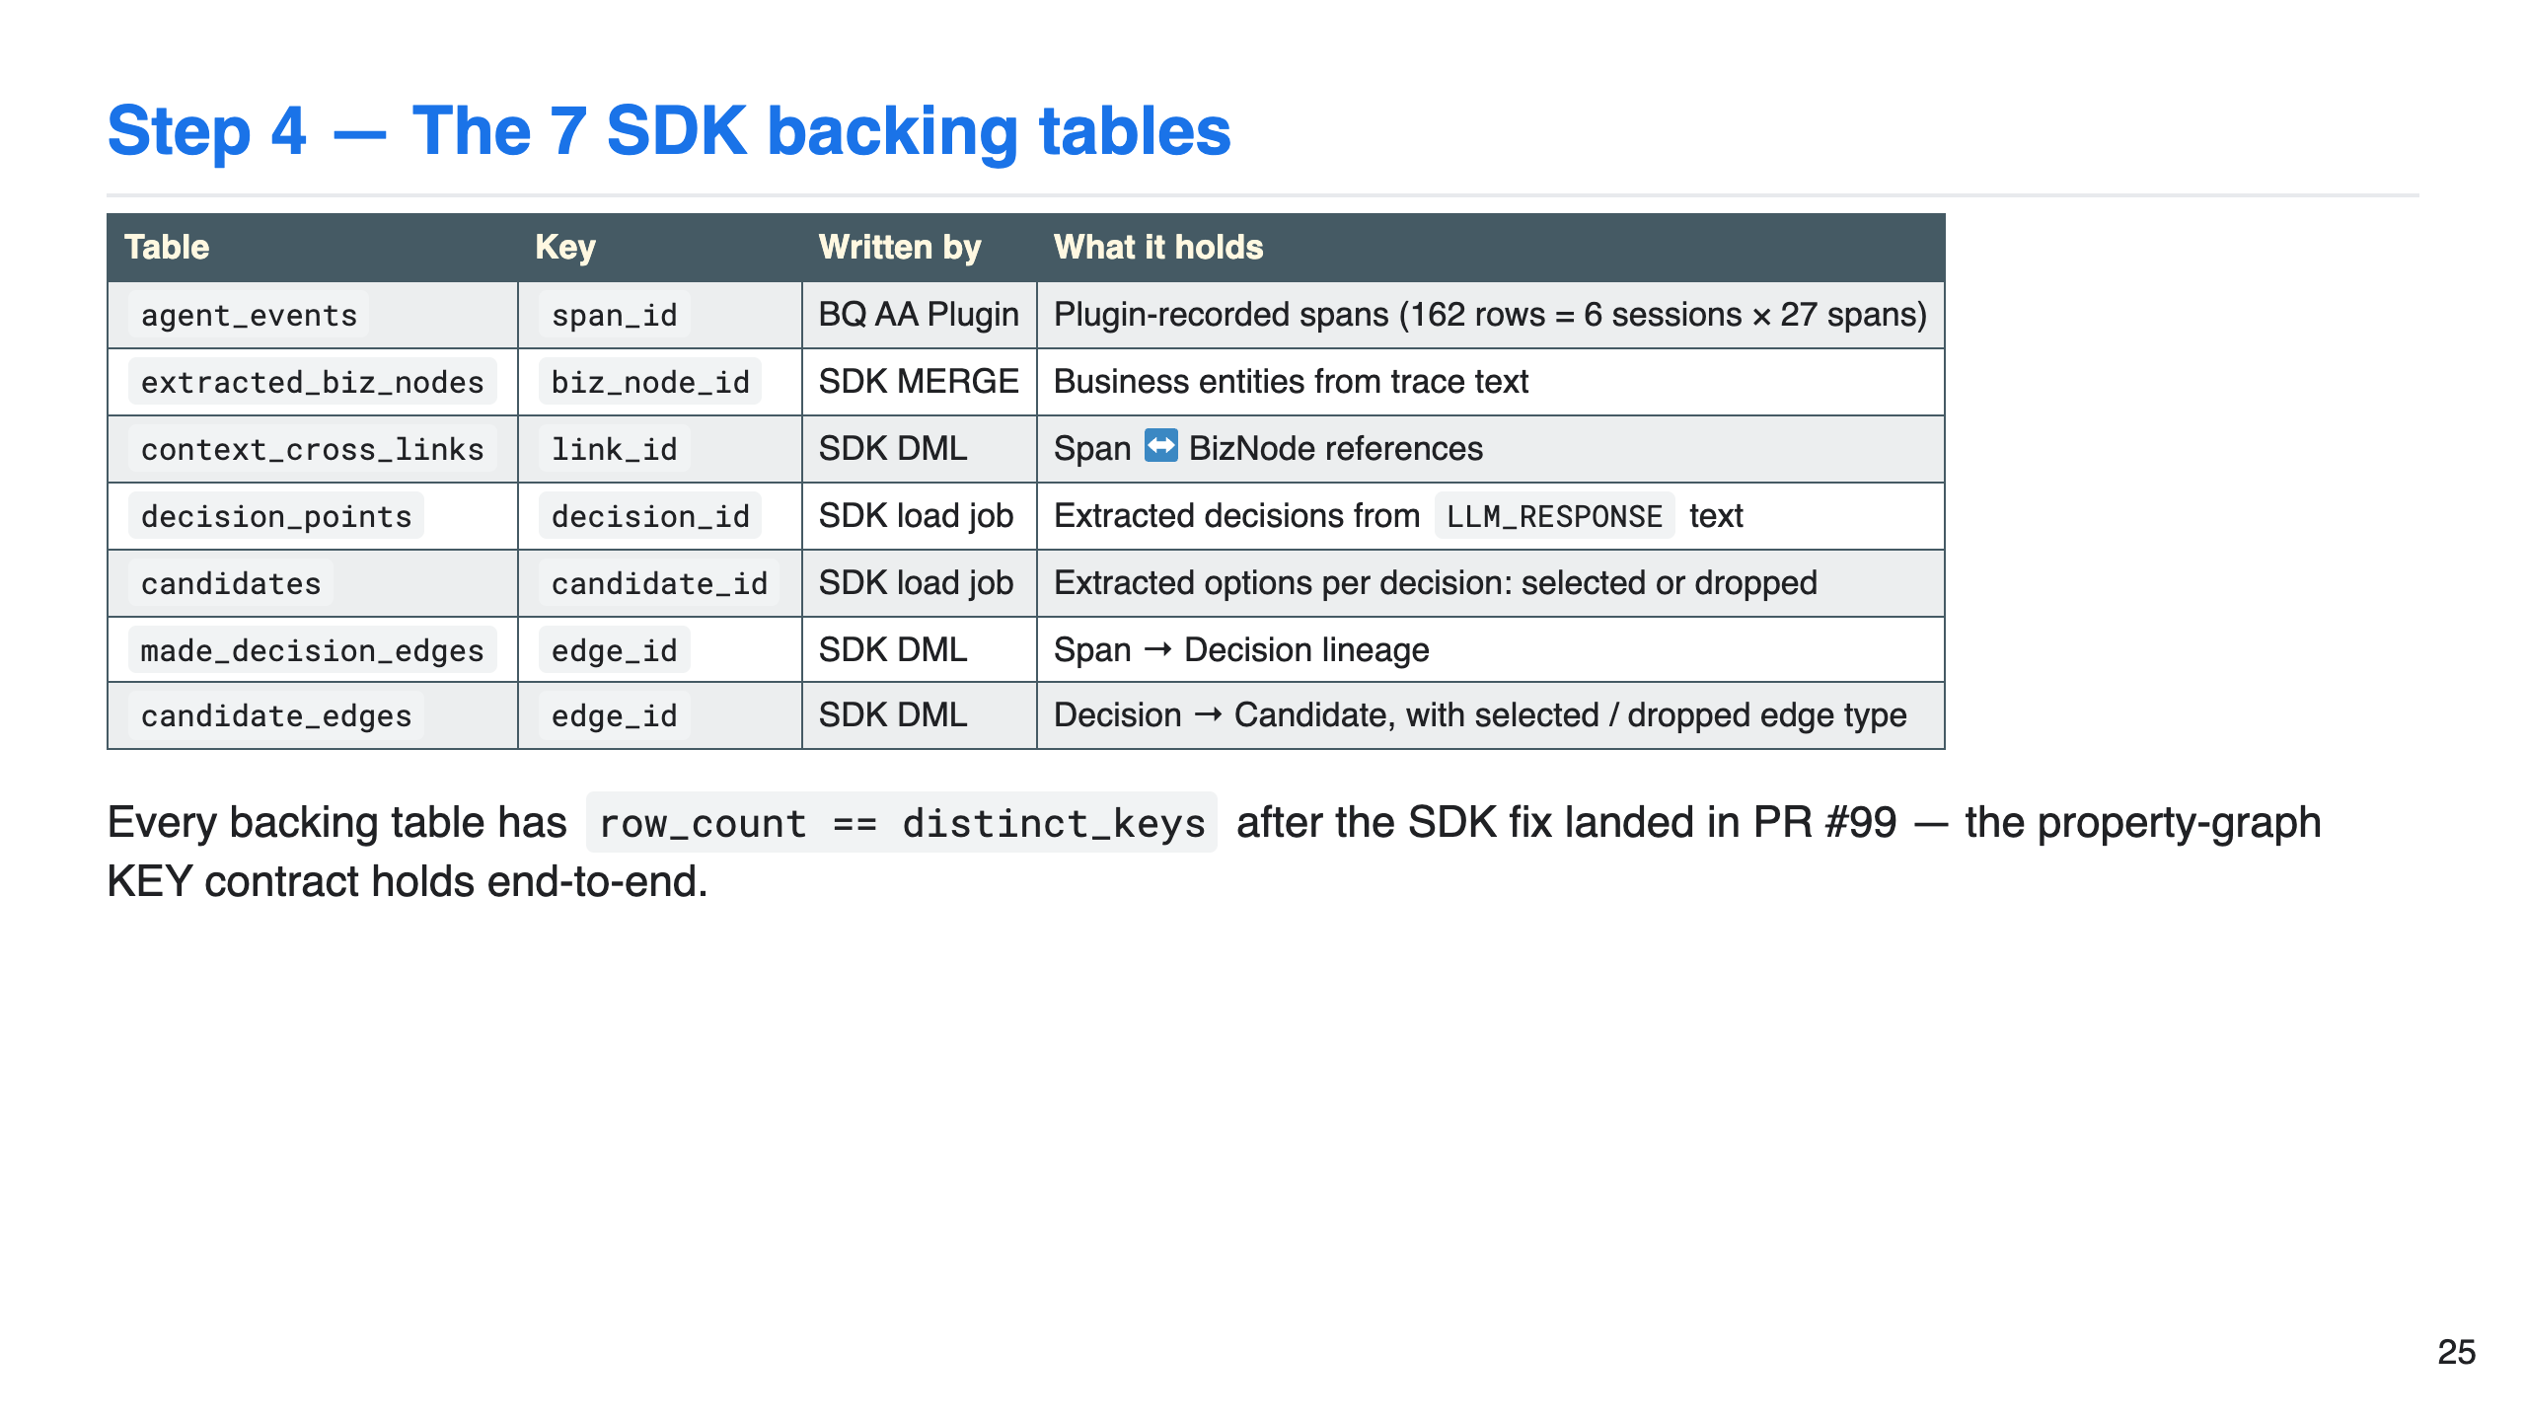

Slide 26
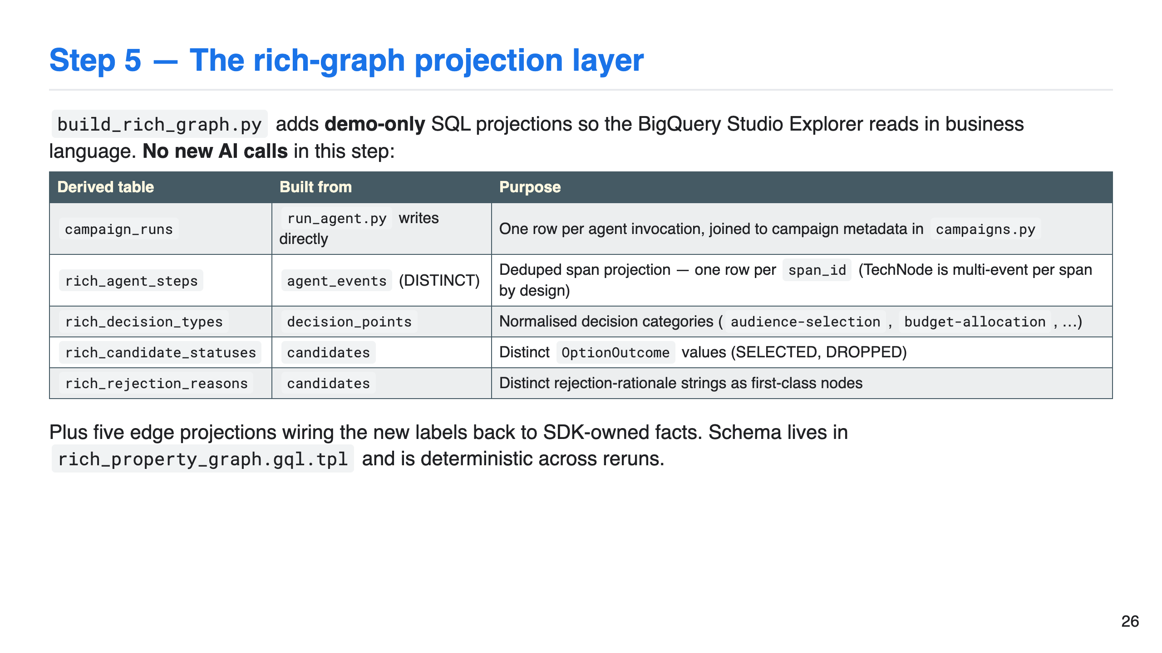

Slide 27
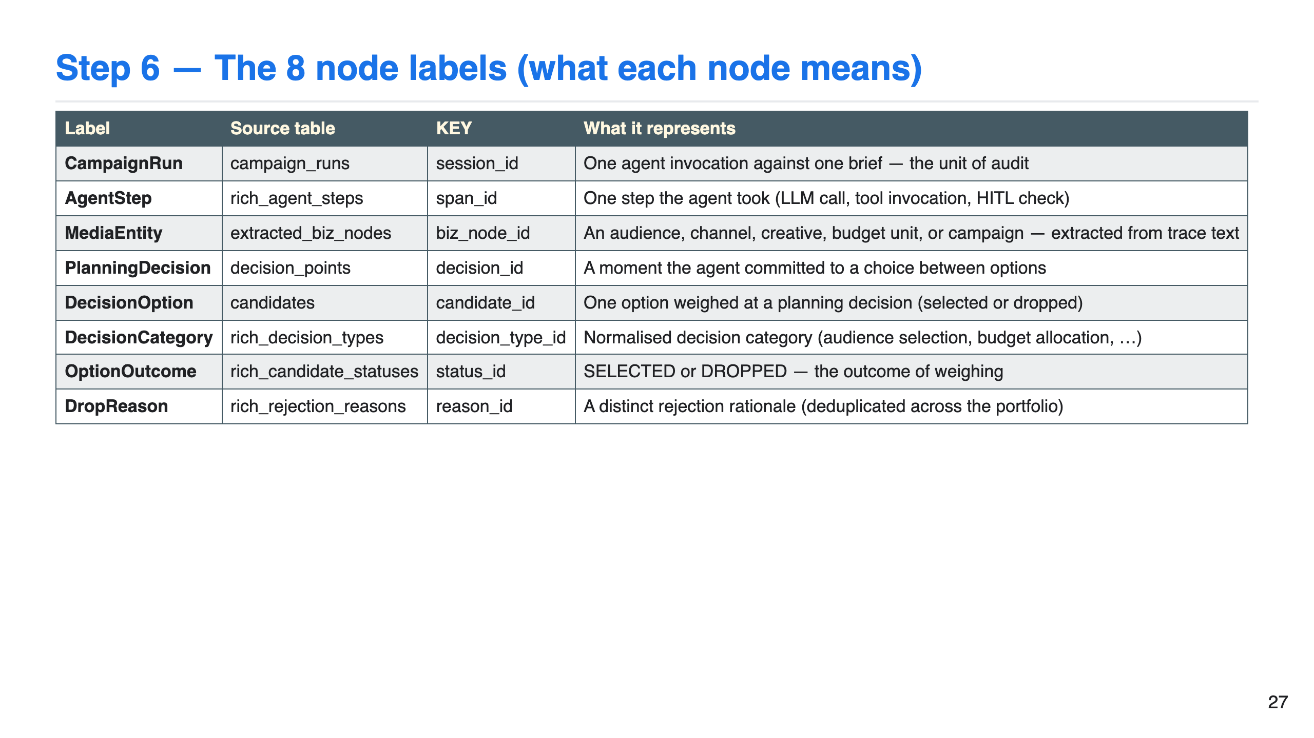

Slide 28
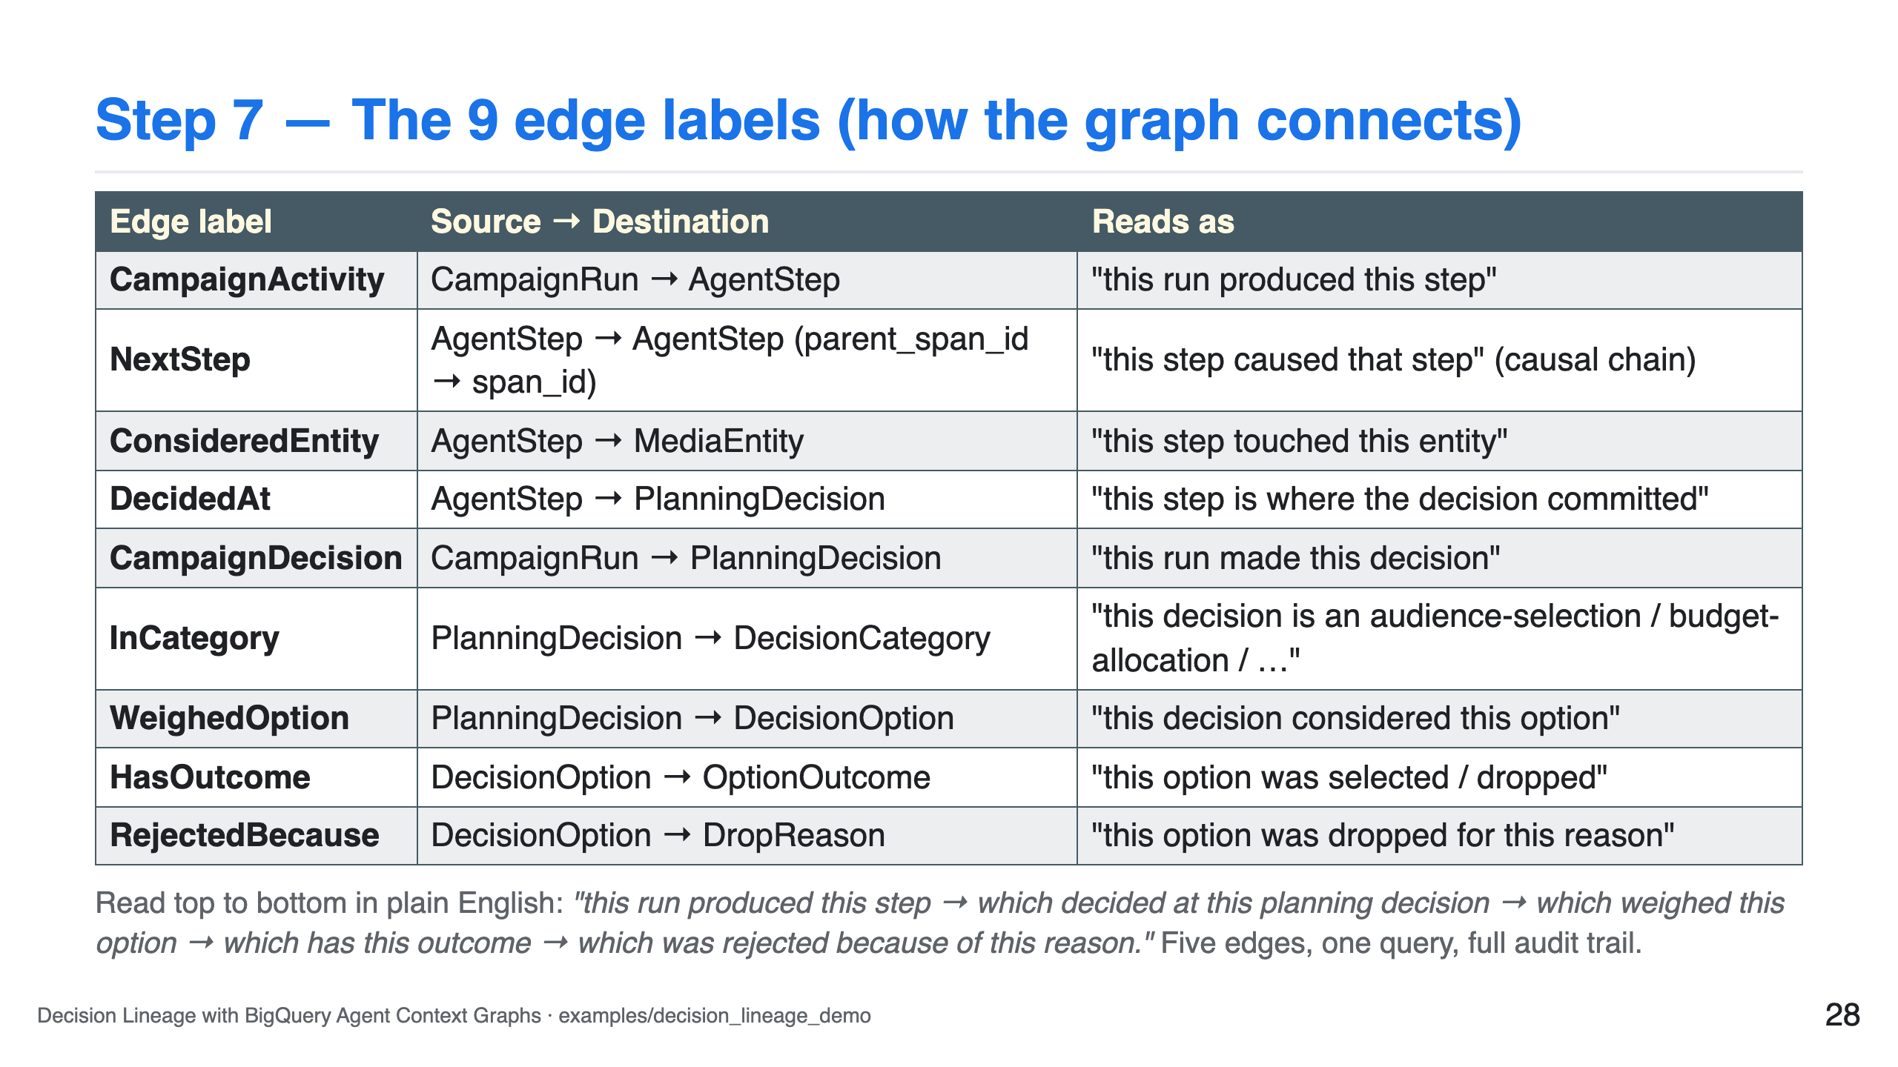

Slide 29
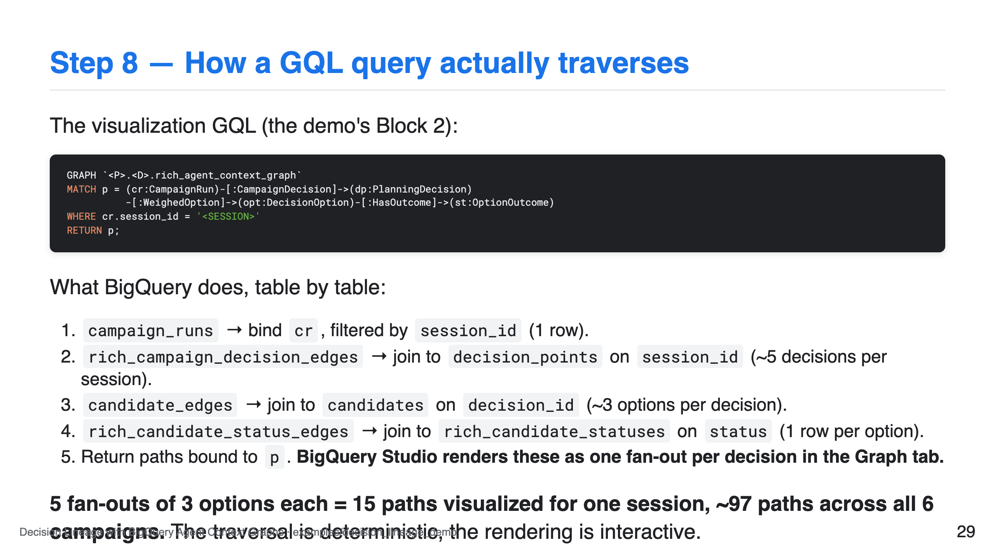

Slide 30
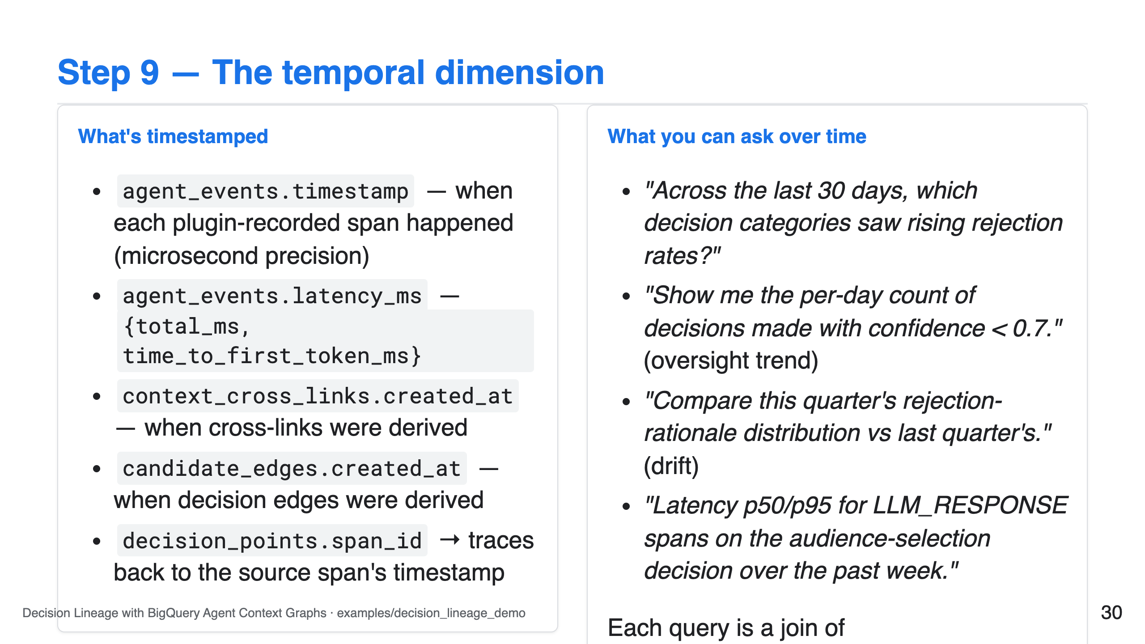

Slide 31
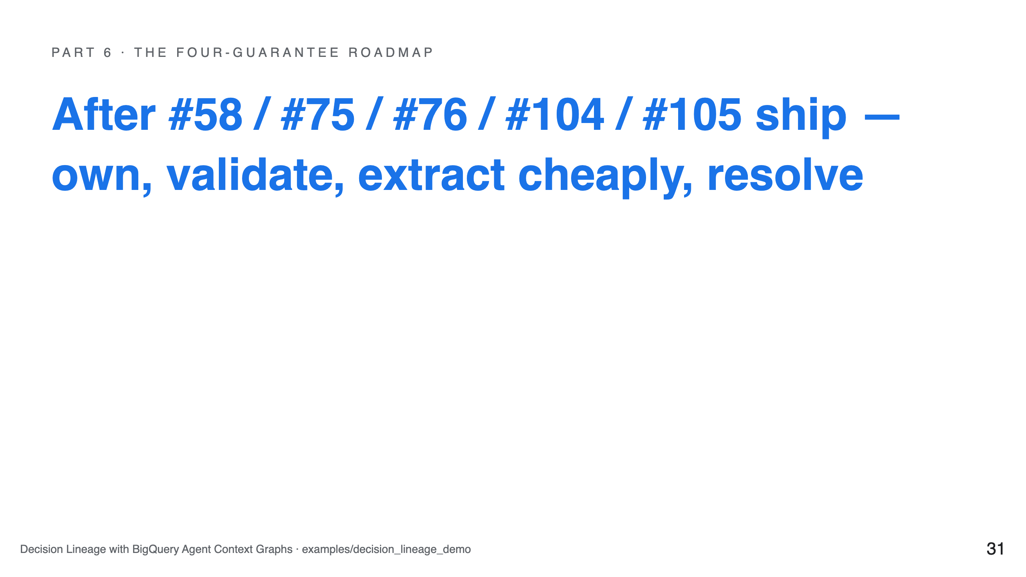

Slide 32
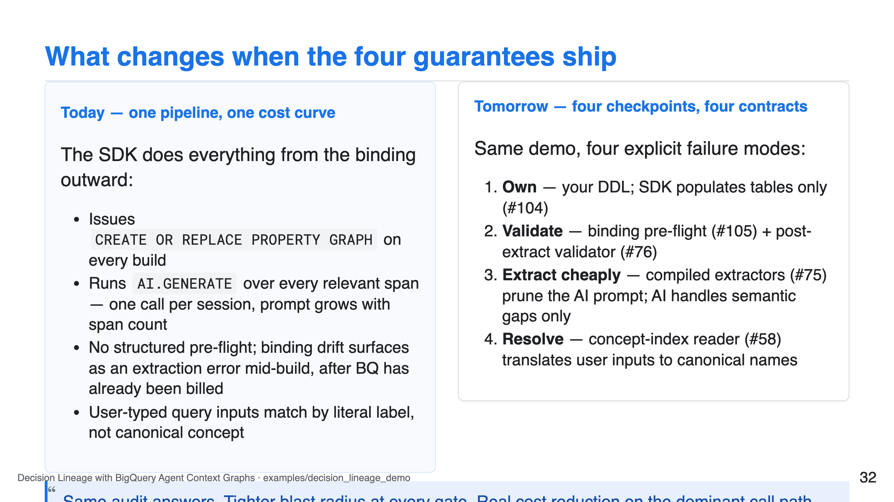
Notes:
SPEAKER NOTE — 45s Frame as evolution, not rewrite. The five issues #58 / #75 / #76 / #104 / #105 ship under the storyboard tracked in #107. Every existing audit question still works the same; the platform contract gets stricter. The cost story sits in beat 3 — that's the slide finance teams care about.

Slide 33
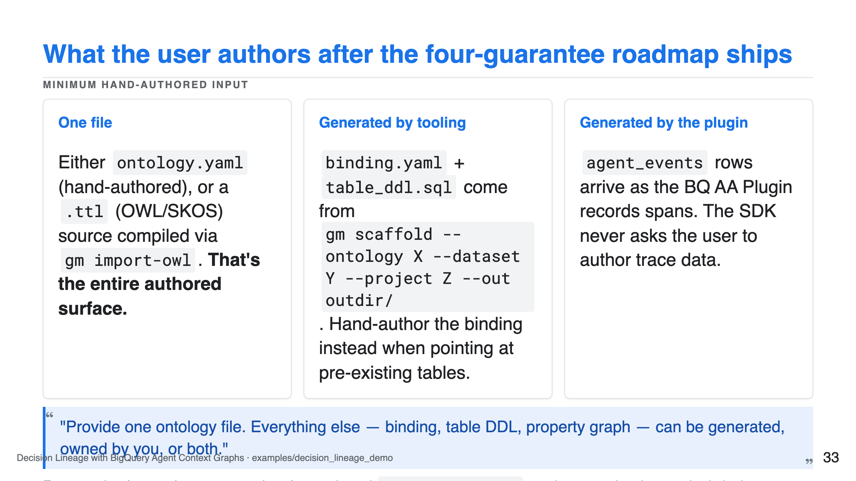

Slide 34
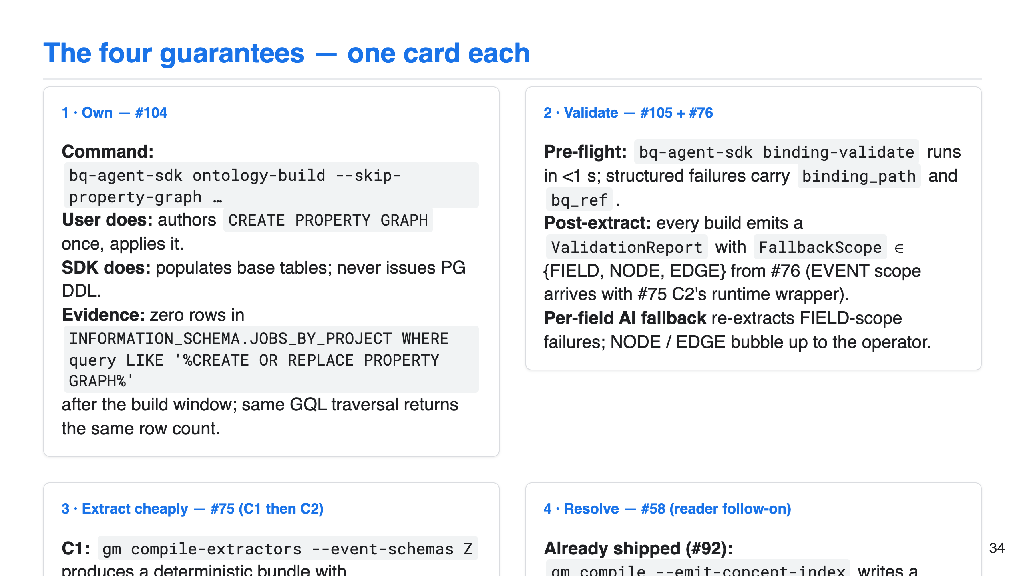

Slide 35
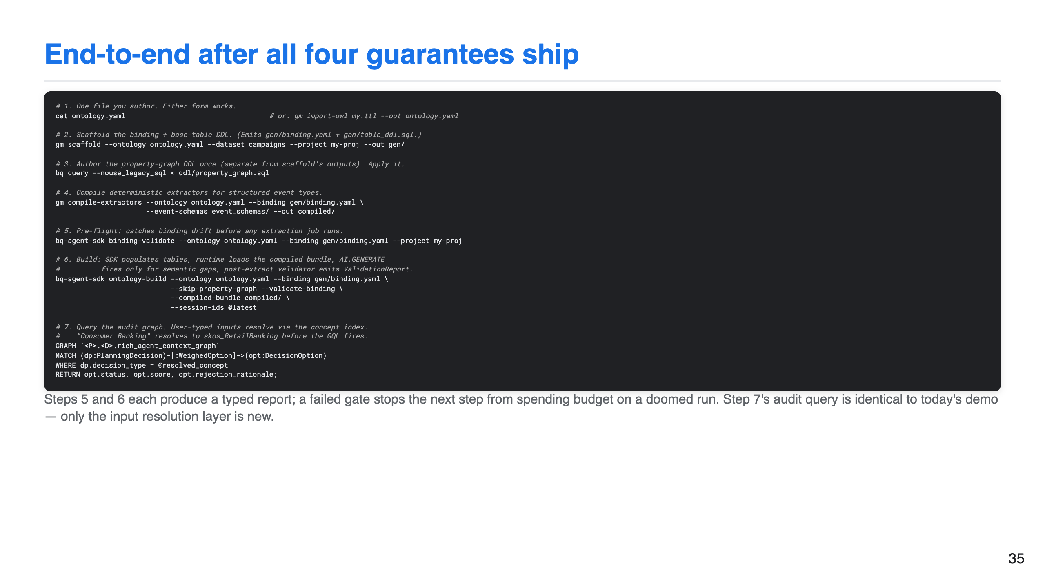

Slide 36
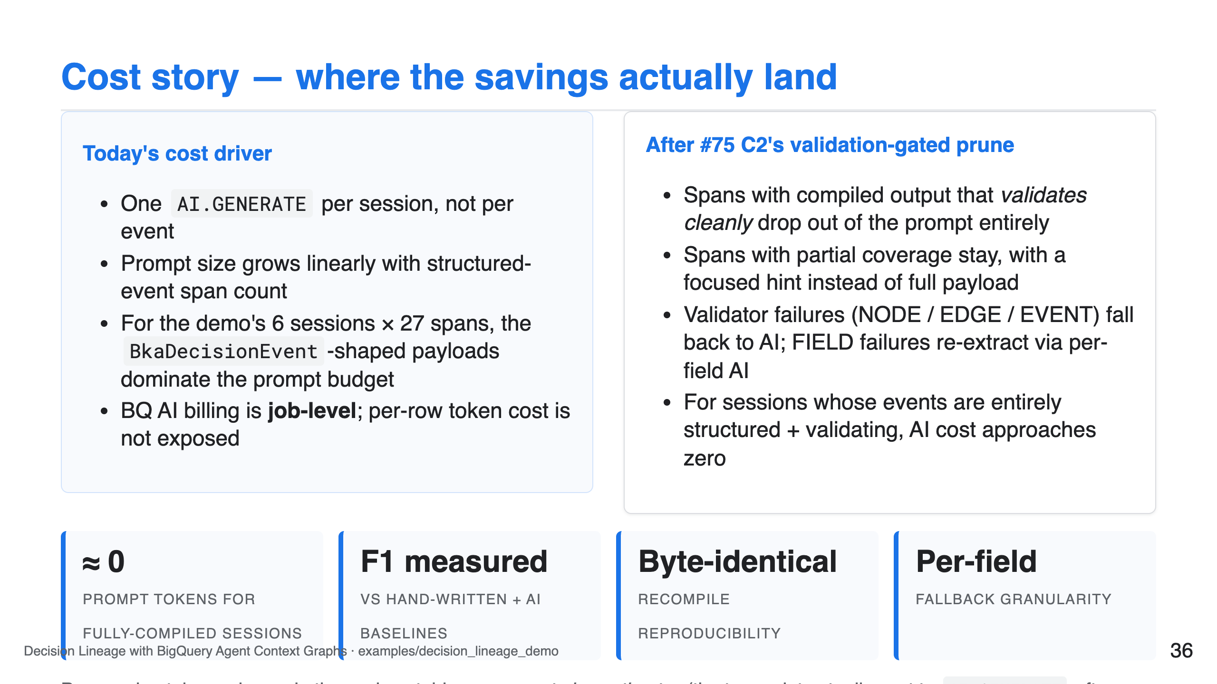

Slide 37
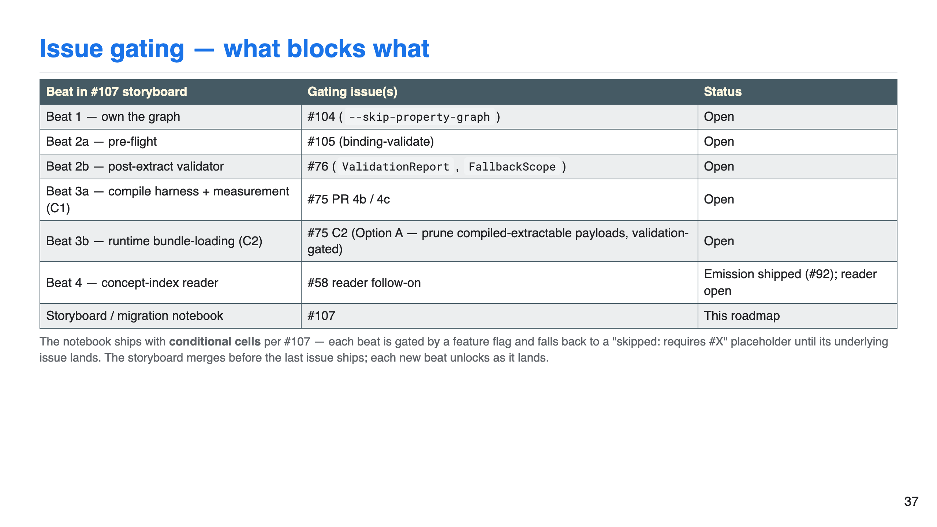

Slide 38
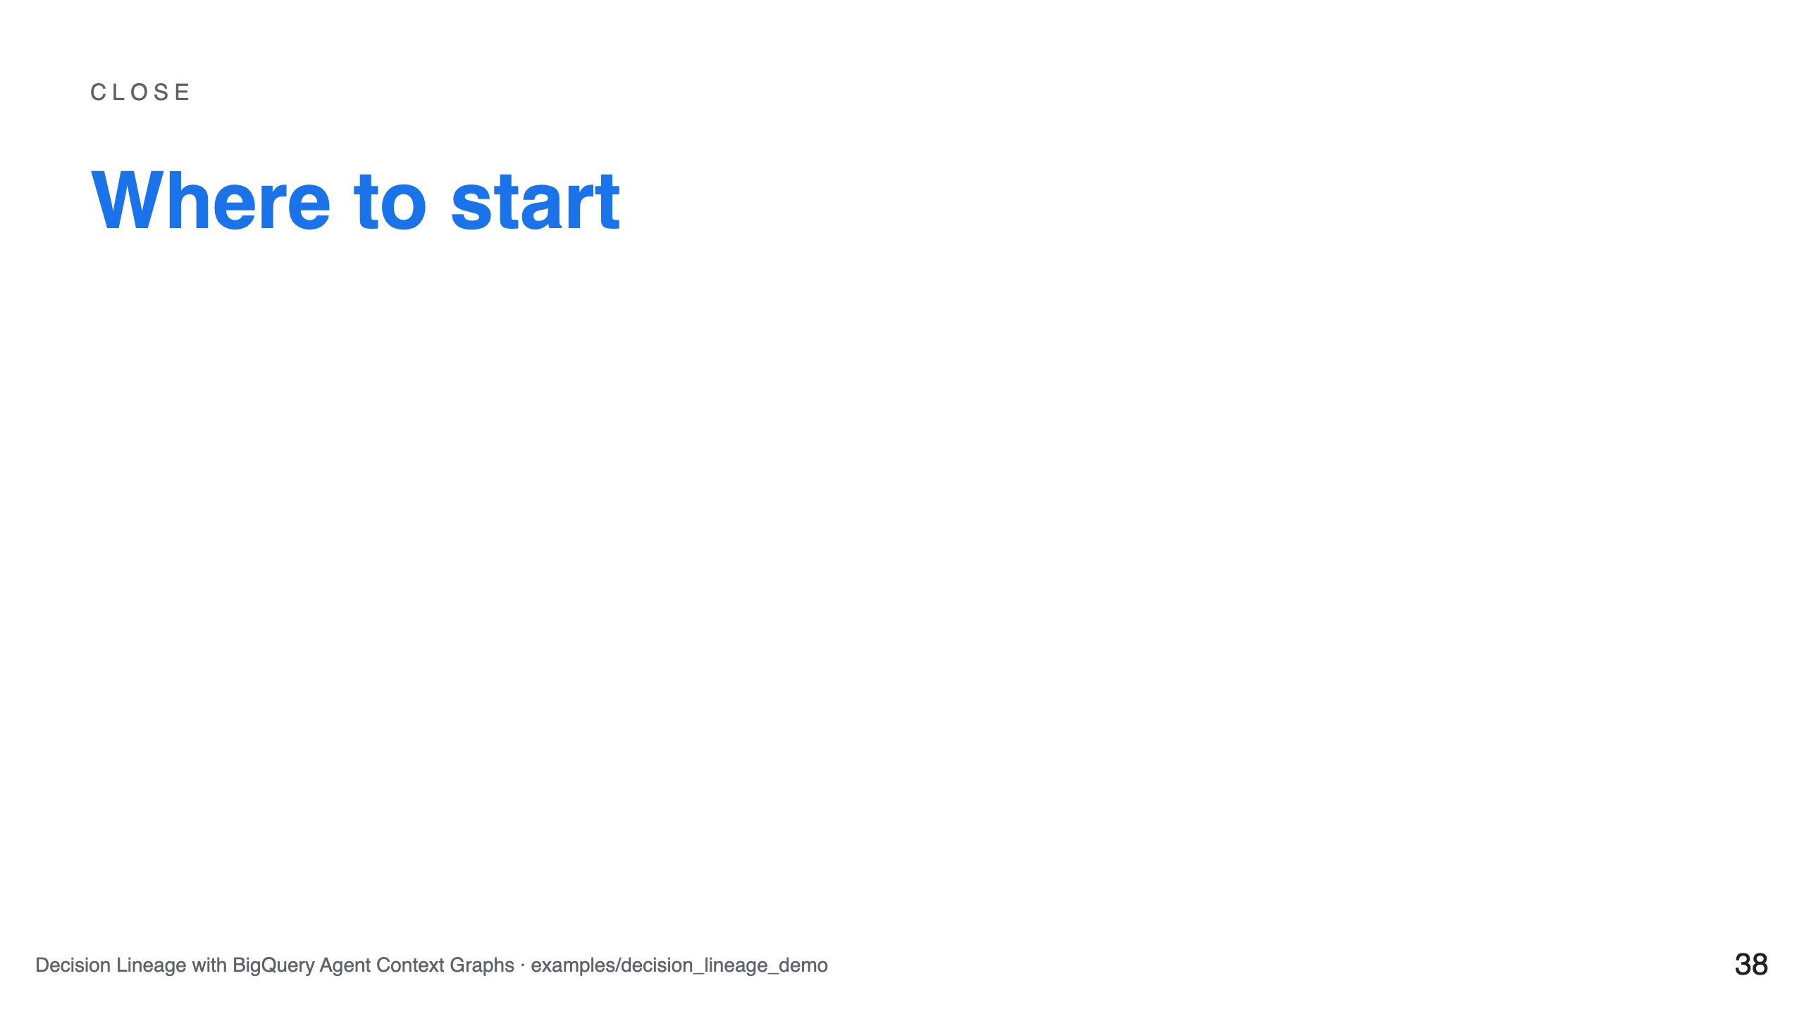

Slide 39
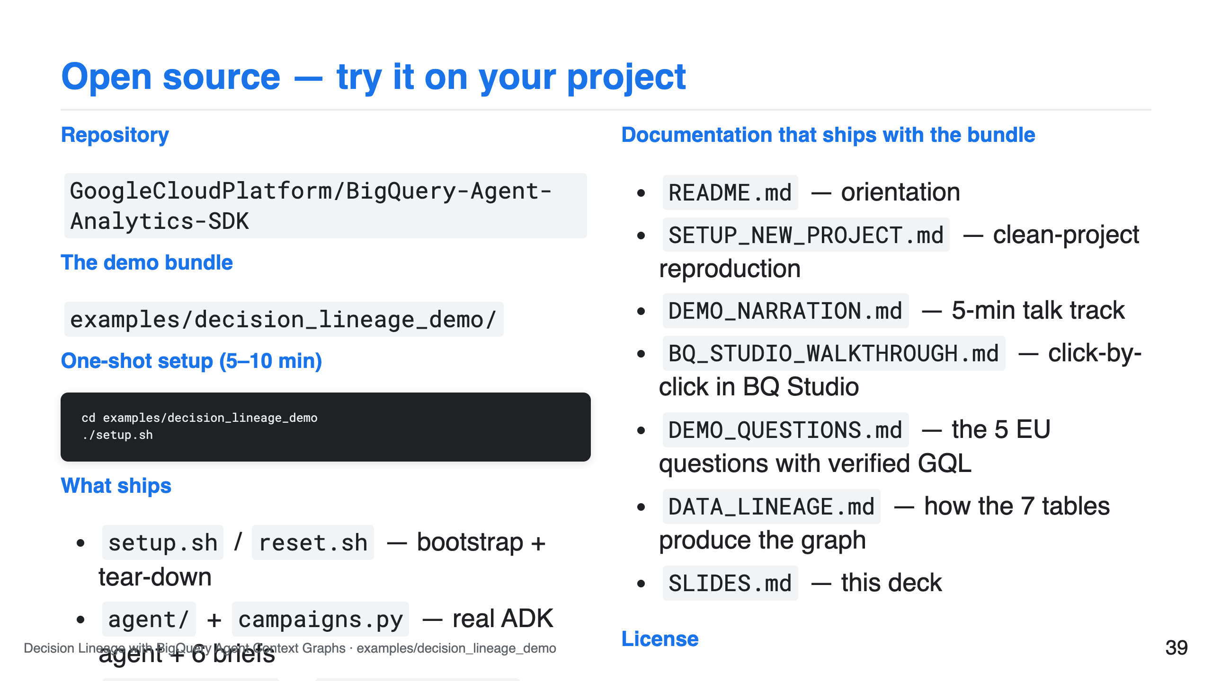

Slide 40
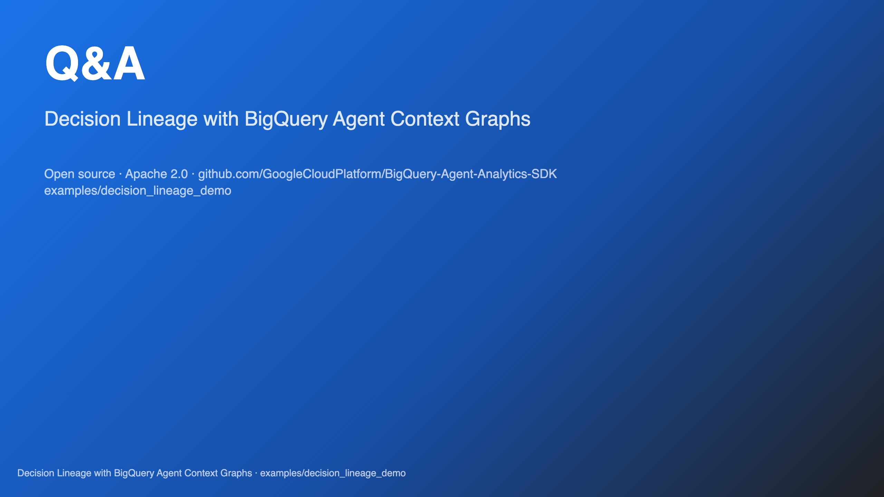
Notes:
SPEAKER NOTE — close "Three takeaways: (1) AI Act fines are real and the trigger date is near. (2) Decision Lineage is the audit substrate the regulator asks for, not a compliance certification. (3) The technical pipeline is open-source and runs on infrastructure you already pay for. Thanks."

