Slide 1
Rebuilding Trust
in the Software Supply Chain
on Kubernetes
Kavish Punchoo | DevOps Architect
CNCF Meetup • June 2026

Slide 2

About Me
Kavish Punchoo
DevOps Architect — Bertelsmann / Arvato Systems Malaysia
Building and securing Kubernetes platforms in production. CKA certified.
Currently focused on containerization strategy across 10+ teams, Kubernetes
operator development, and DevSecOps pipeline standardization.
CKA
10+
60%
Certified
Teams
Fewer incidents

Slide 3


The Attack That Shook npm
Shai-Hulud
Mini Shai-Hulud
Self-replicating worm hidden inside
npm packages
Compromised 500+ packages
Injected malicious postInstall scripts
Exfiltrated CI/CD secrets & credentials
Injected GitHub Actions workflows
Sep 2025 — CISA alert
Nov 2025 — Shai-Hulud 2.0
317 packages compromised in a
single wave
Affected popular packages:
size-sensor (4.2M downloads/mo)
echarts-for-react (3.8M)
@antv/scale (2.2M)
May 2026 — latest wave

Slide 4



How Supply Chain Attacks Happen
Developer updates
a dependency
Malicious version
published to npm
CI/CD pulls it
automatically
postInstall executes
payload
No malicious code in the repo. No compromised credentials.
One routine dependency bump — and the entire supply chain is poisoned.

Slide 5
The Damage
500+
2.2M
~50%
Packages compromised
in single campaign
Weekly downloads of one
affected package (@ctrl/tinycolor)
of npm ecosystem could
be reached transitively
What was at risk:
CI/CD secrets and cloud credentials exfiltrated to attacker-controlled servers
GitHub Actions workflows injected with malicious pipelines for persistence
Downstream users unknowingly deploying compromised code to production
Trust in the open source ecosystem eroded — one update at a time

Slide 6

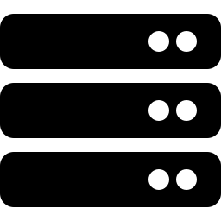


From npm to Your Cluster
The attack chain doesn't stop at the developer machine.
Malicious
npm package
npm install
postInstall runs
Container image
built with payload
Image pushed
to registry
Deployed to
Kubernetes
How do we know what's inside that image?
How do we trust it wasn't tampered with? How do we enforce that trust at admission time?

Slide 7


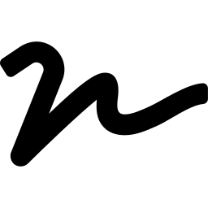

Key Concepts
SBOM
Provenance
Signatures
Software Bill of Materials —
a machine-readable inventory
of every component in your image
Cryptographic proof of where,
when, and how an artifact
was built
Digital signatures verify the
image was signed by a trusted
key — prevents tampering
Admission Control
Attestations
Traceability
Kubernetes policy engine
that enforces trust before
any pod can run
Cryptographically signed
metadata (SBOM, policy
results) attached to images
From source commit to
running pod — every step
is recorded and verifiable

Slide 8
Defense in Depth
BUILD TIME
GITOPS
SBOM generation (Syft)
Dependency policy checks
Provenance creation
Signing & attestation (Cosign)
Git as single source of truth
ArgoCD syncs desired state
Immutable image tags (digests)
Audit trail via git history
RUNTIME — ADMISSION CONTROL
Kyverno ImageValidatingPolicy verifies image signatures at pod creation
Unsigned or tampered images are rejected before they ever run
Attestations can be verified at admission time for deeper policy checks
Supply chain security isn't about preventing every compromise. It's about making compromises detectable, making trust explicit, and making policy enforceable.

Slide 9

CNCF Projects in This Stack
Argo Workflows
Argo CD
Kyverno
Pipeline orchestration
GitOps deployment
Admission control
Multi-step build pipeline with
SBOM generation, policy checks,
signing, and GitOps update
Syncs desired state from git.
Rolls out signed images
or rejects unsigned ones
ImageValidatingPolicy verifies
cosign signatures at pod
creation time
Sigstore / Cosign
Syft (Anchore)
cert-manager
Signing & attestation
SBOM generation
Certificate lifecycle
Signs container images.
Attaches attestations (SBOM,
policies, provenance)
Generates CycloneDX SBOM
from source. Enables dependency
policy enforcement
Manages TLS certificates
for webhooks and
internal services

Slide 10
Key Takeaways
Supply chain attacks are real
and they're hitting the npm
ecosystem right now
Trust must be earned at
every layer — build, registry,
admission, runtime
CNCF tools give you the
building blocks to make
trust explicit and enforceable
Thank you
Questions?
github.com/kavish-p | kavish.punchoo@gmail.com

