Slide 1
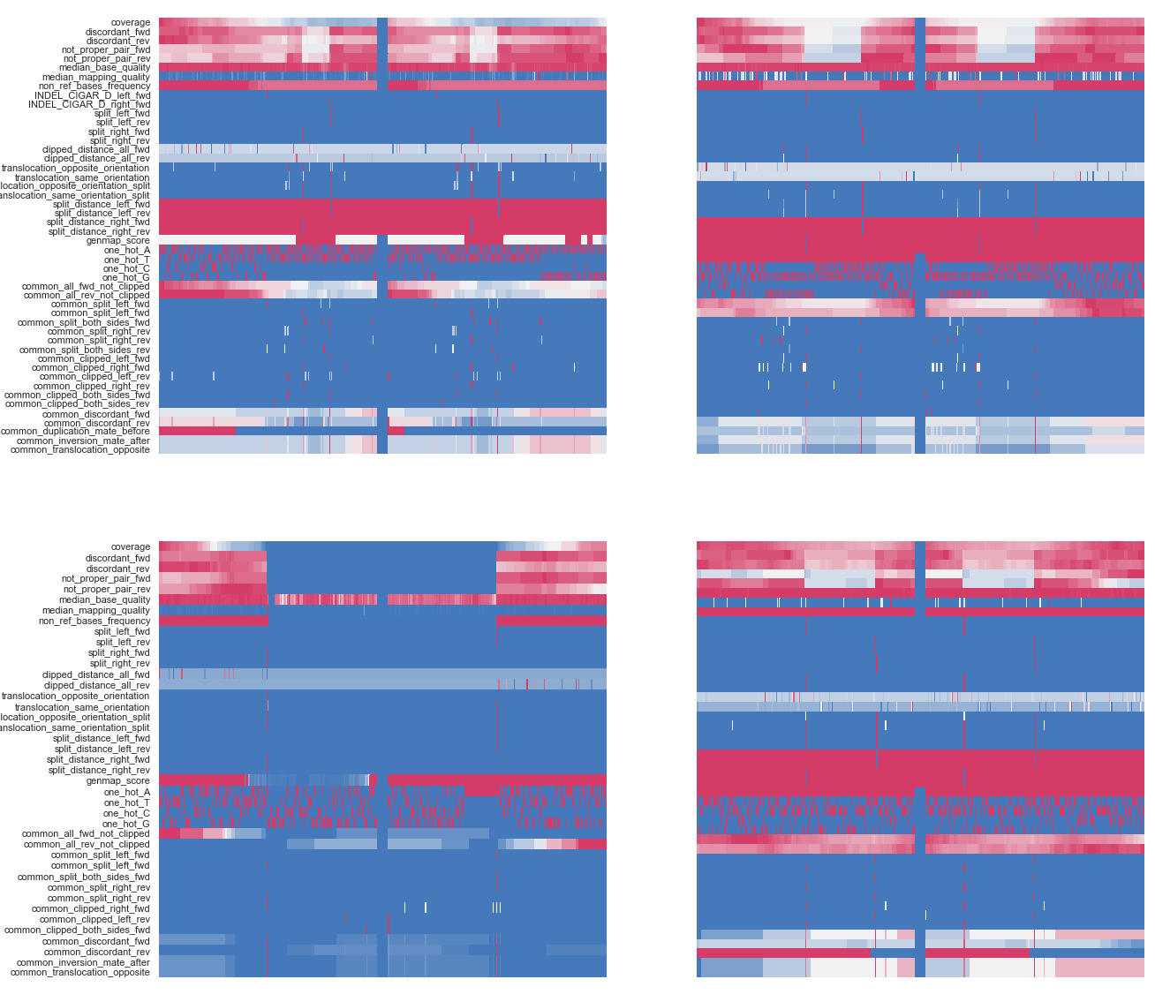
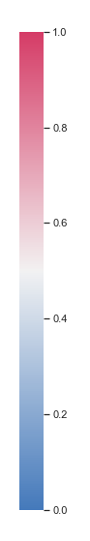
A
B
DEL
REF
read alignment (BAM)
clipped read
split read
reference
deletion
paired windows
channels
…
CNN
200 bp
200 bp
200 bp
200 bp
filter
Conv1D
Dense
SoftMax
SV callset (VCF)
200 bp
200 bp
200 bp
200 bp

