Slide 1
Lab7
Taghreed Alanazi

Slide 2
Recording link: https://drive.google.com/file/d/1HD0Gi6S5PAll1PeIf7igmrp1taYHwHzX/view?usp=share_link

Slide 3
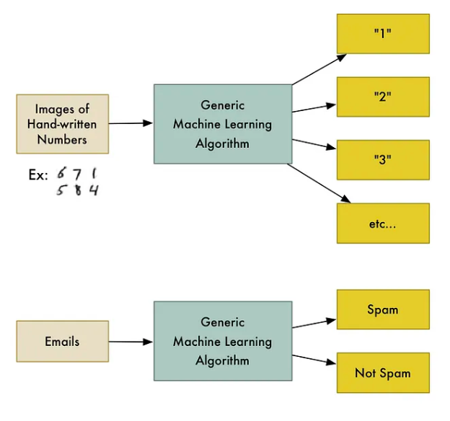
Machine Learning
Machine learning involves using algorithms that can analyze and learn from data on their own, without needing specific instructions for every task.
Instead of writing detailed code for each problem, you provide these algorithms with data, and they figure out the patterns and rules from that data themselves.
For example, a classification algorithm. This type of algorithm sorts data into categories. The same algorithm that learns to identify handwritten digits can also learn to sort emails into 'spam' and 'non-spam' categories.
The algorithm doesn't change; what changes is the data you give it to learn from. When it gets different data, it develops a new understanding and a different way of sorting that data.
ML types: supervised, unsupervised learning, and reinforcement learning.
Linear regression is a type of supervised learning.

Slide 4
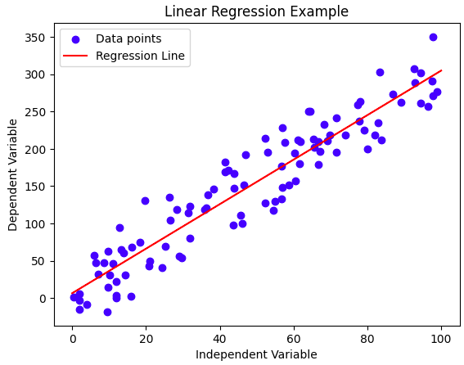
What is Linear Regression?
Linear regression is a statistical method used in machine learning for predicting a continuous outcome (dependent variable) based on one or more predictor variables (independent variables). The relationship between the predictor(s) and the outcome is assumed to be linear, which means it can be represented by a straight line.
Example: predicting house prices.
In this scenario, the house price is the outcome we want to predict (dependent variable)
the predictors (independent variables) could be various features like the size of the house in square feet, the number of bedrooms, the age of the house, etc.
The linear regression model will analyze the historical data of house sales and learn to predict prices for new houses based on these features.

Slide 5
The Linear Equation
The equation of a straight line:
y = m x + c
y: The predicted value (Dependent variable)
m: The slope of the line, representing the change in y for a one-unit increase in x.
x: The independent variable
c: The y-intercept, which is the value of y when x is 0. It is the point where the line crosses the y-axis.
Simple vs Multiple Linear Regression:
simple linear regression, we predict the value of one dependent variable based on one independent variable.
equation: y = b0 + b1*x
while multiple linear regression, we predict the value of one dependent variable based on two or more independent variables.
equation: y = b0 + b1*x1 + b2*x2 + … + bn*xn
Note:
The coefficients b0, b1, b2, ..., bn are learned by the model during the training process.
In simple linear regression, b0 is the y-intercept and b1 is the slope of the line.
In multiple linear regression, b0 remains the y-intercept, but you have multiple slope terms (b1, b2, ..., bn), each associated with a different independent variable (x1, x2, ..., xn).

Slide 6
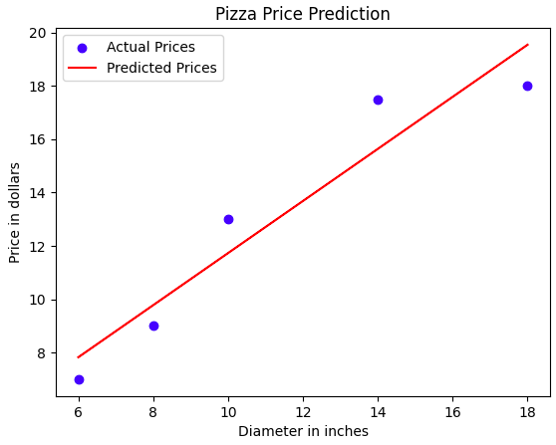
Training & Evaluation
Training a Linear Regression Model
The linear regression model is trained using historical data to find the 'best fit' line. We aim to minimizing the difference between the actual and predicted values (loss minimization).
We use model.fit() method for training the model on a given dataset. (e.g., model.fit(x= x_train, y= y_train) )
we pass the training data as parameters, which consists of the independent variables (aka features or predictors) and the dependent variable (aka the target or label).
The method applies a machine learning algorithm to learn the relationship between the independent variables and the dependent variable.
In the case of linear regression, it calculates the coefficients (the slope and intercept terms) that minimize the loss function, usually the Mean Squared Error (MSE).
The output is a trained model with learned parameters specific to the provided data.
Evaluating Model Performance
We use model.predict() method after the model has been trained using model.fit(). It's used to get predictions on new, unseen data. (e.g., model.predict(x= x_test) )
The method uses the learned parameters from model.fit() to calculate the dependent variable's predicted values for the new data.
The output is the predictions (or target), which are the model's estimates for the dependent variable based on the new input data.
We will provide simple example for:
Single Linear regression.
Multiple Linear regression.

Slide 7
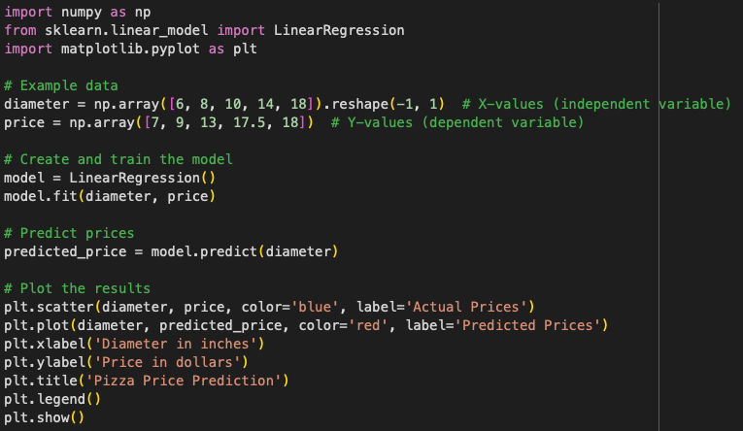
Simple Linear Regression Example
Scenario: Predicting the price of a pizza based on its diameter.(as you notice! one feature!)
Steps:
Set X and Y Values:
X (Independent Variable): Diameter of pizzas (e.g., in inches).
Y (Dependent Variable): Price of pizzas (e.g., in dollars).
Use the Equation:
The linear regression equation is y=mx+c.
After training, we will find the values of m (slope) and c (y-intercept).
Set the Model:
We will use a linear regression model from a library like sklearn.
Train the Model:
Use historical data of pizza diameters and their corresponding prices to train the model.
Evaluate the Model:
Test the model with new pizza diameter data and compare the predicted prices with actual prices.
To generate a dense sequence of values, to ensure that the line is smooth and gives a clear visual representation of the model's predictions across the entire range of interest, we can use np.linspace() to create a sequence of n evenly spaced numbers in a range. (we will see it in the lab7 examples and apply it in the exercises).

Slide 8
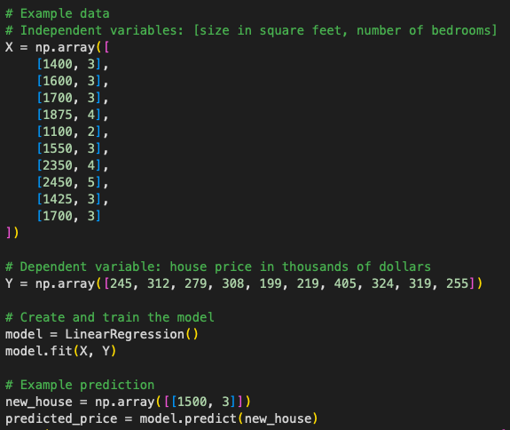
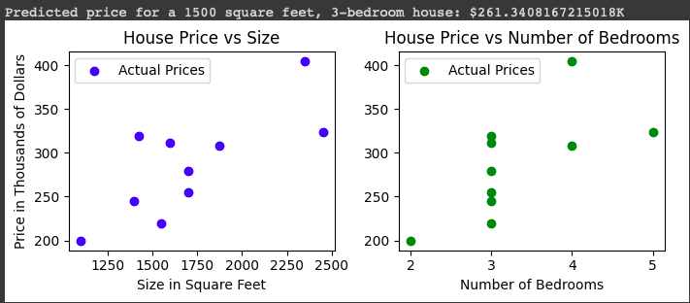
Multiple Linear Regression Example
Scenario: Predicting house prices based on size and number of bedrooms. (as you notice! More than one feature!)
Steps:
Set X and Y Values:
X (Independent Variables): Size of the house (e.g., square feet), Number of bedrooms.
Y (Dependent Variable): Price of the house (e.g., in dollars).
Use the Equation:
The equation is y=b0+b1x1+b2x2, where b0 is the intercept, b1 and b2 are coefficients for size and number of bedrooms, respectively.
Set the Model:
Again, we use a multiple linear regression model from a library like sklearn.
Train the Model:
Train the model using a dataset containing house sizes, number of bedrooms, and their corresponding prices.
Evaluate the Model:
Test the model on new data (new houses) and compare the predicted prices with the actual prices.
While we can't always visualize complex models with many features, the coefficients and intercept give us valuable insights into how each feature influences the prediction.
We can use these attributes instead of visualization with many features:
model.coef_
model.intercept_

Slide 9
Go through the lab7 examples.

Slide 10
Tips for Lab7 assignment:
Exercise 1:
To read txt file, you need to use pd.read_table('filename.txt', delimiter='\t')
Then set X and Y values to extract the features and the target variable:
X_train = …
y_train = …
Declare and train a linear regression model using LinearRegression() and model.fit(...)
Use np.linspace() to create a sequence of numbers from 500 to 5000 (as in examples)
X_new = …
X_new["column_name"] = np.linspace(500, 5000, num=5000)
Then, create a Series out of the predicted values
y_new_ = pd.Series(
model.predict(...), # y values in Series.plot.line()
index=... # x values in Series.plot.line()
)
Finally, plot the data, then the model using plot.scatter() and plot.line()
Please make the fitted line in a different color from the data points color.

Slide 11
Exercise 2:
First method:
Define the coefficient and the intercept:
c = model.coef_
b = model.intercept_
Then use np.linspace() :
x = np.linspace(500, 5000, num=5000)
y = [((c*x_i) + b) for x_i in x]
Finally, you need to plot the results using scatter.
plt.plot(x, y, c='r')
Second method:
You calculate it directly using:
y_pred = (model.coef_ * X_new["coloumn_name"]) + model.intercept_
then, plot the results.

Slide 12
Exercise 3:
Multiple linear regression! Instead of one feature, you will predict the price based on many features. No need to visualize! But interpret the results correctly!
First, define the values of X_train and y_train:
X_train =df[["column1_name", "column2_name", "Full Bath", "column3_name"]] # extract features
y_train = df["column_name"] # extract target variable
Define and train the linear regression model using:
model = LinearRegression()
model.fit(X=..., y=...)
coeff = ...
Then, you need define X_test and add the features in the question to do the prediction:
X_test = pd.DataFrame()
X_test["column_name"] = [value] # 1500 square feet
X_test["column_name r"] = [value] # 3 bedrooms
X_test["column_name"] = [value] # 2 full baths
X_test["column_name"] = [value] # 1 half bath
Then evaluate the model to predict the price with the features mentioned in the question by accessing the coef values for each one using coeff[] with the proper index. remember that the order of coef for each feature will be the same order that you set in X_train. for example, if you define these features in this order: [["Gr Liv Area", "Bedroom AbvGr", "Full Bath", "Half Bath"]] , the coef of "Full Bath" will be coef[2].
Print the coef values and the prediction price for the home, and analyze the results.

Slide 13
Exercise 4:
Wants to fit another linear regression model in a new dataset called tips.csv, which contains information about tips collected by a waiter.
However, all input values need to be numerical, so we will need to map any categorical variables to numerical ones.
The question is to predict how much a male diner will tip on a Sunday bill of $40.00, so:
First you need to create a new df that contains the information of (male, Sunday and bill) which are these columns:
new_df = tips_df.loc[:,["totbill", "sex", "day"]]
Then, you need to convert the values in these columns to be numerical, either to use .replace() or cat.codes method.
For example, you can replace day columns values ['Fri', 'Sat', 'Sun', 'Thu'] to be [2 1 3 0], and the same for sex columns values ['F', 'M'] to be [0 1].
Then, use LinearRegression() and fit() as previous exercises to define and train the model.
Finally, evaluate your model by getting the prediction using:
X_test = pd.DataFrame()
X_test["totbill"] = [40.0] # since the question asked about this value
X_test["sex"] = [..] # either 0.0 or 1.0 for F or M (use the mapping value)
X_test["day"] = [..] # 2.0 if it is Fri, 1.0 if it is Sat , ... etc. (use the mapping value).

Slide 14
Exercise 5:
Fit a linear regression model, with no intercept, that predicts the tip from the total bill.
LinearRegression() has a parameter, fit_intercept=, which is True by default, we need to set it to False exciplicity.
As previous exercises, we will:
Define X_train and y_train to extract features and the target variable.
Define and train a linear regression model
model = LinearRegression(fit_intercept=False)
model.fit(X=X_train, y=y_train)
Define X_new and create a sequence of 200 evenly spaced numbers from 0 to 60 using np.linspace(0, 60, num=200) in X_new["totbill"].
Then, create a Series out of the predicted values y_new_ = pd.Series(...)
Finally, plot the data, then the model using .scatter() and .plot.line()
Answer must mention: No intercept means that when the feature is 0, the target is also 0. You should interpret this in the context of the question (and why it makes sense for this question).

