Slide 1
Lab 8
Taghreed Alanazi

Slide 2
The good news is that we done with the lab assignments :)
We will learn today about: KNN, K-means, and BeautifulSoup.
This is a tutorial lab for self-practicing ‘NOT GRADED’ → very helpful for your final project!

Slide 3
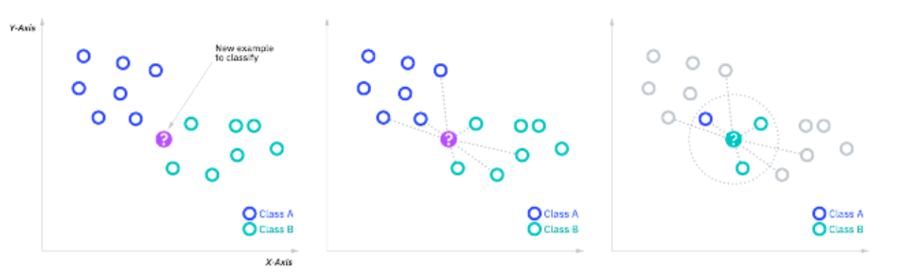
The k-nearest neighbors algorithm (KNN)
It is a non-parametric, supervised learning classifier, which uses proximity to make classifications or predictions about the grouping of an individual data point.
It can be used for either regression or classification problems.
Lazy Learning: KNN does not learn a discriminative function from the training data but memorizes the training dataset instead.
How Does KNN Work?
Choosing 'K':
'K' is a user-defined constant and the core of the KNN algorithm. It represents the number of nearest neighbors to include in the majority voting process (for classification) or averaging (for regression).
Distance Measurement:
The algorithm measures the distance between data points using distance metrics like Euclidean, Manhattan, or Hamming distance. The choice of distance metric can significantly affect the algorithm's performance.
Finding Nearest Neighbors:
For a given data point, the algorithm finds 'K' closest data points (neighbors) in the training set.
Voting or Averaging:
In classification, the most common label among the neighbors is assigned to the data point. In regression, it's the average of the neighbors' values.

Slide 4

Euclidean Distance
The Euclidean distance between two points in Euclidean space is the length of a line segment between the two points. It can be calculated from the Cartesian coordinates of the points using the Pythagorean theorem.
It's the most common choice and works well in many cases, especially in lower-dimensional spaces.
KNeighborsClassifier() by default it is using the Euclidean distance as its metric.
Manhattan Distance:
Also known as the "taxicab" or "city block" distance, the Manhattan distance may be more suitable for high-dimensional data or in cases where you want to give incremental importance to smaller distances.
It's the sum of the absolute differences of their Cartesian coordinates. It can be more appropriate in grid-like path scenarios (like city blocks) or feature spaces where each dimension represents a distinctly different feature.
if you want to use a specific distance metrics, you can simply specify that when initializing the KNeighborsClassifier().
Other Metrics:
Minkowski, Hamming, or Chebyshev distances. The choice of metric can depend on the specific nature and dimensionality of your dataset.
Minkowski distance is a generalization of both Euclidean and Manhattan distances.

Slide 5
Evaluate the model
We can use the confusion matrix and the classification report to evaluate the model.
Confusion Matrix
It is a table used to evaluate the performance of a classification model. Each row of the matrix represents the instances in an actual class, while each column represents the instances in a predicted class.
For example:
[[10 0 0]
[ 0 20 0]
[ 0 0 15]]
Let say the dataset have only 3 classes, the matrix has 3 rows and 3 columns, corresponding to the 3 classes of the dataset.
The first row 10 0 0 means that 10 instances of class 0 (first class) were correctly predicted as class 0, and none were misclassified.
The second row 0 20 0 means all 20 instances of class 1 were correctly predicted as class 1.
The third row 0 0 15 indicates that all 15 instances of class 2 were correctly classified.
There are no off-diagonal elements with non-zero values, indicating there were no misclassifications in your model's predictions.

Slide 6
Classification Report
The classification report displays the precision, recall, F1-score, and support for each class.
e.g.:
precision recall f1-score support
0 1.00 1.00 1.00 10
1 1.00 1.00 1.00 20
2 1.00 1.00 1.00 15
accuracy 1.00 45
macro avg 1.00 1.00 1.00 45
weighted avg 1.00 1.00 1.00 45
Precision tells us the accuracy of the positive predictions. For example, for class 0, the precision is 1.00, meaning 100% of the instances predicted as class 0 are indeed class 0.
Recall (also known as sensitivity) tells us what proportion of actual positives was correctly identified. For each class in your model, this value is 1.00, meaning the model correctly identified all instances of each class.
F1-score is the harmonic mean of precision and recall. An F1-score reaches its best value at 1 (perfect precision and recall) and its worst at 0.
Support is the number of actual occurrences of the class in the specified dataset. For instance, class 0 appears 10 times.
The report also provides overall averages:
Accuracy (here 1.00) is the ratio of correctly predicted observations to the total observations.
Macro average calculates metrics for each label and finds their unweighted mean. This does not take label imbalance into account.
Weighted average calculate metrics for each label, and finds their average weighted by support (the number of true instances for each label).

Slide 7
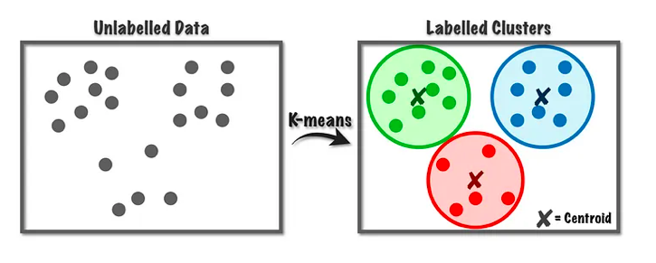
K-means clustering algorithm
K-means is a clustering algorithm that used for unsupervised learning tasks (when the data is unlabeled), where the goal is to discover natural groupings in data. The "K" in K-means represents the number of clusters to be identified in the data.
How K-means Works:
Initialization: The process starts by randomly selecting 'K' centroids, where each centroid is the center of a cluster. These centroids are usually chosen as 'K' different data points from the dataset. The process of K-means clustering is to minimize the total distance between the data points and their respective cluster centroids.
Assignment Step: Each data point in the dataset is assigned to the nearest centroid, based on the distance between the data point and the centroid. The most common distance metric used is the Euclidean distance.
Update Step: After all data points have been assigned to clusters, the positions of the 'K' centroids are recalculated. This is typically done by taking the mean of all data points assigned to that centroid's cluster.
Iterative Process: Steps 2 and 3 are repeated iteratively until the centroids no longer move significantly or the assignments of data points to clusters remain constant. This indicates that the algorithm has converged and found a solution.

Slide 8
The attributes silhouette_score, cluster_centers_, and labels_ are crucial to understanding the results of the clustering in the K-Means algorithm:
silhouette_score
It is a measure of how similar an object is to its own cluster (cohesion) compared to other clusters (separation). The Silhouette Score ranges from -1 to +1, where a high value indicates that the object is well matched to its own cluster and poorly matched to neighboring clusters
cluster_centers_
It represents the coordinates of the cluster centers. If there are N features in the dataset and you're clustering into K clusters, cluster_centers_ will be an array of shape (K, N).
After fitting K-Means, you can use cluster_centers_ to understand the positioning of the clusters in the feature space and to interpret what each cluster might represent in the context of the problem.
labels_
This attribute holds the cluster assignment for each data point in the dataset. Each data point is assigned a label, an integer from 0 to K-1, where K is the number of clusters.
The cluster labels can be used to segment the data into distinct groups after clustering. This can be valuable for downstream tasks such as targeted marketing, customer segmentation, or other forms of stratified analysis.

Slide 9
Web scraping
It is a method used to extract large amounts of data from websites. The process involves fetching the web page and then extracting useful information from it.
Fetching Web Content:
The first step in web scraping is to retrieve the web page's content. This is typically done using HTTP requests. In Python, libraries like ‘requests’ are commonly used for this purpose.
Parsing the Content:
Once the web page's HTML content is fetched, it needs to be parsed so that specific data can be extracted from it. This is where tools like BeautifulSoup come into play.
They allow you to navigate the structure of the HTML document and select the elements you're interested in.
Data Extraction:
After parsing, the desired data (like text, links, images, etc.) is extracted from the HTML elements. For example, you might extract all the headlines from a news site or product information from an e-commerce site.
Data Manipulation and Storage:
The extracted data can then be manipulated or processed according to the requirements of the project. It might involve cleaning the data, transforming it into a specific format, or storing it in a database for further analysis.

Slide 10
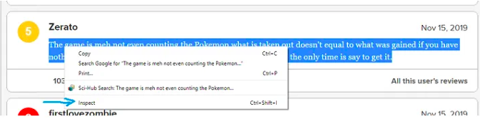
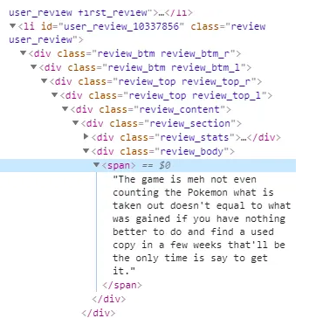
Figure out the web page’s Html structure
Html tags are used to mark page elements, and similar elements are usually contained within the same tags.
The easiest way to find important tags is to use Chrome, select the text you’re interested in scraping, right-click and ‘Inspect’.
HTML Structure:
It consists of a series of elements that structure the content on a web page. These elements are marked by tags like <div>, <span>, <a>, etc.
Classes in HTML:
The class attribute is used in HTML to specify a class name for an element. They are also very useful in identifying and selecting specific elements for web scraping.

Slide 11

BeautifulSoup
How Does BeautifulSoup Work?
It works by creating a parse tree from page sources, which can be used to extract data easily.
You load the HTML content into BeautifulSoup, and then you can search, modify, or navigate the parse tree.
For example, if you're interested in extracting all the headlines from a news website, BeautifulSoup can be used to find all elements of a specific type (like <h1> tags) and return their contents.
BeautifulSoup itself doesn’t fetch the web page. You need to use it in conjunction with requests or other web fetching libraries, like:
requests for fetching web content
pandas for organizing scraped data into structured formats like DataFrames.

Slide 12
Here's how BeautifulSoup works with such structures:
Parsing HTML Content:
When you pass HTML content to BeautifulSoup, it parses the entire structure into a navigable tree. This tree represents the hierarchy and relationships of the HTML tags.
Selecting Elements:
You can select elements in the parsed HTML tree using various methods.
For example, soup.find_all('div') would find all div elements in the HTML.
Using Class Attributes:
To further refine your selection, you can use class attributes.
For example, if you want to find all div elements with a class of example, you can use soup.find_all('div', class_='example').
Navigating and Extracting Data:
Once you have selected the elements, you can navigate through them to extract the needed data.
For example, if you are interested in the text inside these div elements, you can loop through your selection and use .text to get the content.
If an element contains other nested elements (like a div containing a span), you can navigate through this hierarchy as needed.

Slide 13
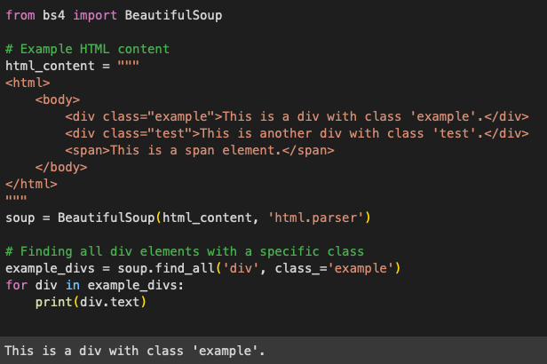
Simple example
In this example, the script prints the text from all div elements that have a class of example.

Slide 14
Go through some of Lab8 examples and assignments.

