Slide 1
LAN Cabling

Slide 2
Objectives
Types of Cabling
  Straight-through
  Cross-over
  Roll-over

Slide 3
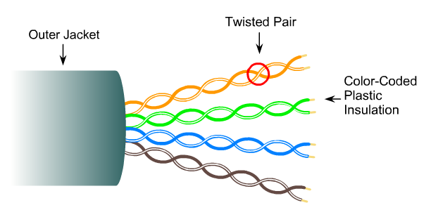
UTP Cables

Slide 4
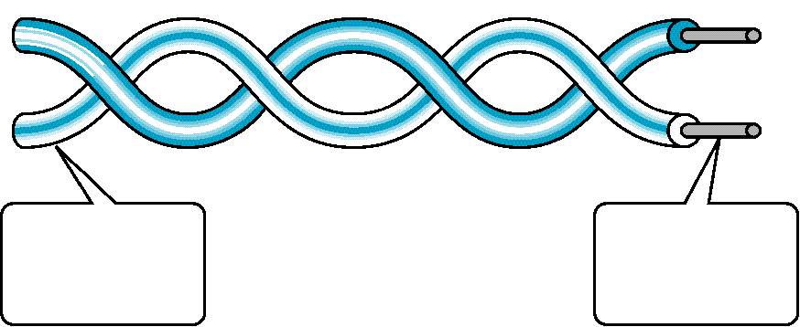
Twisted Pair Cable
Outer Insulator
(PVC)
Solid Copper
Conductors

Slide 5
UTP cable standard
Category | Digital/Analog | Use
1 | Analog | Telephone
2 | Analog/digital | LANs
3 | Digital | LANs
4 | Digital | LANs
5 | Digital | LANs
5e | Digital | LANs
6 | Digital | LANs
6a | Digital | LANs
7 | Digital | LANs

Slide 6
UTP Cables and Ethernet
Types | UTP Cable Type | Duplex | Max Distance
10Base-T | Cat3/Cat5 | Half/Full | 100 m
100Base-T4 | Cat3 | Half/Full | 100 m
100Base-TX | Cat5 | Full | 100 m
1000Base-T | Cat5e/Cat6 | Full | 100 m
1000Base-TX | Cat6 | Full | 100 m
10GBase-T | Cat6a/Cat7 | Full | 100 m

Slide 7
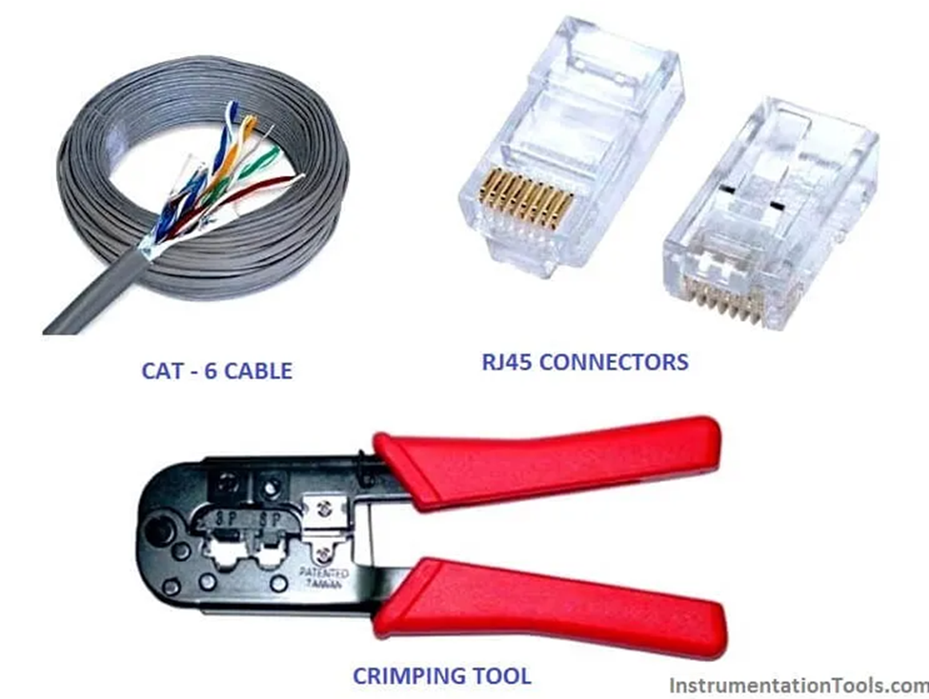
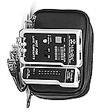
Required tool and materials:
Ethernet Cable – Category 5e or CAT5e or CAT6
RJ-45 Crimping tool
RJ45 Crimpable Connectors
Cable Tester

Slide 8
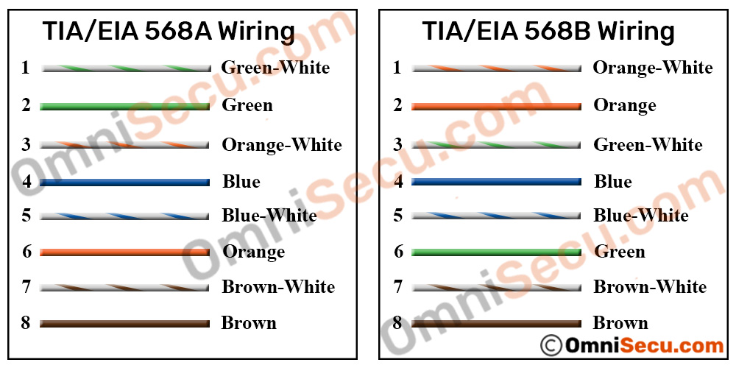

Standard
There are two major Unshielded Twisted Pair Cable wiring standards used widely in networking industry. Telecommunications Industry Association (TIA)/Electronic Industries Alliance (EIA) developed the TIA/EIA 568A & TIA/EIA 568B standards for Unshielded Twisted Pair wiring.

Slide 9
RJ-45 Color Code
1. White/Green
1. White/Orange
2. Green
2. Orange
3. White/Orange
3. White/Green
4. Blue
4. Blue
5. White/Blue
5. White/Blue
6. Orange
6. Green
7. White/Brown
7. White/Brown
8. Brown
8. Brown
EIA/TIA 568 A
EIA/TIA 568 B

Slide 10
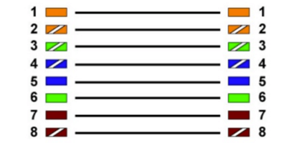
Ethernet Straight-Through Cable
Straight-through cable is a type of cable in which at each end has the same pin out. It is in accordance with either the T568A or T568B standards.

Slide 11
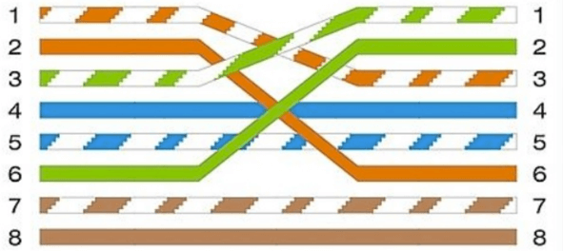
Ethernet Crossover Cable
A Crossover cable is a type of cable where one end isT568A configuration and the other end as T568B Configuration. In this type of cable connection, Pin 1 is crossed with Pin 3, and Pin 2 is crossed with Pin 6.

Slide 12
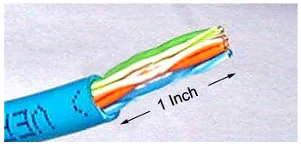
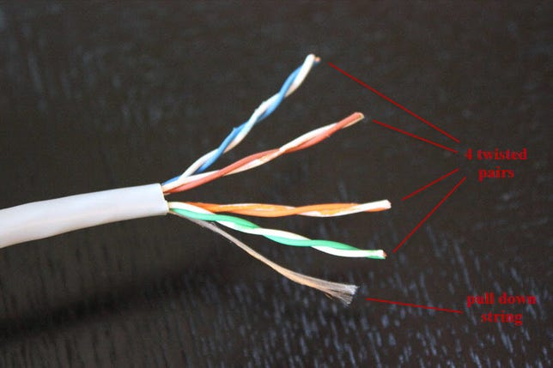
Procedure to make cable :
Step 1: Strip the cable jacket about 1.5 inch down from the end.
1.5 Inch
Step 2: Spread the four pairs of twisted wire apart.

Slide 13
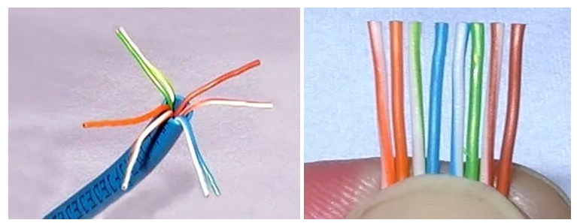
Procedure to make cable :
Step 3: Untwist the wire pairs and neatly align them in the T568A or T568B orientation. Pinch the wires between your fingers and straighten them out in a sequence of color as u want to make cable (Straight cable or cross over cable). The color order is important to get correct.

Slide 14
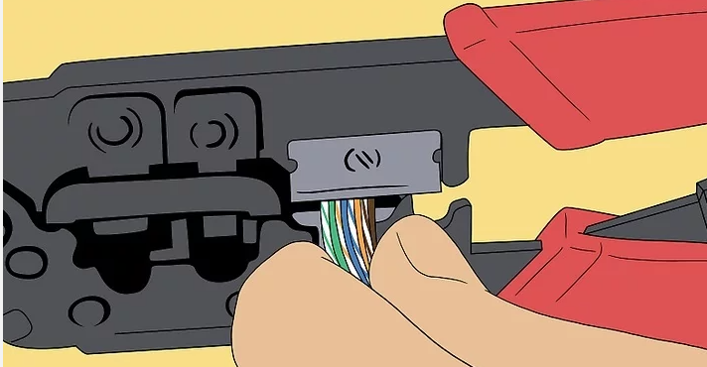
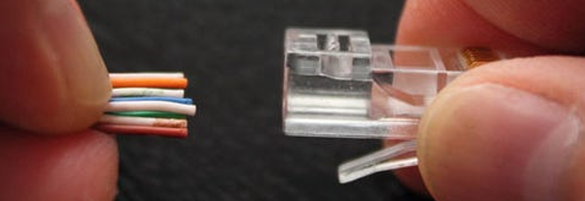
Procedure to make cable :
Step 4: Cut the wires as straight as possible, about 0.5 inch above the end of the jacket.
Step 5: Carefully insert the wires all the way into the modular connector, making sure that each wire passes through the appropriate guides inside the connector.

Slide 15
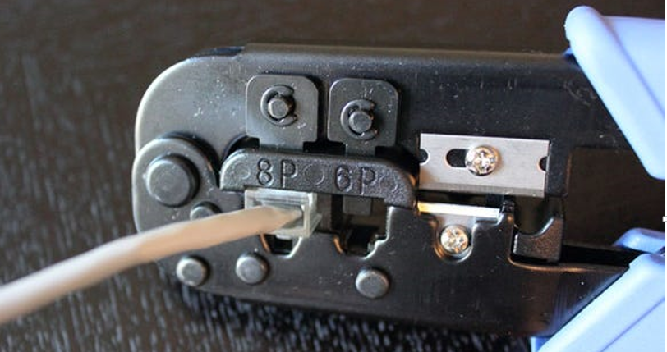
Procedure to make cable :
Step 6: Push the connector inside the crimping tool and squeeze the crimper all the way down.
Step 7: Repeat steps 1-6 for the other end of the cable. For crossover cables, simply make one end of the cable a T568A and the other end a T568B.

Slide 16
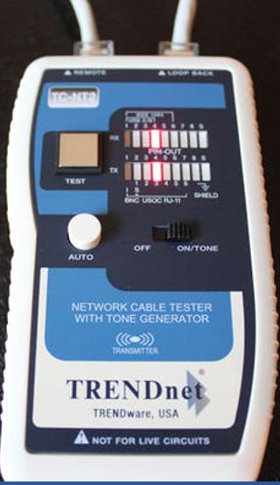
Procedure to make cable :
Step 8: To make sure you've successfully terminated each end of the cable, use a cable tester to test each pin.

Slide 17
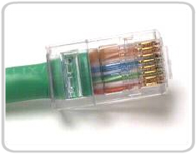
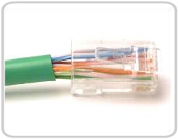
Good vs. Bad Cabling
Good
Bad
Wires are untwisted too long

Slide 18
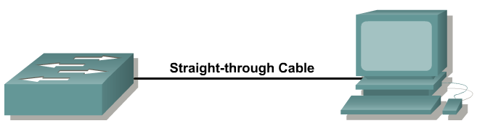
Straight-Through Cable
A straight cable is used to connect a computer to a:
  Switch
  Hub
  router
  (different devices)

Slide 19
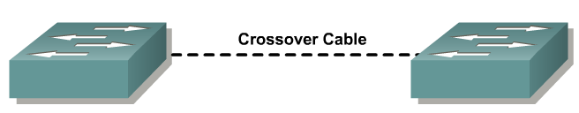
Cross-Over Cable
A cross cable is used to connect:
  Computer to Computer (with ONLY the UTP cable).
  Network device to network device.
  For example: router to router, switch to switch
  (same devices)

Slide 20
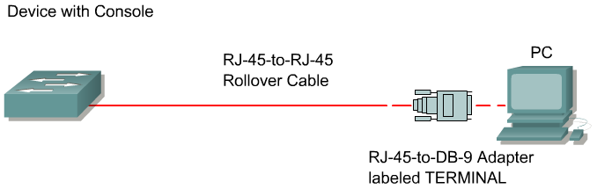
Roll-Over Cable
1
1
2
2
3
3
4
4
5
5
6
6
7
7
8
8
roll-over

