Slide 1



BiNE: Bipartite Network Embedding
ACM SIGIR 2018, July 8, Ann Arbor Michigan, U.S.A.
MingGao*, Leihui Chen*, Xiangnan He⁺, Aoying Zhou*
*East China Normal University ⁺National University of Singapore

Slide 2
Outline
Background & Motivation
Proposed Method
Experiments and Results
Conclusion

Slide 3
Outline
Background & Motivation
Proposed Method
Experiments and Results
Conclusion

Slide 4









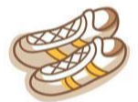


Networks
Network
- Providing a universal approach to describe relationships between entities
Network embedding
- Providing convenience for network analysis
Homogeneous Network
- Social network
Heterogeneous network
- Bipartite Network
Recommender system
Search engines
…

Slide 5
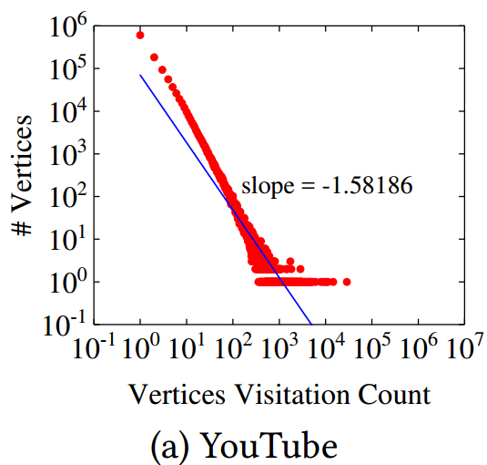
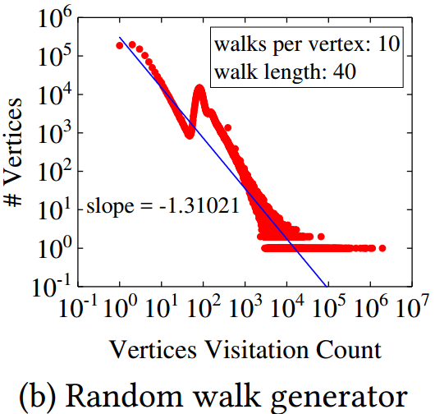
Drawbacks of Existing Method for Embedding Bipartite Network
Homogeneous network embedding
- Ignoring the type information of vertices
Two types of vertices in a bipartite network
Edges exists between vertices of different types
“Modeling implicit relations can improve the recommendation performance”
- Ignoring the characteristics of network
power-law distribution
“A common characteristics of many real-world bipartite networks”
Heterogeneous network embedding (MetaPath2vec)
- Treating the explicit and implicit relations equally
“The explicit and implicit relations typically carry diﬀerent semantics“
Lu Yu, Chuxu Zhang, Shichao Pei, Guolei Sun, and Xiangliang Zhang and. Walkranker: A unifed pairwise ranking model with multiple relations for item recommendation. In AAAI, 2018.
Suchit Pongnumkul and Kazuyuki Motohashi. A bipartite ftness model for online music streaming services. Physica A: Statistical Mechanics and its Applications, 490:1125–1137, 2018.
Meng Jiang, Peng Cui, Nicholas Jing Yuan, Xing Xie, and Shiqiang Yang. Little is much: Bridging cross-platform behaviors through overlapped crowds. In AAAI, pages 13–19, 2016.

Slide 6
Two Characteristics of BiNE
A joint optimization framework
- Modeling the explicit and implicit relations simultaneously
Explicit relations: observed links
Implicit relations: high-order correlations
Combination: hyper-parameters
A biased and self-adaptive random walk generator - Retaining the properties of the bipartite network as many as possible
The number of random walks starting from each vertex: based on its importance
The length of random walks: stopped in a probabilistic way

Slide 7
Outline
Background & Motivation
Proposed Method
Experiments and Results
Conclusion

Slide 8
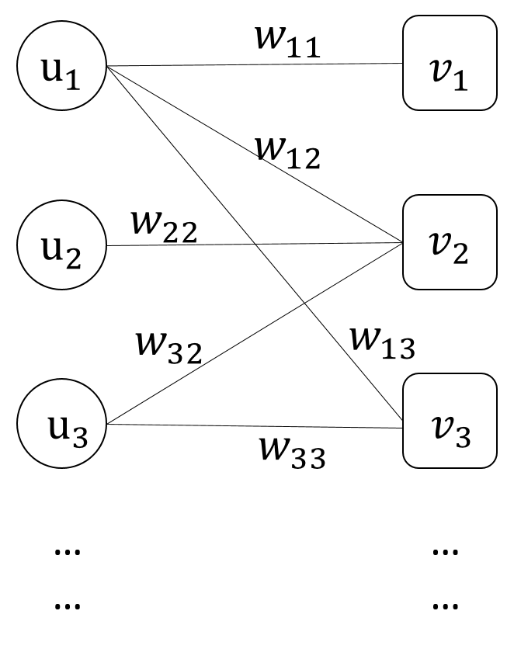




Problem Formulations
Input: A bipartite network $G=(U ,V , E)$and its weight matrix $W$.
Output: A map function $f :U∪V →ℝ^{d}$, which maps each vertex in $G$ to a $d$-dimensional embedding vector: $U = \left[\vec{u_{i}}\right]$ and $V =\left[\vec{v_{i}}\right]$.
$$|d|$$
.2 | .3 | .5 | 1 | .7
.4 | .3 | .5 | .1 | .2
.2 | .6 | .5 | .9 | .1
… | … | … | … | …
$$|U|$$
?
$$|d|$$
.2 | .3 | .5 | 1 | .7
.4 | .3 | .5 | .1 | .2
.2 | .6 | .5 | .9 | .1
… | … | … | … | …
$$|V|$$

Slide 9
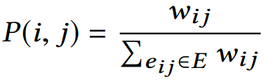
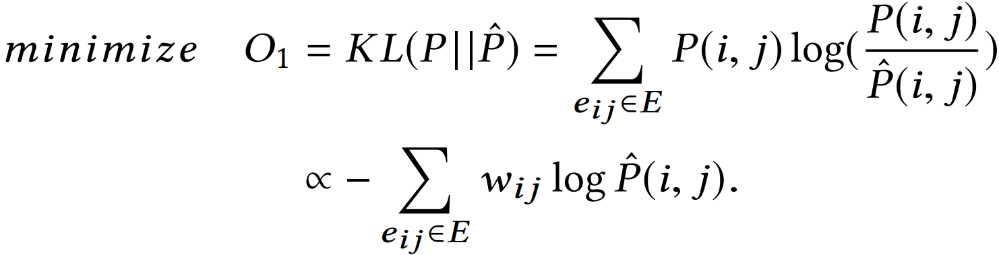
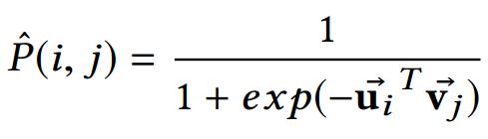
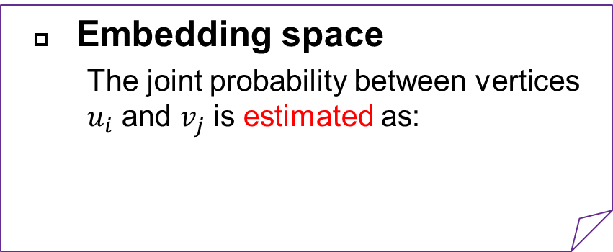
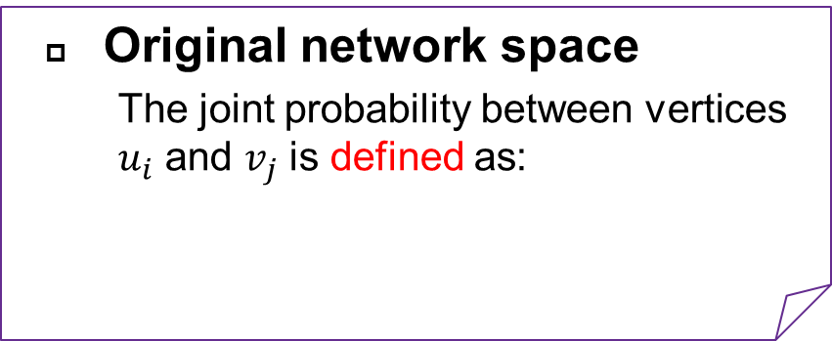
Modeling Explicit Relations (Observed links)
Original network space
The joint probability between vertices $u_{i}$ and $v_{j}$ is defined as:
Preserving the local proximity
Minimizing the difference (KL-divergence) between the two distributions:
Making two vertices that are strongly connected in the original network also close with each other in the embedding space.
Embedding space
The joint probability between vertices $u_{i}$ and $v_{j}$ is estimated as:

Slide 10
Modeling Implicit Relations (High-order correlations)
Key idea: Converting the bipartite network to two corpora of vertex sequences, and performing self-adaptive random walk to encode the high-order implicit relations
- Constructing Corpus of Vertex Sequences
- Optimizing a point-wise classification loss
Frequently co-occurred
Negative Samples

Slide 11
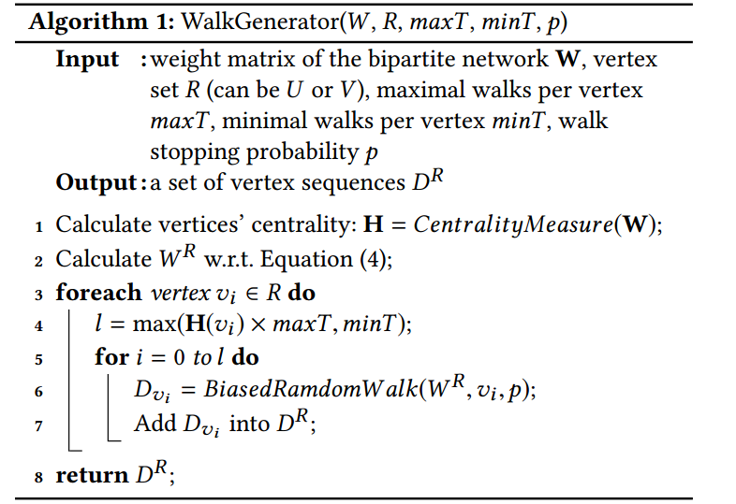

Modeling Implicit Relations (High-order correlations)
Constructing Corpus of Vertex Sequences
Calculating 2nd-order proximity
Relating the number of random walks starting from each vertex to be dependent on its importance (centrality)
Assigning a probability to stop a random walk in each step
A.
B.
C.

Slide 12
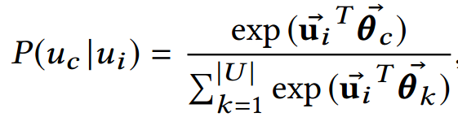
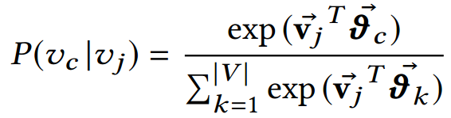














Modeling Implicit Relations (High-order correlations)
Modeling Implicit Relations
- Assumption: vertices frequently co-occurred in the same context of a sequence should be assigned to similar embeddings.
$$u_{1}$$
$$u_{5}$$
Taking corpus of users $D^{U}$ as example , given a sequence $S$, $ws$(=2) and a vertex $u_{i}$:
$$u_{4}$$
$$u_{2}$$
$$S:$$
$$u_{7}$$
$$u_{i}$$
$$u_{3}$$
$$u_{9}$$
Negative sampling
$$u_{8}$$

Slide 13

Modeling Implicit Relations (High-order correlations)
Negative Sampling
- LSH-based negative sampling method
For a center vertex $u_{i}$, high-quality negatives should be the vertices that are dissimilar from $u_{i}$
 | Frequency-based or popularity-based sampling | LSH-based negative sampling (our model)
Strategy | High frequency objects | Dissimilar objects
Word Embedding | Useless words
Network Embedding | Popular items or active users

Slide 14

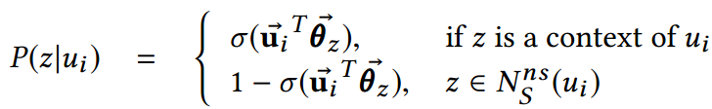
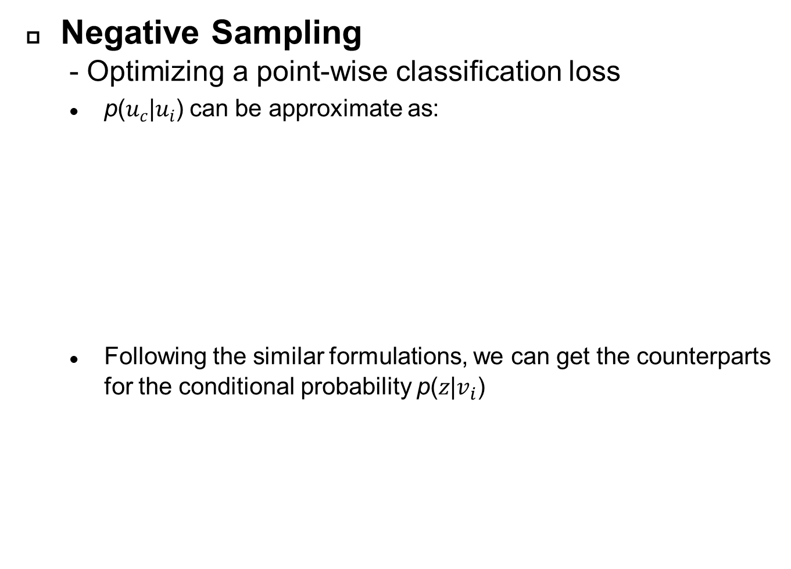
Modeling Implicit Relations (High-order correlations)
Negative Sampling
- Optimizing a point-wise classification loss
$\text{p}\text{(}u_{c}\text{|}u_{i}\text{)}$can be approximate as:
Following the similar formulations, we can get the counterparts for the conditional probability $\text{p}\text{(}z\text{|}v_{i}\text{)}$

Slide 15
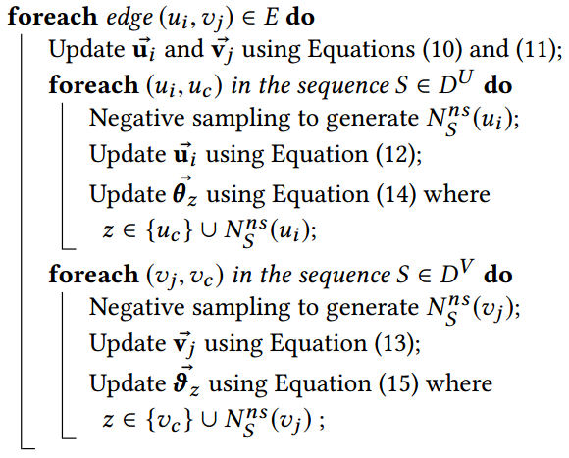

Joint Optimization
A joint optimization framework
explicit relations
Implicit relations

Slide 16
Outline
Background & Motivation
Proposed Method
Experiments and Results
Conclusion

Slide 17
Experiments
Research questions
- RQ1 How does BiNE perform compared with state-of-the-art network embedding methods and other representative baselines of the two applications?
- RQ2 Is the modeling of implicit relations helpful to learn more desirable representations for bipartite networks?
- RQ3 Can our proposed random walk generator contribute to learning better vertex representations?
- RQ4 How do the key hyper-parameters aﬀect the performance of BiNE?

Slide 18
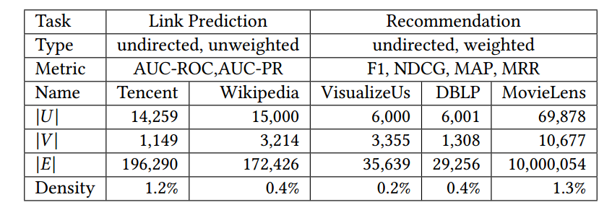
Experiments
Tasks
- Two tasks: link prediction (classification) & recommendation (ranking)
Datasets and Evaluation Protocols
- Five datasets (60% for training and 40% for testing)
Link prediction: Tencent & Wikipedia
Recommendation: VisualizeUs & DBLP & Movielens

Slide 19
Experiments
Baselines
- Network embedding methods
DeepWalk [Perozzi et al KDD 2014]
LINE [Tang et al WWW 2015]
Node2vec [Grover et al KDD 2016]
Metapath2vec++ [Dong et al KDD 2017]
- Link Prediction methods [Xia et al ASONAM 2012]
JC (Jaccard coefficient)
AA (Adamic/Adar)
Katz (Katz index)
PA (Preferential attachment)
- Recommendation methods
BPR [Rendle et al UAI 2009]
RankALS [Takács et al Recsys 2012]
FISMauc [Kabbur et al KDD 2013]

Slide 20
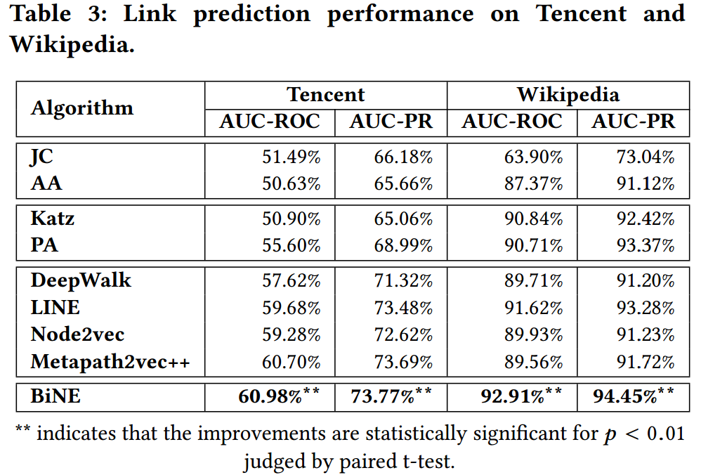
Experiments
Performance Comparison (RQ1)
Observation:
The neural network-based methods predict the links in a data-dependent supervised manner, which is more advantageous.
This points to the positive eﬀect of modeling both explicit and implicit relations into the embedding process.
This improvement demonstrates the eﬀectiveness of our modeling of explicit and implicit relations in diﬀerent ways.

Slide 21
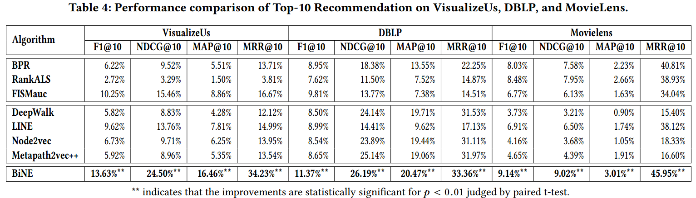
Experiments
Performance Comparison (RQ1)
Observation:
It is important to take the information of weight into consideration. (BiNE v.s. Metapath2Vec)
We should focus on the higher-order proximities among vertices. (BiNE v.s. LINE)
Jointly training is superior to separately training + post-processing. (BiNE v.s. LINE)

Slide 22
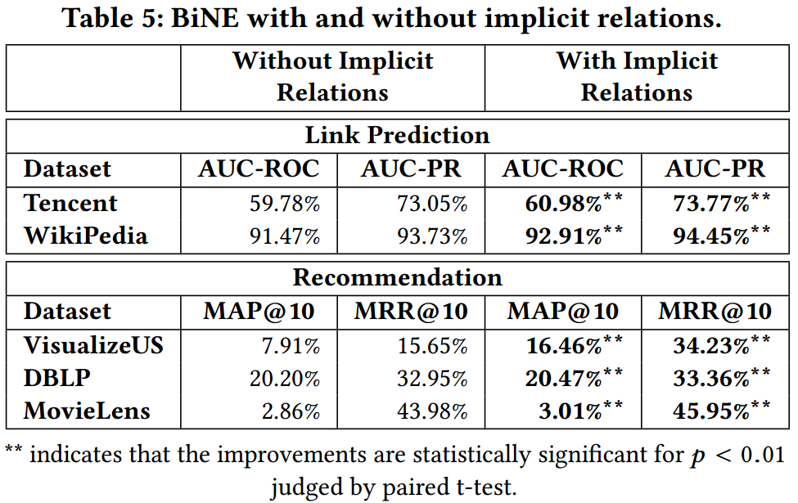
Experiments
Utility of Implicit Relations (RQ2)
Observation:
Our proposed way of modeling high-order implicit relations is rather eﬀective to complement with explicit relation modeling.

Slide 23
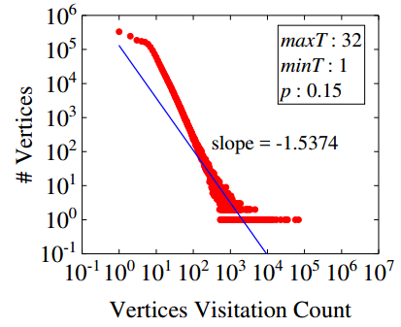
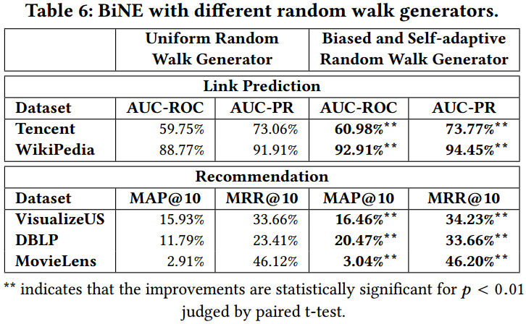
Experiments
Random Walk Generator (RQ3)
Observation:
It indicates that the biased and self-adaptive random walk generator contributes to improving the vertex embeddings.

Slide 24
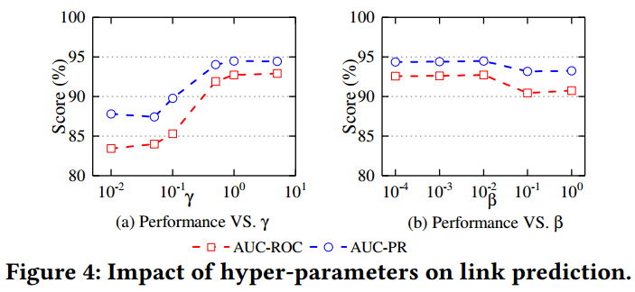
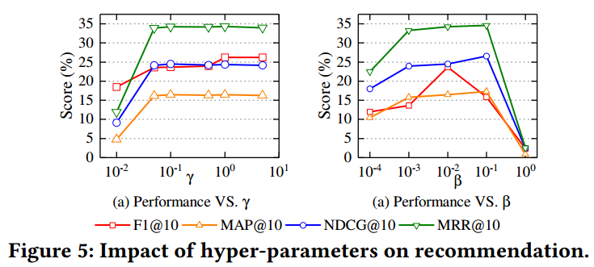
Experiments
Hyper-parameter Studies (RQ4)
Observation:
Purely using explicit or implicit relations is insufficient to learn desirable representations for a bipartite network.
The explicit relations are more important than implicit relations for the bipartite network embeddings. (γ > α, γ > β)

Slide 25
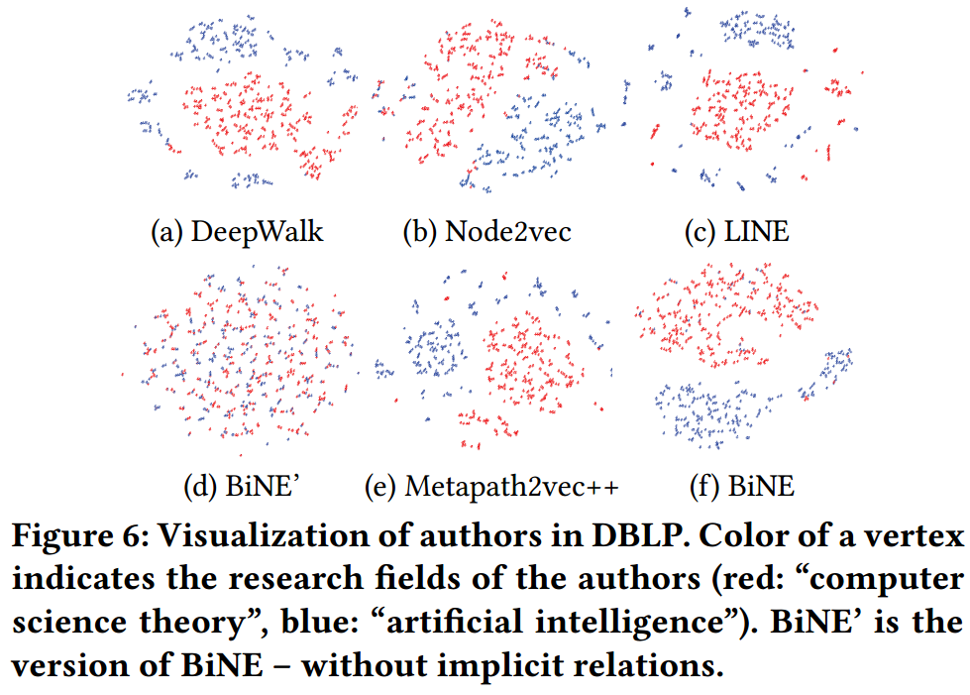
Experiments
Case Study
Observation:
DeepWalk, Node2vec, LINE, Metapath2vec++, and our BiNE are good since researchers belonging diﬀerent research fields are well separated.
Modeling high-order implicit relations is helpful to preserve the network structure well.

Slide 26
Outline
Background & Motivation
Proposed Method
Experiments and Results
Conclusion

Slide 27
Conclusion
Conclusion
- Explore a novel approach for embedding bipartite networks
Jointly modeling both the explicit relations and high-order implicit relations in learning the representation for vertices
Extensive experiments on several tasks of link prediction, recommendation, and visualization demonstrate the eﬀectiveness and rationality of our BiNE method
Future work
- Extending our BiNE method to model auxiliary side
numerical features, textual descriptions, and among other attributes
- Investigating how to efficiently refresh embeddings for dynamic bipartite

Slide 28
THANK YOU!
Q & A
Codes available: https://github.com/clhchtcjj/BiNE

