Slide 1
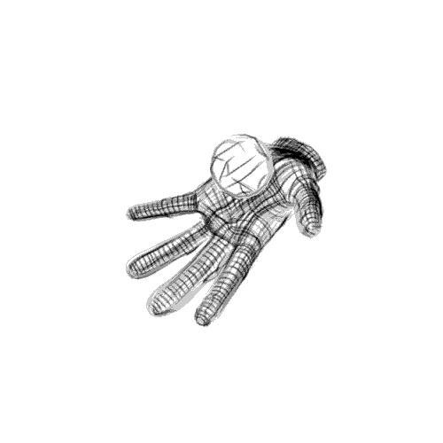
MagneticSynthUïno
Sensor&SensingClass

Slide 2
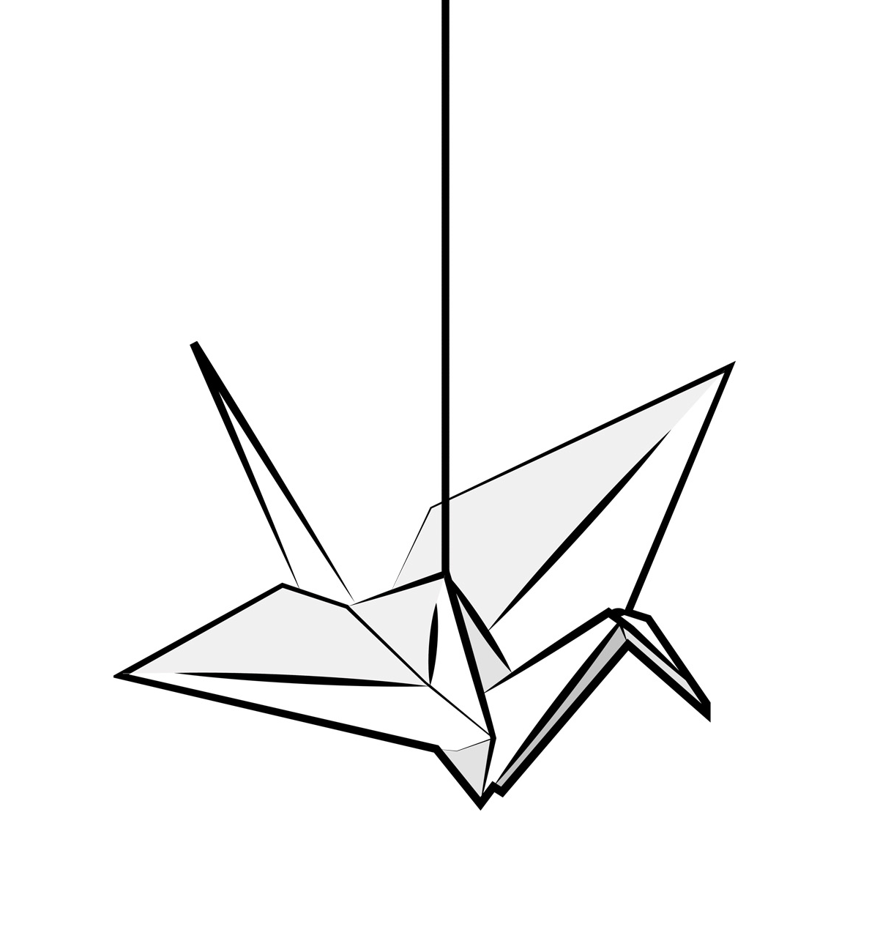
Summary
What is that ?
For What ?
How to,
Montage,
Graphic Interface,
Conclusion.
For the Future !

Slide 3
What is that ?
The MagneticSynthUïno is a Synth;
A synthesizer (often abbreviated as synth, also spelled synthesiser) is an electronic musical instrument that generates electric signals that are converted to sound through instrument amplifiers and loudspeakers or headphones.

Slide 4
For What ?
I have create a MagneticSynthUïno, because you have two different way, the music and the sound.
Here, i’m with you on the way of Sound and for explore this way the conception and the creation of the MagneticSynthUïno is perfect.
Because with the MagneticSynthUïno, you can understand how the sound work and you can create your great modulate sound.

Slide 5
How to,
The MagneticSynthUïno work with three different sensor :
- Piezo → this is a Picth of the Synth
- Potentiometer → the Volume Dimmer of the Synth
- Magnetic → the Frequence Dimmer of the Synth

Slide 6
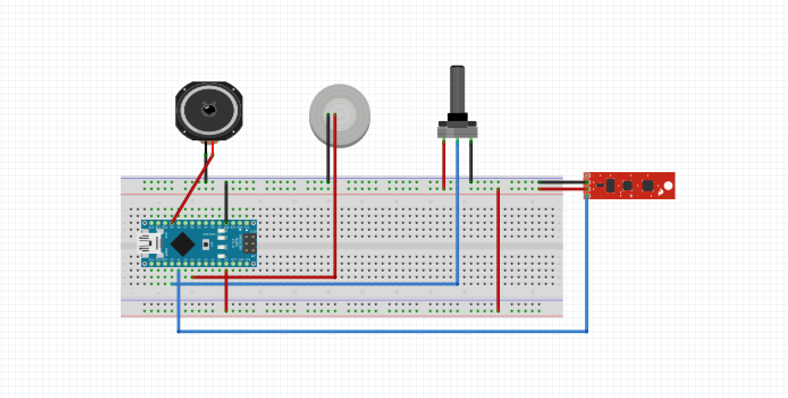
Montage,
That the Fritzing montage of the MagneticSynthUïno.

Slide 7
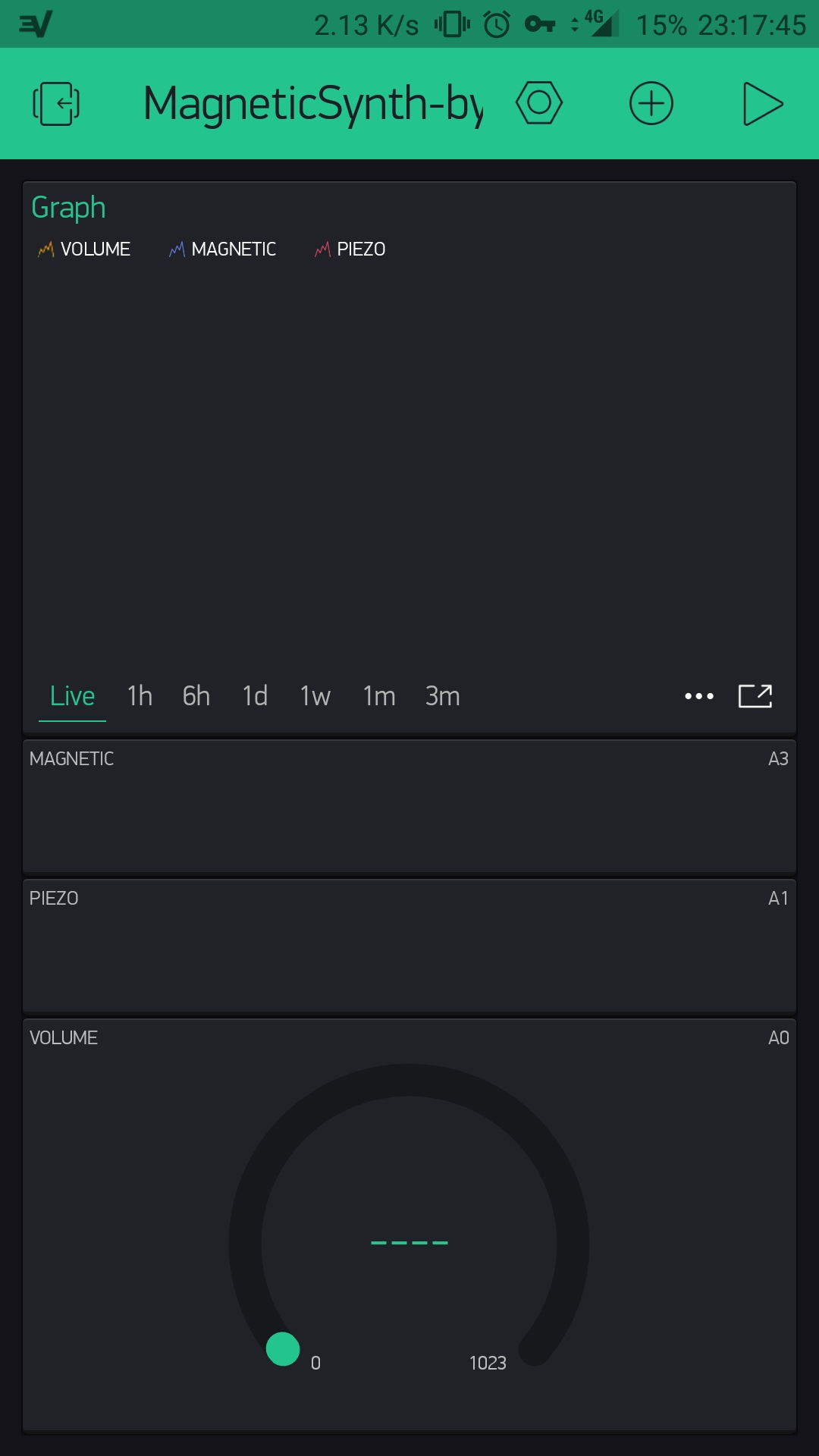

Graphic Interface.
Here you can see two view of the graphique interface of the MagneticSynthUïno create with the « BlynkApp ».

Slide 8
Conclusion
For me the creation of the MagneticSynthUïno is a cool Arduino coding introduction,
And obviously the perfect way for learn more about Sensor.

Slide 9
For the Future !
Plz buy more arduino Component.
  For create potentialy more sophisticated Project !

Slide 10

Thank you

