Slide 1


UPI Transaction Risk &
Performance Analysis
Insights · Performance · Security · Growth
Gopal Sarkar
Career247 | Data Analytics Capstone Project
June 2026
1,00,000
7
2.0%
Transactions Analysed
Linked Data Tables
Overall Fraud Rate
Notes:
Good morning/afternoon. I'm Gopal Sarkar. My capstone project analyzed 1 lakh UPI transactions to identify fraud patterns, failure causes, and actionable business recommendations.

Slide 2
Problem Statement
What problem is this project solving?
The Business Challenge
1,00,000
UPI has grown to billions of transactions across India. But rapid growth brings new problems:
→ Fraud is rising — rooted devices are a major risk
Transactions analysed across 5 years
→ 1 in 17 payments fails — costing user trust every day
→ 248 fraud alerts are still unresolved right now
2.0%
→ Merchant risk scores exist but no one is reviewing them
→ Customer satisfaction averages just 3.61/5 — trust is slipping
Fraud rate — 2,000 flagged transactions
5.87%
These are not just data problems — they are business problems. Left unaddressed, they erode customer confidence and revenue.
Failure rate — 5,871 failed payments
Notes:
I analyzed a UPI platform with 1 lakh transactions across 7 linked tables. My core question: where is fraud happening, why are payments failing, and what can be done?

Slide 3





Project Phases & Methodology
5 phases from raw data to business recommendations
01
02
03
04
05
Data
Validation
Python
EDA
Statistical
Testing
Power BI
Dashboard
Insights &
Present.
Excel
→
Python / Pandas
→
SciPy
→
Power BI
→
This PPT
Checked data types, missing values, and validated structure across all 7 tables
Cleaned data, built derived metrics, visualised fraud & failure patterns across device, region, channel
Two Z-tests, Chi-Square, One-Way ANOVA. IQR anomaly detection on transaction amounts
3-page interactive dashboard with live slicers for region, device, year, channel
5 actionable business recommendations backed by real numbers from the full analysis
Notes:
My project followed 5 phases — validation, EDA, statistical testing, Power BI dashboard, and this presentation. Each phase fed the next.

Slide 4
Tools & Techniques Used
Every tool chosen for a specific reason — not just because it was available
Excel
Checked data types, missing values, and validated all 7 tables for consistency. Built a Data Quality Log.
Data Validation
Python — Pandas
Loaded all 7 CSVs, cleaned data, created 4 derived columns (Fraud Ratio, Failure Rate, Device Risk, Txn Value per Customer).
Data Cleaning & EDA
Python — Matplotlib / Seaborn
Two-Proportion Z-test (rooted vs non-rooted fraud), One-Proportion Z-test (fraud rate vs 1% industry baseline), Chi-Square Test (fraud×region, fraud×channel), One-Way ANOVA (fraud rate across 5 regions).
Visualizations
Python — SciPy
Two-Proportion Z-test (rooted vs non-rooted fraud), One-Proportion Z-test (fraud rate vs 1% industry baseline), Chi-Square Test (fraud×region, fraud×channel), One-Way ANOVA (fraud rate across 5 regions).
Statistical Testing
Power BI
3-page dashboard with live slicers (region, year, device, channel). DAX measures for all KPIs including Unresolved Alerts.
Interactive Dashboard
Notes:
I used Python for the full analysis, Power BI for the interactive dashboard, and four statistical tests to validate findings — not just visual impressions.

Slide 5
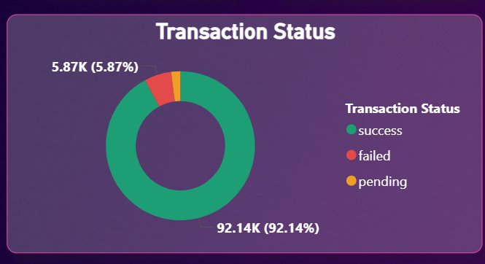
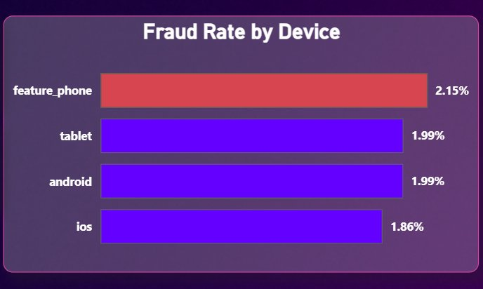
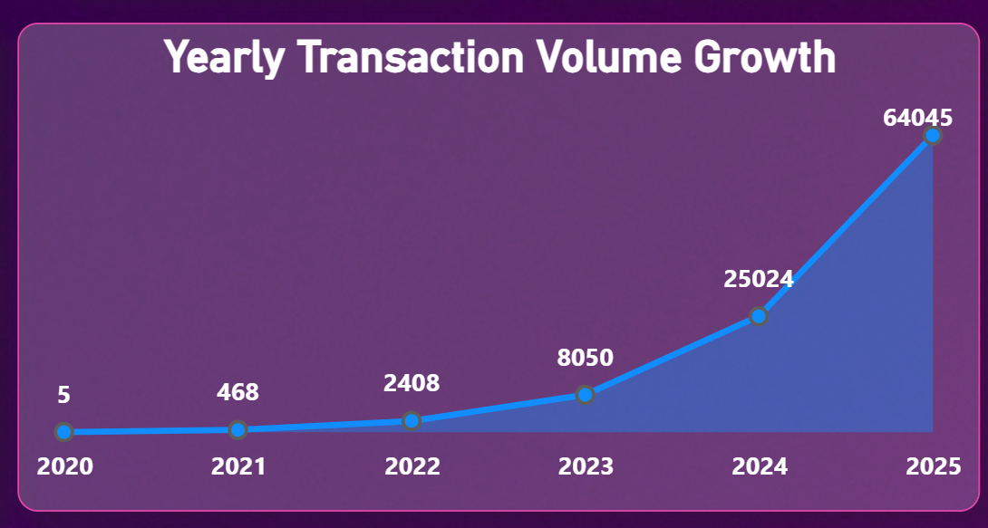
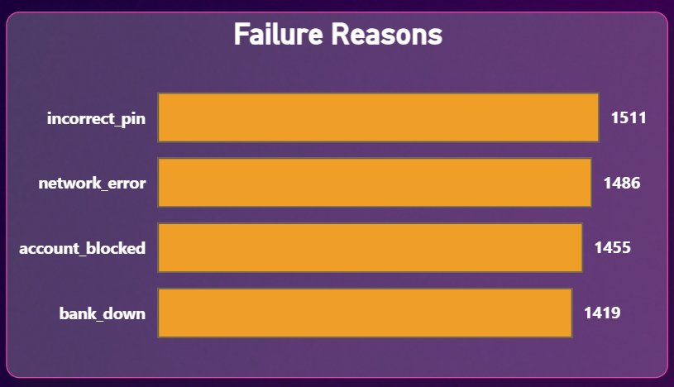
Exploratory Data Analysis — Key Patterns
Charts from Power BI dashboard built on the actual dataset
Notes:
Three EDA findings stand out: 92.14% of transactions succeed but 5.87% fail every day. Feature phones show the highest fraud rate. And transaction volume has grown from 5 transactions in 2020 to 64,000 in 2025 — a growth that makes manual fraud review impossible.

Slide 6
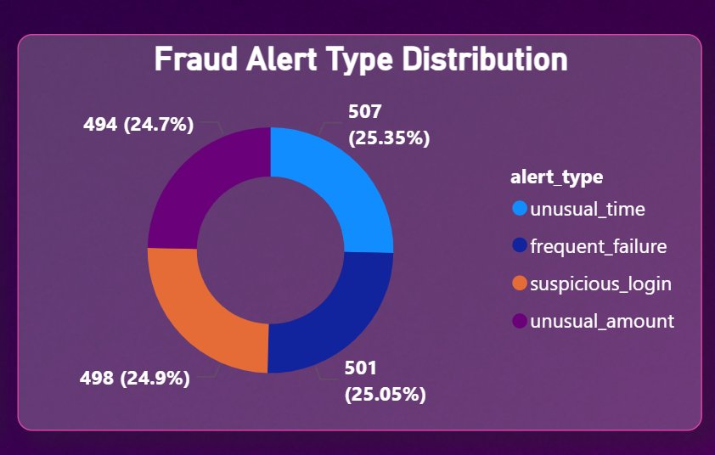
Fraud Alert Analysis
What types of fraud are occurring — and how many are unresolved
2,000
Total fraud alerts logged
248
Unresolved alerts — live risk NOW
87.6%
Resolution rate (1,752 resolved)
Alert Type Breakdown (from data):
Business risk: 248 unresolved alerts are a live financial exposure — not historical. Each alert left open is a transaction that may already be fraudulent and unchallenged.
Unusual Time : 507 (25.35%)
Frequent Failure : 501 (25.05%)
Suspicious Login : 498 (24.90%)
Unusual Amount : 494 (24.70%)
Notes:
248 fraud alerts are still open. This is not a historical insight — it is a live operational risk. The four alert types are almost equally distributed, meaning no single alert type dominates. The 48-hour SLA recommendation directly addresses this.

Slide 7
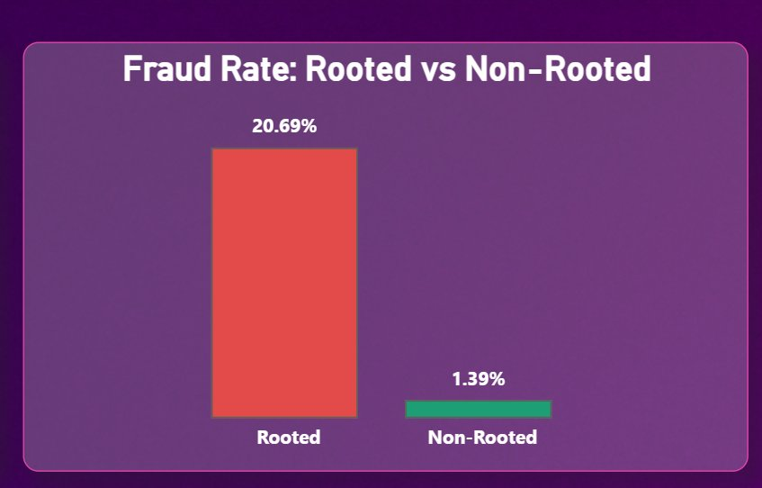
Statistical Testing — Hypothesis Result
The single most important quantitative finding in this project
H₀ (Null): Fraud rate of rooted devices = fraud rate of non-rooted devices H₁ (Alt): Fraud rate of rooted devices > fraud rate of non-rooted devices
20.69%
Fraud rate on rooted devices (370 devices, 3,171 transactions)
1.39%
Fraud rate on non-rooted devices (11,590 devices, 96,829 transactions)
Z-stat = 76.39 | p < 0.0001 | Decision: REJECT H₀ ✓
Rooted devices show a fraud rate 15× higher than non-rooted. This is statistically proven — not a coincidence.
Notes:
This is my strongest finding. Rooted devices showed 20.69% fraud versus 1.39% for normal devices — 15 times higher. Z-statistic was 76.39, p-value effectively zero. Rooted devices are 3.17% of transactions but disproportionately drive fraud.

Slide 8
Statistical Testing — Full Results
All 5 tests with actual p-values from the dataset
✓ REJECT
H₀
Test 1 — Two-Proportion Z-Test
Is fraud rate significantly higher on rooted devices?
Z = 76.39 p < 0.0001
Rooted devices have a 20.69% fraud rate vs 1.39% for non-rooted — a 15× difference that is statistically real.
✗ FAIL TO
REJECT H₀
Test 2 — Chi-Square: Fraud × Channel
Is fraud occurrence associated with the payment channel used?
χ² = 3.88 p = 0.1434
No significant association. App (2.02%), QR Code (2.10%), Intent (1.89%) — channel does not drive fraud.
✗ FAIL TO
REJECT H₀
Test 3 — Chi-Square: Fraud × Region
Does fraud distribution differ significantly across regions?
χ² = 1.52 p = 0.8224
Fraud is evenly spread. South: 2.03%, West: 2.09%, East: 2.00%, North: 1.94%, Central: 1.94%.
✗ FAIL TO
REJECT H₀
Test 4 — One-Way ANOVA: Region-wise Fraud Rate
Does fraud rate differ significantly across regions?
F = 0.38 p = 0.82
Fraud is spread evenly — not a regional problem. Central 1.94%, East 2.00%, North 1.94%, South 2.03%, West 2.09%.
✓ REJECT
H₀
Test 5 — One-Proportion Z-Test: Overall Fraud Rate
Is the platform's overall fraud rate above the 1% industry baseline?
Z = 22.59 p < 0.0001p < 0.0001
Observed fraud rate is 2.00% (2,000 out of 1,00,000), double the 1% industry baseline — confirmed statistically significant.
Notes:
I ran four statistical tests. Only the Z-test was significant — rooted devices are a proven risk. Chi-Square tests showed fraud is not linked to channel or region. ANOVA showed transaction amounts are nearly identical across device types. The correlation result is the most sobering: the existing risk_score field has r = -0.0079, meaning it predicts essentially nothing.

Slide 9
Actionable Insights
5 things I found that the business actually needs to know
01
92.14% of transactions succeed — but 5.87% fail, costing platform trust every day
02
Rooted devices carry a 20.69% fraud rate — 15× higher than normal. The single biggest preventable risk on the platform
03
The top 4 failure reasons (Incorrect PIN 1,511 · Network Error 1,486 · Account Blocked 1,455 · Bank Down 1,419) are all roughly equal — all 4 need fixes
04
248 fraud alerts are unresolved right now — not historical data points, active financial risks with no assigned SLA
05
Fraud is not linked to channel or region (chi-square p=0.14, p=0.82) — it is a device-risk problem, not a location one
Notes:
Five insights stood out from the analysis. The most urgent: 248 fraud alerts are still open right now — that is an active financial risk, not a historical one.

Slide 10
Business Recommendations
Low-cost, practical actions tied directly to what the data showed
01
Set a 48-hour SLA for fraud alert resolution 248 alerts are unresolved. Each is an open risk. Auto-escalate after 24 hours — a process change, not a tech change.
02
Show a PIN reminder after 2 consecutive failed attempts Incorrect PIN is the #1 failure reason (1,511 failures). A one-screen reminder costs almost nothing to build.
03
Flag transactions from rooted devices above ₹500 for extra OTP Rooted devices are 15× riskier. Add friction only on high-value transactions to avoid disrupting normal users.
04
Weekly review of merchants with risk_score > 0.4 (22 merchants) 500 merchants exist but no monitoring process. 22 are above the 0.4 threshold. 9 exceed 0.45 — start with those.
05
Stop building fraud rules around channel or region Chi-square and ANOVA confirm fraud is not tied to channel or region — focus on rooted devices and high-value amounts instead.
Notes:
My recommendations are practical and low-cost. A PIN reminder screen costs almost nothing to build but could meaningfully cut the failure rate. The 48-hour SLA is a process change — no new technology required.

Slide 11





Future Scope
This project is a foundation — here is where it goes next
Real-Time ML
Fraud Scoring
Customer Churn
Prediction
Merchant Rating
System
Geo-Based
Fraud Detection
Replace the static risk_score with a live model scoring every transaction before approval. The 7-table structure built here feeds it directly.
Use transaction frequency, satisfaction scores (avg 3.61/5) and device activity patterns to flag at-risk customers before they leave.
Build a dynamic health score updating weekly on fraud ratio, failure rate and volume — not a static onboarding risk_score.
If location data is added, transactions from unusual locations can be automatically flagged for extra verification.
Thank you — happy to take questions
Gopal Sarkar | Career247 | June 2026
Notes:
This project is a foundation. With more time, the natural next step is a real-time scoring model — the data structure I built here would directly support it. Happy to take questions.

