Slide 1
Diabetes Prediction
Gopal Kumar

Slide 2
Problem statement
Diabetes is a type of chronic disease which is more common among the people of all age groups. The project's primary goal is to construct a robust and accurate machine learning model that can predict the likelihood of diabetes onset in individuals based on relevant clinical and demographic features. Detecting this illness in its early stages can empower individuals to proactively adopt necessary measures and adjust their lifestyles. This can serve a dual purpose: preventing the onset of the condition for those who are at risk and managing the ailment more effectively for those who have already been diagnosed.

Slide 3
Introduction
Diabetes refers to a chronic (long-lasting) health condition that affects how your body turns food into energy. Early detection allows individuals to take vital precautions and adapt their lifestyles to either prevent the disease or manage it effectively. This proactive approach can significantly enhance one's quality of life, reduce healthcare costs, and mitigate the risk of debilitating complications associated with diabetes.

Slide 4
Previous research
Dataset has 200 instances, collected from hospital warehouse. Using WEKA, they used machine learning algorithms, Naïve Bayes, J48, REP Tree, and Random Tree. In this he used 10-fold cross validation approach found J48 best performs and gets highest accuracy 60.2%.
This method detection of diabetes by analyzing data patterns through classification with Decision Tree and Naïve Bayes algorithms. Author used PIMA dataset and used cross validation approach and study found that J48 achieved 74.8% accuracy and Naïve Bayes achieved 79.5% accuracy.

Slide 5
Flow process
Problem Statement
Data Collection and Cleaning
Exploratory Data Analysis
Data Preprocessing
Model Evaluation
Model Development

Slide 6
The Dataset
Pima Indians Diabetes Database - This dataset is originally from the National Institute of Diabetes and Digestive and Kidney Diseases. The objective of the dataset is to diagnostically predict whether or not a patient has diabetes, based on certain diagnostic measurements included in the dataset. In particular, all patients here are females at least 21 years old of Pima Indian heritage.
Diabetes prediction dataset - The Diabetes prediction dataset is a collection of medical and demographic data from patients, along with their diabetes status (positive or negative). The data includes features such as age, gender, body mass index (BMI), hypertension, heart disease, smoking history, HbA1c level, and blood glucose level.

Slide 7
Data preparation
Data cleaning done on both dataset
Removed all zeros that present in first dataset
Added a new features Gender in first dataset
Able to merge both data set

Slide 8
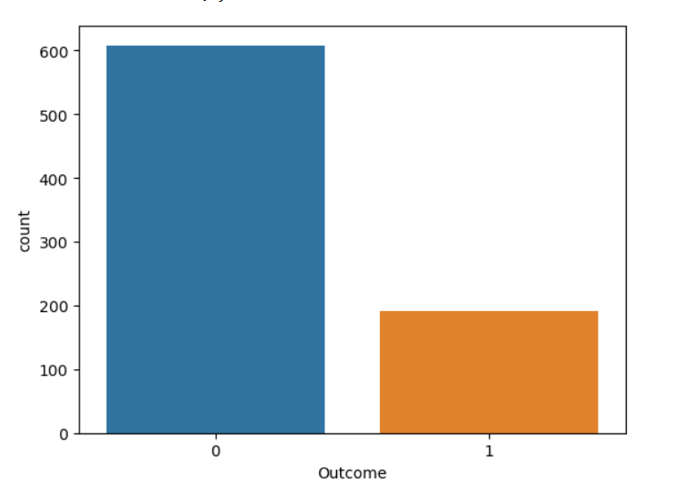
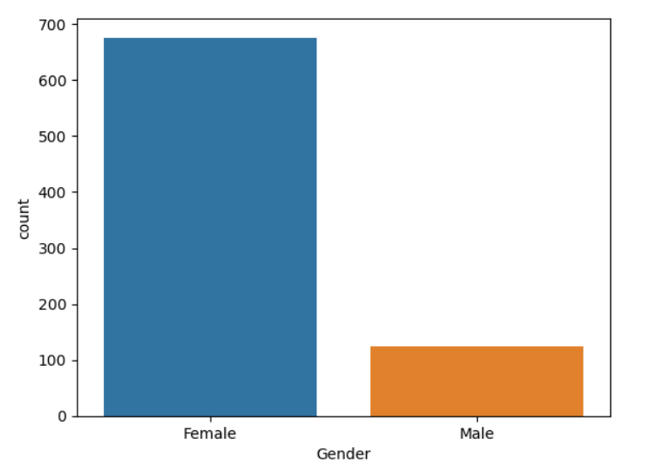
Exploratory data ANalysis
Patients having diabetic or not
Number of Male and Female in dataset

Slide 9
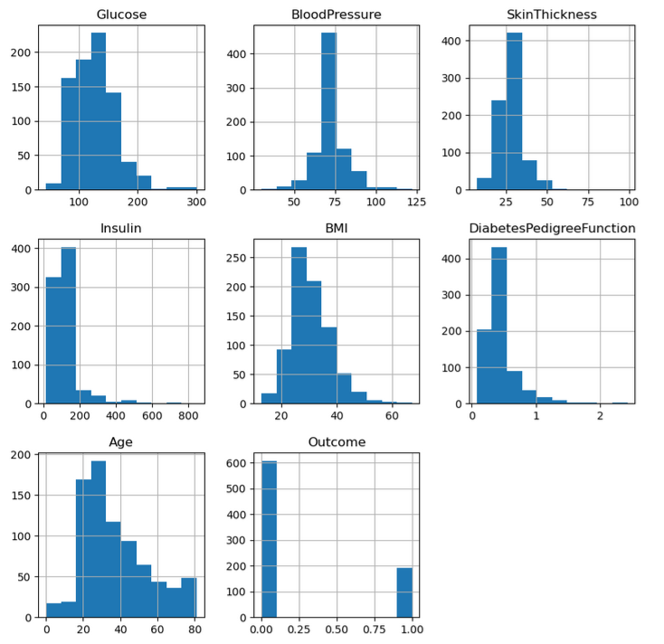
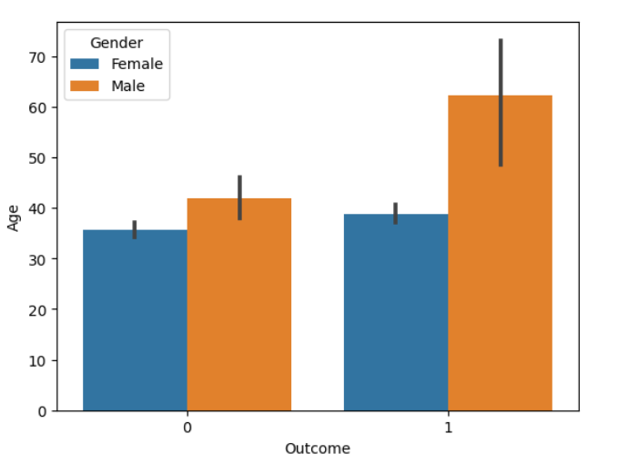
Exploratory data ANalysis
Distribution Plot of Dataset
Just a plot

Slide 10
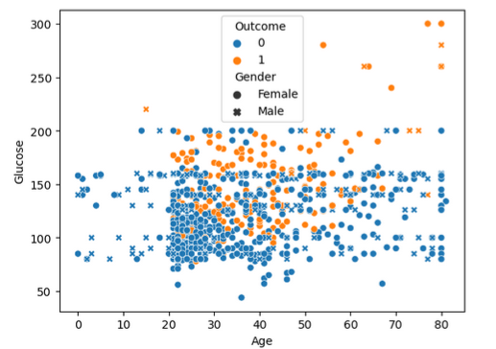
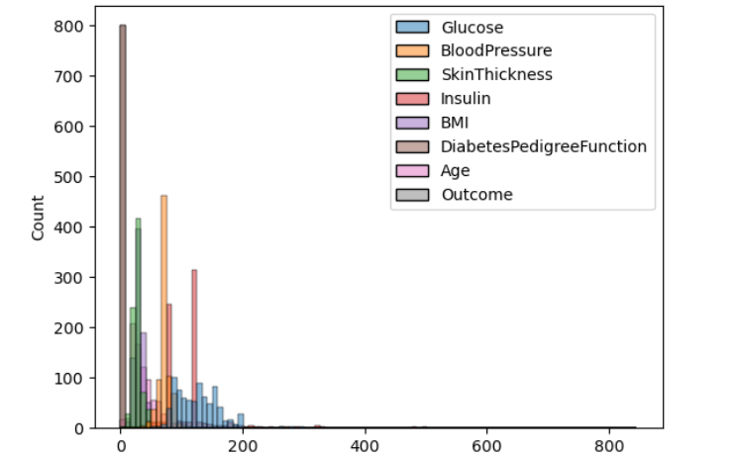
Exploratory data ANalysis
Scatter plot showing the relation with outcome and gender with age
Number of Male and Female in dataset

Slide 11
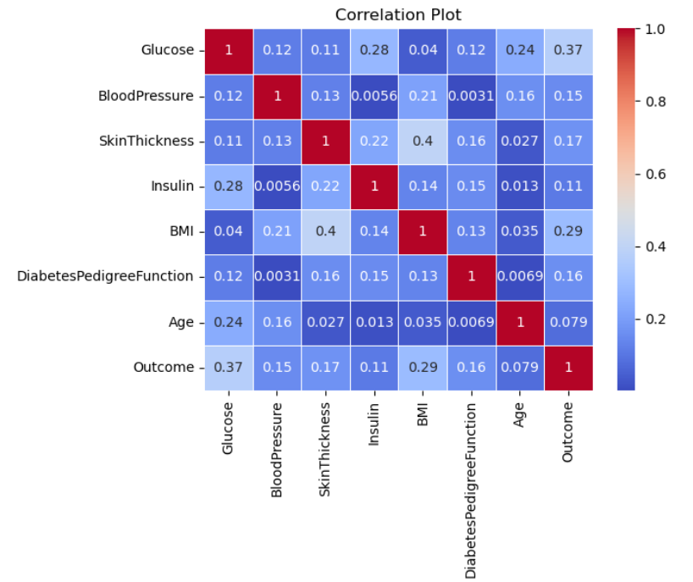
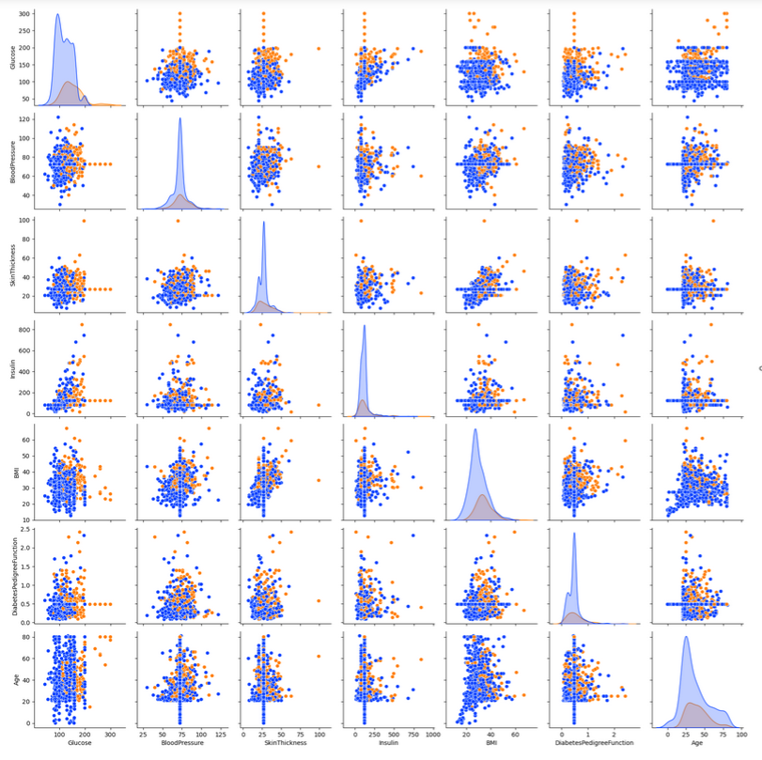
Exploratory data ANalysis
Correlation between the features
Pair plot of all feature

Slide 12
Data preprocessing
Data Splitting: The dataset was divided into training and testing sets using the train-test split method. This separation ensures the evaluation of models on unseen data helping to identify potential issues.
Label Encoding: Label encoding was applied to the categorical “Gender” column, converting them into numerical representations
Handling Outcome Imbalance: SMOTE (Synthetic Minority Over-sampling Technique) used to rectify Outcome imbalance, enhancing model performance.
Feature Scaling: MinMaxScaler is used so data to be transformed into the minimum value becomes 0, and the maximum value becomes 1. This scaling method is referred to as 'min-max scaling' or 'feature scaling to a specific range

Slide 13
Model development
Algorithm Used: Multiple classification algorithms were evaluated to get the performance. This is most important phase which includes model building for prediction of diabetes. We have implemented many algorithms , some of them are Support Vector Classifier, Random Forest Classifier, Decision Tree Classifier,, Logistic Regression, K-Nearest Neighbor, Gaussian Naïve Bayes.
Random Forest Classifier: Random Forest Classifier gets the best performance. The model was fitted to scaled training data was chosen for detailed evaluation. The model was fitted to the scaled training data, and its performance was assessed on both training and test sets.
Model Evaluation: The trained Random Forest Classifier model's accuracy was evaluated on both the training and test datasets. The training accuracy is 99.38%, indicative of a well-fitted model. The test accuracy is 81.87%.

Slide 14
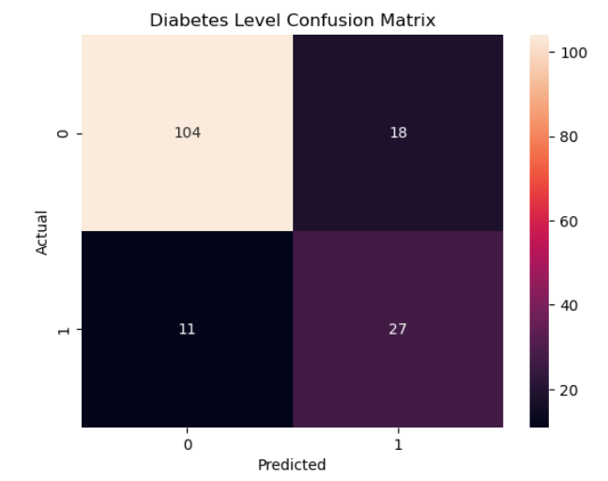
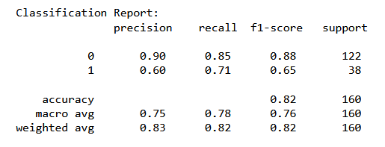
Model development
Classification Report
Confusion Matrix

Slide 15
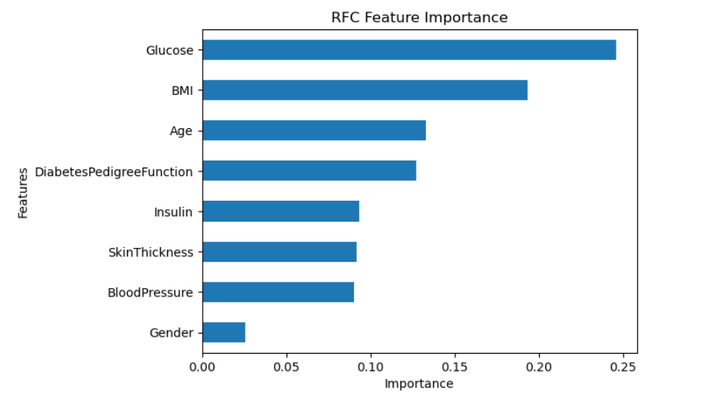
Model development
Importance of features in dataset

Slide 16
Conclusion
This paper based on the diabetes prediction by various machine learning classification algorithm. Based on the gathered information from model, we conclude that Random Forest Classifier predict the best training and testing the model with 99 % accurate training dataset and 82% accuracy in the testing dataset

Slide 17
THANK YOU
Gopal Kumar
gk3910598@gmail.com

