Slide 1
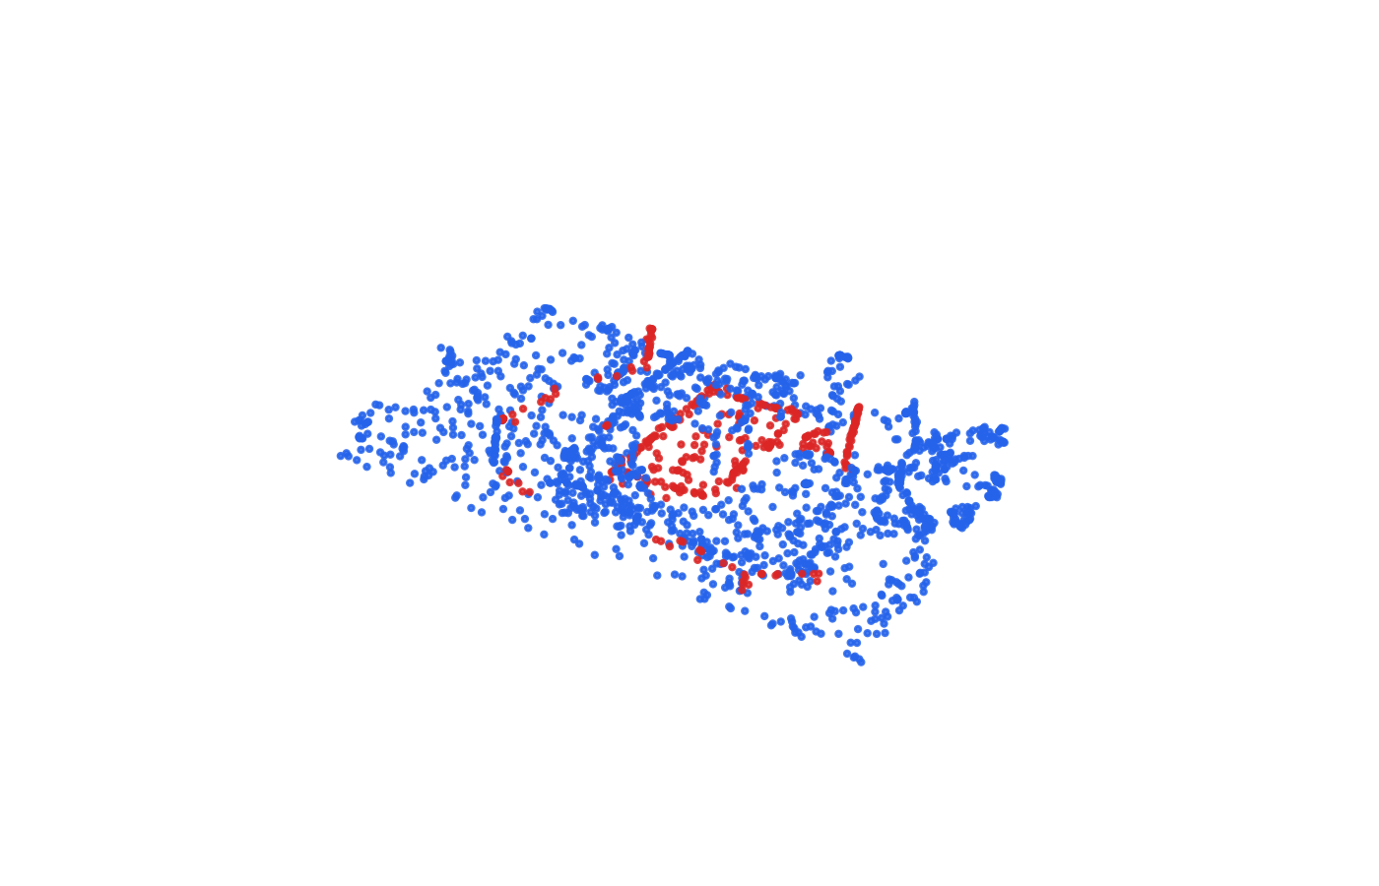
Robust 3D
Change Detection
for Construction
Progress Monitoring
Vishwanath Venugopal CE23B124
Shaik Koduru Asif CE23B114
Computer Vision for Construction Engineering
CV5570 2 November 2026
1
Notes:
Vishwanath Venugopal; 20 seconds.
Our project compares geometric and learned ways to locate additions and removals in repeated construction scans. We focus on controlled robustness, fair evaluation and explicit unsupported areas. The picture shows actual labelled original cores from Bike Parking Construction. We make no claim that a geometric discrepancy proves progress or structural completion.
Chart values rounded to six decimals for portable editable Excel workbooks; full precision remains in CSV evidence.
Sources: User proposal Robust_3D_Change_Detection_v2.pdf; artifacts/historical_pilot/primary_comparison.csv; https://3dom-fbk.github.io/multichange3d/

Slide 2
Data and directional labels
Source epoch | Points | cd_type = 1 means
Scan 0 earlier | 4,444,935 | Removed
Scan 1 later | 5,089,793 | Added
cd_type = 0 means unchanged in both epochs
Quantitative: MultiChange3D pair_01
Qualitative: local ConSLAM Sequence 3 only
CV5570 2 November 2026
2
Notes:
Vishwanath Venugopal; 35 seconds.
All quantitative results use MultiChange3D Bike Parking Construction pair 01, about 4.44 and 5.09 million points. The binary field is unchanged zero or changed one in each epoch. A changed earlier point means removed, and a changed later point means added. We verified the official label preparation and classical binary metric code. ConSLAM has no verified per-point change labels here. Its scans and poses provide qualitative context only. Additional official download links redirected to sign-in, so this submission contains no cross-pair or cross-scene experiment.
Chart values rounded to six decimals for portable editable Excel workbooks; full precision remains in CSV evidence.
Sources: artifacts/dataset_manifest.json; artifacts/data_sources_and_access.md; https://github.com/3DOM-FBK/multichange3d/blob/main/scripts/prepare_gt_labels.py

Slide 3
Three detectors with different assumptions
C2C
Siamese PointNet + NN
Nearest opposite-epoch point
Changed when distance > 7.5 cm
Shared 3–32–64 point encoder
Masked max and mean pooling
128 neighbours within 0.60 m
Paired geometry plus proximity prior
Weighted binary supervision
M3C2-style
Source PCA normals and shared cylinders
Projection radius 10 cm, half-length 1 m
LoD95 and 2 cm minimum-effect floor
Invalid support produces unknown
Registration uncertainty is separate and set to zero
LoD is conditional on that assumption
CV5570 2 November 2026
3
Notes:
Vishwanath Venugopal; 65 seconds.
C2C uses Euclidean nearest-neighbour distance above 7.5 centimetres, fixed from the historical same-pair sweep. M3C2-style estimates source normals at 10, 20 and 40 centimetre radii, then compares two projected neighbourhood means in the same 10 centimetre radius cylinder of half-length one metre. At least ten projected points per epoch and stable normals are required; otherwise it abstains. We checked the population spread and registration-term placement against CloudCompare v2.13.2 source, but did not validate output equivalence. Our learned baseline shares a point MLP between paired 128-point patches, pools geometry and combines it with an NN prior. Ground-truth labels enter supervision only.
Chart values rounded to six decimals for portable editable Excel workbooks; full precision remains in CSV evidence.
Sources: artifacts/geometry_frozen.json; artifacts/learned/model_config.json; artifacts/historical_pilot/reference_conventions.json; https://arxiv.org/abs/1302.1183; https://arxiv.org/abs/1612.00593

Slide 4
Buffered spatial evaluation
Region | Cores per epoch
Train | 8,000
Calibration | 1,000
Test | 4,000
2.22 m buffers
Same scene and epochs
No cross-scene claim
CV5570 2 November 2026
4
Notes:
Vishwanath Venugopal; 55 seconds.
We define these X regions using geometry, with 2.22 metre gaps. The gap exceeds twice the largest clean geometric support halo, so clean train, calibration and test patches do not share neighbourhood support. Both acquisition epochs occur in every split, which means this is a same-scene spatial holdout for the learned model, not cross-scene generalization. We sample original indices across occupied two-metre tiles and use complete clouds for geometric support. Sparse tiles therefore get relatively more weight. Calibration diagnostics freeze geometry before new test and stress scoring. Historical full-pair C2C threshold selection and the earlier exploratory pilot remain disclosed sources of test exposure.
Chart values rounded to six decimals for portable editable Excel workbooks; full precision remains in CSV evidence.
Sources: artifacts/split_config.json; artifacts/geometry_frozen.json; artifacts/spatial_points.json; 220 displayed original Scan 0 cores per split

Slide 5
C2C leads on this clean spatial region
Method | Macro F1 | Macro mIoU | Detector unknown
C2C | 0.4118 | 0.3340 | 0.000%
Siamese + NN | 0.3817 | 0.3091 | 0.000%
M3C2-style | 0.2342 | 0.1561 | 33.125%
5,350 valid cores out of 8,000 requested
Common evaluation coverage 66.875%
C2C and learned all-core results stay separately labelled
CV5570 2 November 2026
5
Notes:
Vishwanath Venugopal; 65 seconds.
All three methods use the exact same valid original indices here: 5,350 of the requested 8,000 directional observations. C2C macro F1 is 0.4118, the learned baseline 0.3817, and M3C2-style 0.2342. M3C2 abstains on 33.125 percent. C2C and learned predictions have no detector abstentions; they are masked here for fairness, and their all-core scores are retained separately. These are lower than the earlier whole-scene pilot because the spatial region and sampled class mix differ. Only 27 removal and 86 addition labels remain after validity filtering, so recall is strongly conditional. We preserve the negative finding rather than promote a more favorable sweep row.
Chart values rounded to six decimals for portable editable Excel workbooks; full precision remains in CSV evidence.
Sources: artifacts/primary_comparison.csv; artifacts/all_spatial_test_metrics.csv; historical full-pair values are in a separate scope in artifacts/all_evaluated_results.csv

Slide 6
Registration errors change each detector differently
C2C
M3C2-style
Siamese PointNet + NN
Fixed parameters and identical perturbations across methods
CV5570 2 November 2026
6
Notes:
Shaik Koduru Asif; 50 seconds.
These are one-sided simulated shifts and rotations of Scan 1, with exact Stage 3 seed and directions. All method settings stay fixed. The smaller perturbation can improve scores for C2C or the learned network in this particular direction, so there is no monotonic or universal benefit from misalignment. At 20 centimetres, the longitudinal comparison on identical clean/current valid cores gives macro-F1 changes of about minus 0.105 for C2C, minus 0.139 for M3C2 and minus 0.045 for the learned network. Each severity uses a saved original-index mapping. The report gives both condition-specific scores and matched clean deltas.
Chart values rounded to six decimals for portable editable Excel workbooks; full precision remains in CSV evidence.
Sources: artifacts/presentation_metrics.json; artifacts/matched_clean_deltas.csv; artifacts/perturbation_geometry.json

Slide 7
Density loss and noise also change valid support
C2C
M3C2-style
Siamese PointNet + NN
Condition-specific common-valid scores; coverage is reported separately
CV5570 2 November 2026
7
Notes:
Shaik Koduru Asif; 50 seconds.
Sparsity retains exactly the same seeded subset for every method, and evaluation keeps only retained Scan 1 cores. Noise is independent Gaussian displacement per coordinate. The model was trained on clean data only. M3C2 coverage falls sharply under severe noise, so a valid-only score can hide difficult abstentions. Our matched-clean table intersects clean and current validity to separate some support effects from actual prediction changes. On 10 percent retention, the learned model loses roughly 0.096 macro F1 on that longitudinal support, while the corresponding C2C change is around minus 0.005. Those observations are single realizations with changing class counts, not a universal robustness ordering.
Chart values rounded to six decimals for portable editable Excel workbooks; full precision remains in CSV evidence.
Sources: artifacts/matched_condition_metrics.csv; artifacts/matched_clean_deltas.csv; artifacts/coverage.png

Slide 8
Occlusion requires a visibility-aware interpretation
C2C
M3C2-style
Separate all-scene geometric supplement; not the learned spatial holdout
CV5570 2 November 2026
8
Notes:
Shaik Koduru Asif; 40 seconds.
The main spatial-test stripe happens to be outside both planned deletion cylinders. Its unchanged scores cannot establish occlusion robustness. We therefore add a separately labelled geometric supplement on the original whole-scene pilot indices. Strict protocol A retains all requested earlier-scan cores. Protocol B excludes cores inside the known synthetic blind cylinder; it changes evaluation support, not the detector. At radius 7.6 metres, M3C2 coverage is about 52 percent in A and 67 percent in B. Missing counterparts remain unknown, not confirmed physical removals. We do not evaluate the learned model on training-region supplement cores and call it a held-out result.
Chart values rounded to six decimals for portable editable Excel workbooks; full precision remains in CSV evidence.
Sources: artifacts/occlusion_supplement/geometry_metrics.csv; artifacts/occlusion_supplement/geometry_frozen.json; all-scene geometric supplement scope

Slide 9
The learned baseline shows a large spatial gap
Scope | Macro F1
Calibration | 0.7649
Spatial test common | 0.3817
Epoch 1 selected
Threshold 0.7 frozen
No test-driven checkpoint selection or stress retuning
CV5570 2 November 2026
9
Notes:
Shaik Koduru Asif; 35 seconds.
We trained one small architecture for 30 predetermined epochs. Calibration loss, not test performance, selected the first epoch, and calibration F1 selected the 0.7 threshold. Weighted training loss continues to decline while calibration loss worsens, which exposes overfitting risk. Calibration macro F1 is about 0.765 versus 0.382 on the spatial-test common support. The model never receives change labels as input and uses no absolute coordinates, but a single-scene split still shifts density, geometry and class balance. This result is a compact learned comparison, not a reproduction of Siamese KPConv or a claim about all learning methods.
Chart values rounded to six decimals for portable editable Excel workbooks; full precision remains in CSV evidence.
Sources: artifacts/learned/training_history.csv; artifacts/learned/model_frozen.json; artifacts/learned/model_config.json; artifacts/primary_comparison.csv

Slide 10
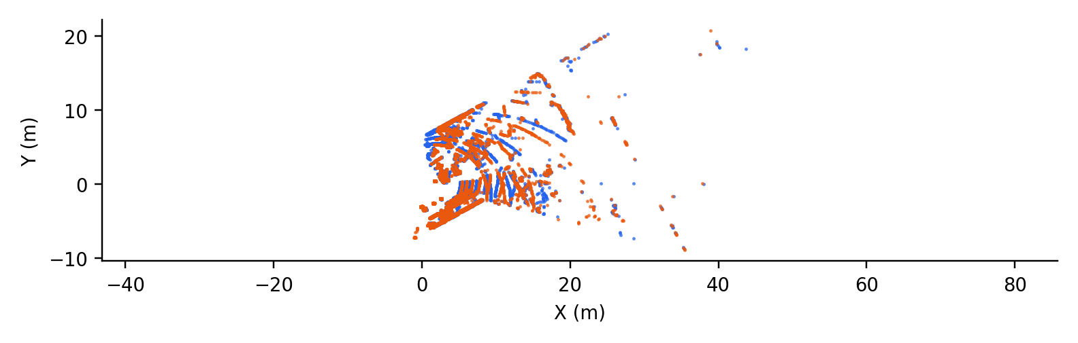
ConSLAM provides qualitative site context
Two LiDAR frames, 4.84 s apart, with supplied poses
No verified change labels, accuracy score or cross-month progress claim
CV5570 2 November 2026
10
Notes:
Shaik Koduru Asif; 35 seconds.
We reuse local Sequence 3 LiDAR, normalized poses and a bounded TLS sample. Only 520 available pose timestamps match the 6,014 LiDAR files exactly. We show the first two matched frames, 4.84 seconds apart, using the supplied poses. Median sampled proximity falls from 0.395 metres before pose application to 0.081 afterwards. That is neither a registration RMS nor change-detection accuracy. The frames belong to one acquisition sequence, and we did not verify a common frame against TLS. Therefore this supports qualitative discussion of alignment and coverage, not a monthly construction-change or progress claim.
Chart values rounded to six decimals for portable editable Excel workbooks; full precision remains in CSV evidence.
Sources: artifacts/conslam/inspection.json; https://www.repository.cam.ac.uk/items/693c260b-e145-4f01-ad88-d2031e4c0590; https://github.com/mac137/ConSLAM

Slide 11
Findings and limits
C2C leads on the matched clean region
M3C2 validity and learned spatial shift limit reliability
One scene and pair, one seed, conditional uncertainty
Candidate geometry alone does not certify construction progress
Offline demo: python code/demo.py
CV5570 2 November 2026
11
Notes:
Shaik Koduru Asif; 30 seconds.
C2C remains the strongest clean method on the matched spatial region. M3C2-style passes geometry tests but has many false positives and unknowns. The compact learned model is feasible on the laptop but exhibits a large spatial validation gap. Our strongest contribution is fair support-aware robustness analysis and an auditable negative result. Limitations include one scene and pair, one seed, historical threshold exposure, uncalibrated registration uncertainty and no independent M3C2 reference-output comparison. The offline demo runs live synthetic geometry and lets you rotate saved measured predictions. Geometry localizes candidate changes; semantic and BIM evidence would be needed to infer completed work or schedule status.
Chart values rounded to six decimals for portable editable Excel workbooks; full precision remains in CSV evidence.
Sources: artifacts/submission_data.json; report/project_report.pdf; README.md; demo uses saved real measurements plus live synthetic check

