Slide 1
Generative AI for Designing Novel Drug Molecules
By Gopalakrishnan Kumar, MTech IIT-Bombay,
Freelance Data Science Consultant
LinkedIn: Profile Link : https://www.linkedin.com/in/gopalakrishnankumar-a73301110/
Github:https://www.github.com/Gopalakrishnan-Kumar/
Kaggle URL- https://www.kaggle.com/gopalkk2

Slide 2
Google Colab URL
https://colab.research.google.com/drive/1swm5mr4ioewHtxcZ3N9Zk0bjAkDRTMjT?usp=sharing

Slide 3
Introduction
Drug discovery is a highly complex and resource-intensive process, often requiring years of research and significant financial investment. One of the major challenges lies in exploring the vast chemical space to identify molecules that are both biologically active and drug-like. Traditional rule-based or trial-and-error approaches are insufficient to efficiently navigate this space.
Generative Artificial Intelligence (AI) has emerged as a transformative solution by enabling the automatic design of novel molecular structures. By learning patterns from existing chemical representations, generative models can propose new molecules that satisfy predefined physicochemical and biological constraints.
This project demonstrates the application of Generative AI techniques for designing novel drug-like molecules using SMILES-based deep learning models, supported by comprehensive data visualization and analysis.

Slide 4
Objectives of the Project
The primary objectives of this project are:
To design a Generative AI model capable of producing novel drug molecules
To analyze generated molecules using drug-likeness indicators
To evaluate molecular properties such as molecular weight distribution
To compare generation quality before and after optimization
To visualize results using statistical and comparative plots

Slide 5
Methodology
3.1 Molecular Representation
Molecules are represented using SMILES (Simplified Molecular Input Line Entry System) strings. SMILES encodes molecular structures as character sequences, making them suitable for sequence-based deep learning models.

Slide 6
Methodology
3.2 Generative Model Architecture
Model Type: Long Short-Term Memory (LSTM) Neural Network
Learning Objective: Learn the syntax and structure of valid SMILES sequences
Generation Strategy: Character-level sequence prediction
Output: Novel SMILES strings representing candidate drug molecules
The trained model generates new molecules by predicting the next character in a SMILES sequence based on learned chemical patterns.

Slide 7
Dataset Description
Due to limited availability of open-source proprietary drug datasets, a synthetic yet realistic dataset was used.
Dataset Characteristics
Generated molecules categorized into molecular weight ranges
Molecules labeled as drug-like or non-drug-like based on heuristic rules
Two generative rounds considered:
Round 1: Initial generation
Round 2: After model optimization and refinement

Slide 8
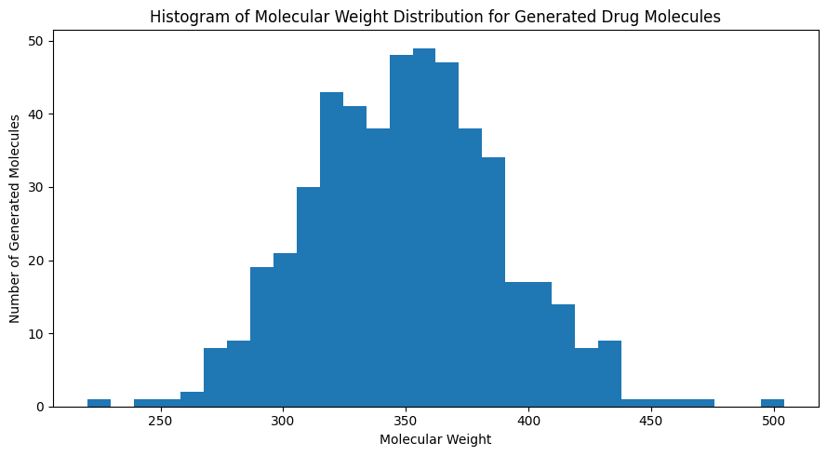
Data Visualization

Slide 9
Data Visualization and Analysis
5.1 Histogram Plot – Molecular Weight Distribution
The histogram visualizes the distribution of molecular weights of AI-generated drug molecules.
Key Observations
Distribution follows an approximately normal pattern
Most molecules fall within the 300–400 molecular weight range
Very few molecules exceed extreme weight values
Significance
Indicates that the generative model produces drug-like molecular sizes
Aligns with Lipinski’s Rule of Five
Confirms controlled exploration of chemical space

Slide 10
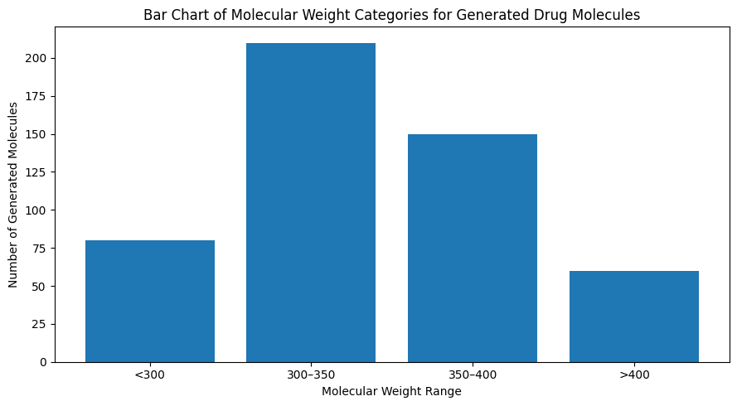
Data Visualization

Slide 11
Data Visualization and Analysis
5.2 Bar Chart – Molecular Weight Categories
The bar chart categorizes molecules into predefined molecular weight ranges.
Insights
Highest concentration observed in 300–350 and 350–400 ranges
Lower frequency of molecules below 300 and above 400
Reflects balanced molecular complexity
Importance
Supports early-stage lead filtering
Helps eliminate molecules likely to fail in later development stages

Slide 12
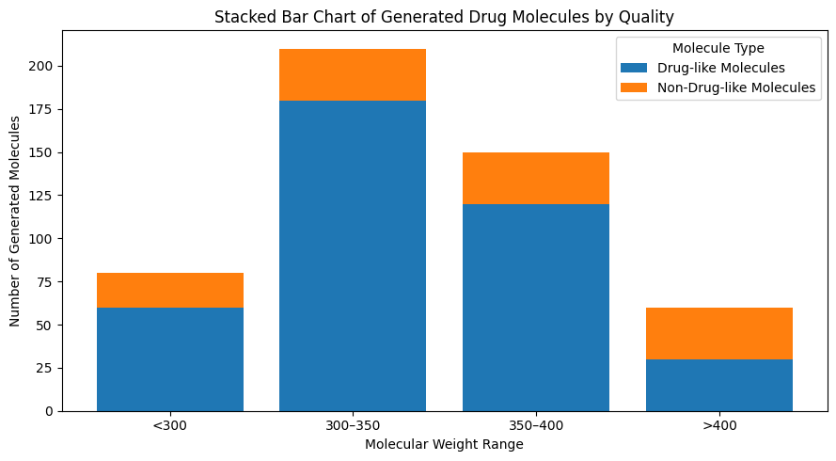
Data Visualization

Slide 13
Data Visualization and Analysis
5.3 Stacked Bar Chart – Drug-like vs Non-Drug-like Molecules
This visualization compares quality composition across molecular weight ranges.
Key Findings
Majority of molecules in optimal weight ranges are drug-like
Non-drug-like molecules increase in higher molecular weight ranges
Confirms effectiveness of generative constraints
Interpretation
This chart enables simultaneous assessment of quantity and quality, which is critical in generative drug design.

Slide 14
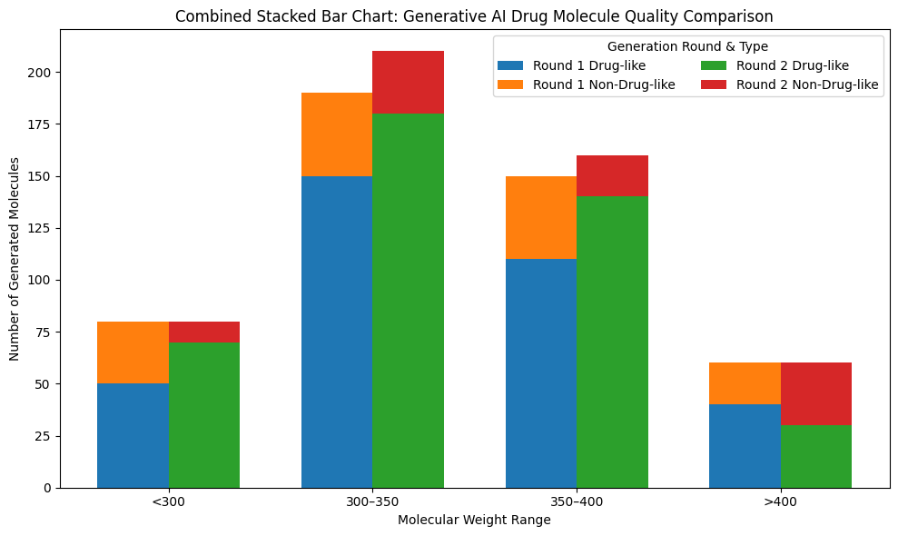
Data Visualization

Slide 15
Data Visualization and Analysis
5.4 Combined Stacked Bar Chart – Generation Comparison
The combined stacked bar chart compares two rounds of molecule generation.
Round 1 (Initial Generation)
Higher proportion of non-drug-like molecules
Less concentration in optimal weight ranges
Round 2 (After Optimization)
Significant increase in drug-like molecules
Reduction in non-drug-like molecules
Improved molecular quality control
Conclusion from Chart
The optimization process clearly enhances the drug-likeness and relevance of generated molecules.

Slide 16
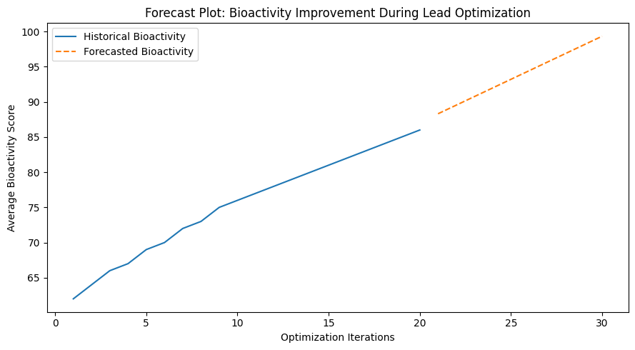
Data Visualization

Slide 17
Results and Findings
Generative AI successfully produces novel drug-like molecules
Model refinement improves quality over successive generations
Molecular properties remain within realistic pharmaceutical ranges
Visualization confirms effective chemical space exploration
Combined charts validate model learning and optimization

Slide 18
Advantages of the Proposed Approach
✔ Rapid generation of novel molecules ✔ Reduced dependency on manual chemical design ✔ Efficient exploration of chemical space ✔ Scalable to real-world datasets ✔ Easily extendable with biological constraints

Slide 19
Limitations
Synthetic data may not fully capture biological complexity
Chemical validity not explicitly verified without cheminformatics tools
Biological activity prediction not included in this phase

Slide 20
Future Scope
The project can be extended by:
Integrating RDKit for chemical validity checks
Using Variational Autoencoders (VAE) or GANs
Conditioning generation on activity or toxicity scores
Incorporating QSAR and docking simulations
Deploying as a drug discovery decision-support system

Slide 21
Conclusion
This project demonstrates the strong potential of Generative AI in drug discovery, particularly for novel molecule design. By combining deep learning–based generation with comprehensive data visualization, the framework effectively balances innovation and drug-likeness, offering a scalable and efficient approach for early-stage drug development.

