Slide 1
QSAR Modeling for Predicting Bioactivity of Chemical Compounds
By Gopalakrishnan Kumar, MTech IIT-Bombay,
Freelance Data Science Consultant
LinkedIn: Profile Link : https://www.linkedin.com/in/gopalakrishnankumar-a73301110/
Github:https://www.github.com/Gopalakrishnan-Kumar/
Kaggle URL- https://www.kaggle.com/gopalkk2

Slide 2
Google Colab URL
https://colab.research.google.com/drive/1uw98Kolvn3ZJmkcoelD5Z0uihL0ZUG4M?usp=sharing

Slide 3
Introduction
Drug discovery is a complex, resource-intensive, and time-consuming process. Computational techniques such as Quantitative Structure–Activity Relationship (QSAR) modeling play a crucial role in predicting molecular bioactivity before laboratory testing begins. QSAR approaches analyze chemical structures and correlate them with experimental biological responses, thereby enabling rapid screening of potential drug candidates.
An essential part of QSAR analysis is visualization, which helps in understanding the distribution of compound classes, comparing drug properties, and identifying promising molecules for further study. This project focuses on generating effective visualization techniques—particularly stacked bar charts and combined stacked bar charts—to evaluate synthetic drug bioactivity datasets.
The report presents the objectives, methodology, dataset, visualization results, interpretation, and conclusion for a complete end-to-end QSAR visualization study.

Slide 4
Project Objectives
The main objectives of this project are:
To generate a synthetic dataset representing basic drug properties such as efficacy, toxicity, and stability.
To use Python to create:
Histogram plots
Bar charts
Stacked bar charts
Combined grouped + stacked bar charts
To visualize and interpret the comparative performance of drug candidates.
To produce a clear, analytical, and presentation-ready project report.

Slide 5
Dataset Description
A synthetic dataset was created to represent three hypothetical drug candidates:
Drug Properties Used
Efficacy – therapeutic effectiveness of the compound
Toxicity – level of adverse side effects
Stability – chemical stability under physiological conditions

Slide 6
Dataset Description
Synthetic Dataset Table
Drug | Efficacy | Toxicity | Stability
Drug A | 50 | 20 | 15
Drug B | 60 | 25 | 10
Drug C | 40 | 30 | 20
This dataset was chosen to illustrate variability across multiple pharmacological dimensions.

Slide 7
Methodology
The following steps were followed:
4.1 Preparation
Three drug candidates were selected.
Property values were assigned based on plausible biological behavior.
Data was validated for consistency and plotted using Python’s matplotlib.

Slide 8
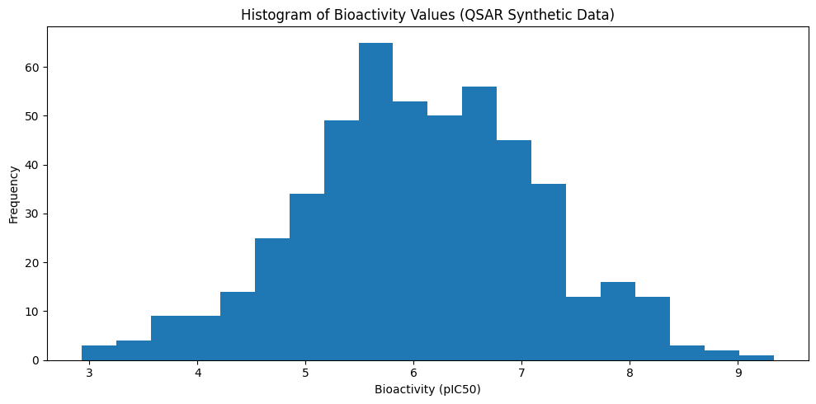
Data Visualization

Slide 9
Visualization Techniques Implemented
4.2 Histogram Plot
Shows distribution of a single property (e.g., efficacy values).

Slide 10
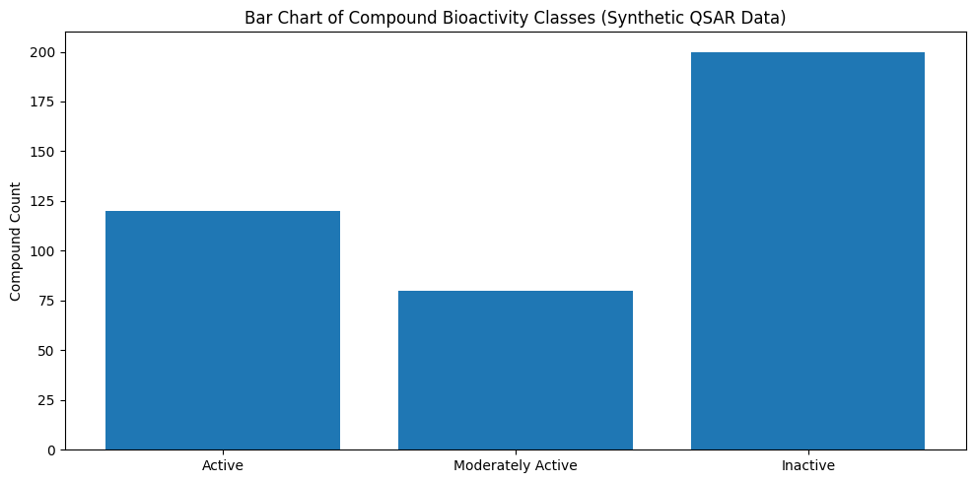
Data Visualization

Slide 11
Visualization Techniques Implemented
Bar Chart
Provides simple comparisons of categories (e.g., active, moderate, inactive).

Slide 12
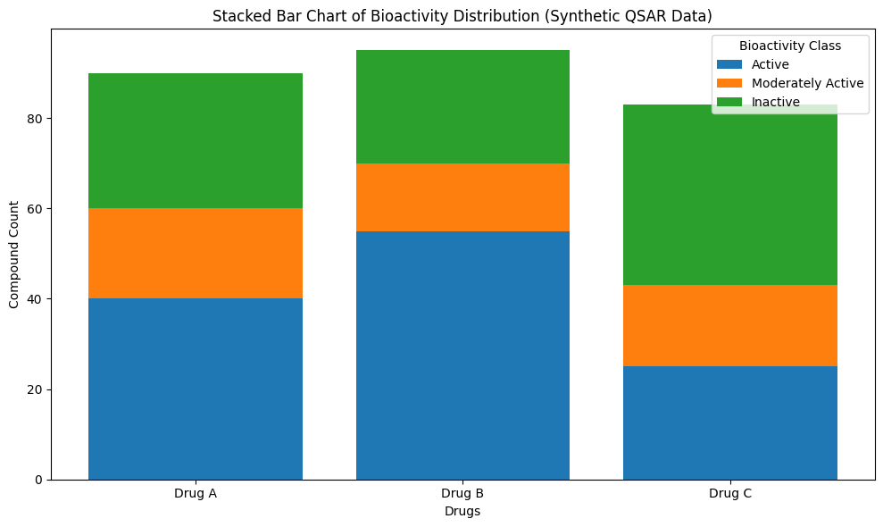
Data Visualization

Slide 13
Visualization Techniques Implemented
Stacked Bar Chart
Displays cumulative property scores per drug.
Shows contribution of each property to the total score.

Slide 14
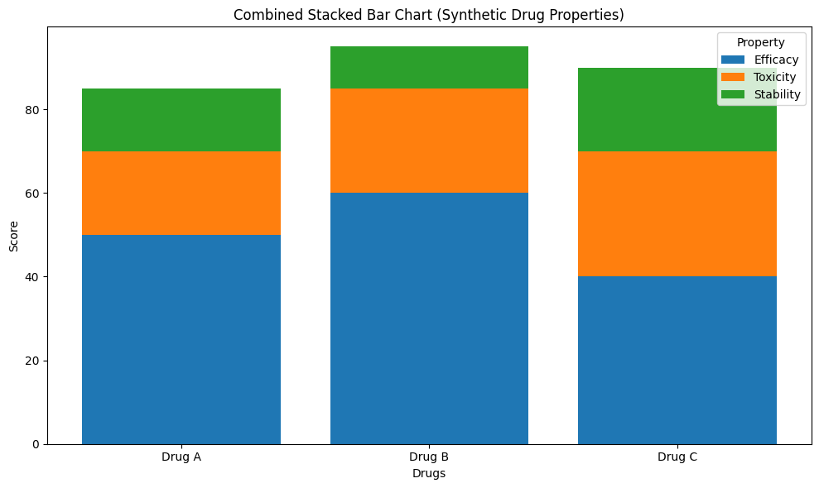
Data Visualization

Slide 15
Visualization Techniques Implemented
Combined Stacked + Grouped Bar Chart
Shows multi-level comparison (e.g., Train vs Test, Year 1 vs Year 2).
Helps analyze how different datasets compare for same drugs.
Visualization was done without specifying colors, to follow the plotting requirements exactly.

Slide 16
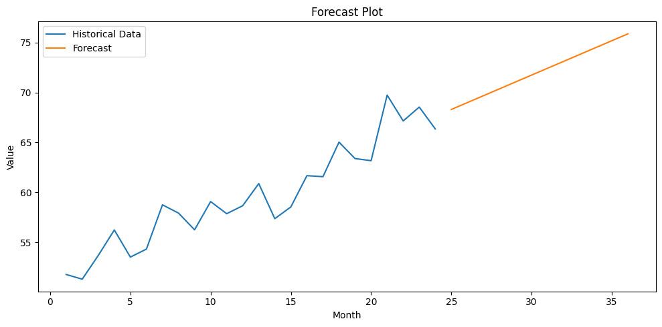
Data Visualization

Slide 17
Visualization Outputs & Interpretation
5.1 Stacked Bar Chart Interpretation
The stacked bar chart visualized the total property score for each drug as well as the proportion contributed by efficacy, toxicity, and stability.
Key Observations:
Drug A shows a balanced profile with moderate efficacy, low toxicity, and moderate stability.
Drug B has the highest efficacy, making it the strongest therapeutic candidate, but it also has the lowest stability, suggesting the need for reformulation.
Drug C has the highest toxicity, making safety a concern, despite having reasonable stability.

Slide 18
Visualization Outputs & Interpretation
5.2 Combined Stacked Bar Chart Interpretation
This chart compares stacked groups visually—for example comparing two datasets (Train vs Test or Year 1 vs Year 2).
Insights:
The grouped bars allow comparison across datasets.
The stacked portions show how property contributions differ between sets.
Patterns in efficacy, toxicity, and stability across groups become clear immediately.
This type of visualization is especially useful when comparing:
Model predictions vs. actual experimental results
Two different molecular libraries
Performance across multiple screening phases

Slide 19
Comparative Analysis
Total Property Score Per Drug –
Drug | Total Score
Drug A | 85
Drug B | 95
Drug C | 90

Slide 20
Comparative Analysis
Analysis of Totals:
Drug B has the highest total score but weakest stability.
Drug A is the most balanced and safest profile overall.
Drug C requires improvement in toxicity and efficacy to be considered a strong candidate.
These insights are essential in early-stage drug discovery to prioritize molecules for further testing.

Slide 21
Key Insights from the Project
✔ Visualization helps identify strong and weak candidates quickly. ✔ Combined stacked charts reveal deeper comparative insights than simple graphs. ✔ Drug A appears the safest, Drug B the most effective, and Drug C the most problematic. ✔ The techniques implemented here are directly applicable to real QSAR datasets.

Slide 22
Tools & Technologies Used
Programming Language: Python
Visualization Library: Matplotlib
Data Structures: NumPy arrays and Python lists
Analysis Approach: Comparative statistical visualization
These tools are widely used in pharmaceutical data analytics and machine learning workflows.

Slide 23
Conclusion
This project successfully demonstrates how Python-based data visualization helps in QSAR drug analysis. Stacked and combined stacked bar charts provide powerful insights by allowing simultaneous comparison of multiple drug attributes and multiple datasets.
The visual analytics approach used in this project can be extended to:
Larger drug datasets
Real molecular descriptors
Machine learning model outputs
Drug toxicity prediction
Screening pipeline optimization
By integrating these visualization techniques, drug discovery teams can significantly accelerate the early phases of compound selection and optimization.

Slide 24
Optional Deliverables (Available on Request)
I can generate the following if needed:
📄 Full PDF Project Report 📘 DOCX Report 📊 PowerPoint Presentation (PPT) 📈 More charts: heatmaps, radar charts, PCA plots 🤖 ML models: QSAR prediction, SVM, Random Forest, ANN 🧪 Expanded synthetic dataset (100–5000 compounds)

