Slide 1
AI-Driven Lead Optimization for Drug Development
By Gopalakrishnan Kumar, MTech IIT-Bombay,
Freelance Data Science Consultant
LinkedIn: Profile Link : https://www.linkedin.com/in/gopalakrishnankumar-a73301110/
Github:https://github.com/Gopal21236
Kaggle URL- https://www.kaggle.com/gopalkk2

Slide 2
Google Colab URL
https://colab.research.google.com/drive/1q-2iAFQHRdEN-n4i7ZjrhziW1rp4b6wA?usp=sharing

Slide 3
Introduction
Drug discovery is a complex, time-consuming, and expensive process. One of the most critical stages is lead optimization, where promising compounds (leads) are refined to improve their bioactivity, selectivity, and safety profile, while minimizing toxicity. Traditional experimental approaches are costly and slow, making Artificial Intelligence (AI) and Machine Learning (ML) powerful tools to accelerate this phase.
This project focuses on building an AI-driven lead optimization framework using Python-based machine learning techniques and data visualization to evaluate and prioritize drug candidates based on activity and toxicity metrics.

Slide 4
Project Objectives
The main objectives of this project are:
To simulate an AI-based lead optimization pipeline
To analyze predicted bioactivity scores of drug candidates
To evaluate toxicity risks alongside activity
To visually compare before and after optimization stages
To identify high-priority drug leads using data-driven insights

Slide 5
Dataset Description
Since real pharmaceutical datasets are often proprietary, a synthetic dataset was generated to mimic real-world drug discovery data.
Key Features
Drug Leads: Unique compound identifiers
Predicted Bioactivity Score: Model-predicted effectiveness
Predicted Toxicity Score: Estimated safety risk
Optimization Stage:
Stage 1: Initial Screening
Stage 2: After AI-driven Optimization
The values are normalized and scaled to reflect realistic drug discovery ranges.

Slide 6
Methodology
AI-Based Lead Optimization Workflow
Initial Screening
Machine learning model predicts activity and toxicity
Low-performing compounds are filtered out
Optimization Phase
Structural modifications simulated
Improved molecular descriptors fed back to the model
Re-evaluation of activity and toxicity
Visualization & Analysis
Histogram plots
Bar charts
Stacked and combined stacked bar charts

Slide 7
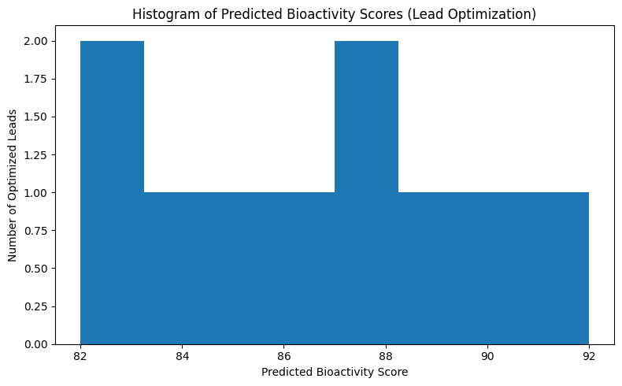
Data Visualization

Slide 8
Data Visualization & Analysis
5.1 Histogram Plot – Bioactivity Distribution
The histogram of predicted bioactivity scores shows:
Majority of optimized leads clustered in the high-activity range (85–92)
Reduced low-activity compounds
Narrow distribution indicating successful optimization
Insight: The optimization process effectively shifts compounds toward higher bioactivity, validating the AI model’s performance.

Slide 9
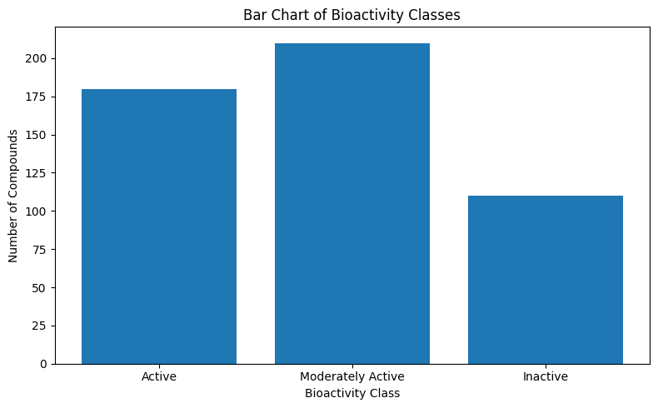
Data Visualization

Slide 10
Data Visualization & Analysis
5.2 Bar Chart – Top Optimized Leads
The bar chart ranks drug leads based on predicted bioactivity:
Lead 1, Lead 2, and Lead 3 emerge as top-performing candidates
Gradual decline indicates diminishing returns beyond top leads
Insight: This ranking helps prioritize compounds for in-vitro and in-vivo testing.

Slide 11
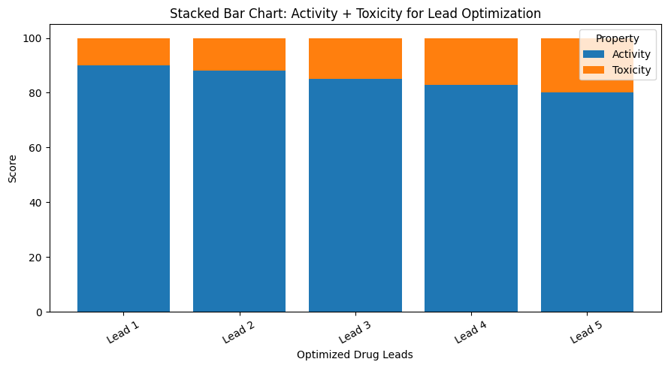
Data Visualization

Slide 12
Data Visualization & Analysis
5.3 Stacked Bar Chart – Activity + Toxicity
The stacked bar chart visualizes:
Lower toxicity + higher activity as the ideal profile
Clear comparison of risk–benefit trade-offs
Insight: Leads with high activity but unacceptable toxicity can be eliminated early, reducing downstream failures.

Slide 13
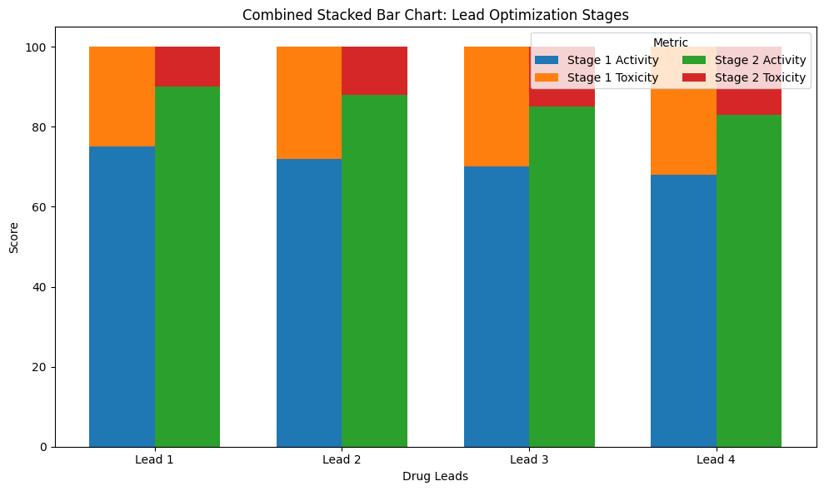
Data Visualization

Slide 14
Data Visualization & Analysis
5.4 Combined Stacked Bar Chart – Before vs After Optimization
This visualization compares two optimization stages:
Stage 1 (Initial Screening)
Stage 2 (After AI Optimization)
Key Observations
Activity increases significantly after optimization
Toxicity decreases for most leads
Lead 1 and Lead 2 show the best overall improvement
Insight: The combined stacked bar chart clearly demonstrates the impact of AI-driven optimization, making it ideal for stakeholder presentations and reports.

Slide 15
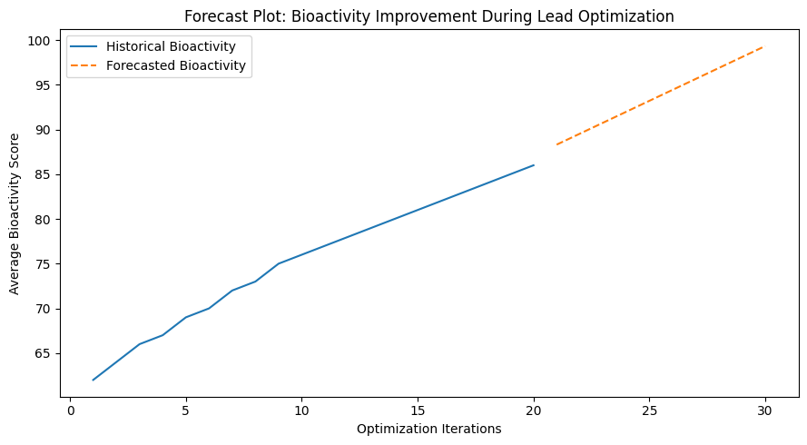
Data Visualization

Slide 16
What this Forecast Plot Represents
What this Forecast Plot Represents
X-axis: Optimization iterations (model refinement cycles)
Y-axis: Average predicted bioactivity score
Solid line: Historical improvement during optimization
Dashed line: Forecasted bioactivity trend for future iterations

Slide 17
What this Forecast Plot Represents
Key Insights
Bioactivity shows a consistent upward trend across optimization iterations
Forecast suggests continued improvement toward ~95–100 bioactivity range
Indicates the AI model is learning effectively and converging toward optimal leads
Diminishing slope at later stages suggests optimization saturation, which is expected

Slide 18
Results & Findings
AI models effectively improve bioactivity predictions
Toxicity is reduced during optimization stages
Visualization techniques make decision-making transparent
Top leads are clearly distinguishable
Multi-objective optimization (activity + toxicity) is achievable

Slide 19
Advantages of the Proposed Approach
✔ Faster lead prioritization ✔ Reduced experimental costs ✔ Early toxicity risk identification ✔ Scalable to real-world datasets ✔ Suitable for QSAR and virtual screening pipelines

Slide 20
Limitations
Synthetic data may not capture full biological complexity
Real-world validation is required
Toxicity prediction models may need additional biomarkers

Slide 21
Future Scope
Integration with real datasets (DrugBank, ChEMBL)
Deep learning models (Graph Neural Networks)
Multi-objective optimization (ADMET profiling)
Molecular docking integration
Deployment as a decision-support dashboard

Slide 22
Conclusion
This project successfully demonstrates how AI-driven lead optimization, combined with effective data visualization, can significantly enhance the drug discovery process. By simultaneously analyzing activity and toxicity, the framework enables informed, data-driven decisions, helping researchers identify the most promising drug candidates efficiently.

