Slide 1
Droplet Generation in a Microfluidic T-Junction
Group - 2
| Gopal - 20CH30008 | Vikram - 20CH10084 |
| Chetan - 20CH10014 | Aryan - 20CH10089 | Sanidhya - 20CH10055 |

Slide 2
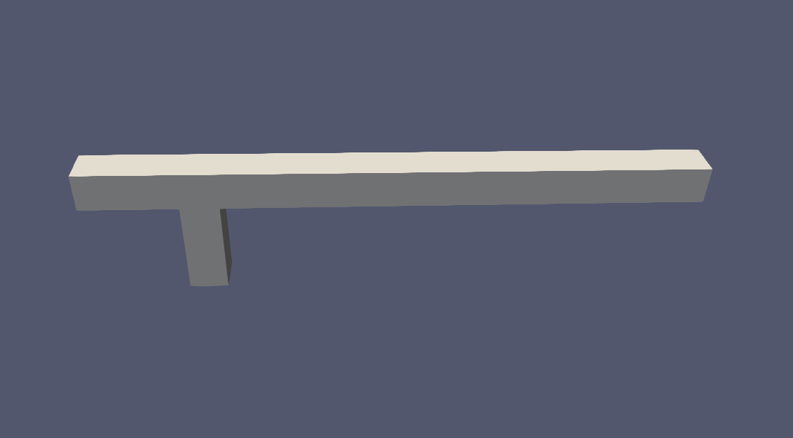

Problem Statement
A 3-D dimensional T–junction microchannel, as shown in figure, is considered to investigate the water droplet formation in a liquid (Oil)
Properties | Water | Oil
Density | 990 kg/m³ | 859 kg/m³
Viscosity | 2.8 × 10⁻² Pa.s | 9.8 × 10⁻¹ Pa.s
Interfacial Tension | 4 × 10⁻³ N/m | 4 × 10⁻³ N/m
Inlet Velocity | 0.0083 m/s | 0.0083 m/s
19
16
9
1600µm
6
8
7
100µm
0
(0,0,0)
1
4
5
250µm
250µm
200µm
3
2
100µm

Slide 3
Mesh Creation
The construction of the T-Junction is broken down into 4 blocks
Sections | Dimensions | Color Code
Section 1 (Oil Inlet) | 100 𝜇m × 100 𝜇m × 250 𝜇m
Section 2 (Water Inlet) | 100 𝜇m × 100 𝜇m × 250 𝜇m
Section 3 (T-Intersection Box) | 100 𝜇m × 100 𝜇m × 100 𝜇m
Section 4 (Co-flow Channel) | 100 𝜇m × 100 𝜇m × 1250 𝜇m
Block-Mesh
Grid Size (∆x = ∆y = ∆z) = 10 𝜇m
Sections | Dimensions | Color Code
Alpha = 0 (Oil) | 100 𝜇m × 100 𝜇m ×1650 𝜇m
Alpha = 1 (Water) | 100 𝜇m × 100 𝜇m × 200 𝜇m
Set-Field (alpha)
200 𝜇m

Slide 4
Boundary Conditions
Block-Mesh (Filename: blockMeshDict)
Inlets and Outlet - type patch - (No geometry/ topological conditioning)
Walls - type wall
Velocity (Filename: U)
Inlet₁ - fixedValue (0.0083 0 0) and Inlet₂ - fixedValue(0 0.0083 0)
Outlet - zeroGradient (Value unknown or to be calculated)
Walls - noSlip (fluid velocity at the wall is zero)
Pressure (Filename: p_rgh)
Inlet₁ and Inlet₂ - zeroGradient
Outlet - fixedValue (0)
Walls - zeroGradient
Alpha (Filename: alpha_water)
Inlet₁ - fixedValue (0)
Inlet₂ - fixedValue (1)
Outlet – zeroGradient
Walls - zeroGradient

Slide 5
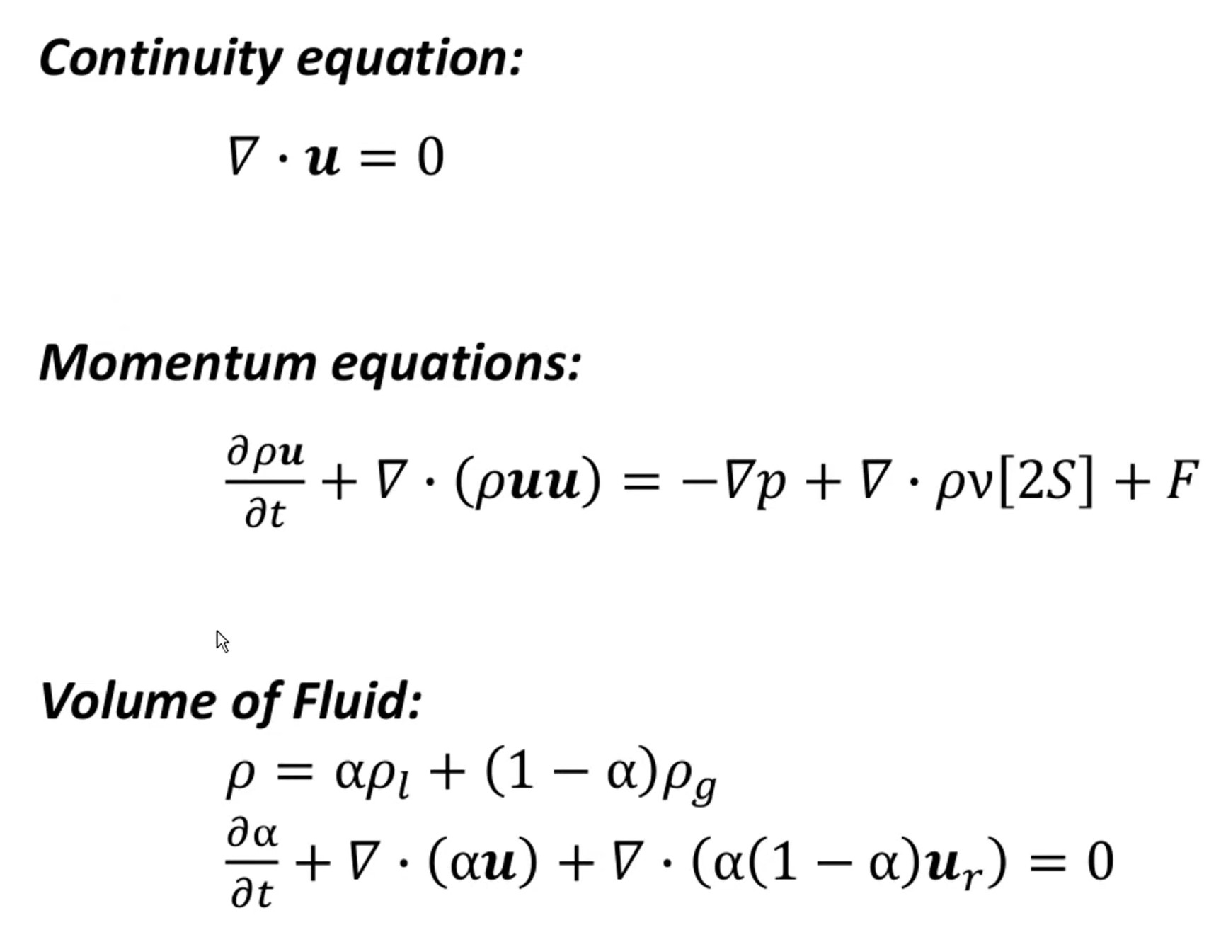
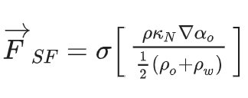
Working Principle behind Solver (interFoam)
interFoam:
‘Solver for 2 incompressible, isothermal immiscible fluid using a VOF (volume of fluid) phase-fraction based interface capturing approach’
Use-cases:
Incompressible
transient
laminar and turbulent
Multiphase
Immiscible
VOF
Isothermal
Combines the PISO and SIMPLE algorithms to give the PIMPLE algorithm

Slide 6
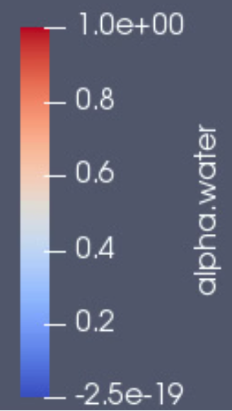
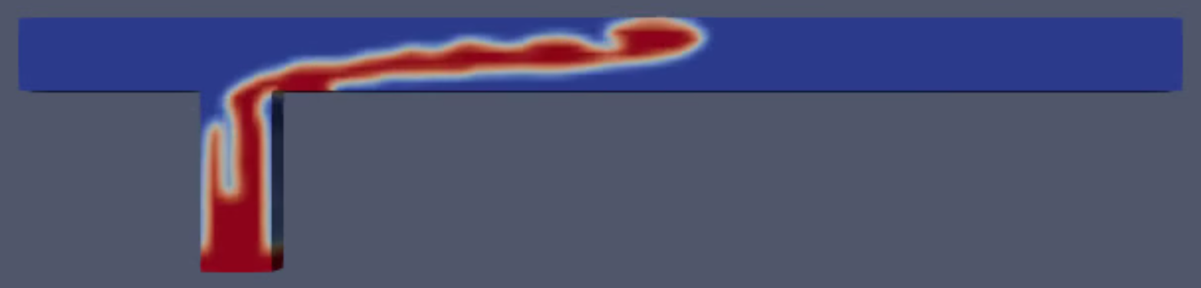
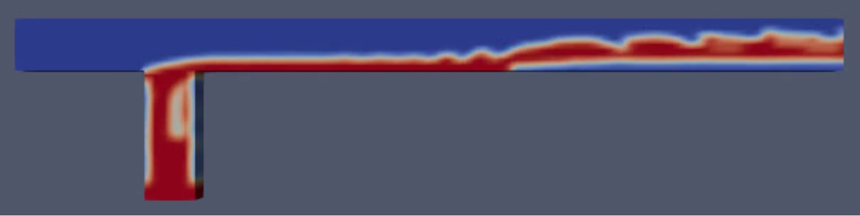
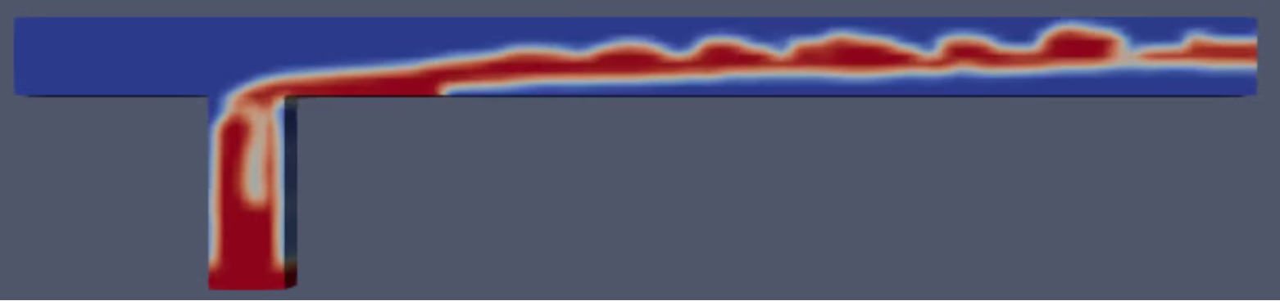
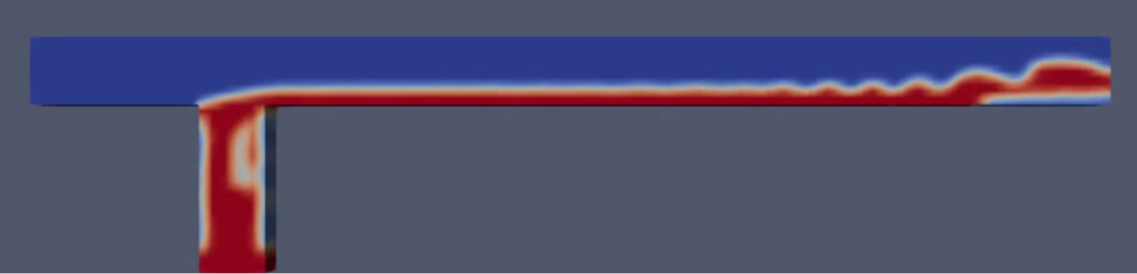
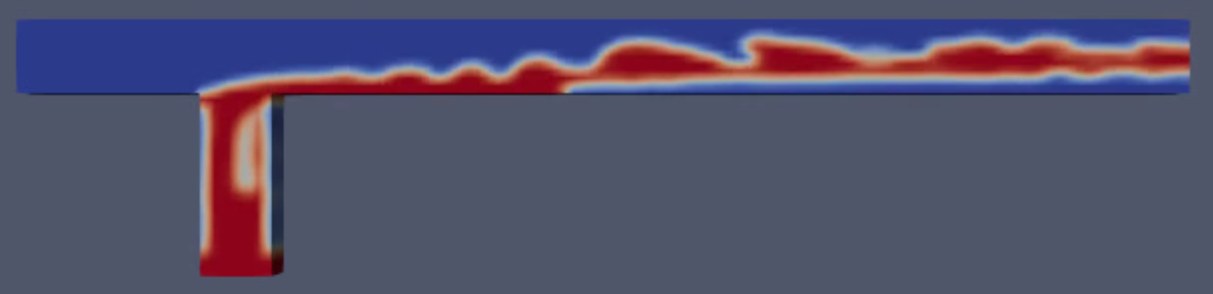
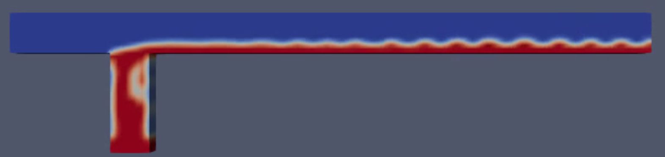
Results
0.5 sec
7 sec
1 sec
10 sec
4 sec
14 sec

Slide 7
Observations
Observed multiphase annular flow in the initial phase, followed by stratified flow for given operating conditions
The turbulence/disturbances observed decreased over time
The time steps observed were extremely small (order of less than 10⁻⁵)

Slide 8
Future Scope in Our Project
In future, prospect we can conduct Grid Independent Test(Efficiency vs Accuracy).
Implement a dynamic mesh adaptation technique which can help in refining the mesh where it is needed, improving the accuracy of your simulations and reducing computational costs.
By varying the velocity, we can Investigate transitional regimes between different flow patterns which can provide valuable information for device design and operation.

Slide 9
Thank You

