Slide 1

Optimizing Angiogenic Inhibition for Precise Tumor Growth Control: A Nonlinear Control Approach
by
Gopal Gupta
Roll No. 20CH30008
Under the guidance of
Professor Amiya Kumar Jana
Department of Chemical Engineering
Indian Institute of Technology Kharagpur

Slide 2
Overview
Introduction
Background
Aim and Objective
Work Progress
Results and Discussion
Conclusion
Future Work
References
Control Design
Indian Institute of Technology Kharagpur

Slide 3
Introduction
Cancer, an escalating health concern, necessitates innovative approaches for effective treatment
Project centers around anti-angiogenic chemotherapy, a modern tumor treatment (still in research phase)
Challenges of Traditional Chemotherapy: Direct targeting tumor cell, yielding side effects and drug resistance
Promise of Anti-Angiogenic Therapy: distinctively minimizes side effects and prevents tumor cells from developing resistance
Vascular Dependency of Tumors: Beyond a certain size, tumors rely on vascular systems for nutrients, prompting angiogenesis
Mechanism of Anti-Angiogenic Therapy: This therapy disrupts angiogenesis, leading to the demise of the tumor
Indian Institute of Technology Kharagpur

Slide 4
Background
O'Reilly et al., 1997: Endostatin as an Endogenous Inhibitor of angiogenesis and tumor growth
Hahnfeldt et al., 1999: Offers insights into the dynamics of tumor development, treatment response, and postvascular dormancy
Ledzewicz and Schatler., 2005: designed optimal bang-bang control on a simplified model
Drexler et al., 2011: Provides a detailed examination of tumor growth, contributing to understanding the underlying dynamics
Kovács et al., 2014: Introduced model-based approach leveraging robust control methods, enhancing predictive accuracy
Czakó & Kovács, 2018 : Explores nonlinear model predictive control using robust fixed-point transformation for controlling tumor growth
Nath et al., 2023: Presents a novel approach in cancer treatment through nonlinear adaptive optimal controller design
Indian Institute of Technology Kharagpur

Slide 5
Aim & Objective
Optimize the Parameter of the Hahnfeldt Dynamic Tumor growth model under angiogenic inhibition
Design and implement a robust nonlinear controller to optimize the administration of anti-angiogenic drug (Endostatin) for cost - effective cancer treatment
Indian Institute of Technology Kharagpur

Slide 6
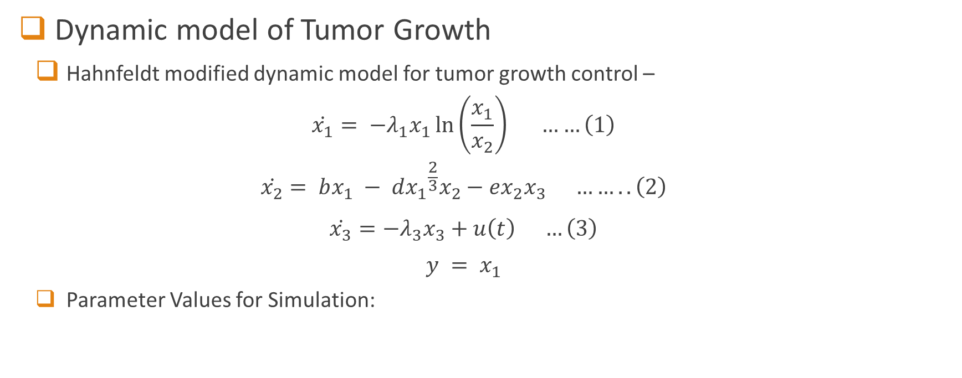

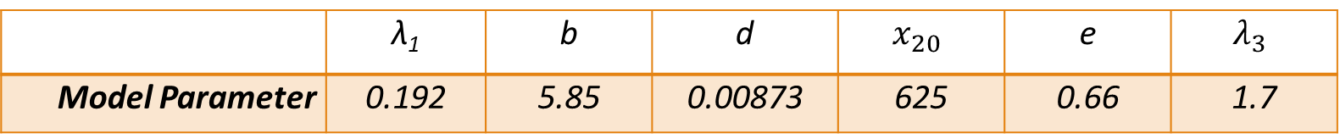
Work Progress
Dynamic model of Tumor Growth
Hahnfeldt modified dynamic model for tumor growth control –
$$\dot{x_{1}}= −λ_{1}x_{1}\ln\left(\frac{x_{1}}{x_{2}}\right) ……\left(1\right)$$
$$\dot{x_{2}}= bx_{1} − d{x_{1}}^{\frac{2}{3}}x_{2}−ex_{2}x_{3} ……..\left(2\right)$$
$$\dot{x_{3}}=−λ_{3}x_{3}+u\left(t\right) …\left(3\right)$$
$$y = x_{1}$$
Parameter Values for Simulation:
$x_{1}$ - tumor volume (mm³)
$x_{2}$ - endothelial volume (mm3)
$x_{3}$ - concentration of administered inhibitor (mg/kg)
$u\left(t\right)$ - inhibitor administration rate (mg/kg/day)
 | λ₁ | b | d | $$x_{20}$$ | e | $$λ_{3}$$
Model Parameter | 0.192 | 5.85 | 0.00873 | 625 | 0.66 | 1.7
Indian Institute of Technology Kharagpur

Slide 7
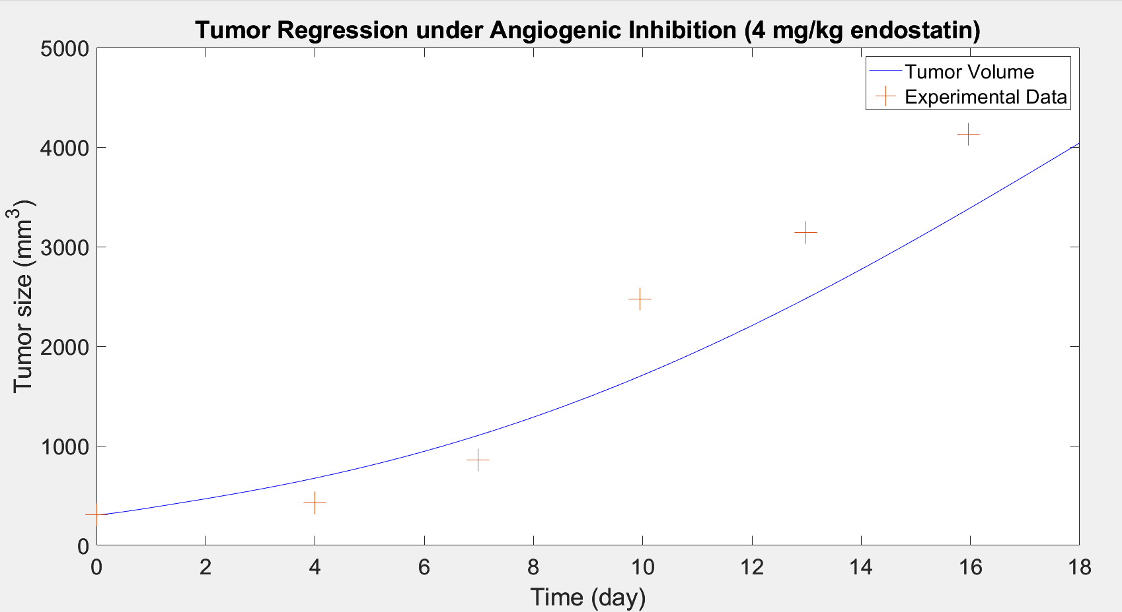
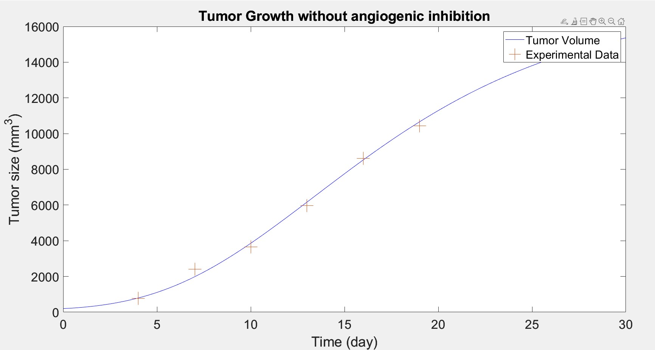
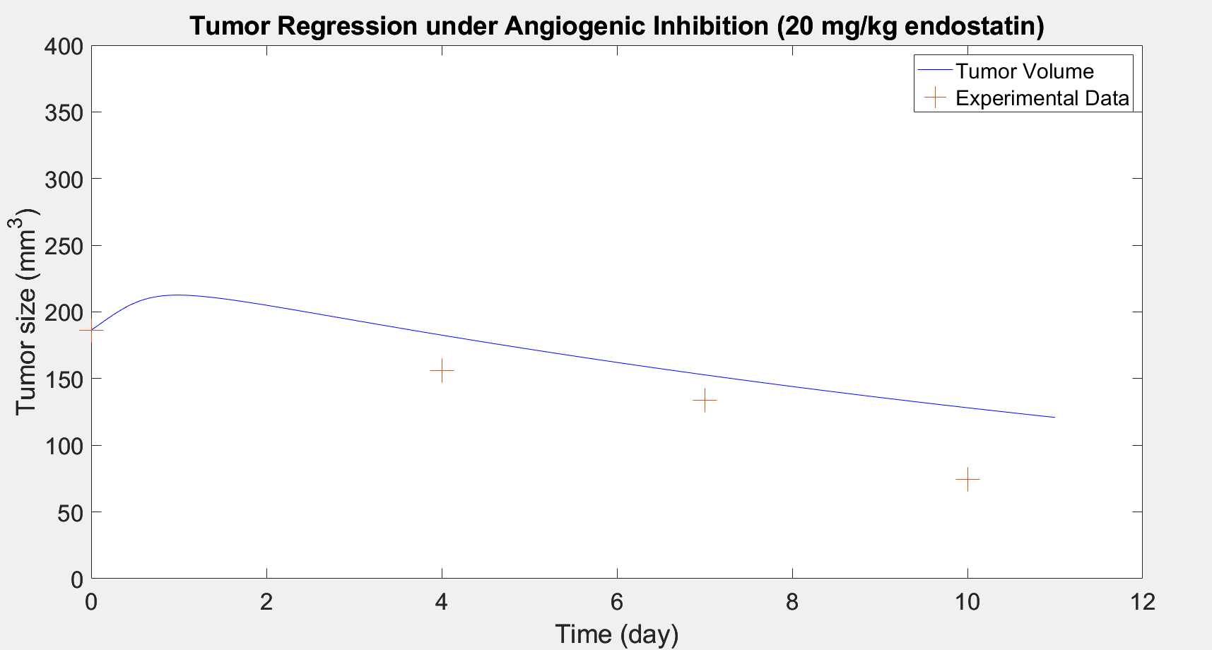
Work Progress
Dynamic model of Tumor Growth
Simulation Results of the Modified Model:
Fig 2 - Tumor Regression under Angiogenic Inhibition (20 mg/kg/day Endostatin)
Fig 3 - Tumor Regression under Angiogenic Inhibition (4 mg/kg/day Endostatin)
Fig 1 - Tumor Growth without Angiogenic Inhibition
(0 mg/kg Endostatin)
Indian Institute of Technology Kharagpur

Slide 8
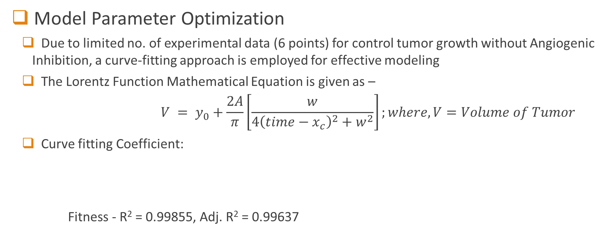
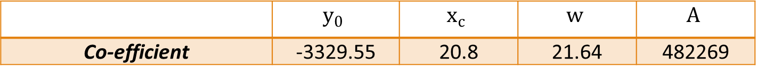
Work Progress
Model Parameter Optimization
Due to limited no. of experimental data (6 points) for control tumor growth without Angiogenic Inhibition, a curve-fitting approach is employed for effective modeling
The Lorentz Function Mathematical Equation is given as –
$$V = y_{0}+\frac{2A}{π}\left[\frac{w}{4{\left(time−x_{c}\right)}^{2}+w^{2}}\right];where, V=Volume of Tumor$$
Curve fitting Coefficient:
Fitness - R² = 0.99855, Adj. R² = 0.99637
 | $$y_{0}$$ | $$x_{c}$$ | $$w$$ | $$A$$
Co-efficient | -3329.55 | 20.8 | 21.64 | 482269
Indian Institute of Technology Kharagpur

Slide 9
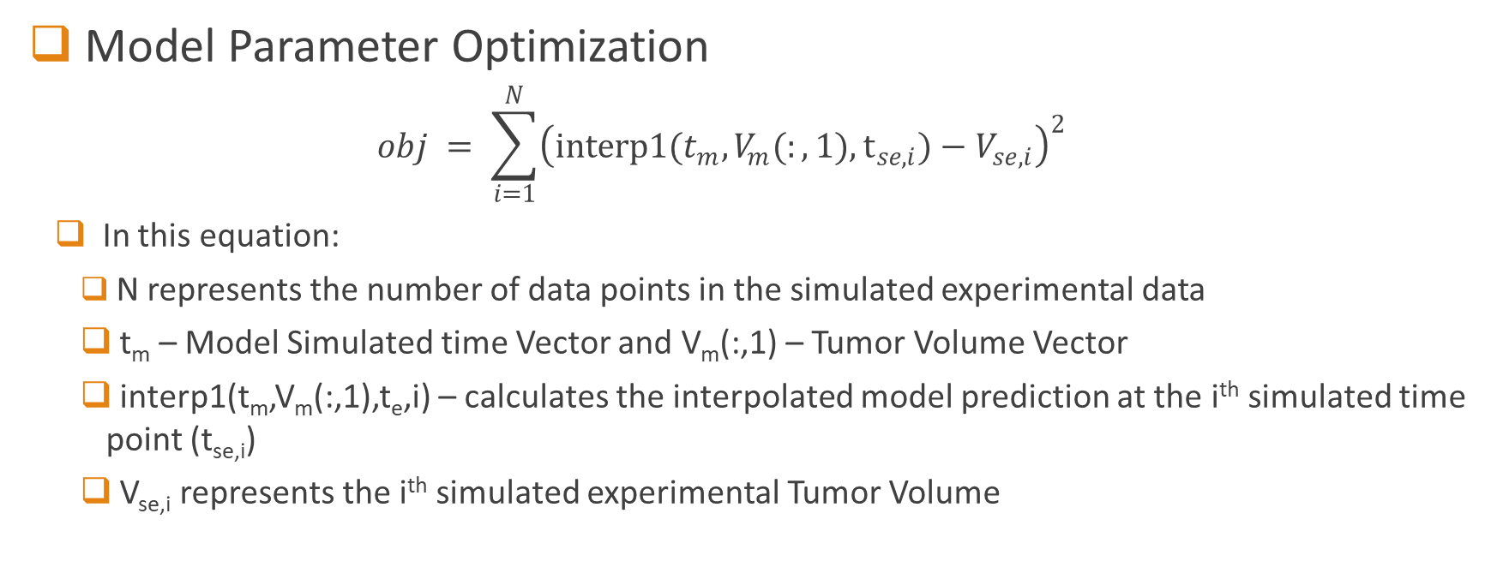
Work Progress
Model Parameter Optimization
$$obj = \sum_{i=1}^{N}{{\left(interp1(t_{m}​,V_{m}​(:,1),t_{se,i}​)−V_{se,i}​\right)}^{2}}$$
In this equation:
N represents the number of data points in the simulated experimental data
t_{m} – Model Simulated time Vector and V_{m}(:,1) – Tumor Volume Vector
interp1(t_{m},V_{m}(:,1),t_{e},i) – calculates the interpolated model prediction at the i^{th} simulated time point (t_{se,i})
V_{se,i} represents the i^{th} simulated experimental Tumor Volume
Indian Institute of Technology Kharagpur

Slide 10
Work Progress
Model Parameter Optimization
Diverse optimization techniques are investigated to refine tumor growth model parameters (λ₁, b, d), minimizing RMSE. Methods include:
lsqnonlin – local minima approach
Global Optimization Method –
Genetic Algorithm (GA)
Pattern Search
Surrogate Optimization
Particle Swarm Optimization (PSO)
Indian Institute of Technology Kharagpur

Slide 11
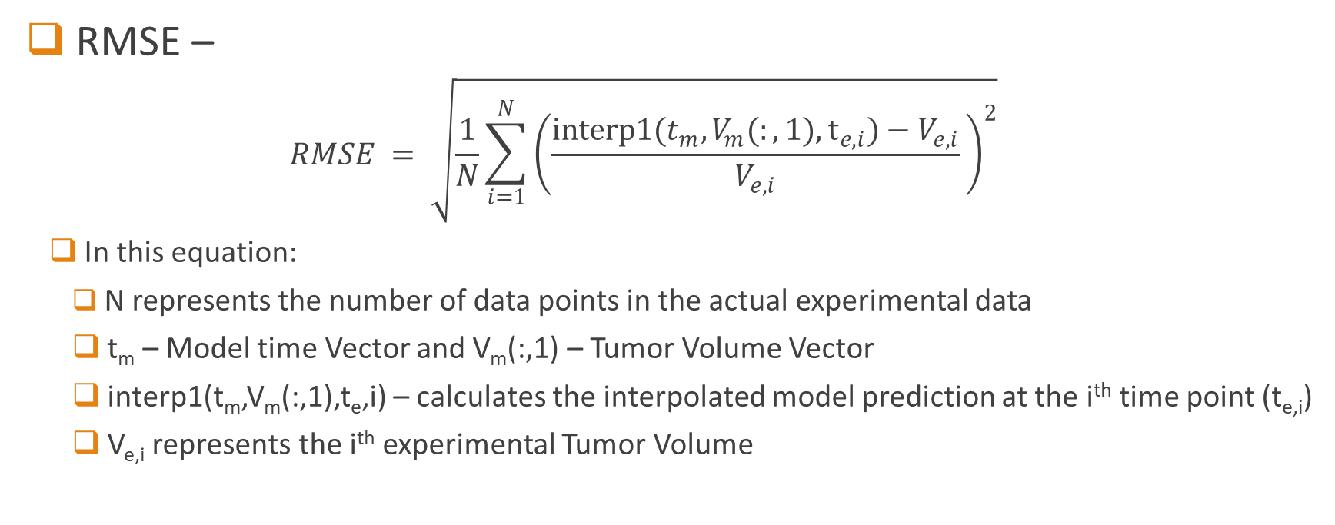
Results and Discussion
RMSE –
$$RMSE = \sqrt{\frac{1}{N}\sum_{i=1}^{N}{{\left(\frac{interp1(t_{m}​,V_{m}​(:,1),t_{e,i}​)−V_{e,i}}{V_{e,i}}​\right)}^{2}}}$$
In this equation:
N represents the number of data points in the actual experimental data
t_{m} – Model time Vector and V_{m}(:,1) – Tumor Volume Vector
interp1(t_{m},V_{m}(:,1),t_{e},i) – calculates the interpolated model prediction at the i^{th} time point (t_{e,i})
V_{e,i} represents the i^{th} experimental Tumor Volume
Indian Institute of Technology Kharagpur

Slide 12
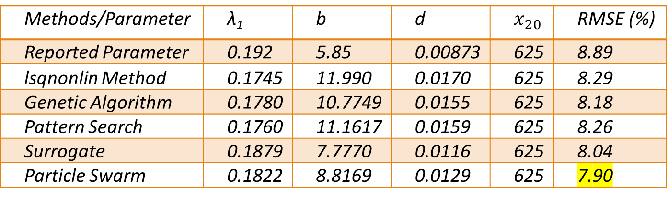
Results and Discussion
Simulation Results for Control Tumor Growth (Endostatin 0 mg/kg) –
Table 2 – Optimization Methods Results
Methods/Parameter | λ₁ | b | d | $$x_{20}$$ | RMSE (%)
Reported Parameter | 0.192 | 5.85 | 0.00873 | 625 | 8.89
lsqnonlin Method | 0.1745 | 11.990 | 0.0170 | 625 | 8.29
Genetic Algorithm | 0.1780 | 10.7749 | 0.0155 | 625 | 8.18
Pattern Search | 0.1760 | 11.1617 | 0.0159 | 625 | 8.26
Surrogate | 0.1879 | 7.7770 | 0.0116 | 625 | 8.04
Particle Swarm | 0.1822 | 8.8169 | 0.0129 | 625 | 7.90
Indian Institute of Technology Kharagpur

Slide 13
Results and Discussion
Simulation Results for Control Tumor Growth (Endostatin 0 mg/kg) –
Fig – 4: Tumor Growth without Angiogenic Inhibition with Tumor Volume New (Using Optimized Parameter) and Tumor Volume Original (Using Reported Parameter)
Indian Institute of Technology Kharagpur

Slide 14
Results and Discussion
Simulation Results for Endostatin (20 mg/kg) -
Table 3 – Optimization Methods for Endostatin 20 mg/kg:
* This parameter (λ₁, b, d, x₂₀) are from the Particle Swarn Method optimization based on the control data
Methods/Parameter | λ₁ | b | d | x₂₀­ | e | λ₃ | RMSE (%)
Reported Parameter | 0.192 | 5.85 | 0.00873 | 625 | 0.66 | 1.7 | 37.07
lsqnonlin | 0.1822 | 8.8169 | 0.0129 | 625 | 0.7992 | 1.0179 | 9.83
Particle Swarn | 0.1822 | 8.8169 | 0.0129 | 625 | 0.7992 | 1.0163 | 9.76
Indian Institute of Technology Kharagpur

Slide 15
Results and Discussion
Simulation Results for Endostatin (20 mg/kg) -
Fig – 5: Tumor Regression under Angiogenic inhibition (20 mg/kg Endostatin)
Indian Institute of Technology Kharagpur

Slide 16
Results and Discussion
Simulation Results for Endostatin (4 mg/kg) -
Fig – 6: Tumor Regression under Angiogenic inhibition (4 mg/kg Endostatin)
Indian Institute of Technology Kharagpur

Slide 17
Results and Discussion
Iterative Optimization for a Balanced Model
Table 4 – Best Possible Parameters for Endostatin 20 mg/kg:
Methods/Parameter | λ₁ | b | d | k₀­ | e | λ₃ | RMSE (%)
Reported Parameter | 0.192 | 5.85 | 0.00873 | 625 | 0.66 | 1.7 | 37.07
Best possible parameters | 0.1822 | 8.8169 | 0.0129 | 625 | 0.8939 | 1.5121 | 37.05
Indian Institute of Technology Kharagpur

Slide 18
Results and Discussion
Simulated result for Iterative Optimization
Fig – 7: Tumor Regression under Angiogenic inhibition (20 mg/kg Endostatin)
Fig – 8: Tumor Regression under Angiogenic inhibition (4 mg/kg Endostatin)
Indian Institute of Technology Kharagpur

Slide 19
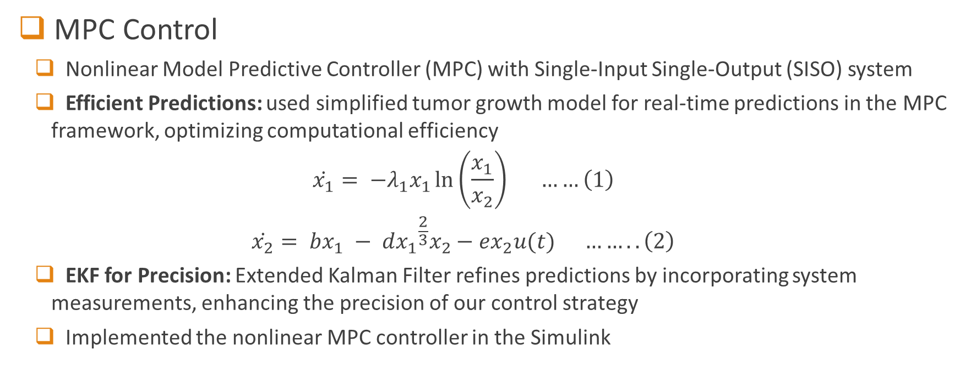
Controller Design
MPC Control
Nonlinear Model Predictive Controller (MPC) with Single-Input Single-Output (SISO) system
Efficient Predictions: used simplified tumor growth model for real-time predictions in the MPC framework, optimizing computational efficiency
$$\dot{x_{1}}= −λ_{1}x_{1}\ln\left(\frac{x_{1}}{x_{2}}\right) ……\left(1\right)$$
$$\dot{x_{2}}= bx_{1} − d{x_{1}}^{\frac{2}{3}}x_{2}−ex_{2}u(t) ……..\left(2\right)$$
EKF for Precision: Extended Kalman Filter refines predictions by incorporating system measurements, enhancing the precision of our control strategy
Implemented the nonlinear MPC controller in the Simulink
Indian Institute of Technology Kharagpur

Slide 20
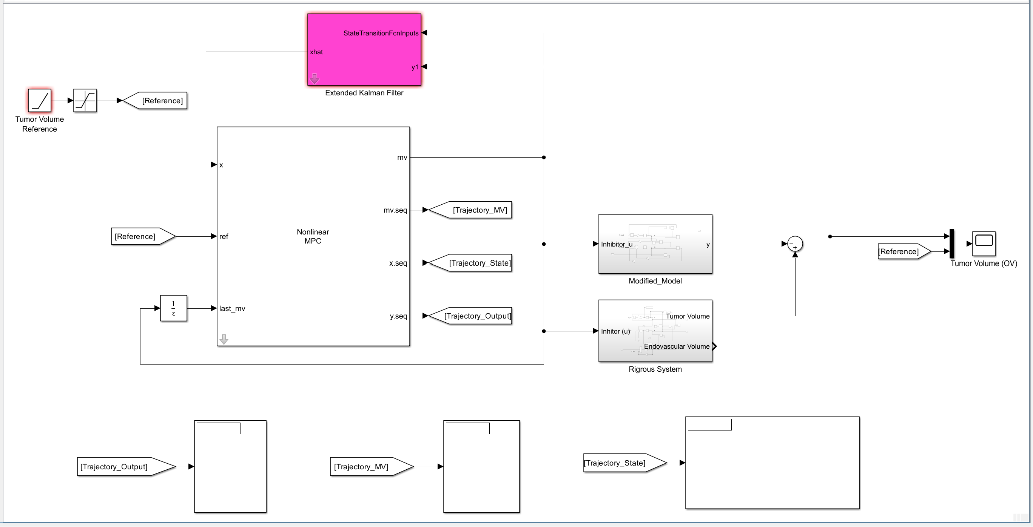
Controller Design
Simulink Design –
Fig – 2: Simulink Design of the control system block
Indian Institute of Technology Kharagpur

Slide 21
Conclusion
Parameter Optimization Challenges: Despite successful parameter optimization using the Particle Swarm Algorithm, discrepancies arose during subsequent testing with 4 mg/kg of Endostatin
Shift to Controller Design: Focusing on optimal drug delivery rates, we transitioned to a nonlinear Model Predictive Control (MPC) approach due to challenges in achieving desired outcomes with Endostatin
Implementation Hurdles: Challenges were encountered in implementing the MPC controller in Simulink, particularly in obtaining the desired output
Indian Institute of Technology Kharagpur

Slide 22
Future Work
Addressing Endostatin Deviation: Explore Nonlinear controllers incorporating parameters to optimize drug delivery rates, particularly in response to deviations observed with 4 mg/kg/day endostatin
Explore Simulink thoroughly for improved controller design results. Investigate potential modifications to enhance the Simulink setup
Diverse Nonlinear Controllers: Broaden the scope by exploring alternative nonlinear controllers beyond MPC. Assess the applicability and efficiency of various control strategies for optimizing drug delivery rates, considering their impact on efficacy and cost-effectiveness
Indian Institute of Technology Kharagpur

Slide 23
References
[1] Kovács, L., Szeles, A., Sápi, J., Drexler, D.A., Rudas, I., Harmati, I., Sápi, Z. Model-based angiogenic inhibition of tumor growth using modern robust control method (2014) Computer Methods and Programs in Biomedicine, 114 (3), pp. e98-e110. https://doi.org/10.1016/j.cmpb.2014.01.002
[2] P. Hahnfeldt, D. Panigrahy, J. Folkman, L. Hlatky, Tumor development under angiogenic signaling: a dynamical theory of tumor growth, treatment response, and postvascular dormancy, Cancer Research 59 (1999) 4770–4775. https://pubmed.ncbi.nlm.nih.gov/10519381/
[3] Drexler, D. A., Kovács, L., Sápi, J., Harmati, I., & Benyó, Z. (2011). Model-based analysis and synthesis of tumor growth under angiogenic inhibition: a case study. IFAC Proceedings Volumes, 44(1), 3753-3758. https://doi.org/10.3182/20110828-6-IT-1002.02107
[4] O'Reilly, M. S., Boehm, T., Shing, Y., Fukai, N., Vasios, G., Lane, W. S., Flynn, E., Birkhead, J. R., Olsen, B. R., & Folkman, J. (1997). Endostatin: An Endogenous Inhibitor of Angiogenesis and Tumor Growth. Cell, 88(2), 277-285. https://doi.org/10.1016/S0092-8674(00)81848-6
[5] Nath, N.; Kil, I.; Hasirci, U.; Groff, R.E.; Burg, T.C. Nonlinear Adaptive Optimal Controller Design for Anti-Angiogenic Tumor Treatment. Biomedicines 2023, 11, 497. https://doi.org/10.3390/ biomedicines11020497
[6] Czakó, B., & Kovács, L. (2018). Nonlinear Model Predictive Control Using Robust Fixed Point Transformation-Based Phenomena for Controlling Tumor Growth. Machines, 6(4), 49. MDPI AG. http://dx.doi.org/10.3390/machines6040049

Slide 24
Thank You

Slide 25

Questions

Slide 26
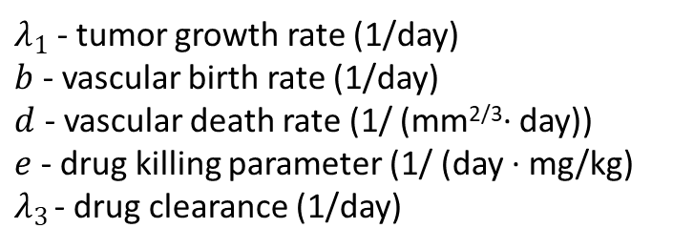
$λ_{1}$ - tumor growth rate (1/day)
$b$ - vascular birth rate (1/day)
$d$ - vascular death rate (1/ (mm^{2/3}· day))
$e$ - drug killing parameter (1/ (day · mg/kg)
$λ_{3}$ - drug clearance (1/day)

Slide 27
Genetic Algorithm
Purpose: Mimics the process of natural selection to find optimal solutions to problems.
Process: Employs crossover (recombination), mutation, and selection operations to create a new generation of solutions, improving over successive iterations.
Step 1 - Initialize a Population
Step 2 - fitness Function
Step 3 - Selection
Step 4 - Crossover and Mutation
Step 5 - Repeat the step 3 and 4 until convergence

Slide 28
Pattern Search
It is used unconstrained optimization problems
Exploratory Move – find the best point in the vicinity of the current point(only one direction)
Pattern Move – Jumps in the direction of Change, if better then continue, else reduce size of exploratory move and continue

Slide 29
Surrogate Optimization Method
Initialization:
Select an initial set of points in the solution space.
Build the surrogate model based on evaluations of the objective function at these points.
Exploration Phase:
Evaluate the surrogate function at various points, emphasizing exploration to discover potential global minima.
Update the surrogate model to incorporate new evaluations.
Speed Phase:
Identify promising regions based on the surrogate model and concentrate evaluations in those areas.
Refine the surrogate model to enhance accuracy in the identified regions.
Convergence Check:
Assess convergence criteria to determine if the optimization process should continue.
If convergence is reached, return the best solution found.

Slide 30
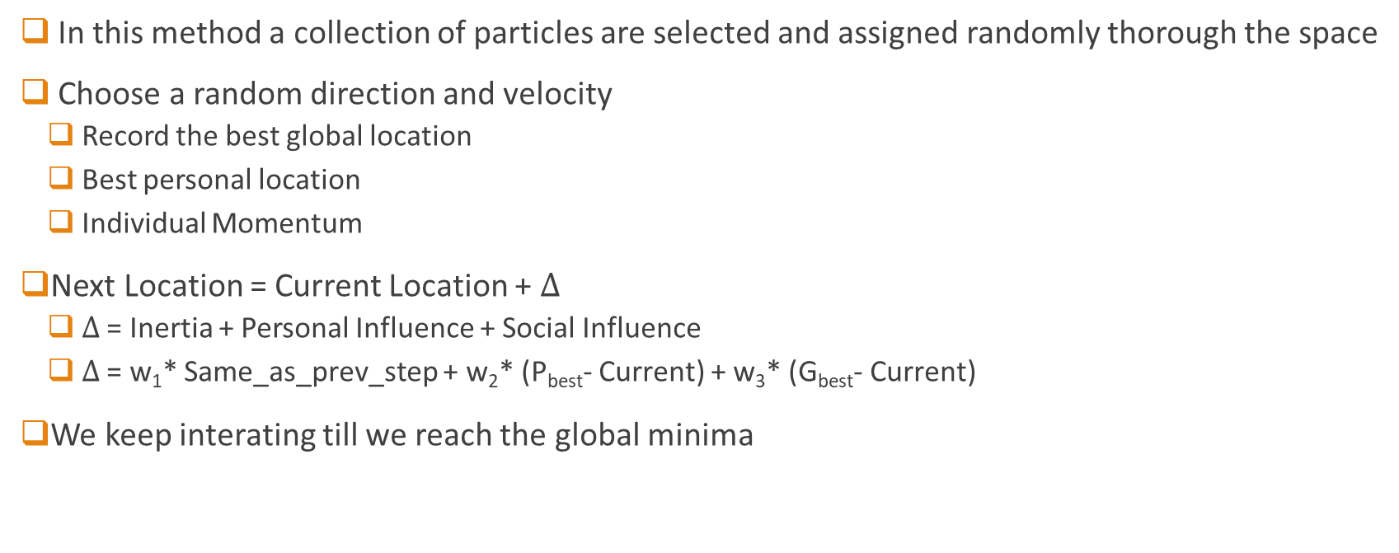
Particle Swarn Algorithm
In this method a collection of particles are selected and assigned randomly thorough the space
Choose a random direction and velocity
Record the best global location
Best personal location
Individual Momentum
Next Location = Current Location + $∆$
$∆$ = Inertia + Personal Influence + Social Influence
$∆$ = w₁* Same_as_prev_step + w₂* (P_{best}- Current) + w₃* (G_{best}- Current)
We keep interating till we reach the global minima

