Slide 1
ELECTION PREDICTION USING TWITTER SENTIMENTAL ANALYSIS
SUBMITTED BY:
SHAIKH ASHAB ALAM
KHAN SHADAB AHMED
ANSARI MOHAMMAD ADNAN
CHAUHAN GOPAL GHANSHYAM

Slide 2
PRESENTATION OUTLINE
MOTIVATION
PROCEDURE
REQUIREMENTS
PROGRAM
ANALYSIS
RESULTS
FUTURE ENHANCEMENT
CONCLUSION

Slide 3

ELECTION PREDICTION RESULTS
Once we have trained the Naive Bayes algorithm on the sentiment-labeled dataset, we can apply it to predict the election outcomes. By analyzing the sentiments expressed in tweets related to different candidates or parties, we can estimate their popularity and potential success. It is important to consider the limitations of the approach, such as potential bias in the dataset or the inﬂuence of other factors on election results.

Slide 4

WHAT IS SENTIMENT ANALYSIS ?
Sentiment analysis is the process of determining the emotional tone behind
a series of texts, such as tweets. It involves classifying the sentiment as positive, negative, or neutral. In the context of election predictions, sentiment analysis helps us gauge the public sentiment towards political candidates or parties.
The Naive Bayes algorithm is a widely used and effective technique for sentiment analysis, as it leverages probability theory
to make predictions

Slide 5
PROCEDURE
Data collection is one of the first and foremost process.We can either do it by searching the keywords or by using the twitter API to find a specific data and save it in the database.The second process is helpful for data extraction and analysis
Sentiment analysis are of two types either by the use of machine learning methods using naive bayes algorithm,where we calculate the probability of occurrence of events or the lexical analysis phase which is a dictionary search method where it check positive and negative hashtags of different word.
DATA COLLECTION
Before analysis the data it needs to remove the stop word,then stem the word and form them into separate tokens which will be used in the further process of analysing the data
SENTIMENT ANALYSIS
PRE-PROCESSING

Slide 6
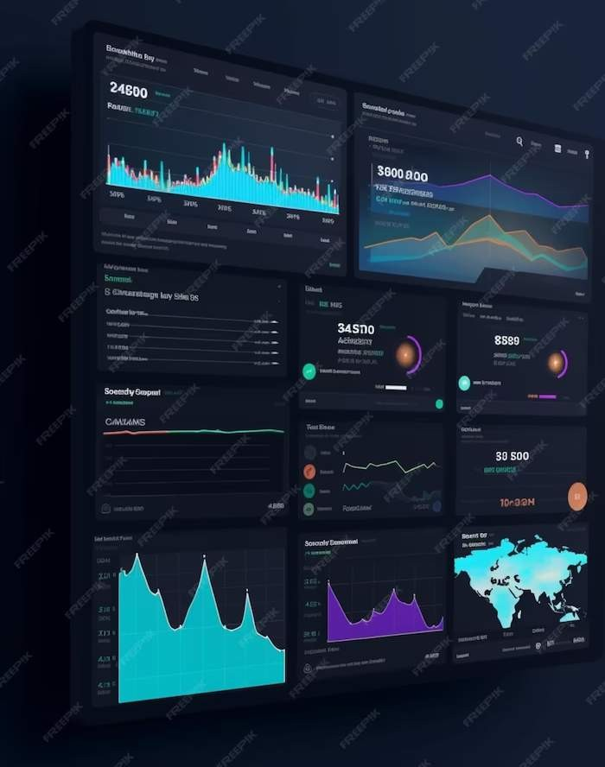
Collecting Twitter Data
To perform sentiment analysis, we need to
collect relevant data from Twitter. We can use
the Twitter API to retrieve tweets based on
specific search queries related to elections and
candidates. By selecting appropriate keywords
and hashtags, we can gather a substantial
amount of data for analysis. It is crucial to ensure
the collected data is representative and
unbiased to achieve reliable predictions

Slide 7
REQUIREMENTS
STREAMLIT LIBRARY:
Streamlit is a Python library that simplifies the process of creating web applications for data science and machine learning projects. It allows you to quickly build interactive web apps using only Python scripts, without needing to write HTML, CSS, or JavaScript.
With Streamlit, you can easily create interactive dashboards, prototype machine learning models, and visualize data. It provides a simple API that allows you to create widgets such as sliders, buttons, and dropdowns to control the behavior of your app. You can display data tables, plots, images, and text, and Streamlit will automatically update the app in response to changes in your Python code.

Slide 8
PANDAS LIBRARY:
Pandas is a powerful Python library for data manipulation and analysis, providing easy-to-use data structures and functions. Its core data structure, the DataFrame, organizes data into rows and columns, similar to a spreadsheet or SQL table. Pandas simplifies tasks such as filtering, sorting, grouping, and reshaping data, making it invaluable for cleaning and preparing datasets for analysis. It offers robust support for handling missing or NaN values, and supports various file formats for data input and output, including CSV, Excel, SQL databases, JSON, and HTML. Pandas excels in handling time-series data, with features for date/time indexing, resampling, and time zone handling. Built on top of NumPy, Pandas seamlessly integrates with NumPy arrays for efficient numerical computations. Widely used in data science, machine learning, and financial analysis, Pandas is a go-to tool for data scientists, analysts, and researchers seeking to explore, manipulate, and analyze structured data in Python.

Slide 9
NUMPY LIBRARY:
NumPy is a fundamental Python library for numerical computing, renowned for its powerful array manipulation capabilities. It provides a high-performance multidimensional array object, called ndarray, along with a collection of functions for array manipulation, mathematical operations, linear algebra, and random number generation. NumPy's ndarray allows for efficient storage and manipulation of large datasets, enabling vectorized operations that significantly enhance computational performance compared to traditional Python lists. Its extensive mathematical functions facilitate complex calculations and statistical analysis. NumPy seamlessly integrates with other Python libraries, such as SciPy, Matplotlib, and Pandas, forming the backbone of many scientific and data analysis workflows. From basic array manipulation to advanced mathematical operations, NumPy is widely used in fields such as machine learning, scientific research, engineering, and finance.

Slide 10
MATPLOTLIB LIBRARY:
Matplotlib is a popular Python library for creating static, interactive, and animated visualizations. It offers a wide range of plotting capabilities for generating various types of graphs, charts, and plots. With Matplotlib, users can create line plots, scatter plots, bar charts, histograms, pie charts, and more, with customizable features for labels, colors, styles, and annotations. It provides a MATLAB-like interface for easy plotting and is highly customizable, allowing users to fine-tune every aspect of their visualizations. Matplotlib seamlessly integrates with NumPy and Pandas, making it suitable for visualizing data stored in arrays or DataFrames. It also supports interactive plotting using tools like Jupyter Notebook and interactive backends like Qt, GTK, and Tk. Whether for exploratory data analysis, scientific visualization, or presentation graphics, Matplotlib is a versatile tool for creating high-quality visualizations in Python.

Slide 11
BAR GRAPH REPRESENTATION
In sentimental analysis, bar diagrams visually represent sentiment distributions. Each bar corresponds to a sentiment category (e.g., positive, neutral, negative), with the height indicating the frequency or proportion of data points in that category. After preprocessing text data and assigning sentiments, aggregate the counts for each sentiment category. Then, plot these counts on the y-axis against sentiment categories on the x-axis. Bar diagrams provide a quick overview of sentiment distribution within a dataset, allowing analysts to identify predominant sentiments and compare their prevalence. They facilitate easier interpretation and communication of sentiment analysis results, aiding decision-making processes in various domains such as customer feedback analysis, social media monitoring, and opinion mining.

Slide 12
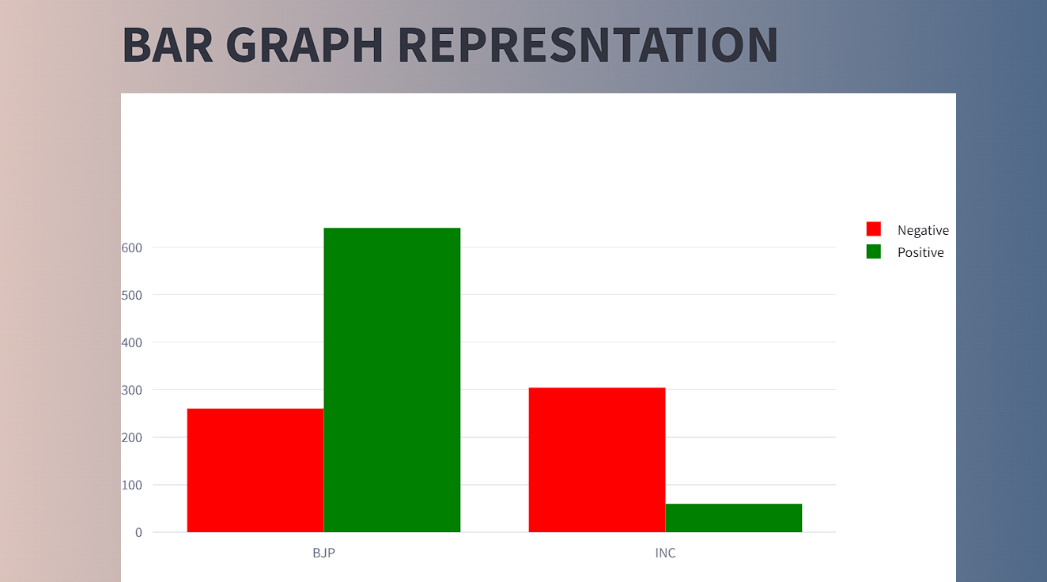

Slide 13
PIE DIAGRAM REPRESENTATION
In sentimental analysis, bar diagrams visually represent sentiment distributions. Each bar corresponds to a sentiment category (e.g., positive, neutral, negative), with the height indicating the frequency or proportion of data points in that category. After preprocessing text data and assigning sentiments, aggregate the counts for each sentiment category. Then, plot these counts on the y-axis against sentiment categories on the x-axis. Bar diagrams provide a quick overview of sentiment distribution within a dataset, allowing analysts to identify predominant sentiments and compare their prevalence. They facilitate easier interpretation and communication of sentiment analysis results, aiding decision-making processes in various domains such as customer feedback analysis, social media monitoring, and opinion mining.

Slide 14
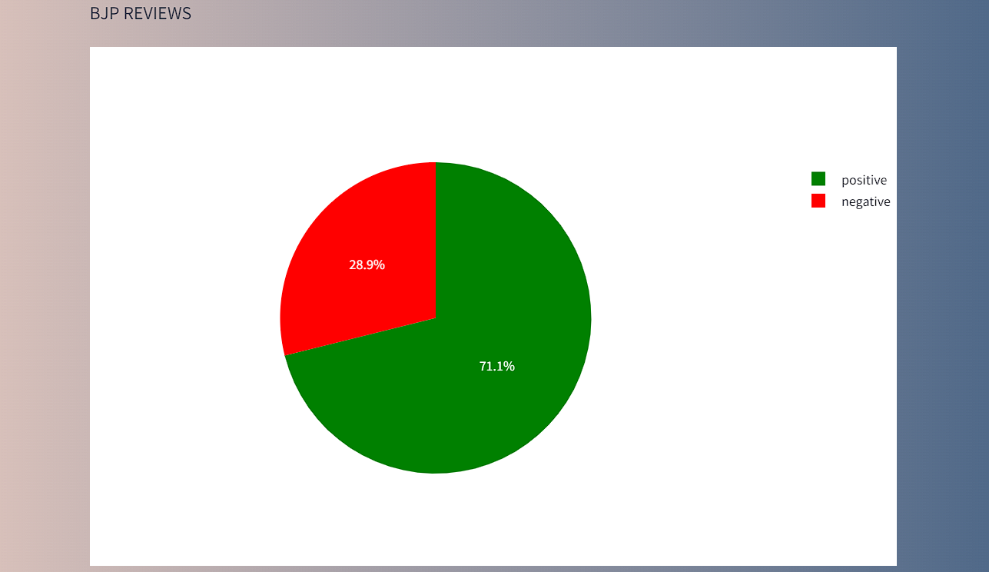
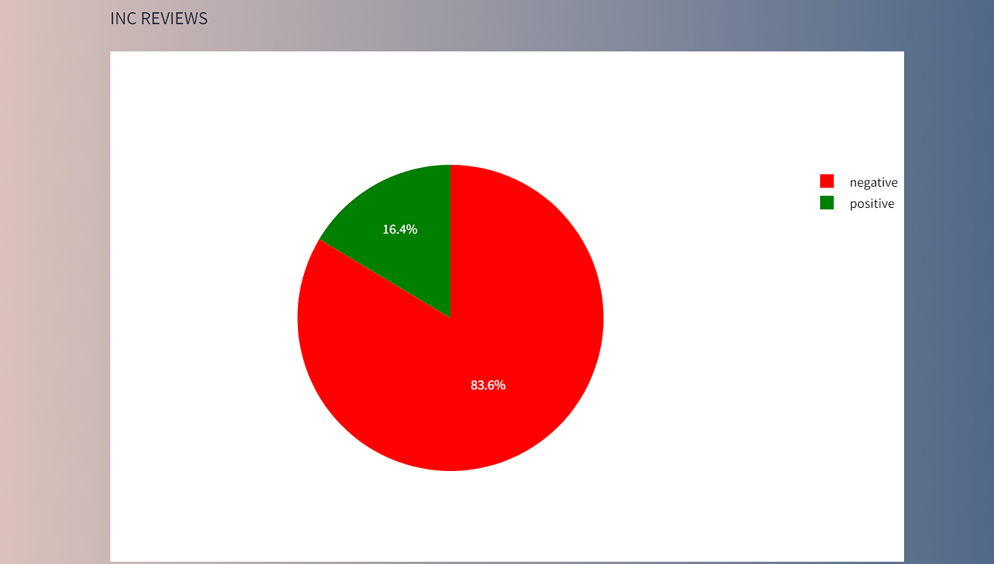

Slide 15
WORDCLOUD REPRESENTATION
In sentiment analysis, a word cloud can be a visual representation of the most frequent words in a given text, where the size of each word is proportional to its frequency. It can help in quickly identifying the prevailing sentiments and themes within the text. For example, in sentiment analysis of customer reviews, positive sentiments might be represented by words like "excellent," "great," or "satisfying," while negative sentiments could be captured by words like "poor," "disappointing," or "unacceptable." By generating a word cloud, analysts can gain insights into the overall sentiment expressed in the text data and prioritize areas for further investigation or improvement.

Slide 16
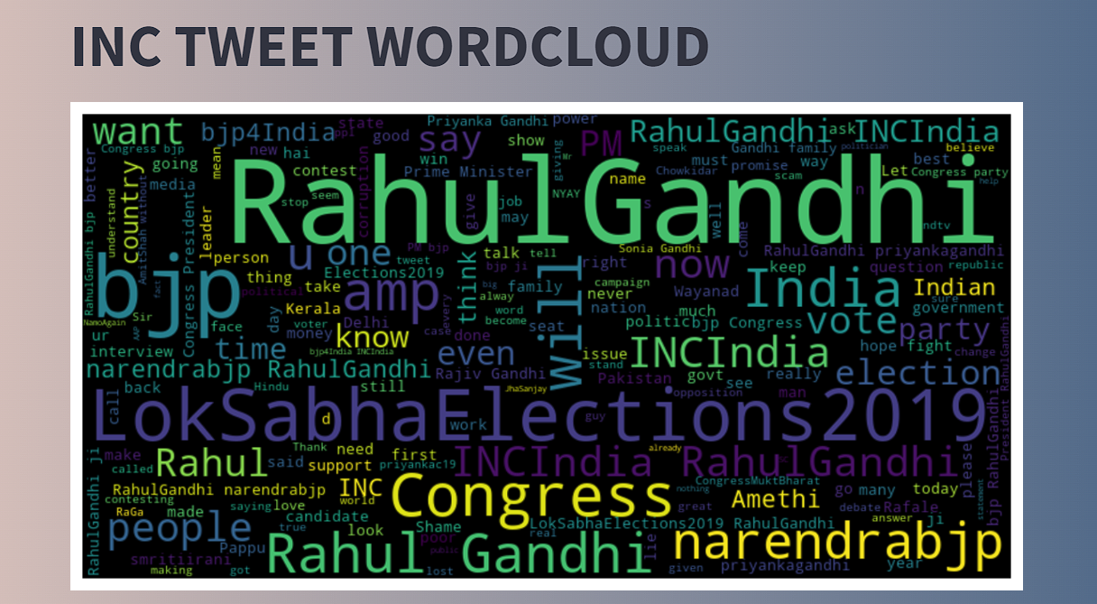
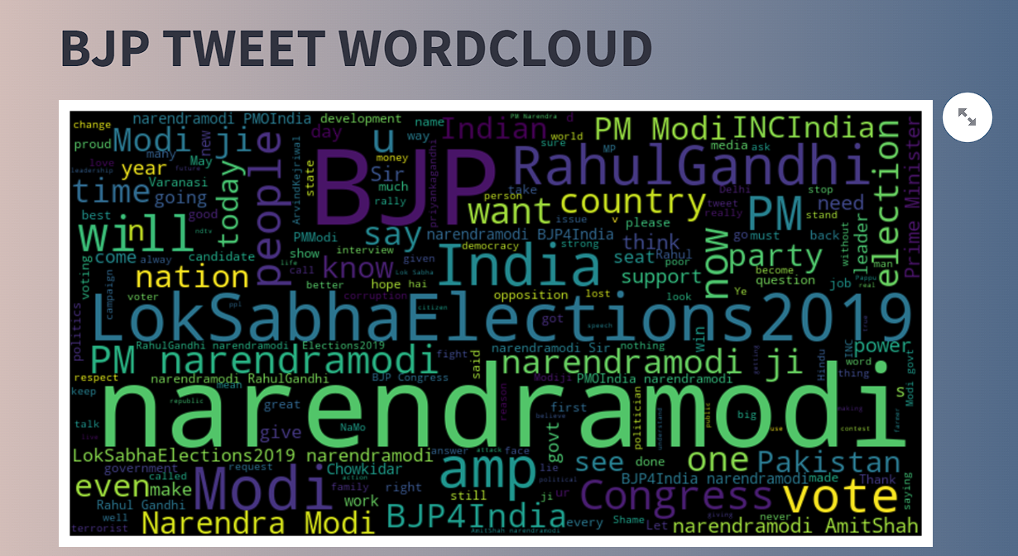

Slide 17
FUTURE ENHANCEMENT
This is just a general representation of the election prediction .
We can take various other situations like coalitions and change of members from one party to another
We can increase the number of tweets and the processing can be done with an interval of less number of days so that we can analyse more number of tweets and have a more accurate idea
We can include multiple conditions to filter the tweet so that we can calculate the elections of any specific place based on certain criteria

Slide 18
CONCLUSION
Twitter sentiment analysis helps us to get a accurate idea about the inclination of the people.We can not only use this method to predict election but also use it to calculate opinions of people about different social and political issues.
This process gives a general idea about the public view.With careful and precise analysis parties can find out their success as well as failures which affects the people’s sentiment and form a better strategy.

Slide 19
THANK YOU

