Slide 1

Cardiovascular Disease Prediction
Vamani Vasu
Sai Gopala Raju

Slide 2

Problem definition
Cardiovascular diseases (CVDs) persist as a formidable global health challenge, necessitating a paradigm shift towards proactive, personalized risk assessment strategies. This project aims to pioneer a cutting-edge predictive modeling approach, integrating multi-dimensional datasets encompassing demographic, lifestyle, and health-related variables, to create a nuanced and accurate tool for early identification of individuals at risk of cardiovascular diseases. The goal is to transcend conventional risk assessment methods, offering a holistic solution that not only predicts but also provides actionable insights for tailored preventive interventions.

Slide 3

Data collection
We have collected dataset from Kaggle
Our dataset consists data of more than 1000 patients with the following columns
Patient Identification Number gives the ID of the patient suffering
Age, and gender give the general age and gender of the patient
Chest pain type of the patient is assigned with values 0,1,2,3 (Value 0: typical angina, Value 1: atypical angina, Value 2: non-anginal pain, Value 3: asymptomatic)
Resting blood pressure, Serum cholesterol give the details of patients
Fasting blood sugar is assigned with 0,1
(0=false, 1=true)

Slide 4
Resting electrocardiogram results is assigned with values 0,1,2
(Value 0: normal, Value 1: having ST-T wave abnormality (T wave inversions depression of > 0.05 mV),
Value2: showing probable or definiteleft ventricular hypertrophy by Estes' criteria)
Maximum heart rate achieved
Exercise induced angina with values 0,1
Slope of peak exercise ST segment with values 1,2,3
1-upsloping, 2-flat, 3- downs l opi ng)
Number of major vessels is assigned with values 0,1,2,3
Target classification finally is assigned with values 0,1
(0 is absence of heart disease
1 is Presence of heart disease)

Slide 5
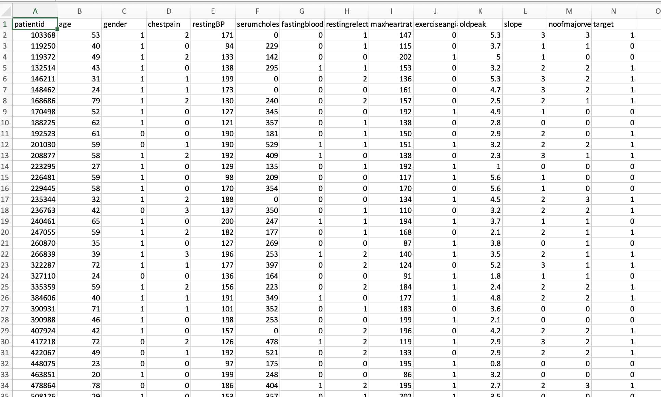

Slide 6

Model Training
The machine translation model is trained using the pre-processed data. The training process involves optimizing the parameters of the model to minimize the loss function that measures the difference between the predicted output and the actual output.

Slide 7

Model: Xgb classifier
XGBoost is an optimized distributed gradient boosting library designed for efficient and scalable training of machine learning models. It is an ensemble learning method that combines the predictions of multiple weak models to produce a stronger prediction. XGBoost stands for “Extreme Gradient Boosting” and it has become one of the most popular and widely used machine learning algorithms due to its ability to handle large datasets and its ability to achieve state-of-the-art performance in many machine learning tasks such as classification and regression.

Slide 8
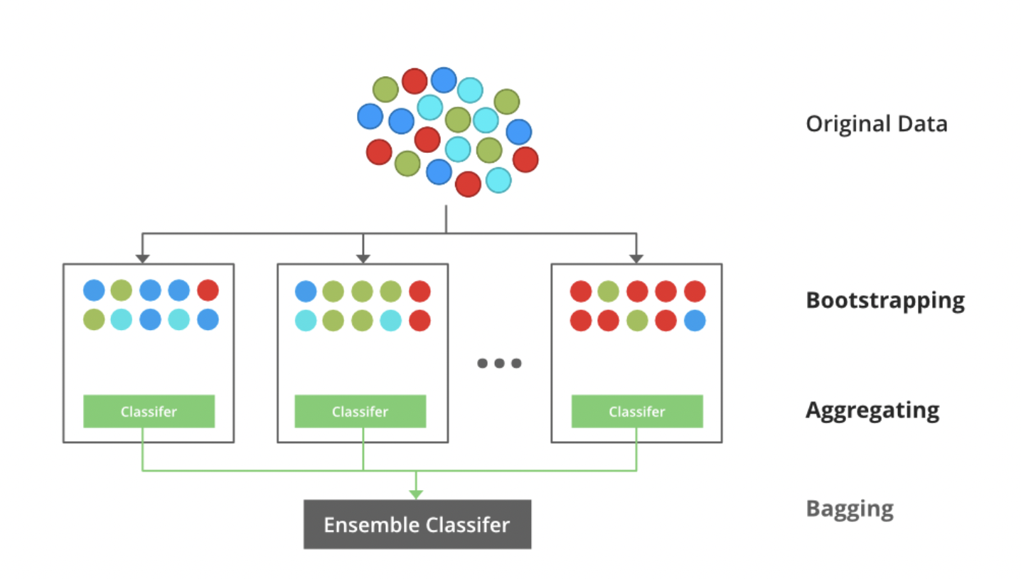

Slide 9
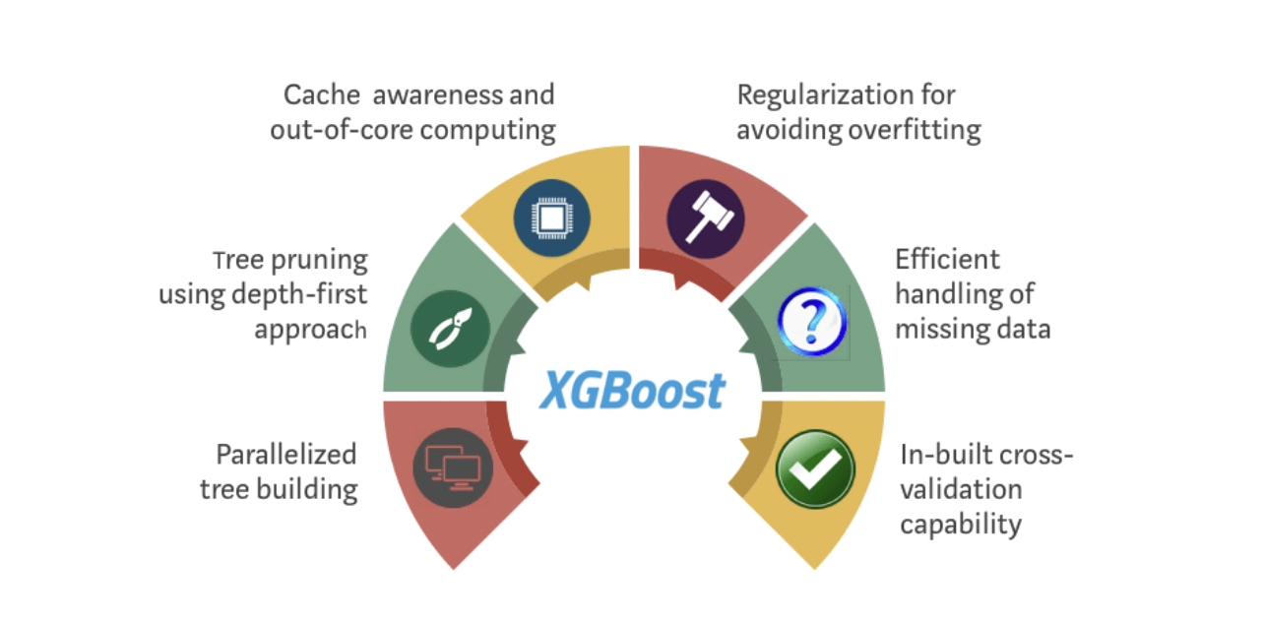
Xgb Classifier Algorithm

Slide 10

Key Features
Gradient Boosting Framework:
XGBoost is based on the gradient boosting framework, where an ensemble of weak learners (typically decision trees) is sequentially trained to correct the errors of the previous models.
2. Regularization:
XGBoost incorporates L1 (LASSO) and L2 (ridge) regularization terms into its objective function. This helps prevent overfitting and enhances the model's generalization capability.
3. Tree Pruning:
XGBoost employs a technique called "tree pruning" to control the depth of individual trees. Pruning helps prevent the trees from becoming overly complex and mitigates the risk of overfitting.
4. Parallel and Distributed Computing:
XGBoost is designed to be highly efficient, supporting parallel and distributed computing. This enables faster training on large datasets, making it suitable for big data scenarios.
5. Cross-Validation:
XGBoost has built-in cross-validation capabilities, allowing for robust model evaluation. It helps in selecting optimal hyperparameters and provides a more accurate estimate of the model's performance.

Slide 11
6. Handling Missing Values:
XGBoost has a built-in mechanism for handling missing values in the dataset. It automatically learns how to treat missing data during the training process.
7. Feature Importance:
XGBoost provides a feature importance score, indicating the contribution of each feature to the model's predictions. This is valuable for feature selection and understanding the model's decision-making process.
8. Early Stopping:
XGBoost supports early stopping, allowing the training process to halt when the model's performance on a validation dataset ceases to improve. This helps prevent overfitting and speeds up the training process.
9. Scalability:
XGBoost is highly scalable and can handle a large number of observations and features. This scalability makes it suitable for a wide range of applications, from small to large datasets.
10, Customizable Objective Function:
Users can define a custom objective function based on the specific requirements of their task

Slide 12
Experiment setting
Training/Test split:
Training Ratio : 80%
Validation :10%
Test Ratio: 10%

Slide 13

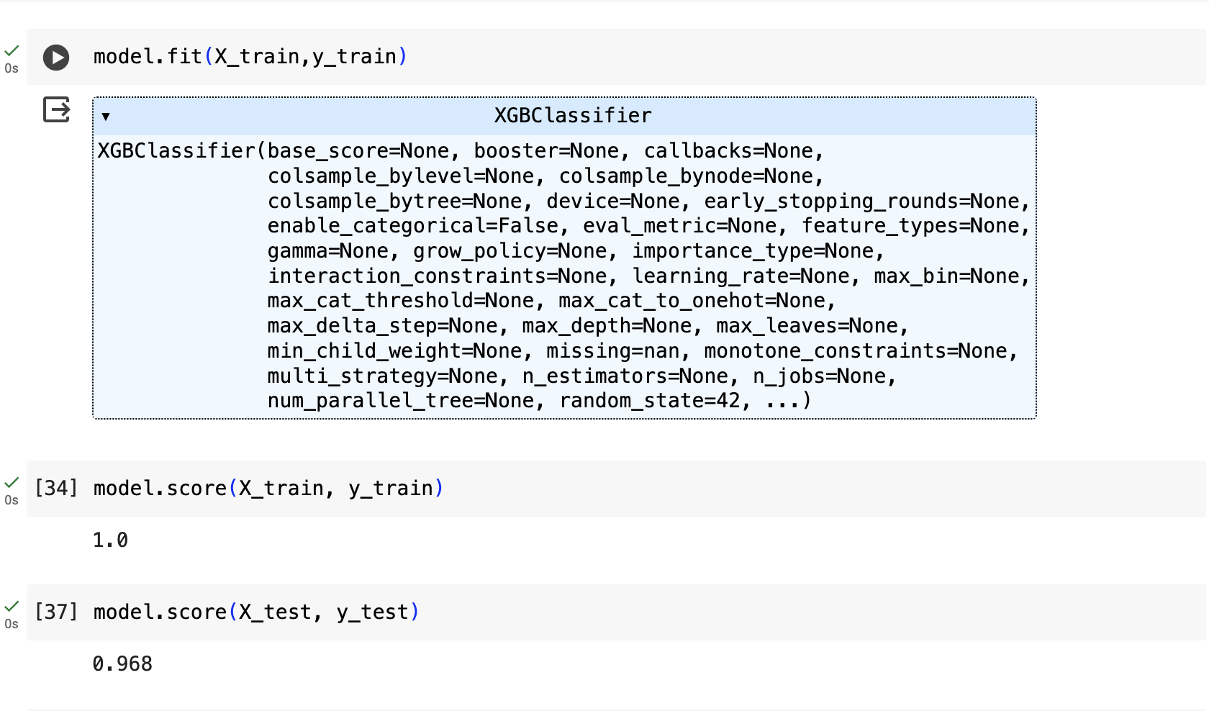
Metrices
Accuracy : 0.96

Slide 14
Conclusion
In conclusion, this cardiovascular disease prediction project has successfully developed a predictive model using XGBoost. The model, trained on diverse and preprocessed data, demonstrates promising performance metrics. The future scope involves integrating the model into healthcare systems, ensuring continuous improvement, and addressing ethical considerations. This project contributes to the advancement of proactive cardiovascular health management, providing a valuable tool for healthcare professionals and individuals alike. As we move forward, the continuous evolution of the model and its responsible implementation are critical for maximizing its impact on public health.

Slide 15

THANK YOU !

