Slide 1

NATIONAL INSTITUTE OF TECHNOLOGY PUDUCHERRY
(An Institution of National Importance under MoE, Govt. of India)
KARAIKAL – 609 609
FEDERATED CNN FOR PLANT DISEASE CLASSIFICATION USING RESNET-18
ASHMITAA S
(EE23B1007)
K S G S LOKESH
(EE23B1027)
Supervisor: Dr. M. Venkatesan, Associate Professor
Dept. of CSE

Slide 2
Introduction
Plant disease detection is a critical task in precision agriculture — early diagnosis reduces yield losses and pesticide use.
Deep learning CNNs excel at image-based plant disease classification, but centralizing training images raises privacy and bandwidth concerns.
Federated Learning (FL) allows multiple clients to train a shared global model while keeping data local — clients share only model weight updates, not raw data.
This project combines FL with transfer learning on a pre-trained ResNet-18 backbone using the PlantVillage dataset to achieve privacy-preserving plant disease classification.
The FedAvg aggregation algorithm combines locally trained weights from 3 simulated clients over 5 communication rounds, achieving 91.37% final test accuracy.

Slide 3
Objectives
Download and preprocess the PlantVillage RGB dataset — resize to 224×224 px and normalize using ImageNet statistics for ResNet-18 compatibility.
Partition training data among 3 simulated federated clients to replicate a distributed, privacy-preserving learning scenario without data sharing.
Implement the FedAvg algorithm to aggregate locally trained model weights into a single global model across 5 communication rounds.
Evaluate the global model using overall accuracy, top-5 accuracy, per-class accuracy, classification report, and confusion matrix.
Visualize the training loss curve and sample predictions to assess model convergence and qualitative performance.

Slide 4
Literature Survey
McMahan et al. (2017) introduced FedAvg — a communication-efficient algorithm for training deep networks from decentralized data without sharing raw data.
Mohanty et al. (2016) showed CNNs trained on PlantVillage achieve over 99% accuracy under controlled conditions, establishing it as the benchmark dataset for plant disease classification.
He et al. (2016) introduced ResNet (Residual Networks) — residual connections enable very deep networks to train effectively. ResNet-18 offers an excellent accuracy-efficiency balance for fine-tuning on domain-specific datasets.
Rieke et al. (2020) highlighted FL for privacy-preserving collaborative learning in healthcare — principles directly applicable to agricultural settings where farm data is sensitive.
Liu et al. (2020) demonstrated that combining FL with transfer learning significantly improves federated model convergence, especially in non-IID data settings.

Slide 5
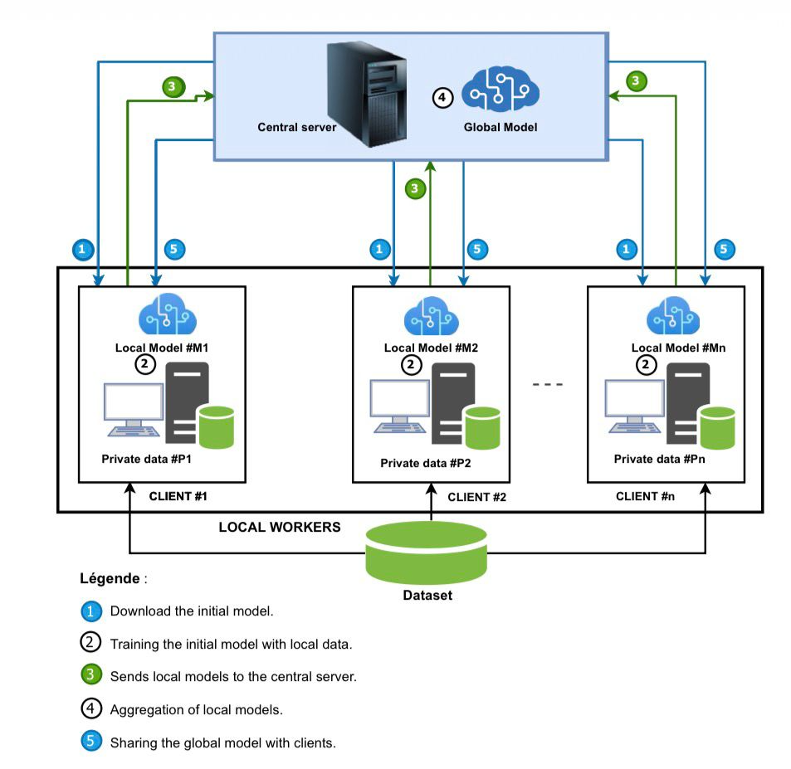
Architecture

Slide 6
Architecture
Data Loading: PlantVillage dataset via KaggleHub, organized with PyTorch ImageFolder. Images resized to 224x224 and normalized with ImageNet statistics.
Federated Partitioning: Training set split equally among 3 simulated clients (disjoint, non-overlapping subsets) — horizontal federated learning scenario.
Model: Pre-trained ResNet-18 (ImageNet) with frozen convolutional layers. Final FC layer replaced with a new linear layer for 38 plant disease classes.
Local Training: Each client trains for 2 epochs using Adam optimizer (lr=0.001) and Cross-Entropy Loss — only the final layer is updated.
FedAvg Aggregation: Server collects weights from all clients, computes arithmetic mean, forms new global model, redistributes for next round — repeated for 5 rounds.

Slide 7
Dataset Used
PlantVillage Dataset (RGB version) — available on Publicly Availabel.
~54,000 RGB leaf images across 38 plant disease and healthy categories.
Images resized to 224x224 pixels and normalized using ImageNet statistics (mean: [0.485, 0.456, 0.406], std: [0.229, 0.224, 0.225]).
Dataset split 80/20 into training and testing subsets using PyTorch random_split.
Training data further partitioned equally among 3 simulated federated clients using non-overlapping index ranges.

Slide 8
Tools & Technologies
Programming Language: Python 3.8+
Deep Learning Framework: PyTorch 1.12+ with torchvision
Libraries: scikit-learn, KaggleHub, seaborn, matplotlib, numpy
Model: ResNet-18 pre-trained on ImageNet (via torchvision.models)
Environment: Google Colab / Jupyter Notebook / Local Python environment

Slide 9
Implementation Steps
Step 1: Install KaggleHub and import PyTorch, torchvision, scikit-learn libraries.
Step 2: Download PlantVillage dataset; discover 38 disease classes by listing subdirectories.
Step 3: Apply image transforms (resize 224x224, normalize) and split dataset 80/20 into train/test.
Step 4: Partition training data equally across 3 federated clients using non-overlapping index ranges.
Step 5: Load ResNet-18 with frozen conv layers; replace final FC layer for 38 classes.
Step 6: Each client trains locally for 2 epochs (Adam, lr=0.001, CrossEntropyLoss).
Step 7: Run FedAvg over 5 rounds — aggregate client weights, update global model, redistribute.
Step 8: Evaluate global model — compute accuracy, top-5, per-class accuracy, confusion matrix, and visualize sample predictions.

Slide 10
Results
Final Global Model Accuracy: 91.37% on the held-out PlantVillage test set after 5 FedAvg rounds.
Top-5 Accuracy: Notably higher than top-1, confirming the correct class consistently appears among the model’s top confident predictions.
Per-class accuracy shows strong performance across most of the 38 categories; classes with more training samples achieve higher accuracy.
Confusion matrix heatmap reveals classes with similar visual features (overlapping disease patterns) are more prone to misclassification.
Sample visualizations of predicted vs. actual class labels confirm the model’s qualitative reliability on individual test images.

Slide 11
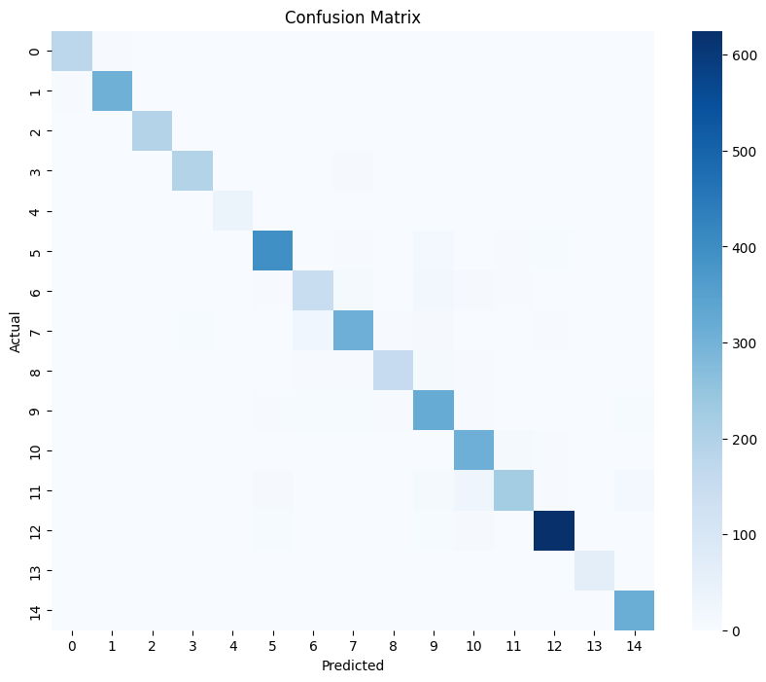
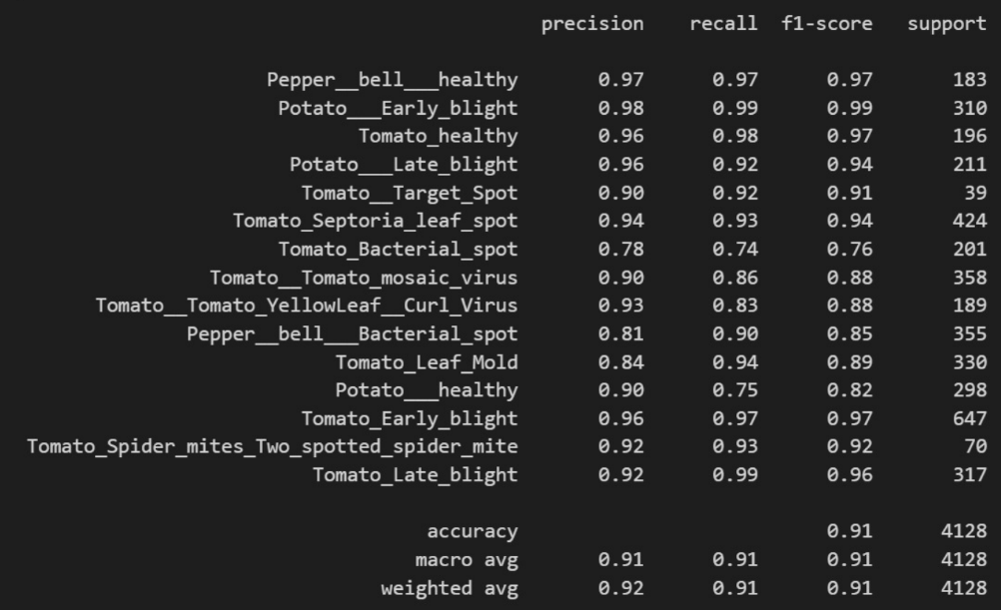
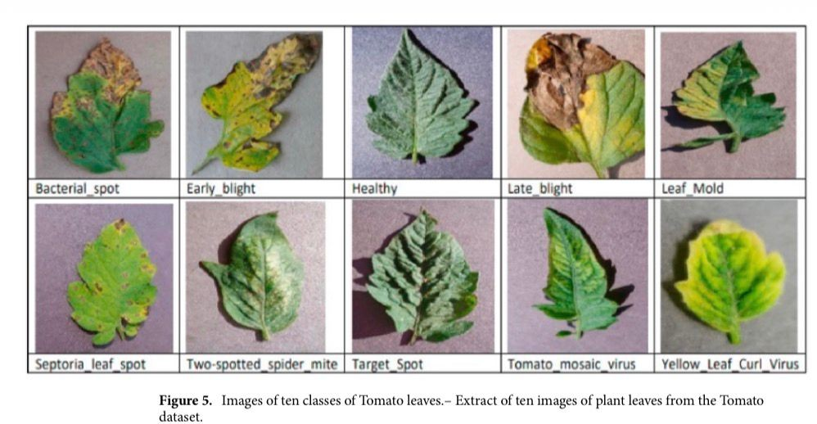
Accuracy Results

Slide 12
Advantages
Privacy-Preserving: Raw training data never leaves client devices — only model weight updates are shared, preserving data privacy.
Reduced Bandwidth: Only model parameters (not full datasets) are transmitted between clients and the central server.
Scalable Architecture: The FedAvg framework can scale to more clients without redesigning the aggregation pipeline.
Strong Initialization: Transfer learning from ImageNet enables effective training with limited local data and fewer epochs.
Comprehensive Evaluation: Overall accuracy, top-5 accuracy, per-class accuracy, confusion matrix and sample visualizations provide thorough model assessment.

Slide 13
Future Scope
Non-IID Data: Simulate non-IID partitioning where clients hold data from only a few crop or disease types, closer to real-world conditions.
More Clients: Scale federated clients beyond 3 to test robustness of FedAvg under realistic distributed conditions.
Advanced Aggregation: Explore FedProx, SCAFFOLD, or FedNova for better convergence in heterogeneous data settings.
Fine-tune More Layers: Gradually unfreeze deeper ResNet layers during federated rounds to further improve accuracy.
On-Device Deployment: Compress and deploy the global model on edge devices (Raspberry Pi, mobile) using TensorFlow Lite or ONNX for real-time field diagnosis.
Privacy Enhancements: Integrate differential privacy and secure aggregation for formal privacy guarantees beyond basic data locality.

Slide 14
Conclusion
Successfully implemented a Federated Learning pipeline for plant disease classification using ResNet-18 on the PlantVillage RGB dataset.
FedAvg effectively aggregates locally trained weights from 3 simulated clients over 5 rounds, producing a robust global model without sharing raw training data.
Transfer learning from ImageNet provides strong initialization, compensating for limited local training epochs — achieving 91.37% final test accuracy.
Federated learning is demonstrated as a viable, privacy-preserving approach for agricultural image classification at scale.

Slide 15
Thank You!
Questions Welcome

