Slide 1


B.S.A College of Engineering & Technology, Mathura
Established & Governed by Shri Agrawal Shiksha Mandal (Regd.), Mathura
An Industrial Training / Internship Assessment Presentation
On
“Computer Based Speech Interface”
Under the guidance of:
Mrs. Shilpi Bansal Mam
Submitted by:
Gopal Sharma
B.tech. CSE 2nd year 3rd Semester
Roll No. 2000650100035
Department of Computer Science & Applications

Slide 2
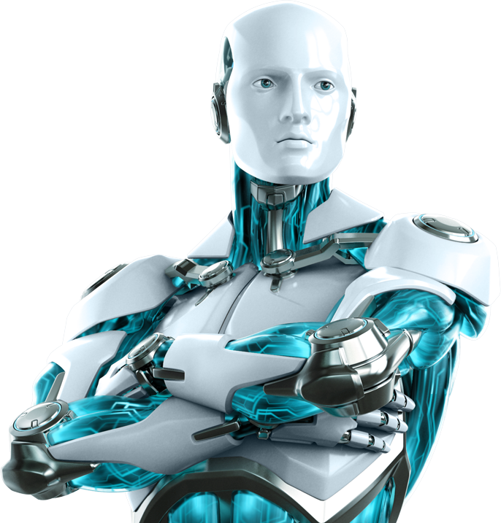

BROTHER
THE A.I.

Slide 3


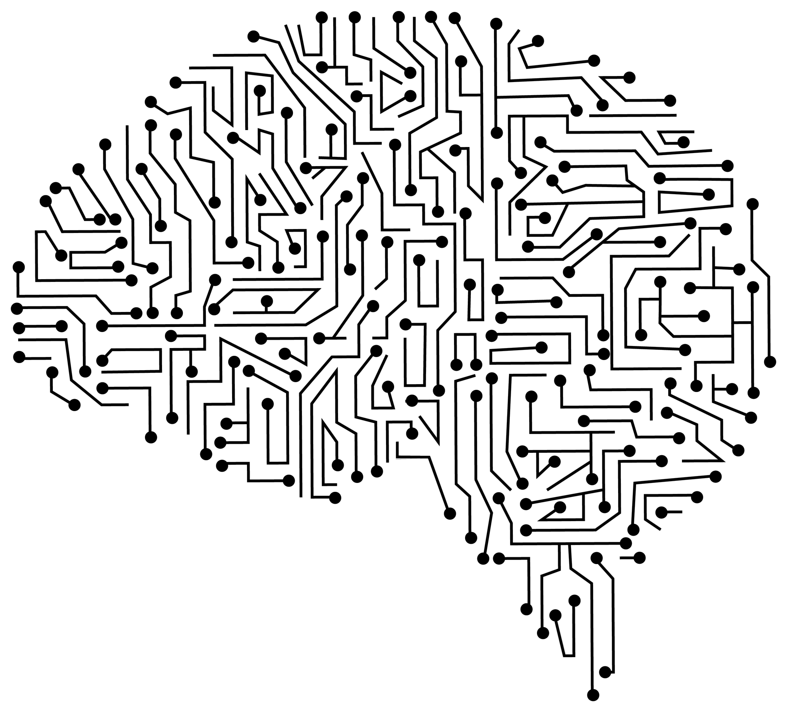
Base concepts
Speech Recognition(NLP)
Text-to-Speech
Speech-to-Text
Applying Intelligence

Slide 4

Libraries used
speech_recognition
pyttsx3
datetime
wikipedia
webbrowser
pywhatkit
random
string
tkinter
os

Slide 5
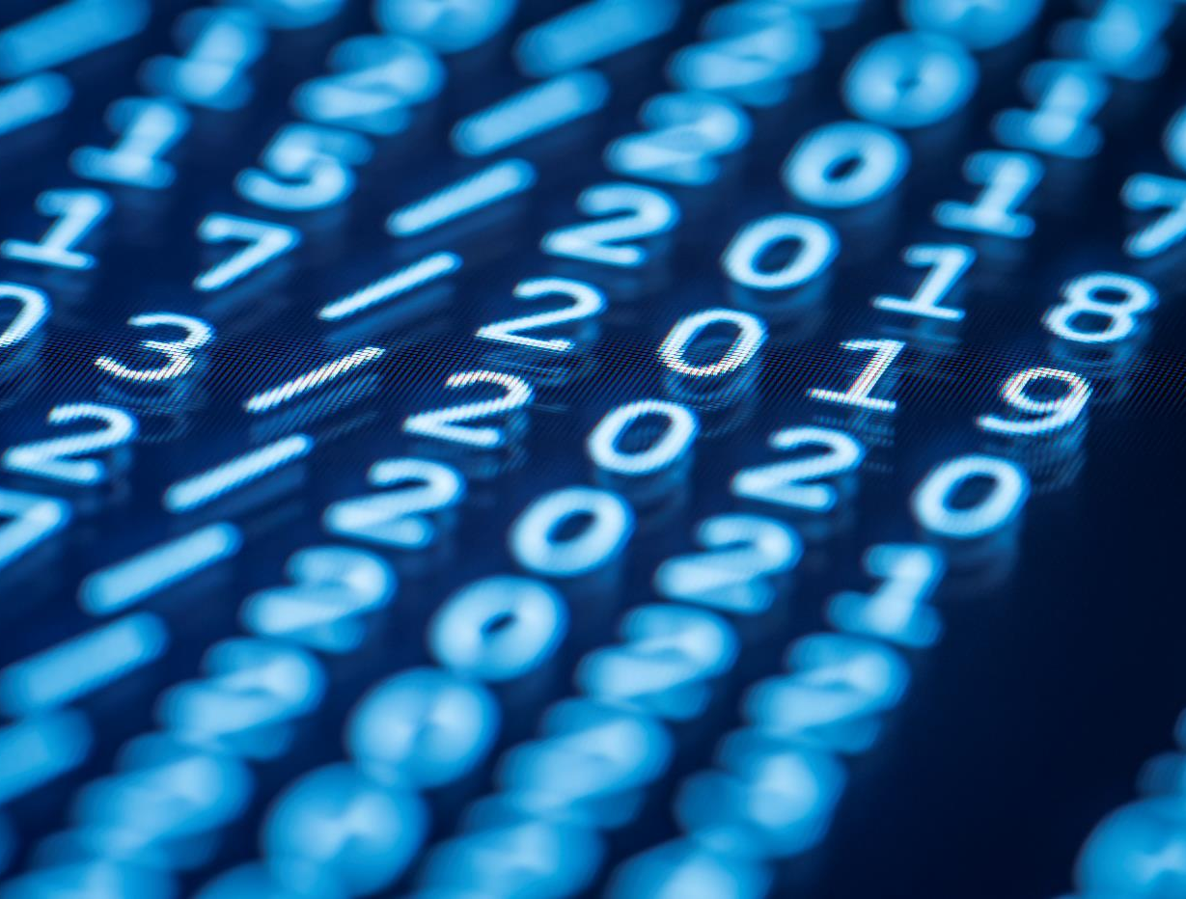
FUNCTIONS
These are what actually the code is

Slide 6
def speak(audio):
It enables BROTHER to speak or say(verbally), whatever it gets as an string input in the parameter ‘audio’.

Slide 7
def wish():
This function let BROTHER to wish the user or it’s owner according to real-time hours and minutes.

Slide 8
def get_command():
It helps BROTHER to take command as a voice input from the user. It takes help of Google’s Speech Recognition system to get and recognize the input via system’s microphone.

Slide 9
def intro():
Who are you(BROTHER)?
Literally, this question is answered by this function which let BROTHER to introduce itself.

Slide 10
def messaging(pnmbr, mesg, thr, tmin):
If you want to send a text message using WhatsApp, give a chance to BROTHER to make it so.

Slide 11
def integer(val):
It’s quite simple. It just convert numbers which are of string type i.e. input by the user as a part of speech recognition, into integer or int type.
OR
It typecast the string typed numbers into integer type.

Slide 12
def password():
Are you tired of thinking a super strong password for you accounts? Here’s the solution…
This function let BROTHER to generate a strong password for you.

Slide 13
def calling_everything():
This function calls all other defined functions within itself whenever they are triggered by a speech input or needed.

