Slide 1


"Dr. Abdul Kalam Technical, Literary & Management Fest, 2022-23"
On
Innovative Prototype/Project Exhibition
Submitted by:
Gopal Sharma
Computer Science & Engineering
Roll No. 2000650100035
B.S.A College of Engineering & Technology, Mathura
Established & Governed by Shri Agrawal Shiksha Mandal (Regd.), Mathura

Slide 2
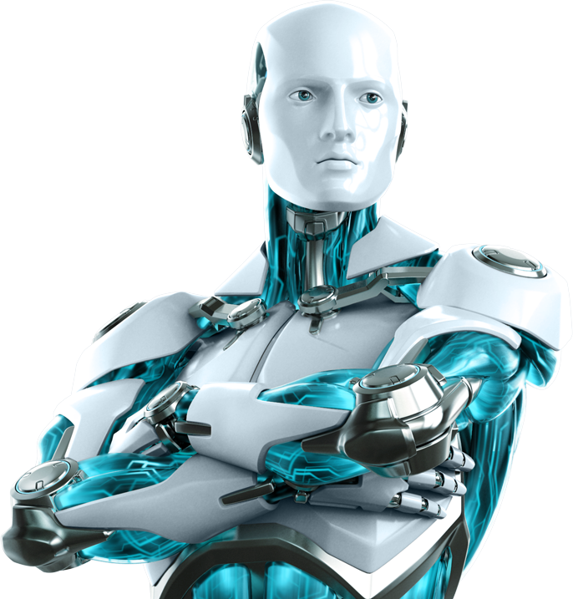

BROTHER
THE A.I.
Based on Cutting-Edge Technology artificial intelligence

Slide 3
CONTENTS
Slide No.
Introduction 04
Technology Used 06
Libraries Used 09
Functions 11
Software Requirements 22
Hardware Requirements 23
Flowchart 24
Working 25
Advantages/Disadvantages 26
Usages 27
Screenshots 28
Conclusion 31

Slide 4
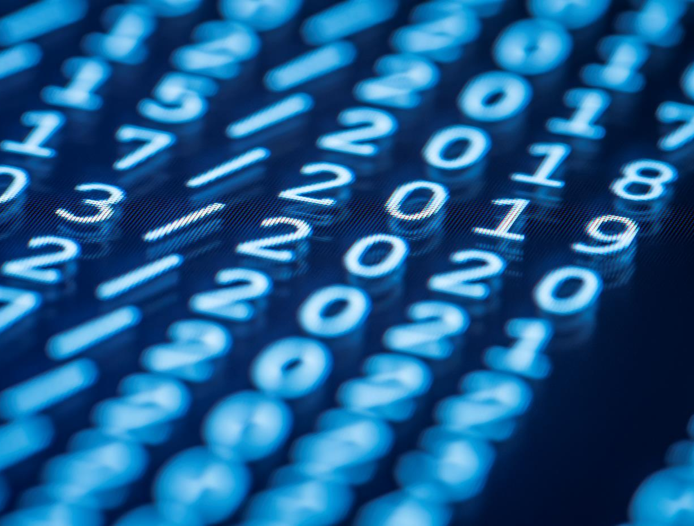
introduction
Let’s have an overview of what it is and how does it works

Slide 5


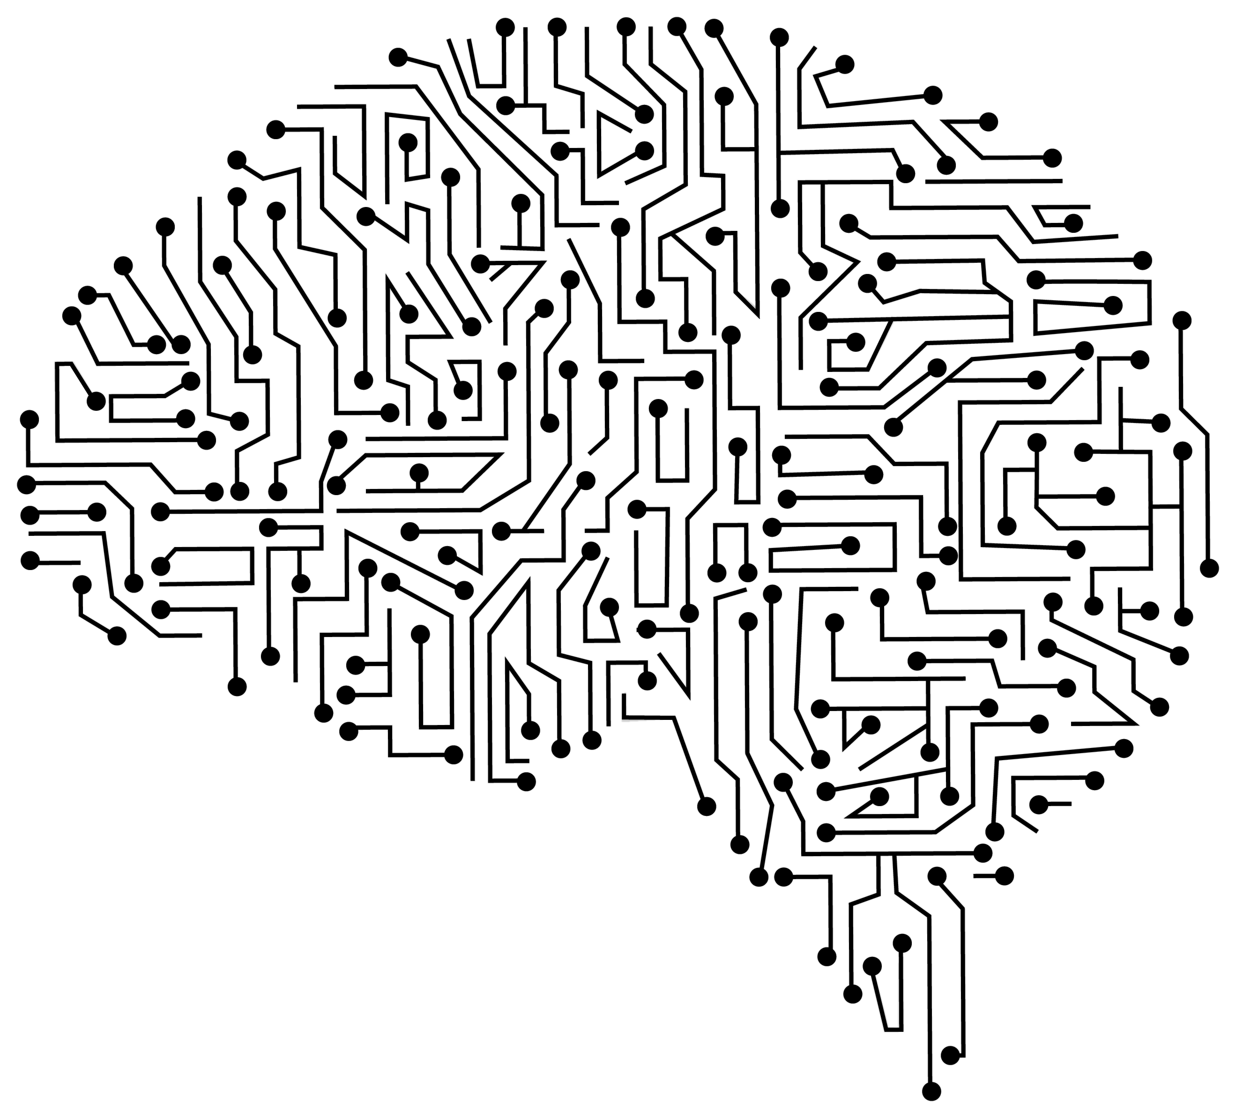
Base concepts
Speech Recognition(NLP)
Speech-to-Text
Text-to-Speech
Applying Intelligence
(As defined in the code)

Slide 6
Technology Used
This section defines on what technology the project is based upon

Slide 7

PYTHON

Slide 8

Why PYTHON?
Free and open-source
Easy to code
Easy to read
Object oriented language
GUI programming support
High level language
Extensible language
Easy to debug
Interpreted language
Dynamically typed language

Slide 9
Libraries used
Are it’s python modules used to write the code

Slide 10

libraries used
speech_recognition
pyttsx3
datetime
wikipedia
webbrowser
pywhatkit
random
string
email.message
os
smtplib

Slide 11
FUNCTIONS
These are what actually the code does

Slide 12
Wish you according to the current time
Converts Speech to Text
Introduce itself
Responds to –
who are you
how are you
who is your owner
where do you live,
what are you doing’ and
your complements like ‘nice’ and ‘thanks’
Open YouTube, Google, Notepad, MS Word
Send Whatsapp message
Play music
Tell Current Time
Search on internet for particular thing you say to it
Generate a super strong Password
Automate the email process.

Slide 13
def speak(audio):
It enables BROTHER to speak or say(verbally), whatever it gets as an string input in the parameter ‘audio’.

Slide 14
def wish():
This function let BROTHER to wish the user or it’s owner according to real-time hours and minutes.

Slide 15
def get_command():
It helps BROTHER to take command as a voice input from the user. It takes help of Google’s Speech Recognition system to get and recognize the input via system’s microphone.

Slide 16
def intro():
Who are you(BROTHER)?
Literally, this question is answered by this function which let BROTHER to introduce itself.

Slide 17
def messaging(pnmbr, mesg, thr, tmin):
If you want to send a text message using Whatsapp, give a chance to BROTHER make is so.

Slide 18
def integer(val):
It’s quite simple. It just convert numbers which are of string type i.e. input by the user as a part of speech recognition, into integer or int type.
OR
It typecast the string typed numbers into integer type.

Slide 19
def password():
Are you tired of thinking a super strong password for you accounts? Here’s the solution…
This function let BROTHER to generate a strong password for you.

Slide 20
If you are busy enough that you can’t even send an email in your schedule, BROTHER may help you in this scenario.
It can automate the whole email process and send email for you.
def autoemail():

Slide 21
def calling_everything():
This function calls all other defined functions within itself whenever they are triggered by a speech input or needed.

Slide 22
Software requirements
Interpreter
Internet
OS
Any OS supporting Python
Python 3.9.7 or above
640Kbps or above

Slide 23
hardware requirements
50MB or above RAM
Microphone
Intel Pentium P4 or Higher Processor
Speaker

Slide 24
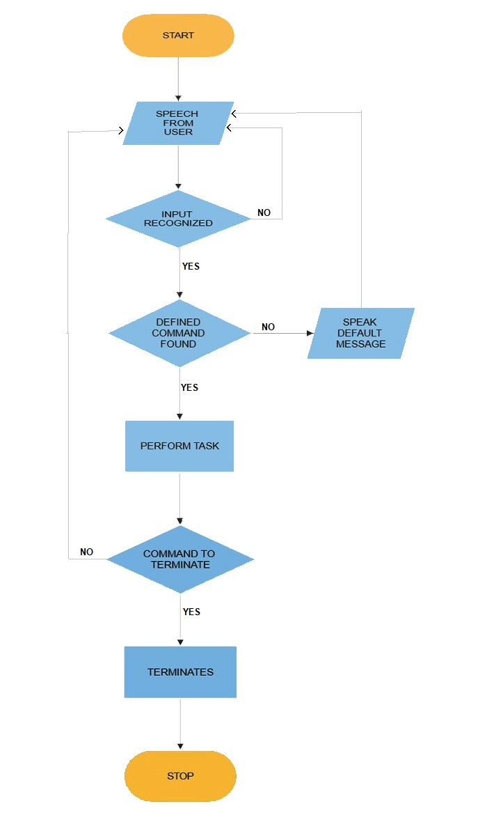
Flowchart

Slide 25
working
It works on the basis of Natural Language Processing.
Take audio as input and convert to string.
Checks if the task according to the input is coded or not.
Perform appropriate task accordingly.
Ultimately, it does your tasks on your one command.

Slide 26
Advantages disadvantages
Saves your time
Increase your productivity
Keeps you fast as your internet
May slower down your work if your internet connection is slow
Not much accurate in listening as it depends on the chaos or disturbances in the environment

Slide 27
Usages
Smart Virtual Assistant
Search results
Language translation
Speech←→Text
Digital Messaging or Mailing
Automation of various tasks like
Email
Whatsapp messaging
Web searching
Opening of apps, etc.
And many more…

Slide 28
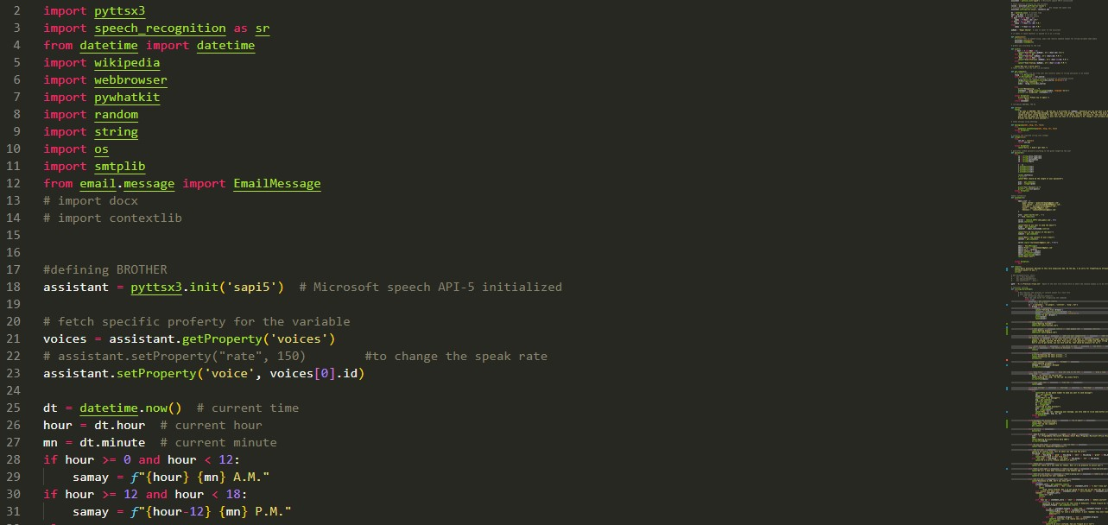
Screenshots

Slide 29
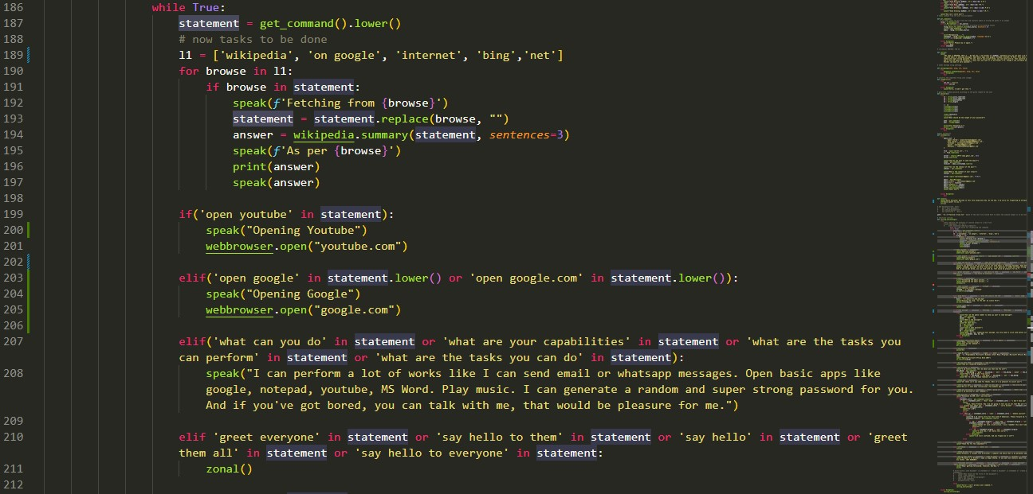
Screenshots

Slide 30
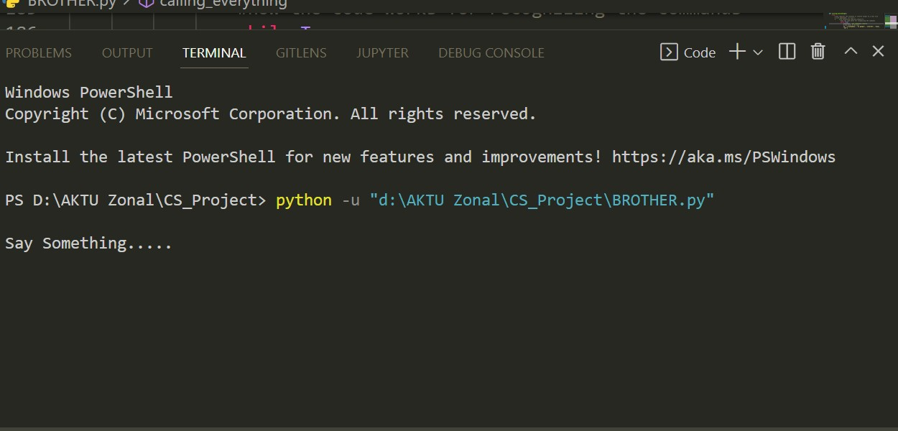
Screenshots

Slide 31
conclusion
BROTHER The A.I. is a NLP based application which can help you to be more productive while doing your work on your PC.
It can do many of your works which bother you while being hooked on your important tasks.
You only have to say BROTHER, do this and this, the next moment will be the execution of your command.
When get evolved, this application would be a very useful and advanced A.I. application.

Slide 32
BROTHER
THANK YOU

