Slide 1


B.S.A College of Engineering & Technology, Mathura
Established & Governed by Shri Agrawal Shiksha Mandal (Regd.), Mathura
An Industrial Training / Internship Assessment Presentation
On
“Computer Based Speech Interface”
Under the guidance of:
Mrs. Shilpi Bansal
Submitted by:
Gopal Sharma
B.tech. CSE 2nd year 3rd Semester
Roll No. 2000650100035
Department of Computer Science & Applications

Slide 2
CONTENTS
Slide No.
Introduction 4
Libraries Used 6
Functions 8
Software Requirements 17
Hardware Requirements 18
Working 19
Advantages/Disadvantages 20
Applications 21
Screenshots 22
Conclusion 24

Slide 3
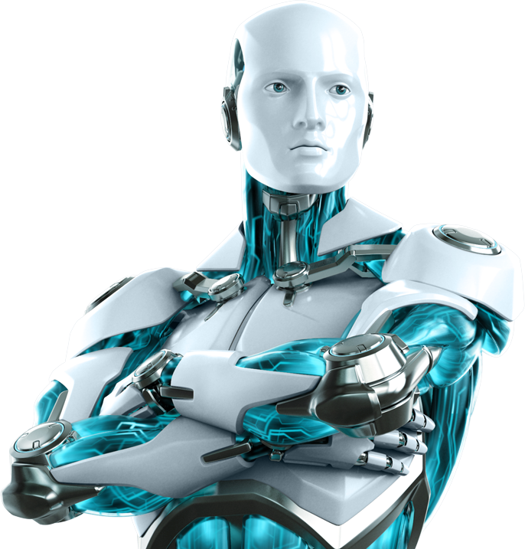

BROTHER
THE A.I.

Slide 4

introduction
Let’s have an overview of what it is and how does it works

Slide 5


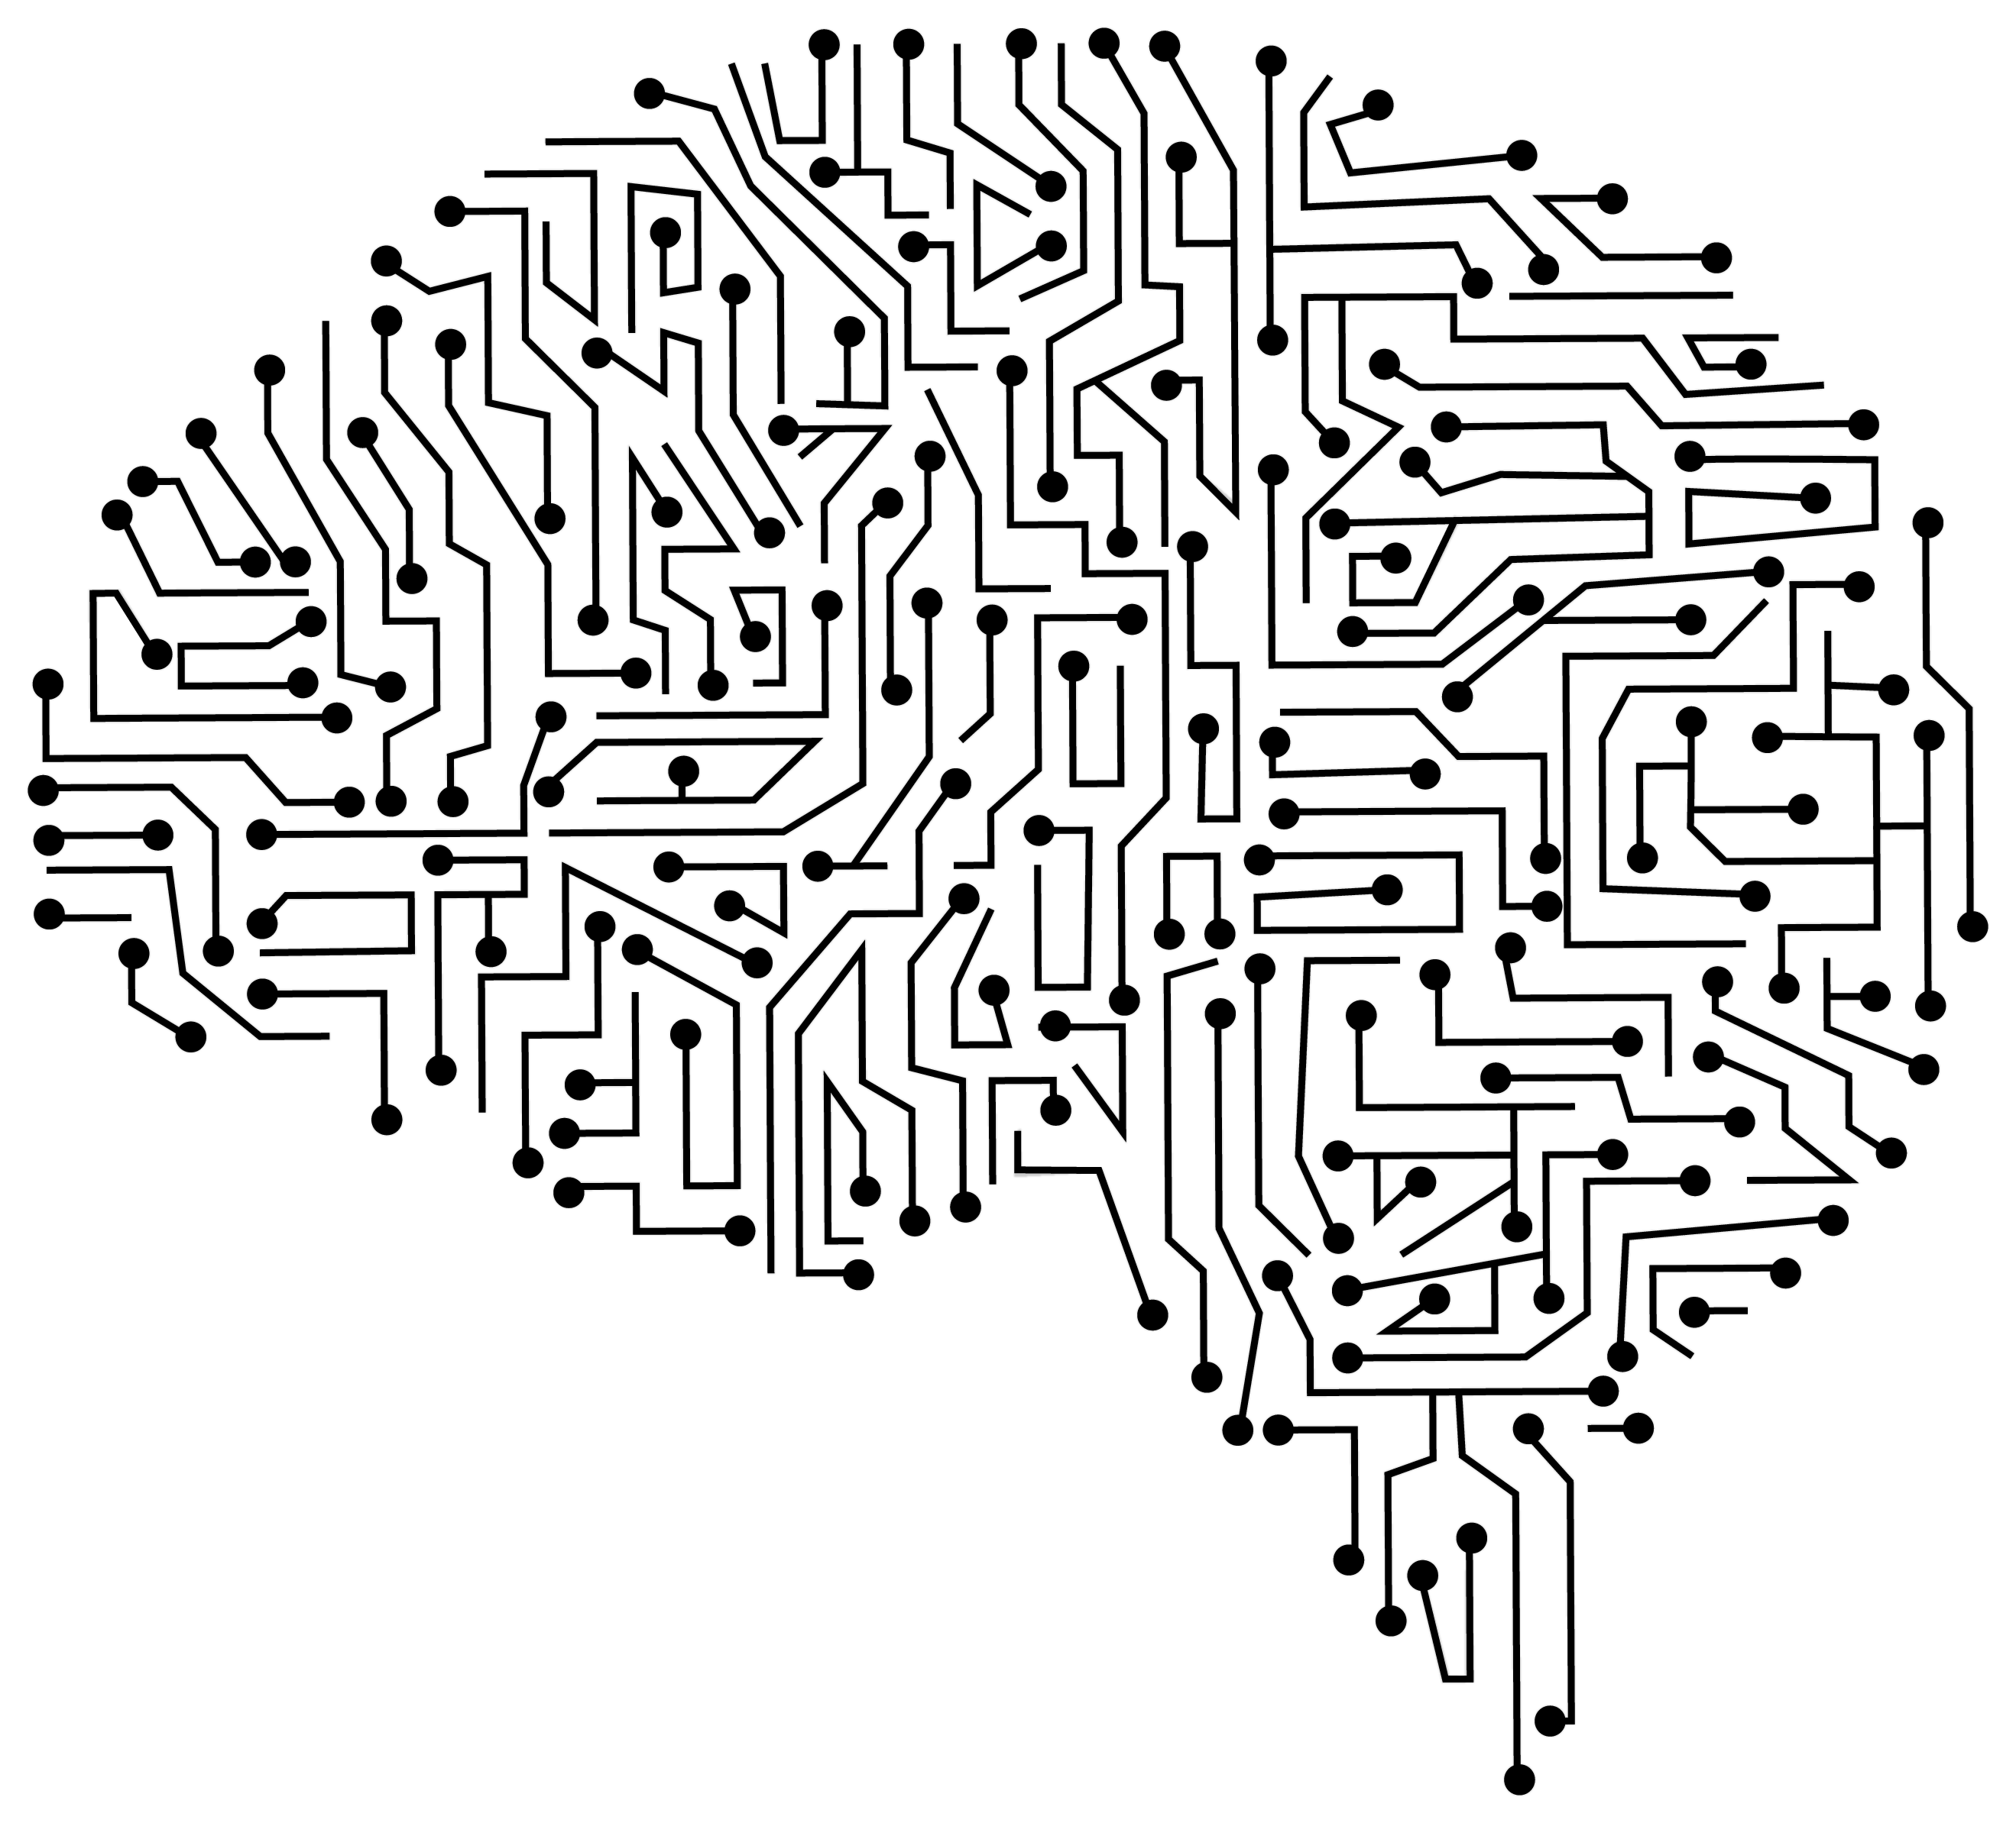
Base concepts
Speech Recognition(NLP)
Text-to-Speech
Speech-to-Text
Applying Intelligence

Slide 6
Libraries used
Are it’s python modules used to write the code

Slide 7

libraries used
speech_recognition
pyttsx3
datetime
wikipedia
webbrowser
pywhatkit
random
string
tkinter
os

Slide 8
FUNCTIONS
These are what actually the code is

Slide 9
def speak(audio):
It enables BROTHER to speak or say(verbally), whatever it gets as an string input in the parameter ‘audio’.

Slide 10
def wish():
This function let BROTHER to wish the user or it’s owner according to real-time hours and minutes.

Slide 11
def get_command():
It helps BROTHER to take command as a voice input from the user. It takes help of Google’s Speech Recognition system to get and recognize the input via system’s microphone.

Slide 12
def intro():
Who are you(BROTHER)?
Literally, this question is answered by this function which let BROTHER to introduce itself.

Slide 13
def messaging(pnmbr, mesg, thr, tmin):
If you want to send a text message using Whatsapp, give a chance to BROTHER make is so.

Slide 14
def integer(val):
It’s quite simple. It just convert numbers which are of string type i.e. input by the user as a part of speech recognition, into integer or int type.
OR
It typecast the string typed numbers into integer type.

Slide 15
def password():
Are you tired of thinking a super strong password for you accounts? Here’s the solution…
This function let BROTHER to generate a strong password for you.

Slide 16
def calling_everything():
This function calls all other defined functions within itself whenever they are triggered by a speech input or needed.

Slide 17
Software requirements
Interpreter
Internet
OS
Win7 or Above
Python 3.9.7 or Above
580KBps or Above

Slide 18
hardware requirements
2GB or Above RAM
Microphone
Intel Pentium P4 or Higher Processor
Speaker

Slide 19
working
It works on the basis of Natural Language Understanding and Natural Language Generation. In short, we can say that it works on NLP i.e. Natural Language Processing.
The ‘get_command()’ function takes input from the user as and audio input and converts it into a string(datatype), then search for the conditions which is to be evaluated TRUE among all the defined conditionals.
It then either calls the specified function mentioned there or speak the string given within itself.
Ultimately, it does your tasks on your one command.

Slide 20
Advantages disadvantages
Saves your time
Increase your productivity
Keeps you fast as your internet
May slower down your work if your internet connection is slow
Not much accurate in listening as it depends on the chaos or disturbances in the environment

Slide 21
applications
Smart Virtual Assistant
Search results
Language translation
Speech←→Text
Digital Messaging
Automation of various tasks
And many more…

Slide 22
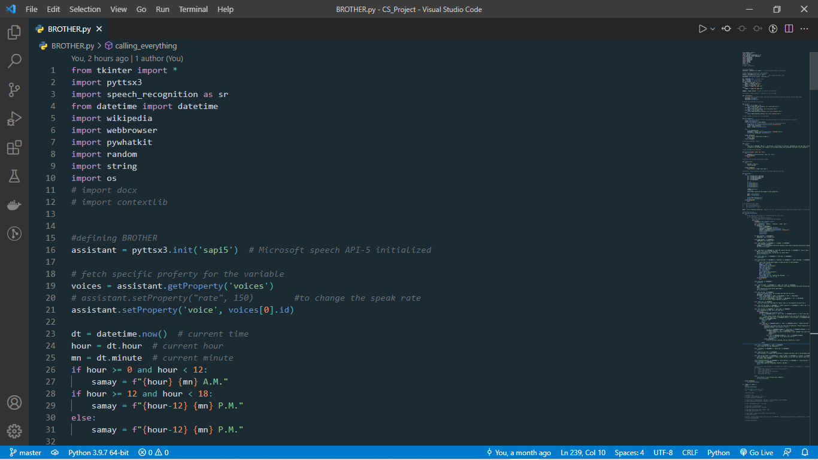
Screenshots

Slide 23
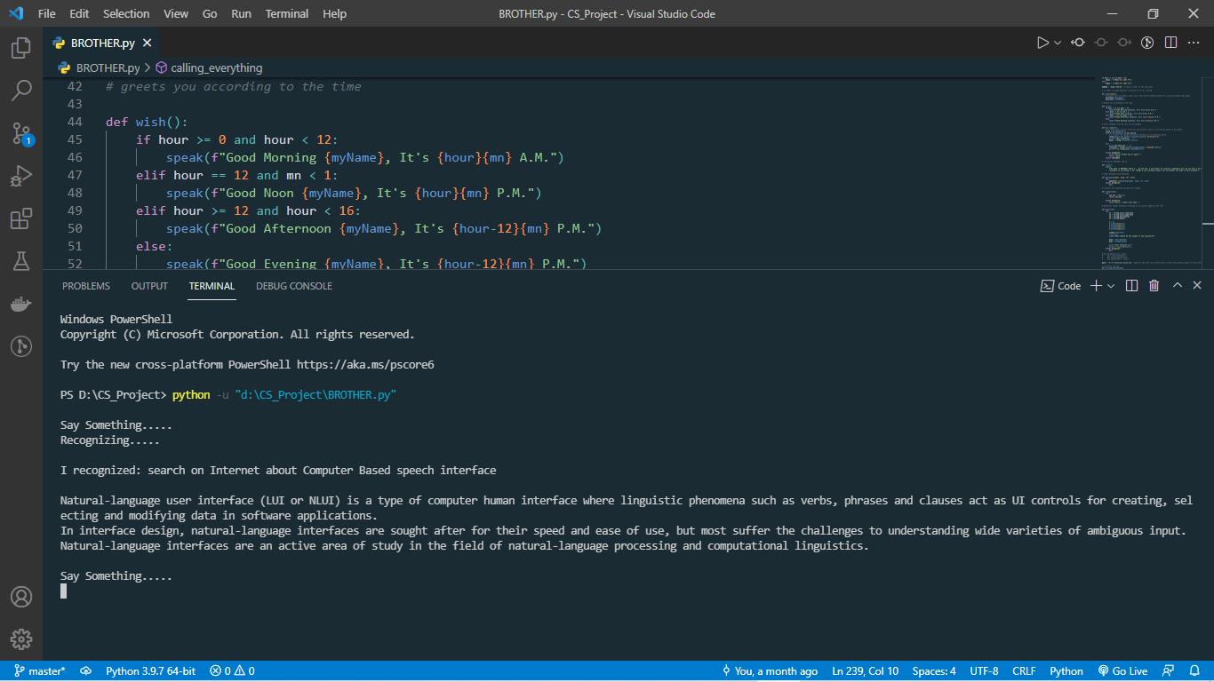
Screenshots

Slide 24
conclusion
BROTHER The A.I. is a NLP based application which can help you to be more productive while doing your work on your PC.
It can do many of your works which bother you while being hooked on your important tasks.
You only have to say BROTHER, do this and this, the next moment will be the execution of your command.
When get evolved, this application would be a very useful and advanced A.I. application.

Slide 25
BROTHER
THANK YOU

