Slide 1


Competitive Programming (PEP) Training Report
By: Gopal Vashishta
Lovely Professional University, Phagwara, Punjab
Duration: June 20 – July 30, 2025
Partner: Programming Pathshala

Slide 2
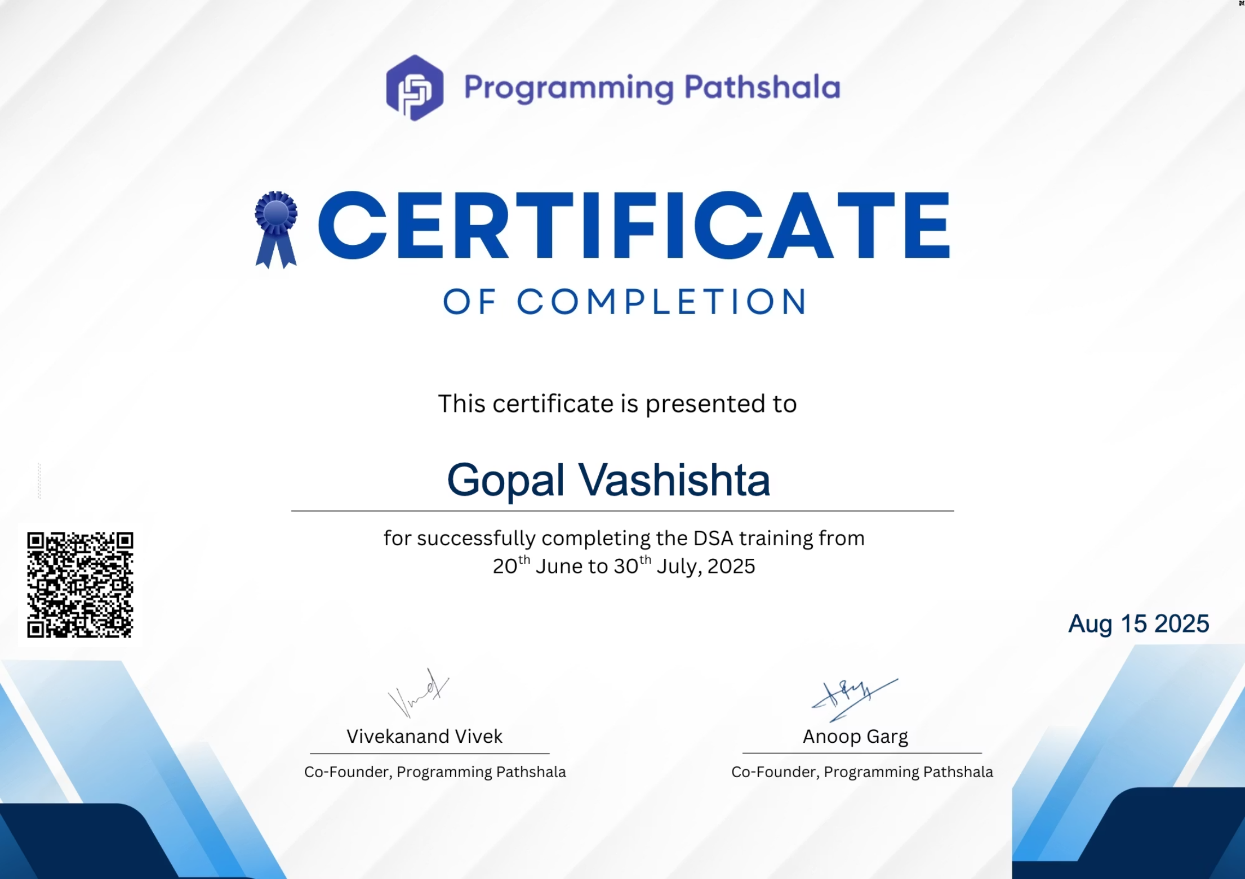



Certificate

Slide 3

Program Overview
Placement Enhancement Program (PEP) – Competitive Programming
Focus: Strengthen core programming & problem-solving
Reinforce DSA concepts
Improve logic & coding efficiency
Prepare for technical interviews
Practice under timed conditions

Slide 4


Skills & Topics Covered
Core Data Structures
Advanced Techniques
Pointers: Memory handling, dynamic allocation
Recursion & Backtracking: N-Queens, Sudoku
Bit Manipulation: Optimizations using binary ops
Dynamic Programming: Knapsack, LIS, LCS
Arrays & Strings: Prefix/suffix, KMP, Z-algo
Advanced: Segment Trees, Fenwick Trees
Linked Lists, Stacks, Queues: Dynamic data structures
Practice Platforms
Trees & BSTs: Traversals, LCA
Graphs: BFS, DFS, Dijkstra, Bellman-Ford
LeetCode, Codeforces
Tries: String storage, prefix search

Slide 5

Project – Graph Algorithm Visualizer
Tool:
Features:
Browser-based (React + Canvas/SVG)
Interactive graph editor (add/move/delete nodes, edges)
Play/pause/step controls with trace inspector
Purpose:
Real-time animation of data structures
Visualize graph algorithms step-by-step

Slide 6


Algorithms Implemented
1
2
BFS
DFS
Layered traversal (Shortest path unweighted)
Depth exploration (Cycle detection)
3
4
Dijkstra
Bellman–Ford
Shortest path (Weighted graphs)
Handles negative weights
5
6
Topological Sort (Kahn)
MST
DAG ordering
Kruskal (DSU) & Prim (PQ-based)

Slide 7
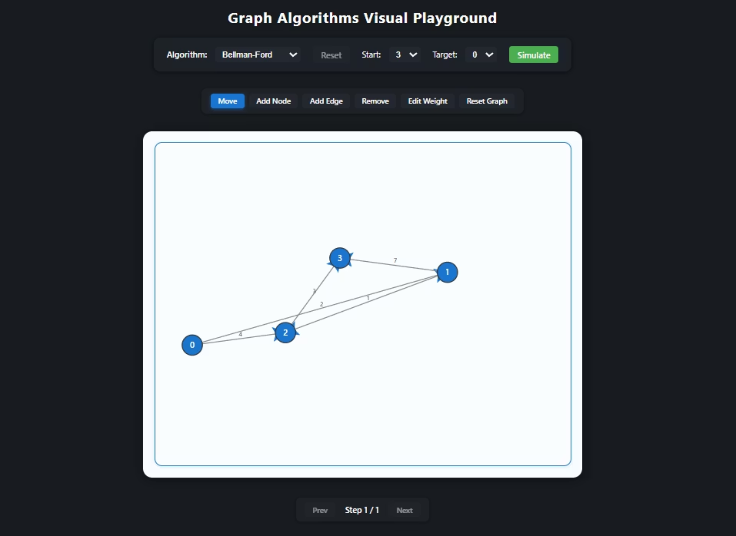

User Interface

Slide 8







Project Objectives
Educational clarity through visualization
Stepwise interactivity with control options
Comparison between algorithms
Modular, reusable, and extendable design
Support for both directed/undirected & weighted graphs

Slide 9



Scope
Included:
Future Enhancements:
BFS, DFS, Dijkstra, Bellman-Ford, Kahn, Kruskal, Prim
A*, Tarjan, Max-Flow
Random graph generation
Performance metrics panel
Edge cases & performance checks
Multi-user & collaborative mode
Pseudocode sync, GIF exports

Slide 10

Company Overview – Programming Pathshala
Founded: 2016 by Vivekanand Vivek & Anoop Garg
Mission: Accessible quality tech education
Focus: DSA, System Design, Interview Prep
Departments: Training, Content, Technology, Support

Slide 11




Conclusion
Achieved objectives of educational visualization
Bridged theory and implementation
Future: More algorithms, collaboration, export features

Slide 12

References
CLRS
Online Resources
Practice Platforms
(Introduction to Algorithms)
CP Algorithms, Visualgo
LeetCode, AtCoder, Codeforces, CSES, VJudge

