Slide 1

Adhiyamaan College of Engineering (Autonomous), Hosur Department of Computer Science and Engineering
Streamlined Project Collaboration and Efficient Management Tool
TEAM MEMBERS Project Guide
Gopala G (AC20UCS034) Mrs.R L Indu leka M.E
Gopi V(AC20UCS154) (Asst.Professor – CSE)
Gokulraj S P(AC20UCS033)
Harish M(AC20UCS040)

Slide 2
ABSTRACT
Our evolved project, the "Streamlined Project Collaboration and Efficient Management Tool" focuses on empowering administrators and staff to efficiently track project team status and progress. It provides a comprehensive overview of project elements, enhancing administrative insights. A user-friendly interface ensures seamless communication and fosters effective collaboration, marking a shift towards an improved project monitoring experience.

Slide 3
INTRODUCTION
Introducing our " Streamlined Project Collaboration and Efficient Management Tool " powered by React and Django. This advanced web application revolutionizes project management, allowing administrators and staff to effortlessly track team status and progress. With a user-friendly interface, it promotes seamless collaboration and communication, representing a significant leap forward in project monitoring capabilities.

Slide 4
OBJECTIVES
To develop a robust software solution using React and Django. This system focuses on facilitating seamless project monitoring for administrators and staff, allowing easy tracking of team status and progress. Through the use of modern technologies and a user-friendly interface, our aim is to provide an efficient tool that simplifies project oversight, fostering collaboration and communication while ensuring project success.

Slide 5
LITERATURE SURVEY
https://ieeexplore.ieee.org/document/7502383
https://ieeexplore.ieee.org/document/6418321
https://ieeexplore.ieee.org/document/6211145

Slide 6
EXISTING SYSTEM
project updates are done by paper or Excel-based, with staff and students submitting statuses manually. It tends to manual error, limited accessibility, and time-consuming

Slide 7
PROPOSED SYSTEM
Our proposed 'Streamlined Project Collaboration and Efficient Management Tool' introduces a digital paradigm, mitigating the limitations of manual methods. Leveraging React and Django, ensures real-time project updates, minimizing errors and enhancing accessibility. This centralized digital platform streamlines data management, offering immediate insights into project and team statuses.

Slide 8
SOFTWARE REQUIREMENTS
Django
React
SQLite DB

Slide 9
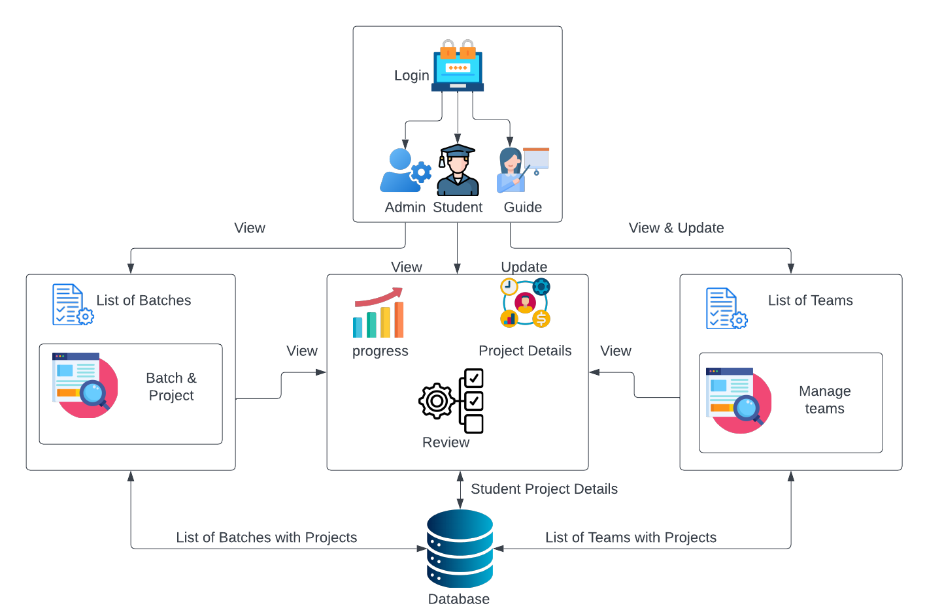
ARCHITECTURE DIAGRAM

Slide 10
MODULES
AUTHENTICATION MODULE:
This module verifies the login and signup data and maintains their information.
ADMIN MODULE:
This module contains the user who is controlling this portal. For example HOD.
PROJECT GUIDE MODULE:
This module contains each team guide. For example project guide.
STUDENT MODULE:
This module contains the team members who working on the project and they can update their progress.

Slide 11
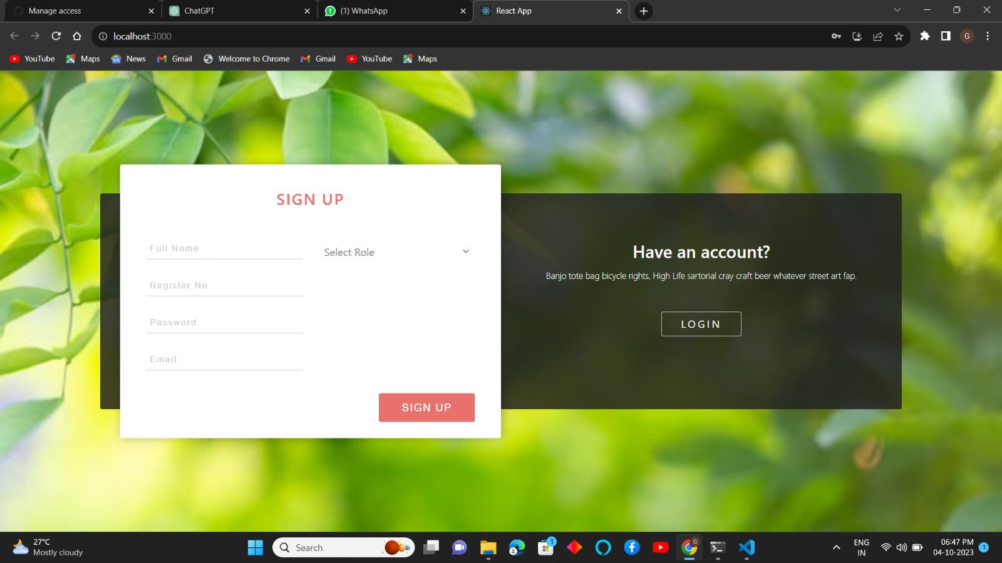
IMPLEMENTATION

Slide 12
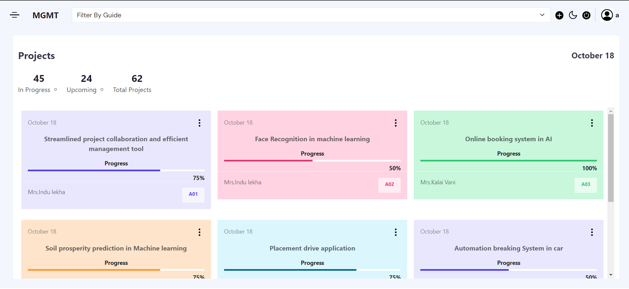
ADMIN MODULE

Slide 13
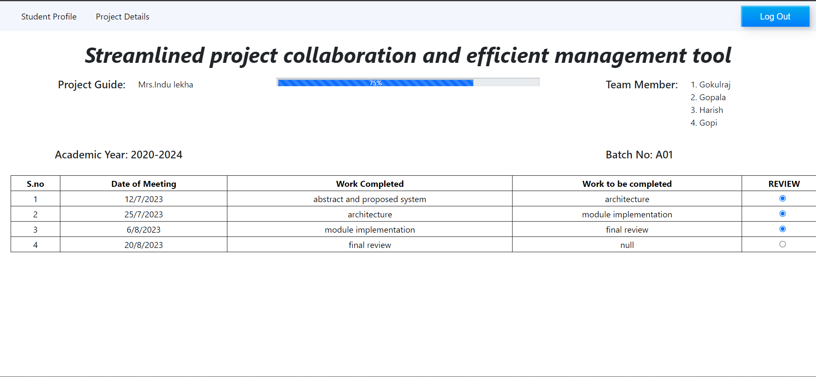
STUDENT MODULE

Slide 14
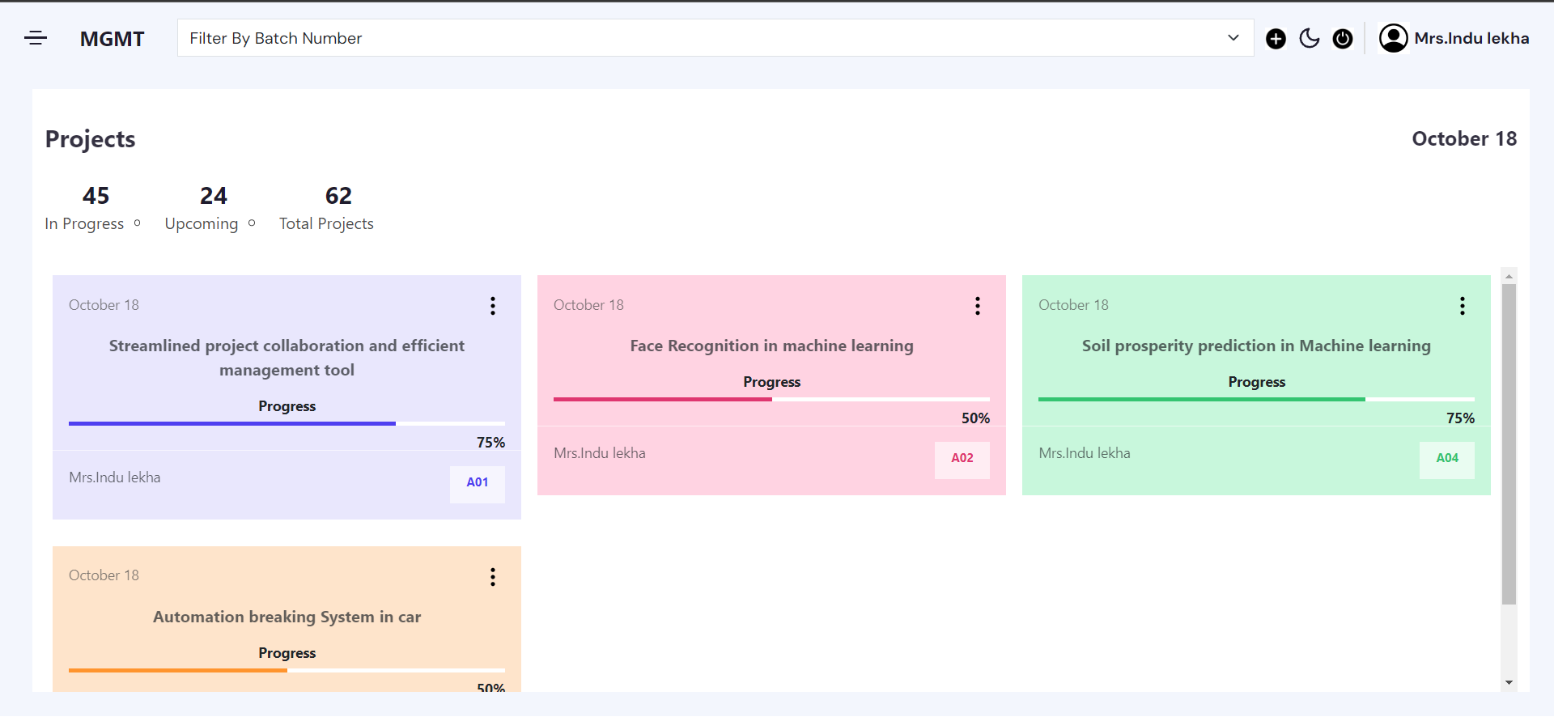
STAFF MODULE

Slide 15
CONCLUSION
The project management web application developed using React for the front end and Django for the back end, provides a robust and dynamic platform for efficiently managing and collaborating on projects. The seamless integration of React’s interactive user interfaces with Django's powerful backend capabilities allows for a user-friendly experience and effective project oversight.

