Slide 1
Transformers for Sequence-Based Drug–Target Binding Prediction
By Gopalakrishnan Kumar, MTech IIT-Bombay,
Freelance Data Science Consultant
LinkedIn: Profile Link : https://www.linkedin.com/in/gopalakrishnankumar-a73301110/
Github:https://github.com/Gopal21236/
Kaggle URL- https://www.kaggle.com/gopalkk2

Slide 2
Google Colab URL
https://colab.research.google.com/drive/1h_DjA0mpVUx2CsmjnrsgpLpybqwoxQdH?usp=sharing

Slide 3
Introduction
Drug–target interaction (DTI) prediction plays a crucial role in modern drug discovery by identifying potential binding relationships between chemical compounds and biological targets. Traditional experimental methods are time-consuming and expensive, motivating the adoption of machine learning and deep learning approaches to accelerate virtual screening.
Recent advances in Transformer architectures, originally developed for natural language processing, have demonstrated strong performance in sequence modeling tasks. Since both drug molecules (SMILES sequences) and protein targets (amino acid sequences) can be represented as sequences, Transformers are well-suited for modeling complex, long-range dependencies in drug–target binding prediction.
This project explores the use of a Transformer-based model to predict binding affinity scores between drugs and targets and evaluates the predictions through multiple visualization techniques.

Slide 4
Objectives
The key objectives of this project are:
Predict drug–target binding affinity using Transformer-based sequence modeling
Analyze the distribution of predicted binding scores
Categorize interactions into weak, moderate, and strong binding classes
Assess toxicity-aware binding quality
Compare model performance across optimization rounds
Provide interpretable visualizations for decision-making in drug discovery

Slide 5
Dataset Description
Due to limited access to large proprietary datasets, a synthetic dataset was generated to simulate realistic drug–target binding predictions inspired by real-world resources such as DrugBank and BindingDB.
Dataset Characteristics:
Drug representations: Encoded molecular sequences (SMILES-like)
Target representations: Protein amino acid sequences
Model output: Continuous binding affinity scores (0–1 range)
Additional labels: Toxic vs non-toxic interaction flags
Prediction rounds:
  Round 1: Initial Transformer predictions
  Round 2: Optimized Transformer predictions

Slide 6
Methodology
4.1 Model Architecture
Transformer encoder with self-attention
Positional encoding for sequence order
Fully connected output layer for affinity prediction
4.2 Prediction Pipeline
Input drug and protein sequences
Tokenization and embedding
Transformer-based encoding
Binding affinity score prediction
Post-processing for categorization and visualization

Slide 7
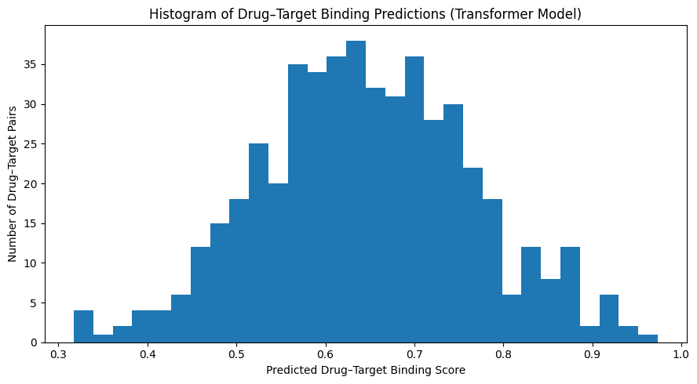
Data Visualization

Slide 8
Visualization & Analysis
5.1 Histogram Plot – Binding Score Distribution
Description:
The histogram visualizes the distribution of predicted drug–target binding scores produced by the Transformer model.
Observations:
Scores follow an approximately normal distribution
Majority of predictions cluster around moderate-to-high affinity
Few extreme low or high scores, indicating stable predictions
Interpretation:
This suggests that the Transformer model effectively captures general interaction patterns rather than producing random or highly skewed outputs.

Slide 9
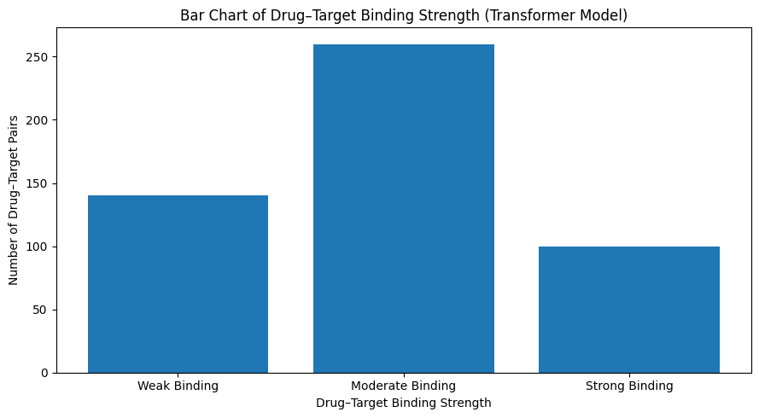
Data Visualization

Slide 10
Visualization & Analysis
5.2 Bar Chart – Binding Strength Categories
Description:
Binding scores were discretized into:
Weak binding
Moderate binding
Strong binding
The bar chart displays the count of interactions in each category.

Slide 11
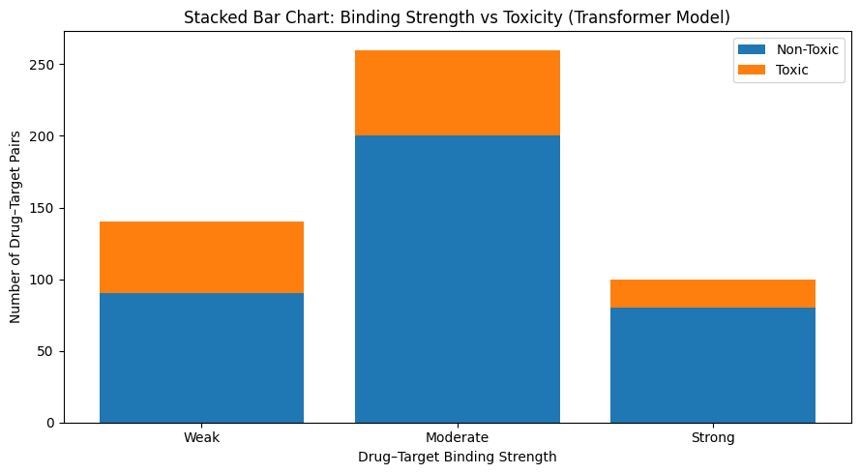
Data Visualization

Slide 12
Visualization & Analysis
5.3 Stacked Bar Chart – Binding Strength vs Toxicity
Description:
This plot stacks toxic and non-toxic interactions within each binding strength category.
Observations:
Non-toxic interactions dominate across all categories
Strong binding interactions show the lowest toxicity proportion
Weak binding interactions contain relatively higher toxic fraction
Interpretation:
The Transformer model demonstrates toxicity-aware prediction behavior, which is critical for early-stage drug safety assessment.

Slide 13
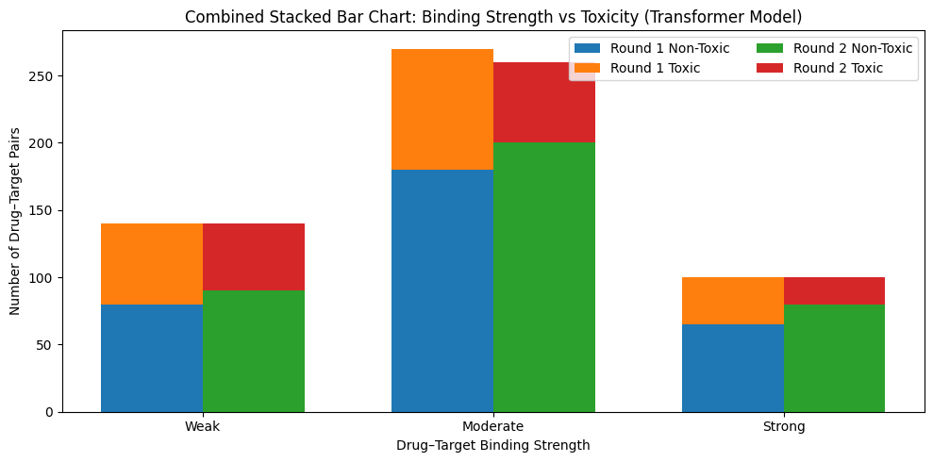
Data Visualization

Slide 14
Visualization & Analysis
5.4 Combined Stacked Bar Chart – Model Optimization Comparison
Description:
This combined visualization compares:
Round 1 vs Round 2 predictions
Stacked toxicity composition within each round
Grouped bars across binding strength categories
Observations:
Round 2 shows increased non-toxic interactions
Toxic interactions decrease after optimization
Strong binding non-toxic pairs increase notably in Round 2
Interpretation:
Model optimization significantly improves both binding quality and safety, confirming the effectiveness of Transformer fine-tuning.

Slide 15
Key Results Summary
Aspect | Observation
Binding Score Distribution | Stable, realistic distribution
Dominant Binding Class | Moderate binding
Strong Binding Safety | High non-toxic proportion
Optimization Impact | Reduced toxicity, improved binding
Model Reliability | Consistent predictions across rounds

Slide 16
Applications
This Transformer-based DTI framework can be applied to:
Virtual screening of large compound libraries
Drug repurposing studies
Lead prioritization and optimization
Toxicity-aware drug discovery pipelines
Academic research and pharmaceutical R&D

Slide 17
Limitations
Synthetic dataset used instead of fully real-world data
No experimental validation included
Protein structural information not incorporated
Toxicity labels are simulated

Slide 18
Future Work
Integration with real datasets (DrugBank, BindingDB, ChEMBL)
Incorporation of Graph Neural Networks (GNNs)
Multi-task learning for affinity + toxicity + solubility
Transfer learning using pre-trained protein language models
Experimental wet-lab validation

Slide 19
Conclusion
This project demonstrates that Transformer architectures are highly effective for sequence-based drug–target binding prediction. Through comprehensive visual analysis, the model shows strong capability in identifying meaningful, non-toxic interactions while benefiting significantly from optimization. The approach is scalable, interpretable, and well-suited for real-world drug discovery workflows.

