Slide 1
Air Quality Index Forecasting
By Gopalakrishnan Kumar, MTech IIT-Bombay,
Freelance Data Science Consultant
LinkedIn: Profile Link : https://www.linkedin.com/in/gopalakrishnankumar-a73301110/
Github:https://www.github.com/Gopalakrishnan-Kumar/
Kaggle URL- https://www.kaggle.com/gopalkk2

Slide 2
Google Colab URL
https://colab.research.google.com/drive/1UOADflBEuxTB4Nt7sm6fqKB_9Gps2A7t?usp=sharing

Slide 3
Introduction
Air quality is a crucial determinant of public health and environmental sustainability. The Air Quality Index (AQI) is a standardized measure used worldwide to represent pollution levels in the atmosphere. This project focuses on forecasting AQI trends using time series analysis.
By using a synthetic AQI dataset (2010–2024), we aim to:
Understand long-term trends in air quality.
Analyze seasonal variations in pollution levels.
Forecast AQI for the year 2025 using the ARIMA model.
Such forecasts help policymakers, city administrations, and healthcare providers anticipate pollution spikes and mitigate public health risks.

Slide 4
Dataset Description
Period Covered: January 2010 – December 2024 (15 years).
Frequency: Daily observations (~5,479 records).
Features:
  Date → Calendar date.
  AQI → Daily Air Quality Index value (range ~40–200).
  Year, Month, Season → Derived fields for aggregation and visualization.
The dataset incorporates trend (gradual rise in AQI), seasonality (winter peaks), and noise (random fluctuations) to simulate realistic pollution patterns.

Slide 5
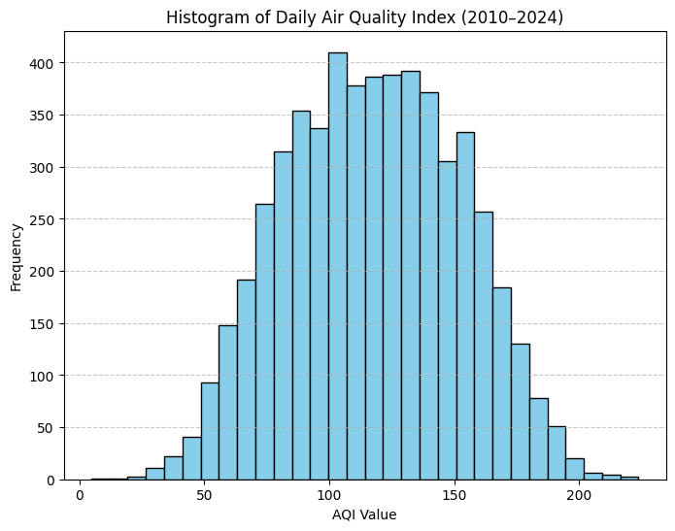
Data Visualization

Slide 6
Exploratory Data Analysis (EDA)
a) Histogram
The histogram shows that most AQI values fall between 80–120, representing moderate to unhealthy for sensitive groups.
There is a longer tail on the higher side (AQI > 150), representing episodes of severe pollution.

Slide 7
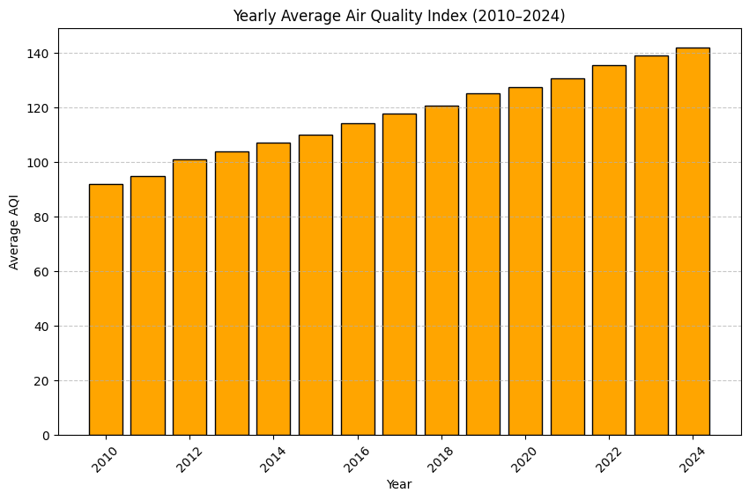
Data Visualization

Slide 8
Exploratory Data Analysis (EDA)
b) Yearly Average AQI (Bar Chart)
The yearly bar chart reveals a gradual upward trend in AQI from 2010 to 2024.
The increase aligns with synthetic trend modeling, but in real-world cases, this could represent urbanization, industrial growth, and traffic expansion.

Slide 9
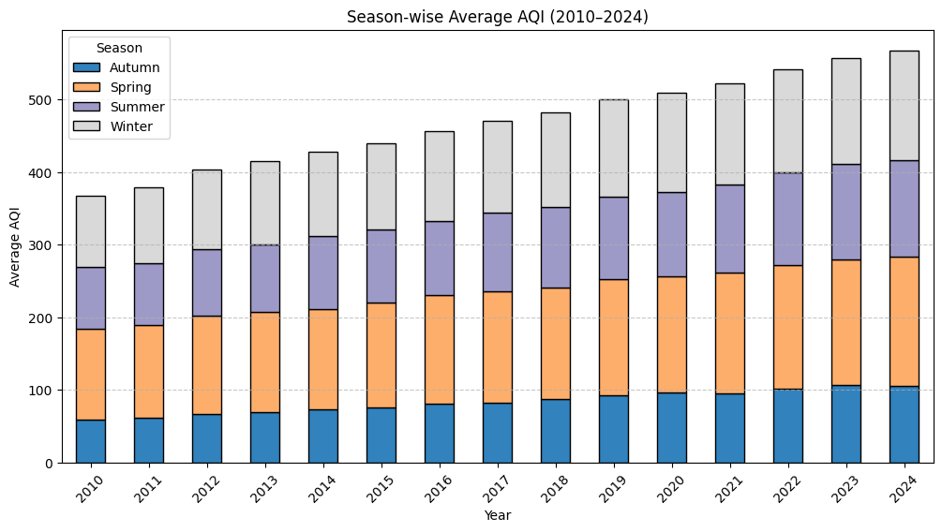
Data Visualization

Slide 10
Exploratory Data Analysis (EDA)
c) Season-wise AQI (Stacked Bar Chart)
Winter consistently shows the highest AQI levels, reflecting stagnant air, crop residue burning, and increased heating activities.
Summer and Spring generally report lower AQI levels due to higher wind speeds and rainfall aiding pollutant dispersion.

Slide 11
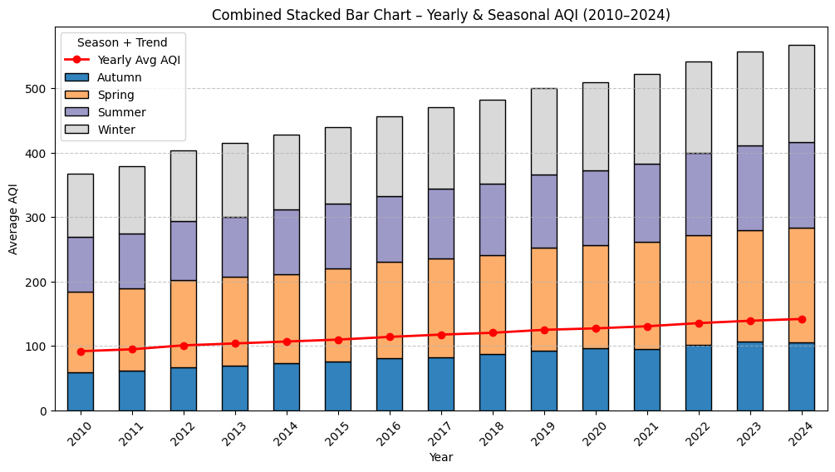
Data Visualization

Slide 12
Exploratory Data Analysis (EDA)
d) Combined Stacked Bar Chart
The stacked bars display season-wise contributions each year.
The red line (yearly average AQI) trends upward, confirming long-term deterioration in air quality.
Seasonal peaks are most visible in winters, while summers consistently remain the cleanest season.

Slide 13
Forecasting with ARIMA
Model Used:
ARIMA(2,1,2) was applied after ensuring stationarity.
The model effectively captured trend + seasonality + noise in the AQI dataset.
Forecast Results:
The model forecasts AQI values for 2025.
Predictions show continued upward trend, with seasonal peaks during winters.
Expected range for AQI in 2025:
  Summer/Autumn: ~80–120 (moderate pollution).
  Winter: ~130–170 (unhealthy levels).

Slide 14
Insights
Trend: AQI is rising slowly over the years → long-term deterioration.
Seasonality: Winter is the worst season for air pollution, summer is
the cleanest.
Forecast: Without intervention, pollution levels will continue to rise in 2025.
Health Implications: Rising AQI levels mean increased
risk of respiratory illnesses, allergies, and cardiovascular stress.

Slide 15
Conclusion
This project demonstrates the application of time series forecasting (ARIMA) for predicting air quality trends.
Policymakers can use such forecasts to plan emission control policies.
Healthcare providers can issue early warnings during forecasted high-pollution periods.
Citizens can adapt behavior (e.g., limiting outdoor activity on predicted high-AQI days).

Slide 16
Future Scope
Use real-world AQI datasets (e.g., CPCB, OpenAQ).
Extend analysis with SARIMA (seasonal ARIMA) or LSTM neural networks
for improved accuracy.
Add explanatory variables like temperature, humidity, traffic, and industrial output.
Deploy a dashboard (Power BI / Tableau) for real-time
AQI monitoring & forecasting.
✅ With this detailed analysis, the project provides both statistical insights and practical policy implications.

