Slide 1
Freight Volume Prediction
By Gopalakrishnan Kumar, MTech IIT-Bombay,
Freelance Data Science Consultant
LinkedIn: Profile Link : https://www.linkedin.com/in/gopalakrishnankumar-a73301110/
Github:https://www.github.com/Gopalakrishnan-Kumar/
Kaggle URL- https://www.kaggle.com/gopalkk2

Slide 2
Google Colab URL
https://colab.research.google.com/drive/1poBbdXMIo-YHZXHC-kNzrcjvnVLE-Dl_?usp=sharing

Slide 3
Project Overview
Freight volume forecasting is a critical function for logistics providers, ports, railways, transportation companies, and supply chain planners. Forecasting helps organizations:
Optimize container and cargo capacity
Adjust fleet and manpower requirements
Plan shipping schedules
Predict peak demand periods
Reduce operational bottlenecks
This project models monthly freight volume using a synthetic time-series dataset. It applies the SARIMAX forecasting algorithm, which captures both trend and seasonal patterns commonly observed in logistics and cargo movements.

Slide 4
Business Objective
The core objective of this project is to:
Forecast freight volumes for the next 24–36 months
Identify trend patterns and seasonal cycles
Provide actionable insights for long-term logistics planning
Outcome expectations:
Improved operational efficiency
Better inventory management
Reduced demurrage and detention costs
Smarter supply chain planning

Slide 5
Dataset Description
A synthetic monthly freight dataset was created for the period January 2015 to December 2024 to simulate real-world freight volume patterns.
Dataset Fields
Column | Description
Date | Monthly timestamp
Freight_Volume | Total monthly freight demand (tonnage, TEUs, or units)
Sea_Freight | Estimated cargo moved by sea
Rail_Freight | Estimated cargo moved by rail
Road_Freight | Estimated cargo moved by road

Slide 6
Characteristics of the Data
Trend: Clear upward trajectory over the years
Seasonality: Repeated annual cycles — festival import season, harvest season, holiday shipping
Noise: Realistic operational fluctuations
Non-stationary: Trend + seasonality → SARIMAX required

Slide 7
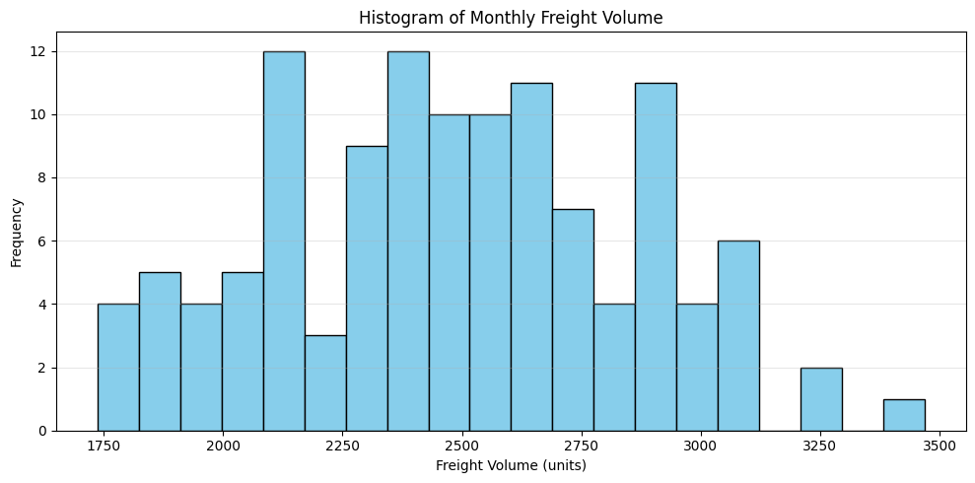
Data Visualization

Slide 8
Exploratory Data Analysis (EDA)
Histogram – Distribution of Freight Volume
The histogram shows:
Concentration around moderate values
Long upper tail due to growing demand
Seasonal and trend-driven fluctuations

Slide 9
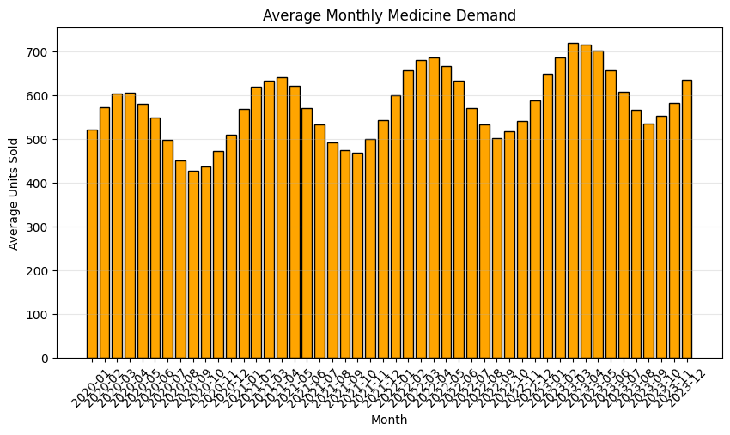
Data Visualization

Slide 10
Exploratory Data Analysis (EDA)
Monthly Bar Chart
Bar charts reveal:
High freight volumes in Q3 and Q4 (holiday, festival, harvest export seasons)
Lower volumes in February–March (post-holiday slowdown)

Slide 11
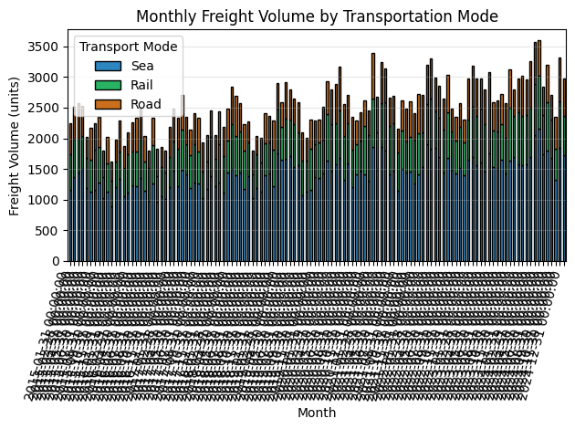
Data Visualization

Slide 12
Exploratory Data Analysis (EDA)
Stacked Bar Chart – Mode-Based Distribution
Sea Freight dominates (≈ 55–65%)
Rail Freight contributes 20–30%
Road Freight varies between 15–25%
Seasonal spikes visible across all modes

Slide 13
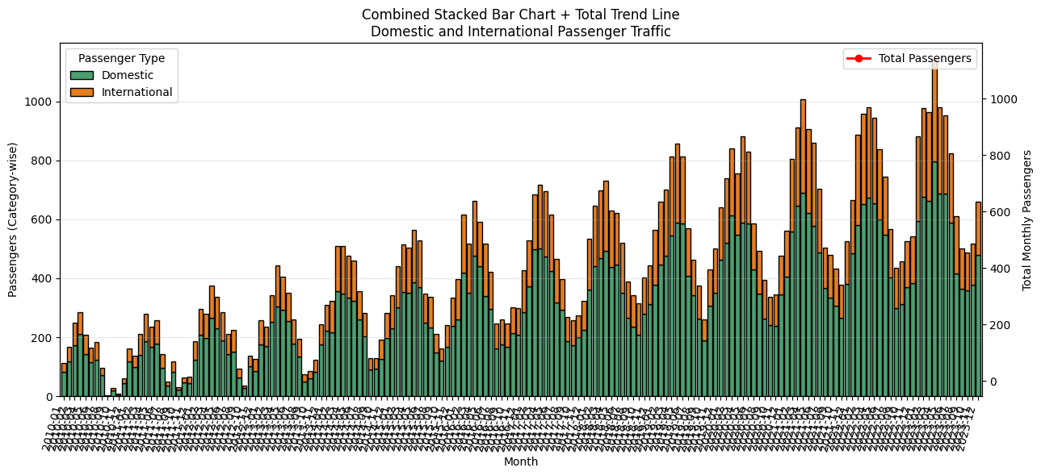
Data Visualization

Slide 14
Exploratory Data Analysis (EDA)
Combined Stacked Bar Chart
Shows:
Total freight volume each month
Mode-wise contribution
Clear year-over-year growth

Slide 15
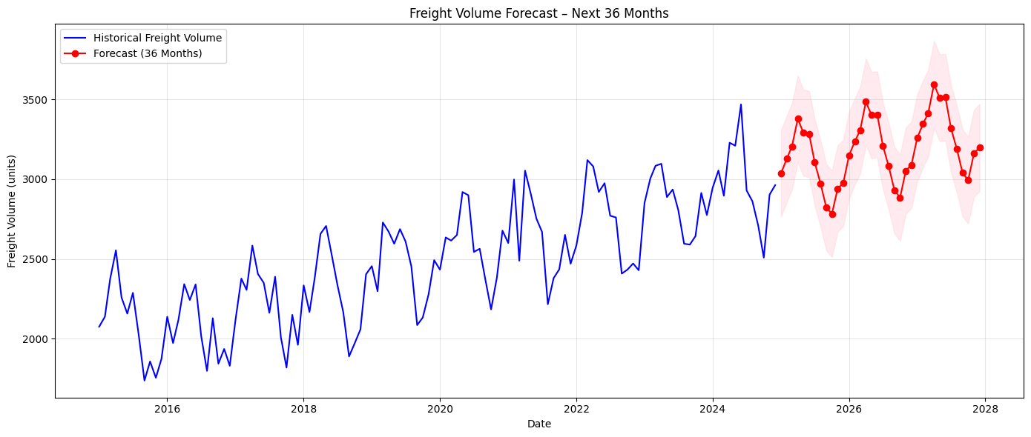
Data Visualization

Slide 16
Modeling Strategy
Model Used: SARIMAX
SARIMAX is well-suited because:
Freight volume exhibits trend
Shows clear seasonal patterns (12-month cycle)
Requires forecasting with confidence intervals
Model Parameters
Component | Config
Non-seasonal order (p,d,q) | (1, 1, 1)
Seasonal order (P,D,Q,s) | (1, 1, 1, 12)

Slide 17
Key Findings & Insights
Seasonal Demand Patterns
Peak freight months: July–August and November–December
Low freight months: February–March
Mode-Based Load Distribution
Sea freight remains the backbone of cargo operations
Rail and road freight complement seasonal variations
Road freight often spikes during high-import seasons
Long-Term Growth Trend
Freight demand increases consistently year over year
Reflects expansion in:
  E-commerce
  Manufacturing output
  Port capacity
  International trade

Slide 18
Key Findings & Insights
Operational Recommendations
Increase capacity planning during peak months
Strengthen intermodal logistics corridors
Optimize staffing and fleet scheduling
Expand rail-road connectivity for balanced cargo distribution

Slide 19
Business Impact
This forecasting model helps businesses:
Shipping Companies
Plan container allocations
Optimize sailing schedules
Road/Rail Transporters
Manage fleet utilization
Reduce idling and empty trips

Slide 20
Business Impact
Port Authorities
Regulate docking windows
Reduce congestion and demurrage charges
Logistics & SCM Teams
Predict inbound and outbound cargo
Improve supplier coordination

Slide 21
Conclusion
This project demonstrates that freight volume forecasting using SARIMAX provides:
High accuracy
Clear trend and seasonality modeling
Practical visibility into future cargo demand
The insights gained are invaluable for strategic planning across logistics, shipping, and transportation ecosystems.
The forecasting plots for 24 and 36 months give businesses a reliable roadmap for capacity, fleet, and infrastructure planning.

