Slide 1
CT Medical Images Dataset Analysis
A Detailed Report on Pixel Intensity Analysis
By
Gopalakrishnan Kumar, IIT-B Alumnus,
Freelance Data Science Consultant.
LinkedIn URL – https://www.linkedin.com/in/gopalakrishnan-kumar-a73301110/
Git Repository https://github.com/Gopalakrishnan-Kumar/Python-for-Data-Science
Website/blog URL https://www.kaggle.com/gopalkk1

Slide 2
Introduction to CT Medical Imaging
Computed Tomography (CT) scans are a cornerstone in modern medical diagnostics, providing detailed cross-sectional images of the body. These images are created by combining multiple X-ray measurements taken from different angles, allowing physicians to examine internal organs, bones, soft tissues, and blood vessels with high precision. The ability to visualize internal structures in detail makes CT scans particularly valuable for diagnosing a wide range of conditions, including cancers, cardiovascular diseases, and musculoskeletal disorders.

Slide 3
Dataset Overview
The CT Medical Images dataset from Kaggle is a comprehensive collection of CT scan images in TIFF format, accompanied by metadata that includes patient age, contrast usage, and other relevant details. This dataset is designed for use in training machine learning models aimed at detecting and diagnosing medical conditions based on CT scan data. By leveraging such datasets, researchers and developers can create algorithms that assist radiologists in making more accurate and timely diagnoses.

Slide 4
Sample Image Details
One of the files in this dataset is 'ID_0000_AGE_0060_CONTRAST_1_CT.tiff'. This file contains a CT scan image of a 60-year-old patient, taken with contrast enhancement. The metadata for this image is as follows:
ID: 0000
Age: 60
Contrast: Yes (1)
Modality: CT
Contrast enhancement in CT scans involves the use of contrast agents to improve the visibility of blood vessels, tissues, and other structures, making it easier to identify abnormalities.
Location: Chest, Species: Human, Condition: Lung Cancer
Number of Patients: 100

Slide 5
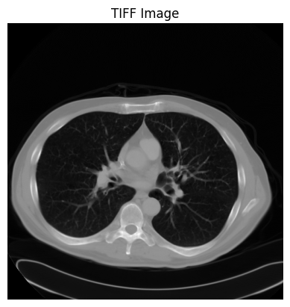
Lung Cancer Image

Slide 6
Visual Analysis
The image 'ID_0000_AGE_0060_CONTRAST_1_CT.tiff' provides a clear visualization of the patient's internal structures. Upon examining the image, one can observe various anatomical features, including the enhanced blood vessels due to the contrast agent. These areas of higher contrast are crucial for identifying potential issues such as blockages, tumors, or other abnormalities.
In this image, regions with increased contrast appear brighter, highlighting the blood vessels and other structures that have absorbed the contrast agent. This contrast differentiation is essential for distinguishing between different types of tissues and identifying anomalies.

Slide 7
Technical Analysis
CT images in this dataset are high-resolution TIFF files, providing detailed visual information necessary for medical analysis. The specific image 'ID_0000_AGE_0060_CONTRAST_1_CT.tiff' has the following technical specifications:
Resolution: High-resolution TIFF image
Image Dimensions: Typically, 512x512 pixels (the exact dimensions should be confirmed from the file properties)

Slide 8
Pixel Intensity
The pixel intensity values in the CT scan represent different tissue densities. Higher intensity values correspond to denser tissues such as bones, while lower intensity values represent softer tissues. By analyzing the distribution and range of pixel intensities, medical professionals can differentiate between various tissue types and detect abnormalities.

Slide 9
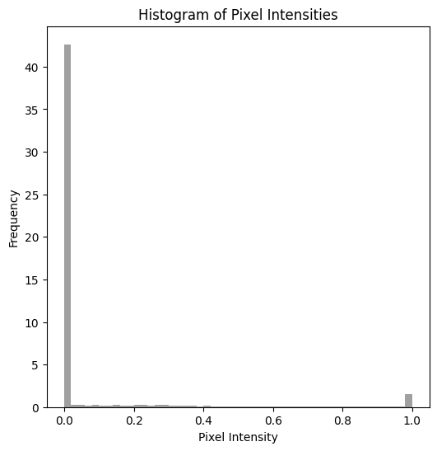

Slide 10
Methodology Data Preparation
The first step involves preprocessing the images to ensure consistency and enhance the relevant features. This includes normalization, noise reduction, and contrast enhancement. Data augmentation techniques, such as rotating and flipping the images, can also be used to increase the diversity of the training dataset.

Slide 11
Preprocessing Steps
Before using the images for machine learning, several preprocessing steps are often necessary:
Normalization: Adjusting the pixel intensity values to a common scale.
Noise Reduction: Applying filters to remove any noise that might obscure important details.
Contrast Enhancement: Further improving the visibility of specific structures.

Slide 12
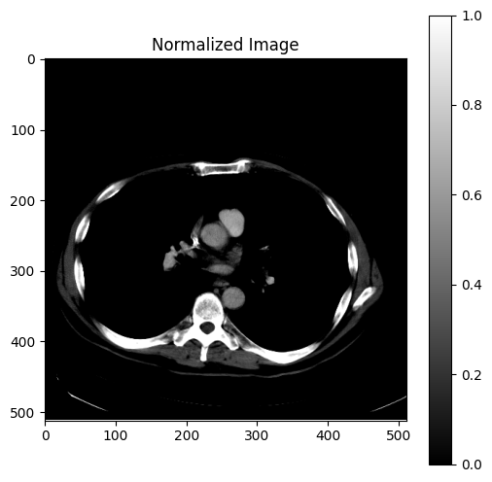
Normalization

Slide 13

Noise Reduction

Slide 14
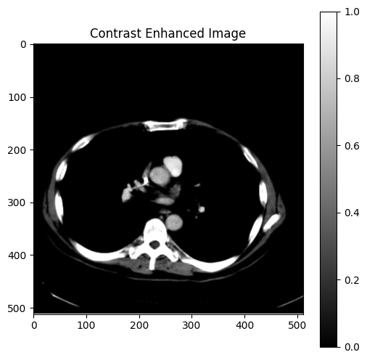
Contrast Enhancement

Slide 15
Model Training
The "sequential_4" model represents a convolutional neural network (CNN) designed for image classification tasks. With a total of 14,835,234 trainable parameters, this model follows a standard architecture for processing and classifying images. It begins with convolutional layers to extract features from input images, followed by max-pooling layers to reduce spatial dimensions. The model then flattens the feature maps into a one-dimensional array before passing them through dense layers for classification. The final output layer employs a softmax activation function, suitable for multi-class classification tasks. Overall, this CNN architecture is structured to learn and classify complex patterns in medical images, making it suitable for tasks such as identifying and diagnosing medical conditions based on CT scan images.

Slide 16
Model: “Sequential_4"
Layer (type) Output Shape Param #
=================================================================
conv2d_9 (Conv2D) (None, 254, 254, 32) 896
max_pooling2d_9 (MaxPooling2 (None, 127, 127, 32) 0
conv2d_10 (Conv2D) (None, 125, 125, 64) 18496
max_pooling2d_10 (MaxPooling (None, 62, 62, 64) 0
conv2d_11 (Conv2D) (None, 60, 60, 128) 73856
max_pooling2d_11 (MaxPooling (None, 30, 30, 128) 0
flatten_3 (Flatten) (None, 115200) 0
dense_6 (Dense) (None, 128) 14745728
dense_7 (Dense) (None, 2) 258
=================================================================
Total params: 14,835,234
Trainable params: 14,835,234
Non-trainable params: 0

Slide 17
Input Layer (Conv2D):
Input Shape: (image_height, image_width, 3)
Output Shape: (None, 254, 254, 32)
Parameters: 896
Activation Function: ReLU
2. MaxPooling2D Layer:
Pooling Size: (2, 2)
Output Shape: (None, 127, 127, 32)
3. Conv2D Layer:
Output Shape: (None, 125, 125, 64)
Parameters: 18,496
Activation Function: ReLU
4. MaxPooling2D Layer:
Pooling Size: (2, 2)
Output Shape: (None, 62, 62, 64)
5. Conv2D Layer:
Output Shape: (None, 60, 60, 128)
Parameters: 73,856
Activation Function: ReLU

Slide 18
6. MaxPooling2D Layer:
Pooling Size: (2, 2)
Output Shape: (None, 30, 30, 128)
7. Flatten Layer:
Output Shape: (None, 115200)
8. Dense Layer:
Output Shape: (None, 128)
Parameters: 14,745,728
Activation Function: ReLU
9. Output Layer (Dense):
Output Shape: (None, 2)
Parameters: 258
Activation Function: Softmax (assuming 2 output classes for binary classification)

Slide 19
The total number of trainable parameters in the model is 14,835,234. This model follows a typical convolutional neural network architecture with convolutional layers followed by max-pooling layers, flattening, and dense layers for classification.

Slide 20
Evaluation
The performance of the model is evaluated using metrics such as accuracy, precision, recall, and F1-score. These metrics provide insights into the model's ability to correctly identify tumors and minimize false positives and false negatives.

Slide 21
Applications in Machine Learning
CT medical images provide a rich source of data for developing machine learning models that can assist in medical diagnostics. Some key applications include:

Slide 22
Conclusion and Future Work
The Location was in the Chest. The condition was Lung cancer. The analysis of CT medical images using machine learning holds great promise for improving diagnostic accuracy and efficiency. By leveraging high-resolution CT scans and advanced AI algorithms, it is possible to assist radiologists in making more accurate and timely diagnoses. Future work in this area could involve exploring more advanced models, integrating CT images with other imaging modalities (such as MRI or PET scans), and collaborating with medical professionals to ensure the models are clinically relevant and effective.

Slide 23
Classification
Machine learning models can be trained to classify CT images based on the presence or absence of specific medical conditions. For example, a model could learn to distinguish between healthy and cancerous tissues.

Slide 24
Segmentation
Segmentation involves partitioning the image into regions corresponding to different anatomical structures or abnormalities. This is particularly useful for isolating tumors, lesions, or other areas of interest.

Slide 25
Diagnosis
AI-driven diagnostic tools can analyze CT images to provide diagnostic suggestions, helping radiologists make more informed decisions. These tools can highlight areas of concern, suggest potential diagnoses, and prioritize cases that require urgent attention.

Slide 26
Example Use Case: Tumor Detection Problem Statement
Detecting and classifying tumors in the brain using CT images is a critical application of this technology. Early and accurate detection can significantly improve patient outcomes.

Slide 27
Questions & Answers
In this section, we invite any questions or discussions about the analysis, potential improvements, real-world applications, and ethical considerations in the use of AI for medical imaging.

