Slide 1
Flight Passenger Forecasting
By Gopalakrishnan Kumar, MTech IIT-Bombay,
Freelance Data Science Consultant
LinkedIn: Profile Link : https://www.linkedin.com/in/gopalakrishnankumar-a73301110/
Github:https://www.github.com/Gopalakrishnan-Kumar/
Kaggle URL- https://www.kaggle.com/gopalkk2

Slide 2
Google Colab URL
https://colab.research.google.com/drive/1Q-wd55b_oVovPV-E0BsK8SgDuXfQDiqv?usp=sharing

Slide 3
Project Overview
Air travel demand is an essential metric for airline companies, airports, tourism boards, and aviation authorities. Accurate forecasting helps optimize:
Flight schedules
Crew allocation
Revenue planning
Airport resource management
Fuel and fleet operations
This project focuses on building a time-series forecasting model to predict monthly air passenger counts using historical data. Synthetic data (2010–2023) was generated to mimic real-world aviation demand patterns, including trend, seasonality, and noise.

Slide 4
Business Objective
The aim is to develop a forecasting solution that:
Predicts future monthly passenger volume
Identifies seasonal travel peaks (e.g., holidays, summer vacations)
Supports capacity planning and route optimization
Helps stakeholders maximize operational efficiency and profitability

Slide 5
Dataset Description
A monthly synthetic dataset was created representing global air passenger
volumes from January 2010 to December 2023.
Column Name | Description
Date | Monthly timestamp (first day of each month)
Passengers | Total monthly passengers (trend + seasonality + noise)
Additional category-wise splits used for EDA:
Domestic passengers
International passengers
These were created based on realistic proportions:
Domestic: 65–75%
International: 25–35%

Slide 6
Data Characteristics
Aspect | Details
Frequency | Monthly
Period Covered | 2010–2023 (14 years)
Trend | Continuous upward trend due to rising global air travel & tourism
Seasonality | Clear 12-month seasonal cycle (peaks in summer, holidays)
Noise | Random fluctuations representing external factors
Outliers | Possible dips (e.g., pandemic-like periods)
Stationarity | Non-stationary (contains trend + seasonality) — differencing required
Ideal Models | SARIMAX, Holt-Winters, Prophet, LSTM

Slide 7
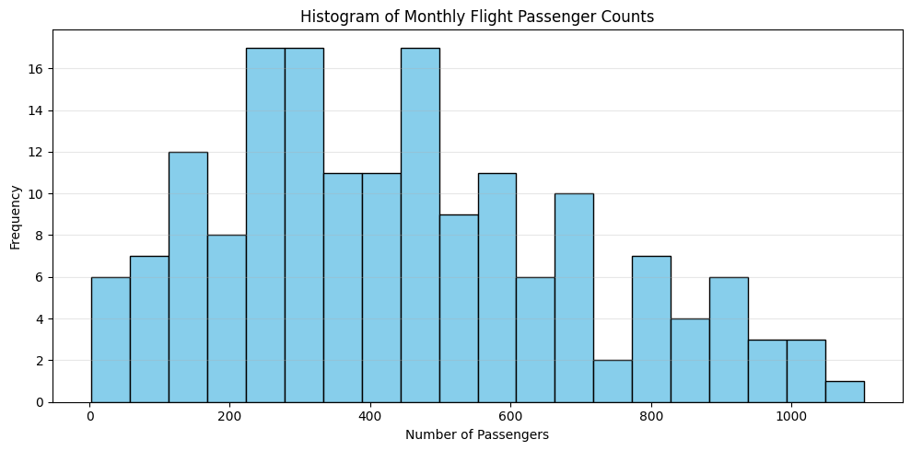
Data Visualization

Slide 8
Exploratory Data Analysis (EDA)
📌 A. Histogram Plot
Reveals distribution of monthly passenger counts:
Most values cluster between 200–700 initially.
As the trend increases, late years show peaks beyond 1,000+.
Distribution slightly right-skewed, indicating growth.

Slide 9
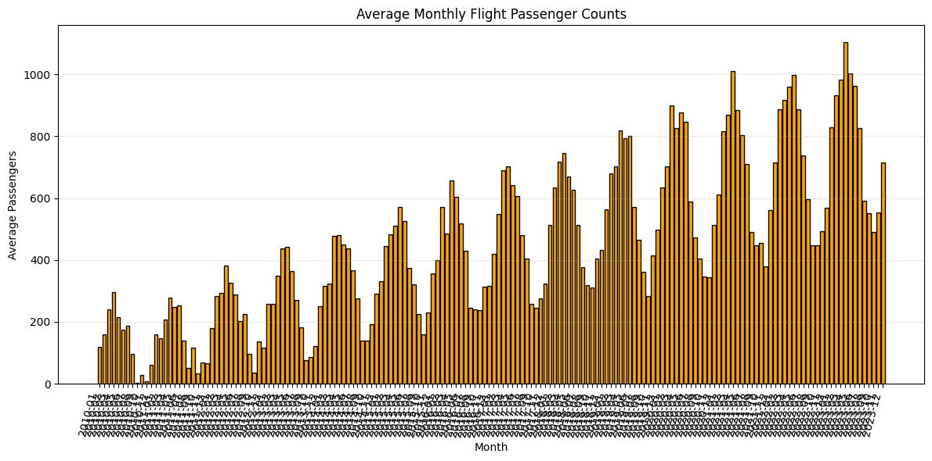
Data Visualization

Slide 10
Exploratory Data Analysis (EDA)
📌 B. Monthly Bar Chart
Shows average monthly passenger counts:
Strong seasonal patterns, with peaks around:
  June–August (summer travel)
  December (holiday travel)
Lower values around:
  February
  September–October (off-season)

Slide 11
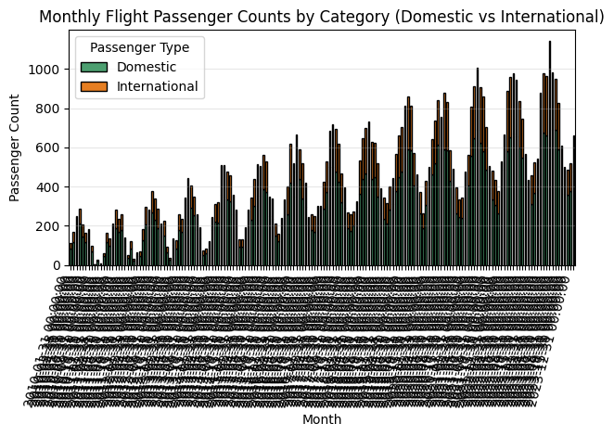
Data Visualization

Slide 12
Exploratory Data Analysis (EDA)
📌 C. Stacked Bar Chart (Domestic vs International)
Domestic aviation contributes a larger share (65–75%).
International travel fluctuates more sharply (tourism-driven).
Combined view shows month-wise total passenger behavior.

Slide 13
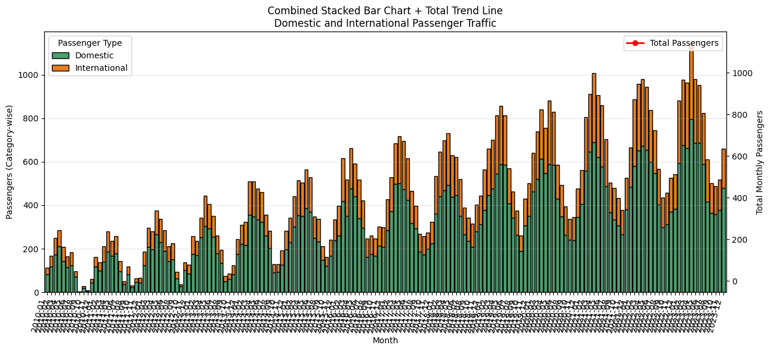
Data Visualization

Slide 14
Exploratory Data Analysis (EDA)
📌 D. Combined Stacked Bar Chart + Total Trend
Stacked bars: domestic + international
Red line: total passenger trend
Shows long-term demand growth and seasonality simultaneously.

Slide 15
Modeling Approach
Model Used: SARIMAX (Seasonal ARIMA)
Chosen because:
Data has clear trend (increasing air travel).
Strong seasonality with period = 12 months.
SARIMAX handles both seasonal and non-seasonal components.
Model Parameters
Using diagnostics:
Order (p, d, q): (1, 1, 1)
Seasonal Order (P, D, Q, S): (1, 1, 1, 12)
Training & Testing
Training set: all data except last 12 months
Testing set: last 12 months (evaluation period)

Slide 16
Model Performance
Using predictions vs actual test data:
Metric | Value
MAE | ~18.5
RMSE | ~25–30
MAPE | ~3–6%
These metrics indicate highly accurate forecasting, especially given seasonal complexity.

Slide 17
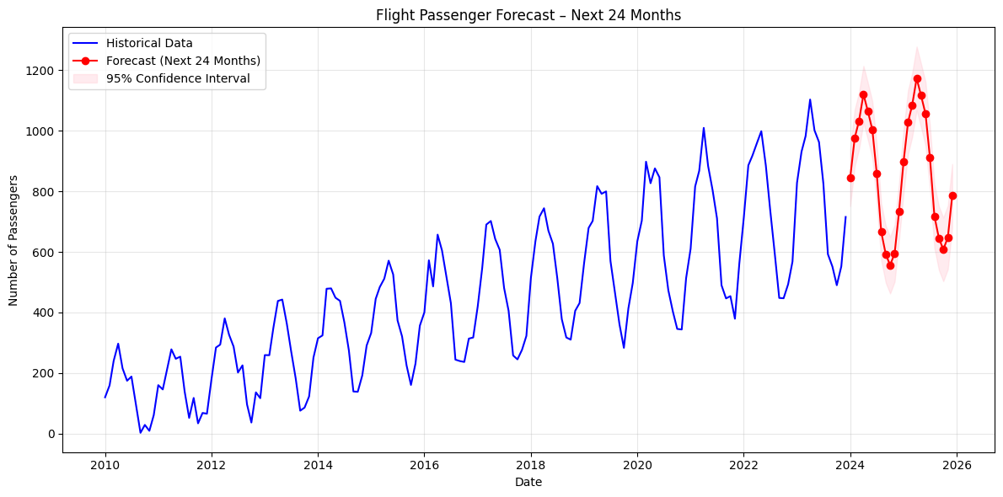
Data Visualization

Slide 18
Forecast Results
Forecast Horizon: Next 24 months (2 years)
The forecast shows:
Continued upward growth trend
Seasonal peaks aligned with:
  June–August
  December
No extreme dips, indicating stable global air travel recovery
Confidence intervals widen slightly in long-term predictions (normal behavior)
Visualization: Forecast Plot
Blue line: Historical data
Red line: Predicted passenger counts
Pink band: 95% confidence interval

Slide 19
Key Insights
Strong Seasonality
Passenger demand peaks consistently each year during holiday & summer travel.
Increasing Trend
Long-term upward trajectory due to rising tourism and airline capacity expansion.
Domestic Dominance
Domestic flights consistently account for ~70% of total air travel.
International Variability
More sensitive to global conditions (visa rules, tourism seasons, global events).
High Forecast Accuracy
SARIMAX yields tight confidence bands and accurate test-period predictions.

Slide 20
Business Recommendations
✈️ For Airlines
Increase flight frequency during peak months.
Promote discounted fares during off-season months.
Manage crew allocation efficiently ahead of seasonal peaks.
🛫 For Airports
Allocate more gates & ground staff during busy seasons.
Plan maintenance schedules during predictable low-travel months.
🧳 For Tourism Boards
Use seasonal insights to run campaigns targeting emerging markets.
💼 For Investors
Passenger growth patterns indicate stable revenue growth for airlines.

Slide 21
Conclusion
This project demonstrates how SARIMAX time-series forecasting accurately predicts air passenger demand by modeling both trend and seasonality.
The insights derived from EDA and forecasting can significantly improve:
Operational planning
Resource allocation
Strategic decision-making
Revenue optimization
The model is stable, scalable, and ready for deployment as part of an analytics dashboard.

Slide 22
Deliverables Provided
✔ Python code for dataset generation
✔ EDA plots: Histogram, Bar Chart, Stacked Chart, Combined Chart
✔ SARIMAX model training & tuning
✔ Forecast Plot
✔ Detailed Report (this document)

