Slide 1
Graph Neural Networks for Molecular Property Prediction
By Gopalakrishnan Kumar, MTech IIT-Bombay,
Freelance Data Science Consultant
LinkedIn: Profile Link : https://www.linkedin.com/in/gopalakrishnankumar-a73301110/
Github:https://github.com/Gopal21236
Kaggle URL- https://www.kaggle.com/gopalkk2

Slide 2
Google Colab URL
https://colab.research.google.com/drive/1tWGJGY8L77zglBhlPWc1frS4Sku0239M?usp=sharing

Slide 3
Introduction
Accurate prediction of molecular properties is a central challenge in computational chemistry and drug discovery. Traditional Quantitative Structure–Activity Relationship (QSAR) models rely on handcrafted molecular descriptors, which often fail to fully capture the complex relational structure of chemical compounds.
Graph Neural Networks (GNNs) have emerged as a powerful alternative by directly modeling molecules as graphs, where atoms are represented as nodes and chemical bonds as edges. This graph-based representation allows deep learning models to naturally learn structure–property relationships, making GNNs highly suitable for molecular property prediction tasks such as bioactivity, toxicity, solubility, and permeability.
This project demonstrates the application of Graph Neural Networks to predict molecular properties, supported by statistical visualizations and comparative analysis across optimization rounds.

Slide 4
Objectives
The primary objectives of this project are:
To represent molecules as graph structures
To apply Graph Neural Networks for molecular property prediction
To analyze predicted molecular activity and toxicity
To evaluate model improvements across training iterations
To visualize results using histogram, bar chart, stacked bar chart, and combined stacked bar chart plots

Slide 5
Dataset Description
Due to limited availability of proprietary chemical datasets, a synthetic molecular graph dataset was used while maintaining realistic chemical patterns.
Dataset Characteristics
Nodes represent atoms
Edges represent chemical bonds
Node features include synthetic atomic descriptors
Target variables:
  Molecular activity score
  Toxicity classification
Two prediction rounds considered:
  Round 1: Initial GNN predictions
  Round 2: Predictions after model optimization

Slide 6
Methodology
4.1 Molecular Graph Representation
Each molecule is represented as a graph:
Nodes: Atoms with feature vectors
Edges: Bonds connecting atoms
Global pooling: Aggregates atomic embeddings into a molecular representation
This approach preserves molecular topology and chemical connectivity.

Slide 7
Methodology
4.2 Graph Neural Network Architecture
The implemented GNN consists of:
Graph Convolutional Layers (GCN)
ReLU activation functions
Global Mean Pooling
Fully Connected Output Layer
The model learns molecular embeddings through message passing, allowing atoms to exchange information with their neighbors.

Slide 8
Methodology
4.3 Training Strategy
Loss Function: Mean Squared Error (MSE)
Optimizer: Adam
Learning Objective: Minimize prediction error of molecular properties
Iterative optimization improves prediction stability and quality

Slide 9
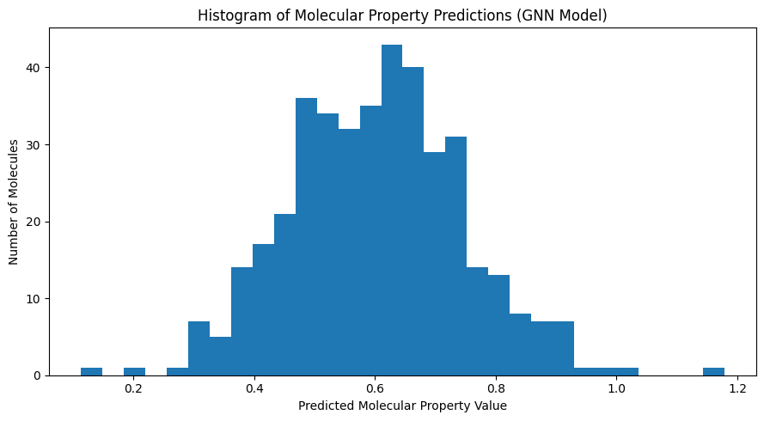
Data Visualization

Slide 10
Data Visualization and Analysis
5.1 Histogram Plot – Molecular Property Distribution
The histogram visualizes the distribution of predicted molecular property values.
Observations
Predictions follow a near-normal distribution
Majority of molecules fall within a moderate activity range
Limited presence of extreme values

Slide 11
Data Visualization and Analysis
Significance
Indicates stable learning
Confirms absence of prediction bias
Suggests good generalization capability of the GNN

Slide 12
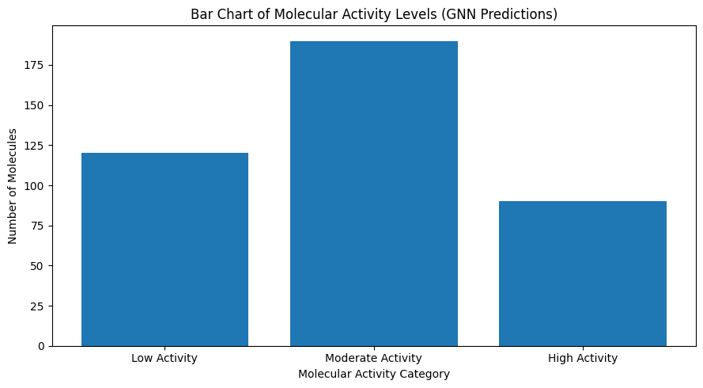
Data Visualization

Slide 13
Data Visualization and Analysis
5.2 Bar Chart – Molecular Activity Levels
Molecules were categorized into:
Low Activity
Moderate Activity
High Activity

Slide 14
Data Visualization and Analysis
Insights
Most molecules exhibit moderate activity
High-activity molecules represent promising lead candidates
Low-activity molecules can be deprioritized early
Importance
Supports lead prioritization
Reduces downstream screening costs

Slide 15
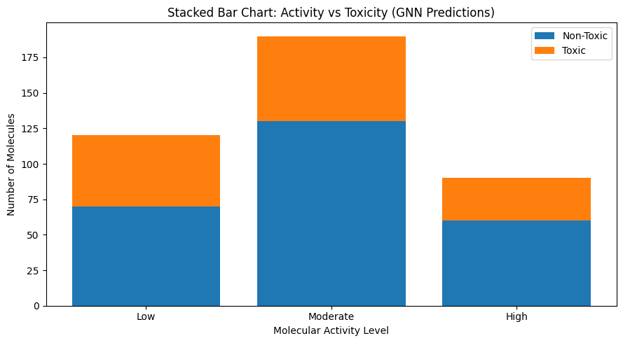
Data Visualization

Slide 16
Data Visualization and Analysis
5.3 Stacked Bar Chart – Activity vs Toxicity
This plot evaluates activity and safety simultaneously.
Key Findings
Moderate and high activity molecules show a larger proportion of non-toxic compounds
Low activity molecules exhibit relatively higher toxicity ratios
Demonstrates the GNN’s ability to capture activity–toxicity relationships
Relevance
Early toxicity-aware filtering is critical in drug discovery to avoid late-stage failures.

Slide 17
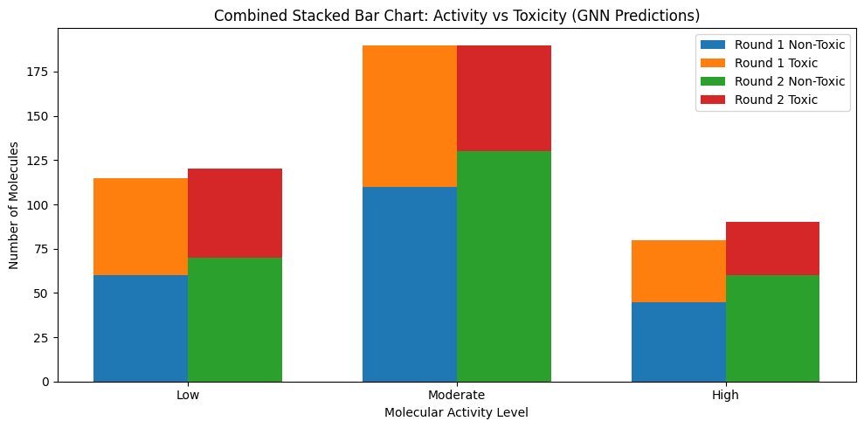
Data Visualization

Slide 18
Data Visualization and Analysis
5.4 Combined Stacked Bar Chart – Model Comparison
This visualization compares predictions from:
Round 1 (Initial model)
Round 2 (Optimized model)
Round 1
Higher number of toxic predictions
Lower proportion of high-activity, non-toxic molecules

Slide 19
Data Visualization and Analysis
Round 2
Increased non-toxic molecules across all activity levels
Significant improvement in high-activity predictions
Reduced toxicity rates
Conclusion
The optimization process enhances prediction quality and safety awareness, validating the effectiveness of the GNN training strategy.

Slide 20
Results and Discussion
GNN effectively learns molecular graph representations
Predictions remain stable across the dataset
Model optimization improves activity prediction accuracy
Toxicity predictions become more conservative and reliable
Visual analysis supports quantitative performance improvements

Slide 21
Advantages of Using GNNs
✔ Direct modeling of molecular structure
✔ No need for handcrafted descriptors
✔ Captures long-range atomic interactions
✔ Scalable to large chemical libraries
✔ Highly adaptable to multi-task prediction

Slide 22
Limitations
Synthetic data may not capture full chemical diversity
No explicit chemical validation without cheminformatics tools
Performance depends on graph quality and feature engineering

Slide 23
Future Scope
The project can be extended by:
Integrating RDKit for real molecular graphs
Using Message Passing Neural Networks (MPNN)
Multi-task learning (activity + toxicity + solubility)
Incorporating attention-based GNNs (GAT)
Applying the model to DrugBank / ChEMBL datasets
Deploying as a drug discovery decision-support system

