Slide 1
Capstone Project
Ramya Gopalan

Slide 2
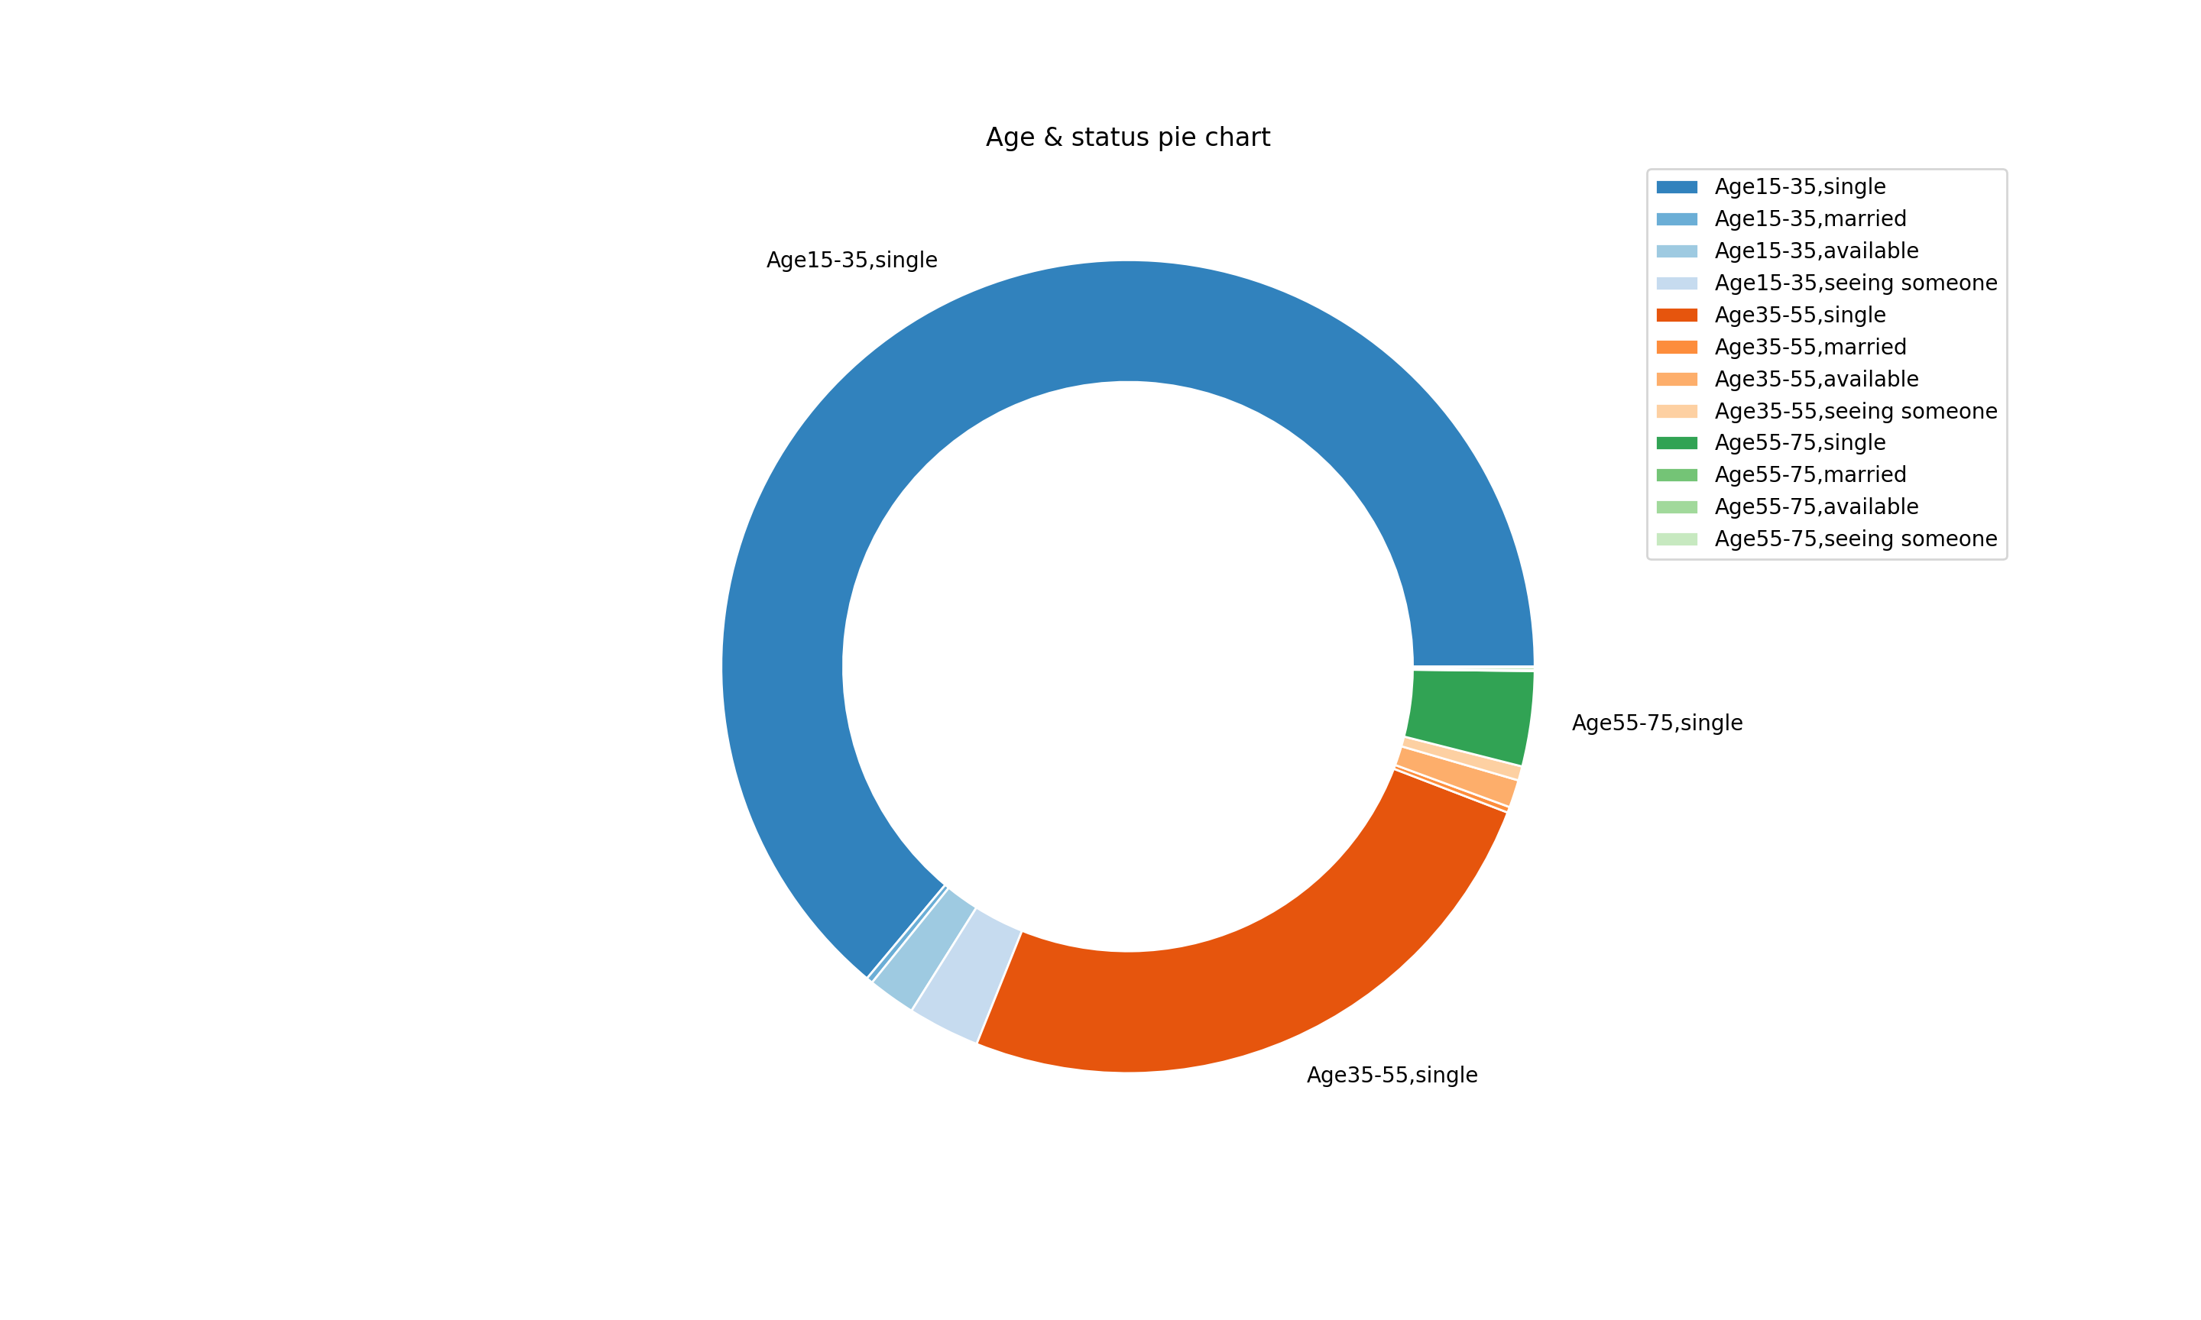
Data Exploration: Plot #1
Majority of OKCupid users fall in the single, age 15 – 35 bracket

Slide 3
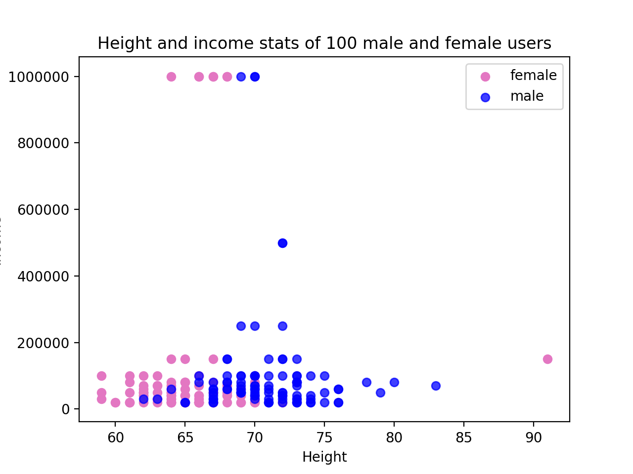
Data Exploration: Plot #2
Height of male users on an average larger than height of female users

Slide 4
Data augmentation
2 new columns created were
status of user mapped to as a set of numbers using panda dataframe’s map function as follows
{'single':1, 'married': 2, 'available': 3, 'seeing someone': 4, 'unknown': 5}
Number of times the user uses love in his/her essay using python string object’s count function and applying it on each index using a lambda function
loveCnts = df.essay0.apply(lambda x: x.count("love"))

Slide 5
Classification Problem Statement
To determine if OKCupid user is male or female based on income and height stats
Based on data exploration experiments, there was no over-whelming feature to discriminate relationship status of user ( single, married, etc) based on income, essay information, or even age
Male-female classification using height of user supported with other features such as income information and essay info showed a good level of accuracy (testing and training).

Slide 6
Regression Problem Statement
To determine age of user based on income and essay length information
Out of all the continuous valued columns in the data set (age, income and height), I picked age as the variable of interest
On doing further data exploration, I was unable to converge to a feature / set of features that did a good job of regressing to the right age.
Both linear regression and KNN regression showed poor accuracy numbers

Slide 7
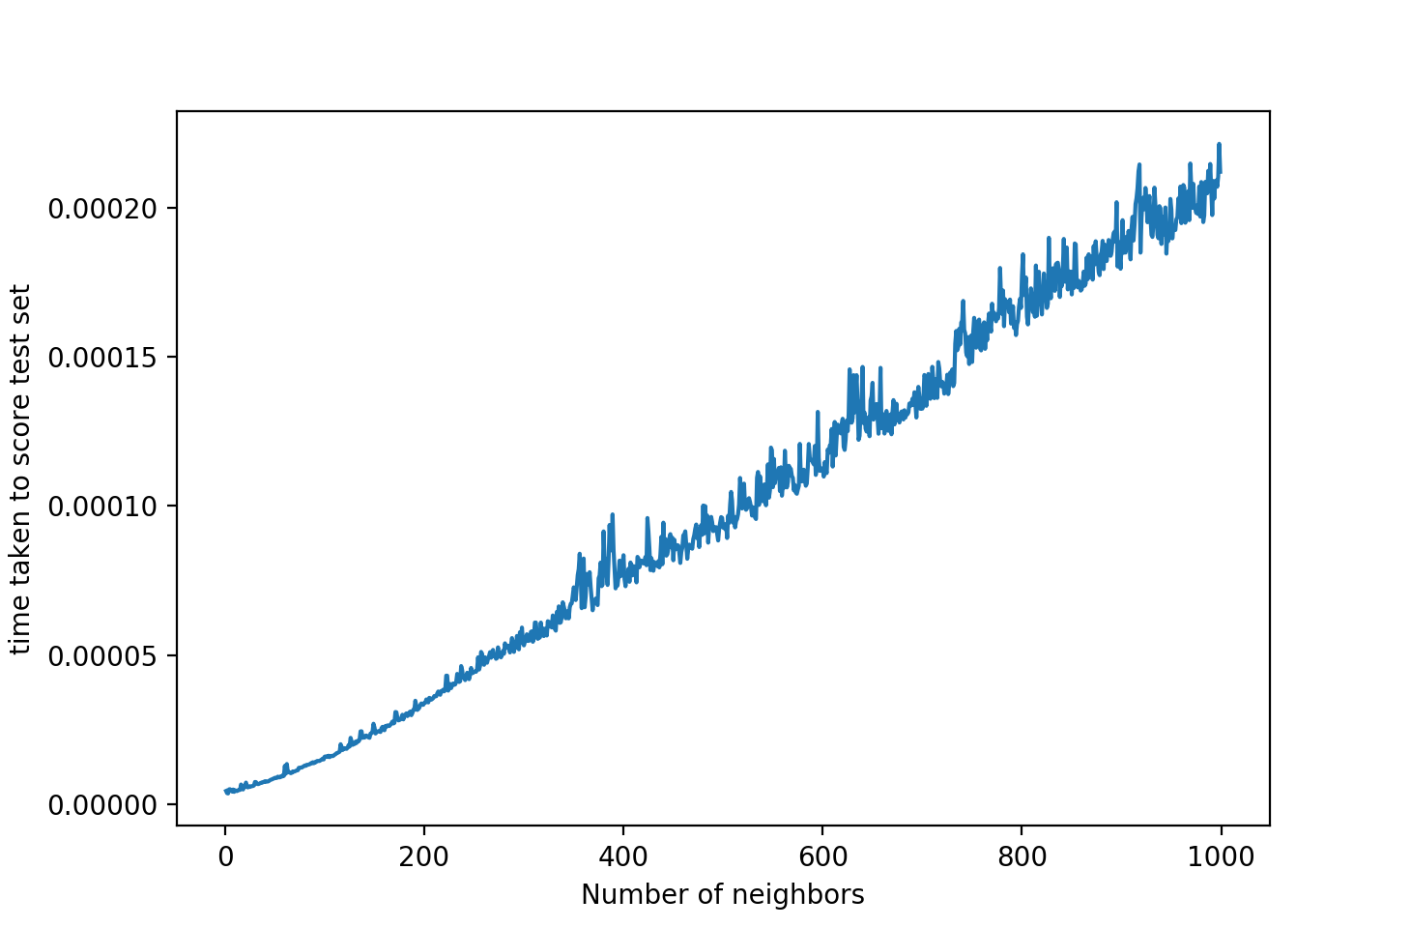
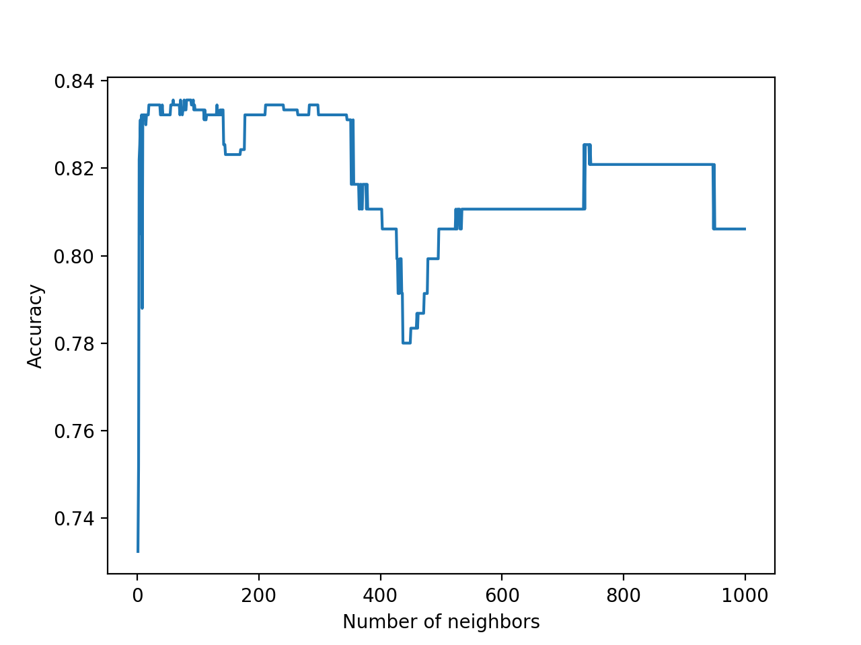
Classification #1: KNN
Maximum accuracy on the test set is in the range 0. 82 to 0.84
Time taken to run classifier using optimal number of neighbors
( between 50 – 200) around 0.00005 seconds on a MacBook Pro
From the time to run, picking 50 neighbors seems optimal
Confusion matrix for n_neighbors = 50 gives the following result
M F
M 379 130
F 37 336
From the confusion matrix, we gather:
Precision for detection of male ~ 379 / (379 + 37)
~ 0.91
Precision for detection of female ~ 336 / (336 + 130)
~ 0.72
Recall for detection of male ~ 379 / (379 + 130)
~ 0.744
Recall for detection of female ~ 336 / (336 + 37)
~ 0.9
Observations:
We obtain pretty good Accuracy, precision and recall scores

Slide 8
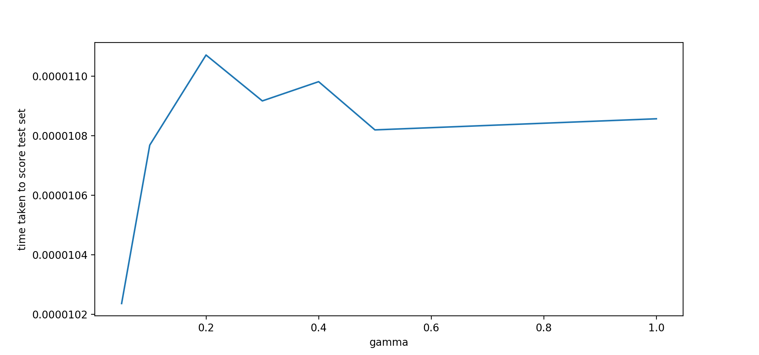
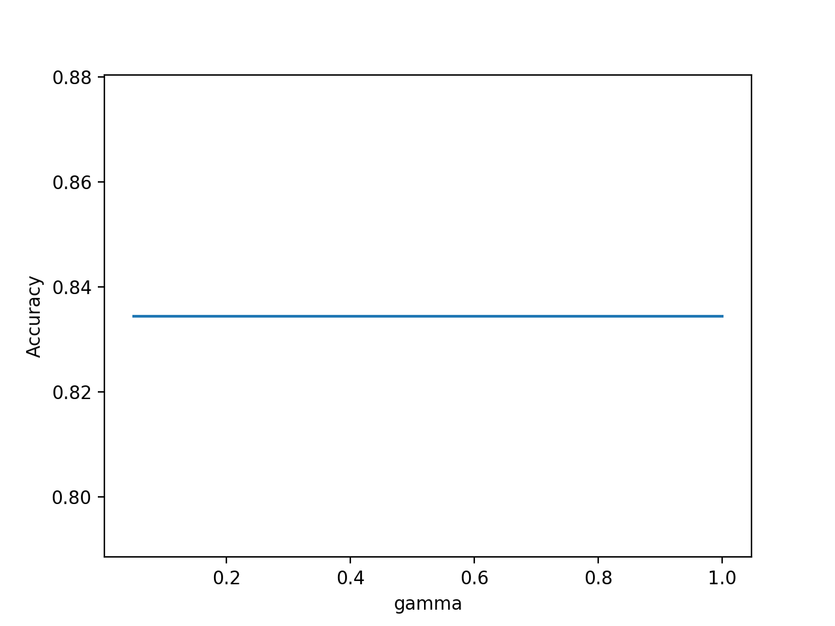
Classification #2: SVM
Pretty high accuracy noted on the test set using a linear kernel ~ 0.84
Time taken to run classifier using linear kernel ~ 0.1 ms similar to KNN which was around 0.5 msec
Confusion matrix
M F
M 419 89
F 77 297
From the confusion matrix, we gather:
Precision for detection of male ~ 419 / (419 + 77)
~ 0.85
Precision for detection of female ~ 297 / (89 + 297)
~ 0.77
Recall for detection of male ~ 419 / (419 + 89)
~ 0.83
Recall for detection of female ~ 297 / (77 + 297)
~ 0.79
Observations:
- We obtain pretty good Accuracy, precision and recall scores
- Male classification seems to be better than female classification

Slide 9
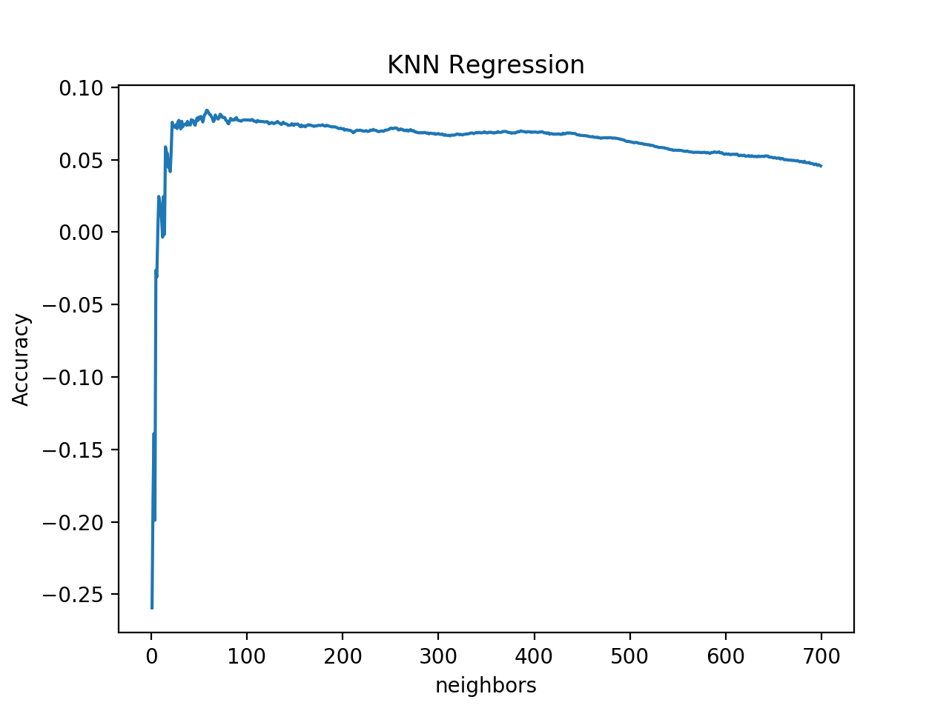
Regression
Age was chosen as variable for interest and income was chosen as the feature
Here are the performance numbers for the 2 regression techniques used
Regression | Accuracy | Timing (secs)
Linear | 0.00067 | 8.539277680066167e-07
KNN | 0.076 | 0.07338544264485392

Slide 10
Regression
On an average, although accuracy was really poor, KNN performed better than linear purely based on objective scores.
But KNN regression took longer than linear regression

Slide 11
Conclusion
Classification of Male v/s Female proved to be pretty robust given height as a feature
Predicting age using regression given features like income, essay length or the number of ‘I’ s used in the essay did not provide good results.
Next steps:
Features (variables) did not show a strong correlation with each other and posed a challenge to discrimination and prediction

