Slide 1
Kepoin Fakultas Teknik Universitas Indonesia (KLENIK)
Kelompok 16:
Muhammad Naufal Faza (NPM)
Muhammad Raihan Azhari (NPM)
Miranty Anjani Putri (NPM)

Slide 2
Apa itu KLENIK?
Kepoin Fakultas Teknik Universitas Indonesia atau KLENIK merupakan sebuah aplikasi berbasis web untuk menampilkan informasi mengenai Fakultas Teknik UI.
KLENIK akan menampilkan informasi-informasi mengenai Jurusan, serta Organisasi dan Kegiatan yang terdapat pada FT UI. Selain itu, user dapat berdiskusi dengan user-user lain. Role user dibedakan menjadi dua: yaitu sebagai mahasiswa dan non-mahasiswa.
User dapat menambahkan maupun menghapus salah satu jurusan sebagai jurusan yang mereka inginkan (wishlist).

Slide 3
Halaman pada Web KLENIK
Pejuang PTN
Berisi daftar Jurusan, Departemen, serta daya tampung per Jurusan.
Tentang Jurusan
Berisi daftar Jurusan, Departemen, Kurikulum, Prospek Karir, dan menambahkan jurusan sebagai wishlist.
Organisasi dan Kegiatan
Berisi seluruh organisasi dan kegiatan yang terdapat pada FT UI.
QnA
Merupakan page untuk user agar mereka dapat berdiskusi.
Wishlist
Berisi jurusan-jurusan yang ingin dipelajari oleh user, kurikulum dan prospek karirnya. User dapat delete jurusan wishlist.

Slide 4





Platform yang digunakan
PostgreSQL
VS Code
NodeJS
Digunakan untuk membuat table serta file csv.
Digunakan untuk coding front-end dan back-end.
NodeJS digunakan untuk Web API database KLENIK.
Mercury
Github
Draw.io
Sebagai platform untuk coding Bersama.
Untuk membuat diagram flowchart, uml, dan erd.

Slide 5
List Tabel
1
9
User
Kurikulum
Terdiri dari user_id, username, password, dan role.
7
Terdiri dari kurikulum_id, dan nama.
8
1
2
9
8
Pertanyaan
Karir
Terdiri dari pertanyaan_id, judul, dan text.
6
Terdiri dari karir_id, dan nama.
3
5
4
3
7
2
Jawaban
Kegiatan
Terdiri dari jawaban_id, judul, dan text.
Terdiri dari kegiatan_id, dan nama.
4
5
6
Departemen
Jurusan
Organisasi
Terdiri dari departemen_id, dan nama.
Terdiri dari jurusan_id, nama, daya_tampung, kuota snmptn, sbmptn, simak ui, ppkb, dan ts.
Terdiri dari organisasi_id, dan nama.

Slide 6
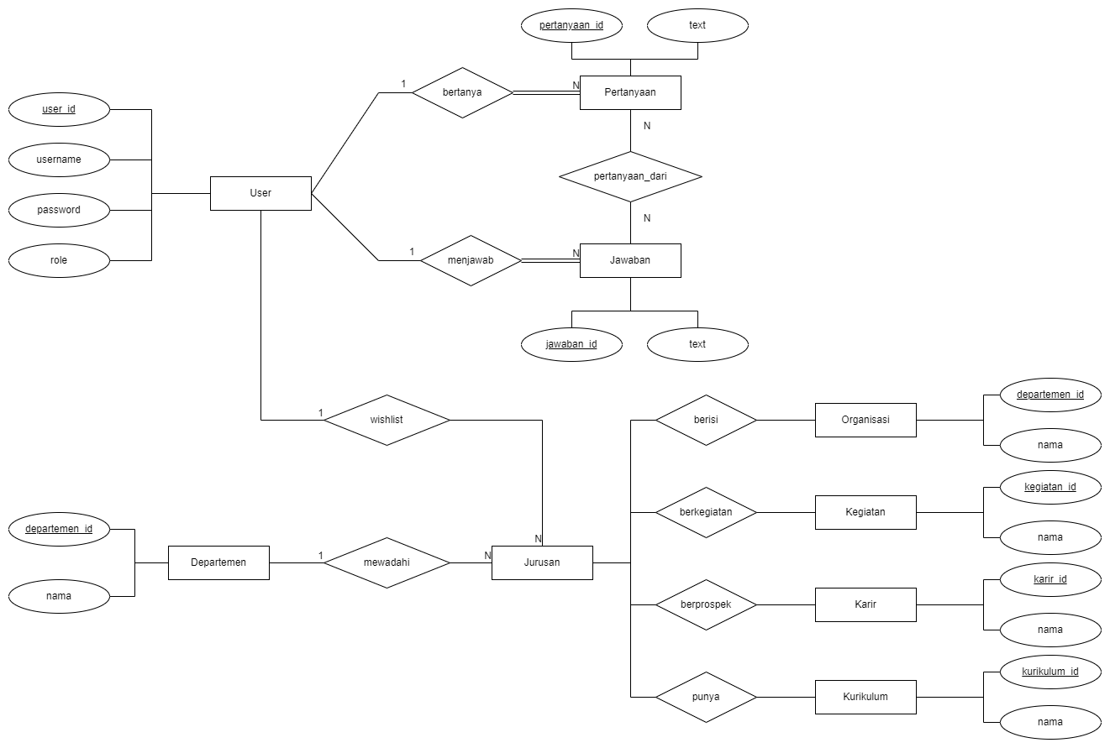
ER Diagram

Slide 7
UML

Slide 8
FLOWCHART

Slide 9
DEMO

Slide 10
List tabel
User
Data center migration: between location/servers
Pertanyaan
Business process migration: Between infrastructures
Application migration: between platforms
Cloud migration: from on-prem/cloud to cloud

Slide 11
Software yang digunakan
PostgreSQL
Venus
Mercury
It’s the farthest planet from the Sun
It’s terribly hot, even hotter than Mercury
Mercury is the closest planet to the Sun
KLENIK
Jupiter
Saturn
Mars
It’s the biggest planet in the Solar System
Saturn is the ringed planet and a gas giant
Despite being red, Mars is a cold place

Slide 12
Data migration process infographics
Venus
Mercury
Venus has a beautiful name and is the second planet from the Sun. It’s terribly hot, even hotter than Mercury
It’s the closest planet to the Sun and the smallest one in the Solar System—it’s only a bit larger than the Moon

Slide 13
Data migration process infographics
Jupiter
Neptune
Jupiter is a gas giant and the biggest planet in the Solar System
Neptune is the farthest planet from the Sun. It’s really cold there
Saturn
Mercury
Saturn is a gas giant with rings. It’s composed of hydrogen and helium
Mercury is the closest planet to the Sun and the smallest one

Slide 14
Data migration process infographics
Neptune
Jupiter
Neptune is the farthest planet from the Sun
It’s the biggest planet in the Solar System
Venus
Saturn
It’s terribly hot, even hotter than Mercury
Saturn is the ringed planet and a gas giant
Mercury
Mars
Mercury is the closest planet to the Sun
Despite being red, Mars is a cold place

Slide 15
Data migration process infographics
Neptune
Jupiter
Mars
Neptune is the farthest planet from the Sun
Jupiter is the biggest planet in the Solar System
Despite being red, Mars is a cold place, not hot
Mercury

Slide 16
Data migration process infographics
Neptune
Jupiter
Neptune is the farthest planet from the Sun
It’s the biggest planet in the Solar System
Venus
Saturn
It’s terribly hot, even hotter than Mercury
Saturn is the ringed planet and a gas giant
Mercury
Mars
Mercury is the closest planet to the Sun
Despite being red, Mars is a cold place
The Sun
The Moon
It’s the star at the center of the Solar System
The Moon is Earth’s only natural satellite

Slide 17
Data migration process infographics
Jupiter
Neptune
Jupiter is a gas giant and the biggest planet in the Solar System
Neptune is the farthest planet from the Sun. It’s really cold there
Saturn
Mercury
Saturn is a gas giant with rings. It’s composed of hydrogen and helium
Mercury is the closest planet to the Sun and the smallest one

Slide 18
Data migration process infographics
Mercury
Mercury is the closest planet to the Sun
Neptune
Neptune is the farthest planet from the Sun
Venus
Jupiter
It’s terribly hot, even hotter than Mercury
It’s the biggest planet in the Solar System
Saturn
Saturn is the ringed planet and a gas giant

Slide 19
Data migration process infographics
01
03
Jupiter
Saturn
Jupiter is a gas giant and the biggest planet in the Solar System
Saturn has several rings. It’s composed of hydrogen and helium
02
04
Mars
Venus
Despite being red, Mars is actually a very cold place
Venus has a beautiful name and is the second planet from the Sun

Slide 20
Data migration process infographics
35%
30%
Neptune
Saturn
Neptune is the farthest planet from the Sun. It’s really cold there
Saturn is the ringed planet. It’s a gas giant, composed of hydrogen and helium
23%
12%
Jupiter
Venus
Jupiter is a gas giant and the biggest planet in the entire Solar System
Venus has a beautiful name and is the second planet from the Sun

Slide 21
Data migration process infographics
45%
Mercury
It’s the closest planet to the Sun and the smallest one in the Solar System—it’s only a bit larger than the Moon
55%
Venus
Venus has a beautiful name and is the second planet from the Sun. It’s terribly hot, even hotter than Mercury

Slide 22
Data migration process infographics
Neptune
Jupiter
Venus
Neptune is the farthest planet from the Sun
Is the biggest planet in the Solar System
Venus is terribly hot, even hotter than Mercury
Saturn
Earth
Mercury
Saturn is the ringed planet and a gas giant
Earth is the beautiful planet where we all live
Mercury is the closest planet to the Sun

Slide 23
Data migration process infographics
Jupiter
Neptune
Jupiter is a gas giant and the biggest planet in the Solar System
Neptune is the farthest planet from the Sun. It’s really cold there
Saturn
Mercury
Saturn is a gas giant. It’s composed of hydrogen and helium
Mercury is the closest planet to the Sun and the smallest one
Venus
Earth
Venus has a beautiful name and is the second planet from the Sun
Earth is the third planet from the Sun and where we all live

Slide 24
Data migration process infographics
Neptune
Jupiter
Neptune is the farthest planet from the Sun
It’s the biggest planet in the Solar System
Venus
Saturn
It’s terribly hot, even hotter than Mercury
Saturn is a gas giant with several rings
Mercury
Mars
Mercury is the closest planet to the Sun
Despite being red, Mars is a cold place

Slide 25
Data migration process infographics
Venus
Jupiter
Mercury
Venus has a beautiful name and is the second planet from the Sun
Jupiter is a gas giant and the biggest planet in the Solar System
Mercury is the closest planet to the Sun and the smallest one

Slide 26
Data migration process infographics
Ceres is located in the main asteroid belt
Neptune is the farthest planet from the Sun
Venus is the second planet from the Sun
Mercury is the closest planet to the Sun
Planning
Data backup
Execution
Post-mig audit
Data profiling
Migration design
Testing
Jupiter is the biggest planet of them all
Despite being red, Mars is a cold place
Saturn is the ringed planet and a gas giant

Slide 27
Data migration process infographics
Introduction of an additional system
Shift to a centralized base
Ceres is located in the main asteroid belt
Despite being red, Mars is a cold place
Storage capacity expansion
Moving data to the cloud
Mercury is the closest planet to the Sun
Neptune is the farthest planet from the Sun
Legacy system modernization
Mergers and acquisitions
Venus is the second planet from the Sun
Saturn is the ringed planet and a gas giant
Historical data
Jupiter is the biggest planet of them all

Slide 28
Data migration process infographics
Data
From
To
Data volume
Mars | Admin system 1 | Cloud service 1 | 1.8 GB
Mercury | Admin system 2 | Cloud service 2 | 25.4 GB
Jupiter | Admin system 3 | Cloud service 3 | 12.8 GB
Saturn | Admin system 4 | Cloud service 4 | 59,.1 GB
Venus | Admin system 5 | Cloud service 5 | 2.9 GB

Slide 29
Data migration process infographics
Mars
Mercury
Despite being red, Mars is a cold place. The planet is full of iron oxide dust
It’s the closest planet to the Sun and the smallest one in the Solar System
Saturn
Venus
Saturn is a gas giant with rings. It’s composed of hydrogen and helium
Venus has a beautiful name and is the second planet from the Sun

Slide 30
Data migration process infographics
Neptune
Jupiter
Neptune is the farthest planet from the Sun
25%
40%
It’s the biggest planet in the Solar System
Venus
Saturn
It’s terribly hot, even hotter than Mercury
70%
85%
Saturn is the ringed planet and a gas giant

Slide 31
Data migration process infographics
Jupiter
Neptune
Jupiter is a gas giant and the biggest planet in the Solar System
Neptune is the farthest planet from the Sun. It’s really cold there
Saturn
Mercury
Saturn is a gas giant with ring. It’s composed of hydrogen and helium
Mercury is the closest planet to the Sun and the smallest one

Slide 32
Data migration process infographics
Neptune
Saturn
Neptune is the farthest planet from the Sun. It’s really cold there
Saturn is the ringed planet. It’s a gas giant, composed of hydrogen and helium
01
02
03
04
Jupiter
Venus
Jupiter is a gas giant and the biggest planet in the entire Solar System
Venus has a beautiful name and is the second planet from the Sun

Slide 33
Data migration process infographics
Process
Description
Risk
Phase 1 | Despite being red, Mars is a cold place
Phase 2 | Mercury is the closest planet to the Sun
Phase 3 | Neptune is the farthest planet from the Sun
Phase 4 | Saturn is the ringed planet and a gas giant
Phase 5 | Venus is terribly hot, even hotter than Mercury

Slide 34
Data migration process infographics
35%
55%
80%
Neptune
Mercury
Jupiter
Neptune is the farthest planet from the Sun. It’s really cold there
Mercury is the closest planet to the Sun and the smallest one
Jupiter is a gas giant and the biggest planet in the Solar System

Slide 35
Data migration process infographics
Neptune
Neptune is the farthest planet from the Sun
Jupiter
Mars
Jupiter is the biggest planet in the Solar System
Despite being red, Mars is a cold place, not hot
Venus
Venus is terribly hot, even hotter than Mercury

Slide 36
Data migration process infographics
Neptune
Jupiter
Neptune is the farthest planet from the Sun
It’s the biggest planet in the Solar System
Venus
Saturn
It’s terribly hot, even hotter than Mercury
Saturn is the ringed planet and a gas giant
Mercury
Mars
Mercury is the closest planet to the Sun
Despite being red, Mars is a cold place

Slide 37
Data migration process infographics
Jupiter
Saturn
Mercury
Venus
60%
19%
12%
9%
Jupiter is a gas giant and the biggest planet in the Solar System
It’s the ringed planet. It’s a gas giant, composed mostly of hydrogen
It’s the closest planet to the Sun and the smallest one of them all
Venus has a beautiful name and is the second planet from the Sun

Slide 38
Instructions for use
In order to use this template, you must credit Slidesgo in your final presentation.
You are allowed to:
- Modify this template.
- Use it for both personal and commercial projects.
You are not allowed to:
- Sublicense, sell or rent any of Slidesgo Content (or a modified version of Slidesgo Content).
- Distribute Slidesgo Content unless it has been expressly authorized by Slidesgo.
- Include Slidesgo Content in an online or offline database or file.
- Offer Slidesgo templates (or modified versions of Slidesgo templates) for download.
- Acquire the copyright of Slidesgo Content.
For more information about editing slides, please read our FAQs or visit Slidesgo School:
https://slidesgo.com/faqs and https://slidesgo.com/slidesgo-school

Slide 39
Instructions for use (premium users)
As a Premium user, you can use this template without attributing Slidesgo or keeping the "Thanks" slide.
You are allowed to:
Modify this template.
Use it for both personal and commercial purposes.
Hide or delete the “Thanks” slide and the mention to Slidesgo in the credits.
Share this template in an editable format with people who are not part of your team.
You are not allowed to:
Sublicense, sell or rent this Slidesgo Template (or a modified version of this Slidesgo Template).
Distribute this Slidesgo Template (or a modified version of this Slidesgo Template) or include it in a database or in any other product or service that offers downloadable images, icons or presentations that may be subject to distribution or resale.
Use any of the elements that are part of this Slidesgo Template in an isolated and separated way from this Template.
Register any of the elements that are part of this template as a trademark or logo, or register it as a work in an intellectual property registry or similar.
For more information about editing slides, please read our FAQs or visit Slidesgo School:
https://slidesgo.com/faqs and https://slidesgo.com/slidesgo-school

Slide 40
Infographics
You can add and edit some infographics to your presentation to present your data in a visual way.
Choose your favourite infographic and insert it in your presentation using Ctrl C + Ctrl V or Cmd C + Cmd V in Mac.
Select one of the parts and ungroup it by right-clicking and choosing “Ungroup”.
Change the color by clicking on the paint bucket.
Then resize the element by clicking and dragging one of the square-shaped points of its bounding box (the cursor should look like a double-headed arrow). Remember to hold Shift while dragging to keep the proportions.
Group the elements again by selecting them, right-clicking and choosing “Group”.
Repeat the steps above with the other parts and when you’re done editing, copy the end result and paste it into your presentation.
Remember to choose the “Keep source formatting” option so that it keeps the design. For more info, please visit Slidesgo School.

