Slide 1
PHP

Slide 2
Originally known as “Personal Home Page”.
Created by Rasmus Lerdorf in 1993 and released in 1995.
Now officially known as “PHP-Hypertext Preprocessor”.
PHP code executes on the web server
This allows for dynamic content generation and easy interaction with databases and other server-side resources.
PHP standards are maintained and set by the PHP Framework Interoperability Group (PHP-FIG).
PHP files ends with .php
Open-source and free to use.
Runs on all major operating systems.
Large and active developer community.

Slide 3
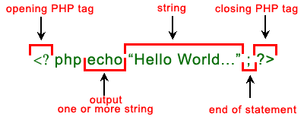
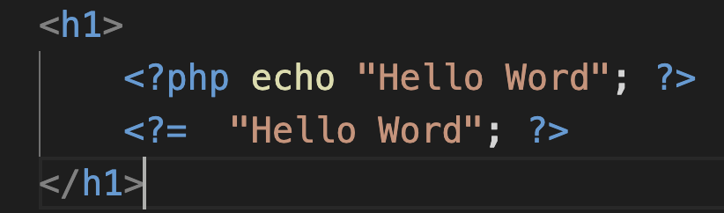
Syntax

Slide 4
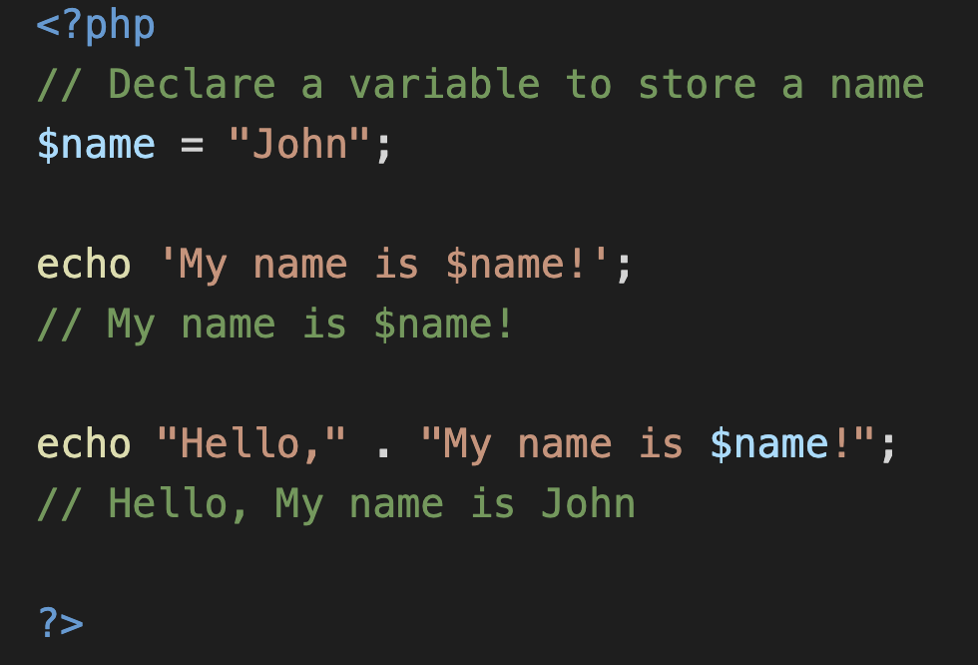
PHP variable
Can declare variables using a dollar sign ($) followed by a descriptive name.
Can start with a letter or underscore (_) but cannot start with a number.
Can contain letters, numbers, and underscores.
Are case-sensitive. $name and $Name are considered different variables.
Single quotes (') prevent variable interpolation (embedding values), while double quotes (") allow it.
Use the dot (.) to combine strings and variables.

Slide 5
PHP datatypes
Variables can store data of different types, and different data types can do different things.
PHP supports the following data types:
String
Integer
Float (floating point numbers - also called double)
Boolean
Array:
Indexed Arrays-accessed using a numeric index
Ex: $fruits=['Apple', 'Banana', 'Orange’];
Associative Arrays-collections of key-value pairs
$car = array('brand'='Ford', 'model'='Mustang');
Object
NULL
Resource: Represents external resources like file handles, database connections, etc.
We can get the data type of any object by using the var_dump() function.

Slide 6
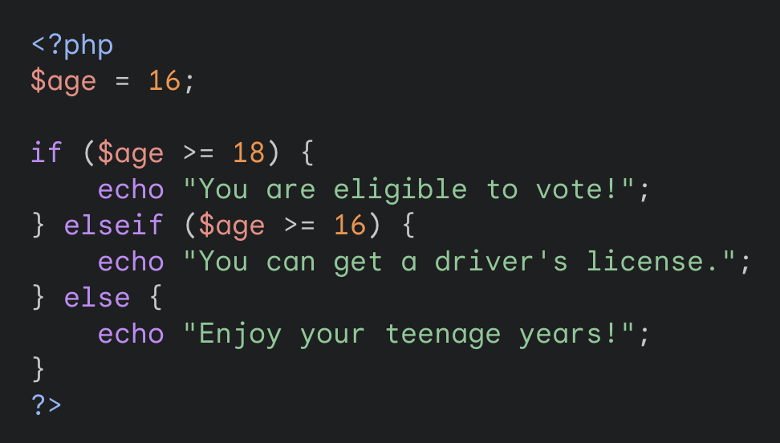
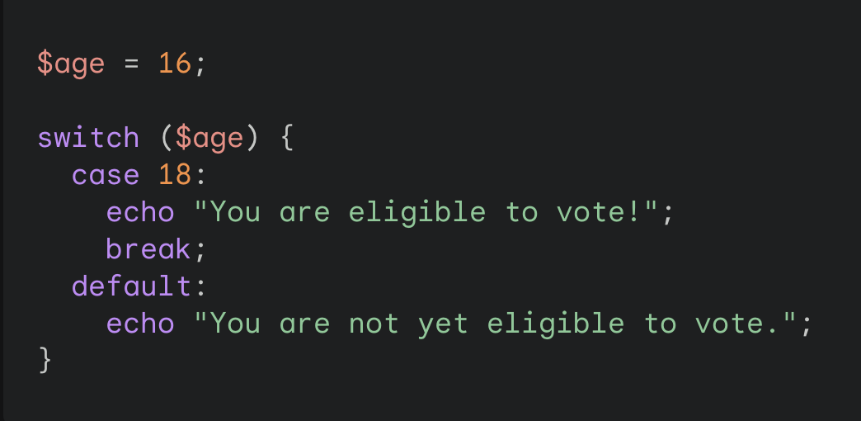
Conditional statements

Slide 7
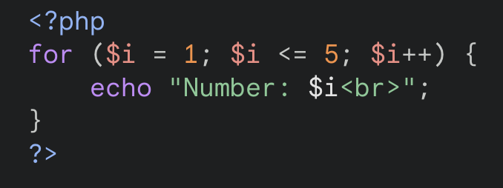
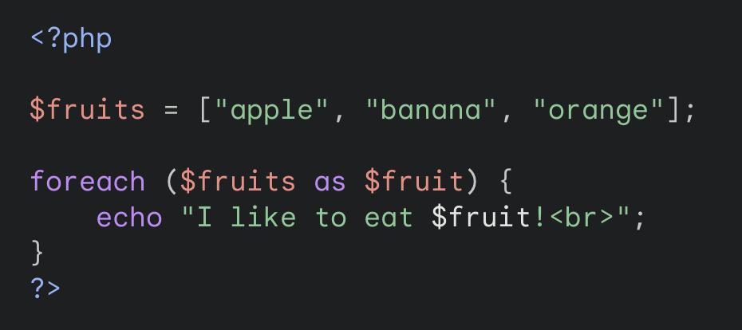
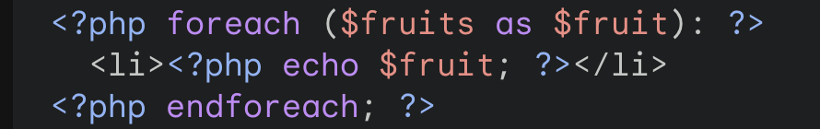
Loop
Loops are used to execute the same block of code again and again, as long as a certain condition is true.
for - loops through a block of code a specified number of times
while - loops through a block of code as long as the specified condition is true
do...while - loops through a block of code once, and then repeats the loop as long as the specified condition is true
foreach - loops through a block of code for each element in an array

Slide 8
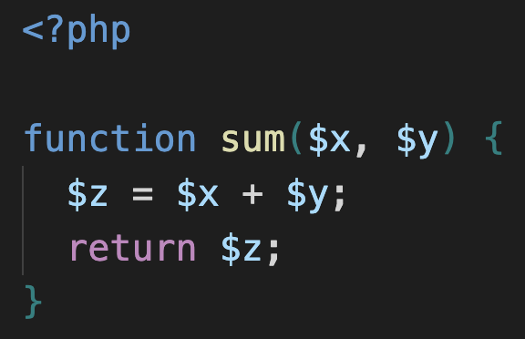
Functions
A function is a block of statements that can be used repeatedly in a program.
A function will not execute automatically when a page loads.
A function will be executed by a call to the function.
Built-in Functions-PHP has over 1000 built-in functions that can be used directly
User Defined Functions-A user-defined function declaration starts with the keyword function, followed by the name of the function
Information can be passed to functions through arguments.

Slide 9
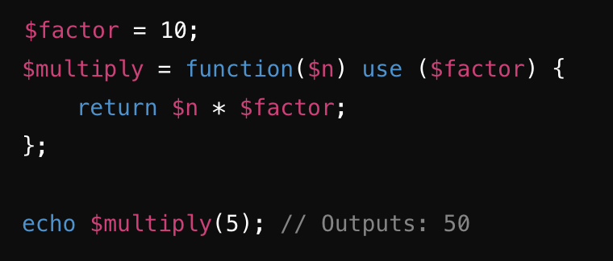
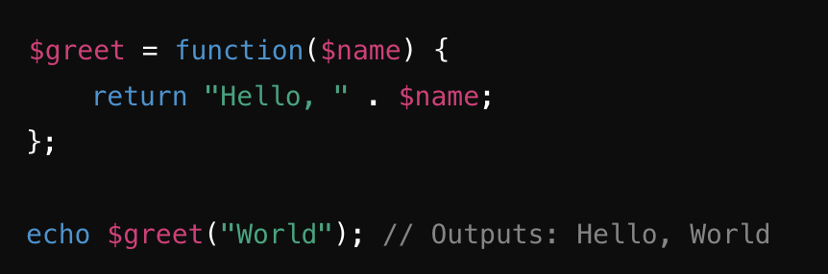
Lambda Functions
It is a function with no name that is often used as a callback or for inline operations.
Commonly used for short, one-time tasks, such as array operations and event handling.
Can be stored in variables and passed as arguments.
Often used with functions like array_map, array_filter, and array_reduce.

Slide 10
PHP Constants
The value cannot be changed during the script.
starts with a letter or underscore (no $ sign before the constant name).
To create a constant, use the define() function.
define() or const keyword used to create constant.
const MYCAR = "Volvo"; echo MYCAR;
PHP has nine predefined constants that change value depending on where they are used, and therefor they are called "magic constants".
These magic constants are written with a double underscore at the start and the end, except for the ClassName::class constant.
__CLASS__, __DIR__ etc are some examples.

Slide 11
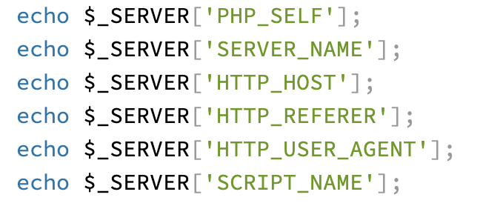
PHP Superglobals
Superglobals are built-in global arrays in PHP that are always accessible, regardless of scope.
They are used to retrieve various types of information from forms, sessions, cookies, server environment, and more.
The PHP superglobal variables are:
$GLOBALS
$_SERVER
$_REQUEST
$_POST
$_GET
$_FILES
$_ENV
$_COOKIE
$_SESSION

Slide 12
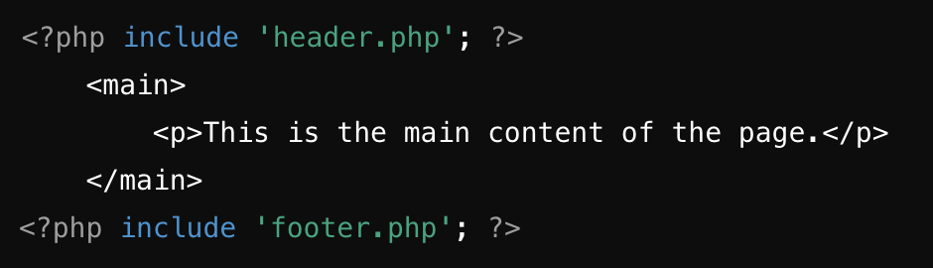
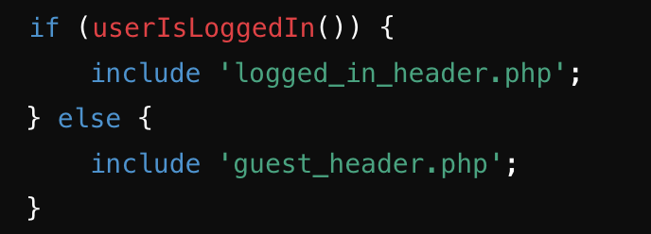
PHP Partials
Partials are reusable pieces of HTML or PHP code that can be included in multiple places within a web application.
They promote code reuse and maintainability by breaking down complex pages into manageable, reusable components.
Including Partials in PHP
include Statement: Includes and evaluates a specified file.
require Statement: Similar to include, but produces a fatal error if the file cannot be found.
include_once and require_once: Ensures the file is included only once.

Slide 13
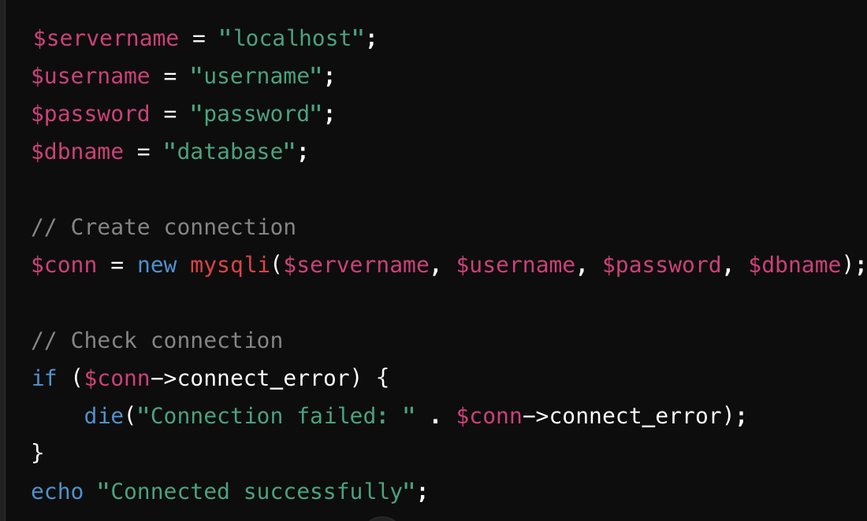
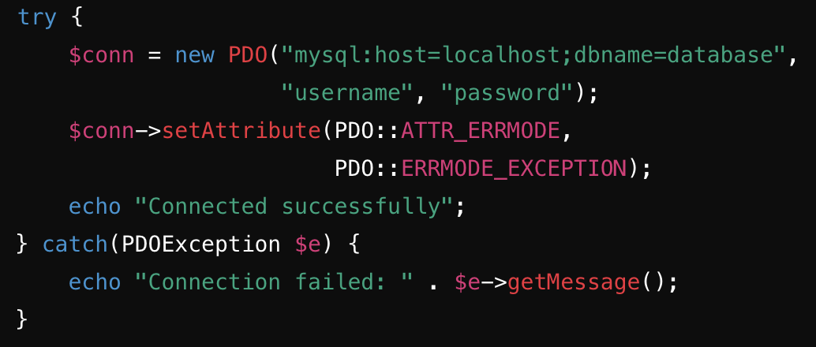
Connecting with DB
Enable PHP scripts to interact with databases for data operations.
Generally mySQL is preffered.
Methods to Connect PHP to MySQL
MySQLi (MySQL Improved)
mysqli_connect: Function used to establish a connection to the MySQL database.
PDO (PHP Data Objects)
new PDO: Creates a new PDO instance, establishing a database connection.

Slide 14
PHP Form Validation
Ensure user inputs are valid and secure before processing.
Prevents invalid data, enhances security, and improves user experience.
Client-Side Validation:
Provides immediate feedback.
Uses JavaScript and HTML5 attributes (e.g., required, pattern).
Server-Side Validation:
Ensures data integrity.
Uses PHP to validate input after form submission.
Sanitize Inputs: Use functions like trim(), stripslashes(), and htmlspecialchars() to clean input data.
Validate Inputs: Check for required fields, correct formats, and valid data types.
Prepared Statements: Always use prepared statements to protect against SQL injection.
Error Handling: Provide clear error messages for users to correct their inputs.

Slide 15
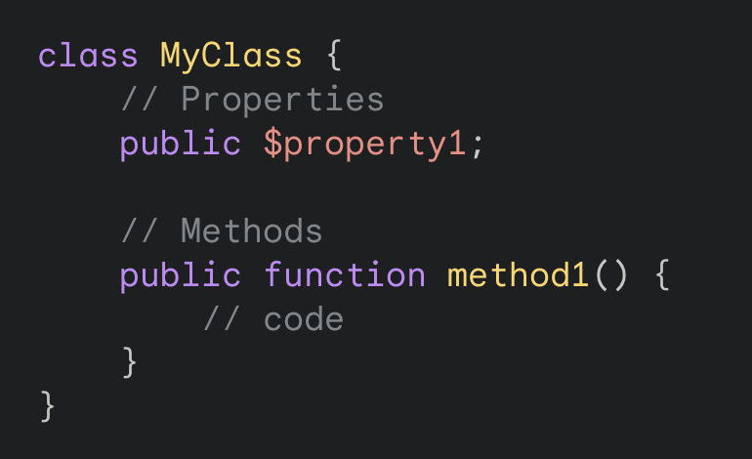
PHP Classes
A class is a blueprint or template for creating objects.
It defines the properties (variables) and methods (functions) that an object of that class will have.
Benefits of using classes:Code reusability and organization
Encapsulation: Protecting data from external access
Inheritance: Creating new classes based on existing ones
Polymorphism: Allowing objects to be treated as different types
To define a PHP class, you use the class keyword followed by the name of the class.
A constructor allows you to initialize an object's properties upon creation of the object.
__construct() function, PHP will automatically call this function when you create an object from a class.

Slide 16
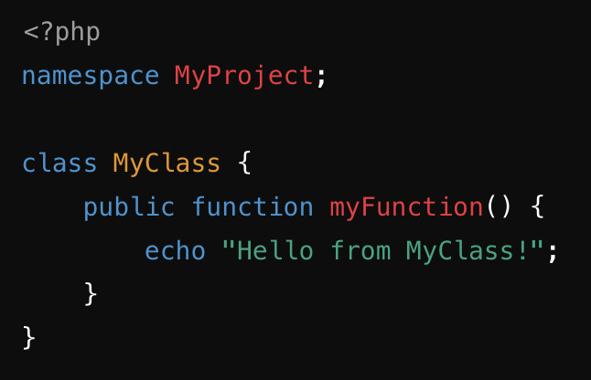
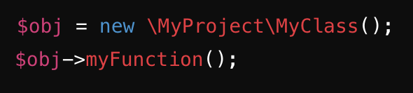
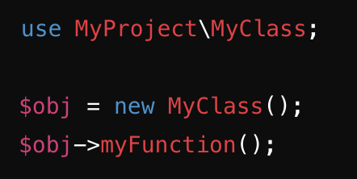
Namespace
Namespaces in PHP are a way to organize and encapsulate code elements, such as classes, functions, and constants, to avoid name collisions and improve code readability.
Key Benefits of Namespaces
Avoid Name Collisions: Namespaces prevent the same name from being used for different classes, functions, or constants, ensuring that each element is unique.
Improved Organization: Namespaces group related code elements together, making it easier to find and manage them.
Better Readability: By using namespaces, you can clearly indicate the origin of a class or function, making the code more readable and maintainable.
Declaring a Namespace
A namespace is declared at the beginning of a PHP file using the namespace keyword.
Access elements within a namespace using the backslash (\) separator.Use use statements to import elements from other namespaces.

Slide 17
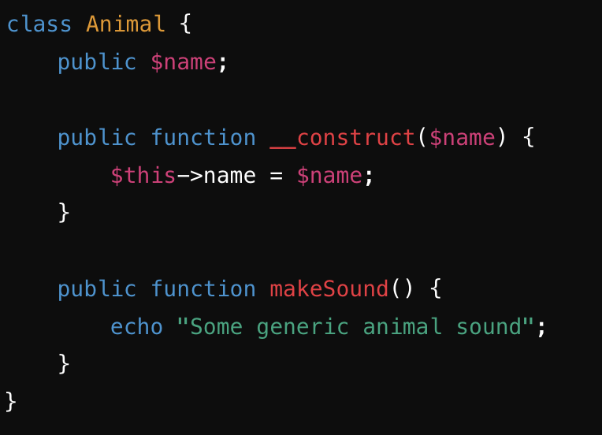
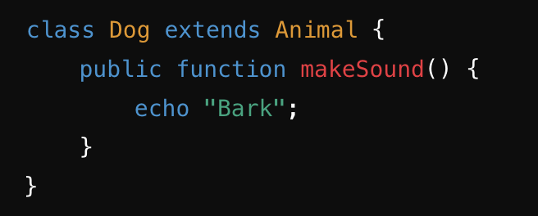
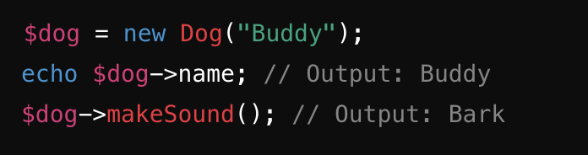
Inheritance
Allows one class to inherit properties and methods from another class.
Promotes code reuse, simplifies code maintenance, and supports polymorphism.
‘extends’ keyword is used to define a child class that inherits from a parent class.

Slide 18
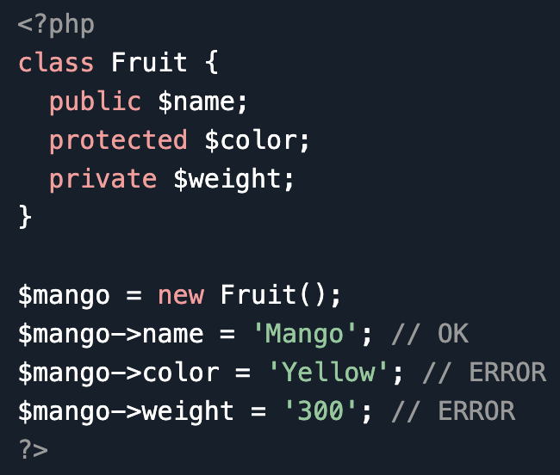
PHP Access Modifiers
Used to control the visibility and accessibility of class properties and methods.
Encapsulate data and provide security by restricting access to internal implementation details.
There are three access modifiers:
public - the property or method can be accessed from everywhere. This is default
protected - the property or method can be accessed within the class and by classes derived from that class
private - the property or method can ONLY be accessed within the class

Slide 19
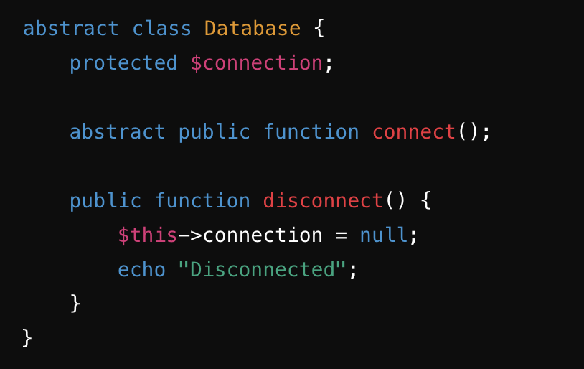
Abstract Classes
Provide a blueprint for other classes. Cannot be instantiated.
An abstract class or method is defined with the abstract keyword
when we have a common base class with shared functionality and a need to enforce a common interface we use abstract class
Enforce consistent interface for derived classes, facilitating code organization and maintainability.

Slide 20
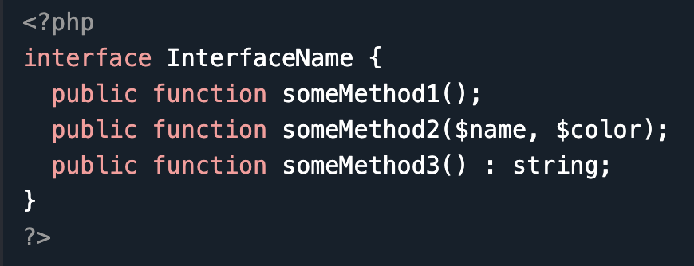
Interfaces
Interfaces make it easy to use a variety of different classes in the same way.
When one or more classes use the same interface, it is referred to as "polymorphism".
Interfaces are declared with the interface keyword
Contains only method declarations without implementations.
Cannot contain properties or constants.
All methods declared in an interface must be public.
Interface are similar to abstract classes. The difference between interfaces and abstract classes are:
Interfaces cannot have properties, while abstract classes can
All interface methods must be public, while abstract class methods is public or protected
All methods in an interface are abstract, so they cannot be implemented in code and the abstract keyword is not necessary
Classes can implement an interface while inheriting from another class at the same time

Slide 21
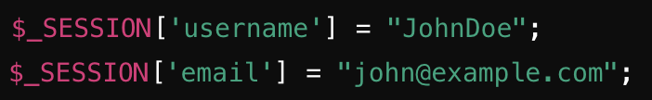
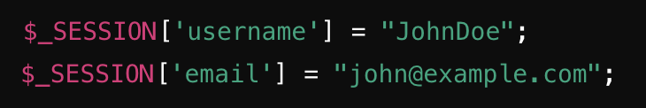
PHP Sessions
Maintain user state and data across multiple pages.
Essential for user login systems, shopping carts, and personalized user experiences.
A session is started with the session_start() function.
Session variables are set with the PHP global variable $_SESSION and is used to store session data and can retrieve these details later using the same variable..
To remove all global session variables and destroy the session, use session_unset() and session_destroy();

Slide 22
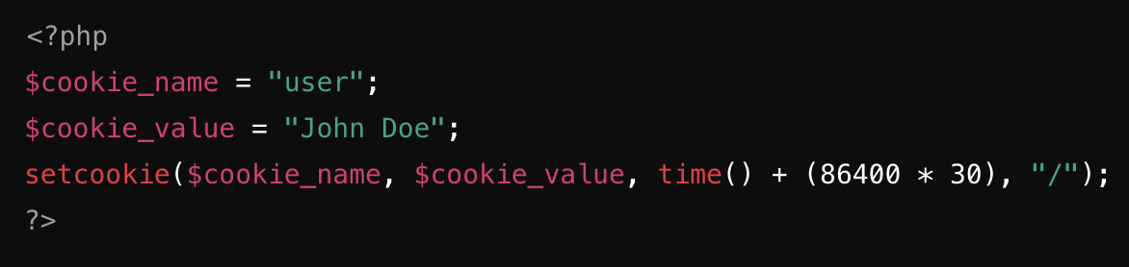
PHP Cookies
Store small amounts of data on the client's browser.
A cookie is created with the setcookie() function.
Useful for persisting user preferences, session information, and tracking user activity.
The expiration time is set as a Unix timestamp.
Cookies without an expiration time or with 0 expire when the browser closes.

Slide 23

Composer
Dependency management tool for PHP.
Simplifies library and package management, facilitates autoloading, and manages project dependencies.
Composer allows PHP projects to declare and manage external libraries and dependencies.
Manages versions and resolves dependencies automatically.
Automatically loads PHP classes without manual require or include statements.
Improves code organization and reduces boilerplate code.

Slide 25
References
https://www.php.net/
https://www.w3schools.com/php/
https://developer.mozilla.org/en-US/docs/Glossary/PHP

