Slide 1
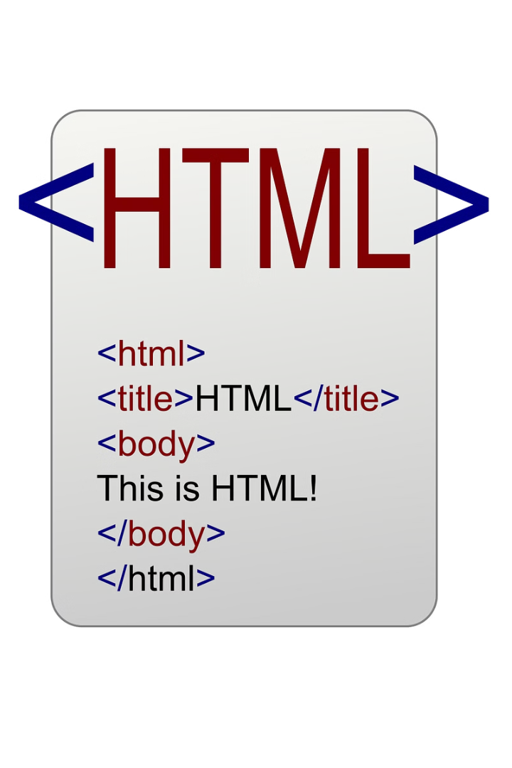
Hyper Text Markup
Language

Slide 2
Hyper Text Markup Language
.
HTML, the backbone of the web
HTML describes the structure of a Web page
HTML consists of a series of elements
HTML elements tell the browser how to display the content.
Tim Berners-Lee developed HTML in 1991.
HTML5 is released in 2014.
All HTML files ends with .html

Slide 3
HTML Tags <> </>
Building blocks of web pages, used to define elements and content.
Its represented by a pair of angular brackets.
Behavior of content changes as per the tag.
HTML Elements
Part of a web page defined by a start tag, content, and an end tag.
Block Elements: Take up the full width available, start on a new line.
Examples: <div>, <p>, <h1>
Inline Elements: Take up only as much width as necessary, do not start on a new line.
Examples: <span>, <a>, <img>

Slide 4
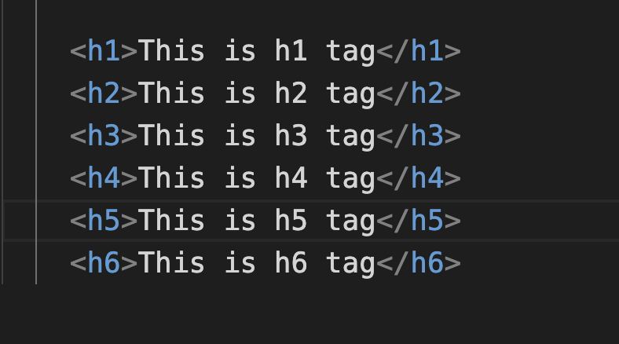
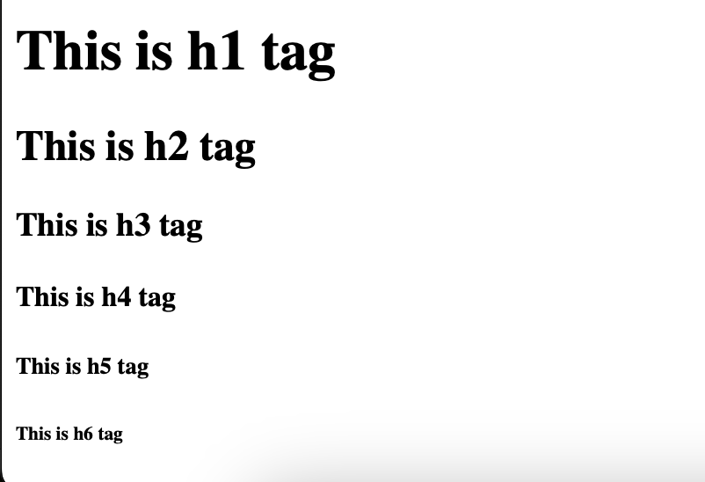
<h1> Different HTML Elements </h1>
<h2> Heading Element </h2>
Heading tags are used to define headings of different levels of importance, from <h1> to <h6>
These tags help structure the content of a webpage, making it easier for users to read and for search engines to index.
Usually h1 tag is used only once and good practice use to use in order from h1 to h6

Slide 5
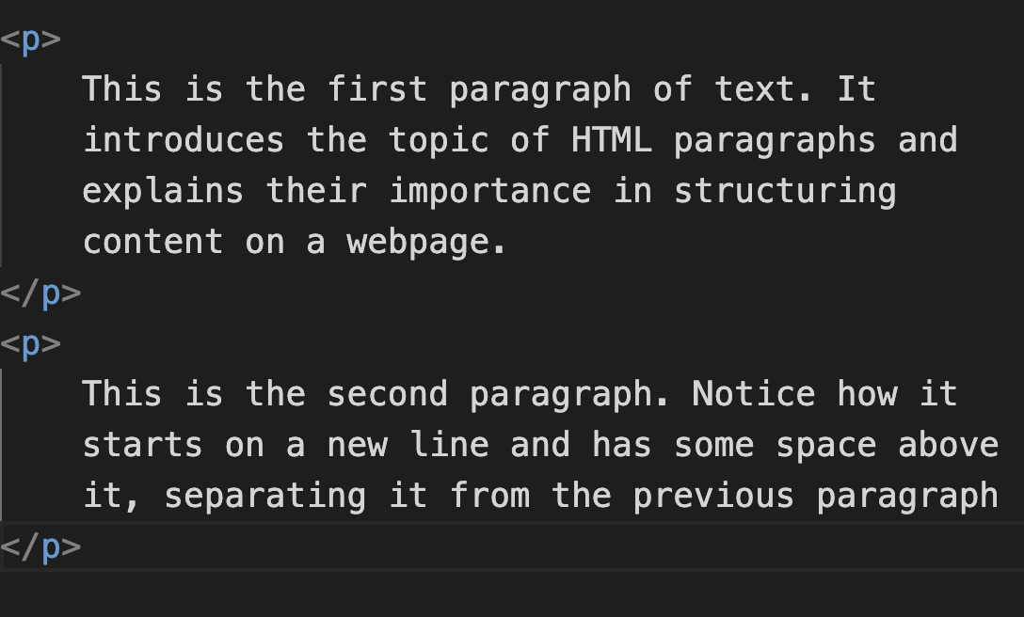
<p> Paragraph Element </p>
Used to define a paragraph of text.
It is a block-level element.
Essential for structuring and organizing text content on a webpage, making it more readable and manageable.
Browsers typically add some vertical margin (space) before and after paragraphs to separate them from other elements.
The content inside a <p> element automatically wraps to fit within the width of its container.
It is bad practice to nest <p> elements
within each other

Slide 6
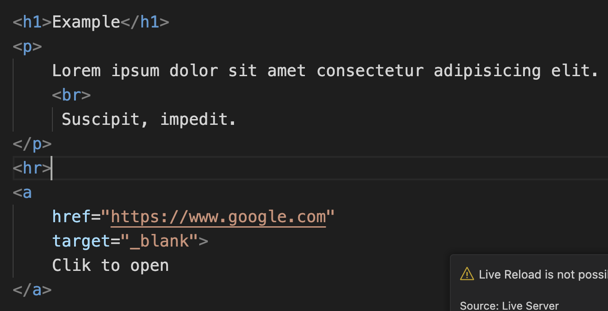
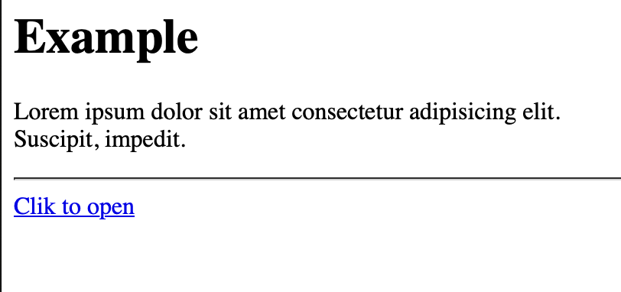
Void Elements
Also known as Self-closing elements
Do not have any content or closing tags
Written with a single tag and cannot have any child elements
<br>, <hr>, <img> , <link>, <input>
Anchor Elements
Used to create hyperlinks.
Helpful in navigation, clickable link etc.
‘hraf’ specifies the URL of the page the link goes to
‘target’ specifies where to open the linked document.
_ self (default, opens in the same tab),
_blank (opens in a new tab)
title provides additional information about the link, often displayed as a tooltip when the mouse hovers over the link.

Slide 7
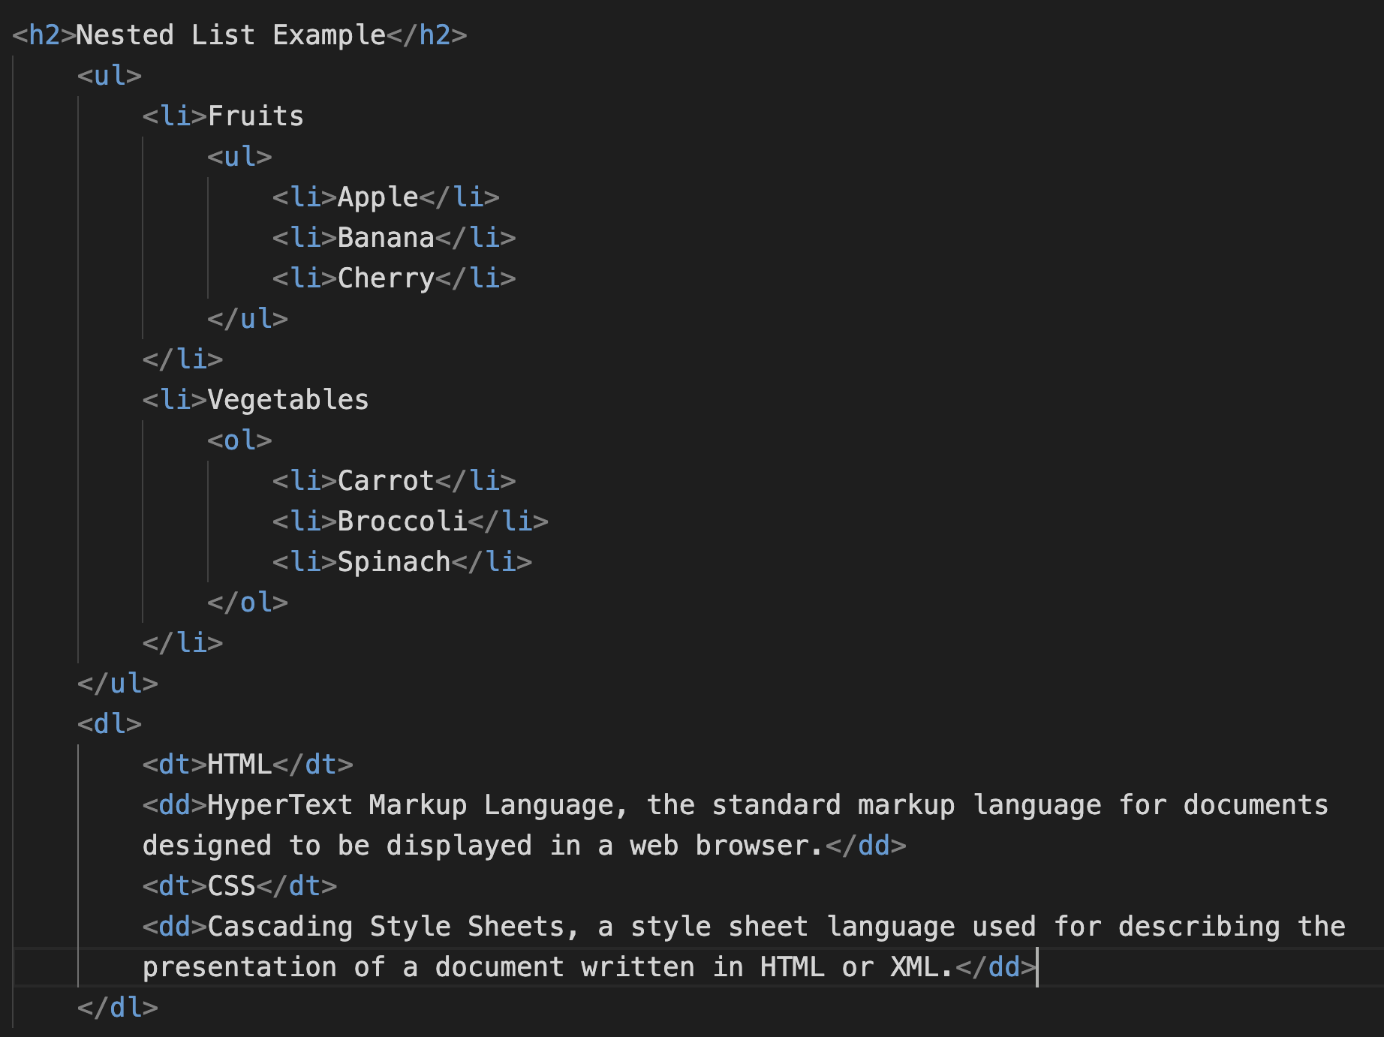
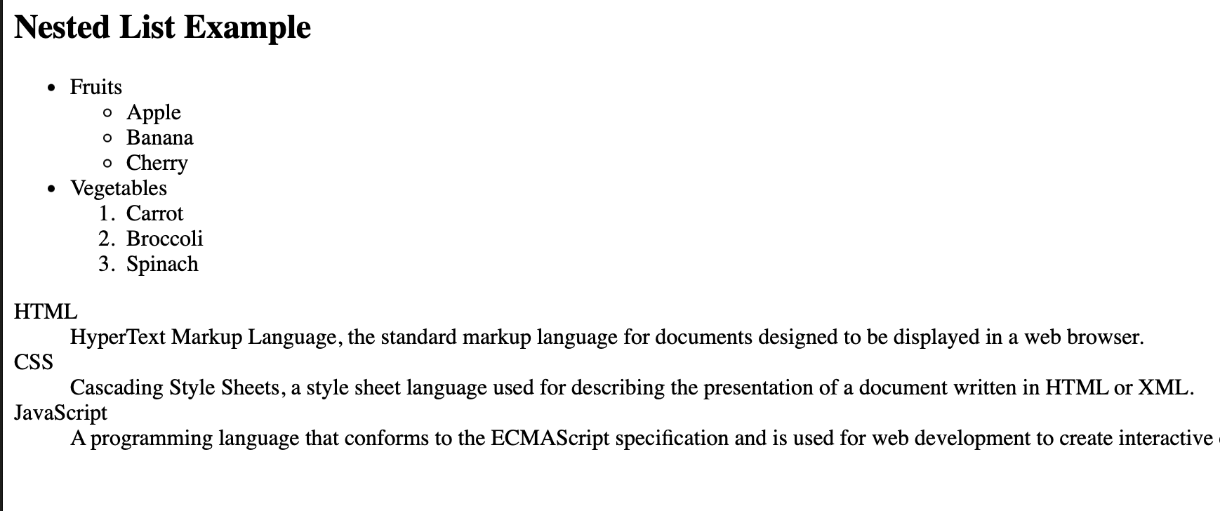
<li> List Element </li>
List elements are used to group related items together in a structured way.
There are three main types of lists:
Ordered List (<ol>): Used for lists where the order of items matters, and items are numbered.
Unordered List (<ul>): Used for lists where the order of items does not matter, and items are usually marked with bullets.
Description List (<dl>): Used for lists of terms and their descriptions.
Can nest lists within lists to create more complex structures.

Slide 8
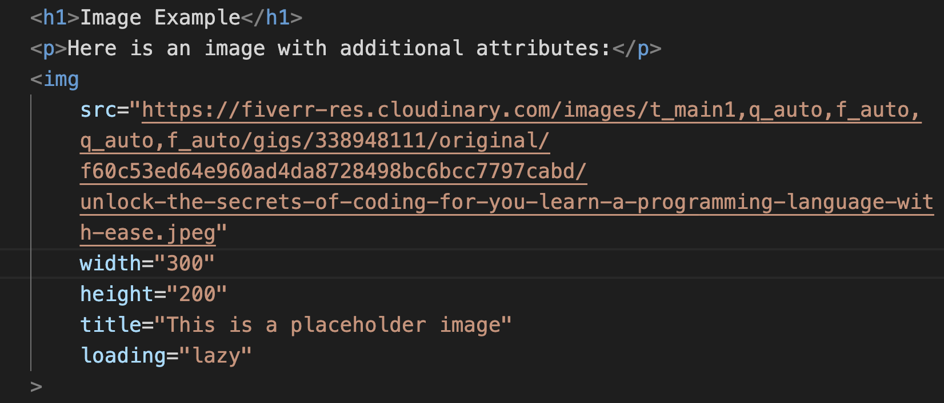
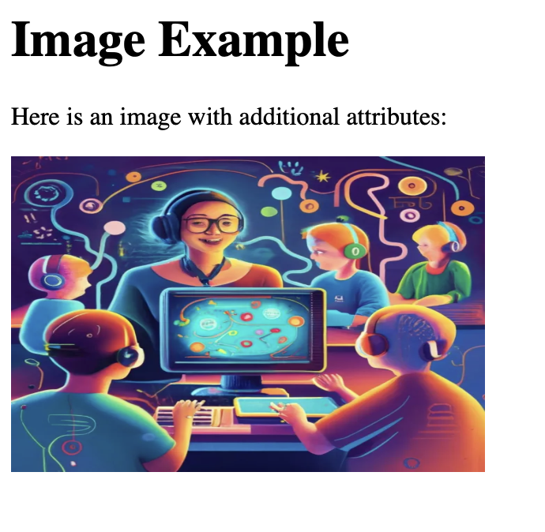
Image Element
Used to embed images into a webpage
It’s a void element
Relies on attributes to provide the necessary information.
Key Attributes of the <img> Element:
1. src: Specifies the URL of the image to be displayed. This is a required attribute.
2. alt: Provides alternative text for the image if it cannot be displayed. This is important for accessibility and SEO.
3. width: Sets the width of the image (optional).
4.height: Sets the height of the image (optional).
5. title: Provides additional information about the image, often displayed as a tooltip when the mouse hovers over the image (optional).
6. loading: Specifies the loading behavior of the image. Common values are lazy (defer loading until the image is near the viewport) and eager (load immediately).

Slide 9
Common html elements
<div>: Defines a generic block-level container
<span>: Defines a generic inline container.
<table>: Defines a table for data.
<tr>: Defines a row in a table.
<td>: Defines a cell in a table.
<th>: Defines a header cell in a table.
<blockquote>: Defines a block quotation.
<button>: Defines a clickable button.
<article>: Defines an independent, self-contained piece of content.
<footer>: Defines the footer of a document or section.
<header>: Defines the header of a document or section.
<nav>: Defines a section of navigation links.
<iframe>: Embeds a nested browsing context, typically used for embedding external content like maps or videos.
<pre>: Defines preformatted text, preserving both spaces and line breaks.
<marquee>: Defines a scrolling text or image.

Slide 10
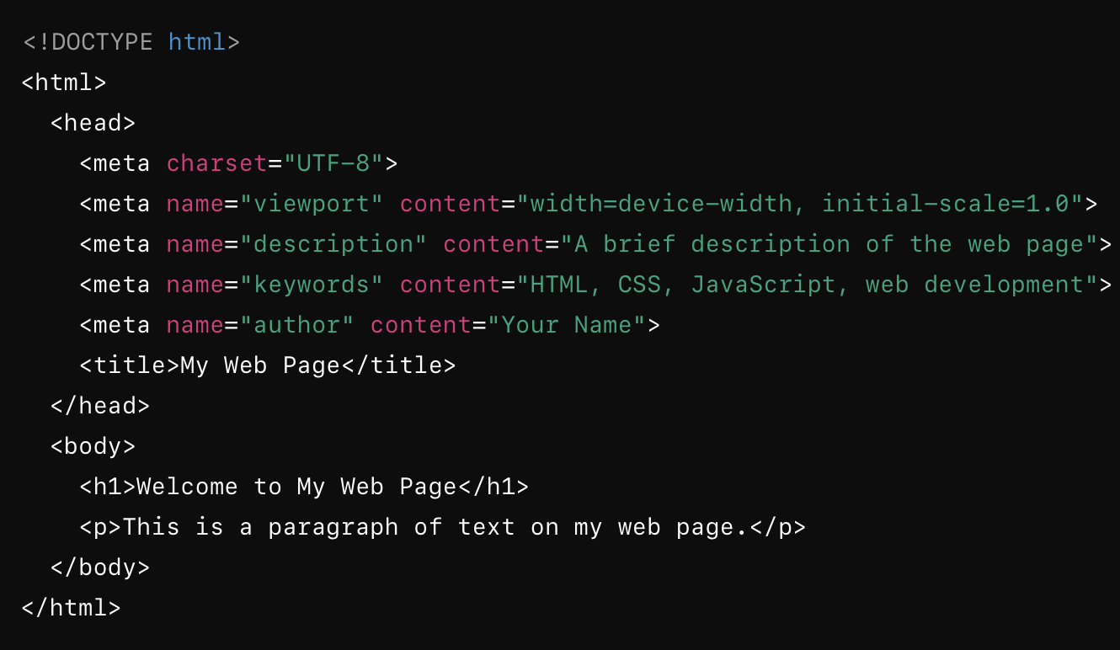
Structure of HTML Document
The <!DOCTYPE html> declaration defines that this document is an HTML5 document
The <html> element is the root element of an HTML page
The <head> element contains meta information about the HTML page
The <title> element specifies a title for the HTML page (which is shown in the browser's title bar or in the page's tab)
The <body> holds the visible page content
The <h1> element defines a large heading
The <p> element defines a paragraph
<meta> tag defines metadata about an HTML document. Used to specify character set, page description, keywords, author of the document, and viewport settings
<link> tag is in head is used to link external css.
<style> tag is used for writing internal css
<script > tag is used link/ write Javascript.

Slide 11
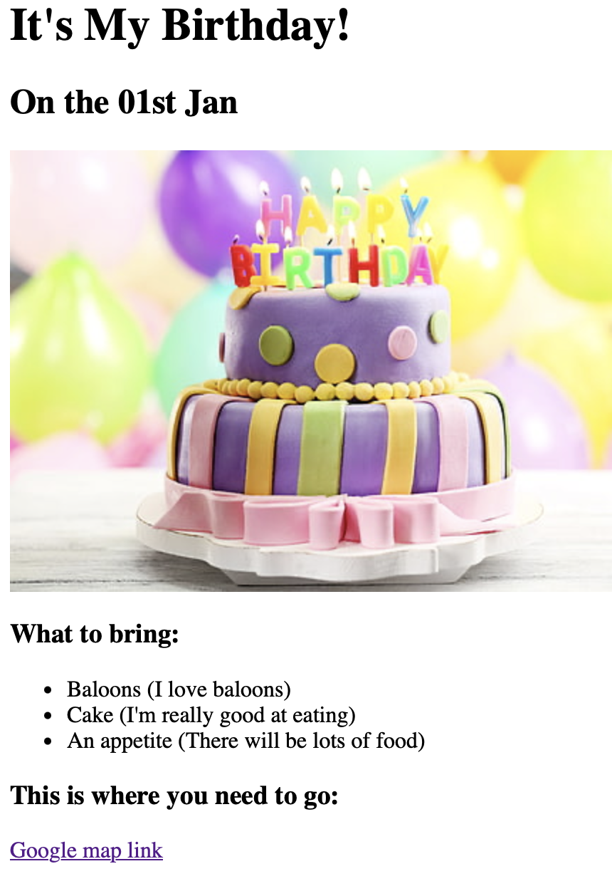
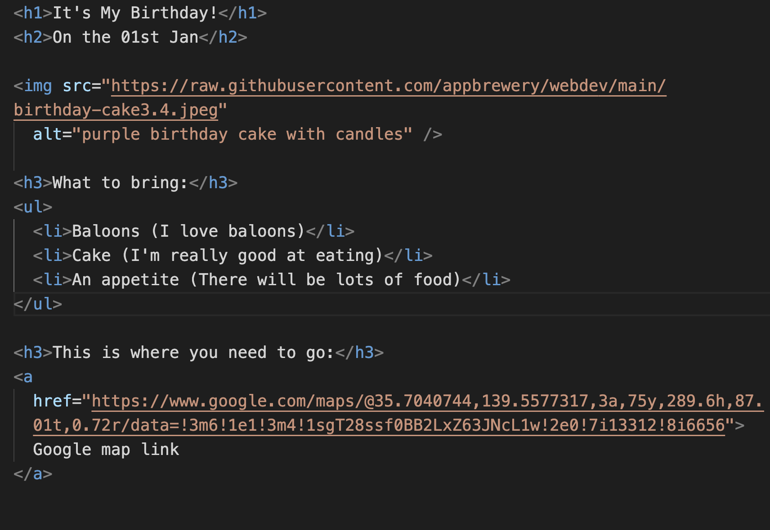

Slide 12
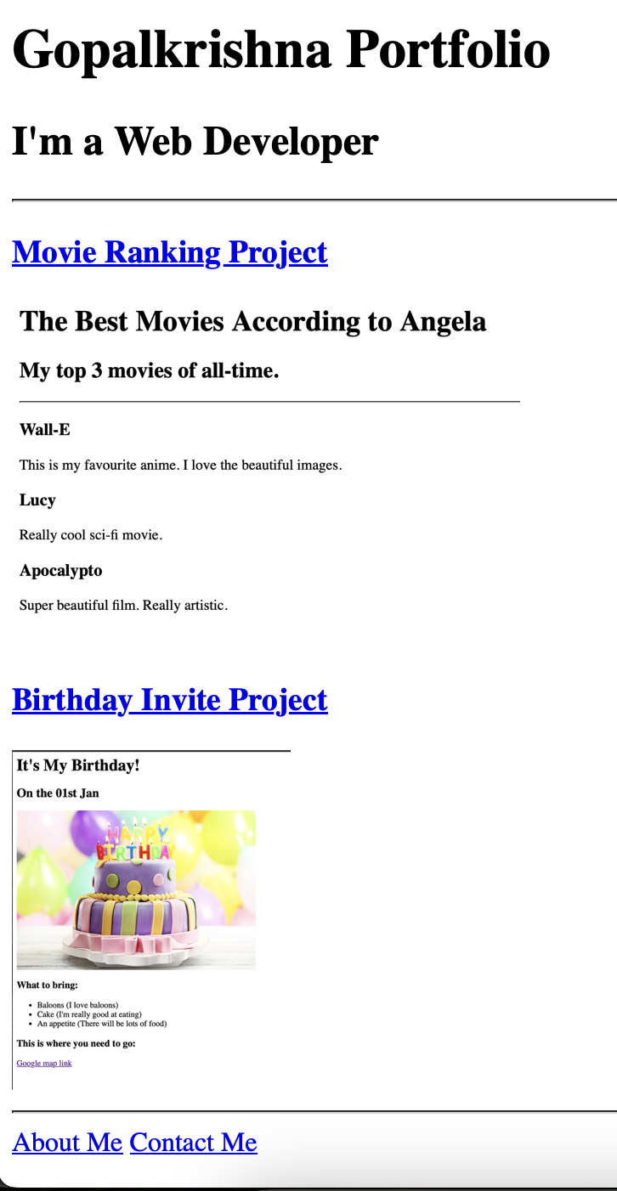
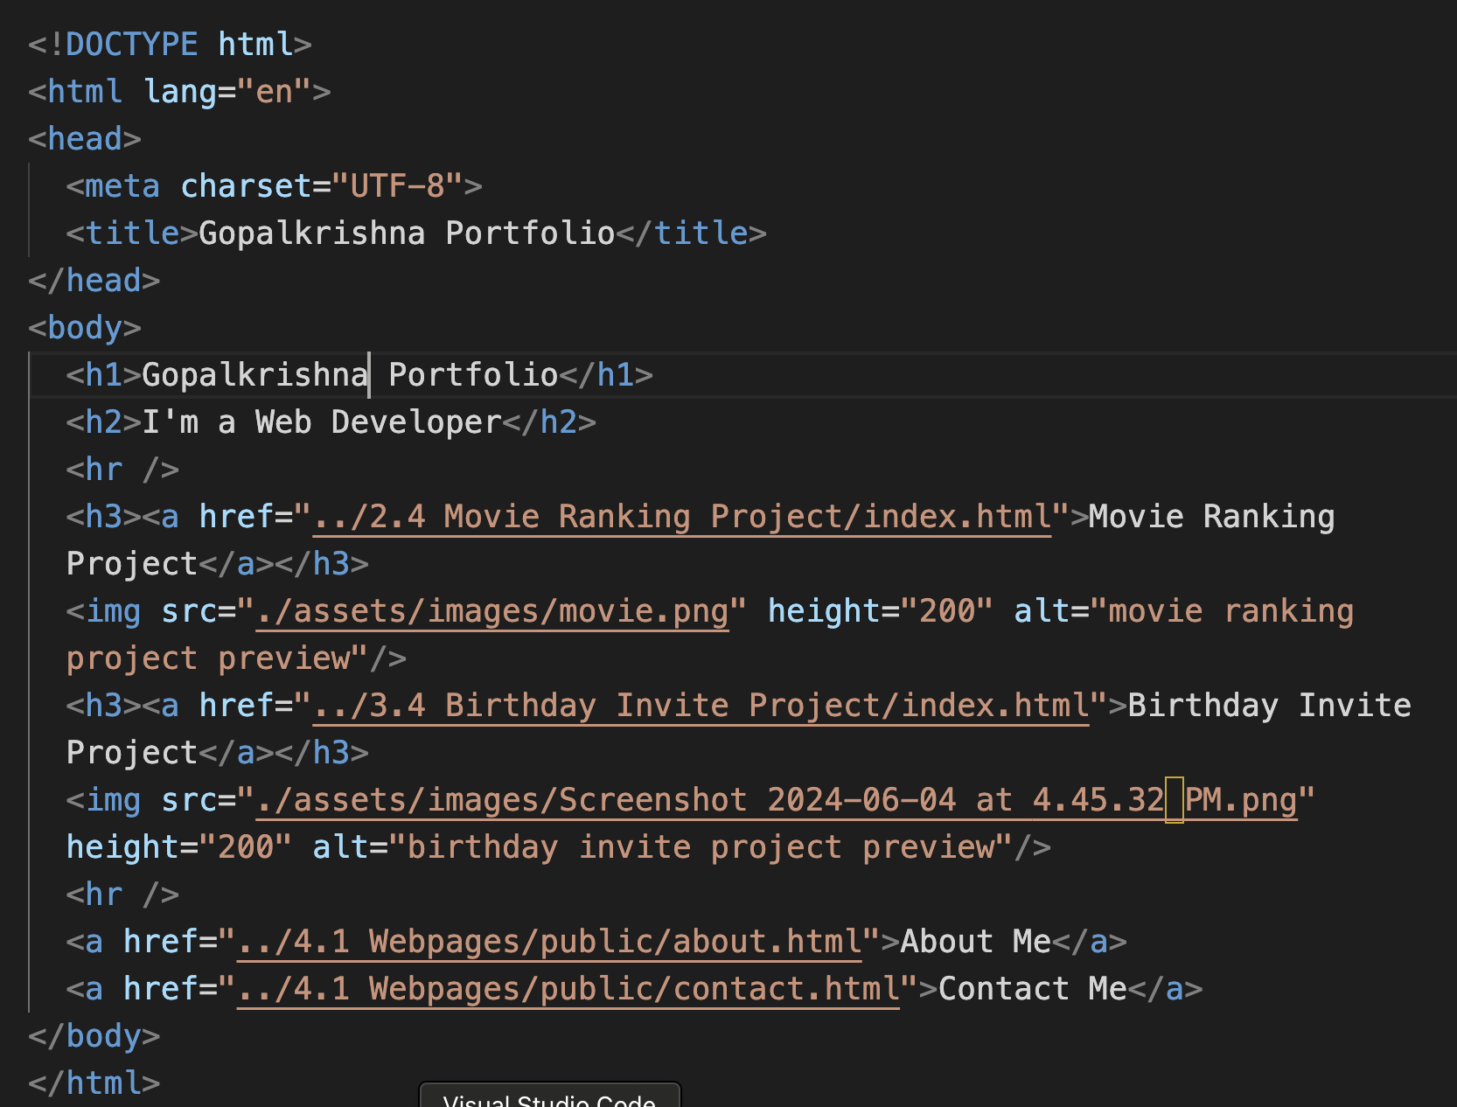

Slide 13
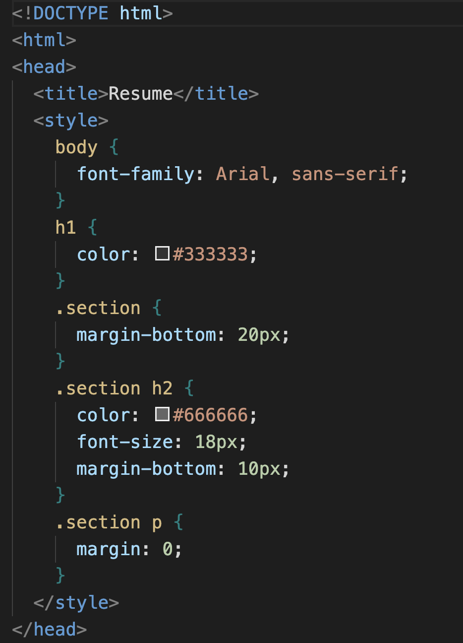
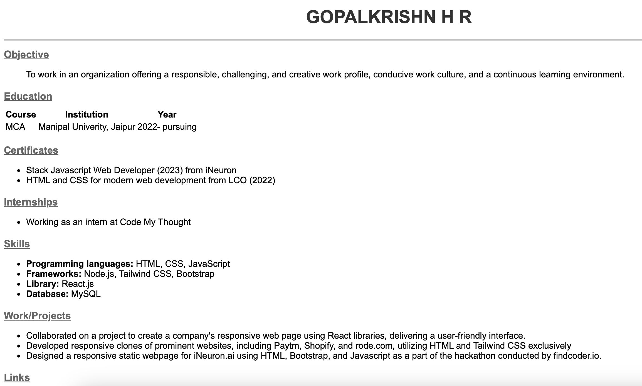
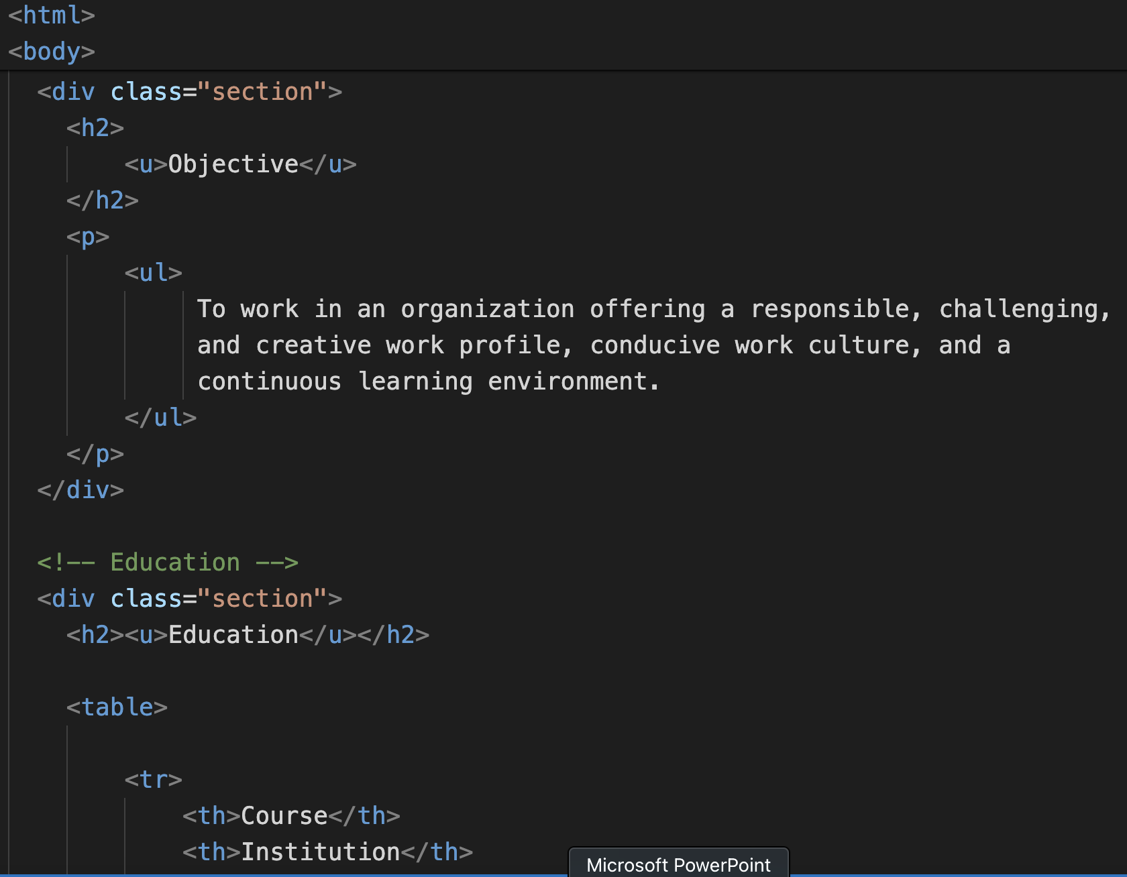

Slide 14
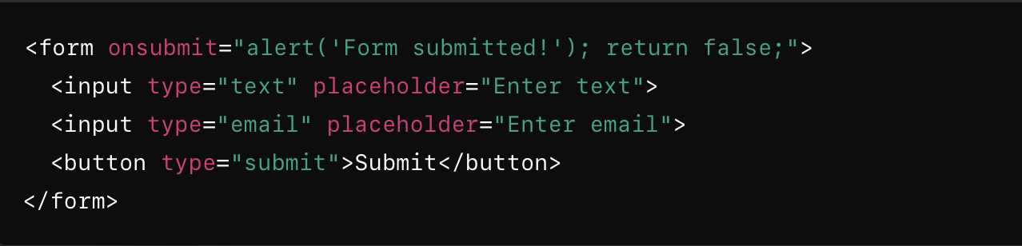
HTML Attributes: Adding Extra Functionality
id : Uniquely identifies HTML element, allowing for targeted CSS styling and JavaScript manipulation.
class: Assigns a class name enables the application of shared styles across multiple elements.
src and href: Specify the source or destination URL for images, links, and other media elements.
alt: Provides alternative text descriptions for images, improving accessibility for users with disabilities.
HTML Event Attributes
HTML has the ability to let events trigger actions in a browser, like starting a JavaScript when a
user clicks on an element.
Form Events:
Example: onchange, onsubmit, onfocus
Keyboard Events:
Example: onkeypress, onkeydown
Mouse Events:
Example: onclick, onmousemove,
onmouseover

Slide 15
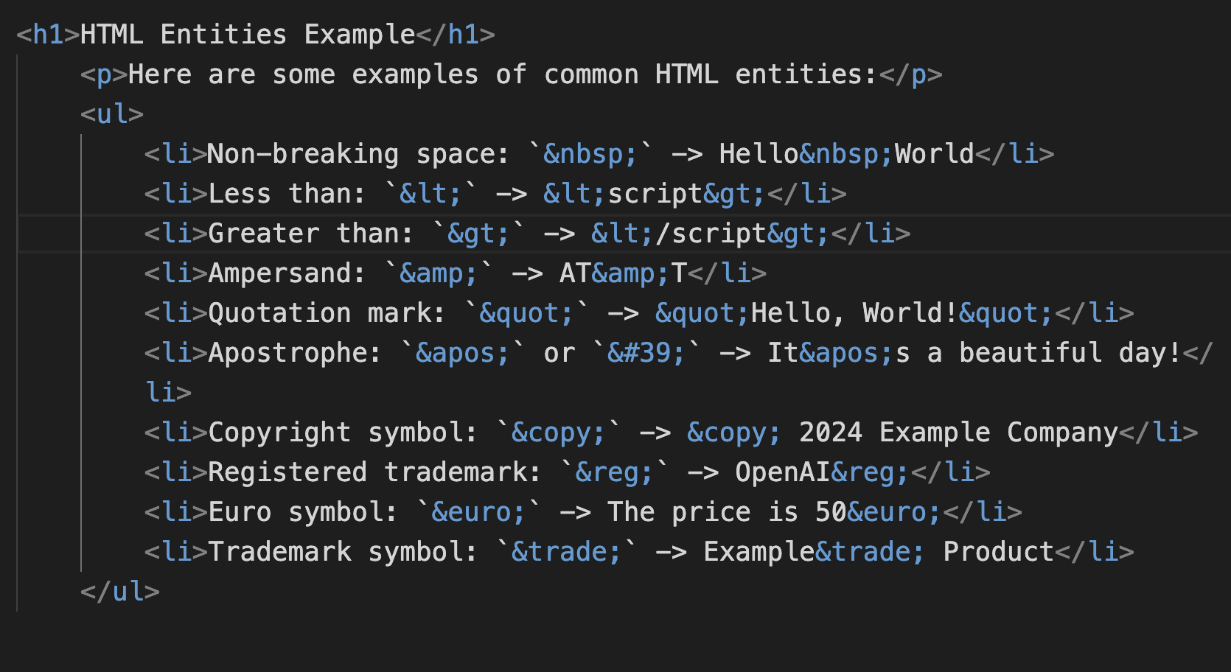
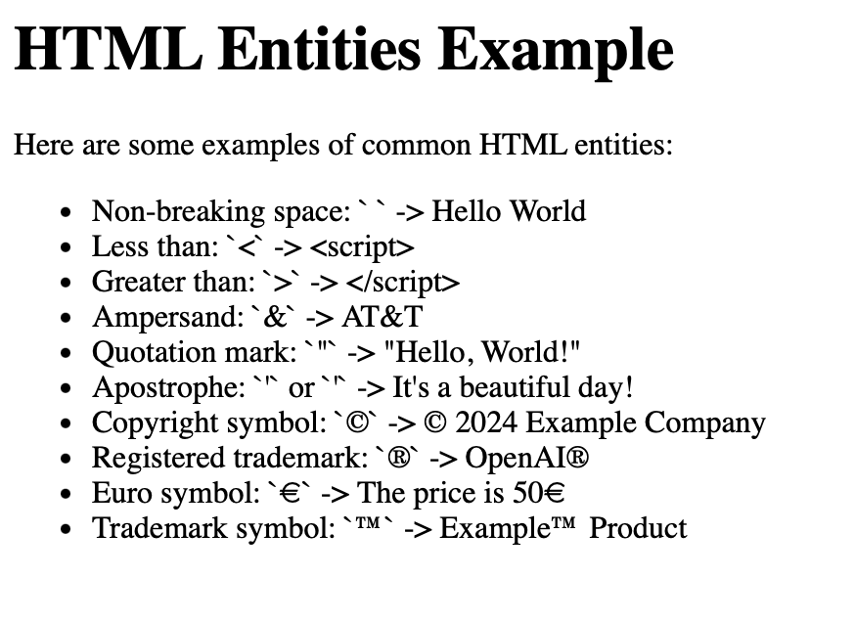
HTML Entities
To write reserved HTML characters html entities are used.
They help avoid conflicts with the syntax of HTML and ensure that the characters are displayed correctly in the browser.
Starts with an ampersand (&) and ends with a semicolon (;).
Entity names are case sensitive.

Slide 16
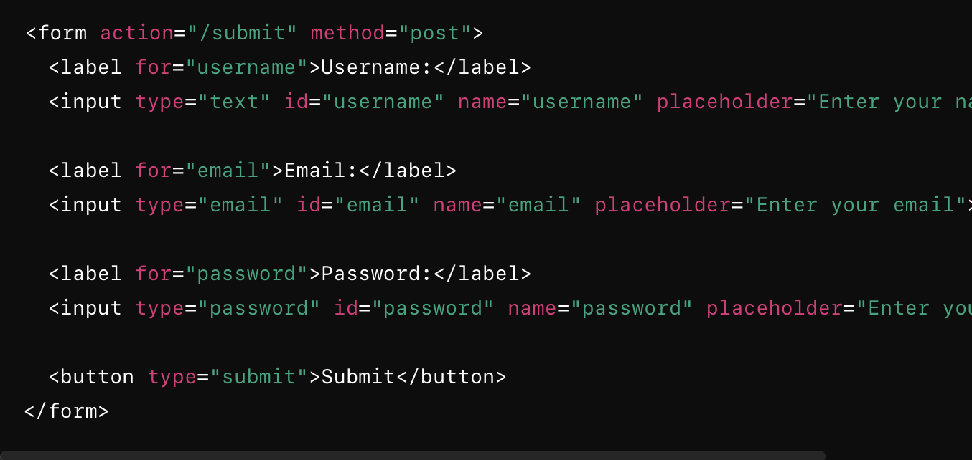
HTML Forms:
HTML forms are used to collect user input and submit it to a server for processing.
Form Tag: The action attribute specifies the URL where the form data will be sent. The method attribute specifies the HTTP method (GET or POST).
Label Tags: Provide labels for the input fields, improving accessibility.
Input Fields: Different types of inputs for text, email, and password collection.
Submit Button: Submits the form data to the server.

Slide 17
HTML Standards :
HTML standards are defined and maintained by the World Wide Web Consortium (W3C) and the Web Hypertext Application Technology Working Group (WHATWG).
Syntax and Structure: Elements are structured hierarchically, forming a tree-like structure called the Document Object Model (DOM).
Semantics :HTML provides semantic elements (e.g., <header>, <nav>, <footer>) to describe the structure and meaning of content, aiding accessibility and search engine optimization (SEO)
Accessibility: Should be understandable by all users, including those with disabilities. Features like semantic elements, ARIA(Accessible Rich Internet Applications) attributes, and proper markup and combination correct color contribute to accessibility.
Compatibility: HTML standards aim for cross-browser and cross-platform compatibility, ensuring consistent rendering and behavior across different devices and browsers.
Use <label> elements to associate text labels with form.
Ensure that all interactive elements (links, buttons, form controls) are accessible via keyboard.
Always use doctype
Use the lang attribute to specify the language .
Always close the tag in case of non void elements.
Use meta tag to include keywords, IE compatibility, character encoding, author, viewport and other details.
Maintain the order of the attribute
Comment <!-- --> : Use the comments wherever necessary.

Slide 18
HTML 5
Semantic Elements
Multimedia Elements
Elements like <header>, <footer>, <nav>, <main> and <article> provide better structure and meaning to web pages..
Audio & Video: The <audio> and <video> tags make it easy to embed multimedia content directly into web pages.
API Enhancements
Offline Capabilities
Features like Geolocation and Local Storage allow for more dynamic and interactive web applications.
The Application Cache lets web applications run offline, enhancing user experience.
Graphics and Drawing
Form Enhancements
Canvas & SVG: The <canvas> and <svg> tags enable drawing graphics and creating animations..
New input types (like email and date) and attributes (placeholder, required) make forms more user-friendly.

Slide 19
References
https://developer.mozilla.org/en-US/docs/Web/HTML
https://www.w3schools.com/html/

