Slide 1


CASE STUDY-3
ENERGY EFFICIENCEY IN SMART BUILDINGS

Slide 2
TEAM
GOPALAKRISHNAN.V (TEAM LEADER -S4F_CP_Team_12197)
REGUL KUMAR.N (TEAM MEMEBER-S4F_CP_Team_12197)
GOKULSRINATH.M (TEAM MEMEBER-S4F_CP_Team_12197)
MOHAMMED YOUNUS.S (TEAM MEMEBER-S4F_CP_Team_12197)
HARIPRASATH.R (TEAM MEMEBER-S4F_CP_Team_12197)

Slide 3
Content
Abstract
Problem Statement
Objective
Data Collection and Preparation
Proposed Solution (Methodology)
Model Performance Evaluation
Screenshots / Demonstration (video)
Future Scope
Conclusion
Notes:
Abstract
Problem Statement (Clearly define the challenge)
Objective (State your project's goal)
Background and Research (Discuss existing solutions, trends, and gaps)
Data Collection and Preparation (Focus on data sources, cleaning, and augmentation)
Proposed Solution (Methodology)
Model Architecture (e.g., CNN, U-Net, YOLOv5)
Key Techniques (e.g., Transfer Learning, Image Augmentation)
Model Performance Evaluation
Metrics (Accuracy, Precision, Recall, IoU, etc.)
Graphs (Confusion Matrix, ROC Curve, etc.)
Screenshots / Demonstration (Visual proof of system functionality)
Future Scope (Improvements, scalability, and integration ideas)
Conclusion (Summarize results and impact)
Q&A Session
3

Slide 4
Abstract
Smart buildings leverage advanced technologies, such as sensors, automation, and data analytics, to optimize energy consumption and reduce environmental impact.
The increasing demand for energy efficiency has made smart buildings a crucial aspect of sustainable architecture.
Through the analysis of existing models and technologies, this study provides insights into the current state of energy-efficient buildings, and proposes solutions for enhancing their performance while minimizing energy waste.

Slide 5
Problem Statement
The construction and operation of buildings account for a significant portion of global energy consumption and carbon emissions.
With urban populations growing, there is an urgent need to develop and implement energy-efficient solutions in buildings.
Traditional buildings, without automation and advanced control systems, consume energy inefficiently, leading to unnecessary waste, high operational costs, and increased environmental footprints.
There is a lack of integrated systems that allow for the real-time monitoring and optimization of energy consumption in existing buildings, which exacerbates these issues.

Slide 6
Objective
The primary objective of this study is to explore the role of smart building technologies in enhancing energy efficiency. Specific objectives include:
To identify the key technologies enabling energy efficiency in smart buildings.
To propose a methodology for integrating energy-efficient solutions in new and retrofitted buildings.
To evaluate the performance of smart building systems and assess their impact on energy consumption.
To explore the challenges faced in implementing these solutions and provide recommendations for overcoming them.

Slide 7
Data Collection and Preparation
Dataset includes:
Energy usage data
Occupancy data
Weather conditions
Collected over a two-year period.

Slide 8
Proposed Solution (Methodology)
1.Data preprocessing
2. Feature engineering
3. Train machine learning model
4. Evaluate performance
5. Deploy AI-driven energy management system

Slide 9
Model Performance Evaluation
Energy Consumption Reduction: Compare energy consumption before and after implementing smart systems.
Cost Savings: Analyze the reduction in operational costs due to optimized energy use.
Environmental Impact: Measure the reduction in carbon emissions based on the energy savings.
Occupant Comfort and Satisfaction: Survey building occupants to assess comfort levels in terms of temperature, lighting, and overall environment quality.
ROI (Return on Investment): Assess the payback period for implementing smart energy solutions based on energy savings and cost reduction.

Slide 10
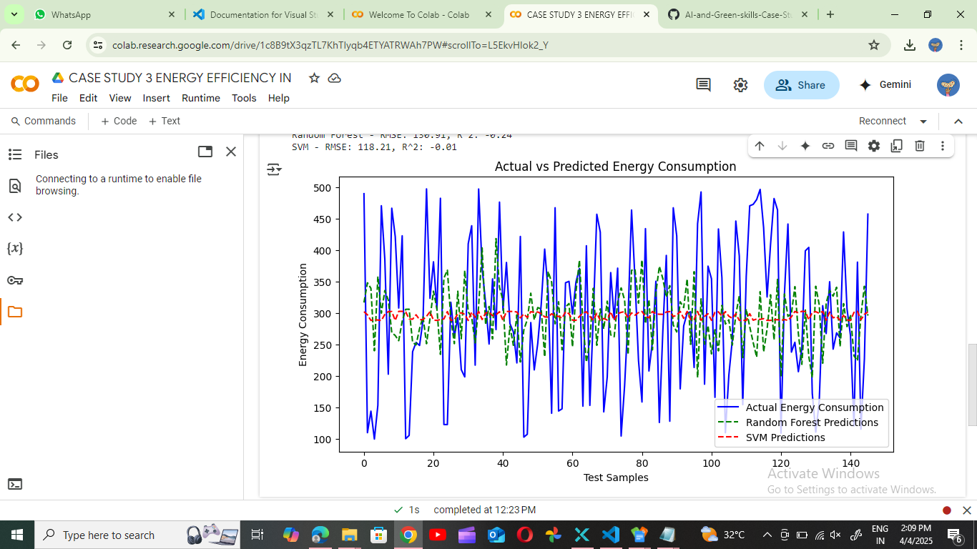
Screenshots / Demonstration (video)
GITHUB LINK: https://github.com/Gopalkrishnan143/AI-and-Green-skills-Case-Study-3

Slide 11
Future Scope
Integration of Renewable Energy Sources
Trend: As buildings move towards becoming more sustainable, integrating renewable energy sources like solar, wind, and geothermal can help power building operations.
AI's Role: AI can predict energy production from renewable sources and optimize their usage by adjusting energy demand in real-time.
Example: Smart systems can adjust HVAC and lighting systems to utilize solar energy when available, reducing reliance on the grid.

Slide 12
Conclusion
The implementation of AI-powered energy management systems in the smart office building in Singapore has demonstrated significant potential in enhancing energy efficiency and reducing operational costs. By leveraging real-time data, such as occupancy patterns, weather forecasts, and historical energy usage, the system was able to optimize HVAC settings, resulting in:
A 20% reduction in energy consumption
A 10% decrease in operating costs
This real-world example highlights the critical role AI can play in not only improving energy efficiency but also in achieving cost savings in commercial buildings with high energy demands. It showcases how advanced technology can help businesses meet sustainability targets while maintaining a comfortable and productive environment for occupants.

Slide 13
Questions
1. What features in the dataset are most important for predicting equipment failures?
The most important features for predicting inverter or equipment failures in a solar power system include:
Temperature of panels/inverter: Overheating can signal impending failure or efficiency drops.
Voltage output: Abnormal voltage levels may indicate faults in the inverter or panels.
Current output: Current irregularities can be early signs of malfunction.
Energy output trends: Decreasing efficiency or fluctuations in energy output can suggest an issue.
Weather data (e.g., irradiance, humidity, ambient temperature): Weather affects performance; anomalies under similar conditions may hint at hardware issues.
Historical maintenance records: Frequency and types of past failures can help identify patterns or recurring problems.
Operational hours or time since last maintenance: Equipment wear and tear often correlates with usage time.

Slide 14
2. Develop a machine learning model to predict inverter failure.
Here's a high-level approach to building the model:
a. Data Preparation
Clean missing or corrupted sensor readings.
Engineer time-based features (e.g., average temperature over the last hour).
Label inverter failures using historical logs (binary classification: failure vs. no failure).
b. Model Selection
Use supervised learning algorithms such as:
Random Forest or XGBoost: Good for handling non-linear relationships and importance ranking.
LSTM/GRU (for time-series data): If sensor data is time-stamped and sequential.
Logistic Regression: As a simple and interpretable baseline.
c. Model Training
Split the data into training and testing sets.
Apply cross-validation.
Tune hyperparameters using grid search or Bayesian optimization.
d. Evaluation Metrics
Precision & Recall: Crucial for failure prediction (better to catch true positives).
F1-Score: Balances false positives and false negatives.
ROC-AUC: Assesses the classifier's performance.

Slide 15
3. How would you improve the model's accuracy?
To enhance model accuracy:
Feature Engineering: Add rolling averages, lags, or derived metrics like power = voltage × current.
Anomaly Detection: Combine supervised learning with unsupervised methods to flag rare events.
Ensemble Models: Combine predictions from multiple models to reduce variance and bias.
Address Class Imbalance: Use SMOTE, ADASYN, or balanced class weights if failure cases are rare.
Model Monitoring and Retraining: Continuously update the model with new data to adapt to system changes.
External Data: Integrate more contextual data (e.g., solar irradiance, dust level on panels, grid feedback).
4. What actions should be taken if a failure is predicted?
When a failure is predicted, actions may include:
Automated Alert System: Notify technicians and operators in real time.
Schedule Preventive Maintenance: Before the predicted failure time to avoid downtime.
Load Balancing: Temporarily shift load to other operational units.
Inspect the Equipment: Focus inspection on the predicted component (e.g., inverter, panel).
Document and Learn: Log the incident to improve future predictions.

Slide 16
5. How can predictive maintenance contribute to sustainability and reduce waste?
Predictive maintenance supports sustainability in several ways:
Reduces Waste: Avoids premature replacement of functional parts and extends equipment life.
Increases Energy Efficiency: Minimizes downtime, maximizing renewable energy generation.
Lowers Carbon Footprint: Reduces the need for emergency repairs and unnecessary transport emissions.
Reduces Resource Use: Efficient scheduling means fewer spare parts used and less manpower deployed.
Supports Circular Economy: Early detection allows for repair over replacement, encouraging reuse.

