Slide 1
JDBC Java DataBase Connectivity

Slide 2
What is JDBC?
“An API that lets you access virtually any tabular data source from the Java programming language”
JDBC Data Access API – JDBC Technology Homepage
What’s an API?
What’s a tabular data source?
“… access virtually any data source, from relational databases to spreadsheets and flat files.”

Slide 3
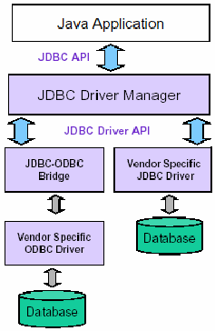
General Architecture
What design pattern is implied in this architecture?
What does it buy for us?
Why is this architecture also multi-tiered?

Slide 4
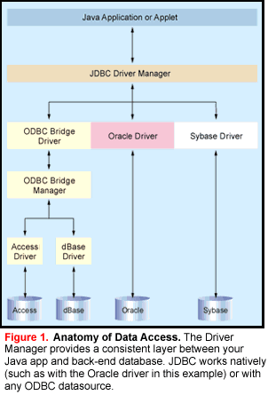

Slide 5
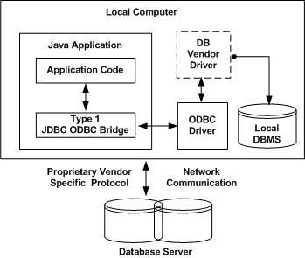
Type 1: JDBC-ODBC Bridge Driver

Slide 6
The JDBC-ODBC bridge driver uses ODBC driver to connect to the database. The JDBC-ODBC bridge driver converts JDBC method calls into the ODBC function calls. This is now discouraged because of thin driver.

Slide 7
Advantages:
easy to use.
can be easily connected to any database.
Disadvantages:
Performance degraded because JDBC method call is converted into the ODBC function calls.
The ODBC driver needs to be installed on the client machine.

Slide 8
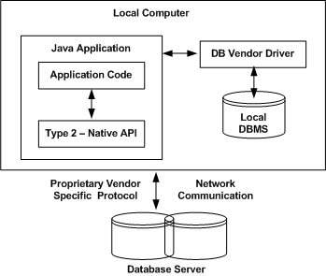
Type 2: JDBC-Native API Driver

Slide 9
The Native API driver uses the client-side libraries of the database. The driver converts JDBC method calls into native calls of the database API. It is not written entirely in java.

Slide 10
Advantage:
performance upgraded than JDBC-ODBC bridge driver.
Disadvantage:
The Native driver needs to be installed on the each client machine.
The Vendor client library needs to be installed on client machine.

Slide 11
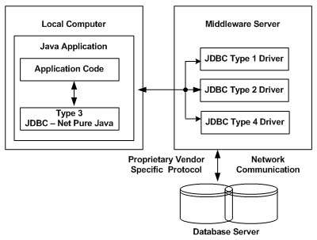
Type 3: JDBC-Net pure Java Driver

Slide 12
This driver uses middleware (application server) that converts JDBC calls directly or indirectly into the vendor-specific database protocol. It is fully written in java.

Slide 13
Advantage:
No client side library is required because of application server that can perform many tasks like auditing, load balancing, logging etc.
Disadvantages:
Network support is required on client machine.
Requires database-specific coding to be done in the middle tier.
Maintenance of Network Protocol driver becomes costly because it requires database-specific coding to be done in the middle tier.

Slide 14
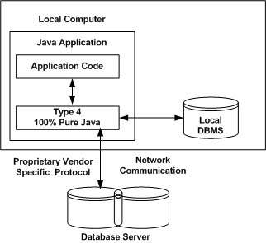
Type 4: Native Protocol Pure Java Driver

Slide 15
The thin driver converts JDBC calls directly into the vendor-specific database protocol. That is why it is known as thin driver. It is fully written in Java language

Slide 16
Advantage:
Better performance than all other drivers.
No software is required at client side or server side.
Disadvantage:
Drivers depends on the Database.

Slide 17
Which Driver should be Used?
If you are accessing one type of database, such as Oracle, Sybase, or IBM, the preferred driver type is 4.
If your Java application is accessing multiple types of databases at the same time, type 3 is the preferred driver.
Type 2 drivers are useful in situations, where a type 3 or type 4 driver is not available yet for your database.
The type 1 driver is not considered a deployment-level driver, and is typically used for development and testing purposes only.

