Slide 1

XCM v2概览与去中心化的Liquid Staking方案
平行链开发经验及工具分享
江成 2021年9月25日

Slide 2

江成
全栈，区块链工程师
ParallelFI 核心开发者
https://github.com/GopherJ

Slide 3
目录
ParallelFI 介绍
XCM v0的回顾
XCM v1, v2的新特性
What is & why Liquid Staking
Liquid Staking方案探索
Liquid Staking验证人选举
基于Transact和衍生账户的Liquid Staking实现
平行链开发经验及工具分享
引用

Slide 4
ParallelFI 介绍
春季 Substrate Hackathon 时建立的团队
4月份成立Parallel Finance，总部位于美国
团队成员主要位于中国，美国，欧洲，印度，俄罗斯
2200万美元A轮融资，波卡生态中最大的一轮融资
Parallel Finance = Lending + Liquid Staking + AMM + Auction Loan + Cross chain wallet

Slide 5
Part 1
XCM v2概览

Slide 6
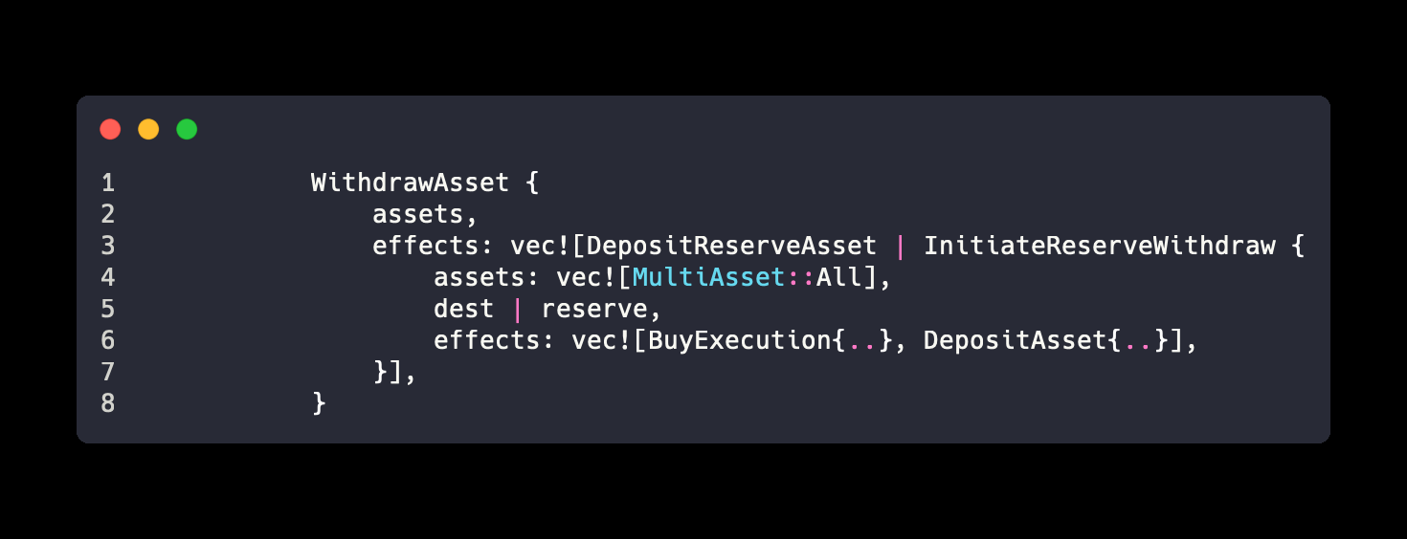
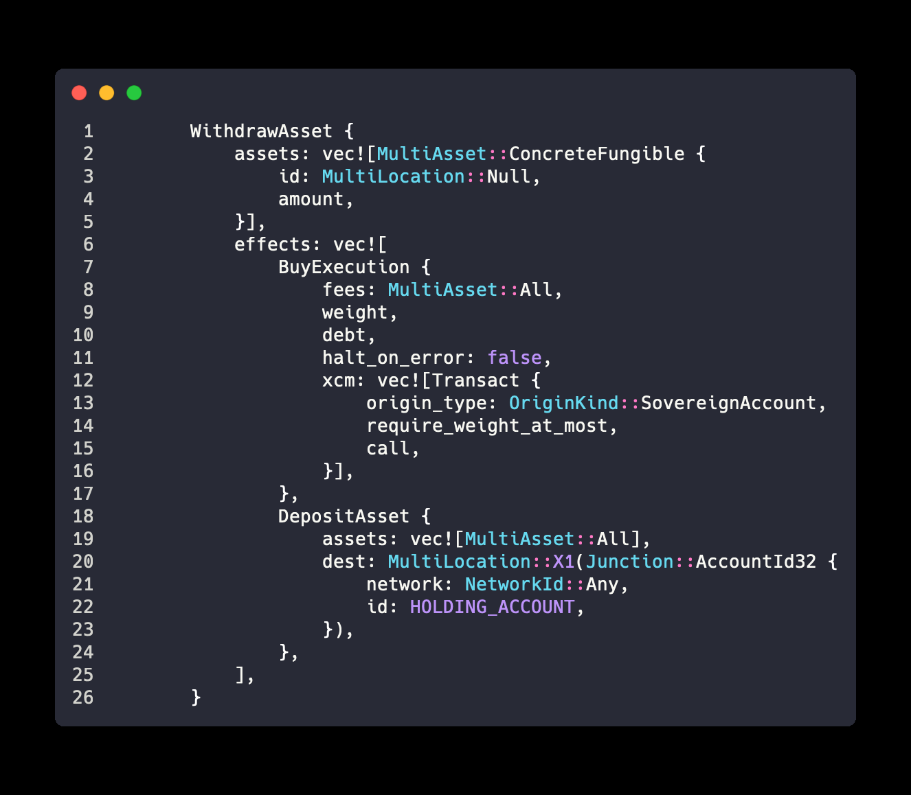
XCM v0 的回顾
pallet-xcm
xcm-builder
xcm-executor
XCMP / UMP / DMP QUEUE
XCM v0
XCM v1
XCM v2

Slide 7
XCM v1, v2 的新特性
类型结构简化 (v1)
版本自动协商 (v1添加类型，v2添加实现）
Extrinsics回调 (v2)
VM (v2)

Slide 8
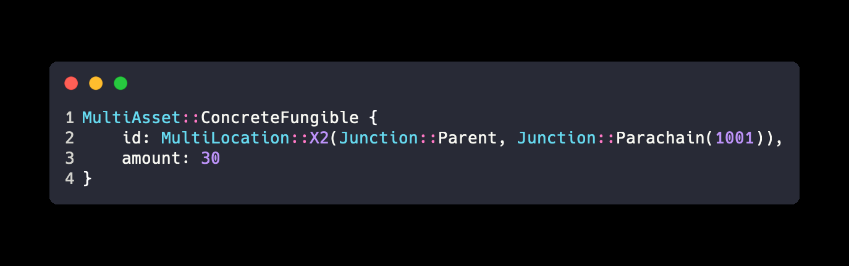
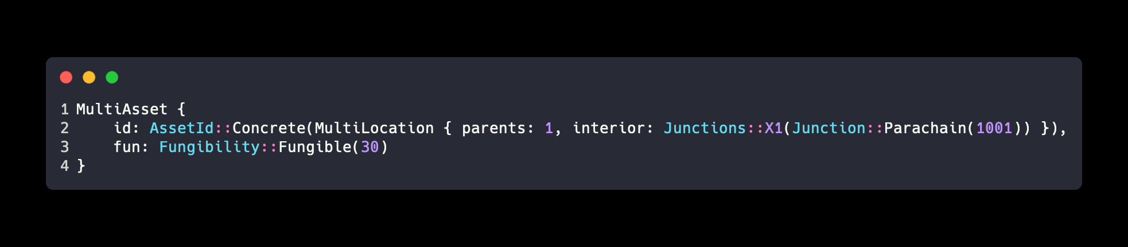
XCM v1, v2 的新特性
类型结构简化
MultiAsset -> AssetId + Fungibility + WildMultiAsset (v1)
MultiLocation X1…X8 -> MultiLocation { parents: u8, interior: Junctions } (v1)
Xcm, Order -> Instruction (v2)
BuyExecution weight + debt -> WeightLimit::Limited(weight) (v2)
例子：在 Parachain(2000) 上表示 Parachain(1001) 上的 30 个同质化 Token
V0
V1, V2

Slide 9
XCM v1, v2 的新特性
版本自动协商
Add new target
Version
Notify
Targets
pallet-xcm
Version
Notify
Targets
ParaB
xcm
SubscribeVersion
wrap version
QueryResponse { .., response: v1 }
note unknown
version
Version DiscoveryQueue
pallet-xcm
on_initialize
check and notify xcm version change, migrate storage
2. request version notify
SupportedVersions
XCM_VERSION.MultiLocation <-> XcmVersion
ParaA

Slide 10
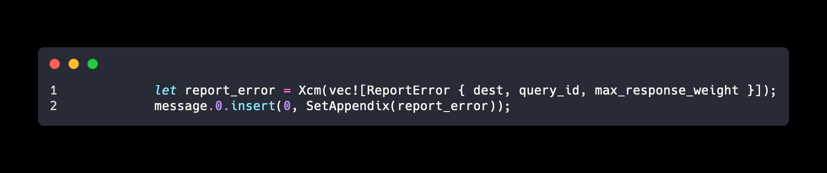
XCM v1, v2 的新特性
Extrinsics回调
ParaB
xcm
query_id, weight, error_index
query_id, weight
query_id, weight, error_index
on_response
pallet-xcm
report_outcome_notify
wrapper(xcm)
dispatch
Router
new_query
Some(call info)
[ SetAppendix(ReportError), … ]
Queries
query_id <—> Option<[pallet_index, call_index]>
ParaA

Slide 11
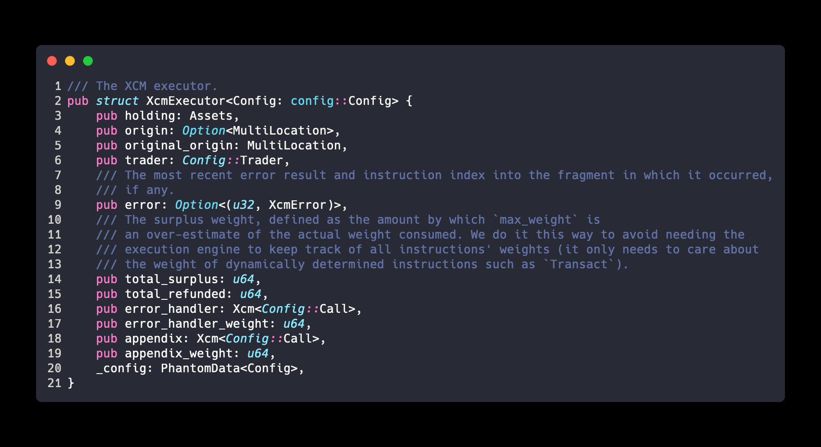
XCM v1, v2 的新特性
VM
xcm
new vm
set / fire error handler
set appendix
…..
process instruction
execute appendix

Slide 12
Part 2
去中心化的 Liquid Staking 方案

Slide 13
What is & why Liquid Staking
波卡使用 NPOS 保证网络安全
用户可以质押自己的 Token 提名验证者来获得奖励
Token 质押期间不具有流动性，无法获得可流动的 “票据”
只有波卡网络知道这笔锁住的 Token
问题：为什么不提供票据释放流动性呢？让用户能自由的在各个平台交易“票据”
流动性释放的类似案例： Bifrost SALP 协议释放 Crowdloan 期间锁住 Token 的流动性

Slide 14
Liquid Staking 方案探索
链下多签 + 代理的 v1 版本
Relay Chain
xcm upward transfer + bond / bond_extra
nominate
stake
unstake
xcm downward transfer
bond duration arrived
amount reached threshold
offchain
stake-client
Proxy::A
Proxy::B
pallet-liquid-staking
start redeem allocation
anonymous
validators
multi-sig
offchain nominate-client
Alice
Bob
Charlie

Slide 15
Liquid Staking 方案探索
基于 Transact 和衍生账户的 v2 版本
upward transfer
derive_bond / derive_bond_extra
derive_unbond
derive_rebond
Relay Chain
total_stake
total_unstake
Ledger
stake
unstake (charge 3/1000)
derive_withdraw_unbonded
downward transfer
Unstake
Queue
peek front
pallet-liquid-staking
push back
summary(bonding_amount, unbonding_amount)
insert
nominate / payout_stakers
validators
rewards / slashes
update amount
Withdrawing
offchain nominate-client
Governance

Slide 16
Liquid Staking 验证人选举
$$Score=R⋅(crf⋅(1-CR)+nf⋅\frac{1}{N}+epf⋅\frac{EEP}{EEPA})⋅SR$$
R: Reputation, 0 or 1
CR: Commission Rate
N: Nomination of one validator
EEP: Average Era Points of one validator in the past 28 eras.
EEPA: Average Era Points of All validators in the past 28 eras.
crf: A constant shows how much influence of the Commission Rate of a validator. The default value is 100.
nf: A constant shows how much influence of the Nomination of a validator. The default value is 1000.
epf: A constant shows how much influence of the Era Points of a validator. The default value is 10.
SR: Slash Record, default 1, set to 0 if ever slashed in the past month

Slide 17
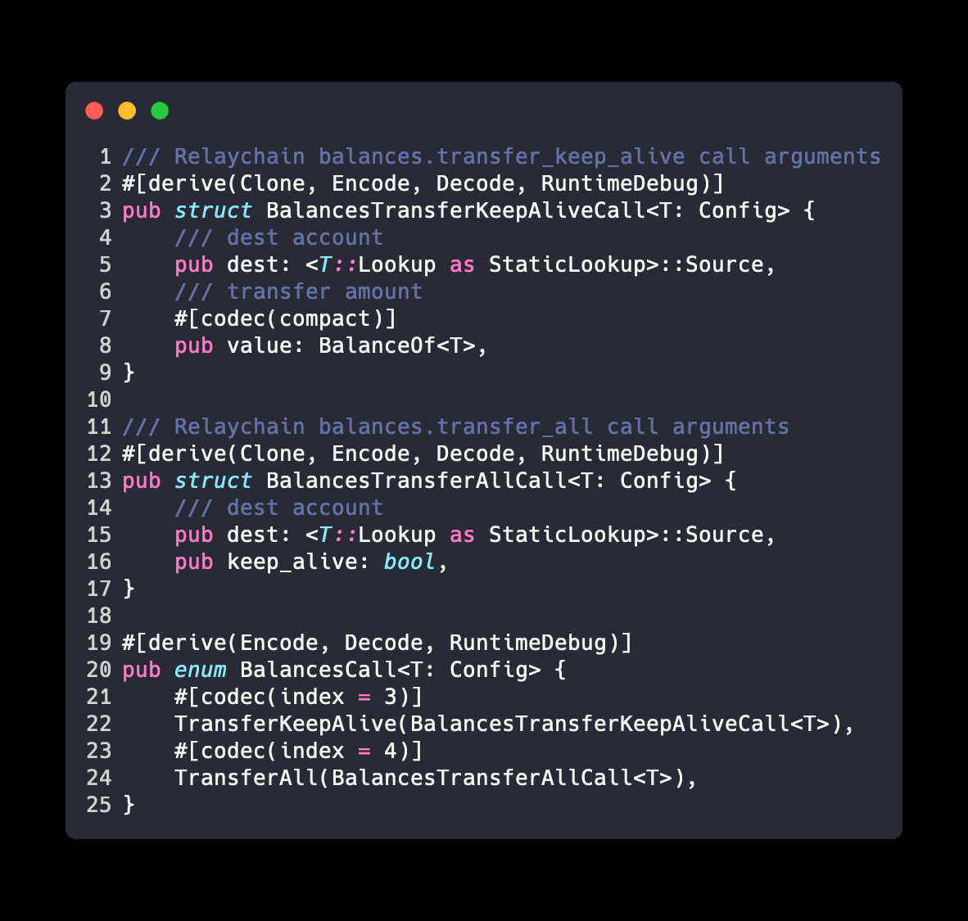
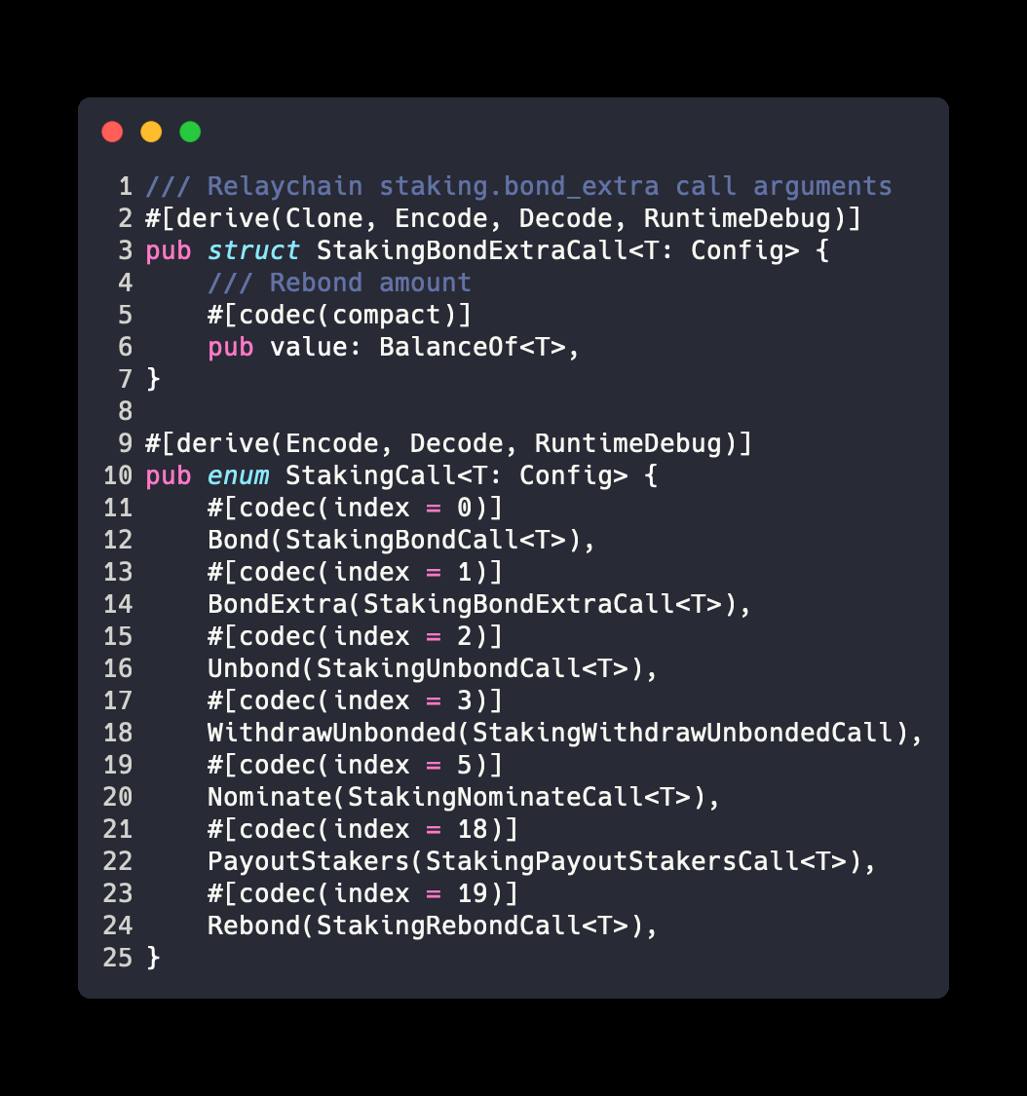
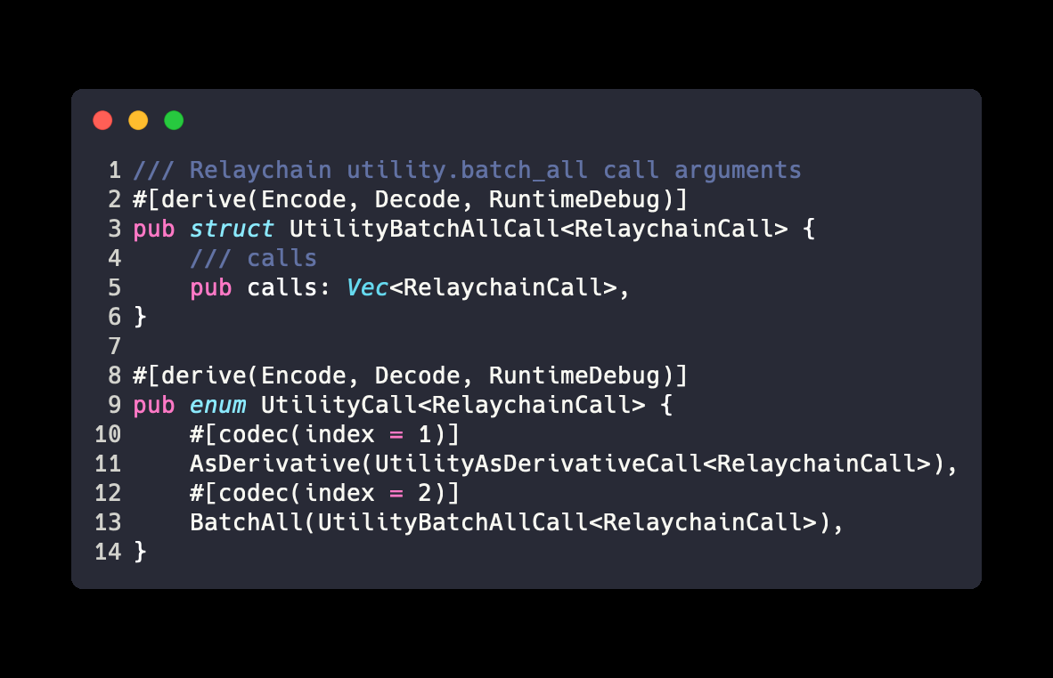
基于 Transact 和衍生账户的 Liquid Staking 实现
中继链方法定义
pallet_balances
pallet_staking
pallet_utility
注意：参数的 #[codec(compact)] 需与中继链保持一致，否则会报 WeightNotComputable 错误

Slide 18
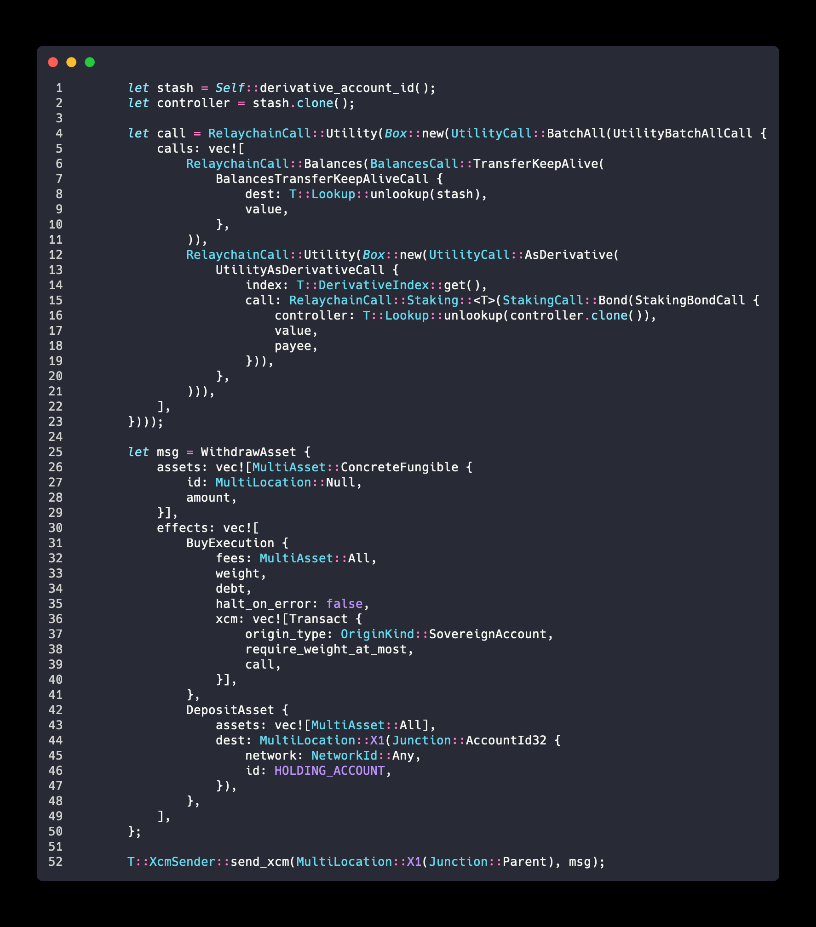
基于 Transact 和衍生账户的 Liquid Staking 实现
XCM消息格式
staking.bond
Heiko
upward transfer
balance transfer
Kusama
Holding
Derivative
pallet
staking
derivative call

Slide 19
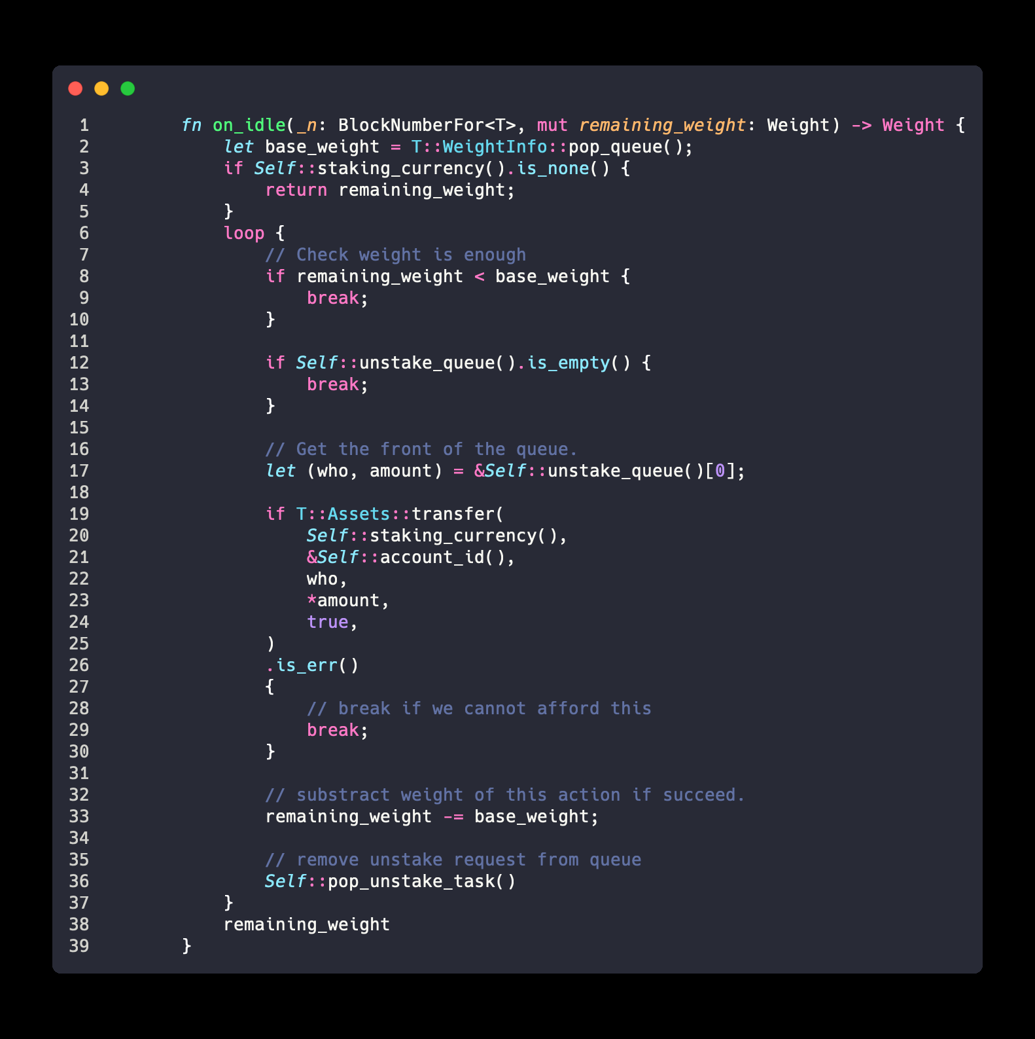
基于 Transact 和衍生账户的 Liquid Staking 实现
on_idle 尝试对 unstake 队列 peek_front 并支付 Staking Currency
remaining weight
> required_weight ?
transfer(queue.peek_front())
queue.pop_front

Slide 20
Part 3
平行链开发经验及工具分享

Slide 21
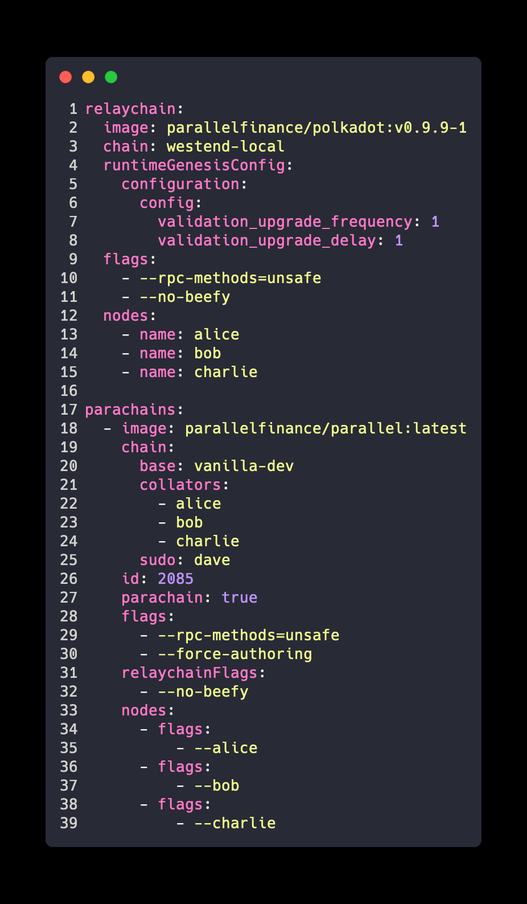
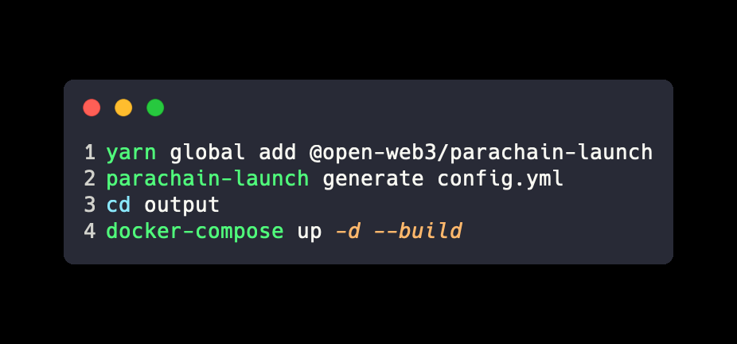
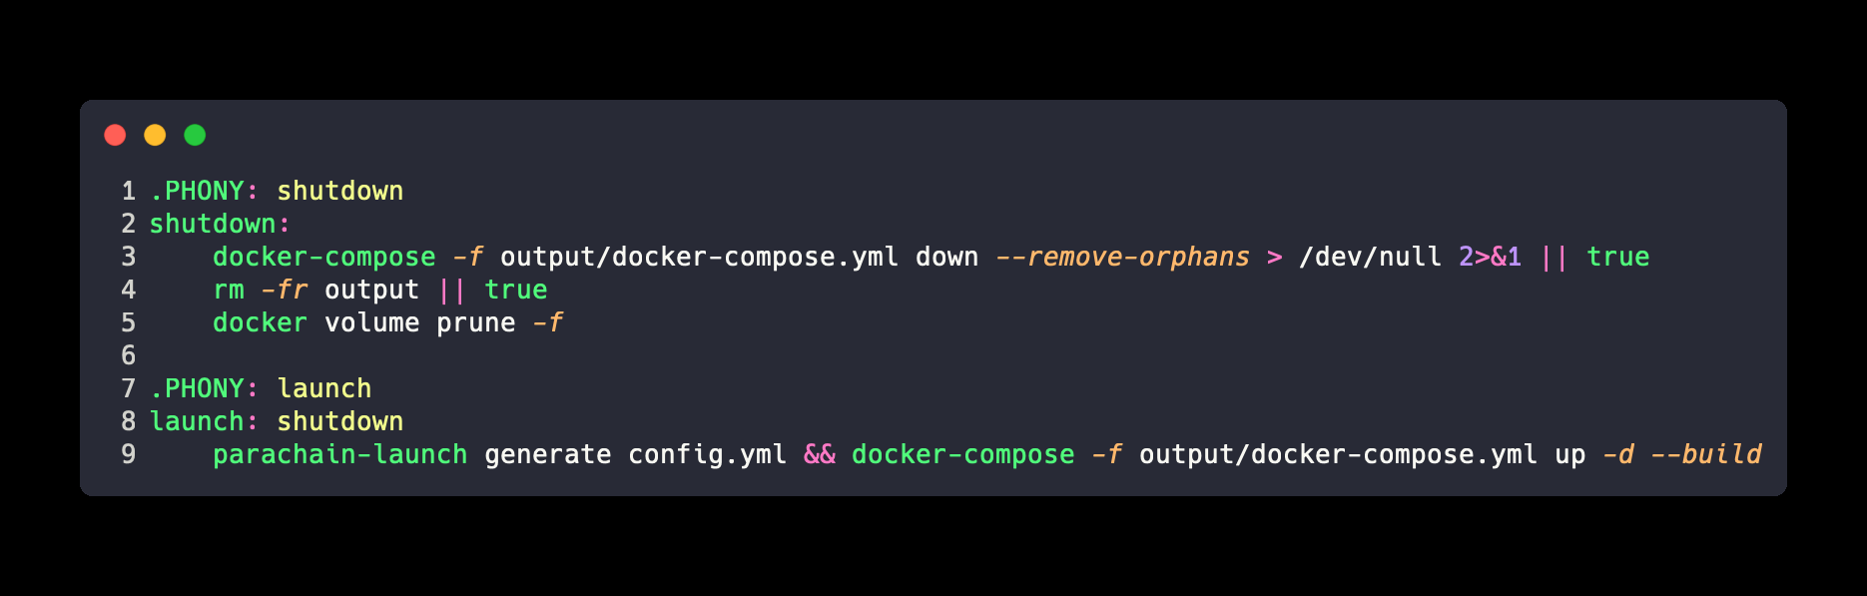
平行链开发经验及工具分享
parachain-launch
config.yml
Makefile

Slide 22
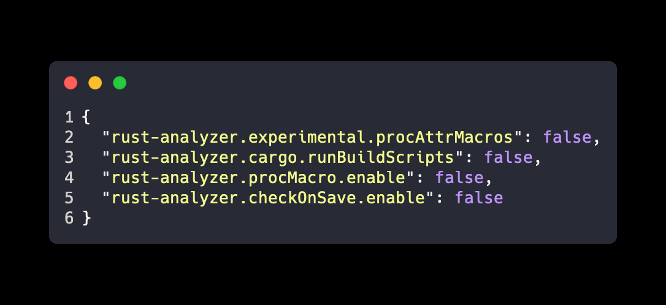
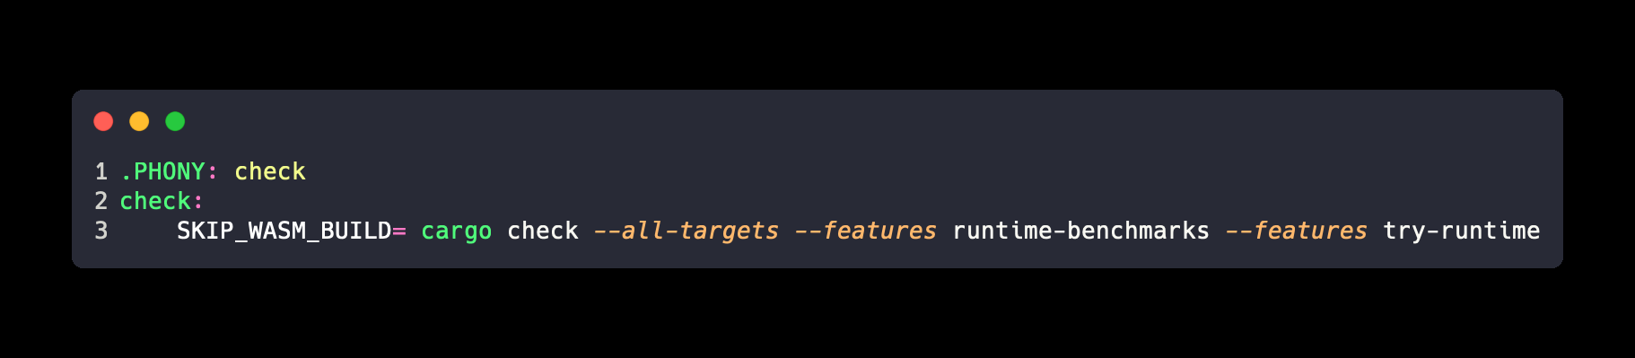
平行链开发经验及工具分享
rust-analyzer 针对平行链开发的配置优化
.vscode/settings.json | ~/.config/nvim/coc-settings.json
Makefile

Slide 23
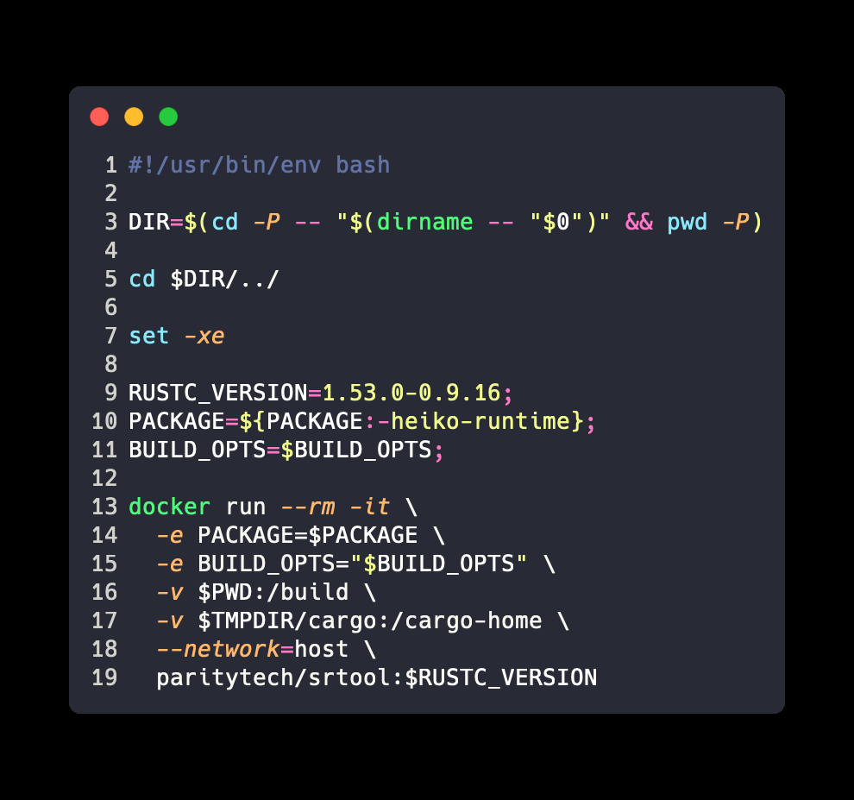
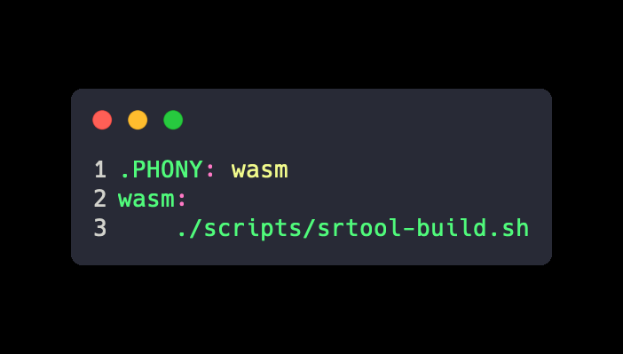
平行链开发经验及工具分享
srtool 确定性编译
scripts/srtool-build.sh
Makefile

Slide 24
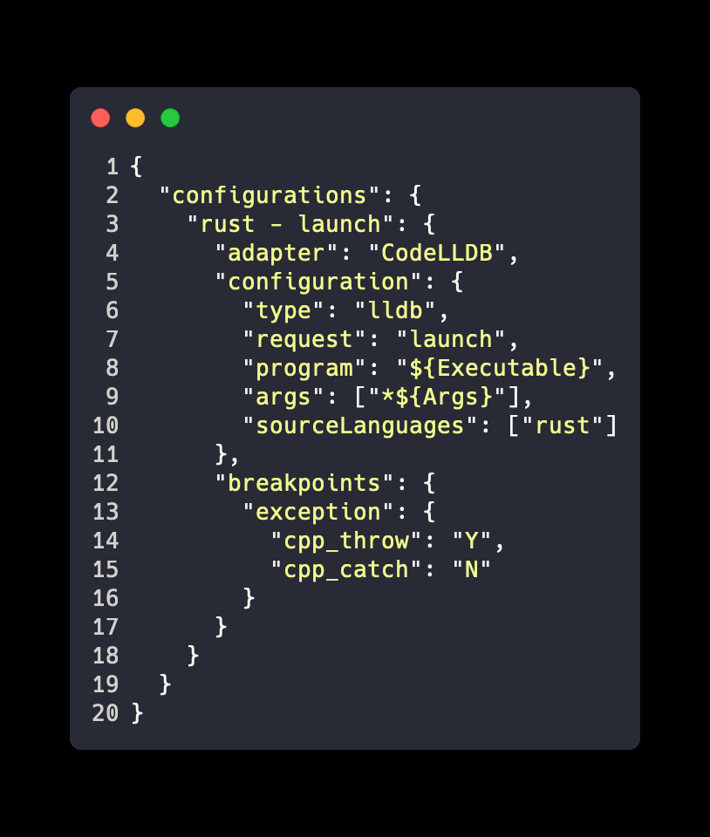
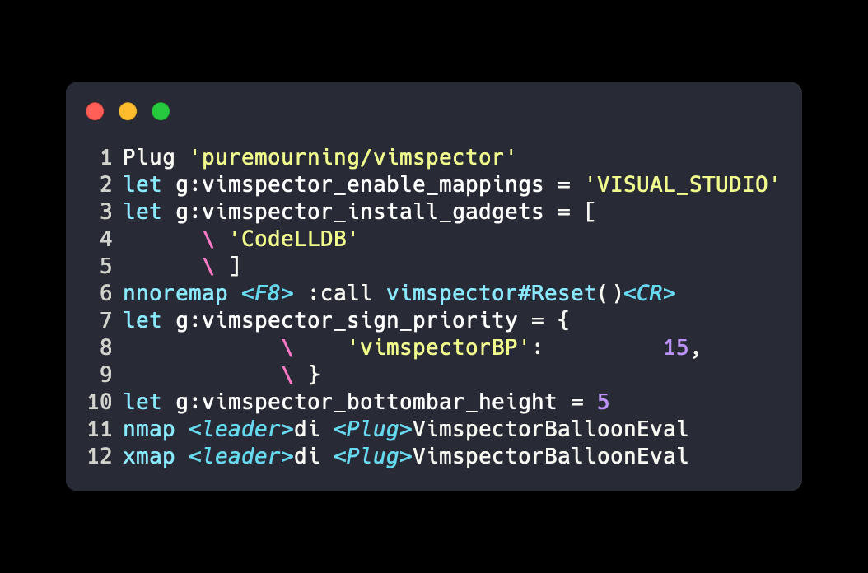
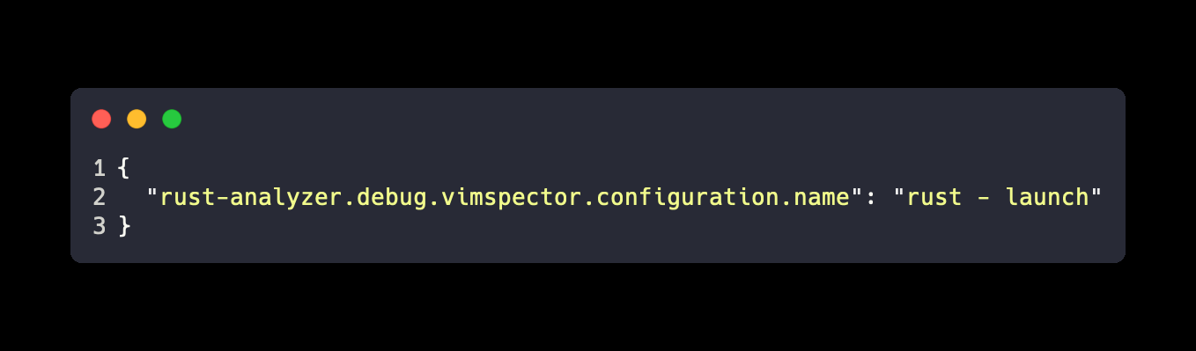
平行链开发经验及工具分享
vim 下基于 codelldb, vimspector, coc-rust-analyzer 调试
~/.vimspector.json
~/.config/nvim/init.vim
~/.config/nvim/coc-settings.json

Slide 25
引用
[XCM part II: Versioning and compatibility] https://medium.com/polkadot-network/xcm-part-ii-versioning-and-compatibility-b313fc257b83
[XCM: The Cross-Chain Message Format] https://medium.com/polkadot-network/xcm-the-cross-consensus-message-format-3b77b1373392
[XCM v1] https://github.com/paritytech/polkadot/pull/2815
[XCM v1 version notificatio stub] https://github.com/paritytech/polkadot/pull/3766
[Automatic version negociation] https://github.com/paritytech/polkadot/pull/3736
[XCM v2: Scripting, Query Responses, Exception handling and error reporting] https://github.com/paritytech/polkadot/pull/3629

Slide 26
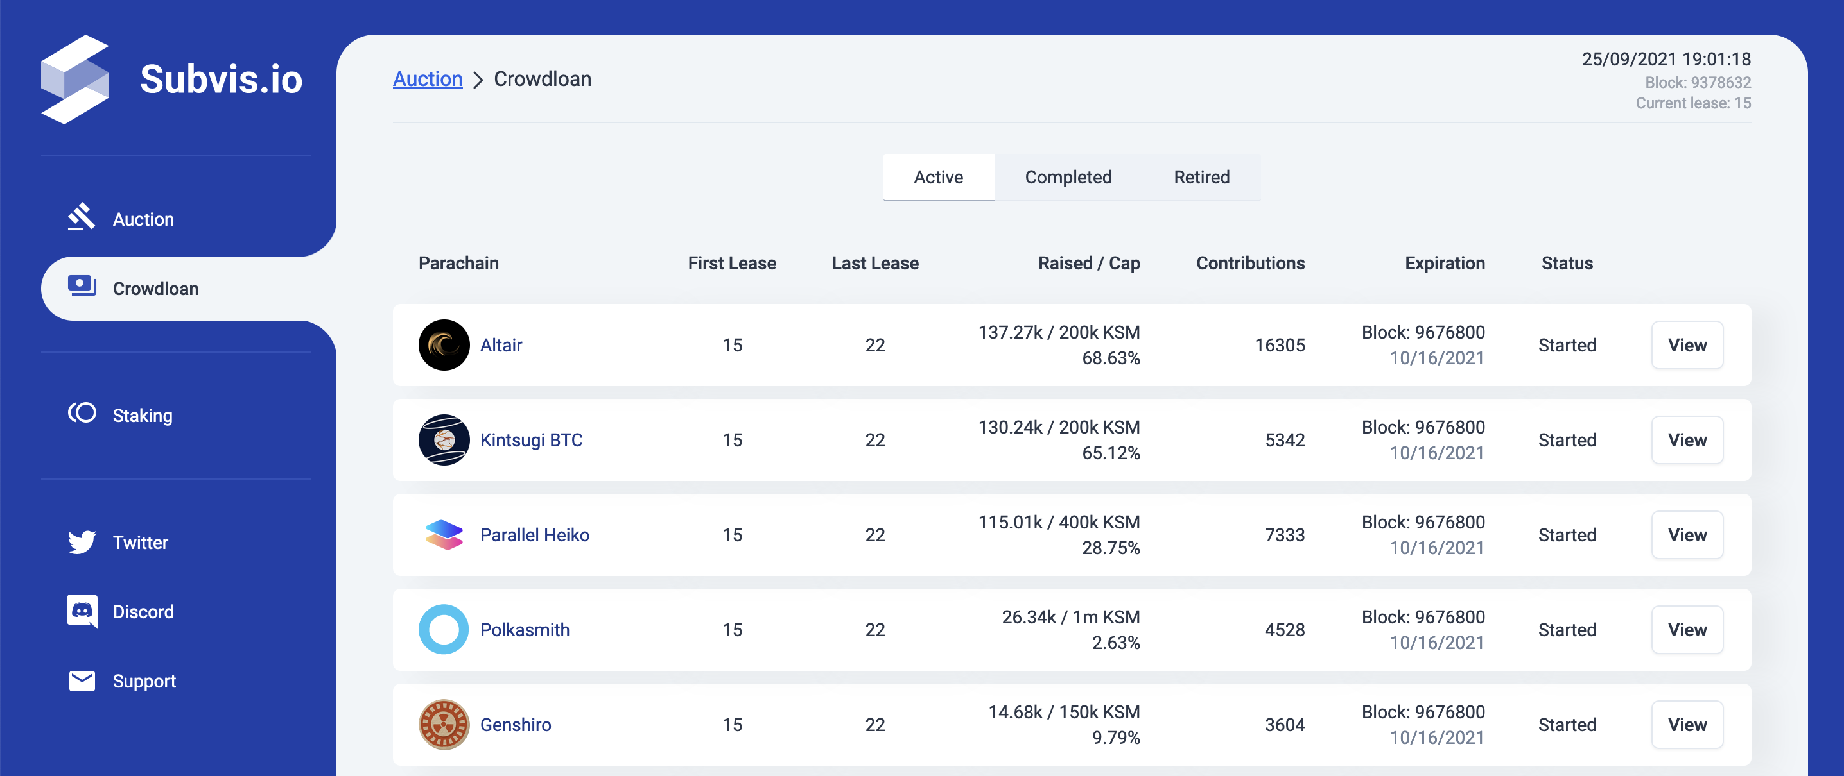
Kusama 插槽众贷
https://app.parallel.fi

Slide 27
Thank You!

