Slide 1





Introduction to Robotic Process Automation
MEDICINE PRICE COMPARISON AND AUTOMATION BOT
220701076
GOPINATH R
Mrs. J. Jinu Sophia, M.E., (Ph.D.),
Assistant Professor (SG),
Department of Computer Science and Engineering.

Slide 2
Abstract
The "Medicine Price Comparison and Automation Bot" is an innovative solution developed using UiPath to automate the extraction and management of medicine prices from a pharmacy website. The bot begins by retrieving a list of medicines from a pre-saved Excel file, ensuring an organized input process. It then navigates to the pharmacy website, searches for each medicine, and extracts the corresponding price details. The scraped data is sorted, validated, and stored in a dynamically generated Excel file for easy reference. Upon completion, the bot automatically emails the generated price report to the user’s specified email address. This automation reduces manual intervention, minimizes errors, and offers a reliable and efficient way to track medicine prices. The project highlights UiPath’s capability in handling repetitive tasks and showcases its potential in decision-making for medicine price management.

Slide 3
Need for the Proposed System
The proposed system eliminates the manual effort of comparing medicine prices across pharmacy websites, a time-consuming and error-prone process.
By automating data extraction, validation, and reporting using UiPath, the bot ensures accurate, efficient, and timely price comparisons.
It improves decision-making, reduces human error, and streamlines pharmaceutical price management with features like email integration and dynamic data storage.

Slide 4
Advantages of the Proposed System
Time-Saving: Automates the entire process of price comparison, significantly reducing manual effort.
Accuracy: Ensures precise data extraction and validation, minimizing errors.
Efficiency: Generates dynamic reports and sends them via email for easy access.
User-Friendly: Simplifies price tracking with automation and scheduled tasks.
Scalability: Can be expanded to include multiple websites or advanced features in the future.
Cost-Effective: Helps users identify the best prices, leading to potential cost savings.
Reliability: Consistently performs repetitive tasks without fatigue or inconsistencies.

Slide 5
Main Objective
The primary objective of this project is to automate the extraction, sorting, and email distribution of medicine prices from a pharmacy website. The bot retrieves medicine names from an Excel sheet, searches for them on the website, scrapes their prices, and organizes the data into a new Excel file. It then automates the process of sending the updated price list to the user’s email account, providing a seamless and efficient solution.

Slide 6
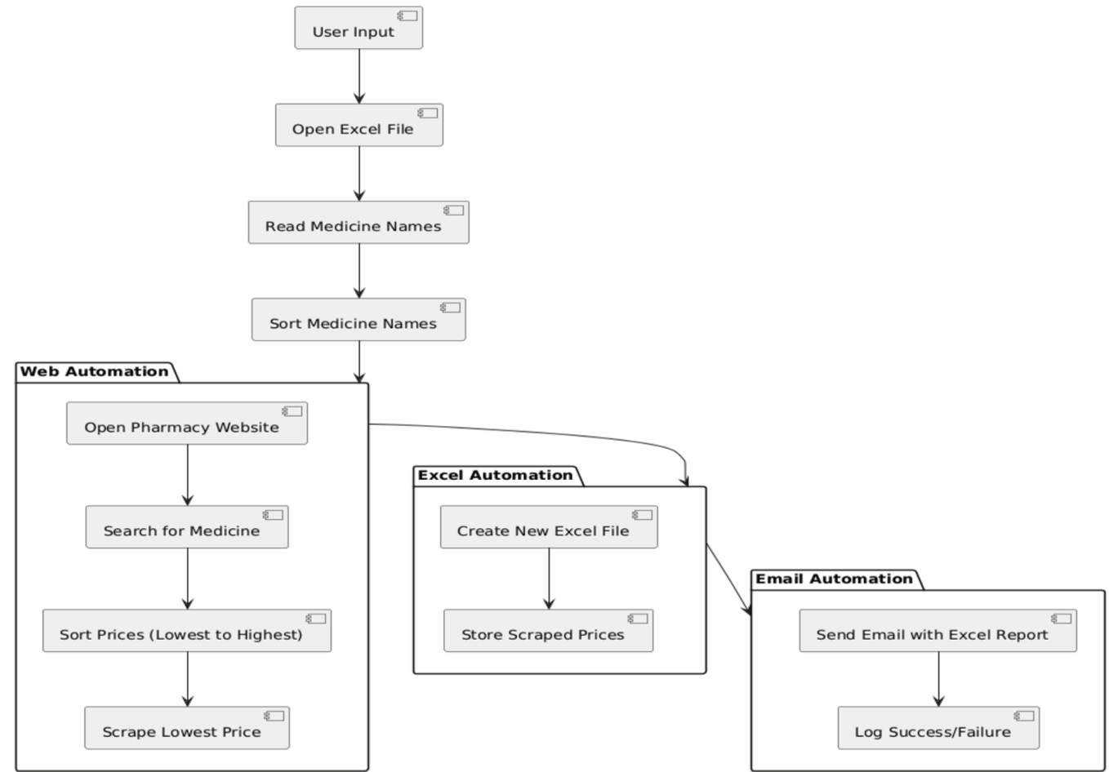
Architecture

Slide 7
System Requirements
HARDWARE:
Processor: Minimum Dual-Core, Recommended Quad-Core or higher
RAM: Minimum 4GB, Recommended 8GB or higher
Storage: At least 10GB free space
System: Windows-compatible desktop or laptop
SOFTWARE:
UiPath Studio and Orchestrator: For developing and deploying the bot
Microsoft Excel: For managing input and output data
Web Browser: Google Chrome or Microsoft Edge for web automation
Email Client: SMTP-supported email service (e.g., Gmail, Outlook)
Operating System: Windows 10 or higher

Slide 8
Functional Description
Module 1: Input Handling and Initialization
This module manages the retrieval of the medicine list from a pre-saved Excel file and initializes the search process by ensuring all inputs are structured and ready for automation. It also sets up configurations like pharmacy website details and email preferences.
Module 2: Medicine Search and Price Extraction
This module automates the process of navigating the pharmacy website, searching for each medicine, extracting price details, and validating the data. Extracted information is sorted and stored in a dynamic Excel report.

Slide 9
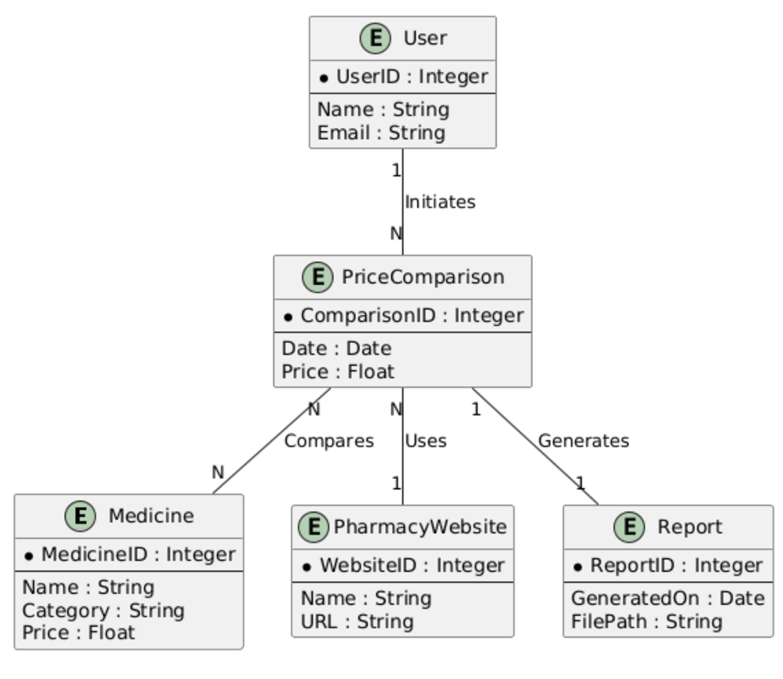
Table Design

Slide 10
Process Design
Main Process:
Automate the price comparison of medicines across a pharmacy website and generate a comprehensive report.
Retrieve the list of medicines.
Navigate to the pharmacy website and extract price details.
Validate and organize the extracted data.
Generate and email a price report.
Sub-Processes:
Input Handling
Medicine Search
Price Extraction
Data Storage
Report Generation and Emailing

Slide 11
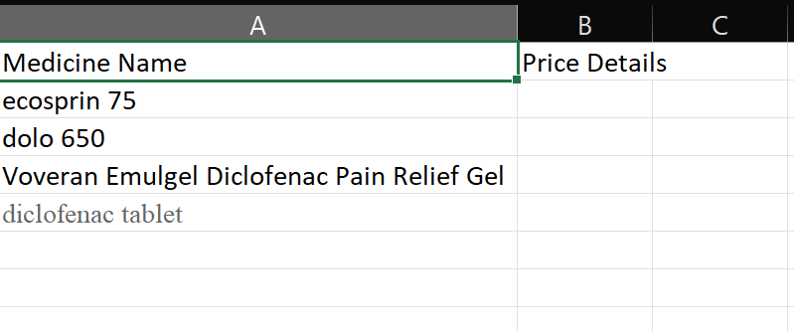
Implementation
Implementation of Module 1: Input Handling and Initialization

Slide 12
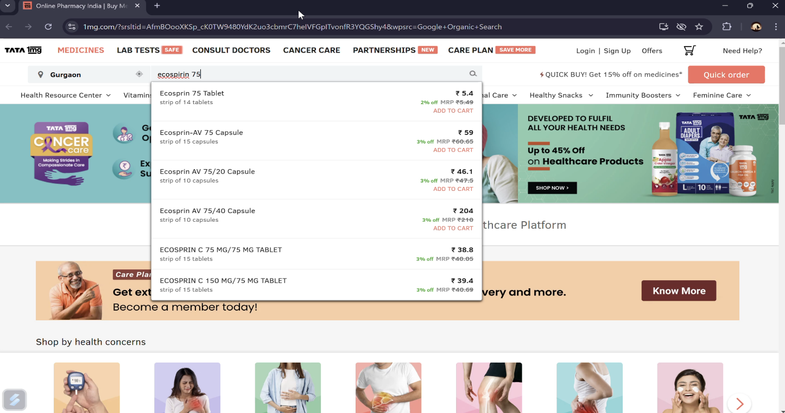
Implementation
Implementation of Module 2: Medicine Search and Price Extraction

Slide 13
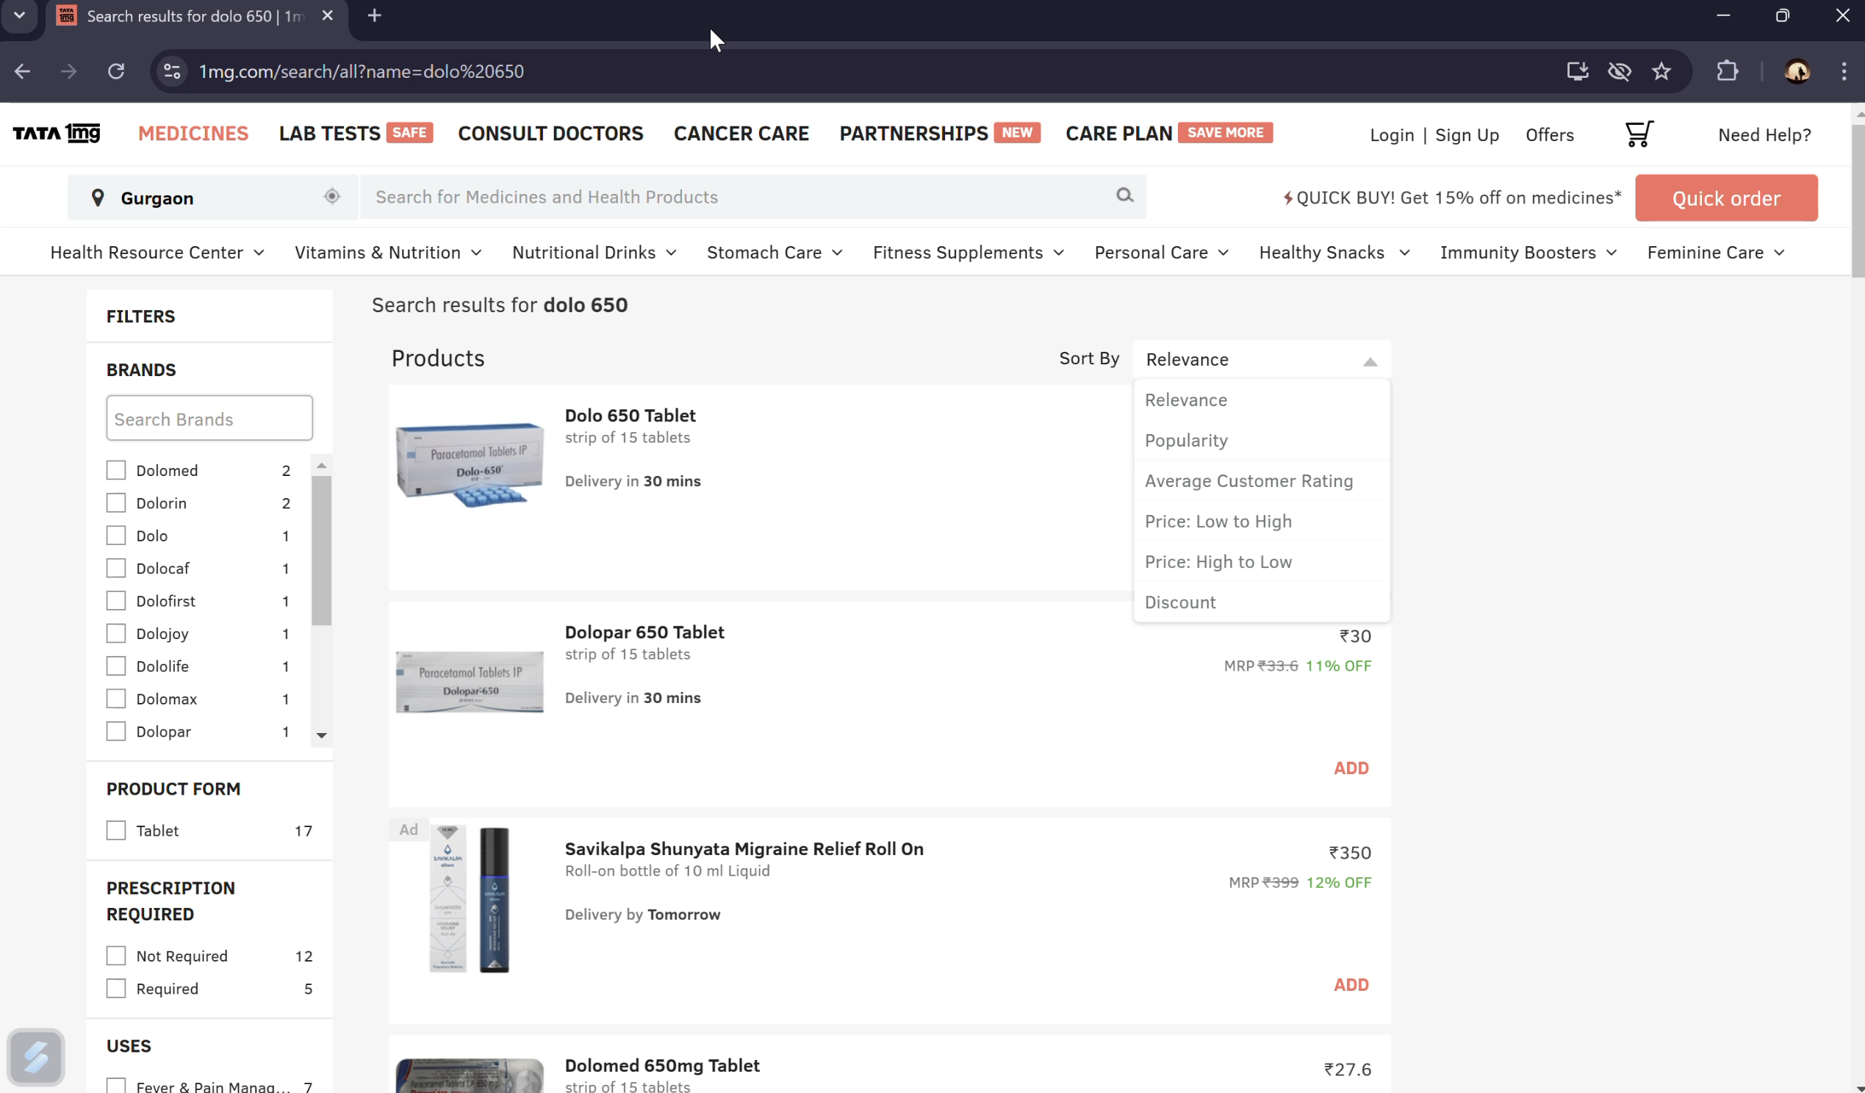
Implementation
Implementation of Module 2: Medicine Search and Price Extraction

Slide 14
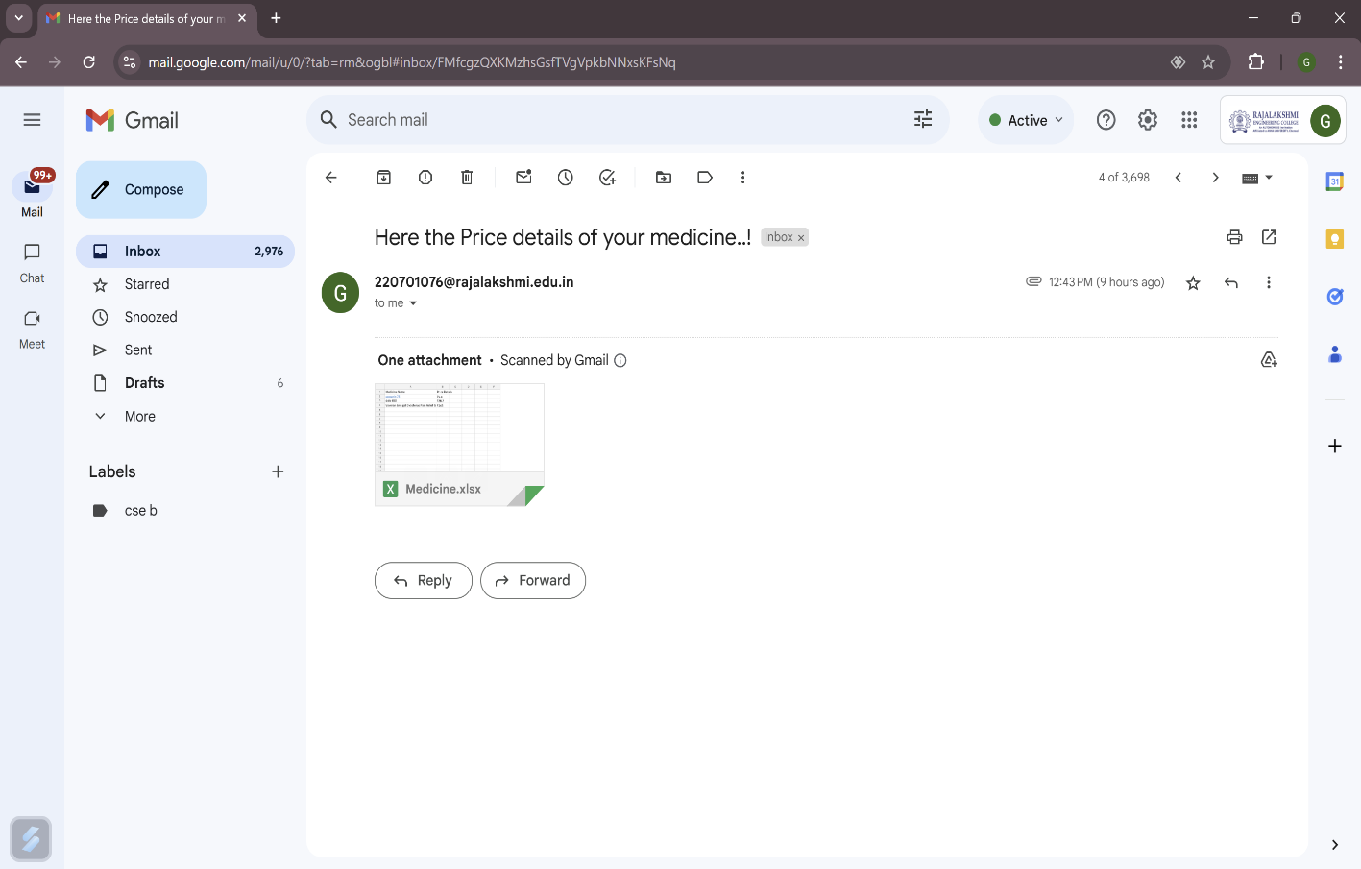
Implementation
Implementation of Module 3: Mail Price list to the user

Slide 15
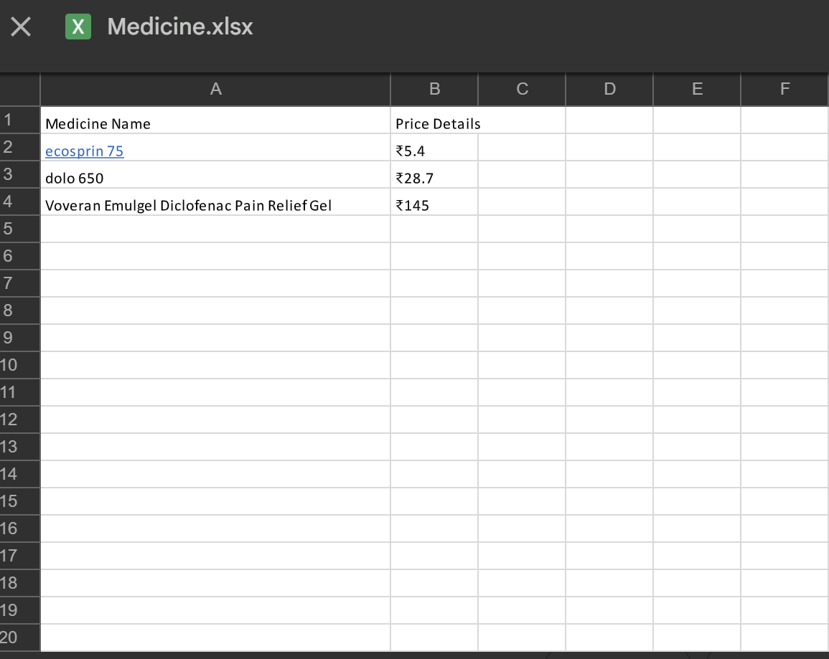
Implementation
Implementation of Module 2: Medicine Search and Price Extraction

Slide 16
Conclusions
This innovative bot, powered by UiPath's Robotic Process Automation (RPA), automates the extraction, comparison, and reporting of medicine prices from online pharmacy websites. It streamlines the retrieval of accurate and real-time pricing data, significantly reducing manual effort and enhancing decision-making.
The bot efficiently searches, validates, and stores price data, then generates and emails detailed reports, ensuring a seamless process. While the system excels in automating repetitive tasks, challenges may arise with website format inconsistencies and data extraction errors. Ongoing updates to data validation methods will ensure continued accuracy.
This implementation showcases the potential of RPA to revolutionize pharmaceutical price management, offering a foundation for future advancements in automated price comparison systems.

Slide 17
Future Enhancement
Future advancements in price comparison systems lie in integrating advanced technologies like machine learning for predictive analytics and Natural Language Processing (NLP) for better data interpretation. These innovations can help systems offer deeper insights, such as price trends and optimal purchasing times, ensuring users make informed decisions.

Slide 18
References
Flowcharts: Studio - Flowcharts (uipath.com)
Data scraping: Studio - About Data Scraping (uipath.com)
Email activity: Activities - Send SMTP Mail Message (uipath.com)
Email activity: https://youtu.be/8vlLvsyCO3Q

Slide 19
Queries

Slide 20
Demonstration

Slide 21
Thank You

