Slide 1

FLIGHT PRICE PREDICTION
(Theme Based Project )
BATCH - 09
S. Gopi Krishna(1602-19-737-071)
Vishwa Teja(1602-20-737-119)
Teja(1602-20-737-115)

Slide 2
Contents
Introduction
Abstract
Problem statement
Proposed model
Use cases
Experiment results
Conclusion and Future work
References

Slide 3
ABSTRACT
People who frequently travel through flight will have better knowledge on best discount and right time to buy the ticket. For the business purpose many airline companies change prices according to the seasons or time duration. They will increase the price when people travel more. Estimating the highest prices of the airlines data for the route is collected with features such as Duration, Source, Destination, Arrival, Departure. Features are taken from chosen dataset and in this mini-project, we have used machine learning techniques and regression strategies for prediction of the price wherein the airline price ticket costs vary overtime. We have implemented flight price prediction for users by using decision tree and random forest algorithms.

Slide 4
Introduction
For purchasing an airplane ticket, the traditional purchase strategy is to buy a ticket far in advance of the flight’s departure date to avoid the risk that the price may increase rapidly before the departure date. However, this is usually not always true, airplane companies can decrease the prices if they want to increase the sales.
Airline companies use many different variables to determine the flight ticket prices that indicates whether the travel is during the holidays, the number of free seats in the plane etc., or even in which month it is, some of the variables are observed, but some of them are hidden.
In this context, buyers are trying to find the right day to buy the ticket, and on the contrary, the airplane companies are trying to keep the overall revenue as high as possible. Airline companies have the freedom to change the flight ticket prices at any moment. Travellers can save money if they choose to buy a ticket when its price is the lowest.

Slide 5
PURPOSE
The goal of this project is to study how airline ticket prices change over time, extract the factors that influence these fluctuations, and describe how they're correlated. A machine learning framework was developed to predict the quarterly average airfare price at the market segment level. Several features were extracted from the datasets and combined with macroeconomic data, to model the air travel market segments. With the help of the feature assortment methods, our proposed model can forecast the quarterly average airfare price with an adjustment. The cheapest available ticket for a given date gets more or less expensive over time.

Slide 6
PROBLEM DEFINITION
Nowadays, the airline corporations are using complex strategies for the flight ticket fare calculations. This highly complicated method makes the flight ticket fare difficult to guess for the customers, since the fare changes dynamically.
Our project “Flight Price Prediction System” which resolves this problem and will provide a facility where people will be able to predict the flight-ticket price before purchasing the ticket.

Slide 7
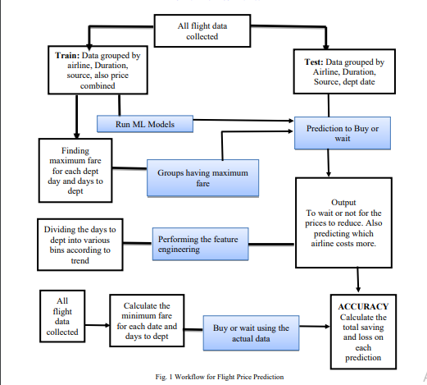
PROPOSED MODEL

Slide 8
Technology used
Front-end: HTML, CSS, Flask
Back-end Modules used: Matplotlib, Machine Learning (Supervised learning)

Slide 9
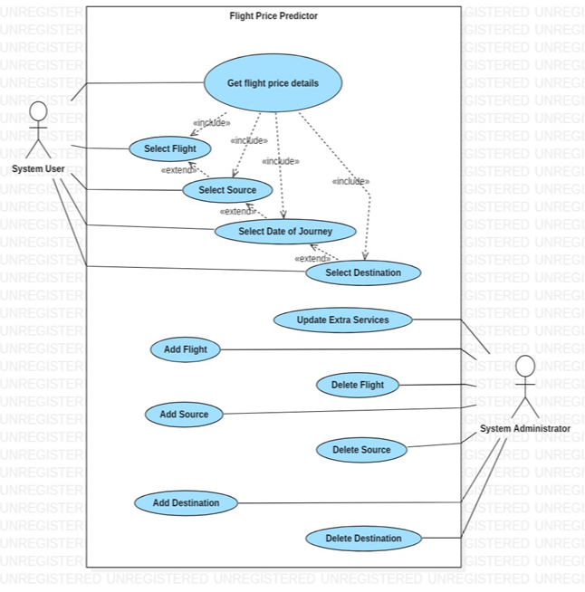
USE CASE DIAGRAM

Slide 10
USE CASE DESCRIPTION
USE CASE 01:
SELECT FLIGHT: The flight company the user want to travel .
USE CASE 02:
SELECT DATE AND TIME OF THE JOUNEY: The user will give the time and date of the start and he will provide the destination date and time.
USE CASE 03:
SELECT SOURCE: The user will select the source information from which the user will start the journey.
USE CASE 04:
SELECT DESTINATION : The user will select the destination information .
USE CASE 05:
GET PRICE DETAILS: By submitting the required details, the user will get the flight price details.

Slide 11
FEATURES
Airline: The name of the airline.
Date_of_Journey: The date of the journey
Source: The source from which the service begins.
Destination: The destination where the service ends.
Route: The route was taken by the flight to reach the destination.
Dep_Time: The time when the journey starts from the source.
Arrival_Time: Time of arrival at the destination.
Duration: Total duration of the flight.
Total_Stops : Total stops between the source and destination.
Additional_Info: Additional information about the flight.
Price:The price of the ticket

Slide 12
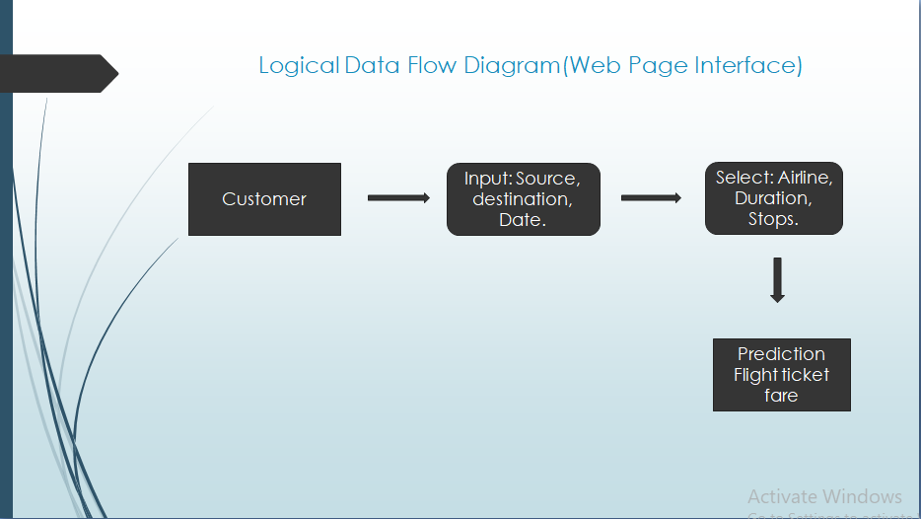
DATA FLOW DIAGRAM
:

Slide 13
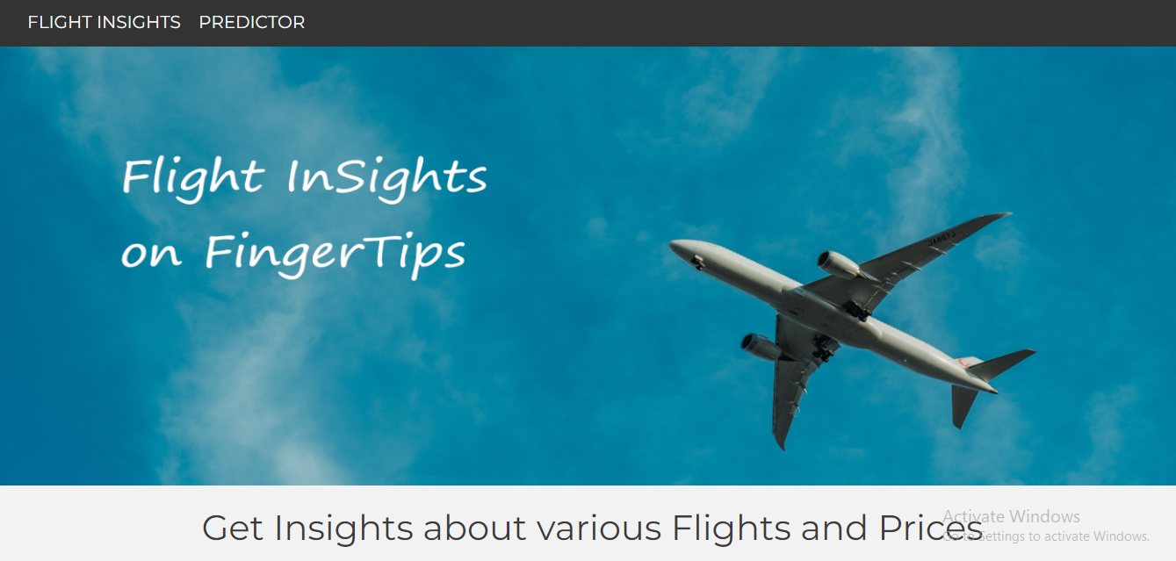
OUTPUT AND RESULT

Slide 14
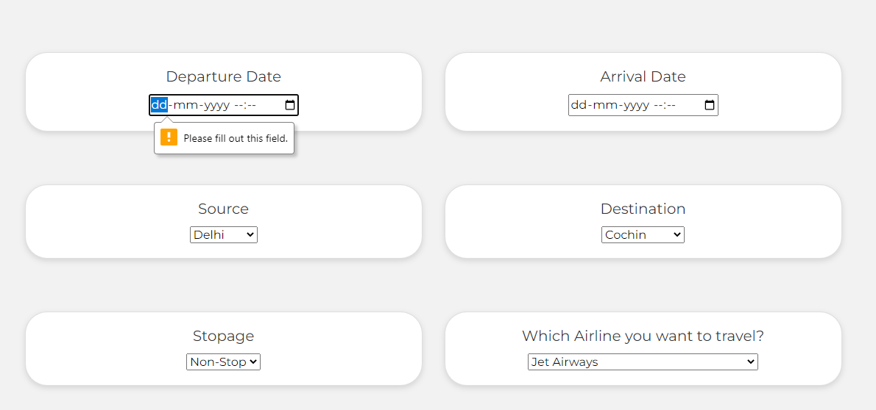

Slide 15
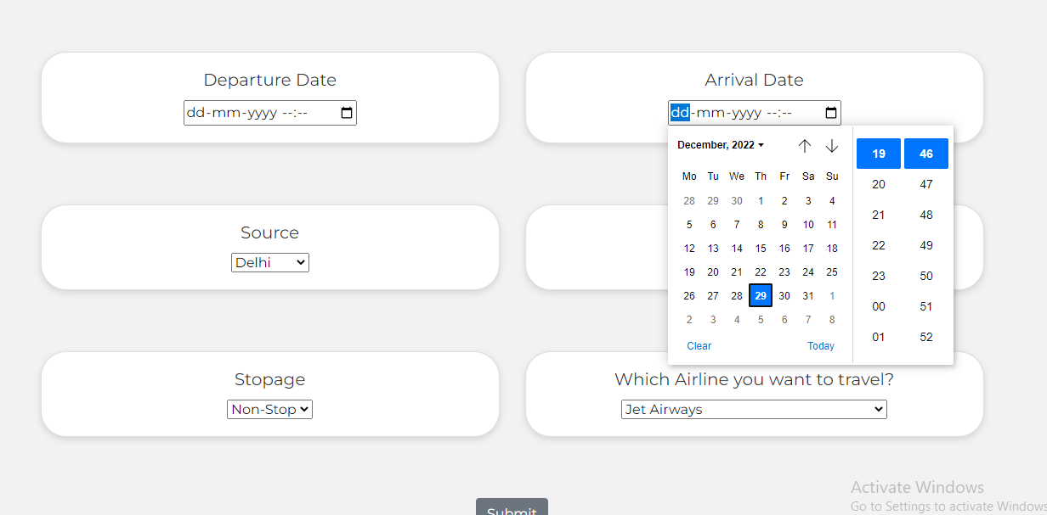

Slide 16
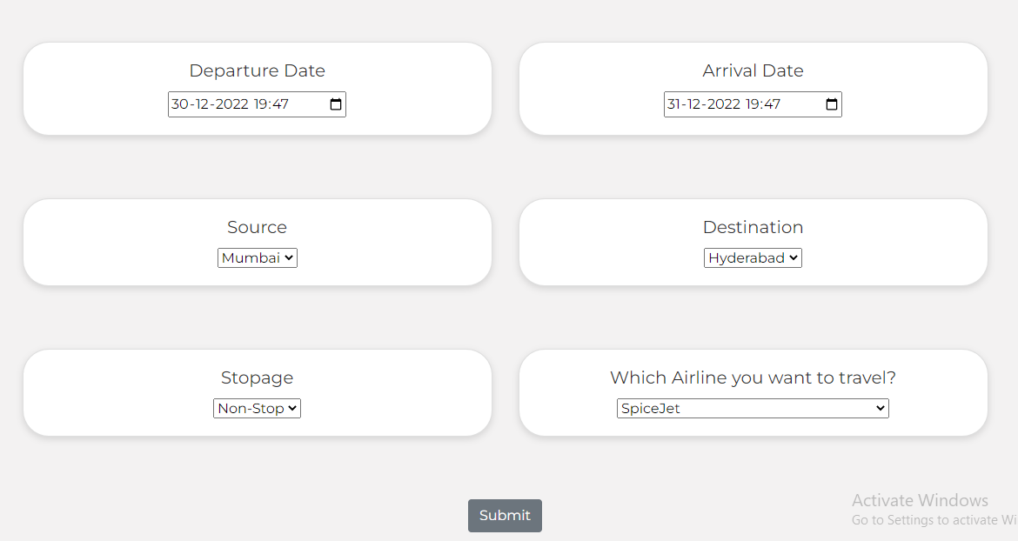

Slide 17
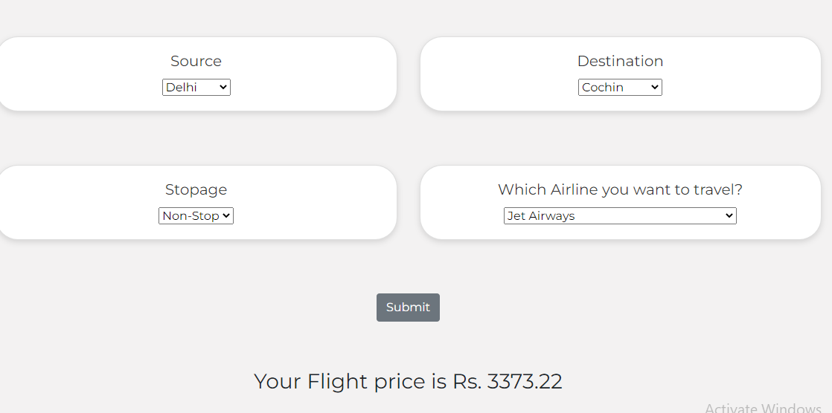

Slide 18
conclusion
This System customer can predict the flight price of a particular seat on a day before booking the flight tickets. It will provide an ease to the customer for the flight ticket booking. Travelers can save money if they choose to buy a ticket when its price is the lowest. The problem is how to determine when is the best time to buy flight ticket for the desired destination and period.
From our thorough analysis of each of the 18 routes, we can define the following. Flight prices almost always remain constant or increase between the major cities. Tourist routes that offer services involving Tier-2 cities of the country have uneven treads related to the increase and decrease of airline ticket prices. Routes with data collected over a longer duration of time tend to facilitate much more accurate predictions in the model and thus lead to higher average savings.

Slide 19
Future scope
More routes can be added and the same analysis can be expanded to major airports and travel routes in India. The analysis can be done by increasing the data points and increasing the historical data used that will train the model better giving better accuracies and more savings. More rules can be added to the Rule-based learning based on our understanding of the industry also incorporating the offer periods given by the airline. Developing a more user-friendly interface for various routes giving more flexibility to the users

Slide 20
References
https://youtu.be/Z1RJmh_OqeA
https://youtu.be/J4Wdy0Wc_xQ
[1] Bachis, E., & Piga, C. A. (2011). “Low-cost airlines and online price dispersion. International Journal of Industrial Organization”, 29(6), 655– 667. doi:10.1016/j.ijindorg.2011.02.006
[2] Groves, W. and Gini, M., 2021. “A Regression Model For Predicting Optimal Purchase Timing For Airline Tickets.”. Available at: https://conservancy.umn.edu/handle/11299/215872

Slide 21


