Slide 1



FInal Group Project
Impact of COVID-19 on ABC Company’s Parcel Delivery Business
Presented by:
Gurpreet & Akshen
April 22,2025

Slide 2



Final Group Project
Objectives
We use a combination of Python analytics, Excel verification, and Power BI dashboards to present insights
The aim is to inform executive decisions with data-backed recommendations.
This presentation analyzes the effect of the COVID-19 pandemic on ABC Company’s parcel delivery operations.

Slide 3



Final Group Project
Background & Context
The COVID-19 pandemic disrupted many industries, with varying effects. At ABC Company, we deliver parcels for a diverse customer base. Our goal is to evaluate how our business, especially parcel volume and customer behavior, was impacted during 2020, using 2019 as a baseline.

Slide 4

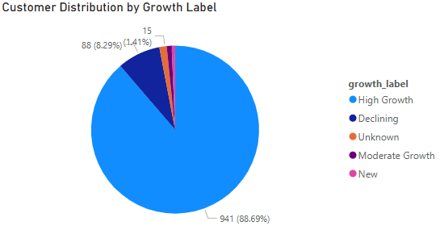
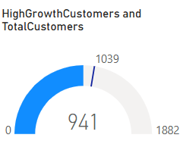
Final Group Project
Customer Growth Distribution Visuals
Pie chart: Customer segmentation by growth label.
Gauge: Share of High Growth customers.
Insight: High Growth customers accounted for over 30% of the base. New customers also formed a substantial share, showing that ABC Company attracted new business during the pandemic.

Slide 5



Final Group Project
Business Questions
In our analysis, we focused on the following key questions:
When did we first observe a shift in customer volume due to COVID?
What events influenced these shifts?
How did peak season compare before and during COVID?
How were different customer segments impacted in terms of growth and revenue?

Slide 6

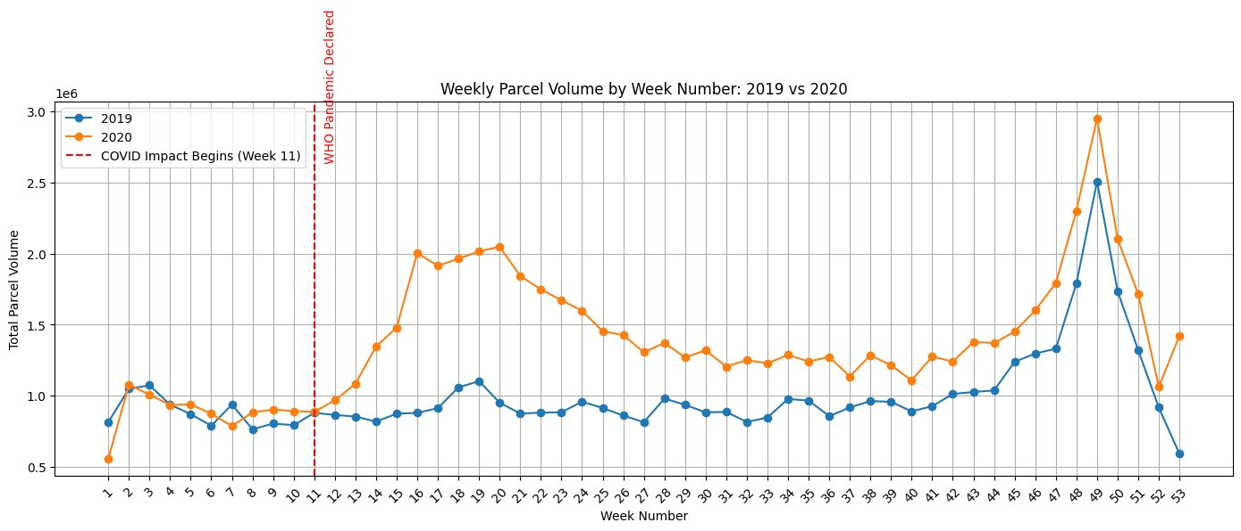
Final Group Project
Annual Parcel Volume Trends Visual
Bar chart comparing weekly parcel volumes in 2019 vs. 2020. Key insight: Volumes rose significantly post-March 2020, indicating accelerated e-commerce activity during lockdown periods. This surge reflects increased dependence on parcel delivery services amid pandemic restrictions.

Slide 7

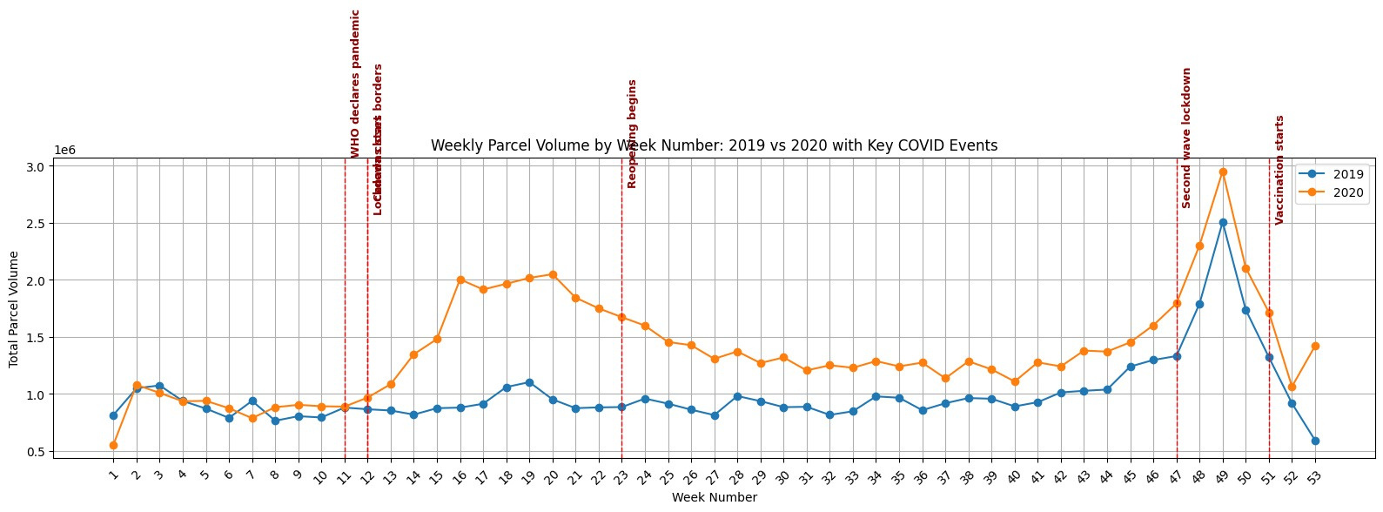
Final Group Project
Weekly Parcel Volume Trend with COVID Milestones (2019 vs 2020)
This line chart compares weekly parcel volumes in 2019 (pre-COVID) and 2020 (COVID-impacted year).
Notable pandemic events such as lockdowns, reopenings, and vaccine rollout are marked along the timeline.

Slide 8
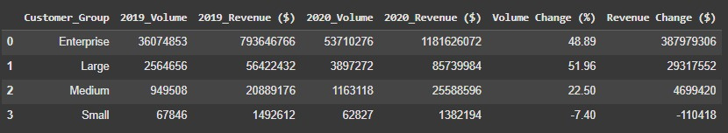
Final Group Project
Customer Segment Revenue and Volume Shift
Enterprise and Large segments saw significant growth in both volume and revenue during 2020, with Enterprise revenue increasing by over $387M.
Medium customers experienced moderate growth.
Small customer group declined in both volume and revenue, suggesting they were more affected by the pandemic.
Strategic focus should remain on Enterprise and Large customers, while support mechanisms should be considered for Small businesses.

Slide 9

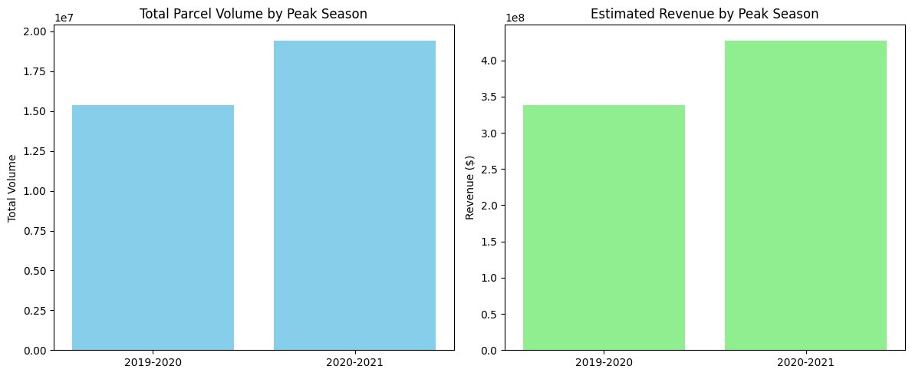
Final Group Project
Customer Segment Revenue and Volume Shift
Total volume and revenue increased significantly during the 2020–2021 peak season compared to the previous year.
This growth aligns with increased online shopping and reliance on parcel delivery during lockdowns.
Indicates a strong seasonal performance and potential for continued high demand during future peak seasons.

Slide 10
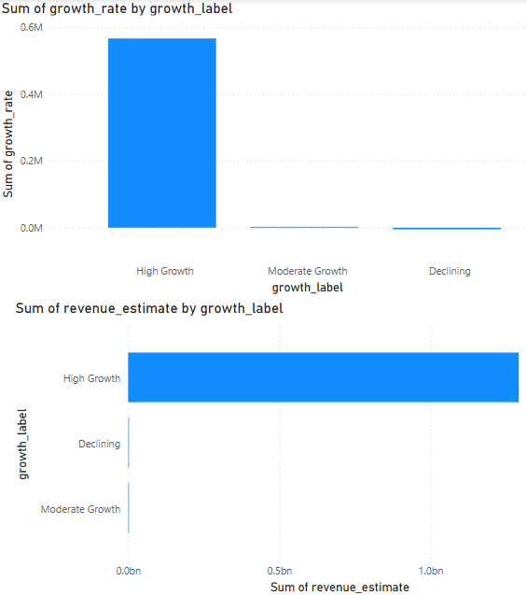
Final Group Project
Weekly Growth & Revenue Trend Visuals
Bar chart: Weekly growth by label
Line chart: Revenue estimates week-over-week
Observation: Volatility corresponds with lockdown measures and reopening stages. Despite uncertainty, peak seasons remained robust due to online shopping spikes.

Slide 11

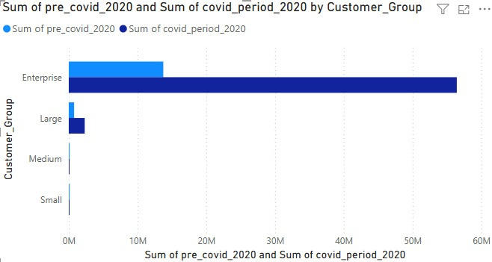
Final Group Project
Customer Group Volume Comparison: Pre-COVID vs COVID Period (2020)
This clustered bar chart compares parcel volumes of different customer groups during pre-COVID and COVID periods in 2020.
Enterprise customers contributed the most significant increase in volume during the COVID period.
Smaller customer groups (Large, Medium, and Small) had minimal impact in comparison.

Slide 12


Final Group Project
Peak Season Comparison: Volume & Revenue (2019–2021)
The peak season parcel volume grew from 15.3 million (2019–2020) to 19.4 million (2020–2021).
Corresponding estimated revenue increased from $338M to $427M, showing a significant rise of nearly 26%.
This suggests a surge in parcel demand and business scalability during the pandemic.

Slide 13

Final Group Project
Tools & Techniques Used
Python (Jupyter): Volume trends, growth rate classification, revenue calculations.
Excel: Spot-checks and formula cross-validation.
Power BI: Interactive visual dashboards for storytelling.

Slide 14

Final Group Project
Thank You

