Slide 1



FInal Group Project
Impact of COVID-19 on ABC Company’s Parcel Delivery Business
Presented by:
Gurpreet & Akshen
April 22,2025

Slide 2



Final Group Project
Objectives
We use a combination of Python analytics, Excel verification, and Power BI dashboards to present insights
The aim is to inform executive decisions with data-backed recommendations.
This presentation analyzes the effect of the COVID-19 pandemic on ABC Company’s parcel delivery operations.

Slide 3



Final Group Project
Background & Context
The COVID-19 pandemic disrupted many industries, with varying effects. At ABC Company, we deliver parcels for a diverse customer base. Our goal is to evaluate how our business, especially parcel volume and customer behavior, was impacted during 2020, using 2019 as a baseline.

Slide 4



Final Group Project
Business Questions
In our analysis, we focused on the following key questions:
When did we first observe a shift in customer volume due to COVID?
What events influenced these shifts?
How did peak season compare before and during COVID?
How were different customer segments impacted in terms of growth and revenue?

Slide 5
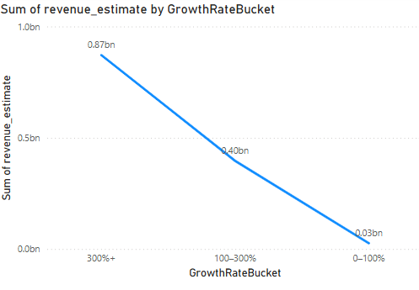


Final Group Project
Line chart of estimated revenue by growth category. High Growth customers generated the most revenue. New customers, brought in during COVID, also contributed significantly. Stable customers maintained steady volumes.
Revenue by Growth Bucket Visual

Slide 6

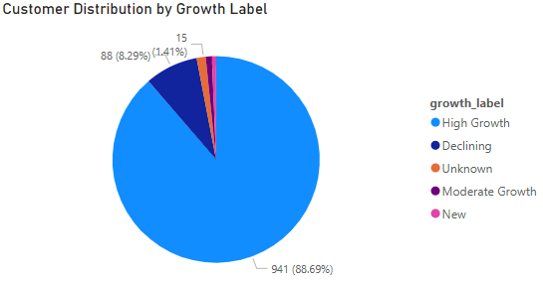
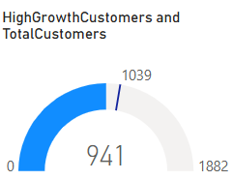
Final Group Project
Customer Growth Distribution Visuals
Pie chart: Customer segmentation by growth label.
Gauge: Share of High Growth customers.
Insight: High Growth customers accounted for over 30% of the base. New customers also formed a substantial share, showing that ABC Company attracted new business during the pandemic.

Slide 7
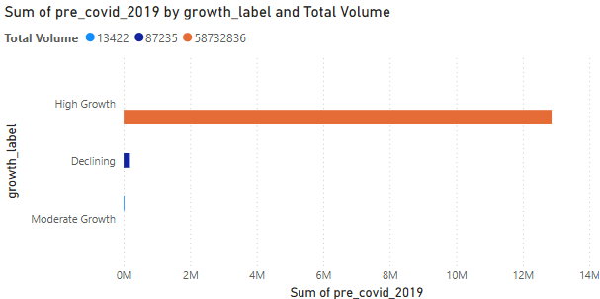

Final Group Project
Pre-COVID vs COVID Volume Comparison Visual
Clustered bar chart of parcel volumes (2019 vs COVID period) by customer segment.
Takeaway: Enterprises and large customers adapted quickly, leading growth. Declining and Lost customers point to potential revenue risks.

Slide 8
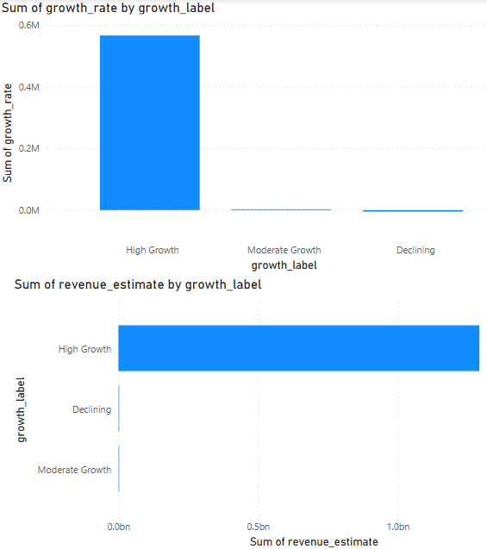
Final Group Project
Weekly Growth & Revenue Trend Visuals
Bar chart: Weekly growth by label
Line chart: Revenue estimates week-over-week
Observation: Volatility corresponds with lockdown measures and reopening stages. Despite uncertainty, peak seasons remained robust due to online shopping spikes.

Slide 9

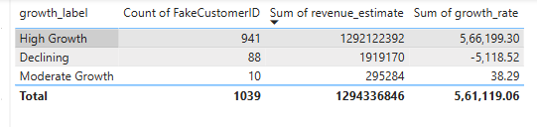
Final Group Project
Customer Summary Table Visual
Table with growth label, customer count, revenue, and growth rate.
Insight: High Growth and New customers delivered the majority of revenue. Stable customers offer long-term reliability. Lost customers highlight a need for churn analysis.

Slide 10

Final Group Project
Insights & Recommendations
Prioritize High Growth and New customers in retention and loyalty programs.
Monitor Stable customers for potential uplift opportunities.
Investigate causes for customer decline or loss and address service issues.
Continue weekly tracking and dashboard reporting to stay agile.

Slide 11

Final Group Project
Tools & Techniques Used
Python (Jupyter): Volume trends, growth rate classification, revenue calculations.
Excel: Spot-checks and formula cross-validation.
Power BI: Interactive visual dashboards for storytelling.

Slide 12

Final Group Project
Thank You

