Slide 1


Third-Party Risk Management Audit - Physical, Environmental, and Information Governance
This presentation provides an overview of a third-party risk management audit, focusing on the physical, environmental, and information governance domains to ensure robust security controls and compliance across an organization's third-party ecosystem.
by Suprmentr

Slide 2

Overview of Third-Party Risk Management (TPRM)
1
Definition of TPRM
2
Importance of TPRM
3
Key TPRM Objectives
TPRM is the process of identifying, assessing, and mitigating risks associated with an organization's third-party relationships and dependencies.
TPRM helps organizations protect against data breaches, compliance issues, and operational disruptions that can arise from third-party vulnerabilities.
Ensuring third-party security, resilience, and alignment with an organization's policies and regulatory requirements.

Slide 3

Scope of Audit in Physical & Environmental Security
Physical Security
Environmental Safeguards
Assess the effectiveness of measures like access controls, surveillance, and facility hardening to protect against physical threats.
Evaluate the adequacy of fire prevention, power backup, climate control, and other environmental controls to ensure business continuity.
Compliance Verification
Ensure third-party facilities meet relevant safety, security, and environmental regulations and industry standards.

Slide 4
Assessment of Physical Security Controls
Access Management
Surveillance and Monitoring
Facility Hardening
Evaluate the effectiveness of identity verification, access authorization, and visitor management procedures.
Assess the coverage, quality, and monitoring of CCTV cameras and other physical security systems.
Review the physical barriers, locks, and other measures in place to deter and delay potential intruders.

Slide 5
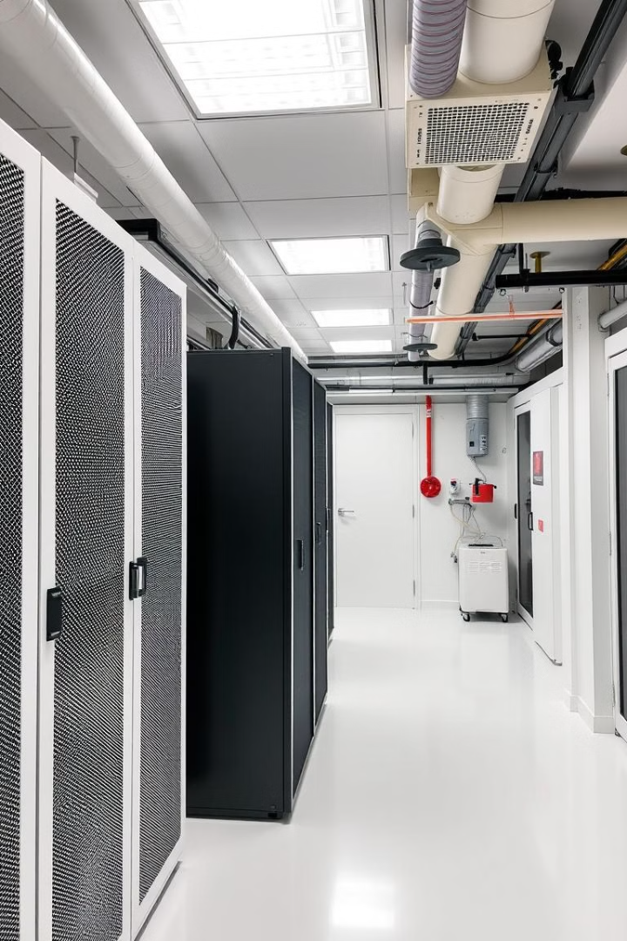
Evaluation of Environmental Safeguards
1
Power Resilience
Assess the reliability and redundancy of power sources, including backup generators and uninterruptible power supplies.
2
Fire Prevention
Examine the effectiveness of fire detection, suppression, and evacuation systems to protect against fire-related incidents.
3
Climate Control
Review the adequacy of cooling, heating, and humidity control systems to maintain optimal environmental conditions.

Slide 6

How can Physical and Environmental Security be assessed remotely without an on-site visit?

Slide 7




Examination of Information Governance Practices
Data Protection
Assess the measures in place to safeguard sensitive data, including encryption, access controls, and secure disposal.
Policy Alignment
Verify that the third party's information governance policies and procedures align with the organization's requirements.
Regulatory Compliance
Ensure the third party adheres to relevant data protection, privacy, and industry-specific compliance regulations.

Slide 8




Findings and Recommendations
Key Findings
Summarize the significant issues and weaknesses identified during the audit across physical, environmental, and information governance domains.
Recommendations
Provide actionable recommendations to address the identified risks and improve the third-party's security posture.
Prioritization
Suggest a prioritized approach to implementing the recommended improvements based on risk level and potential impact.

Slide 9
Conclusion and Next Steps
Conclusion
Next Steps
Summarize the key takeaways from the third-party risk management audit and reiterate the importance of ongoing TPRM efforts.
Outline the proposed actions, including follow-up assessments, vendor engagement, and implementation of recommended improvements.

