Slide 1
ISM 6136
Data Mining
Dr. Tim Smith

Slide 2
Guiding Agenda
08:30-08:35 - Class Agenda
08:35-09:30 - Intro to predictive analytics
09:45-10:00 - Break
10:00-10:25 - Modeling Processes and Types
10:25-11:00 - Python and Jupyter Lab Intro

Slide 3
Predictive Analytics Introduction

Slide 4
Learning Objectives
Understand basic data labeling and terms
Understand the role of the representational model verses the hidden relationship
Understand the distinction between modeling technique used and the parameters of the model
Understand the problem of overfitting and how this is mitigated by data splitting
Understand the k-fold cross validation technique

Slide 5
Scope of Analytics
Descriptive analytics: What happened?
- uses data to understand past, answers the questions what happened and why did it happen
Diagnostics Analytics: Why did this happen?
- uses data to infer the antecedent factors that caused some outcome to happen
Predictive analytics: What could happen?
- utilizes statistical and machine learning techniques to make predictions about the future
Prescriptive analytics: What should we do?
- often uses optimization techniques, provides recommendations of actions that will take advantage of the predictions

Slide 6
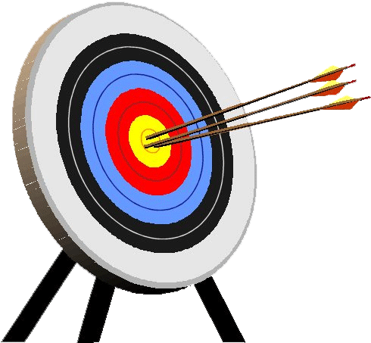
Predictive Modeling
Goal: build a representational model of a relationship between input and target values that predicts target measures that we have not yet seen.
Input
Hidden
Relationship
Target
Representational Model
Predicted
Target
The “hidden relationship” produces the target we are attempting to “hit”.
A representation model attempts to “hit” the target.

Slide 7
Models are Not Perfect
Ideally, we identify a predictive model that accurately (without error) predicts future data… realistically, we never fully achieve this:
Satisficing, we never have enough cognitive capacity, resources, or time.
The world is noisy and stochastic
The world often changes.
“All models are wrong, but some are useful”(George E. P. Box)
Predictive analytics offers a set of practices, tools and approaches that can help us achieve “good” models that prove reasonably accurate.

Slide 8
Context Setting… let’s begin with a quick review of the fundamentals

Slide 9
Data Labeling
Data Set
In predictive modeling we identify and label variables as inputs and targets.
NOTE: You may also hear similar terms such as Independent and Dependent variables,
Explanatory and Response variables.
Though there are subtle differences between these terms, today we will see these as essentially “meaning” the same thing
inputs
target
Each row in our table is an observation, also known as cases.

Slide 10
Identify a Predictive Model
Data Set
inputs
target
Our goal is to identify a “Good” model that associates the observed inputs to observed targets

Slide 11
Predictive Models “Predict” Target values
Data Set
inputs
predictions
A predictive model, when given a set of input measurements, produces “predictions” of what the target value will be

Slide 12
The Predictive Modeling Process
Involves “training” a model to learn the best fit for the given data
Data Set
inputs
target
predictions
Guided by known values of our target variable, a number of candidate models are tested and “fine tuned”.

Slide 13
The Predictive Modeling Process
“training” a model to learn the best fit for the given data
Data Set
inputs
target
predictions
errors
+
Model Selection &
Refinement
Prediction
Better models have smaller error signals. The “best model” has the lowest error signal.
This error signal can get small, but rarely goes to zero.
The selection of models is bounded by skill, knowledge, capacity, and time
Supervised Learning Process
Model Testing
Error Signal

Slide 14
Assessing model “fit”…
In general, we have two key approaches to assessing model fit:
Accuracy: Represent the error between the predicted values and the target values (i.e. sum of squared errors, r², misclassification rate, etc.) without assuming too much about the population
Confidence: Conduct a statistical test to identify how confident you are that the model fits the target population and is not the result of chance (based on assumptions about the population).
errors
The smaller the error the better the fit to the given data
NOTE: For the purposes of predictive modeling in data mining, it is quite common to focus on the 1st approach – representing how well the model predicts target values based on some measure or representation of error. Such a focus decreases the burden of assuming/guessing about characteristics of the population – but conversely, doesn’t provide you with “confidence” measures/indicators
Sampling approaches and model testing strategies can help us bridge these two approaches… we’ll cover this in a few slides ☺

Slide 15
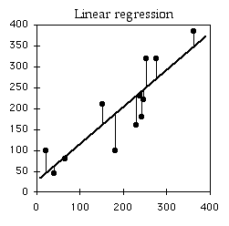
An Example…
One example that many of you will be familiar with is a (Least Squares) Regression Model
Given a set of data – with one continuous input variable, and one continuous output variable, we may then visually determine that the “best” model is the linear model – and we then attempt to fine tune the fit of this model by adjusting m and b (slope and intercept from y=mx+b ) to best fit (least error) the predicted values to the observed values
Take inputs and use
a linear model to predict target values…
inputs
target
predictions
Difference between
Predicted and Observed Target values are Errors
errors
The smaller the error the better the fit to the given data
Using Regression, we
develop a prediction
model …
Prediction=β₀+β₁(input)
(simply another form of y=mx+b)

Slide 16
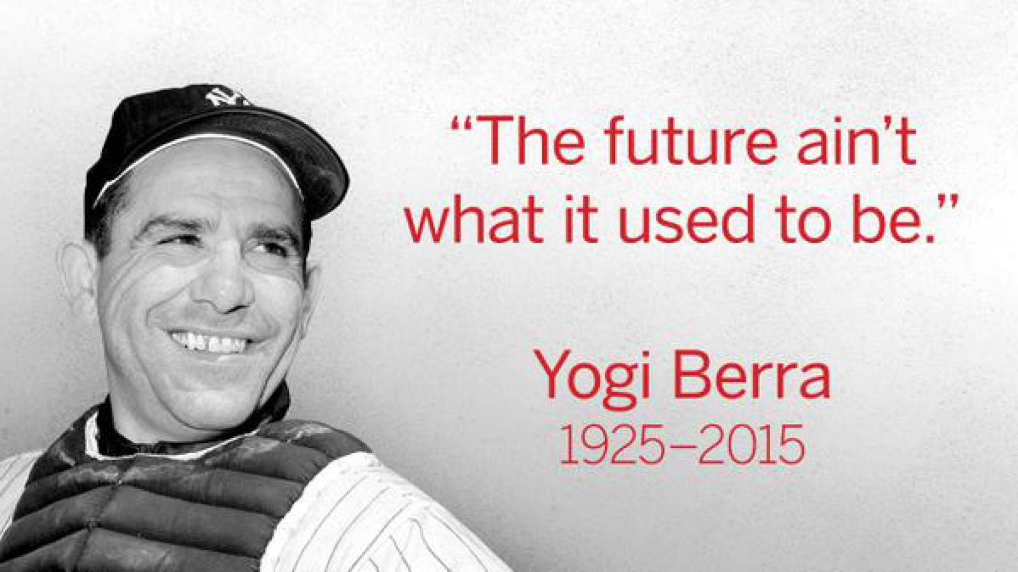
Now, let’s focus on two important issues in predictive analytics that set it apart from descriptive analytics…

Slide 17
Let’s ‘try’ to predict the future …
For demonstration purposes, I’ve created a data generating stochastic process. There is a pattern within this data that is hidden from us. Let’s to identify this pattern.

Slide 18
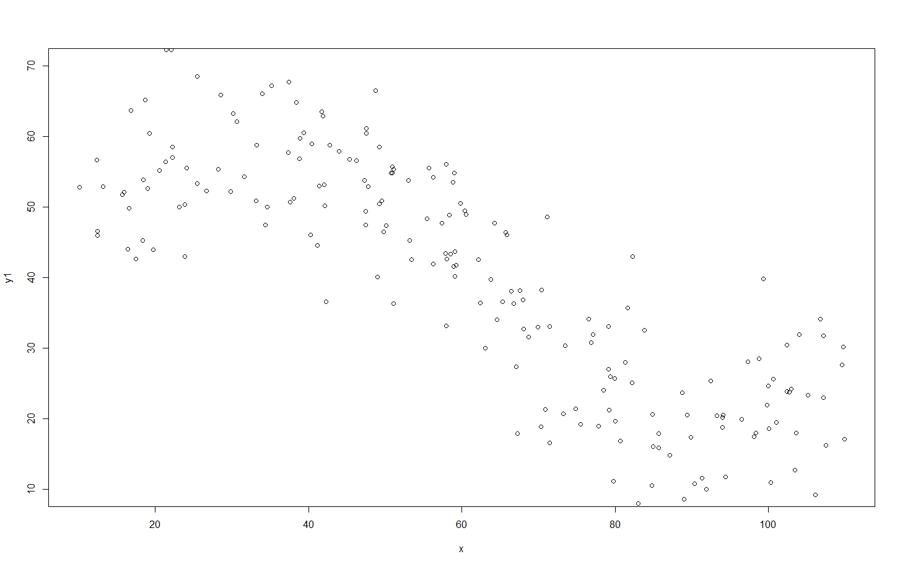
Using this process, I generate 200 observations…

Slide 19
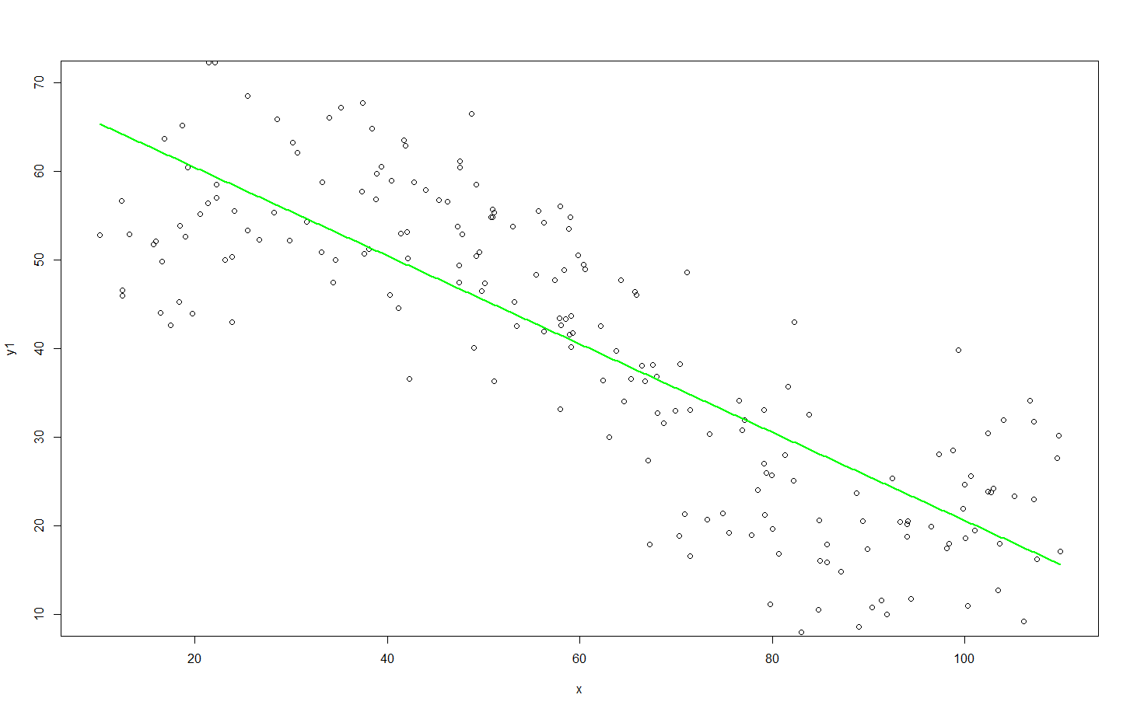
I fit my 1st Candidate Model to this “training” data:
Y=β₀+β₁x
Y=70.3-0.51x
Root Mean Squared Error = 10.71

Slide 20
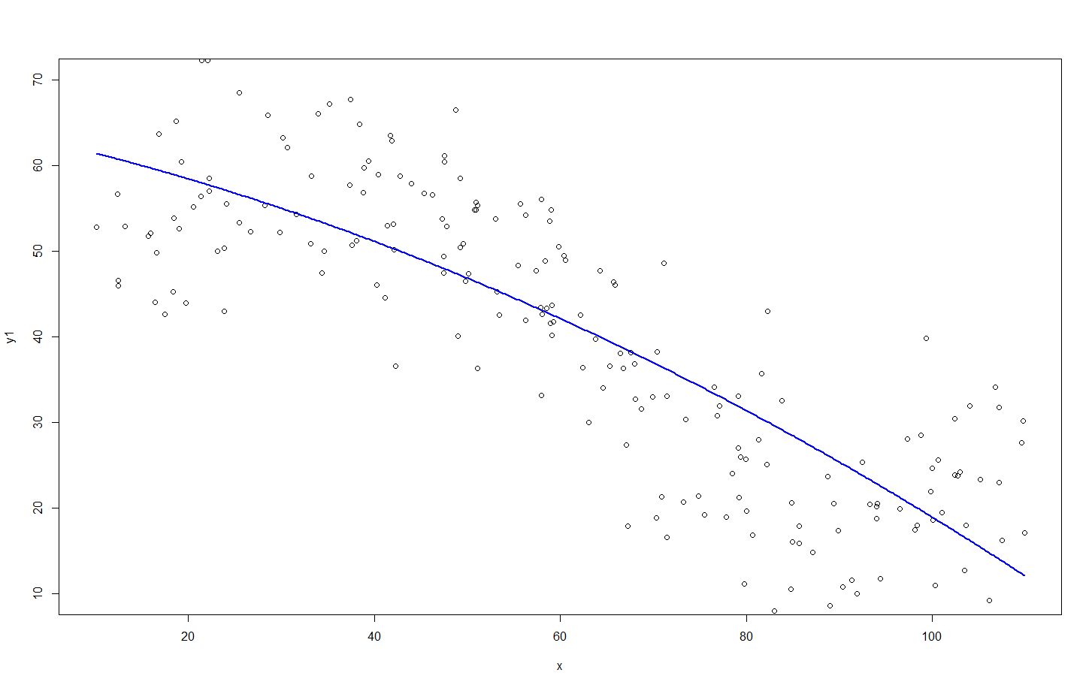
…Then, my 2nd Candidate Model:
Y=β₀+β₁x + β₂x²
Y=63.8-0.22x-0.002x²
Root Mean Squared Error = 9.94

Slide 21
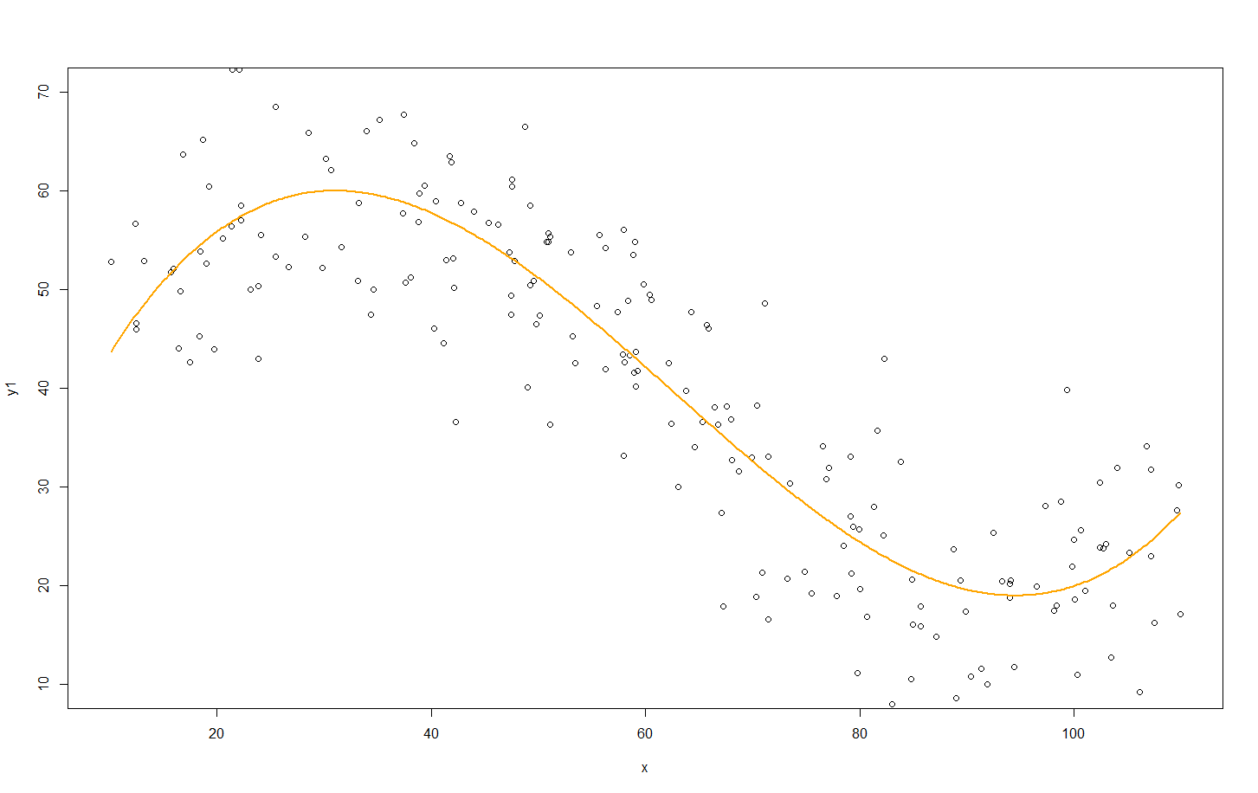
3rd Candidate Model:
Y=β₀+β₁x +β₂x²+β₃x³
Y=24.4+3.66x-0.058x²+0.0003x³
Root Mean Squared Error = 7.64

Slide 22
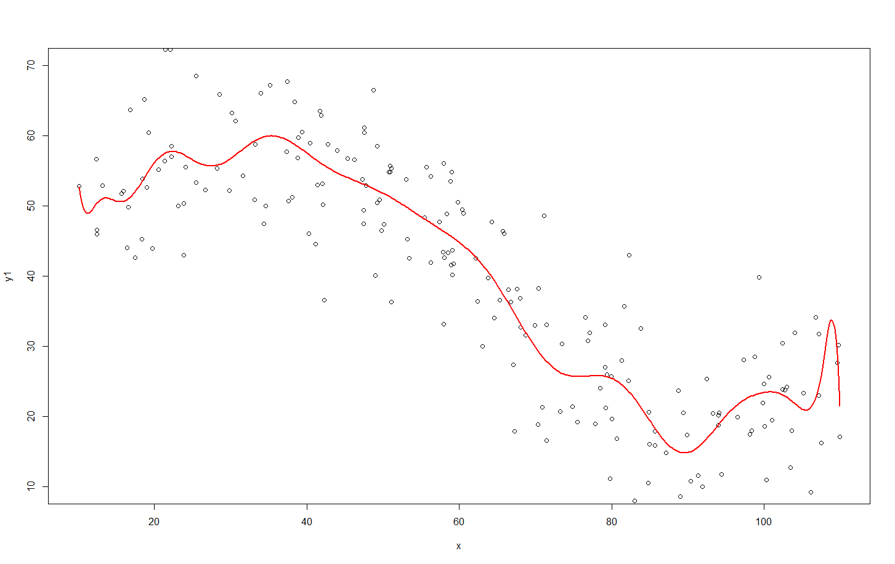
4th Candidate Model:
Y=β₀+β₁x +β₂x²+β₃x³+ β₄x⁴+β₅x⁵+ β₆x⁶+β₇x⁷+ β₈x⁸+β₉x⁹+ β₁₀x¹⁰+β₁₁x¹¹+ β₁₂x¹²+β₁₃x¹³+ β₁₄x¹⁴+β₁₅x¹⁵+ β₁₆x¹⁶+β₁₇x¹⁷+ β₁₈x¹⁸+β₁₉x¹⁹+ β₂₀x²⁰
Y=11490-4490.9x +777.3x²-78.1x³+ 5.1x⁴-0.29x⁵+ 0.007x⁶-0.00017x⁷+ 2.7*10⁻⁶x⁸-3.12*10⁻⁸x⁹+ … -1.97*10⁻²⁴x²⁰
Root Mean Squared Error = 7.38

Slide 23
The “Best” Performing Model??
Set of Predictive Models | Model Fit on Training Data (Root Mean Square Errors)
#1) Y=β₀+β₁x | 10.71
#2) Y=β₀+β₁x β₂x² | 9.94
#3) Y=β₀+β₁x +β₂x²+β₃x³ | 7.64
#4) Y=β₀+β₁x +β₂x²+β₃x³+ β₄x⁴+β₅x⁵+ β₆x⁶+β₇x⁷+ β₈x⁸+β₉x⁹+ β₁₀x¹⁰+β₁₁x¹¹+ β₁₂x¹²+β₁₃x¹³+ β₁₄x¹⁴+β₁₅x¹⁵+ β₁₆x¹⁶+β₁₇x¹⁷+ β₁₈x¹⁸+β₁₉x¹⁹+ β₂₀x²⁰ | 7.38

Slide 24
Is a that last model (the 20th order polynomial) the better predictive model? To answer this, we need to understand how to systematically balance between complexity, and guarding against under/over fitting

Slide 25
The “Best” Performing Model…
Using the four models that “I fitted” to the training data, I test the fit of each model on a new batch of data (produced by the same stochastic process that I used to generate the first batch), we’ll call this new data the validation data…
Set of Predictive Models | Model Fit on Training Data (Sum of Squared Errors) | Model Fit on Validation Data (Sum of Squared Errors)
#1) Y=β₀+β₁x | 10.71 | 10.31
#2) Y=β₀+β₁x β₂x² | 9.94 | 10.21
#3) Y=β₀+β₁x +β₂x²+β₃x³ | 7.64 | 8.99
#4) Y=β₀+β₁x +β₂x²+β₃x³+ β₄x⁴+β₅x⁵+ β₆x⁶+β₇x⁷+ β₈x⁸+β₉x⁹+ β₁₀x¹⁰+β₁₁x¹¹+ β₁₂x¹²+β₁₃x¹³+ β₁₄x¹⁴+β₁₅x¹⁵+ β₁₆x¹⁶+β₁₇x¹⁷+ β₁₈x¹⁸+β₁₉x¹⁹+ β₂₀x²⁰ | 7.38 | 9.19
NOTICE: Notice that I’m only using training and validation data. This is quite common and approach. Therefore, it can be confusing on when we should use a test. This “depends” on our goals, and the size and quality of your dataset.

Slide 26
The “Best” Performing Model…
Set of Predictive Models | Model Fit on Training Data (Sum of Squared Errors) | Model Fit on Validation Data (Sum of Squared Errors)
#1) Y=β₀+β₁x | 10.71 | 10.31
#2) Y=β₀+β₁x β₂x² | 9.94 | 10.21
#3) Y=β₀+β₁x +β₂x²+β₃x³ | 7.64 | 8.99
#4) Y=β₀+β₁x +β₂x²+β₃x³+ β₄x⁴+β₅x⁵+ β₆x⁶+β₇x⁷+ β₈x⁸+β₉x⁹+ β₁₀x¹⁰+β₁₁x¹¹+ β₁₂x¹²+β₁₃x¹³+ β₁₄x¹⁴+β₁₅x¹⁵+ β₁₆x¹⁶+β₁₇x¹⁷+ β₁₈x¹⁸+β₁₉x¹⁹+ β₂₀x²⁰ | 7.38 | 9.19
Increasing
Complexity
Better fit
Worse fit
What’s going on here is that the most complicated model — in this case, the 20th order polynomial— is not fitting the generalizable features of the data. Instead, this model is fitting the sampling noise, or the accidents which don’t repeat.
In general overly complex models tend to over-fit the data. Conversely, models that are too simple may not describe the generalized features of the data with sufficient detail, and thus result in under-fitting.

Slide 27
Which is the better predictive model…
Set of Predictive Models | Model Fit on Training Data (Sum of Squared Errors) | Model Fit on Validation Data (Sum of Squared Errors)
#1) Y=β₀+β₁x | 10.71 | 10.31
#2) Y=β₀+β₁x β₂x² | 9.94 | 10.21
#3) Y=β₀+β₁x +β₂x²+β₃x³ | 7.64 | 8.99
#4) Y=β₀+β₁x +β₂x²+β₃x³+ β₄x⁴+β₅x⁵+ β₆x⁶+β₇x⁷+ β₈x⁸+β₉x⁹+ β₁₀x¹⁰+β₁₁x¹¹+ β₁₂x¹²+β₁₃x¹³+ β₁₄x¹⁴+β₁₅x¹⁵+ β₁₆x¹⁶+β₁₇x¹⁷+ β₁₈x¹⁸+β₁₉x¹⁹+ β₂₀x²⁰ | 7.38 | 9.19
✓
Though #4 best fit the data we used for training, it performed poorly on the validation (new) data. Therefore, the best predictive model seems to be #3, not #4.

Slide 28
Some approaches to this…
Big Data:
With more and more data, law of large numbers tells us that is should become more and more representative of there “true” model (distribution).
Penalize complexity:
To combat overly-flexible models, apply some penalty for complexity (i.e. Put limits on number of parameters, levels, etc.)
Cross-validation:
Divide data into two parts. Call one part the training set, and the other the validation set. Develop the model on the training set and assess performance on the validation set.

Slide 29
…let’s elaborate on this last approach (which is arguably the best overall approach, and one that you’ll commonly use)

Slide 30
Data Splitting and “Right” Fitting Honest Testing of our Predictive Model
Validation
Training
Test

Slide 31
Addressing issues of fit and complexity
The training set is used to determine the best fitting parameters for each of our models.
The validation set allows us to test each model against new data and determine the best performing model.
The test set allows us to conduct an honest assessment (or scoring) of how well the selected model performs. Our goal is to verify if the accuracy is sufficient.
Application phase is the deployment and use of the model. If the performance of the model becomes unsatisfactory (especially is the population “drift”), revisit the model development process

Slide 32
Data Partitioning
Training Data
Original Data
inputs
target
inputs
target
Validation Data
inputs
target
Test Data
inputs
target
Three data sets (Training, Validation, and Test) are sampled from the original data sets.

Slide 33
Predictive Model Sequence
Training Data
Validation Data
inputs
target
inputs
target
1
2
Using the training data create a number of potential models – some of which more complex than others
3
4
5
Model
Complexity

Slide 34
Model Performance Assessment
Training Data
Validation Data
inputs
target
inputs
target
1
Rate model performance using validation data.
2
3
4
5
Model
Complexity
Validation
Assessment

Slide 35
Model Selection
Training Data
Validation Data
inputs
target
inputs
target
1
Select the simplest model with the highest validation assessment.
2
3
4
5
Model
Complexity
Validation
Assessment

Slide 36
“Honestly” Assessing Selected Model Performance
Training Data
Test Data
inputs
target
inputs
target
Rate the model’s performance on a test set of data… A set of data not used in the training of the model or to cross validate the model.
3

Slide 37
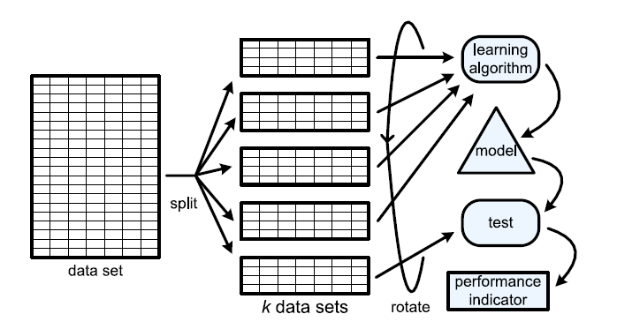
K-fold Cross Validation
Shuffle the dataset randomly.
Split the dataset into k groups
Repeat k times the following…
Take one of the k-groups as a hold out or test data set (one that hasn’t yet been used)
Take the remaining groups as a training data set
Fit a model on the training set and evaluate it on the test set
Store the evaluation score
Summarize the skill of the model using the mean of the evaluation scores of the k-tests.
(source: Van der Aalst, W. (2011). Process mining: discovery, conformance and enhancement of business processes.)

Slide 38
Modeling Processes and Types

Slide 39
Learning Objectives
Be able to identify and discuss the three common paradigms of data mining process.
Understand supervised vs unsupervised learning
Categorize the common machine learning techniques

Slide 40
Paradigms for Data Mining (variations)
KDD
SEMMA (from SAS)
CRISP-DM (SPSS/IBM)

Slide 41
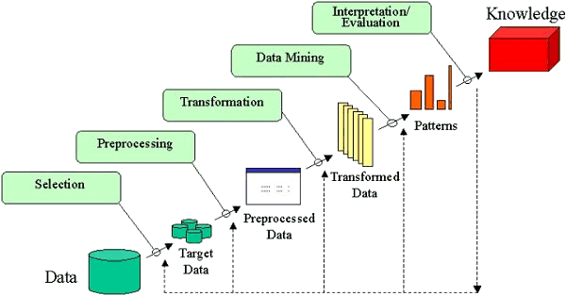
KDD
Knowledge Discovery in Databases, or KDD for short
Uses data mining methods (algorithms) to extract (identify) what is deemed knowledge, according to the specifications of measures and thresholds, using a database along with any required preprocessing, subsampling, and transformations of that database.
For more information: https://sceweb.uhcl.edu/boetticher/ML_DataMining/p27-fayyad.pdf

Slide 42
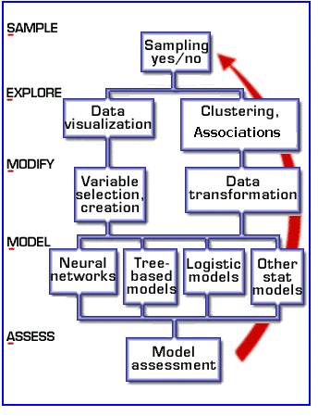
SEMMA
Developed by SAS
Sample the data by creating one or more data tables. The samples should be large enough to contain the significant information, yet small enough to process.
Explore the data by searching for anticipated relationships, unanticipated trends, and anomalies in order to gain understanding and ideas.
Modify the data by creating, selecting, and transforming the variables to focus the model selection process.
Model the data by using the analytical tools to search for a combination of the data that reliably predicts a desired outcome.
Assess the data by evaluating the usefulness and reliability of the findings from the data mining process.
Source: SAS Introduction to SEMMA

Slide 43
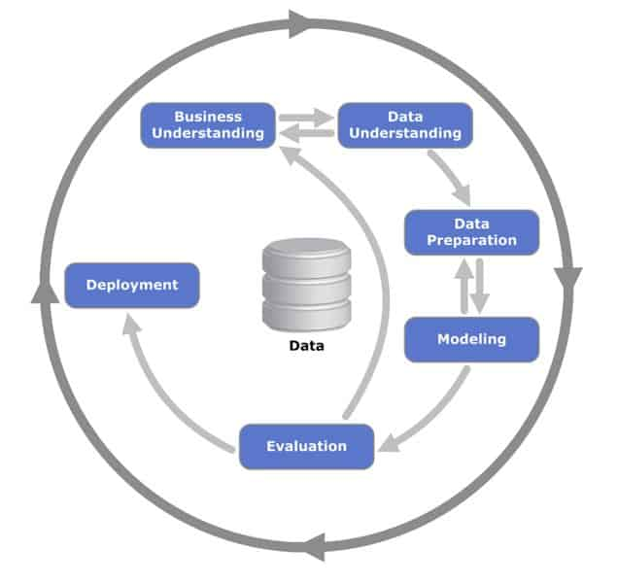
CRISP-DM
CRISP-DM (SPSS/IBM)
Business Understanding
Data Understanding
Data Preparation
Modeling
Evaluation
Deployment

Slide 44
Supervised Learning
Goal: Predict a single “target” or “outcome” variable
Training data, where target value is known
Score to data where value is not known
Methods: Classification and Prediction

Slide 45
Unsupervised Learning
Goal: Segment data into meaningful segments; detect patterns
There is no target (outcome) variable to predict or classify
Methods: Association rules, collaborative filters, data reduction & exploration, visualization

Slide 46
Supervised: Classification
Goal: Predict categorical target (outcome) variable
Examples: Purchase/no purchase, fraud/no fraud, creditworthy/not creditworthy…
Each row is a case (customer, tax return, applicant)
Each column is a variable
Target variable is often binary (yes/no)

Slide 47
Supervised: Prediction
Goal: Predict numerical target (outcome) variable
Examples: sales, revenue, performance
As in classification:
Each row is a case (customer, tax return, applicant)
Each column is a variable
Taken together, classification and prediction constitute “predictive analytics”

Slide 48
Unsupervised: Association Rules
Goal: Produce rules that define “what goes with what” in transactions
Example: “If X was purchased, Y was also purchased”
Rows are transactions
Used in recommender systems – “Our records show you bought X, you may also like Y”
Also called “affinity analysis”

Slide 49
Unsupervised: Collaborative Filtering
Goal: Recommend products to purchase
Based on products that customer rates, selects, views, or purchases
Recommend products that “customers like you” purchase (user-based)
Or, recommend products that share a “product purchaser profile” with your purchases (item-based)

Slide 50
Unsupervised: Data Reduction
Distillation of complex/large data into simpler/smaller data
Reducing the number of variables/columns (e.g., principal components)
Reducing the number of records/rows (e.g., clustering)

Slide 51
Unsupervised: Data Visualization
Graphs and plots of data
Histograms, boxplots, bar charts, scatterplots
Especially useful to examine relationships between pairs of variables

Slide 52
Topology of Modeling Techniques
 | Supervised |  | Unsupervised
 | Continuous Target | Categorical Target | No Target
Continuous Input Predictors | Linear Regression k nearest neighbors Neural Networks | K-Nearest Neighbors Logistic Regression Neural Networks Discriminant Analysis Ensembles | Principle Components Collaborative Filtering Cluster Analysis
Categorical Input Predictors | Linear Regression Regression Trees Neural Networks Ensembles | Naïve Bayes Classification Trees Logistic Regression Neural Networks Ensembles | Association Rules Collaborative Filtering

Slide 53
Python Review

Slide 54
Learning Objectives
Understand why Python in Data Analytics
Understand how to create, load, and edit Jupyter Lab Notebooks
Be able to navigate within a notebook – change cell types, create new cells, delete cells, copy and paste cells, and moved cells.
Know how to create a csv file and load csv file intro pandas.
Review python fundamentals from assigned DataCamp courses: Variables, Variable Types, Immutable vs Mutable, common data structures (list and dictionaries), Numpy and Pandas, and creating basic scatterplots using matplotlib.

Slide 55
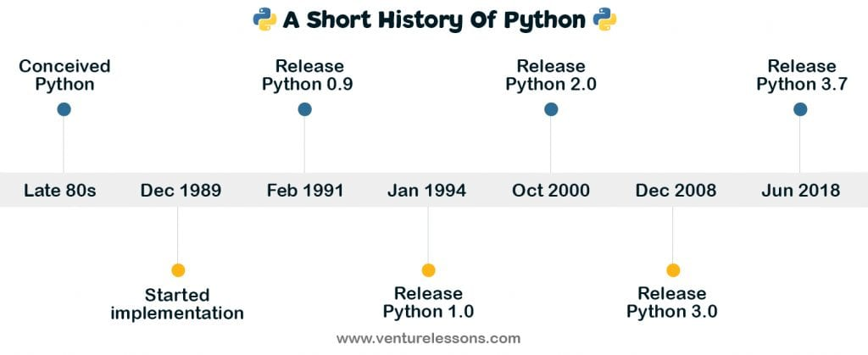
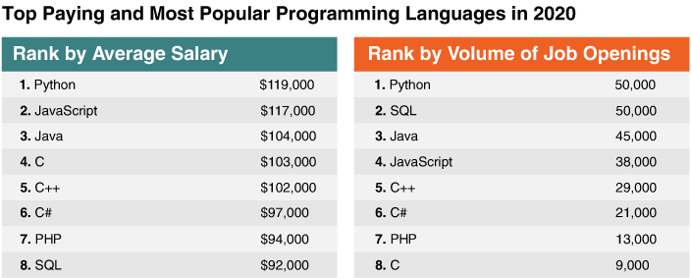
Python
Python is an object-oriented scripting language which is easy to read, write, maintain and is a free open source tool.
Conceived by Guido van Rossum
Monty Python, not Snake
Used Extensively in Data Analytics

Slide 56
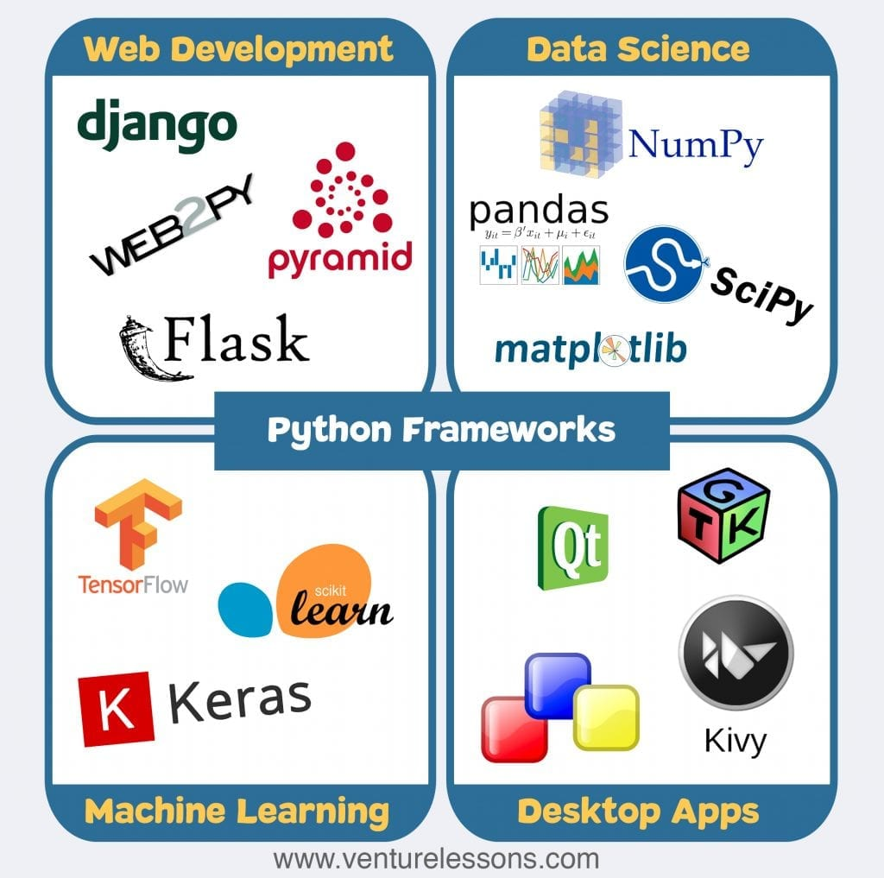
Python Frameworks & Libraries
We will primarily work with NumPy, Pandas, Matplotlib, and SciPy
NumPy - Vectors , Linear Algebra simulation
Pandas – Data Wrangling/Munging
Matplotlib – Visualizations/plotting
SciPy – Developing, testing, and deploying models

Slide 57
“Running” Jupyter…
There are three primary ways in which to run python code:
Interactive Prompt
Scripts (these can be compiled into executables as well)
Jupyter Notebooks
We will focus exclusively on Notebooks!

Slide 58
Jupyter Notebooks
Jupyter: A browser-based application that allows you to create and share documents (i.e. Jupyter Notebook files) that contain live code, equations, visualizations and narrative text.
Began as iPython, with support only for Python
Jupyter supports over 100 other languages
Java, R, Julia, Matlab, Octave, Scheme etc.
Jupyter Lab is a ground up rewrite of Jupyter
it may replace Jupyter in the future, but I’d stick with Jupyter for now.

Slide 59
Software and Hardware Considerations
Software
Installed on your computer
Python.org (standard distribution) or Anaconda
Or run in the “cloud”
Google Colab, Kaggle, AWS, Azure
Hardware
Storage – for this course, datasets will be relatively small (<50mb)
Memory - >4gb, recommend 8+GB
CPU – any modern CPU will suffice
GPU – Can speed up Deep Learning Models (Neural Net) training

Slide 60
Demonstration and Review of Python

Slide 61
Learning Objectives
Know the set of commonly used Jupyter Notebook keyboard shortcuts
Know how to split screen, remove side bar, and change sidebar from filesystem to notebook structure.
Review of Python basics:
What was covered in DataCamp
PLUS: a few additional things
Demonstration of your first model development
Use a linear regression model to ‘guess’ what the hidden relationship between two variables may be.

Slide 62
Summary

Slide 63
Discussion Board
After class, be sure to go to the discussion board and respond to this week's questions.
This weeks question is posted at the top of the discussion board. For your first post, reply to the question posed by the professor.
Be sure to provide links/references when applicable.

Slide 64
Next Week
Will be a recorded class
You do not need to attend
NOTE: This is because my Monday class can’t meet – so, for all sections, I’ll post a recorded lecture.

Slide 65
To do List for this week:
Complete the assigned DataCamp courses.
Three new courses are now available.
Start early!!!!
Participate in this week's discussion
Post your response to this week’s discussion question.
Post early; don’t leave this to the last day or two.
Add to/respond to at least one other student posting.

Slide 66
Happy Learning!

