Slide 1
ISM 6136
Data Mining
Dr. Tim Smith

Slide 2
Agenda
08:35-09:05 – Quiz 1 and 2
09:05-09:15 - Introduction to Classification Modeling
09:15-10:00 - Introduction to k-NN
Break
10:00-10:20 – k-NN Example walkthrough
10:20-10:30 - Introduction to Confusion Matrices
10:30-11:35 - The Case of Universal Bank

Slide 3
Class Business
I will post a video outlining a sample solution this Thursday morning (I need to wait until after my Thursday class submits theirs).
We will only be taking two quizzes today – I discussed the content of these quizzes in the last live class.
Quizzes must be taken using Lockdown Browser
All electronic devices other than your laptop must be turned off and put away (not on desk, in lap, etc.).
A failure to do this will constitute an academic integrity violation.

Slide 4
To give you a break
Our final quiz mark will be based on your highest 8 quizzes
2 of your lowest will be dropped.

Slide 5
Classification Models (Classifiers)

Slide 6
Learning outcomes :
Understand the difference between a classification model and linear regression.
Understand the difference between binary classification modeling and multiclass classification modeling.
Know examples of both binary and multiclass classification modeling.

Slide 7
Classification Modeling
So far, we’ve used linear regression modeling to find patterns between continuous input variables and a continuous target variable.
…But, what about non-continuous targets?
When we attempt to predict a non-continuous target (aka category) we create a ‘classifier’ (also referred to as a classification model)

Slide 8
Classification
In many areas, decisions are made on a “yes” or “no” basis. This is called binary classification.
1. Credit score: give credit or not
2. Spam or not: corporate email
3. Fraudulent credit card transaction or not
4. Hospital - operate or wait (the triage problem) [MASH unit]
5. Invest or not: $1B fund
6. Travel or not: critical corporate personnel or senior government officials

Slide 9
Classification
When the decision involves more than a “yes” or “no”, such as “maybe”, or “high”, “medium”, “low”, or recognizing handwritten numbers 0 – 9, then it is called multiclass classification.
1. Character Recognition: Digits 0 through 9
2. Medical Diagnostics: Retinal scans to detect Diabetic Retinopathy (mild, moderate, severe, or proliferative)
3. Product Classification: Input an image and a description, and identify if the product is under electronics category, clothes, etc.

Slide 10


Evaluating a binary classifier
Overall accuracy is one metric
Input | Target | Prediction
10 | 0 | 0
23 | 1 | 1
34 | 1 | 1
23 | 1 | 0
66 | 0 | 0
43 | 0 | 0
Out of 6 predictions, 5 were correct.
Accuracy is correct prediction count over total predictions.
In this case:
Accuracy = 5/6 = 83.33%

Slide 11
Classification Modeling using k-NN

Slide 12
Learning outcomes :
Understand how k-NN classifies new data.
Understand how to implement a k-NN classifier using python.
Understand one of the big issues k-NN (and other modeling techniques) can have
This problem is revealed later in the slides and will be discussed/explored.

Slide 13
K-NN
There are many ways we could model a classifier.
Today we will create our first classifier using k-NN (k-nearest neighbors)
Don’t confuse this with K-means clustering – which represents an unsupervised algorithm, mainly used for clustering.
High level overview….
k-NN looks at the distance between a new point and those around it. Based on knowing the classification of its neighbors, we can predict the classification of this new point.

Slide 14
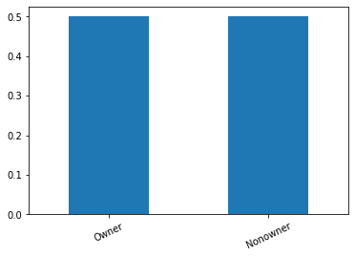
Classification Modeling Example
Income | Lot_Size | Ownership
60 | 18.4 | Owner
85.5 | 16.8 | Owner
64.8 | 21.6 | Owner
61.5 | 20.8 | Owner
87 | 23.6 | Owner
110.1 | 19.2 | Owner
108 | 17.6 | Owner
82.8 | 22.4 | Owner
69 | 20 | Owner
93 | 20.8 | Owner
51 | 22 | Owner
81 | 20 | Owner
75 | 19.6 | Nonowner
52.8 | 20.8 | Nonowner
64.8 | 17.2 | Nonowner
43.2 | 20.4 | Nonowner
84 | 17.6 | Nonowner
49.2 | 17.6 | Nonowner
59.4 | 16 | Nonowner
66 | 18.4 | Nonowner
47.4 | 16.4 | Nonowner
33 | 18.8 | Nonowner
51 | 14 | Nonowner
63 | 14.8 | Nonowner
By looking at our count distribution, we can see that we have excellent representation of each category
NOTE: What does and “acceptable” distribution look like? This is a judgment call on your part. If there is one class with little representation, the predictive power of any model you fit will be lower than if we have a more even split.

Slide 15
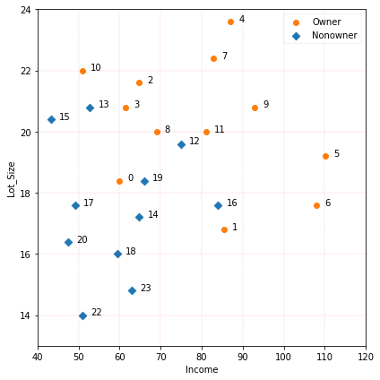
Classification Modeling Example
Visualize our data…
Question:
What model can we develop that will allow us to predict ownership based on having Income and LotSize?

Slide 16
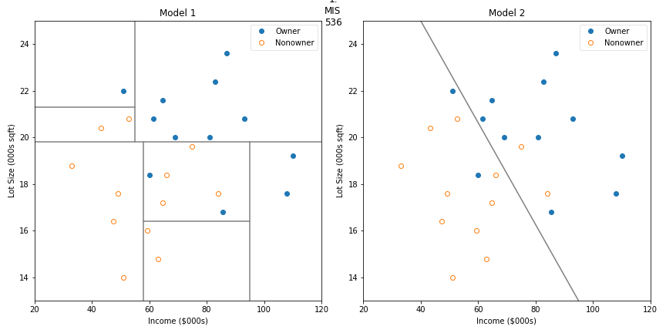
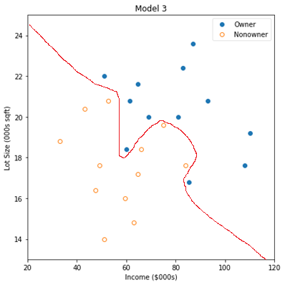
Classification Modeling Example
Income | Lot_Size | Ownership
60 | 18.4 | Owner
85.5 | 16.8 | Owner
64.8 | 21.6 | Owner
61.5 | 20.8 | Owner
87 | 23.6 | Owner
110.1 | 19.2 | Owner
108 | 17.6 | Owner
82.8 | 22.4 | Owner
69 | 20 | Owner
93 | 20.8 | Owner
51 | 22 | Owner
81 | 20 | Owner
75 | 19.6 | Nonowner
52.8 | 20.8 | Nonowner
64.8 | 17.2 | Nonowner
43.2 | 20.4 | Nonowner
84 | 17.6 | Nonowner
49.2 | 17.6 | Nonowner
59.4 | 16 | Nonowner
66 | 18.4 | Nonowner
47.4 | 16.4 | Nonowner
33 | 18.8 | Nonowner
51 | 14 | Nonowner
63 | 14.8 | Nonowner
In the first class, we contemplated a linear classifier and a tree classifier and some seemingly random line that we drew (more on these later) .

Slide 17
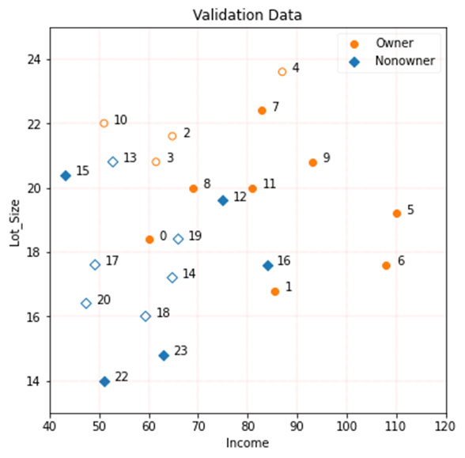
k-NN
Now here’s another way...
Income | Lot_Size | Ownership
60 | 18.4 | Owner
85.5 | 16.8 | Owner
64.8 | 21.6 | Owner
61.5 | 20.8 | Owner
87 | 23.6 | Owner
110.1 | 19.2 | Owner
108 | 17.6 | Owner
82.8 | 22.4 | Owner
69 | 20 | Owner
93 | 20.8 | Owner
51 | 22 | Owner
81 | 20 | Owner
75 | 19.6 | Nonowner
52.8 | 20.8 | Nonowner
64.8 | 17.2 | Nonowner
43.2 | 20.4 | Nonowner
84 | 17.6 | Nonowner
49.2 | 17.6 | Nonowner
59.4 | 16 | Nonowner
66 | 18.4 | Nonowner
47.4 | 16.4 | Nonowner
33 | 18.8 | Nonowner
51 | 14 | Nonowner
63 | 14.8 | Nonowner
Look at each data point, then choose k neighbors (where k is some integer between 1 and the total number of observations).
Based on these identified k-nearest neighbors, look at the actual category for each, and then choose the major category. This is your prediction for the given point.
There is an algorithm for that!
K-Nearest Neighbors

Slide 18
k-NN
Set k
Income | Lot_Size | Ownership
60 | 18.4 | Owner
85.5 | 16.8 | Owner
64.8 | 21.6 | Owner
61.5 | 20.8 | Owner
87 | 23.6 | Owner
110.1 | 19.2 | Owner
108 | 17.6 | Owner
82.8 | 22.4 | Owner
69 | 20 | Owner
93 | 20.8 | Owner
51 | 22 | Owner
81 | 20 | Owner
75 | 19.6 | Nonowner
52.8 | 20.8 | Nonowner
64.8 | 17.2 | Nonowner
43.2 | 20.4 | Nonowner
84 | 17.6 | Nonowner
49.2 | 17.6 | Nonowner
59.4 | 16 | Nonowner
66 | 18.4 | Nonowner
47.4 | 16.4 | Nonowner
33 | 18.8 | Nonowner
51 | 14 | Nonowner
63 | 14.8 | Nonowner
Let’s look at k=3, therefore we are testing a 3-nn model.
Let’s look at observation #9.
We see that of the three nearest neighbors, all are “Owners”. Therefore, we’d predict that this is an owner. Correct!

Slide 19
k-NN
Now here’s another way...
Income | Lot_Size | Ownership
60 | 18.4 | Owner
85.5 | 16.8 | Owner
64.8 | 21.6 | Owner
61.5 | 20.8 | Owner
87 | 23.6 | Owner
110.1 | 19.2 | Owner
108 | 17.6 | Owner
82.8 | 22.4 | Owner
69 | 20 | Owner
93 | 20.8 | Owner
51 | 22 | Owner
81 | 20 | Owner
75 | 19.6 | Nonowner
52.8 | 20.8 | Nonowner
64.8 | 17.2 | Nonowner
43.2 | 20.4 | Nonowner
84 | 17.6 | Nonowner
49.2 | 17.6 | Nonowner
59.4 | 16 | Nonowner
66 | 18.4 | Nonowner
47.4 | 16.4 | Nonowner
33 | 18.8 | Nonowner
51 | 14 | Nonowner
63 | 14.8 | Nonowner
Now, let’s look at observation #0.
We see that of the three nearest neighbors, all are “Nonowners”. Therefore, we’d predict that this is a nonowner. Incorrect ☹

Slide 20
k-NN
Income | Lot_Size | Ownership
60 | 18.4 | Owner
85.5 | 16.8 | Owner
64.8 | 21.6 | Owner
61.5 | 20.8 | Owner
87 | 23.6 | Owner
110.1 | 19.2 | Owner
108 | 17.6 | Owner
82.8 | 22.4 | Owner
69 | 20 | Owner
93 | 20.8 | Owner
51 | 22 | Owner
81 | 20 | Owner
75 | 19.6 | Nonowner
52.8 | 20.8 | Nonowner
64.8 | 17.2 | Nonowner
43.2 | 20.4 | Nonowner
84 | 17.6 | Nonowner
49.2 | 17.6 | Nonowner
59.4 | 16 | Nonowner
66 | 18.4 | Nonowner
47.4 | 16.4 | Nonowner
33 | 18.8 | Nonowner
51 | 14 | Nonowner
63 | 14.8 | Nonowner
We keep doing this for every value in the train data set.
After doing this, we calculated how well the given k value of 3 predicted outcomes by calculating the percentage of correct predictions.

Slide 21
k-NN
Income | Lot_Size | Ownership
60 | 18.4 | Owner
85.5 | 16.8 | Owner
64.8 | 21.6 | Owner
61.5 | 20.8 | Owner
87 | 23.6 | Owner
110.1 | 19.2 | Owner
108 | 17.6 | Owner
82.8 | 22.4 | Owner
69 | 20 | Owner
93 | 20.8 | Owner
51 | 22 | Owner
81 | 20 | Owner
75 | 19.6 | Nonowner
52.8 | 20.8 | Nonowner
64.8 | 17.2 | Nonowner
43.2 | 20.4 | Nonowner
84 | 17.6 | Nonowner
49.2 | 17.6 | Nonowner
59.4 | 16 | Nonowner
66 | 18.4 | Nonowner
47.4 | 16.4 | Nonowner
33 | 18.8 | Nonowner
51 | 14 | Nonowner
63 | 14.8 | Nonowner
Now, what about other possible values of k?
We can redo the NN procedure for any value of k (between 1 and n-1).
For instance, here we see k=3
NOTE: This is for illustration purposes…as you may notice, I haven’t put a circle around every value in our training set.
n is the number of observations (aka rows)

Slide 22
k-NN
If we keep repeat this process for all values from 1 to the number of observations, we determine a percentage accuracy for each value of k.
Income | Lot_Size | Ownership
60 | 18.4 | Owner
85.5 | 16.8 | Owner
64.8 | 21.6 | Owner
61.5 | 20.8 | Owner
87 | 23.6 | Owner
110.1 | 19.2 | Owner
108 | 17.6 | Owner
82.8 | 22.4 | Owner
69 | 20 | Owner
93 | 20.8 | Owner
51 | 22 | Owner
81 | 20 | Owner
75 | 19.6 | Nonowner
52.8 | 20.8 | Nonowner
64.8 | 17.2 | Nonowner
43.2 | 20.4 | Nonowner
84 | 17.6 | Nonowner
49.2 | 17.6 | Nonowner
59.4 | 16 | Nonowner
66 | 18.4 | Nonowner
47.4 | 16.4 | Nonowner
33 | 18.8 | Nonowner
51 | 14 | Nonowner
63 | 14.8 | Nonowner
k | Accuracy
1 | 0.7
2 | 0.8
3 | 0.9
4 | 0.7
5 | 0.9
6 | 0.9
7 | 0.9
8 | 0.9
9 | 0.8
10 | 0.8
11 | 0.9
12 | 0.4
13 | 0.4

Slide 23
Classification Modeling Example
k | Accuracy
1 | 0.7
2 | 0.8
3 | 0.9
4 | 0.7
5 | 0.9
6 | 0.9
7 | 0.9
8 | 0.9
9 | 0.8
10 | 0.8
11 | 0.9
12 | 0.4
13 | 0.4
Question: Based on this table, which is the “best” model?

Slide 24
Classification Modeling Example
k | Training Data | Validation Data
1 | 0.7 | ?
2 | 0.8 | ?
3 | 0.9 | ?
4 | 0.7 | ?
5 | 0.9 | ?
6 | 0.9 | ?
7 | 0.9 | ?
8 | 0.9 | ?
9 | 0.8 | ?
10 | 0.8 | ?
11 | 0.9 | ?
12 | 0.4 | ?
13 | 0.4 | ?
To best determine performance, we should test the model on unseen data… in this case, the data we set aside for validation.

Slide 25
Classification Modeling Example
k | Training Data | Validation Data
1 | 0.7 | 0.7
2 | 0.8 | 0.9
3 | 0.9 | 0.9
4 | 0.7 | 0.8
5 | 0.9 | 0.9
6 | 0.9 | 0.9
7 | 0.9 | 0.9
8 | 0.9 | 0.9
9 | 0.8 | 0.8
10 | 0.8 | 0.9
11 | 0.9 | 0.9
12 | 0.4 | 0.5
13 | 0.4 | 0.6
To best determine performance, we should test the model on unseen data… in this case, the data we set aside for validation.

Slide 26

How do we calculate distance?
Calculate the distance between observation 9 and observation 5.
(X₉, Y₉)
$$\sqrt{{\left(X_{9}−X_{5}\right)}^{2}+{\left(Y_{9}−Y_{5}\right)}^{2} }$$
(Y₉ – Y₅)
(X₉ – X₅)
(X₅, Y₅)
Note: Pythagorean Theorem also works to calculate distance in more the two dimensions.
$$\sqrt{{\left(X_{9}−X_{5}\right)}^{2}+{\left(Y_{9}−Y_{5}\right)}^{2}+{\left(Z_{9}−Z_{5}\right)}^{2} }$$

Slide 27
How do we calculate k-nearest?
Give the point of interest, the algorithm involves calculating the distance between this point and all other points in the data set (note: each “point” is an observation).
The result is then sorted ascending, and the k lowest values are taken.
For instance, if we are testing 2-NN, then
d2
d3
d4
d1
 | distance
d3 | 5.3
d2 | 5.9
d4 | 6.2
d1 | 7.0
2 nearest neighbors

Slide 28
Worked Example
Download c04-knn-walkthrough.ipynb
The professor will walk through this notebook that demonstrates the concept of knn.

Slide 29
One potential problem… Scale
Unless the two values are recorded using the same scale, I terms of distance, then one variable may “dominate” the other.
To help address this problem, it’s often advised to create a common scale across your variables.
There are three common methods to accomplish this.
Min-Max Normalization
Mean Normalization
Standardization

Slide 30



Scaling a variable
Min-Max normalization
Mean normalization
Standardization (Z-score Normalization)
✓
Use for k-NN

Slide 31
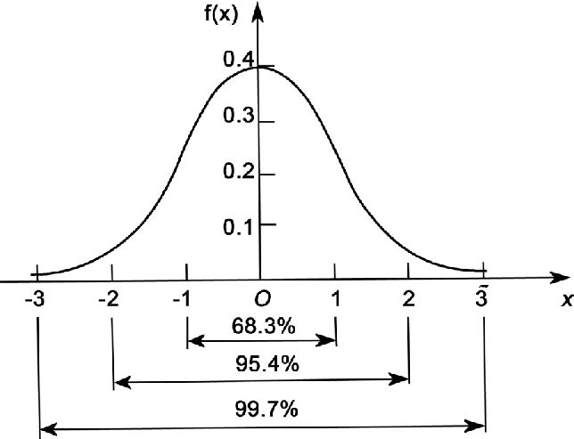
Scaling a variable
Standardization (Z-score Normalization)
mean
Standard Deviation

Slide 32
Worked example with normalized variables
Download c04-knn-walkthrough-normalized.ipynb
The professor will walk through this notebook that demonstrates the concept of knn using normalized variables.

Slide 33
K-NN Summary
Machine Learning algorithm
Focused on predicting outcomes
Doesn’t tell us anything about which factors are more Influential than others
Doesn’t require any assumptions around predictors.
Does require…
Rescaling all predictors to a common scale (normalization or standardization techniques)
Transforming categorical variable to dummy variable

Slide 34
Scoring Classification Models

Slide 35
Learning outcomes :
Read and interpret a confusion matrix
Understand the various scoring measures that can be derived from a confusion matrix.
Understand that the context of the problem will dictate which measures are most important to optimize.
Understand how we can evaluate models using profit and loss.

Slide 36
Learning outcomes :
Understand that accuracy is not always the best measure of model performance.
Understand the types of errors classification models produce.
Be able to create a confusion matrix representation of the performance of a model.
Be able to calculate the metrics: Accuracy, Error Rate, Precision, Recall, and F1-Score.
Gain an appreciation of the trade-off between FP’s and FN’s.
Calculate the expected P&L of both a ‘null model’, and a proposed model.

Slide 37
Are there more performance measures?
So far, we’ve measured the performance of classifier using accuracy: That is, the percentage the model correctly predicted the target value.
Today, we will explore how we can more rigorously evaluate a classifier using something called a confusion matrix.

Slide 38
Introducing the Confusion Matrix
Was prediction correct?
Predicted
No
Predicted
Yes
TN
FP
Actual
No
True Positive
True Negative
False Negative
False Positive
FN
TP
Actual
Yes
You may see different versions of confusion matrix; to help avoid ‘confusion’, we will follow the same format at the output from Python’s sklearn confusion matrix.
What was predicted?

Slide 39
Predicted
No
Predicted
Yes
TN
FP
Accuracy:
Actual
No
(TN+TP) / (TN+TP+FP+FN)
FN
TP
Actual
Yes

Slide 40
Predicted
No
Predicted
Yes
TN
FP
Misclassification (error) Rate:
Actual
No
(FN+FP) / (TN+TP+FP+FN)
FN
TP
Actual
Yes

Slide 41
Predicted
No
Predicted
Yes
TN
FP
Precision:
Actual
No
TP / (TP+FP)
FN
TP
Actual
Yes
When a positive value is predicted, how often is the prediction correct? In other words: How "precise" is the classifier when predicting positive instances?
Also referred to as Positive Predictive Value

Slide 42
Predicted
No
Predicted
Yes
TN
FP
Recall:
Actual
No
TP / (TP+FN)
FN
TP
Actual
Yes
Ability of a classification model to identify all relevant instances
Also referred to as Sensitivity, Probability of Detection, True Positive Rate

Slide 43
Predicted
No
Predicted
Yes
TN
FP
F1 Score:
Actual
No
(2*precision*recall) / (precision + recall)
FN
TP
Actual
Yes
A single metric that combines recall and precision using the harmonic mean

Slide 44
Let’s look at a couple of examples:
Medical Test
is the patient sick or not sick)
Spam Detector
is the email spam or not spam

Slide 45



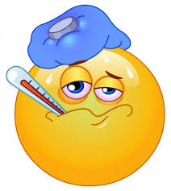
A medical test
Diagnosed Healthy
Diagnosed Sick
There are two errors that we can make FP and FN
Are the ‘costs’ of these two types of errors equal?
TN
FP
Healthy
TN
FP
FN
TP
Sick
FN
TP
Each error will have some cost, but (depending on the severity of the illness and the invasiveness of the test) we may want to prefer Diagnosed Sick when they are Healthy over Diagnosed Healthy when they are sick.

Slide 46

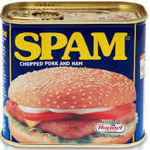
A spam detector
Predicted as not spam
Predicted as spam
Are the ‘costs’ of these two types of errors equal?
Are the ‘costs’ of these two types of errors equal?
TN
FP
Not spam
TN
FP
FN
TP
Spam
FN
TP
Each error will have some cost, but we might want to prefer Predicted as Not Spam when it’s Spam over flagging a good email as spam.
46

Slide 47
Key points: It’s about understanding and analyzing trade-offs
It’s natural to initial focus on maximizing accuracy (or minimizing error rate).
In an ideal world we would be able to produce 100% accurate models, but this is rarely possible in real world situations.
Since we generally need to accept some error rate, we need to evaluate the cost of such errors:
If the cost of a FN is greater than a FP, we will want to focus more on optimize recall.
If the cost of an FP is greater than a FN, we will want to focus on optimizing recall.
NOTE: Later we will see FBeta, which can further help us in such situations.

Slide 48
Activity
Let’s look at how we can apply our new knowledge of confusion matrices and k-NN to evaluate a real word problem
Download and follow along with C03-knn-universal-bank.ipynb

Slide 49
Summary of steps
Step 1: Import the necessary Libraries
Step 2: Load and clean the dataset
This process varies by the problem context and actual data
Check column names
Check to see you have good representation of all the categories found in your target variable
Drop records with a significant number of missing values
Impute missing values
Identify and rebalance any significant data imbalances. <- this is what you’ll explore in assignment02 and discussion04.
Step 3: Split the data into training and test sets
70/30 split is commonly used (book used a 60/40 split, so that’s what I used in the sample solution)
Note: there is debate on what is an appropriate ratio is/ literature indicates a 70-75% allocation for training might be optimal.

Slide 50
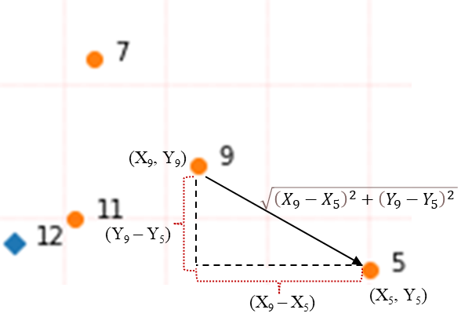
Summary of steps
Step 4: Standardize/Normalize the data scale of the predictors
Train(fit) your scaler on the training data
Apply the trained scaler on your training and validation dataset
Do not normalize/standardize the target variable.
Why standardize/normalize the predictors?
A scale indicates how something is measured
K-NN algorithm is based on the measurement of multidimensional distances
Normalizing/standardizing variables brings all measures into the same scale
Why train the scaler only on the training data?
We don’t want information leak from our training set to our validation/test set.
Remember: We’re trying to simulate ‘future’ data, data that we’ve not seen (as this will be the situation in production, where we won’t know the target variable.
Step 5: Train the Model for each value of k using transformed training set and assess performance on validation/test data.
As a general rule, train model using k values up to n^{1/2} (with large data sets this may take too long to process, so try a smaller set, and look at the trend in performance (step 6) for increasing k values)

Slide 51
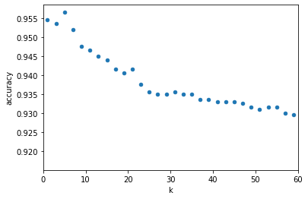
Summary of steps
Step 7: Evaluate the performance of your set of k values, select a k value the produces the best performance (for the given context).
Determine the most appropriate scoring measure(s) (you may need to consider more than one).
With many k values, you should visualize (or put into table form) the model score for variable values of k
Step 8: Deploy Model
Support a single decision or Integrate model into business process(es) for continuous prediction

Slide 52
This week: Discussion posting 04 and assignment 02
Post your response to this weeks discussion:
The question is about the imbalanced data we saw in our Universal bank example.
Research the problem of data imbalance. Identify and post one article that discusses the problem of data imbalance in machine learning/data mining. Then answer the following three questions:
What is data imbalance and how do we identify it?
How might imbalanced data impact a k-NN model?
What is _one_ approach we can use to reduce the problem of imbalanced data?
Assignment 02
Review the assignment 02 description on canvas.

Slide 53
Happy Learning!

