Slide 1
ISM 6136
Data Mining
Dr. Tim Smith

Slide 2
Agenda
More on model evaluation:
”Which is the best metric”
How do we evaluate multiclass models?
Decision Tree Pruning
The bias/variance tradeoff
The various ways we can prune a tree
Hyperparameter Tuning and k-fold cross validation

Slide 3
More on evaluating models

Slide 4
Review: Evaluating a binary classifier
Predicted
No
Predicted
Yes
TN
FP
Accuracy = (TP+TN)/(TP+TN+FP+FN)
Misclassification = 1 – Accuracy
Recall = TP / (FN + TP)
Precision = TP (FP + TP)
F1 = 2 * (precision * recall) / (precision + recall)
Actual
No
FN
TP
Actual
Yes

Slide 5
Review
Accuracy: Of all the predictions I made, how many were correct?
Precision: Of all the positive predictions I made, how many of them are truly positive?
Recall: Of all the actual positive examples out there, how many of them did I correctly predict to be positive?
F1: Harmonic mean of precision and recall; and provides a more balanced summation of a models performance.

Slide 6
Which one is ‘better’?
As we will see in the notebook, which metric is ‘better’ depends on the context.
Watch video…
c06_b_binay_scoring_metrics
Review the notebook … c06_1_binary_scoring_metrics.ipynb

Slide 7
So which metric? … Consider the context!
If there is a significant difference between cost/profit between the two types of errors (FP and FN), then you need to focus on either recall or precision
If FP is preferred over FN – focus on Recall
If FN is preferred over FP – focus on Precision
If there is not much of difference in P&L between FN’s and FP’s
If classes are reasonable in balance – focus on Accuracy
If classes are imbalanced – focused on F1 score.

Slide 8
Not all problems are binary classification…
 | Number of Targets | Target Cardinality
Binary Classification | 1 | 2
Multiclass classification | 1 | >2
Multilabel classification | >1 | 2
Multiclass-multioutput classification | >1 | >2

Slide 9
Binary Classification
1 target variable that has a cardinality of 2
Easiest to interpret
Simplest of the classification models to evaluate
Examples:
Will a customer take a loan or not
Does a person have a disease or not
Is an email spam or not

Slide 10
Multi-class (aka Multinomial) classification
1 target variable that has a cardinality > 2
Confusion matrix is more complex
Many classification modeling techniques (i.e.. K-NN and decision trees) support multi-class:
Therefore do not require any special transformation or processing:
Not all classification modeling techniques support multi-class
These include logistic regression and support vector machines.
To compensate: split the multiclassification dataset into multiple binary classification datasets and fit a binary classifier.
Two approaches: One versus One (OvO) or One versus Rest (OvR)
Examples of these types of problems:
Which major will a college student choose
Which blood type does a person have
Which candidate will a person vote for

Slide 11
Multilabel Classification
> 1 targets with cardinality of 2 (0 or 1)
When we have two of more classes and we predict if an observation belongs to zero or more of these classes.
Generally approached using one of three strategies
Transform the problem into a multiclass problem using coding
Represent each class as a binary code – creating one class for each combination found
See sklearn’s “OutputCodeClassifier”
Transform the problem into a number of binary models (one-vs-one)
One binary classifier per pair of labels
See sklearn’s “OneVsOneClassifier”
Transform the problem into a multiclass problem (one-vs-rest)
Create one classifier per class – it exists or not
See sklearn’s “OneVsRestClassifier”
Once transformed, the problem is handled using binary or multiclass techniques.
Examples:
Reviews on twitter – customer refers to price, quality and/or service.
Movies – classified as drama, comedy, romantic and/or adventure.

Slide 12
Multiclass multi-output classification
>1 targets variable with cardinality > 2
Best handled by modeling techniques/algorithms that can handle this situation:
Out of scope for us in this course, but be aware of this type of problem.
For examples, see
https://www.kaggle.com/code/depture/multiclass-and-multi-output-classification
https://medium.com/@cactuscode/multioutput-multiclass-classification-b0737a0693ec

Slide 13
OvR
One-vs-rest is a method for using binary classification algorithms for multi-class classification.
OvR approach splits the multi-class dataset into multiple binary classification problems.
Example: Predicting red, blue, green or yellow:
Binary classification problem 1: red vs [blue, green, yellow]
Binary classification problem 2: blue vs [red, green, yellow]
Binary classification problem 3: green vs [red, blue, yellow]
Binary classification problem 4: yellow vs [red, blue, green]
A binary classifier is then trained on each binary classification problem and predictions are made using the model that is the most confident.

Slide 14
OvO
Like one-vs-rest, one-vs-one splits a multi-class classification dataset into binary classification problems.
One-vs-one approach splits the dataset into one dataset for each class versus every other class.
Example: Predicting red, blue, green or yellow:
Binary classification problem 1: red vs. blue
Binary classification problem 2: red vs. green
Binary classification problem 3: red vs. yellow
Binary classification problem 4: blue vs. green
Binary classification problem 5: blue vs. yellow
Binary classification problem 6: green vs. yellow
Each binary classification model may predict one class label and the model with the most predictions or votes is predicted by the one-vs-one strategy.

Slide 15
Let’s look at a multi-class classifier
k-NN and Decision Trees can easily handle a multi-class classification problem.
By default, Sklearn uses a OvR approach when calculating multi-class evaluation metrics for models that are not inherently multiclass (see here for more detail)
These are easier to interpret and use, so it’s a good default
Let’s use k-NN, and demonstrate the fitting and evaluation of a multi-classifier model (k-NN is inherently multiclass):
c06_2_multiclass_scoring_metrics.ipynb

Slide 16

Assessing a multi-classifier
The confusion matrix is more difficult to interpret:
Predicted
1
2
3
23 | 0 | 0
1 | 18 | 0
0 | 0 | 12
1
What are FN’s vs FP’s?
How can we calculate accuracy, precision, recall and f1 scores?
2
Actual
3

Slide 17
Assessing a multi-classifier
A micro-average will aggregate the contributions of all classes to compute the average metric
Accuracy = 53/54 = 0.981418
Total TP = 23+18+12 = 53
Total FP = (1+0)+(0+0)+(0+0) = 1 # vertical
Total FN = (0+0)+(1+0)+(0+0) = 1 # horizonal
Precision = 53/(53+1) = 0.981481
Recall = 53/(53+1) = 0.981481
F1 = 2* (0.981481*0.981481)/(0.981481+ 0.981481) = 0.981418
When evaluating multiclass classifiers using average=‘micro’….
Accuracy=Precision=Recall=F1
This changes though for multi-label problems
Average=‘micro’
Predicted
1
2
3
23 | 0 | 0
1 | 18 | 0
0 | 0 | 12
1
2
Actual
3

Slide 18
Assessing a multi-classifier
The math behind these averaging metrics is out of scope for this course. There are many internet resources that walk through this for you (i.e. here, or here, or here …)
A few things to note:
In multiclass evaluation accuracy=recall=precision=f1 for ‘micro’ average
This will not be the case for a multi-label problem
Use micro-averaging score when there is a need to weight each instance or prediction equally.
Use macro-averaging score when all classes need to be treated equally to evaluate the overall performance of the classifier with regard to the most frequent class labels.
Use weighted macro-averaging score in case of class imbalances (different number of instances related to different class labels).

Slide 19
Decision Tree Pruning (and hyper-parameter tuning)

Slide 20
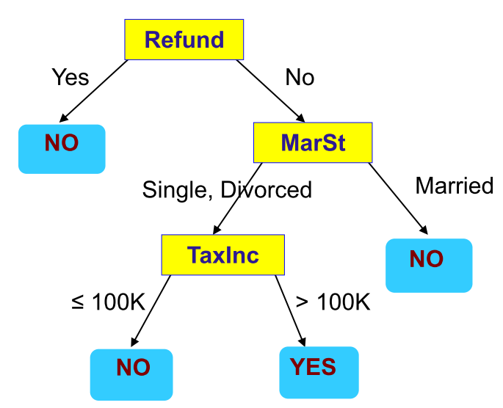
Decision Tree - review
Supervised Learning Model
Predictors/features/attributes as input
Predicted Output/Outcome can be checked with known result
Flowchart like Tree structure
Two types of Decision Tree:
Classification Tree (outcome is classification) ← this is our focus in this course
Regression Tree (outcome is continuous)
Root Node
Internal Nodes
Leaf Nodes

Slide 21
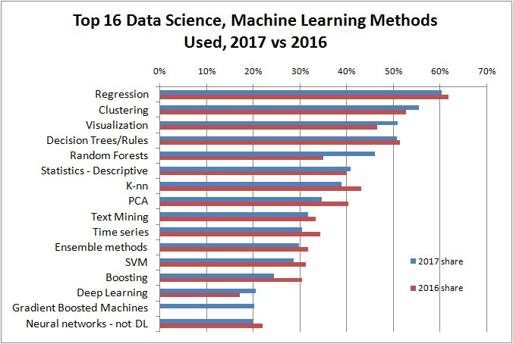
The most popular techniques… Decision tree increasingly popular

Slide 22
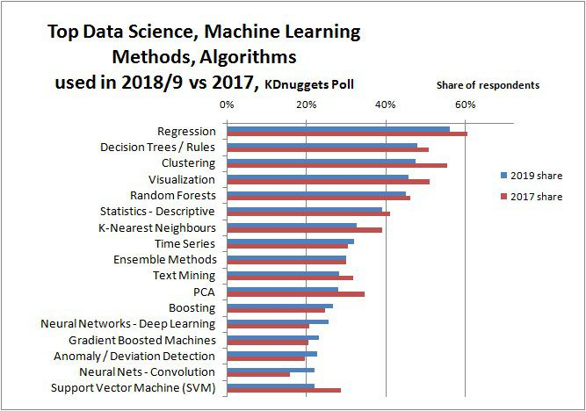
The most popular techniques… Decision tree even more popular

Slide 23
Decision Tree “class” of models…
A decision tree is a simple, decision making-diagram.
Random forests are a large number of trees, combined (using averages or "majority rules") at the end of the process.
Gradient boosting machines also combine decision trees, but start the combining process at the beginning, instead of at the end.

Slide 24
Advantages of DT’s
Simple to understand
Once trained, fast to execute

Slide 25
Potential Problems with DT’s
Overfitting
Tends to overfit data, reducing the performance of the model on future data.
Variance error
Small changes in data can yield a big change in the resulting tree

Slide 26
Classes of Prediction Error
With modeling, our object is to reduce model error (that is, error’s in the models predictions made on a given dataset)
Model error can be segmented into error we can correct for, and error we cannot.
Model Error = Reducible Error + Irreducible Error
Reducible Error is further segmented into Model Bias and Model Variance error:
Bias Error
Variance Error

Slide 27
Irreducible Error
This is error that cannot be reduced by any algorithm choice.
The error is caused by elements outside our control, such as statistical noise in the observations.
This is error can be introduced through the framing/context of the problem, or inherent in the data:
Unknown/unrecorded variables
Measurement error
Though we can work on squashing reducible error, irreducible error cannot be addressed with modeling.
Irreducible error will therefore always introduce an upper bounds to the performance of our model.

Slide 28
Model Bias Error
The bias is a measure of how close the model can capture the mapping function between inputs and outputs.
Low Bias: Weak assumptions regarding the functional form of the mapping of inputs to outputs.
High Bias: Strong assumptions regarding the functional form of the mapping of inputs to outputs.
A model with high bias is helpful when the bias matches the true but unknown underlying mapping function for the predictive modeling problem, but such models are not helpful if the bias does not match the underlying relationship.
i.e. Linear model
Easy to understand, quick to calculate/compute
Less flexible, and low predictive performance on complex problems that do not match underlying simplifying assumptions BUT, if the underling relationship is in fact linear, it will capture the mapping well.
This is also why we often spend a lot of time exploring and hypothesizing about the underlying relationship when using high biased models.

Slide 29
Variance Error
This is the amount/magnitude of change in predictions if different training data is used.
Low Variance: Changes in training data only result in small changes in prediction(s)
High Variance: Changes in training data result in large changes in prediction(s)
Examples of low-variance machine learning algorithms include:
Linear Regression, Linear Discriminant Analysis and Logistic Regression.
Examples of high-variance machine learning algorithms include:
Decision Trees, k-Nearest Neighbors and Support Vector Machines.
High variance models will perfectly match the relationship between and input and target in the training data, but will often perform poorly on new data.
We address this by limiting the model’s ability to fit the data (i.e. pruning in decisions trees), or utilizing ensemble techniques such as boosting and bagging.

Slide 30
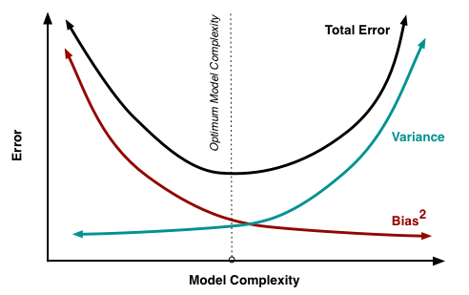
The Error ‘dilemma’…
There is no escaping the relationship between bias and variance in machine learning.
Increasing the bias will decrease the variance.
Increasing the variance will decrease the bias.

Slide 31
Managing Bias and Variance
Limiting bias:
The more assumptions you make about the relation (i.e. it’s linear, distribution is normal, etc.) the more you introduce bias (this isn’t necessarily bad, but can be if not applicable)
What is important is the performance of the model on the data you actually have
Limiting variance
Some modeling techniques (i.e. decision trees) exhibit a high degree of variance.
Pruning/constraining your model
Bagging and Resampling
Bagging (Bootstrap Aggregating) can reduce variance in model predictions
What about getting more data?
More data will help manage the problem of variance, but will not impact bias
Bias can only be changed by altering the modeling technique

Slide 32
Decision Trees: Bias and Variance
Decision trees exhibit…
low bias
Not impeded by strong assumptions/constraints
Will fit/model complex relationships
high variance
Small changes in the training set will results in large changes in predictions/model produced.

Slide 33
How to address these problems with DT’s
Approach 1: Pruning
Depth, Min Split size, Min information decrease, etc.
Approach 2: Use ensemble techniques
Random Forests
Boosted Trees

Slide 34
Happy Learning!

