Slide 1
ISM 6136
Data Mining
Dr. Tim Smith

Slide 2
Agenda
Quiz5
More on Hyperparameter Tuning
RandomSearchCV
Review of Bias and Variance and how to address this using ensemble techniques: Bagging and Boosting
Review Bagging and Boosting Techniques for Dtrees
Random Forests
Gradient Boosted Trees
XGBoost
Team Challenge

Slide 3
More on Hyper Parameter Tuning

Slide 4
Significantly increases computational cost in training models…
You could have many 100’s of thousands of combinations that sklearn will test.
GridSearchCV is an exhaustive search:
It will check every value given in your parameter ranges.
RandomizeSearchCV is a random search
It will randomly sample a given number of combinations of your parameter ranges.
Ideally you want to check a wide range of values using small incremental changes in the parameters.
In reality, this is often take too much time!
Common Strategy
Use RandomizedSearchCV to check a number of random samples of a wide range of parameter values.
Use GridSearch to check small incremental changes around the best values found with the RandomizedSearchCV.

Slide 5
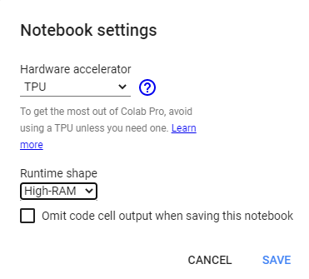
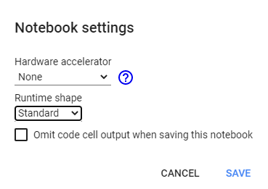
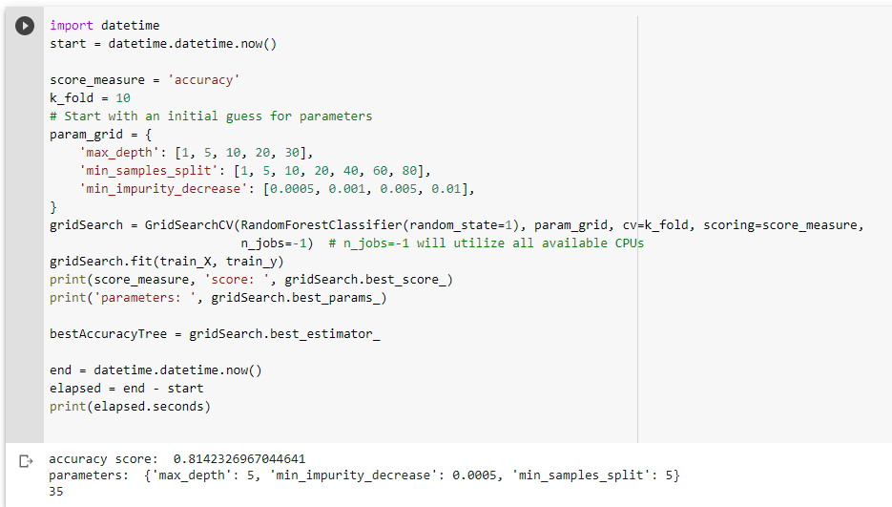
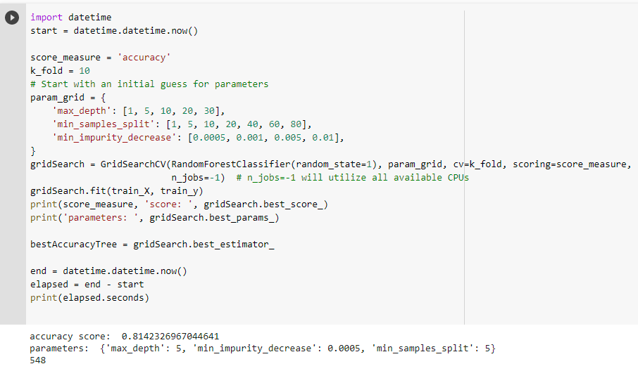
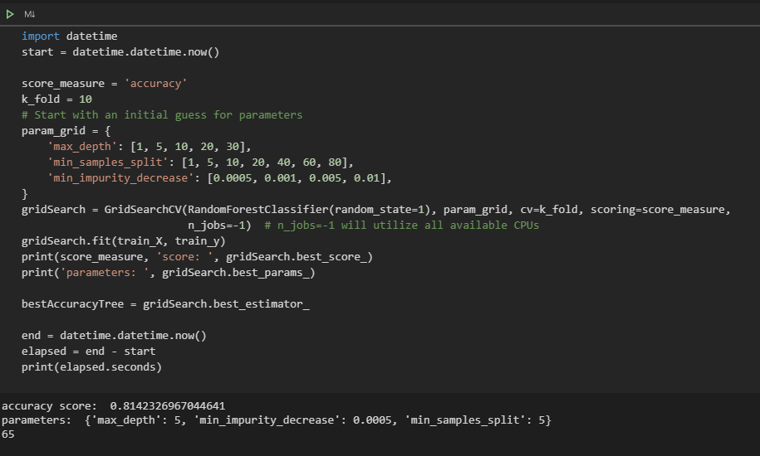
training with hyperparameter tuning takes time…
548
seconds
35
seconds
Laptop
Intel Core i9 10th generation
32 GB Ram
2080 Super Nvidia GPU
You will also experience “diminishing returns”, where it takes an increasingly large amount of computing time to achieve smaller gains in mode performance.
The degree you can ‘tune’ your model is dependent on time and computing resources.
65
seconds

Slide 6
RandomizedSearch Example
See notebook Week07_01

Slide 7
Bagging and Boosting

Slide 8
Decision Trees: Bias and Variance
Decision trees exhibit…
low bias
Not impeded by strong assumptions/constraints
Will fit/model complex relationships
high variance
Small changes in the training set will results in large changes in predictions/model produced.

Slide 9
Ansembles
Ensembles involve combining a number of weaker models into an ensemble. The end result is a stronger aggregate model.
Two popular ensemble approaches are:
Bagging
Boosting

Slide 10
Bagging
Bagging :
A way to decrease the variance in the prediction by generating additional data for training from dataset using sampling techniques to create multi-sets of the original data
Bagging approach's:
Randomly select observations (with replacement) from the training data set.
This is called bootstrapping
Randomly select subset of features
Repeat this n iteration (default 100)
Aggregate the resulting trees by averaging the result from each tree in the set.
Bagging features:
Variance reduced
Note: Choosing all features, better individual trees but worse forest. Choosing less features, worse individual trees, but better forest. Default, less – three rules of thumb are found, N/3, root N, log base 2 (N + 1)

Slide 11
Bagging
Bagging is a method of converting a set of weak learners into strong learners.
Model 1: Misclassification of 0.49 (just better than a coin toss)
Model 2: Misclassification rate of 0.48
…
Model n: Misclassification rate of e
In ‘bagging’ we take a series of ‘weak learners’ average their predictions.

Slide 12
Boosting
Boosting is a method of converting a set of weak learners into strong learners.
How is this different than Bagging?
In ‘boosting’ we combine these ‘weak learners’ together in a a more sophisticated way.
Boosting involves creating a weak learner, then creating a new learner that includes information from the previous learner, and this process continues where each new learner has utilized information from the previous learner.

Slide 13
Boosting
Similar to bagging in that it created a random sample of observations and of features
Boosting differs in that it’s sequentially selected – that is, each tree is built using knowledge gained from previous tree. In contrast, random forests randomly select all data and build trees without an influence of other trees built.
There are multiple techniques used for boosting (i.e. Ada, Gradient Descent, and Extreme Boosting)

Slide 14
How to address the variance problem with DT’s
Approach 1: Pruning
Depth, Min Split size, Min information decrease, etc.
We saw this last class!
Approach 2: Use ensemble techniques
Bagging: RandomForest
Boosting: AdaBoost, GradientBoost, XGBoost
This is what we will look at today!

Slide 15
Random Forests and Boosted Trees

Slide 16
Random Forests
An “ensemble” machine learning method.
A Random Forest is a bunch of Decision Trees bundled together to make a decision.
Each individual tree ‘votes’ for the classification.
Majority vote determines the predicted class/value.

Slide 17
Why Random Forests?
As we saw with decision trees, they can be prone to overfitting.
Approach to combat this we covered last class was “pruning” a tree.
Random Forest – reduces the chance of overfitting by using more trees (some that may overfit, some that may underfit – average reduces chance of overfitting).
Hi variable – trees from same data set can change signification based on decision tree
Random forest will reduce variance a single decision will have.

Slide 18
How to build Random Forests?
We use a technique called “Bagging”
Uses “bootstrapping” sampling technique
… means drawing random samples with replacement to create a number of different training sets
N-decision trees are create from this random sampling technique
Sample, with replacement, n training examples from the dataset.
Train a decision tree on the n samples.
Repeat t times, for some t.
When complete n-iterations, aggregate the vote and choose majority decision from all trees.

Slide 19
Results: Random “Forest” of trees
Random sample 1
Random sample 2
Random sample 3
Random sample 4
Random sample n
Bootstrapping
…
Doesn’t Take Loan
Takes Loan
Doesn’t Take Loan
Takes Loan
Takes Loan
Aggregating
Majority predict “Takes Loan” – Therefore, random forest model predicts “Takes Loan”
Bagging

Slide 20
Generalized Boosting Approach to DTrees
+
+
+
Error
+
+
+
Iterations

Slide 21
XGBoost
Stands for Extreme Gradient Boosting
It’s an implementation of a gradient boosted decision tree
Its recently been used quite successfully in many competitive machine learning events.
Key tuning parameters are:
n_estimators (how many models to test)
early_stopping_rounds (stop if incremental improvement does not meet minimum)
learning_rate (the incremental improvement targeted for each iteration – smaller numbers tend to increase accuracy, but increase training time).

Slide 22
Let’s look at examples…
See Wwk07_2 notebook

Slide 23
HyperParam tuning summary
Learning Algoritm | Classifier | Regressor | Key Tuning Parameters | Notes:
k-NN | KNeighborsClassifier | KNeighborsRegressor | k, metric, weights | try all odd k's from 1 through root N. Generally, leave weights to distance. Try all metrics.
 | RadiusNeighborsClassifier | RadiusNeighborsRegressor | radius, metric, weights | radius can take on many values - k's are much easier to work with. Try all metrics, generally leave weights to distance.
DecisionTree | DecisionTreeClassifier | DecisionTreeRegressor | criterion, max_depth, min_samples_split, min_samples_leaf, max_leaf_nodes, min_impurity_decrease | This is all about finding the best 'pruning' parameter settings.
RandomForest | RandomForestClassifier | RandomForestClassifier | n_estimators, criterion, max_depth, min_samples_split, min_samples_leaf, max_leaf_nodes, min_impurity_decrease | n_estimators (the number of trees) and the pruning of the tree are the biggest considerations.
AdaBoost | AdaBoostClassifier | AdaBoostRegressor | n_estimators, learning_rate, loss | generally, leave loss function to default
GradientBoosting | GradientBoostingClassifier | GradientBoostingRegressor | loss, learning_rate, n_estimators, subsample, criterion | generally, leave loss function to default. If subsample is set (0 to <1.0) then this is getting into stochastic gradient decent and better to use that model.
XGBoost | XGBClassifier | XGBRegressor | n_estimators, max_depth, max_leaves, grow_policy, learning_rate, gamma (min_split_loss) | Focus on how many weak learners and tree pruning parameters.

Slide 24
Team Challenge
See canvas

Slide 25
Happy Learning!

