Slide 1
ISM 6136
Data Mining
Dr. Tim Smith

Slide 2
Agenda
More on model evaluation:
ROC/AUC curves and Precision Recall charts
Introduction to Logistic Regression
Review of Final Project
Review of Final Test Format

Slide 3
More on Model Evaluation: Fbeta’s, ROC AUC, PR AUC

Slide 4
Learning outcomes
Model evaluation
Fbeta
Understand what an Fbeta score is
Understand how to implement Fbeta scoring in sklearn
Understand what score ranges are for beta when you prefer
ROC AUC
Understand what ROC is, and how ROC AUC is calculated
Create ROC Curves and calculate ROC AUC using python
Understand what a ROC AUC curve ‘says’ about a model
PR AUC
Understand what PR is, and how PR AUC is calculated
Create PR Curves and calculate PR AUC using python
Understand what a PR AUC curve ‘says’ about a model

Slide 5
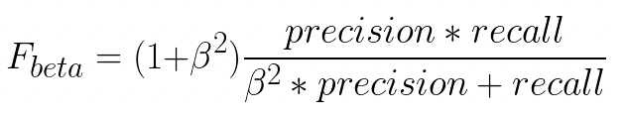
FBeta
The F1 score is a special case of a more general scoring method.
An F1 score is an FBeta score when beta is 1 (it’s the 1 in F1).
Other betas can be selected
Beta == 1
Balance between recall and precision
0 < Beta < 1
Favor precision over recall
Beta > 1
Favor recall over precision

Slide 6
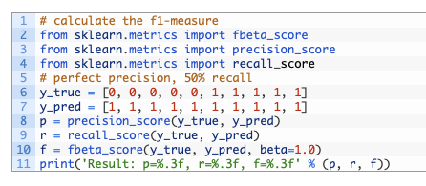
Fbeta Scorer in SKLearn
Sklearn has an fbeta scoring function in sklearn.metrics…
See sklearn documentation on fbeta_score

Slide 7
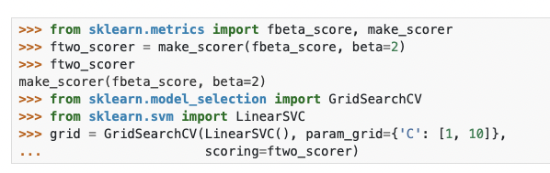
Using FBeta in Hyperparameter tuning
For hyperparameter tuning, you need to create a custom scorer:

Slide 8
Common FBeta’s
F1
When you care equally about recall and precision
F0.5
When you care more about precision than recall
F2
When you care more about recall than precision
Why not use recall and precision when you care about one or the other?
If you do not care at all about precision, then use recall – and vice versa.
When you still care about both, but favor one over the other – use an appropriate FBeta

Slide 9
Fbeta Summary
F Beta allows you look for balance between precision and recall, or prefer one over the other without ignoring the other.
F1 – Balance Precision and Recall
F0.5 – Favor Precision, but also consider Recall
Versus Precision – Favor precision and ignore recall
F2 – Favor Recall, but also consider Precision
Versus Recall – Favor recall and ignore precision

Slide 10
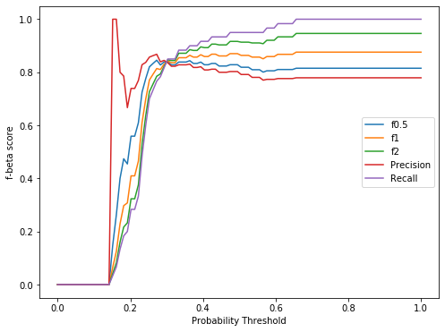
Nice visualization
Source:https://medium.com/@douglaspsteen/beyond-the-f-1-score-a-look-at-the-f-beta-score-3743ac2ef6e3

Slide 11
A graphical example

Slide 12
More evaluation metrics
TPR –True Positive Rate
Also known as recall
TP / (TP + FN) …. this is the same as TP/ total positive cases
FPR – False Positive Rate
FP/(FP+TN) … this is the same as FP/ total negative cases

Slide 13

Receiver Operating Characteristic Curve
1.0
ROC curve, is a graphical plot that summarizes the tradeoff between true positive rate and false positive rate using different probability thresholds.
It plots the relationship between TPR and FPR.
ROC AUC
AUC is used to compare the performance of different classifiers.
More area under curve = better
Better
True Positive Rate
0.5
Worse
Random Classifier
0.0
1.0
0.0
0.5
The method was originally developed for operators of military radar receivers starting in 1941, which led to its name.
False Positive Rate

Slide 14
Precision Recall Curve
Perfect Model
1.0
PR curve, is a graphical plot that summarizes the tradeoff between precision and recall using different probability thresholds.
It plots the relationship between Precision and Recall
PR AUC
Area Under Curve is as a metric to compare the performance of different classifiers.
More area under curve = Better
Better
Precision
Worse
0.5
0.0
No Skill Model
0.0
0.5
1.0
Recall

Slide 15
Let’s see examples using SKLearn
See Notebook week08_ROC_AUC_census.ipynb

Slide 16
Logistic Regression

Slide 17
Regression vs Classification
Classification
Regression
Predicted Value
Actual Value
Target (y)
Predict Blue
Target (y)
Predict Green
Predictor (X1)
Predictor (X1)

Slide 18

Linear Regression
Regression
$\hat{y}$= b₀+ b₁x₁+ …
y = $\hat{y}$+ error
y = b₀ + b₁x₁ + error
Predicted Value
Actual Value
Target (y)
Note: For simplicity, I’m referring to the difference between the predicted a value and the observed as error. In statistics, this is often referred to as the residual and the term error is reserved to denote errors in measurement (irreducible error).
Predictor (x₁)

Slide 19
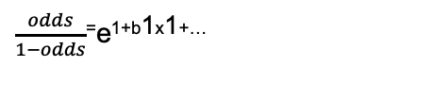

Logistic Regression
Classification
P (y=green | x1=?) = $\frac{1}{1−e−(B0+B1∗x1+..)}$
Let’s say, we’re looking for P(C=1)…
Target (y)
Predict Blue
Predict Green
$\frac{odds}{1−odds}$⁼e^{1+b1x1+…}
Predictor (X1)

Slide 20

Logistic Regression
Classification
P (y=green | x1=?) = $\frac{1}{1−e−(B0+B1∗x1+..)}$
0.92
Let’s say, we’re looking for P(y=green | x1=10)…
We use the derived logistic regression model to product P given x1 is 10
In this case, our model predicts 0.92 (92%) probability that an observation with X1=10 is green.
Target (y)
10
Predictor (X1)

Slide 21

Logistic Regression
Classification
P (y=green | x1=?) = $\frac{1}{1−e−(B0+B1∗x1+..)}$
Let’s say, we’re looking for P(y=green | x1=8)…
We use the derived logistic regression model to product P given x1 is 10
In this case, our model predicts 0.28 (28%) probability that an observation with X1=8 is green
Target (y)
0.28
8
Predictor (X1)

Slide 22
Example1
X | Y
0.5 | Blue
1.1 | Blue
1.5 | Blue
2.0 | Blue
3.3 | Blue
4.7 | Blue
5.3 | Blue
7.0 | Blue
6.5 | Blue
7.5 | Blue
8.0 | Green
8.3 | Blue
8.7 | Blue
9.1 | Blue
8.5 | Green
9.5 | Green
10.1 | Green
12.0 | Green
12.7 | Green
14.0 | Green
15.3 | Green
16.1 | Green
17.8 | Green
# build and train a logistic regression classifier
logClassifier = LogisticRegression(random_state=1)
logClassifier.fit(X_train, y_train)
# create predictions based on threshold 0.25
THRESHOLD = 0.25
validation_predictions_threshold25 = np.where(logClassifier.predict_proba(X_train)[:,1] > THRESHOLD, 1, 0)
validation_predictions_threshold25
# show predictions vs actual validation values
pd.DataFrame({"predicted":validation_predictions_threshold25, "actual":y_trrain})
See Class08_Example1 notebook

Slide 23

Logistic Regression
Classification
P (y=green | x1=?) = $\frac{1}{1−e−(B0+B1∗x1+..)}$
But, what is assumed in the previous models?
That our threshold for predicting the existence of a class is 50%.
Target (y)
Threshold 50%
0.28
Predictor (X1)

Slide 24

Logistic Regression
Classification
P (y=green | x1=?) = $\frac{1}{1−e−(B0+B1∗x1+..)}$
But, what is assumed in the previous models?
That our threshold for predicting the existence of a class is 50%.
What’s our prediction is we change our threshold to 25%?
Since .28 is greater than our threshold, we predict this to be green.
Target (y)
0.28
Threshold 25%
Predictor (X1)

Slide 25
Logistic Regression
Classification
Classification
X
Target (y)
Target (y)
Threshold 50%
Threshold 25%
X
X
X
X
X
10
10
Predictor (X1)
Predictor (X1)

Slide 26
Logistic Regression
50% Threshold
25% Threshold
95% Threshold
X
X
X
Target (y)
Target (y)
Target (y)
X
X
X
X
X
Predictor (X1)
Predictor (X1)
Predictor (X1)

Slide 27
Example2 – Threshold 25%
Classification
# build and train a logistic regression classifier
logClassifier = LogisticRegression(random_state=1)
logClassifier.fit(train_X,train_y)
# create predictions based on threshold 0.25
THRESHOLD = 0.25
validation_predictions_threshold25 = np.where(logClassifier.predict_proba(valid_X)[:,1] > THRESHOLD, 1, 0)
validation_predictions_threshold25
# show predictions vs actual validation values
pd.DataFrame({"predicted":validation_predictions_threshold25, "actual":valid_y})
Target (y)
Threshold 25%
X
X
X
10
Predictor (X1)
See Class08_Example2 notebook

Slide 28
Example3 – Hyperparameter Tuning Logistic Regression Model
See Week08_Example3 notebook

Slide 29
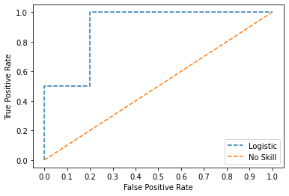
ROC Curve for “Blue Green” sample data
The plot to the right is a ROC plot of our logistic regression example (Green or Blue).
Note: Since it’s a small sample, it’s a “rough” or jagged curve. As we work with even larger samples we find a “smoother” curve
See Class08_Example4 notebook

Slide 30
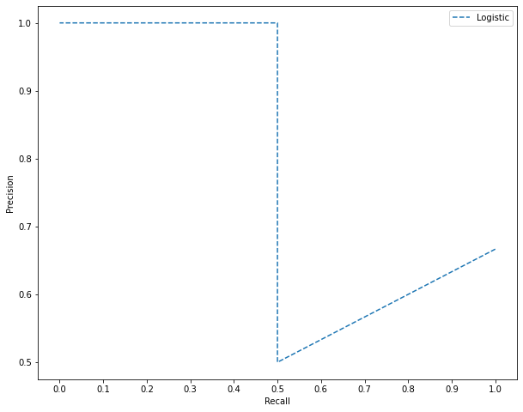
Precision Recall Curve
Plot the relationship between Precision and Recall for various thresholds.
Best Precision
Best Recall
See Class08_Example5 notebook

Slide 31
Final Exam and Final Project

Slide 32
Final Test
Worth 30% of final mark
Dates:
Section 04 Nov. 7th
Section 05 Nov. 8th
Section 03 Nov. 10th
Exam Consists of two parts:
Multiple choice: 10% - 20 multiple chose/multi-answer questions
Multiple choice questions will be pertaining to both Python and Modeling concepts. Each question will be work 5 points each.
Analysis Report: 20% - Create a predictive model for a given set of data
Analysis of a given problem. This will involve loading, cleaning, & modeling a given dataset - and discussing results. This portion of the test is worth 150 pts.
Discussion of results is important. Speak in full sentences, and support your points with numbers/data from your analysis. Use markdown for any headers, bullet points, etc.
Taken during class time
The exam will start at 8:35 am and end at 10:30 am
Part 1: Multiple choice will be open from 8:35 to 9:15 am
Part 1 is closed book – this means no help from anyone, no notes, or any other assistance.
Part 2: Analysis Report will be open from 9 to 10:30 am.
Part 2: You can access your previous notebooks, and notebooks from the class
You must submit your Part 1 before beginning Part 2
You must submit on time, so be sure to leave yourself enough time to submit and handle any technical issues
For the analysis portion of the exam, a good strategy is to submit a rough draft well before the deadline. This will ensure you have a submission. As you improve, submit again. I will mark the last submission.
No submission = zero points

Slide 33
Review Final Project details on Canvas

Slide 34
Happy Learning!

